Slide 1
ALERT beam background simulation with gemc
Rong WANG
IPN-Orsay

Slide 2
Material and geometry - 1
Assume temperature = 300 K.
He gas at 1 atm: 0.0001642 g/cm3
He gas at 3 atm: 0.000487 g/cm3
Al foil: 15 um; 2.7 g/cm3
Kapton foil: 55 um; 1.42 g/cm3; (C12 H10 O5 N2, mass fraction: C - 0.69, H - 0.026, O - 0.21, N – 0.073)
DC gas: 0.000487 g/cm3; (vol. fraction: 80% He, 20% CO2; mass fraction: He – 0.27, C – 0.2, O – 0.53)

Slide 3
Material and geometry - 2
Target: length = 34 cm, radius = 0.6 cm, material = He at 3 atm
Target window: Al foil
Target wall: kapton foil
DC sensitive volume: length = 30 cm, inner radius = 2.5 cm, outter radius = 8.5 cm, DC gas
ALERT DC wall and window: kapton foil
Helium bag: length = 60 cm, radius = 4 cm, He at 1 atm
Helium bag wall: kapton
Helium bag window downstream: Al foil

Slide 4
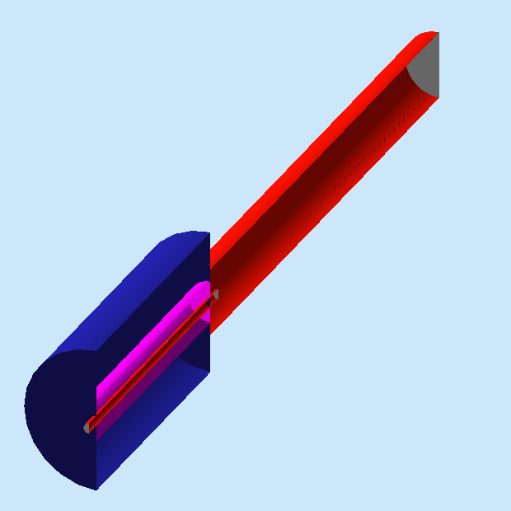
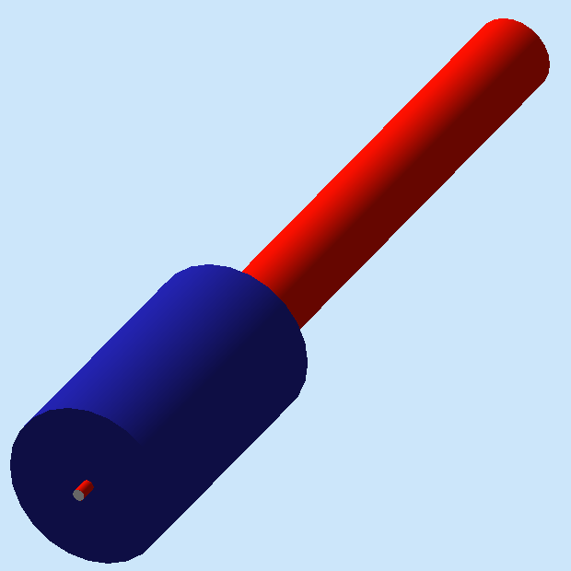
Material and geometry - 3
Helium bag
ALERT-DC-UnsensitiveParts-v1.gdml: clear space is filled with DC gas!
ALERT-DC-UnsensitiveParts-v2.gdml: clear space is filled with He at 1 atm; a division wall of kapton locates at R = 2.5 cm, additionally.
DC
Clear space: the space between target and DC sensitive volume
Target

Slide 5
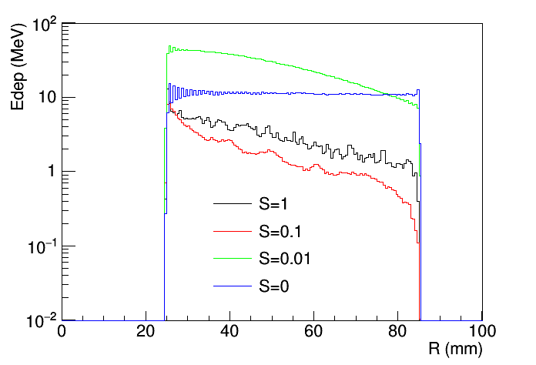
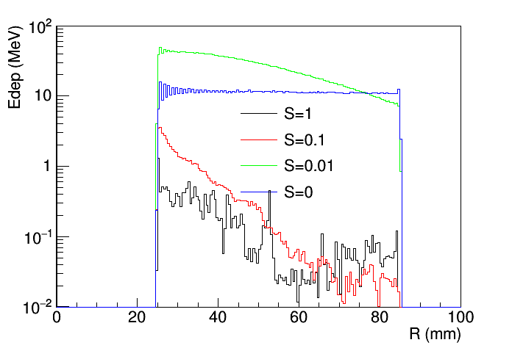
Energy deposition as a function of radius
S is the Solenoid_field scale, 1 is the maximum
Without Helium-bag downstream
With Helium-bag downstream
Note: clear space filled with DC gas mixture; beam = 1 nA of 1.25 ms

Slide 6
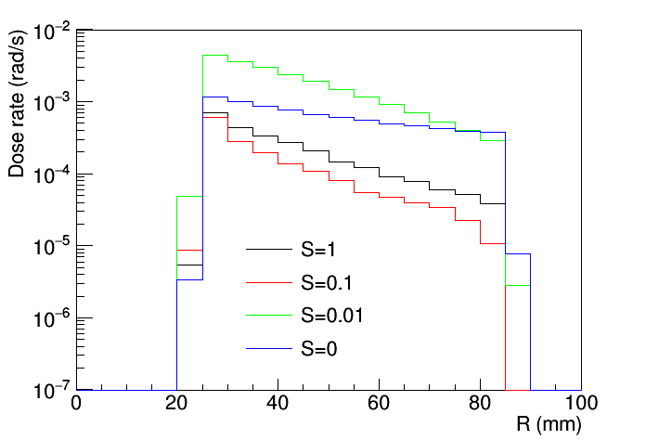
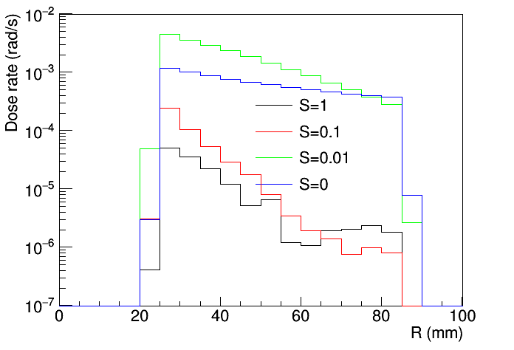
Dose rate at 1 nA
1 rad = 1 erg/gram
Without Helium-bag downstream
With Helium-bag downstream
Note: clear space filled with DC gas mixture. Helium-bag is perfered.

Slide 7
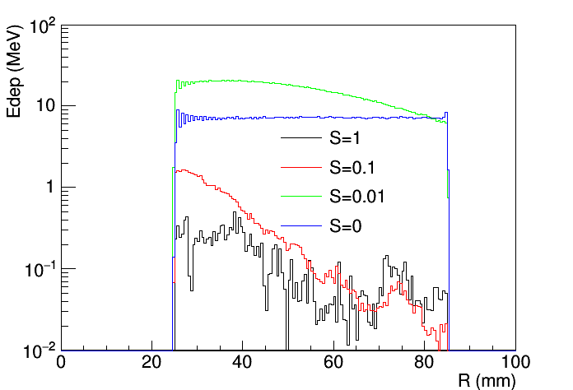
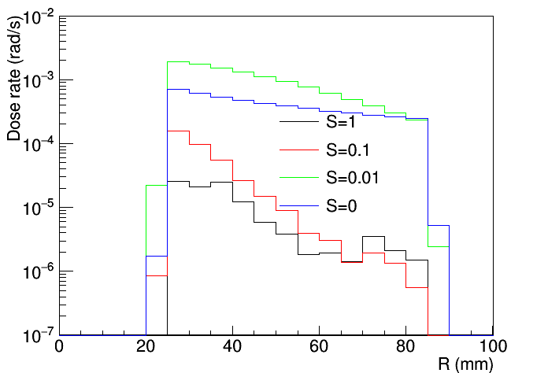
Design-v2: clear space is filled with helium-4
Comparing to the previous slides, we can see that the clear space filled with either DC gas or helilum-4 won’t make big differences.

Slide 8
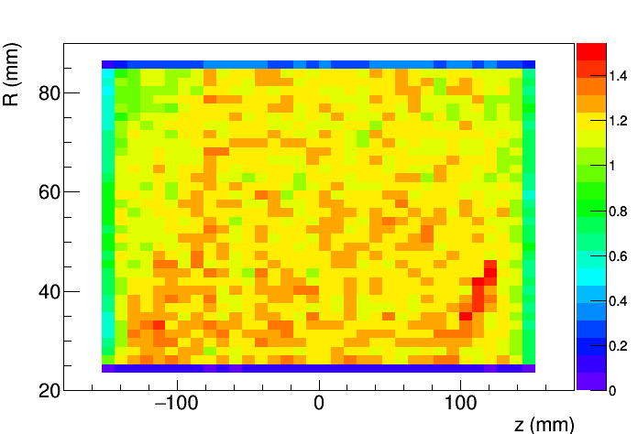
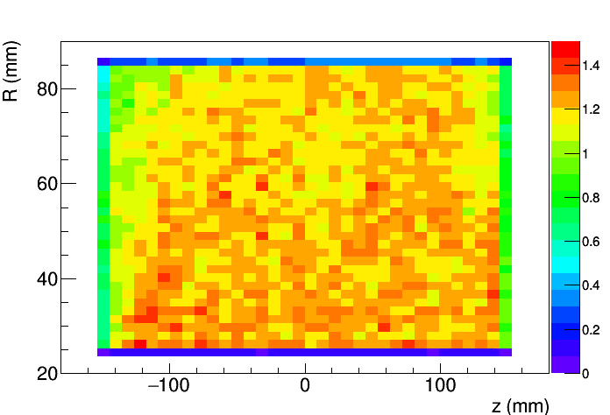
Backup-1: Edep dis. (design-v1, Solenoid=0)
No Helium-bag
With Helium-bag

Slide 9
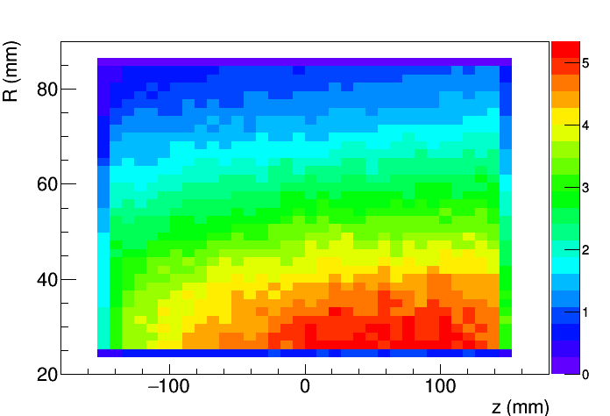
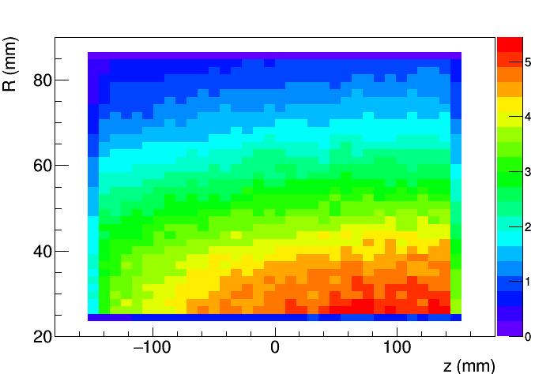
Backup-2: Edep dis. (design-v1, Solenoid=0.01)
No Helium-bag
With Helium-bag

Slide 10
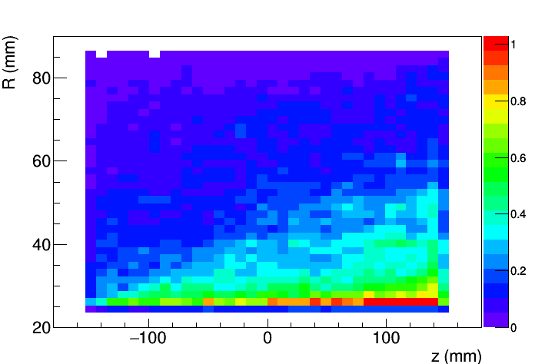
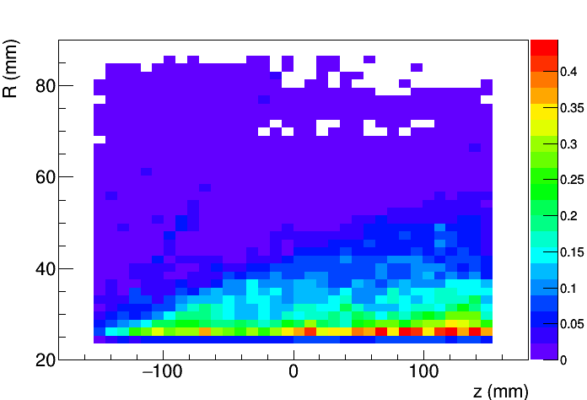
Backup-3: Edep dis. (design-v1, Solenoid=0.1)
No Helium-bag
With Helium-bag

Slide 11
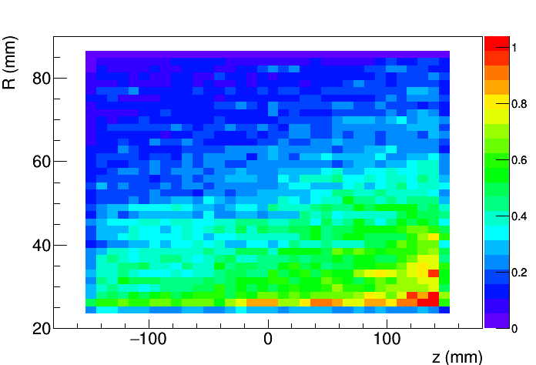
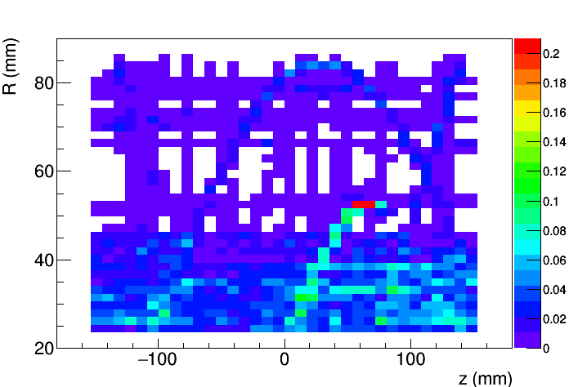
Backup-4: Edep dis. (design-v1, Solenoid=1)
No Helium-bag
With Helium-bag

Slide 12
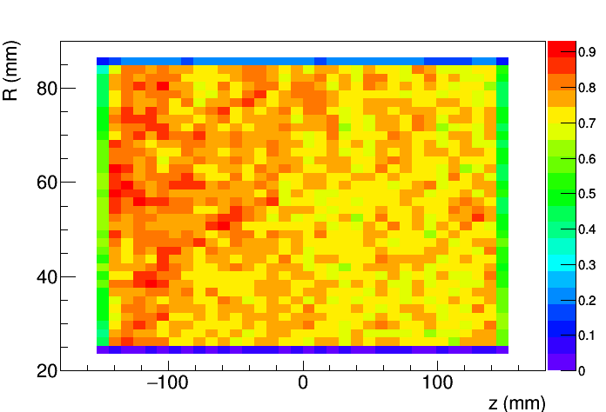
Backup-5: Edep dis. (design-v2, Solenoid=0)
With Helium-bag

Slide 13
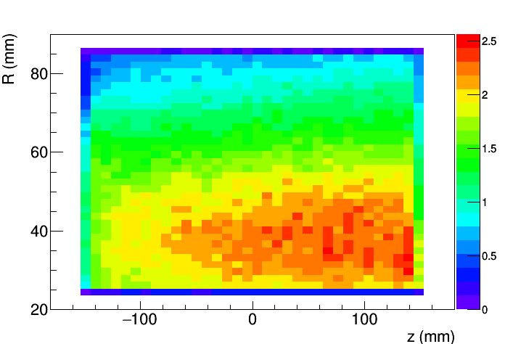
Backup-6: Edep dis. (design-v2, Solenoid=0.01)
With Helium-bag

Slide 14
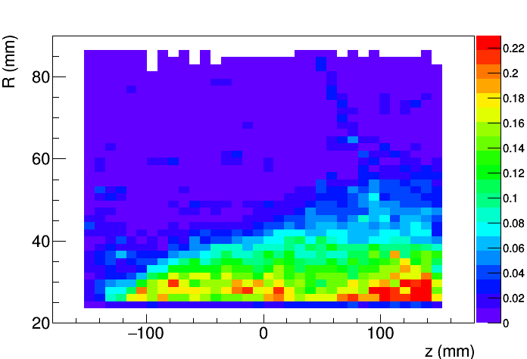
Backup-7: Edep dis. (design-v2, Solenoid=0.1)
With Helium-bag

Slide 15
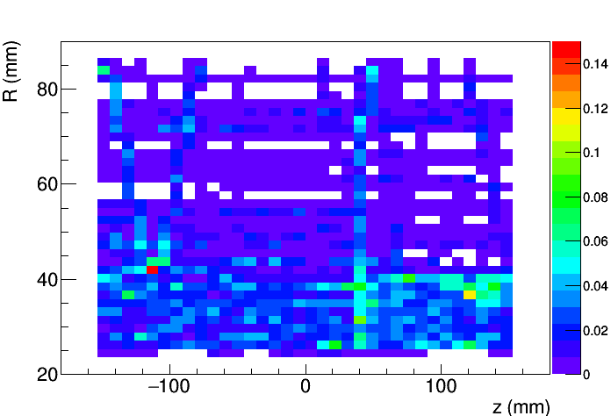
Backup-8: Edep dis. (design-v2, Solenoid=1)
With Helium-bag

