Slide 1
rayTrace SVD Analysis
Ryan Bodenstein
3/27/2012
B-team Meeting

Slide 2
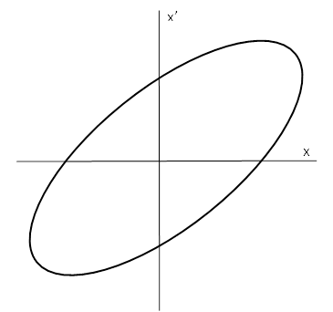
What is rayTrace?
Differential orbit measurements at all BPMs
Use two correctors to kick beam along model phase ellipse
Calculate Twiss Parameters
Kick
Kick
Kick
Gather Data
Gather Data
Gather Data
Kick
Gather Data

Slide 3
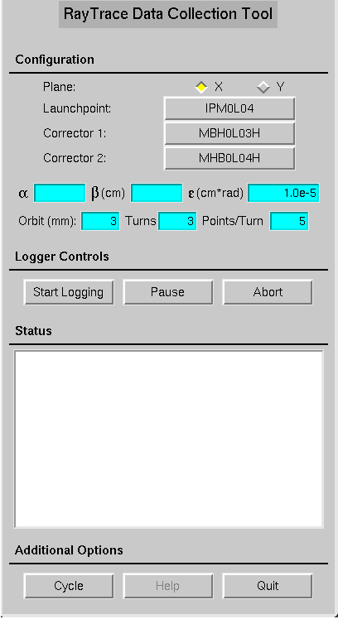
How is rayTrace run?
Select plane.
Choose launchpoint. α and β are automatically entered from the design model at the launchpoint. They can also be manually entered.
Set orbit size/emittance.
Choose number of turns and points/turn.
Start Logging.

Slide 4
And what do you get out?
BPM1 | BPM2 | BPM3 | BPM4 | BPM5 | BPM6 | BPM7 | BPM8 | BPM9 | BPM10 | ... | ...
Data1 | Data1 | Data1 | Data1 | Data1 | Data1 | Data1 | Data1 | Data1 | Data1 | ... | ...
Data2 | Data2 | Data2 | Data2 | Data2 | Data2 | Data2 | Data2 | Data2 | Data2 | ... | ...
Data3 | Data3 | Data3 | Data3 | Data3 | Data3 | Data3 | Data3 | Data3 | Data3 | ... | ...
No Beam | No Beam | No Beam | No Beam | No Beam | No Beam | No Beam | No Beam | No Beam | No Beam | ... | ...
No Beam | No Beam | No Beam | No Beam | No Beam | No Beam | No Beam | No Beam | No Beam | No Beam | ... | ...
Data4 | Data4 | Data4 | Data4 | Data4 | Data4 | Data4 | Data4 | Data4 | Data4 | ... | ...
... | ... | ... | ... | ... | ... | ... | ... | ... | ... | ... | ...

Slide 5
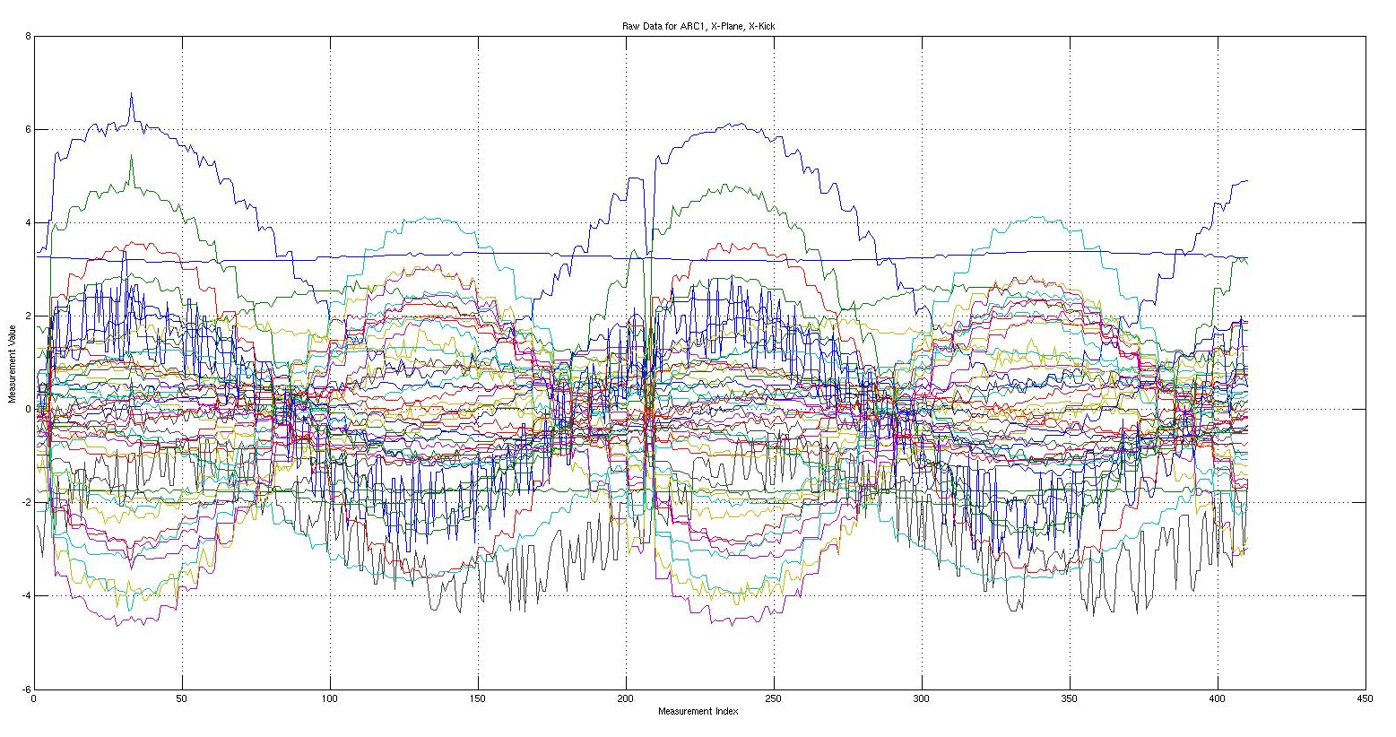
Raw Data for ARC1
X-Plane, X-Kick

Slide 6
What can I do with this data?
Singular Value Decomposition

Slide 7
BPM1 | BPM2 | BPM3 | BPM4 | BPM5 | BPM6 | BPM7 | BPM8 | BPM9 | BPM10 | ... | ...
Data1 | Data1 | Data1 | Data1 | Data1 | Data1 | Data1 | Data1 | Data1 | Data1 | ... | ...
Data2 | Data2 | Data2 | Data2 | Data2 | Data2 | Data2 | Data2 | Data2 | Data2 | ... | ...
Data3 | Data3 | Data3 | Data3 | Data3 | Data3 | Data3 | Data3 | Data3 | Data3 | ... | ...
No Beam | No Beam | No Beam | No Beam | No Beam | No Beam | No Beam | No Beam | No Beam | No Beam | ... | ...
No Beam | No Beam | No Beam | No Beam | No Beam | No Beam | No Beam | No Beam | No Beam | No Beam | ... | ...
Data4 | Data4 | Data4 | Data4 | Data4 | Data4 | Data4 | Data4 | Data4 | Data4 | ... | ...
... | ... | ... | ... | ... | ... | ... | ... | ... | ... | ... | ...
V
U

Slide 9
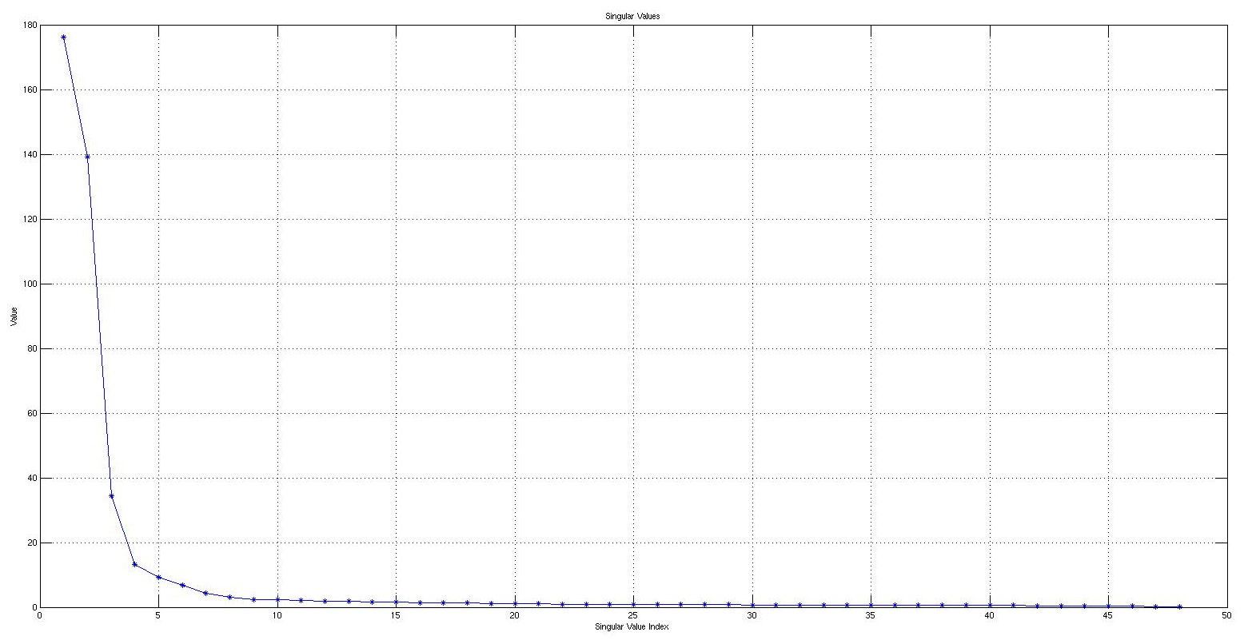
So, back to the ARC1 data…
~175
~140
~35

Slide 10
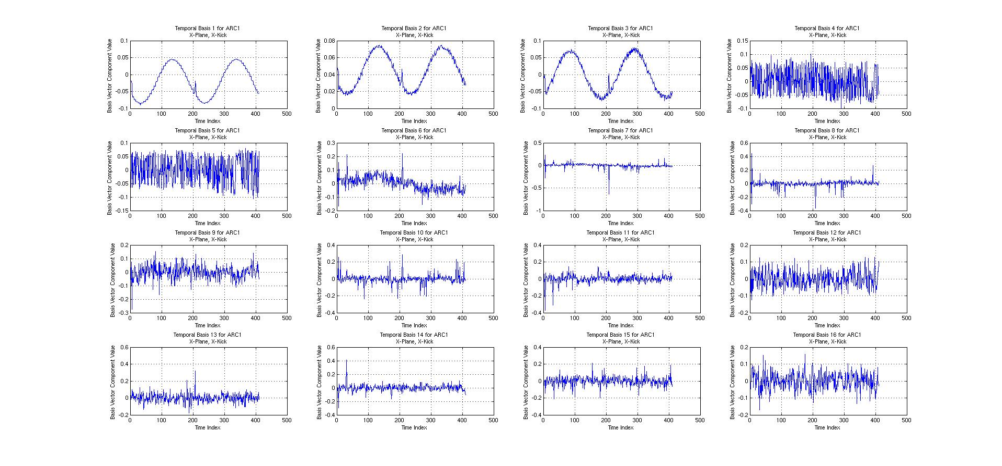
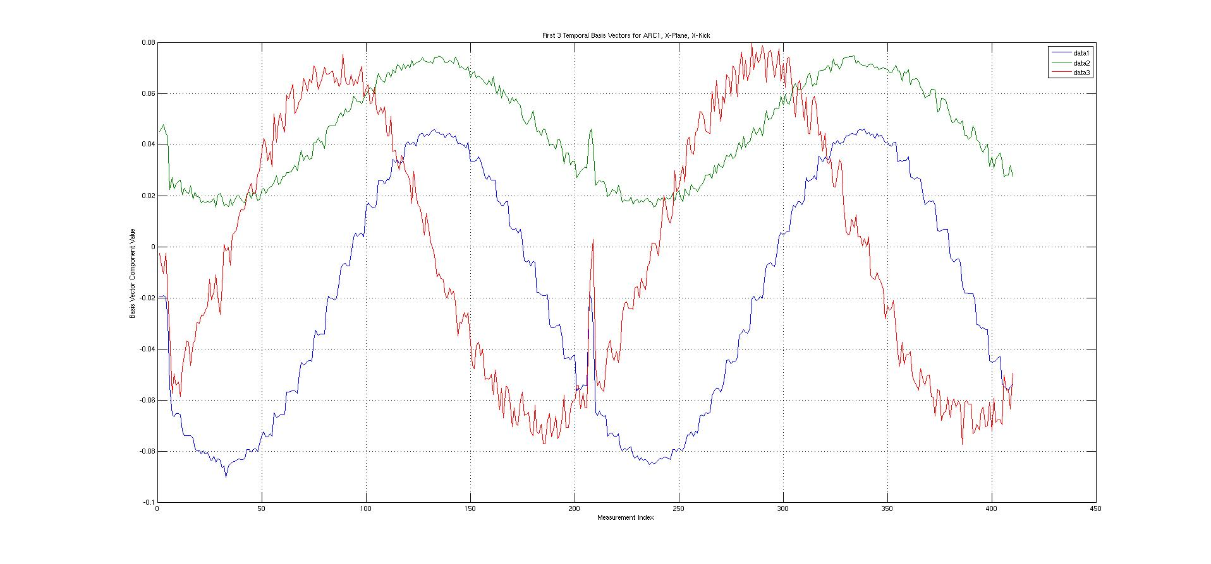
And with those singular values…

Slide 11
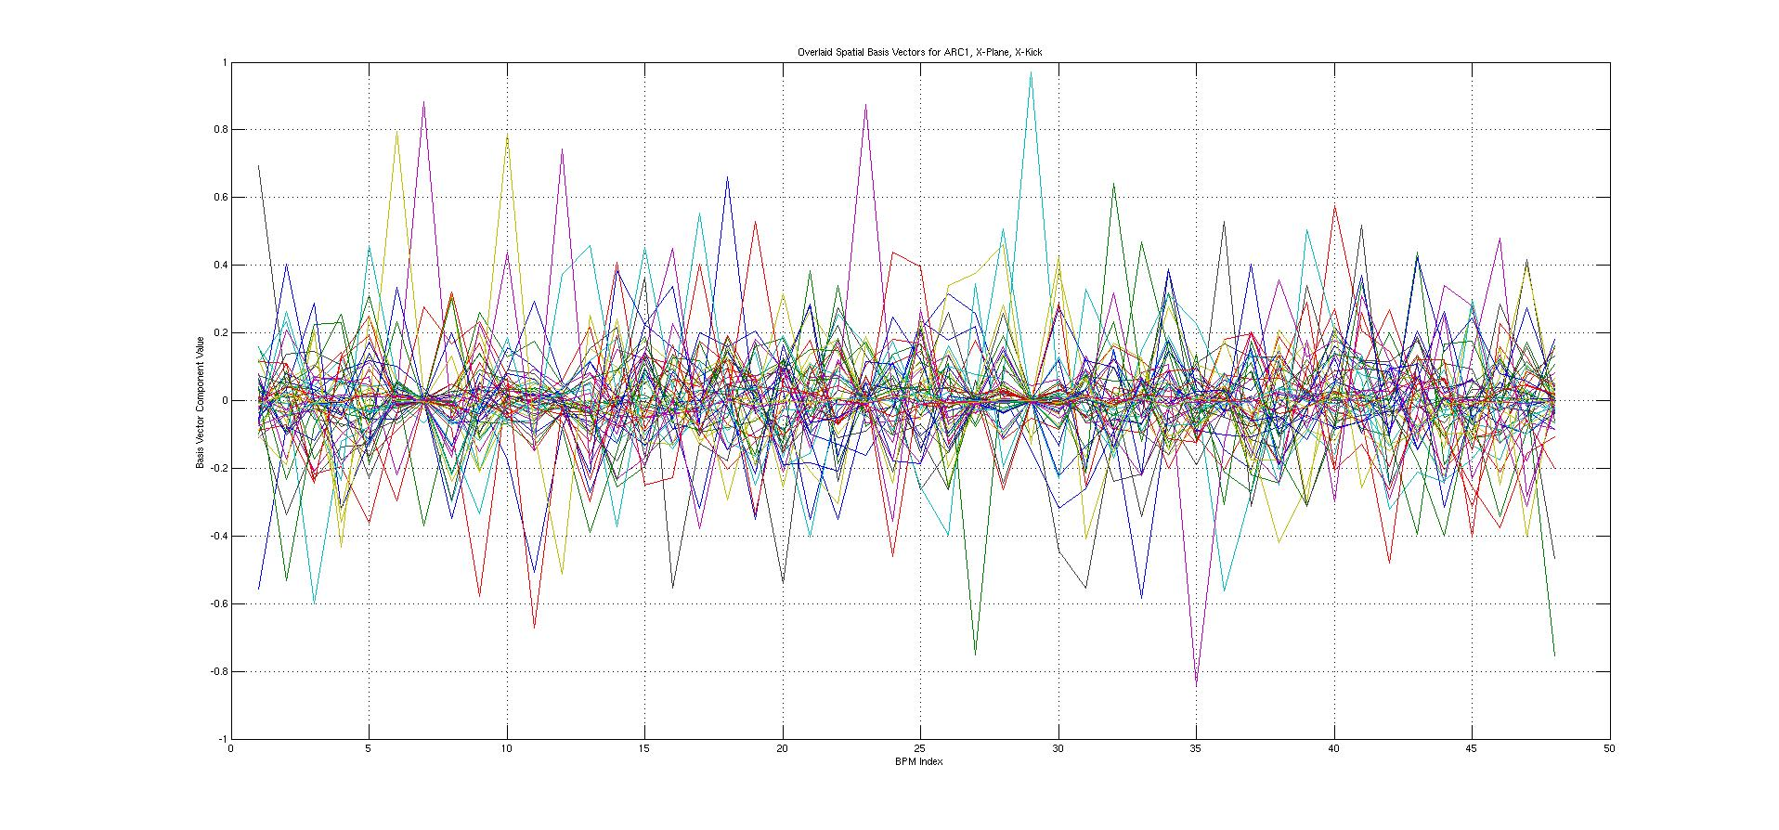
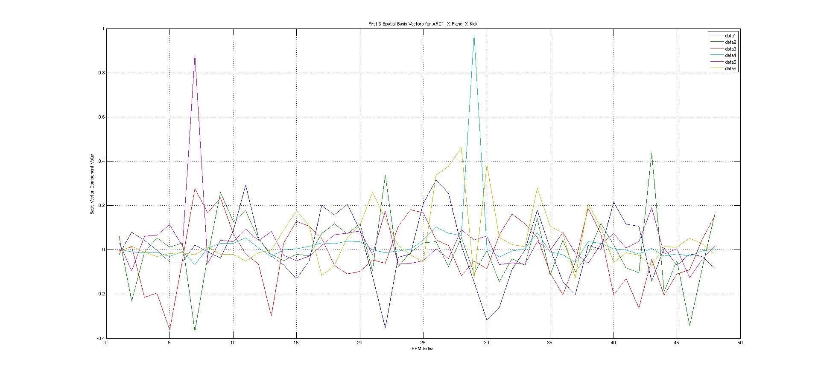
As far as the spatial basis vectors…

Slide 12
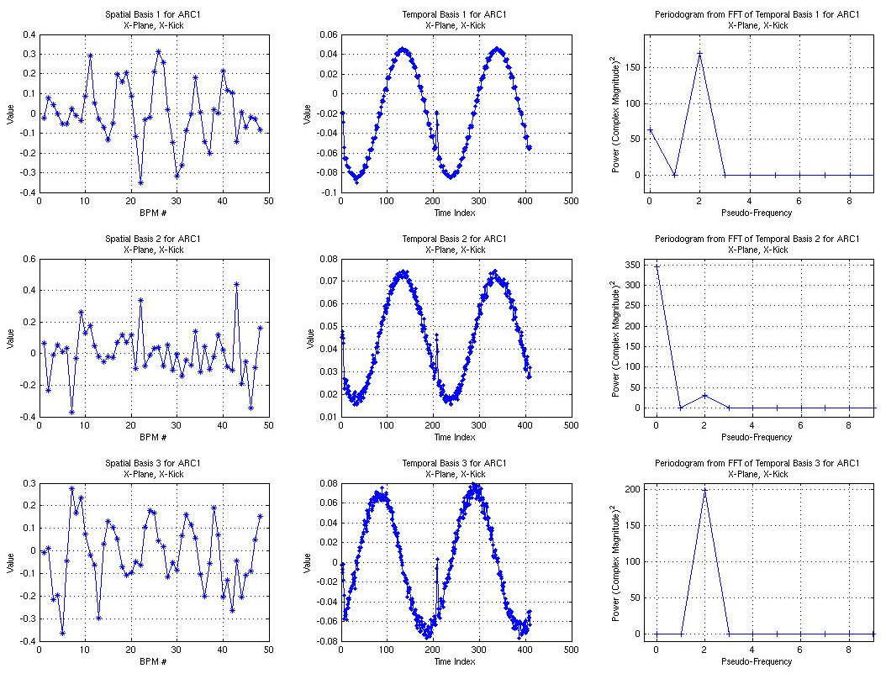
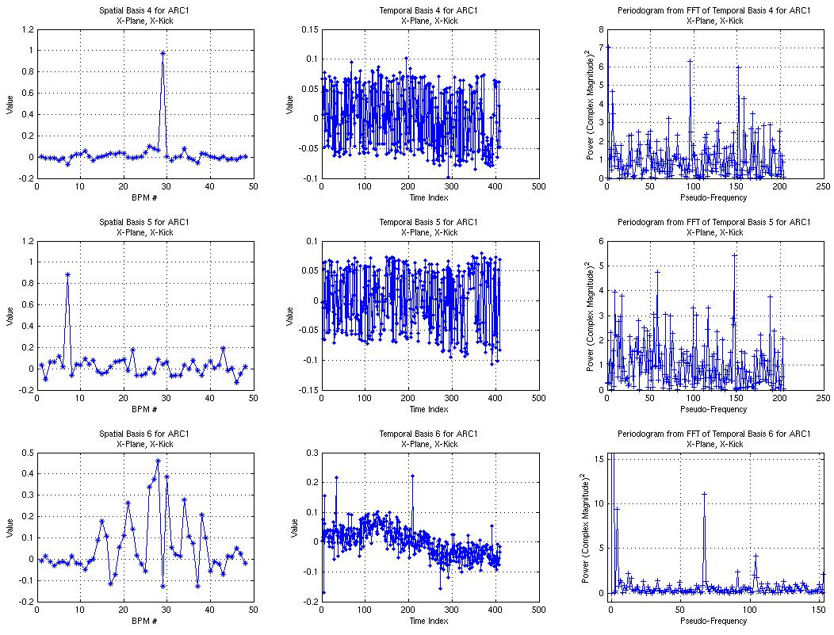
So, we see a few possibly bad BPMs…

Slide 13
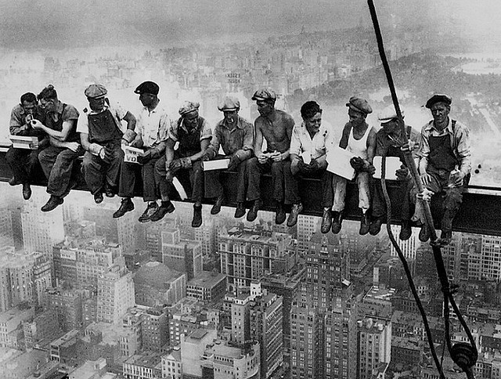
Time for Lunch!!!

