Slide 1

RF Gradient Calibration
Jay Benesch

Slide 2
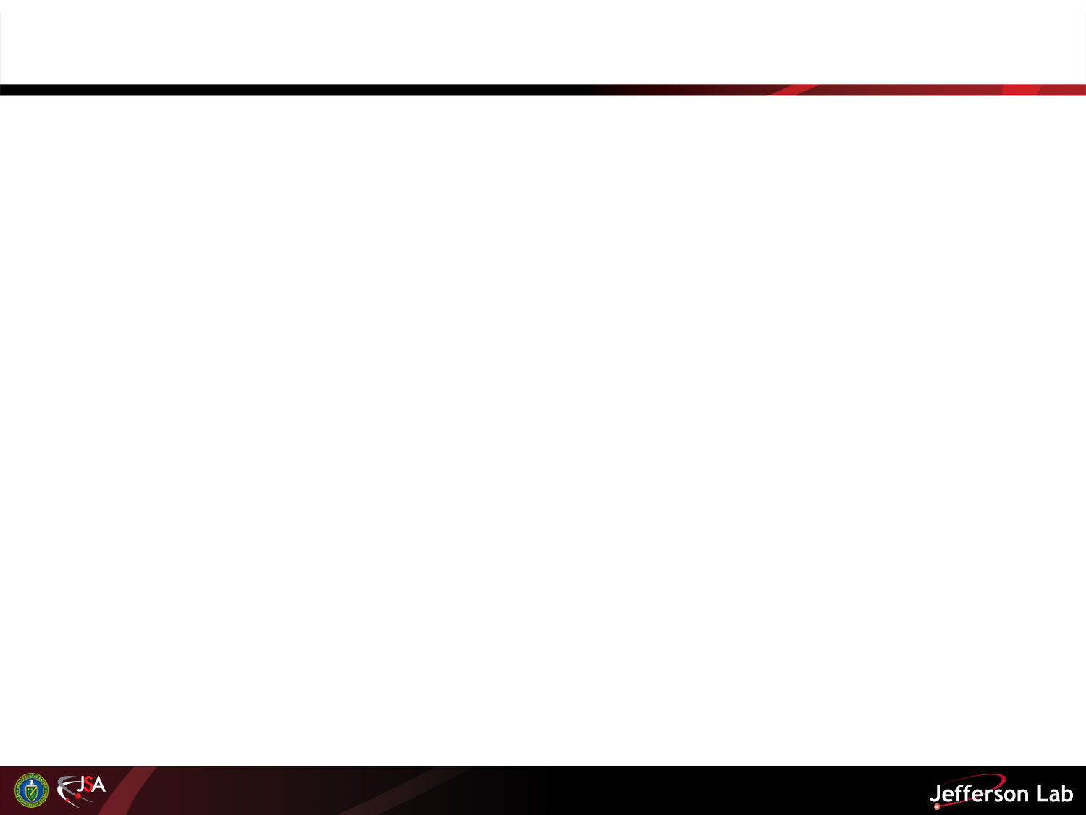
Outline
SRF actions
Confusing and sorry status
Recommendations
Raw data location
Notes:
Calculate slope ratios for old and new models and compare to calibration factor ratios. Also compare two day interval values appropriately normalized.

Slide 3
SRF actions
SRF insisted on recommissioning everything over my objections at the July 2012 RF-PIT meeting
M. Drury claimed to have recalibrated all old RF
M. Drury promised to put all commissioning data in https://jlabdoc.jlab.org/docushare/dsweb/View/Collection-19670
J. Preble stated that would be complete 7/1/14
Data for only two cavities and the incomplete summary spreadsheet are available there 8/2/14.
Large lem fudge factors were required to get around arcs, thus new beam-based calibration Spring 2014.

Slide 4
North Linac reference cavity calibration
Owl shift so I wasn’t around.
Three data sets taken; very different results
GGBBC PV was said to be 10*log10(ratio), not 20*log10 as learned much later
Calibration of most NL cavities done with dp/p>2E-4; BEM might be good to 1E-5
Multiple global adjustments during spring run due to lem fudge and GGBBC realization.
Reference recalibration ratio 1.048 (4/28) makes no sense given lem fudge on that date.

Slide 5
4/28 ref cal
But lem fudge 1.003, not 0.952, 4/28

Slide 6
RFCM download files
Likely the only items changed during recommissioning.
M. Erb was able to extract values from database for 5/1/12, 1/2/14 (after SRF) and 5/1/14 after NL beam-based calibration and global (NL mean) change to SL values.
Only gset_prob and gmes_prob changes appear to be relevant to gradient calibration; I’ve sent difference file to G. Lahti to verify.

Slide 7
What RF download files showed 1/2/14
118 cavities, 4 zones in NL and balance SL, were NOT recalibrated by SRF per RFCM download files. Based on NL means and Drury’s statement, I multiplied all old SL cals by 0.92. This remains the case. Oops.

Slide 8
NL beam based calibration
RFCM cals 2014 after beam based calibration divided by RFCM values based on 1995 calibration and ? done on C50s. Does NOT include factor of 1.048. This would shift mean to 1.022, incompatible with lem fudge 1.003 unless C100s totally screwed up, but 20log₁₀ discovered experimentally via R100 and injector spectrometer.

Slide 9
lem models
101 low-significance lem models were developed with 2014 fault data.
No correlations evident with 2012 models, whether or not 1.048 factor is included.
No correlation was expected given Isabel and standby-refrigerator experience
New models have generally lower GSETs for 2-day fault interval with or without 1.048, but significance is lacking
Spreadsheet will be sent to anyone interested.

Slide 10
Recommendations
Revert to 2012 gset_prob and gmes_prob values to restore connection to 17 year cavity fault record.
As resource (M. Erb) permits, use RFCM download database to correct fault data obtained FY14 so it can be used to help determine how the long down affected cavity performance. Significant effort required because there were multiple changes.
Try other methods of beam-based calibration in order to get standard deviation of repeated measurements on single cavity down to a percent. See Tiefenback TN-13-050 for some ideas.
New Q(E) method also needed (no RT valve)

Slide 11
Raw data
Operators used shared spreadsheets I created in ~benesch/gradcal2014 as the repositories for the data obtained during the measurement process. Anyone with an ops account should be able to access them.

