Slide 1

Measurements of Accelerator Control for Pathlength Issue
January, 2015
Chris Curtis

Slide 2
January 2015 Measurements
Measurement of all survey control points and 5 quad stacks in east arc
Measurement of all survey control points and 5 quad stacks in west arc
Measurement of long distances in each linac
Measurement of distances between penetrations on the surface

Slide 3
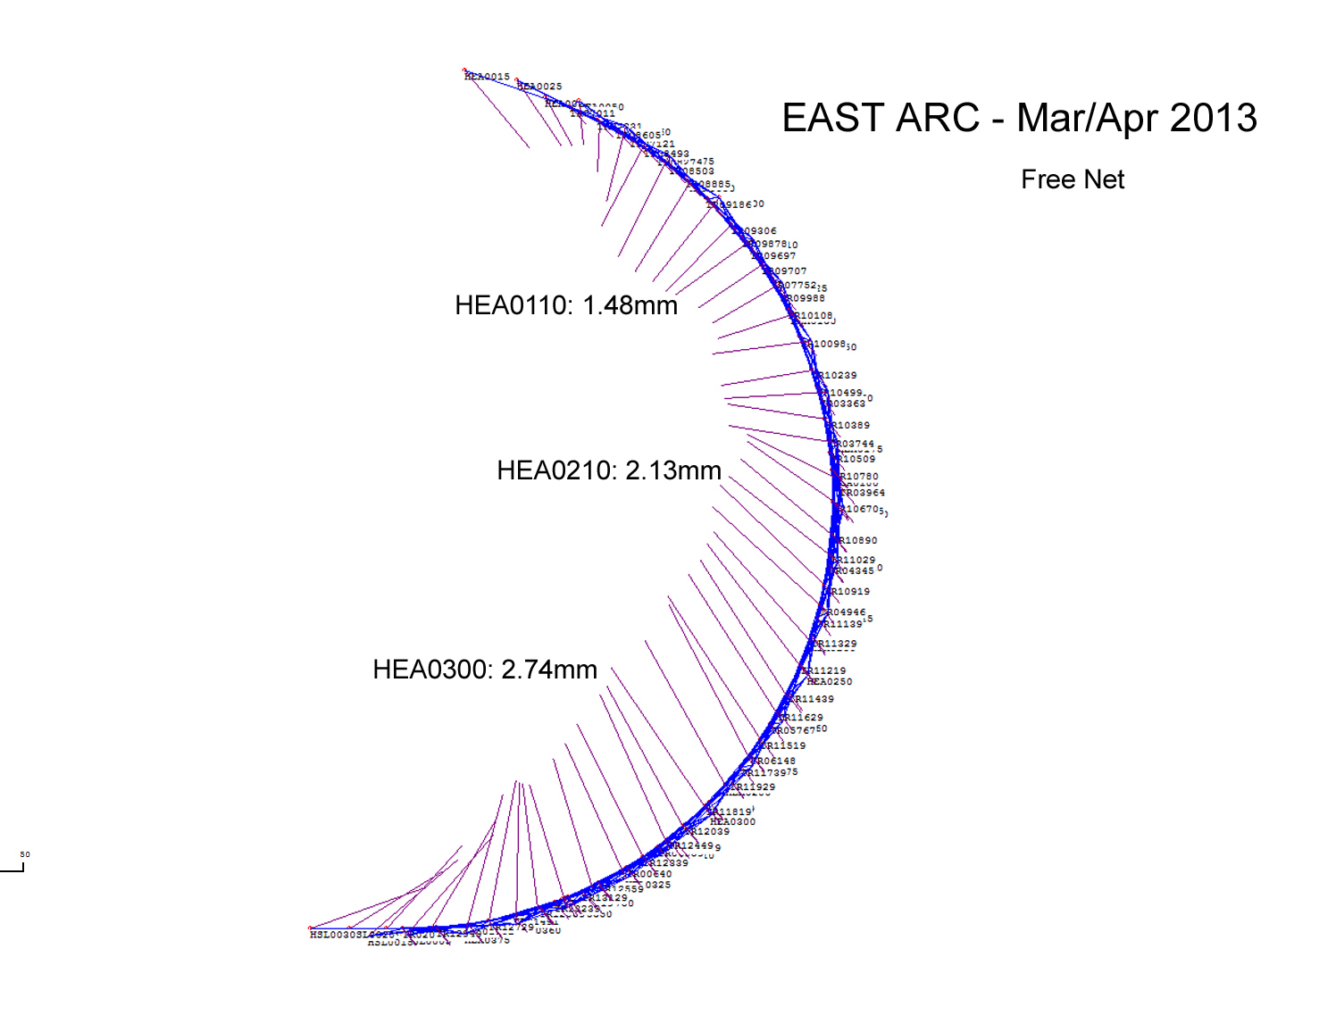
East Arc Control

Slide 4
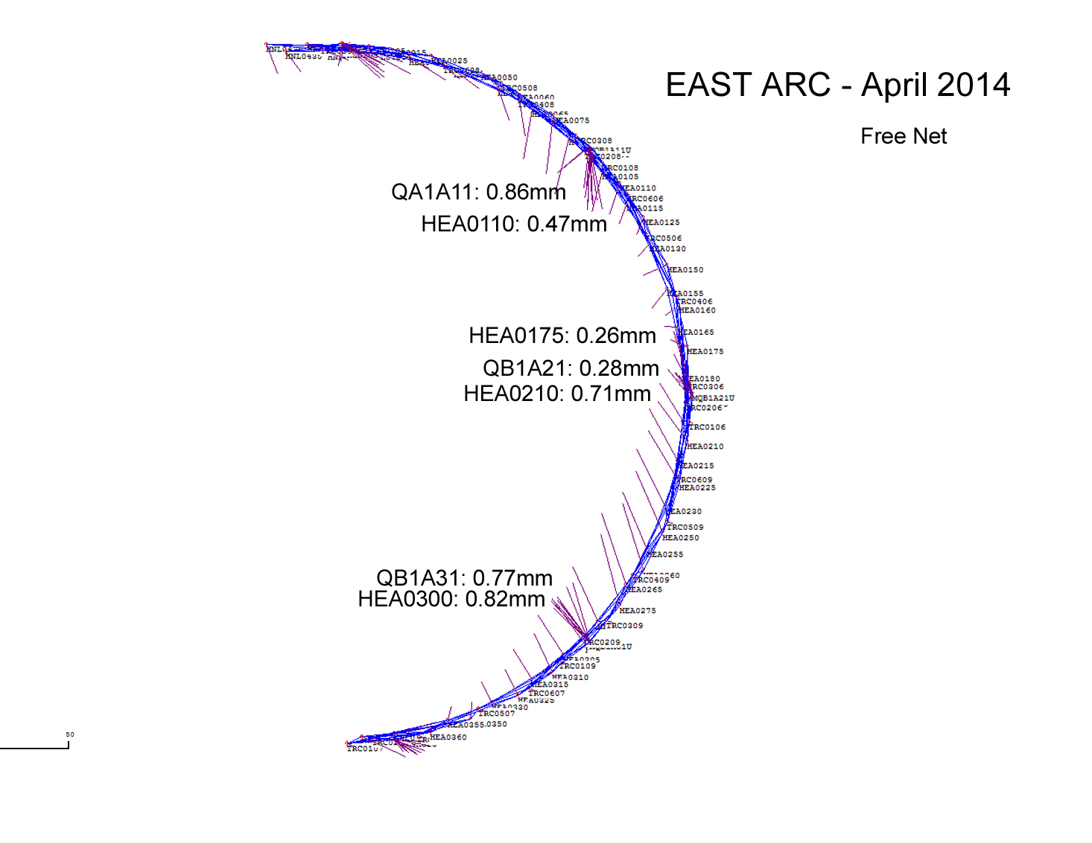
East Arc Control

Slide 5
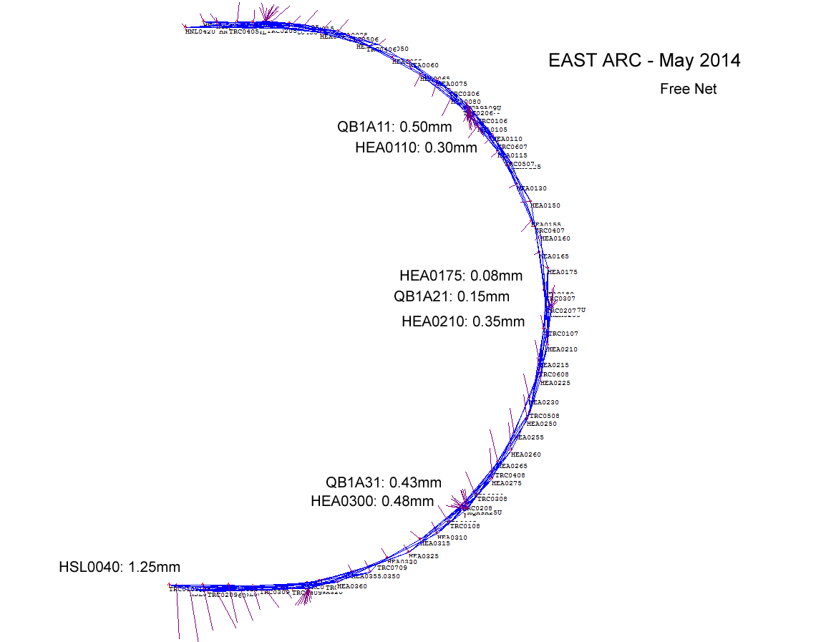
East Arc Control

Slide 6
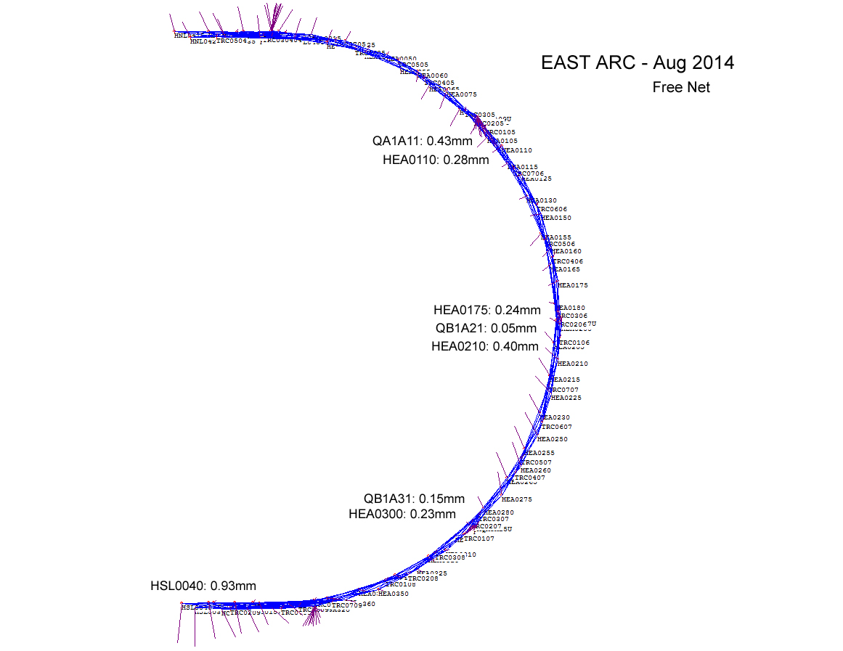
East Arc Control

Slide 7
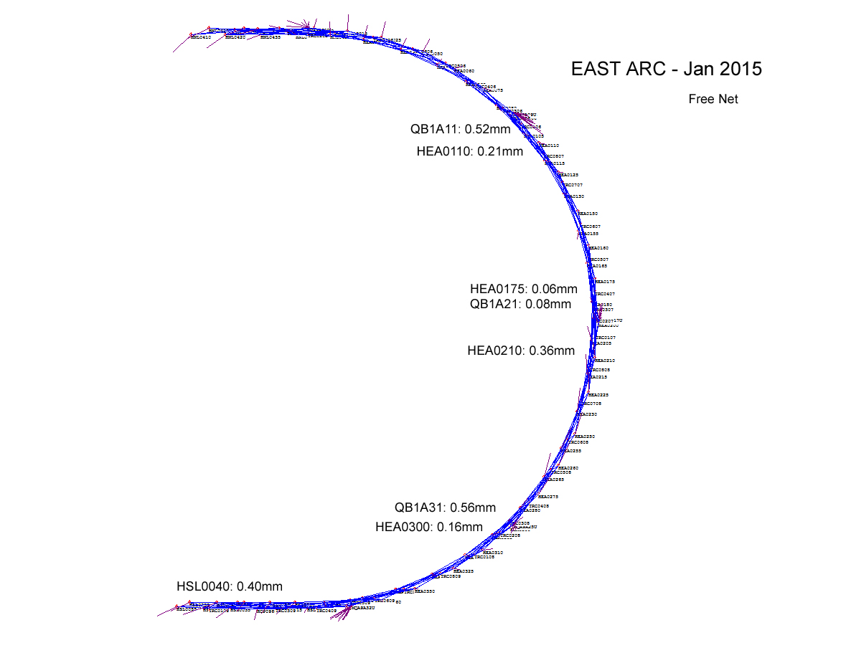
East Arc Control

Slide 8
East Arc Control
Comparison to June 2012 Network survey
 | Mar-13 | Apr-14 | May-14 | Aug-14 | Jan-15
Avg. Vector Length (free) | 1.87 mm | 0.58 mm | 0.35 mm | 0.32 mm | 0.25 mm
9par scale (free) | -25.7 ppm | -7.6 ppm | -2.9 ppm | -2.3 ppm | -0.2 ppm
9par scale (mek.) | ** | ** | -5.5 ppm | -4.1 ppm | -2.0 ppm
"Traverse" 2012 | 243.70899 m | 243.70899 m | 243.70899 m | 243.70899 m | 243.70899 m
Traverse length | 243.70020 m | 243.70654 m | 243.70835 m | 243.70795 m | 243.70965 m
Traverse length diff. | -8.79 mm | -2.45 mm | -0.64 mm | -1.04 mm | +0.66 mm
Avg. Sampled Temp. | NA | 29.8 | 29.5 | 28.7 | 27.9

Slide 9
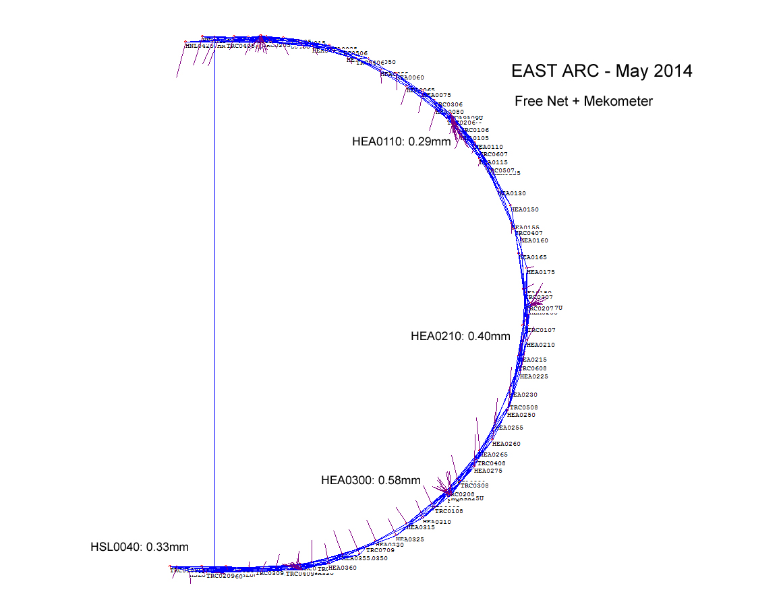
East Arc Control

Slide 10
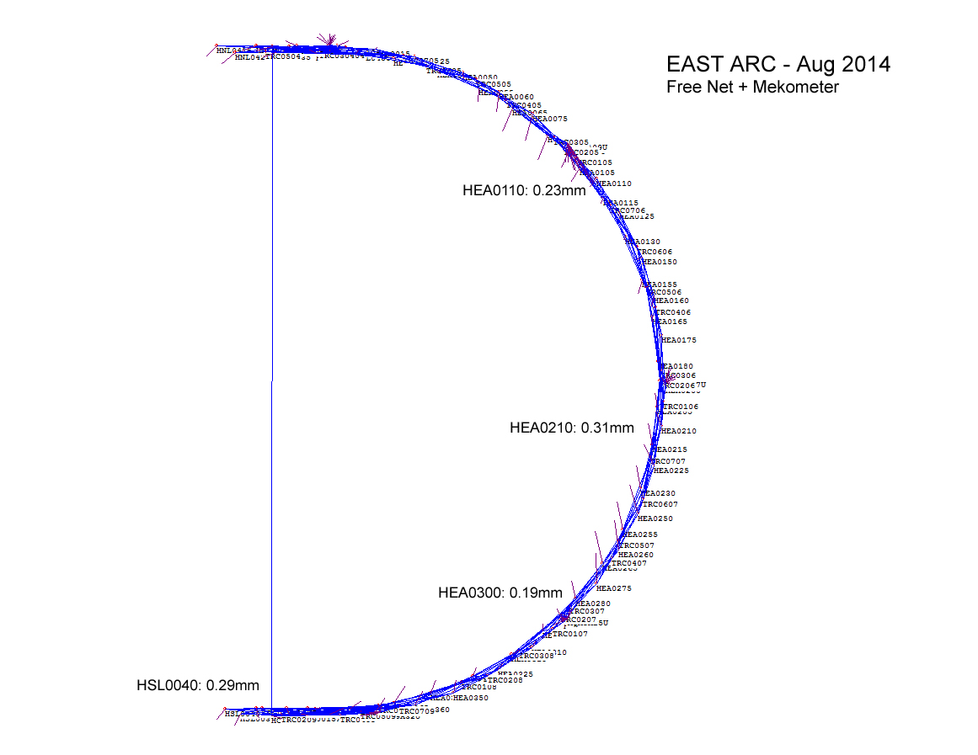
East Arc Control

Slide 11
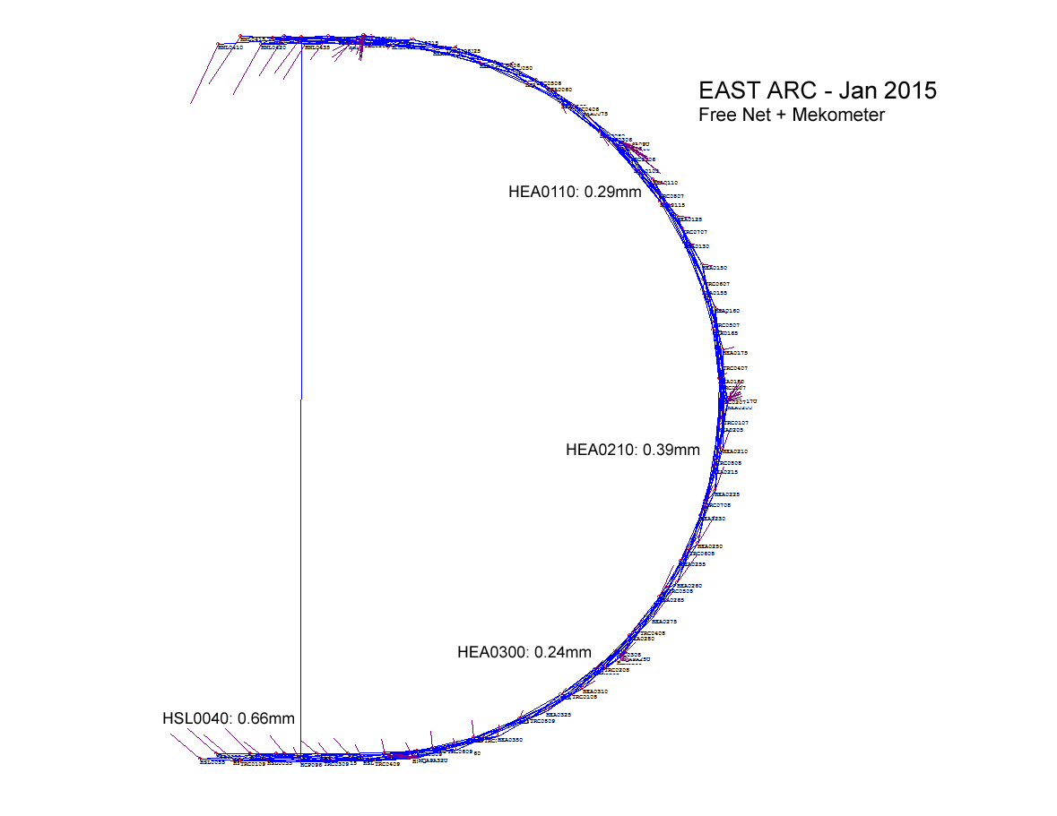
East Arc Control

Slide 12
Linac Distances
 | Mar- | 13 | Apr- | 14 | May- | 14 | Aug- | 14 | Jan- | 15
North Linac | Avg Dist. | Diff 2012 | Avg Dist. | Diff 2012 | Avg Dist. | Diff 2012 | Avg Dist. | Diff 2012 | Avg Dist. | Diff 2012
HNL0030-420 | 361.57716 | +2.1 ppm | 361.57648 | +0.2 ppm | 361.57623 | -0.5 ppm | 361.57595 | -1.2 ppm | 361.57573 | -1.9 ppm
HNL0030-455 | 390.39103 | +3.2 ppm | 390.39026 | +1.3 ppm | 390.38969 | -0.2 ppm | 390.38971 | -0.1 ppm | 390.38950 | -0.7 ppm
HNL0060-420 | 340.35929 | +2.6 ppm | 340.35846 | +0.2 ppm | 340.35809 | -0.9 ppm | 340.35811 | -0.9 ppm | 340.35774 | -1.9 ppm
HNL0060-455 | 369.17304 | +3.6 ppm | 369.17222 | +1.4 ppm | 369.17179 | +0.3 ppm | 369.17173 | +0.1 ppm | 369.17156 | +0.4 ppm
Avg. Temp | 21.0 |  | 26.8 |  | 27.2 |  | 27.1 |  | 27.1
 | NL Avg: | +2.9 ppm | NL Avg: | +0.8 ppm | NL Avg: | -0.3 ppm | NL Avg: | -0.6 ppm | NL Avg: | -1.2 ppm
South Linac
HSL0010-420 | 376.56254 | +3.2 ppm | 376.56169 | +0.9 ppm | 376.56091 | -1.1 ppm | 376.56069 | -1.7 ppm | 376.56088 | -1.2 ppm
HSL0010-445 | 395.75880 | +4.0 ppm | 395.75802 | +2.0 ppm | 395.75738 | +0.4 ppm | 395.75737 | +0.4 ppm | 395.75739 | +0.5 ppm
HSL0040-420 | 354.99806 | +5.6 ppm | 354.99650 | +1.2 ppm | 354.99567 | -1.1 ppm | 354.99533 | -2.1 ppm | 354.99530 | -2.2 ppm
HSL0040-445 | 374.19450 | +6.9 ppm | 374.19290 | +2.6 ppm | 374.19214 | +0.6 ppm | 374.19184 | -0.2 ppm | 374.19212 | +0.6 ppm
Avg. Temp | 20.7 |  | 25.5 |  | 26.7 |  | 28.5 |  | 28.5
 | SL Avg: | +4.9 ppm | SL Avg: | +1.7 ppm | SL Avg: | -0.3 ppm | SL Avg: | -0.9 ppm | SL Avg: | -0.6 ppm
NOTE: Average temp of 2012 distance measurements: 29.0 (5ppm on 350m is 1.75mm)

Slide 13
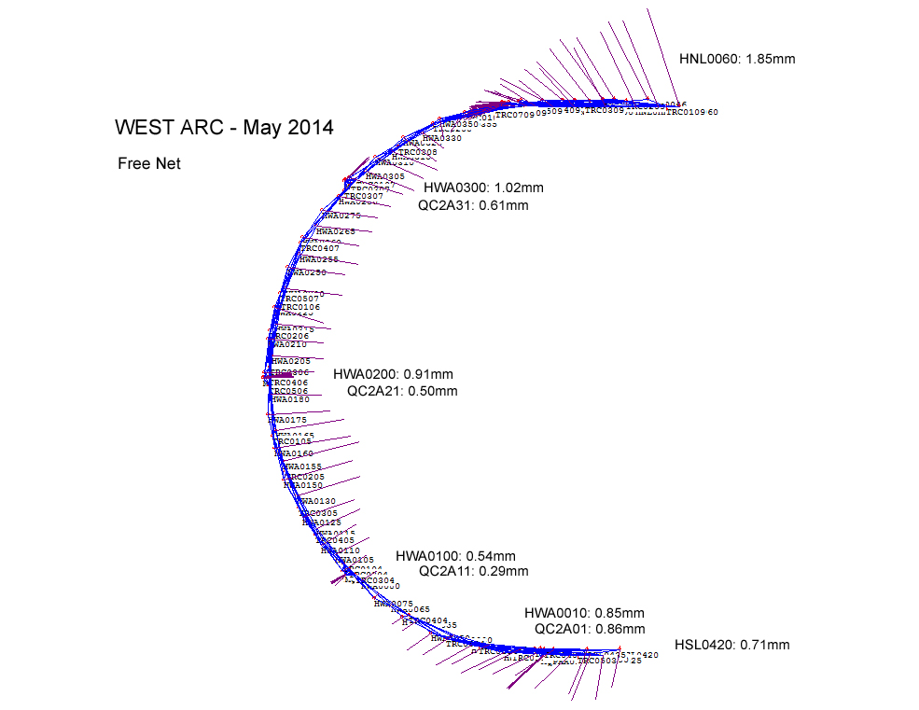
West Arc Control

Slide 14
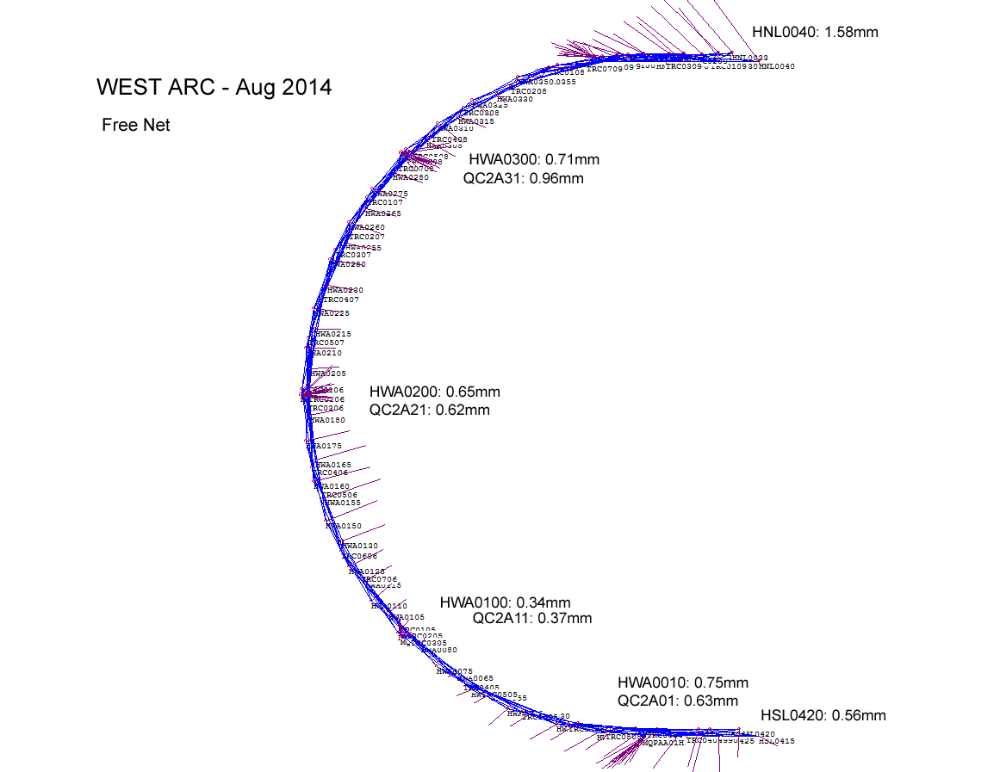
West Arc Control

Slide 15
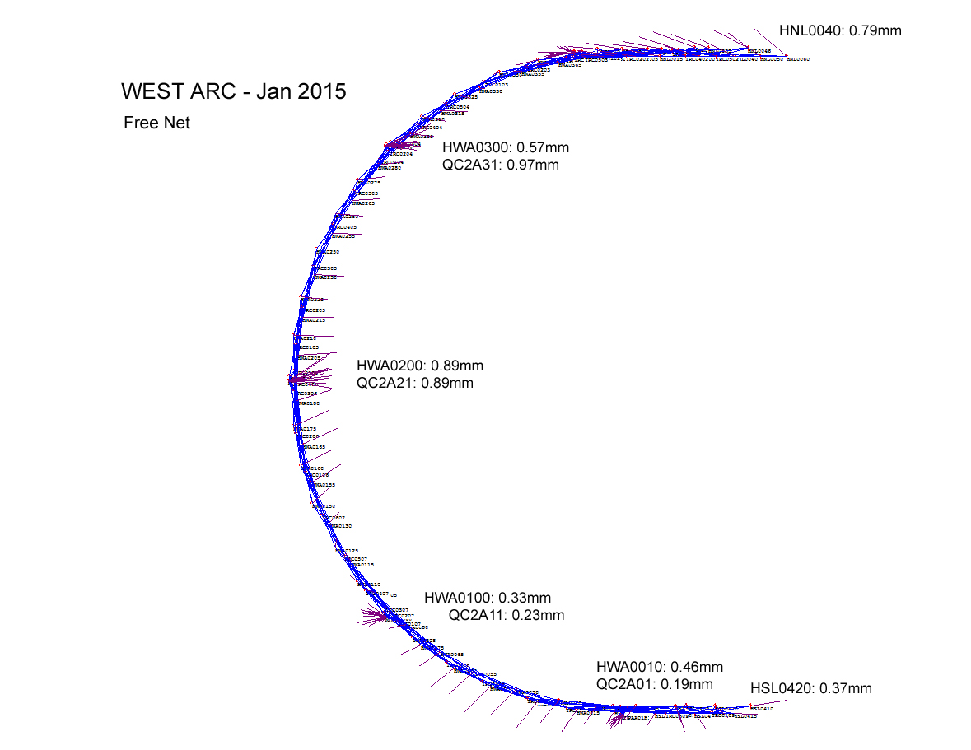
West Arc Control

Slide 16
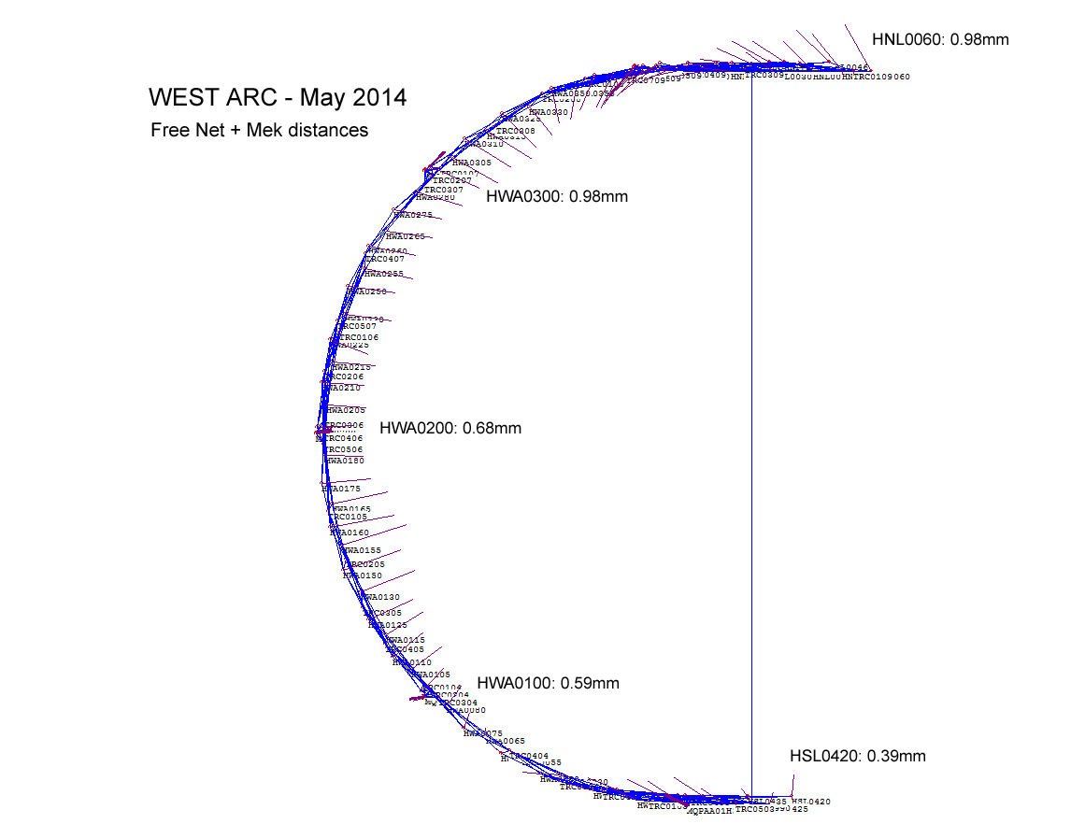
West Arc Control

Slide 17
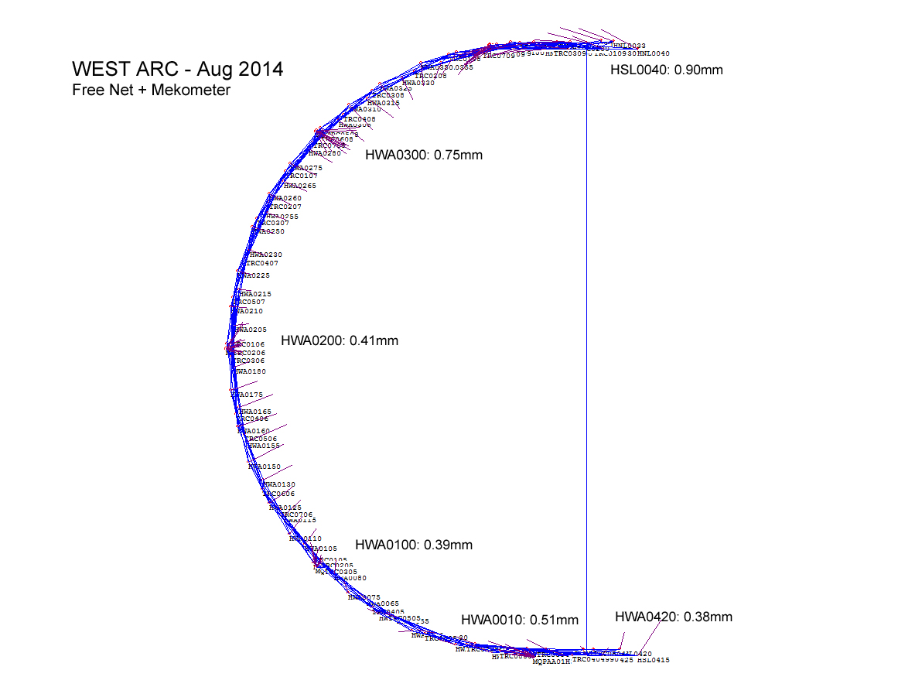
West Arc Control

Slide 18
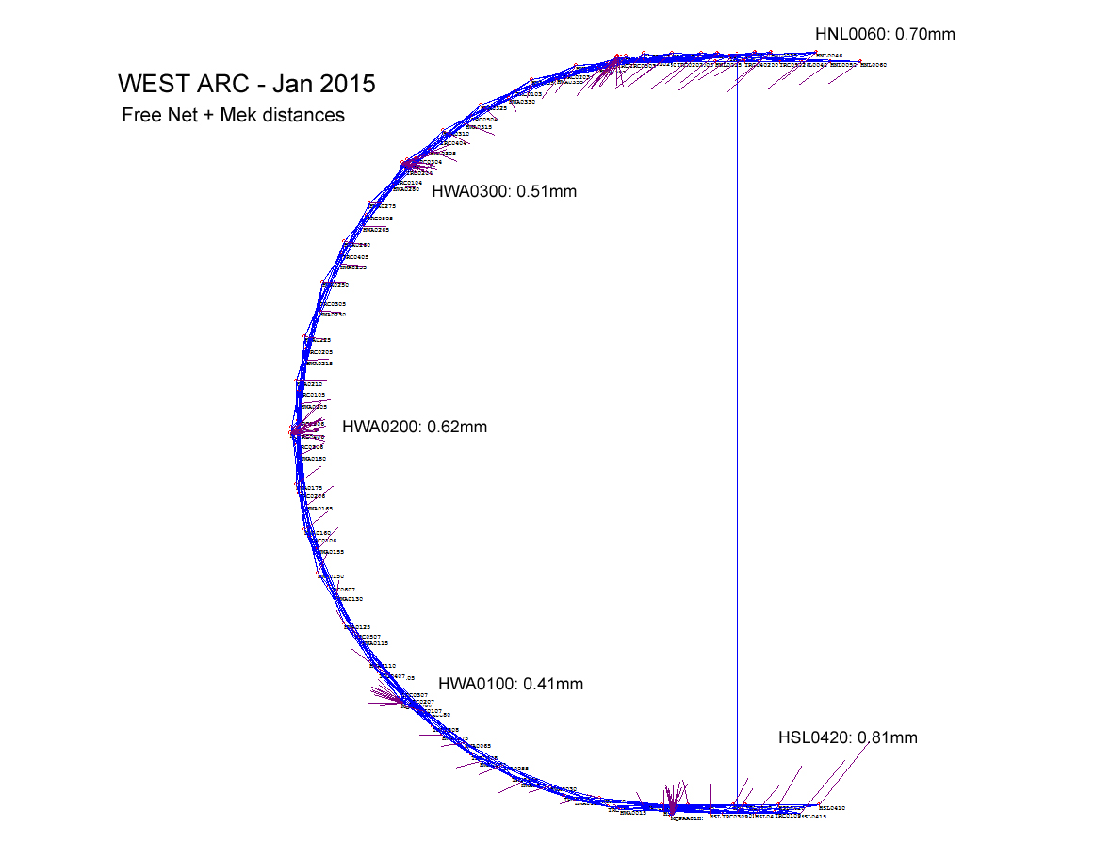
West Arc Control

Slide 19
West Arc Control
Comparison to June 2012 Network survey
 | May-14 | Aug-14 | Jan-15
Avg. Vector Length (free) | 0.80 mm | 0.60 mm | 0.55 mm
9par scale (free) | -5.2 ppm | -3.8 ppm | -1.5 ppm
9par scale (mek.) | -7.9 ppm | -6.4 ppm | -4.2 ppm
"Traverse" 2012 | 244.01590 m | 244.01590 m | 244.01590 m
Traverse length | 244.01288 m | 244.01305 m | 244.01436 m
Traverse length diff. | -3.02 mm | -2.85 mm | -1.54 mm
Avg. Sampled Temperature | 28.9 | 30.0 | 28.7

Slide 20
Summary
Survey network measured June 2012 used to re-align all elements in the accelerator (excluding 1st part of injector). This is basis for comparison.
April 2013 final alignment : East arc shorter than 2012 by approx. 25 ppm Linacs lengthened approx. +3 to +5 ppm
April 2014: East arc expanded, but still approx. -8 ppm from 2012
  Linacs at +1 to +2 ppm from 2012
May 2014: East arc continued expansion to approx. -3 to -5ppm from 2012
      West arc Shorter than 2012 by -5 to -8ppm
    Linacs about same as 2012
Aug 2014: East arc Transformation shows slight expansion to -2 to -4ppm from 2012, but “traverse” shows slight shortening from May ‘14
      West arc Slight expansion to -4 to -6ppm from 2012
    Linacs about same as 2012
Jan 2015: East arc Transformation shows continued expansion to about -1ppm from 2012. Traverse now slightly longer than 2012
      West arc Continued expansion to about -3ppm and -1.5mm on traverse
    Linacs NL continues contraction, SL between last 2 measurements (2014)

Slide 21
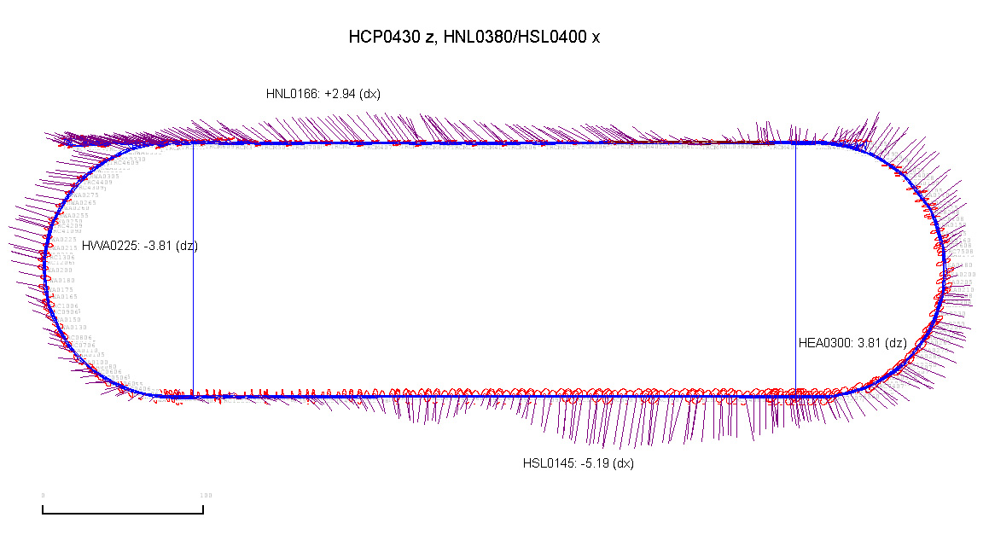
Preliminary Survey Network
Network Survey Results - 2008

Slide 22
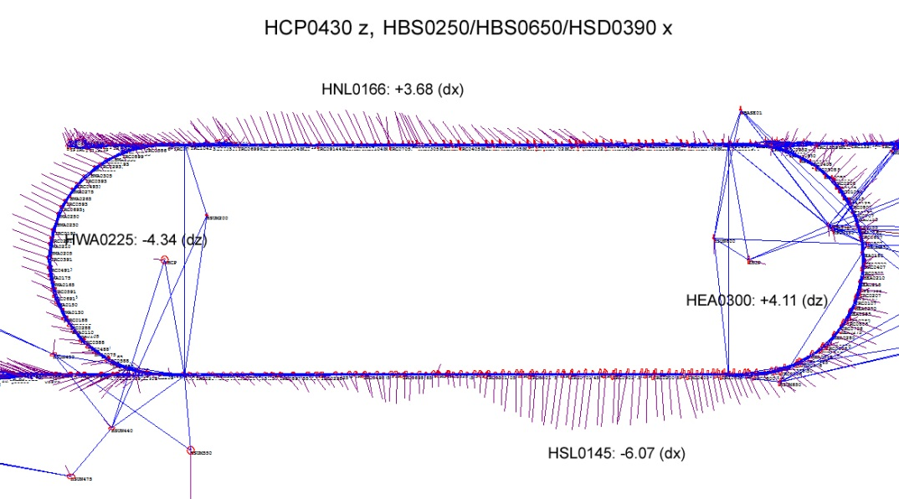
Current Survey Network
Network Survey Results - 2012

