Slide 1
Arc 1 with Adjusted Body Gradients Alex Bogacz
BT Mtg.April 28, 2020

Slide 2
Arc 1 Optics Architecture - Dispersion/M₅₆ Control
0.5
PHASE_X&Y
ΔQ_{x} = 3π/2
ΔQ_{x} = 3π/2
0
57
Q_X
Q_Y
185
150
7
BETA_X&Y[m]
DISP_X&Y[m]
0
-7
0
BETA_X
BETA_Y
DISP_X
DISP_Y
242.23
1A11
1A21
1A31
BT Mtg.April 28, 2020

Slide 3
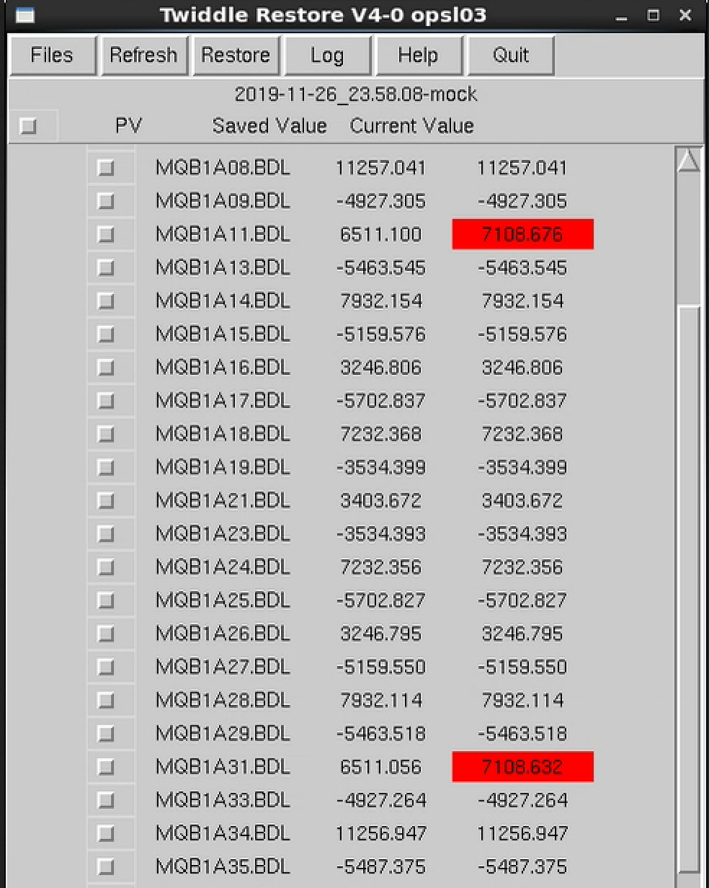
Arc 1 M₅₆ Retune to Isochronous
Arc1 at 1152.5 MeV/c

Slide 4
M₅₆ Retune to Isochronous (at 1152.5 MeV/c)
Using our Optics model one can conclude that:
increase of 1A11 and 1A31 quad strengths by 597.58 Gauss is equivalent to reducing arc bends’ body gradients to 52% of what we originally had in the model, namely from:
With reduced body gradient, Arc 1 Optics (before tuning) was NOT isochronous, M₅₆ = -21.3 cm
$GJD = 2.558 Gauss/cm
to
$GJD = 1.318 Gauss/cm
BT Mtg.April 28, 2020

Slide 5
Arc 1 Optics – Design vs. Actual
150
M₅₆ = 0
7
BETA_X&Y[m]
DISP_X&Y[m]
0
0
BETA_X
BETA_Y
DISP_X
DISP_Y
409.13
-7
150
7
M₅₆ = - 21.3 cm
BETA_X&Y[m]
DISP_X&Y[m]
0
-7
0
BETA_X
BETA_Y
DISP_X
DISP_Y
409.13
BT Mtg. January 15, 2019

Slide 6
Arc 1 Optics with Adjusted Body Gradients
$GJD = 1.318 Gauss/cm
0.5
PHASE_X&Y
ΔQ_{x} = 3π/2
ΔQ_{x} = 3π/2
0
57
Q_X
Q_Y
185
150
7
BETA_X&Y[m]
DISP_X&Y[m]
0
-7
0
BETA_X
BETA_Y
DISP_X
DISP_Y
242.23
1A11
1A21
1A31
BT Mtg.April 28, 2020

Slide 7
Arc 1 with Adjusted Body Gradients
$GJD = 1.318 Gauss/cm
150
M₅₆ = 0
7
BETA_X&Y[m]
DISP_X&Y[m]
0
-7
0
BETA_X
BETA_Y
DISP_X
DISP_Y
409.13
re-match
1A11
1A21
1A31
re-match
ΔQ_{x} = 3π/2
ΔQ_{x} = 3π/2
BT Mtg.April 28, 2020

Slide 8
Arc 1 – ‘New’ Design Model
qMQN1S04 old=-14089.749 new*s=-14137.458 delta=47.709 %=0.339
qMQL1S05 old=14848.116 new*s=14825.388 delta=22.728 %=-0.153
qMQB1S06 old=-10414.543 new*s=-10362.825 delta=-51.718 %=-0.497
qMQL1S07 old=-2815.345 new*s=-2751.284 delta=-64.061 %=-2.275
qMQL1S08 old=3783.834 new*s=3753.228 delta=30.606 %=-0.809
qMQL1S09 old=-3277.155 new*s=-3272.588 delta=-4.567 %=-0.139
qMQB1S10 old=2946.700 new*s=2879.687 delta=67.014 %=-2.274
qMQB1E01 old=-2279.556 new*s=-2450.474 delta=170.918 %=7.498
qMQB1E02 old=1799.664 new*s=1733.784 delta=65.880 %=-3.661
qMQB1E03 old=-2523.108 new*s=-2539.077 delta=15.969 %=0.633
qMQB1A01 old=878.290 new*s=907.089 delta=-28.799 %=3.279
qMQB1A02 old=5076.928 new*s=5102.736 delta=-25.808 %=0.508
qMQB1A03 old=-6467.883 new*s=-6464.052 delta=-3.831 %=-0.059
qMQL1A04 old=14308.226 new*s=14294.912 delta=13.314 %=-0.093
qMQB1A05 old=-5278.974 new*s=-5283.377 delta=4.403 %=0.083
qMQB1A06 old=5491.084 new*s=5551.956 delta=-60.871 %=1.109
qMQB1A07 old=-5775.590 new*s=-5771.586 delta=-4.003 %=-0.069
qMQB1A08 old=11848.197 new*s=11894.031 delta=-45.834 %=0.387
qMQB1A09 old=-5186.060 new*s=-5166.576 delta=-19.484 %=-0.376
qMQB1A11 old=6853.032 new*s=6865.037 delta=-12.005 %=0.175
qMQB1A13 old=-5750.469 new*s=-5752.466 delta=1.997 %=0.035
qMQB1A14 old=8348.719 new*s=8346.835 delta=1.885 %=-0.023
qMQB1A15 old=-5430.537 new*s=-5429.529 delta=-1.008 %=-0.019
qMQB1A16 old=3417.318 new*s=3417.318 delta=0.000 %=0.000
qMQB1A17 old=-6002.337 new*s=-5988.465 delta=-13.872 %=-0.231
qMQB1A18 old=7612.195 new*s=7665.653 delta=-53.458 %=0.702
qMQB1A19 old=-3720.018 new*s=-3675.186 delta=-44.832 %=-1.205
qMQB1A21 old=3813.982 new*s=3881.248 delta=-67.266 %=1.764
BT Mtg.April 28, 2020

Slide 9
Arc 1 – ‘New’ Design Model cont.
qMQB1A23 old=-3720.018 new*s=-3675.186 delta=-44.832 %=-1.205
qMQB1A24 old=7612.195 new*s=7665.653 delta=-53.458 %=0.702
qMQB1A25 old=-6002.337 new*s=-5988.465 delta=-13.872 %=-0.231
qMQB1A26 old=3417.318 new*s=3417.318 delta=0.000 %=0.000
qMQB1A27 old=-5430.537 new*s=-5429.529 delta=-1.008 %=-0.019
qMQB1A28 old=8348.719 new*s=8346.835 delta=1.885 %=-0.023
qMQB1A29 old=-5750.469 new*s=-5752.466 delta=1.997 %=0.035
qMQB1A31 old=6853.032 new*s=6865.037 delta=-12.005 %=0.175
qMQB1A33 old=-5186.060 new*s=-5166.576 delta=-19.484 %=-0.376
qMQB1A34 old=11848.197 new*s=11894.031 delta=-45.834 %=0.387
qMQB1A35 old=-5775.590 new*s=-5771.586 delta=-4.003 %=-0.069
qMQB1A36 old=5491.084 new*s=5551.956 delta=-60.871 %=1.109
qMQB1A37 old=-5278.974 new*s=-5283.377 delta=4.403 %=0.083
qMQL1A38 old=14308.226 new*s=14294.912 delta=13.314 %=-0.093
qMQB1A39 old=-6467.883 new*s=-6464.052 delta=-3.831 %=-0.059
qMQB1A40 old=4553.762 new*s=4647.475 delta=-93.714 %=2.058
qMQB1R01 old=6344.068 new*s=6389.510 delta=-45.442 %=0.716
qMQL1R02 old=-10824.216 new*s=-11104.698 delta=280.482 %=2.591
qMQL1R03 old=13822.412 new*s=13839.155 delta=-16.744 %=0.121
qMQL1R04 old=-10129.649 new*s=-9895.287 delta=-234.362 %=-2.314
qMQB1R05 old=-6161.088 new*s=-6117.648 delta=-43.440 %=-0.705
qMQL1R06 old=16947.360 new*s=16881.330 delta=66.030 %=-0.390
qMQL1R07 old=-10209.444 new*s=-10248.561 delta=39.117 %=0.383
BT Mtg.April 28, 2020

