Slide 1
HALL A FFB Machine Studies Summary
Ryan Bodenstein, Nick Sereno
Riad Suleiman
05-28-2025
Notes:
Tip: Keep titles under 60 characters for readability
To change the photo: Right-click on photo and select change photo

Slide 2
FFB Studies with Hall A 05-28-2025
Studies Plan:
Recalibrate to get updated response especially at dispersive bpms (data much different than design model where there was a single peak at 1C12)
Closed loop: Change helicity states and take data sets (30, 960, 1920 Hz)
Open loop: Change helicity states and take data sets (30, 960, 1920 Hz)
Turned feedback (FB), feedforward (FF) and energy FB on and off individually and in combination
Restore the machine (return the hall A FFB to operational status)
Only had a chance to look at some open loop data as any motion at this frequency would be seen by the 1.8 kHz fast sampled FFB BPMs
Most interesting to understand system performance is to look at motion spectrum with various combinations of the system open/closed loop (FB, FF, Energy FB)
So, lots of “dog ate my homework” excuses why I have not looked much at this yet☺
Notes:
Guidelines: 6-8 bullets per slide; Use sentence fragments for bullets
To change the photo: Right-click on photo and select change photo

Slide 3
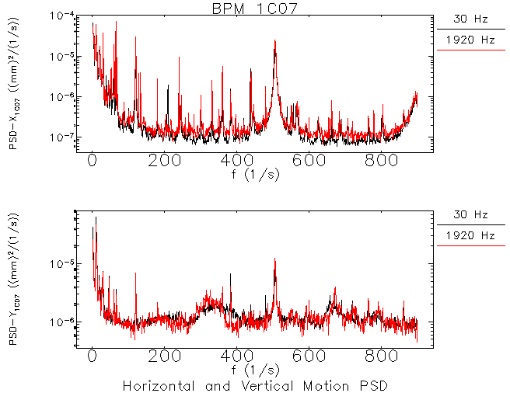
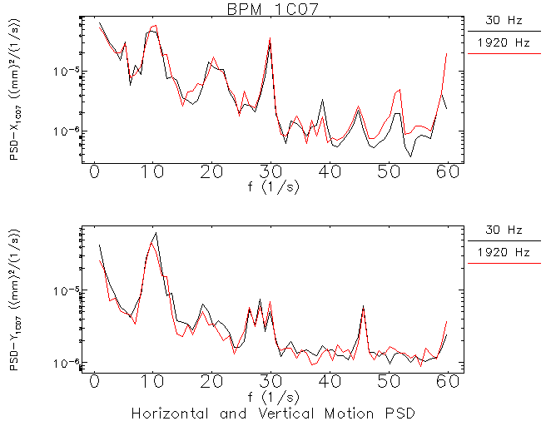
FFB Studies with Hall A 05-28-2025
Horizontal and Vertical Motion PSD for 1C07 (full and zoomed)
Wide 500 Hz signal seen, Not much difference at 30 Hz
Notes:
Guidelines: 6-8 bullets per slide; Use sentence fragments for bullets
To change the photo: Right-click on photo and select change photo

Slide 4
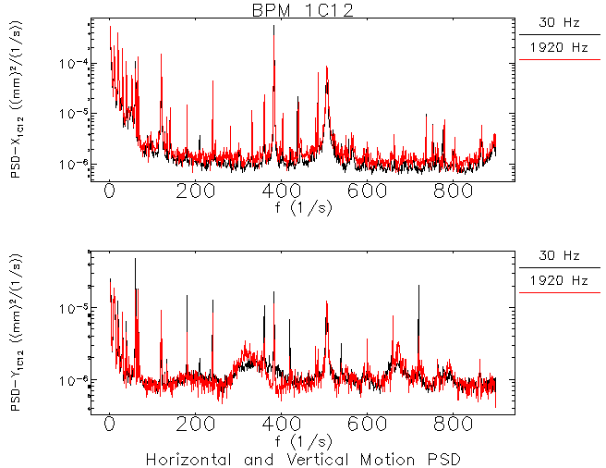
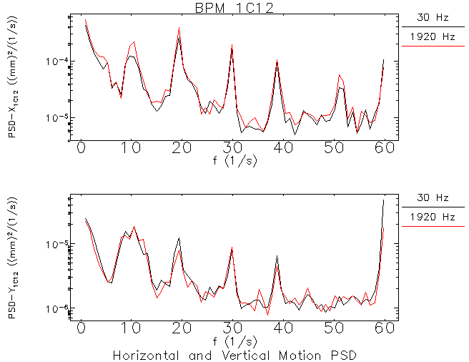
FFB Studies with Hall A 05-28-2025
Horizontal and Vertical Motion PSD for 1C12 (full and zoomed)
Wide 500 Hz signal seen, Not much difference at 30 Hz
Notes:
Guidelines: 6-8 bullets per slide; Use sentence fragments for bullets
To change the photo: Right-click on photo and select change photo

Slide 5
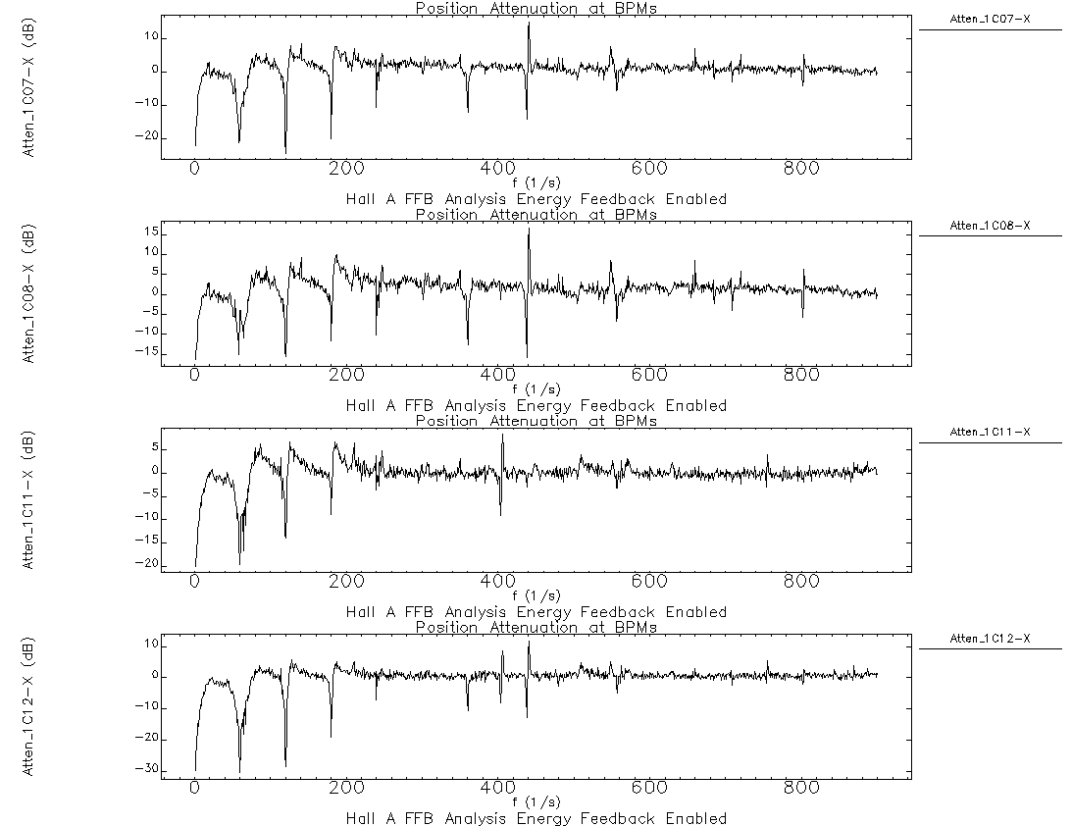
FFB Studies with Hall A 05-28-2025
Horizontal and Vertical Orbit Attenuation
Some large 10-15 dB amplification near 1st three 60 Hz harmonics
Notes:
Guidelines: 6-8 bullets per slide; Use sentence fragments for bullets
To change the photo: Right-click on photo and select change photo

Slide 6
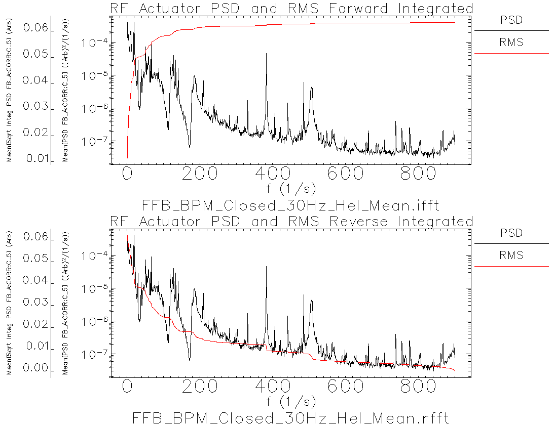
FFB Studies with Hall A 05-28-2025
RF actuator effort (C5)
See some non-negligible effort closed loop at 500 Hz - interesting
Notes:
Guidelines: 6-8 bullets per slide; Use sentence fragments for bullets
To change the photo: Right-click on photo and select change photo

Slide 7
Questions, Comments, Discussion?
Notes:
Before sharing your presentation, confirm:
Fonts are consistent
Images meet quality standards
Charts use template colors
Footer information is current
Spell check completed
Links are working
File size is optimized

