Slide 1

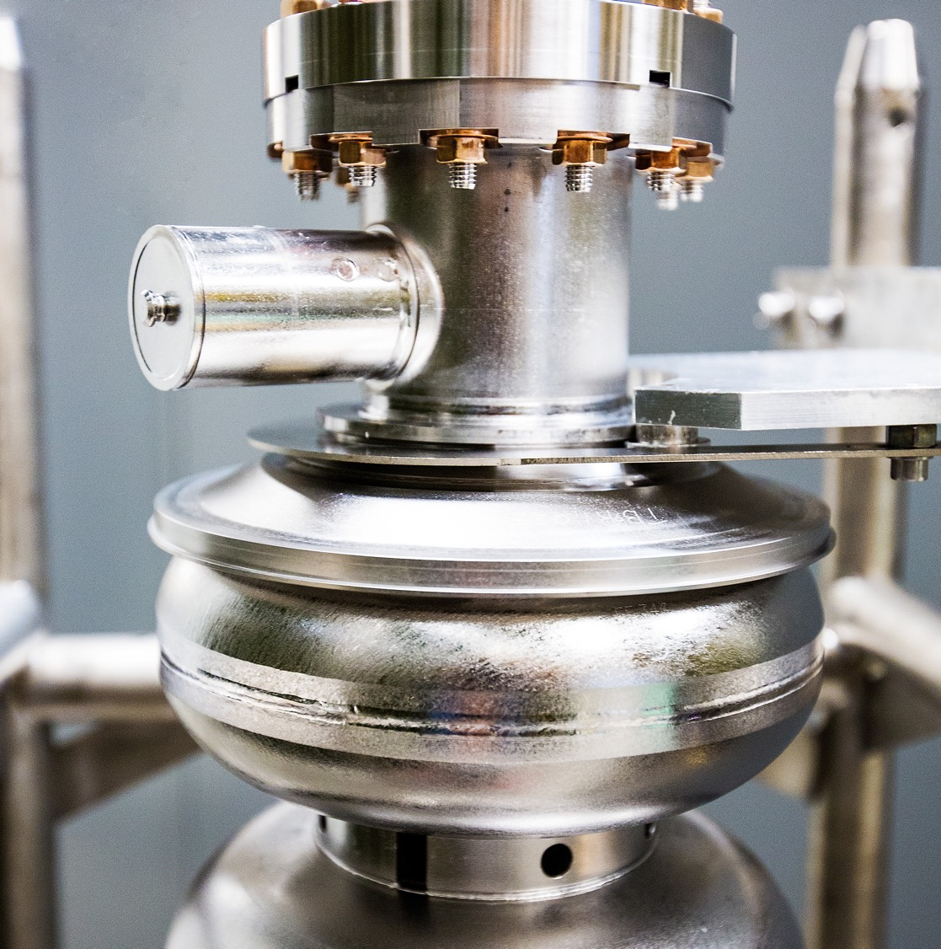
Introduction to SDDS and the SDDS Toolkit
Nick Sereno
June 3, 2025
Notes:
Tip: Keep titles under 60 characters for readability
To change the photo: Right-click on photo and select change photo

Slide 2
Acknowledgements and a Brief History
Developed by Michael Borland, Louis Emery and many others at Argonne/APS and worldwide
In 1993, APS needed to find or create general-purpose software for APS commissioning
Developed the Self Describing Data Sets (SDDS) file protocol and tookit to meet this need
Planned to later write traditional high-level applications based on the algorithms developed with these tools
Concept worked so well that it was used to control to run the original APS and is used in APS operations today for APS-U (where the Tcl/Tk scripting language is used to develop GUIs)
450 MeV S-Band normal-conducting linac (originally a 450 MeV positron linac)
Particle Accumulator Ring (PAR)
Booster (7 GeV)
Storage ring (APS and APS-U)
Originally developed for accelerator commissioning, SDDS tools are well suited to control room data acquisition and analysis (My opinion☺)
Also used for pre and post processing of accelerator simulation data (Elegant and other programs)
SDDS tools are used at APS, DESY, IPNS, BESSY II, RHIC, SLAC…JLAB
Notes:
Guidelines: 6-8 bullets per slide; Use sentence fragments for bullets
To change the photo: Right-click on photo and select change photo

Slide 3
What is SDDS?
Or, what is “self describing data”?
Concept 1: Its data that is identified and accessed by name only
Concept 2: A toolkit of programs reads and processes sdds data
Toolkit programs act as operators on sdds data files always reading sdds files and delivering processed results to sdds files
One can rapidly build very sophisticated processing algorithms with a simple set of toolkit programs operating on sdds data
There is a very interesting introduction by Michael Borland in the first reference on how these two concepts:
Are very different than using and processing data within say a spreadsheet program or matlab
Capabilities, advantages, problems and limitations of the sdds data/toolkit program concept
Notes:
Guidelines: 6-8 bullets per slide; Use sentence fragments for bullets
To change the photo: Right-click on photo and select change photo

Slide 4
What is SDDS?
With self-describing data the approach is to define a standard file protocol (structure) and write all the toolkit programs to work with this protocol
Make a simple file protocol so that the “sdds toolkit programs as operators” concept is easy to implement
Each toolkit program performs a simple task that may or may not be useful in and of itself without use of other programs
Spend your time using the toolkit programs rather than writing programs (with all this implies - defining variables, loop indices, arrays and avoids having to edit, compile, debug, test etc.)
I’ll quit here on this discussion and encourage you to read the first reference: Getting started with SDDS…
Notes:
Guidelines: 6-8 bullets per slide; Use sentence fragments for bullets
To change the photo: Right-click on photo and select change photo

Slide 5
References
I borrowed heavily from various references created by M. Borland and others:
Getting started with SDDS: GettingStartedWithSDDS.pdf
User’s Guide for SDDS Toolkit Version 5.0 (document): SDDStoolkit.pdf
User’s Guide for SDDS Toolkit Version 5.0: User’s Guide for SDDS Toolkit Version 5.0
Users Guide for SDDS-compliant EPICS Toolkit Version 1.5: User's Guide for SDDS-compliant EPICS Toolkit Version 1.5
User’s Manual for Elegant: User’s Manual for elegant - Used as the model for CEBAF
Installation guides, software packages, source code, demo scripts, OAG/Tcl/Tk scripts, documentation at: Software | Advanced Photon Source
Application Programmers Guide for SDDS Version 4: Application Programmer’s Guide for SDDS Version 4 (make your own toolkit programs)
Notes:
Guidelines: 6-8 bullets per slide; Use sentence fragments for bullets
To change the photo: Right-click on photo and select change photo

Slide 6
SDDS toolkit programs
All open source
Written in C and all use common libraries to read and write sdds files
Typing a toolkit program on the command line without options gives the usage and all commandline options
You can write your own if the processing needed is not already part of the toolkit by referring to the Application Programmers Guide reference
So no need to wait for new features to existing toolkit programs to be added
However it is very unlikely that some processing feature does not already exist in the toolkit for your data analysis algorithm
Toolkit is installed on ACE in /bin
Notes:
Guidelines: 6-8 bullets per slide; Use sentence fragments for bullets
To change the photo: Right-click on photo and select change photo

Slide 7
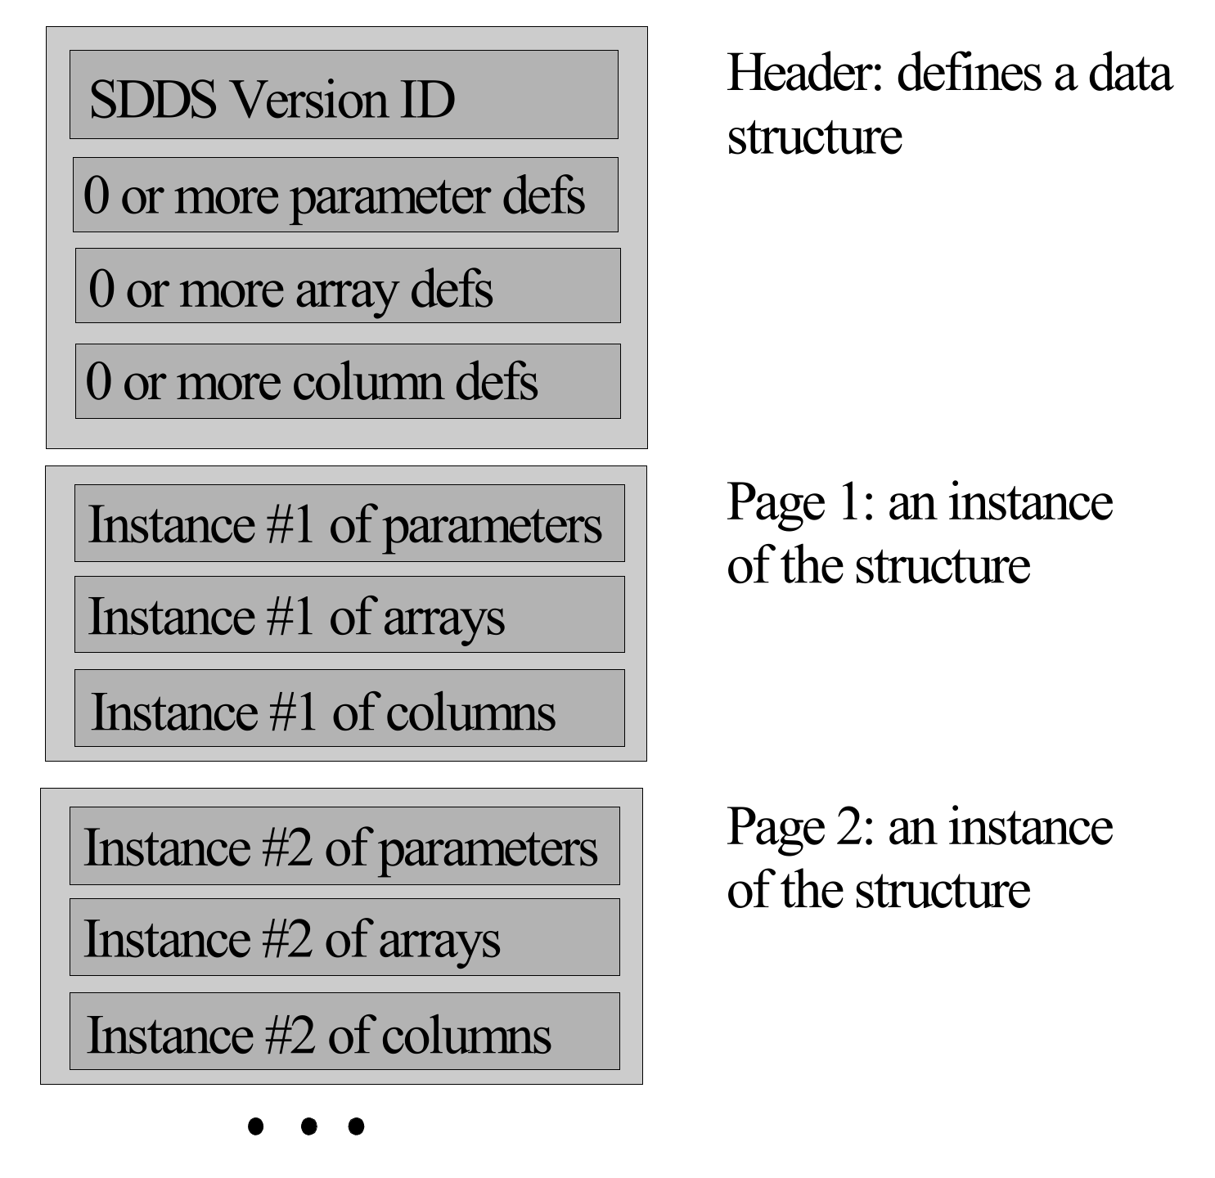
SDDS File Structure (Protocol)
There are other more complex self-describing data protocols in existence
The Argonne/APS/Borland version of SDDS is simple enough to be useful and not too complicated for toolkit program development (see the reference for details)
Structure of an SDDS file:
Begins with a file header defining the data structure in the file
Header includes the SDDS version number
Data contained in the file are parameters, columns and arrays
Each page is a different instance of the same header structure
Arrays are little used (a series of columns is an array)
Could have a header for each page
Makes programming toolkit programs difficult
Get around this limitation by using different sdds files
Toolkit has programs to take data from one file and move it to another file
Notes:
Guidelines: 6-8 bullets per slide; Use sentence fragments for bullets
To change the photo: Right-click on photo and select change photo

Slide 8
SDDS File Structure (Protocol)
This simplified structure for SDDS files is created in recognition of the fact that most scientific data can be represented as scalar (parameter) values and tables (multiple columns) and multiple instances of these structures
SDDS supports six data types (each column or parameter has one of these):
Single and double precision floating point numbers (“float”, “double” types)
Short and long integers (“short” and “long” types)
One-byte characters and character strings (“character” and “string” types)
Each column and parameter in addition to a name can have fields:
Units
Symbol for plotting with sddsplot (can include Greek letters such as for beta functions etc.)
A description
Notes:
Guidelines: 6-8 bullets per slide; Use sentence fragments for bullets
To change the photo: Right-click on photo and select change photo

Slide 9
SDDS File Example
SDDS1
&parameter name=Filename, description="Name of file from which this page came", type=string, &end
&parameter name=NumberCombined, description="Number of files combined to make this file", type=long, &end
&parameter name=Max_Temp, units="deg C", description="maximum of Temperature", type=double, &end
&parameter name=Warmest_City, description="maximum of Temperature", type=string, &end
&parameter name=Min_Humidity, units=%, description="minimum of Humidity", type=double, &end
&parameter name=Driest_City, description="minimum of Humidity", type=string, &end
&column name=City, type=string, &end
&column name=Temperature, units="deg C", type=double, &end
&column name=Humidity, units=%, type=double, &end
&data mode=ascii, &end
! page number 1
USCityWeather.sdds
2
4.000000000000000e+01
"Los Angeles"
4.200000000000000e+01
"San Francisco"
4
Chicago 3.800000000000000e+01 9.500000000000000e+01
"New York" 3.200000000000000e+01 7.000000000000000e+01
"San Francisco" 3.000000000000000e+01 4.200000000000000e+01
"Los Angeles" 4.000000000000000e+01 6.500000000000000e+01
! page number 2
EUCityWeather.sdds
2
3.500000000000000e+01
Vienna
5.000000000000000e+01
Munich
3
London 2.800000000000000e+01 5.500000000000000e+01
Munich 3.000000000000000e+01 5.000000000000000e+01
Vienna 3.500000000000000e+01 6.500000000000000e+01
A simple sdds file
6 parameters
3 columns
2 pages
Some parameters created by the toolkit programs automatically (1st two)
Here I’ve converted the file to ascii using sddsconvert <filename> -ascii
The header is always in ascii, most of the time data is binary
Notes:
Guidelines: 6-8 bullets per slide; Use sentence fragments for bullets
To change the photo: Right-click on photo and select change photo

Slide 10
Creating the SDDS File Example
Start with two simple sdds files:
Print contents using sddsprintout
Combine them using sddscombine
sddsprintout -param -col USCityWeather.sdds
warning: no parameter matches *
Printout for SDDS file USCityWeather.sdds
City Temperature Humidity
deg C %
------------------------------------------------
Chicago 3.800000e+01 9.500000e+01
New York 3.200000e+01 7.000000e+01
San Francisco 3.000000e+01 4.200000e+01
Los Angeles 4.000000e+01 6.500000e+01
sddsprintout -param -col EUCityWeather.sdds
warning: no parameter matches *
Printout for SDDS file EUCityWeather.sdds
City Temperature Humidity
deg C %
------------------------------------------------
London 2.800000e+01 5.500000e+01
Munich 3.000000e+01 5.000000e+01
Vienna 3.500000e+01 6.500000e+01
sddscombine USCityWeather.sdds EUCityWeather.sdds US_EUCityWeather.sdds
sddsprintout -param -col US_EUCityWeather.sdds
Printout for SDDS file US_EUCityWeather.sdds
Filename = USCityWeather.sdds NumberCombined = 2
City Temperature Humidity
deg C %
------------------------------------------------
Chicago 3.800000e+01 9.500000e+01
New York 3.200000e+01 7.000000e+01
San Francisco 3.000000e+01 4.200000e+01
Los Angeles 4.000000e+01 6.500000e+01
Filename = EUCityWeather.sdds NumberCombined = 2
City Temperature Humidity
deg C %
------------------------------------------------
London 2.800000e+01 5.500000e+01
Munich 3.000000e+01 5.000000e+01
Vienna 3.500000e+01 6.500000e+01
Notes:
Guidelines: 6-8 bullets per slide; Use sentence fragments for bullets
To change the photo: Right-click on photo and select change photo

Slide 11
SDDS Toolkit Processing Example
Now do something useful: Process the data using sddsprocess and find out something about the weather in the US and Europe
sddsprintout -param -col US_EUCityWeather.proc
Printout for SDDS file US_EUCityWeather.proc
Filename = USCityWeather.sdds NumberCombined = 2 Max_Temp (deg C) = 4.000000e+01
Warmest_City = Los Angeles Min_Humidity (%) = 4.200000e+01 Driest_City = San Francisco
City Temperature Humidity
deg C %
------------------------------------------------
Chicago 3.800000e+01 9.500000e+01
New York 3.200000e+01 7.000000e+01
San Francisco 3.000000e+01 4.200000e+01
Los Angeles 4.000000e+01 6.500000e+01
Filename = EUCityWeather.sdds NumberCombined = 2 Max_Temp (deg C) = 3.500000e+01
Warmest_City = Vienna Min_Humidity (%) = 5.000000e+01 Driest_City = Munich
City Temperature Humidity
deg C %
------------------------------------------------
London 2.800000e+01 5.500000e+01
Munich 3.000000e+01 5.000000e+01
Vienna 3.500000e+01 6.500000e+01
sddsprocess US_EUCityWeather.sdds US_EUCityWeather.proc \
-process=Temperature,maximum,Max_Temp \
-process=Temperature,maximum,Warmest_City,functionOf=City,position \
-process=Humidity,minimum,Min_Humidity \
-process=Humidity,minimum,Driest_City,functionOf=City,position
Notes:
Guidelines: 6-8 bullets per slide; Use sentence fragments for bullets
To change the photo: Right-click on photo and select change photo

Slide 12
More SDDS Processing
List the warmest and driest cities in the US and Europe
sddsprintout -param -col US_EUCityWeather.col
warning: no parameter matches *
Printout for SDDS file US_EUCityWeather.col
Filename NumberCombined Max_Temp Warmest_City Min_Humidity Driest_City PageNumber
deg C %
----------------------------------------------------------------------------------------------------------------
USCityWeather.sdds 2 4.000000e+01 Los Angeles 4.200000e+01 San Francisco 1
EUCityWeather.sdds 2 3.500000e+01 Vienna 5.000000e+01 Munich 2
sddscollapse US_EUCityWeather.proc US_EUCityWeather.col
Notes:
Guidelines: 6-8 bullets per slide; Use sentence fragments for bullets
To change the photo: Right-click on photo and select change photo

Slide 13
More SDDS Processing
Now we can process the new columns of data (which were formerly parameters on each page) to find out something else:
List the coldest of the warmest and the most humid of the driest cities between the US and Europe
sddsprocess US_EUCityWeather.col US_EUCityWeather_ColdestOfWarmest_MostHumidOfDriest.SecondProc \
-process=Max_Temp,minimum,ColdestOfWarmest_US_EU_Cities,functionOf=Warmest_City,position \
-process=Min_Humidity,maximum,MostHumidOfDriest_US_EU_Cities,functionOf=Driest_City,position
sddscollapse US_EUCityWeather_ColdestOfWarmest_MostHumidOfDriest.SecondProc US_EUCityWeather_Coldest_MostHumidOfDriest.final
sddsprintout -param -col US_EUCityWeather_ColdestOfWarmest_MostHumidOfDriest.final
warning: no parameter matches *
Printout for SDDS file US_EUCityWeather_ColdestOfWarmest_MostHumidOfDriest.final
ColdestOfWarmest_US_EU_Cities MostHumidOfDriest_US_EU_Cities PageNumber
---------------------------------------------------------------------------
Vienna Munich 1
Notes:
Guidelines: 6-8 bullets per slide; Use sentence fragments for bullets
To change the photo: Right-click on photo and select change photo

Slide 14
More SDDS Processing
The processing steps shown on slides 10-13 show how toolkit programs act as operators on sdds files each doing a simple task:
Modify their contents (create new parameters, columns, pages)
Repeatedly process data previously processed by toolkit programs
End up with a simple result
One repeatedly has this same type of “hierarchical” processing over and over with sdds simulation and control room data (repeated use of sddscollapse and sddsprocess)
What about all those intermediate files?? are they really needed if one just wants to know the coldest of the warmest and most humid of the driest cities between the US and Europe? Answer NO
But are useful when first testing the algorithm
Notes:
Guidelines: 6-8 bullets per slide; Use sentence fragments for bullets
To change the photo: Right-click on photo and select change photo

Slide 15
More SDDS Processing
The pipe option used for the previous example
sddscombine -pipe=out USCityWeather.sdds EUCityWeather.sdds \
| sddsprocess -pipe \
-process=Temperature,maximum,Max_Temp \
-process=Temperature,maximum,Warmest_City,functionOf=City,position \
-process=Humidity,minimum,Min_Humidity \
-process=Humidity,minimum,Driest_City,functionOf=City,position \
| sddscollapse -pipe \
| sddsprocess -pipe \
-process=Max_Temp,minimum,ColdestOfWarmest_US_EU_Cities,functionOf=Warmest_City,position \
-process=Min_Humidity,maximum,MostHumidOfDriest_US_EU_Cities,functionOf=Driest_City,position \
| sddscollapse -pipe \
| sddsprintout -pipe=in -param –col
warning: no parameter matches *
Printout for SDDS file stdin
ColdestOfWarmest_US_EU_Cities MostHumidOfDriest_US_EU_Cities PageNumber
---------------------------------------------------------------------------
Vienna Munich 1
Don’t really need that last sddscollapse operation
sddscombine -pipe=out USCityWeather.sdds EUCityWeather.sdds \
| sddsprocess -pipe
-process=Temperature,maximum,Max_Temp \
-process=Temperature,maximum,Warmest_City,functionOf=City,position \
-process=Humidity,minimum,Min_Humidity \
-process=Humidity,minimum,Driest_City,functionOf=City,position \
| sddscollapse -pipe \
| sddsprocess -pipe \
-process=Max_Temp,minimum,ColdestOfWarmest_US_EU_Cities,functionOf=Warmest_City,position
-process=Min_Humidity,maximum,MostHumidOfDriest_US_EU_Cities,functionOf=Driest_City,position \
| sddsprintout -pipe=in –param
Printout for SDDS file stdin
ColdestOfWarmest_US_EU_Cities = Vienna MostHumidOfDriest_US_EU_Cities = Munich
Notes:
Guidelines: 6-8 bullets per slide; Use sentence fragments for bullets
To change the photo: Right-click on photo and select change photo

Slide 16
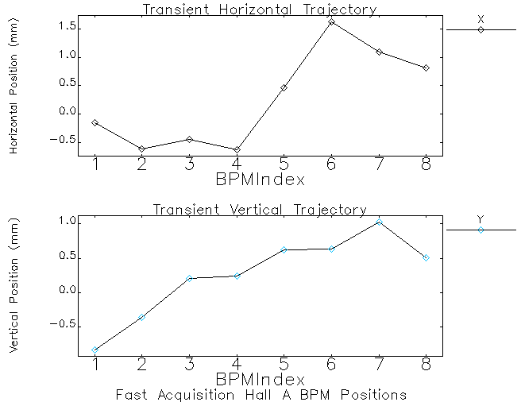
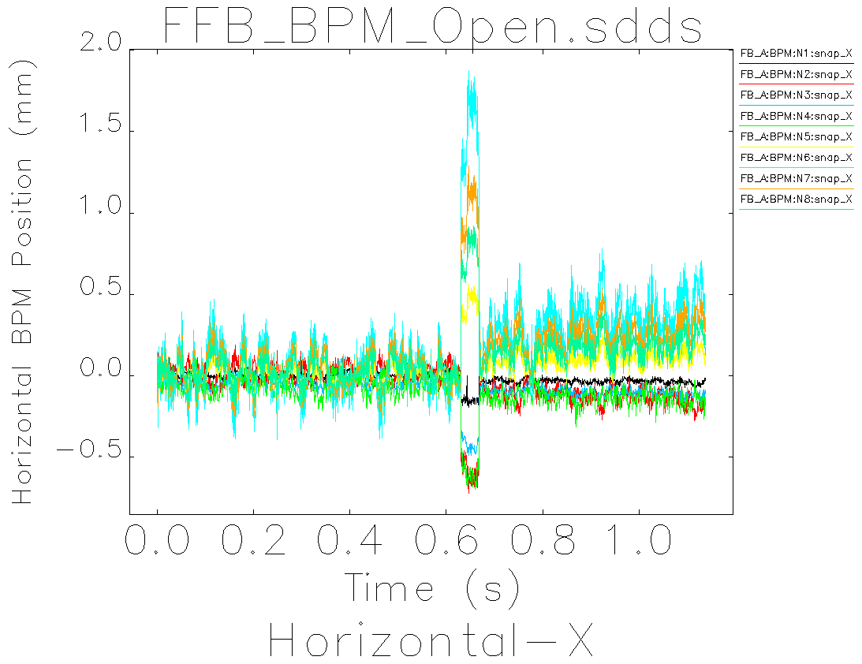
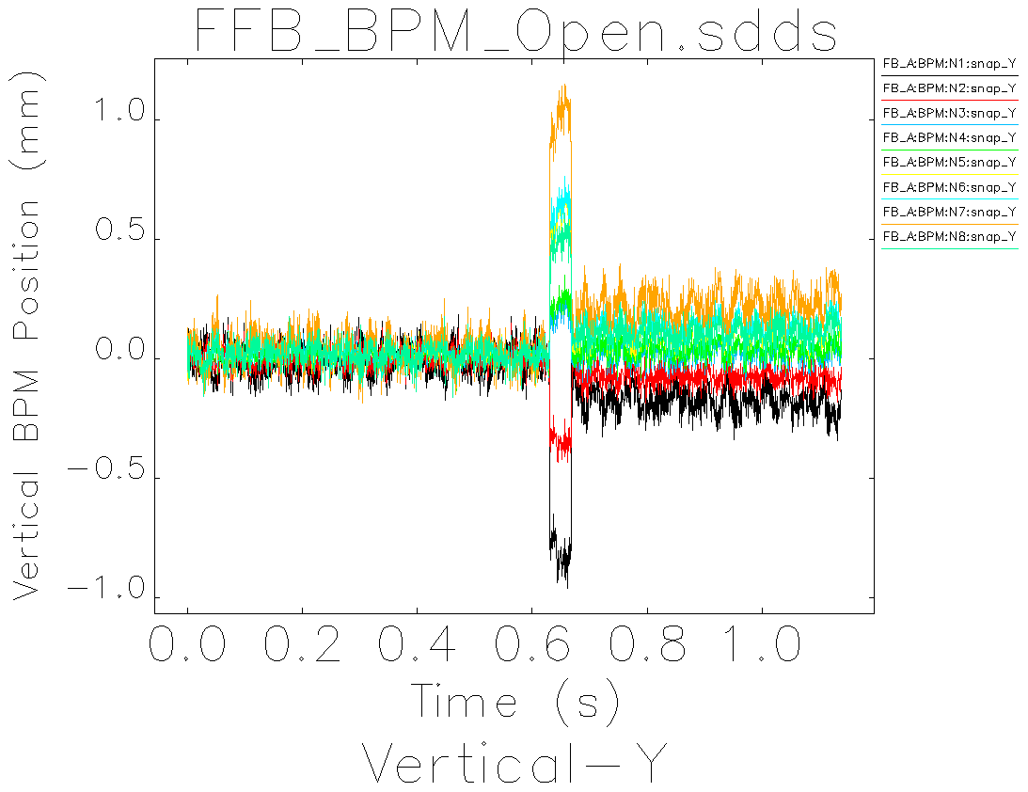
JLAB Example: Hall A FFB BPM Glitch Analysis
Look at a particularly large ~38 ms transient in data set 87 Open Loop (feedback system off)
Analysis: Took ~20 ms in the center of the transient and averaged the position
Plot this average (X,Y) position vs bpm index
Looks like a trajectory glitch, not energy (dispersion)
Sine-like
Cosine-like
sddsplot -filenames -sep=page -split=page \
-title=Horizontal-X "-yLabel=Horizontal BPM Position (mm)" \
"-col=Time,FB*_X" -leg -graph=line,vary FFB_BPM_Open.sdds &
Notes:
Guidelines: 6-8 bullets per slide; Use sentence fragments for bullets
To change the photo: Right-click on photo and select change photo

Slide 17
JLAB Example: Hall A FFB BPM Glitch Analysis
Use sdds compliant epics toolkit program sddswmonitor to gather fast bpm data
sddswmonitor
-PVnames=FB_A:BPM:N1:snap_X,FB_A:BPM:N2:snap_X,…,FB_A:BPM:N1:snap_Y,FB_A:BPM:N2:snap_Y,… \
-steps=100 -interval=2,seconds -scalars=FFB_Scalars.mon -verbose FFB_BPM_Open.sdds
Gather 100, eight X and Y bpm fast waveforms every 2 seconds and put into SDDS columns
Make a PNG bpm trajectory plot (previous slide)
Process the Horizontal BPM Data (Vertical similar)
sddsconvert -pipe=out FFB_BPM_Open.sdds \
-fromPage=87 -toPage=87 \
-delete=param,* \
| sddsprocess -pipe \
-filter=col,Time,0.64,0.66 \
-process=FB_A:BPM:N*:snap_X,average,%s_Avg_X_Pos \
| sddscollapse -pipe \
| sddsconvert -pipe -delete=col,PageNumber \
| sddstranspose -pipe \
| sddsprocess -pipe=in FFB_BPM_Open_Glitch_87_X.sdds \
"-redefine=col,BPMIndex,i_row 1.0 +“
sddsplot -layout=1,2 \
-col=BPMIndex,Column -leg=spec=X \
FFB_BPM_Open_Glitch_87_X.sdds \
-graph=symb,conn,sca=2,vary,subtype=0 \
"-yLabel=Horizontal Position (mm)" \
"-topline=Transient Horizontal Trajectory" –end \
-col=BPMIndex,Column -leg=spec=Y \
FFB_BPM_Open_Glitch_87_Y.sdds \
-graph=symb,conn,sca=2,vary,subtype=2 \
"-topline=Transient Vertical Trajectory" \
"-yLabel=Vertical Position (mm)" \
"-title=Fast Acquisition Hall A BPM Positions" \
-dev=png -output=Horiz_Vert_Glitch_Trajectories.png
Filter out the glitch
Compute the average bpm
position using wildcards
Remove all columns except bpm average position columns
Treat the bpm average position columns as a simple 1x8 matrix and make a 8x1 matrix
Create column BPMIndex so one can plot the glitch trajectory
Printout for SDDS file stdin
FB_A:BPM:N1:snap_X_Avg_X_Pos FB_A:BPM:N2:snap_X_Avg_X_Pos FB_A:BPM:N3:snap_X_Avg_X_Pos FB_A:BPM:N4:snap_X_Avg_X_Pos
FB_A:BPM:N5:snap_X_Avg_X_Pos FB_A:BPM:N6:snap_X_Avg_X_Pos FB_A:BPM:N7:snap_X_Avg_X_Pos FB_A:BPM:N8:snap_X_Avg_X_Pos
mm mm mm mm
mm mm mm mm
------------------------------------------------------------------------------------------------------------------------
-1.515465e-01 -6.126561e-01 -4.439887e-01 -6.217348e-01
4.699189e-01 1.621267e+00 1.091556e+00 8.068892e-01
Notes:
Guidelines: 6-8 bullets per slide; Use sentence fragments for bullets
To change the photo: Right-click on photo and select change photo

Slide 18
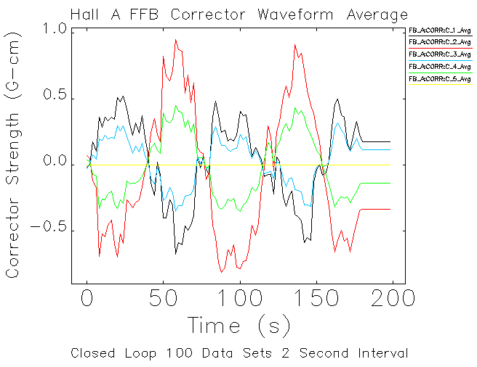
JLab Example: Slow 80 Second Oscillation FFB Correction
Took data when this slow beam motion was still present and cause unknown
Turned out to be the final dipole in the injection chicane oscillating at 1 mA out of 10 A
Hall A FFB correctors were correcting this beam motion
Note FFB energy lock was off
Notes:
Guidelines: 6-8 bullets per slide; Use sentence fragments for bullets
To change the photo: Right-click on photo and select change photo

Slide 19
JLab Example: Slow 80 Second Oscillation Hall A FFB Correction
Used sddswmonitor to take Hall A FFB Corrector Data closed loop (FFB running):
100 Data sets
2 second (sampling) interval
sddsprocess -pipe=out FFB_BPM_Closed_02.sdds \
-process=*CORR*,average,%s_Avg \
| sddscollapse -pipe \
| sddsprocess -pipe=in FFB_BPM_Closed_02_CorrAvg.col \
"-redefine=col,Time,i_row 2.0 *,units=s"
sddsplot -leg -graph=line,vary \
"-topline=Hall A FFB Corrector Waveform Average" \
"-title=Closed Loop 100 Data Sets 2 Second Interval" \
"-yLabel=Corrector Strength (G-cm)" \
-col=Time,*Avg FFB_BPM_Closed_02_CorrAvg.col
Notes:
Guidelines: 6-8 bullets per slide; Use sentence fragments for bullets
To change the photo: Right-click on photo and select change photo

Slide 20
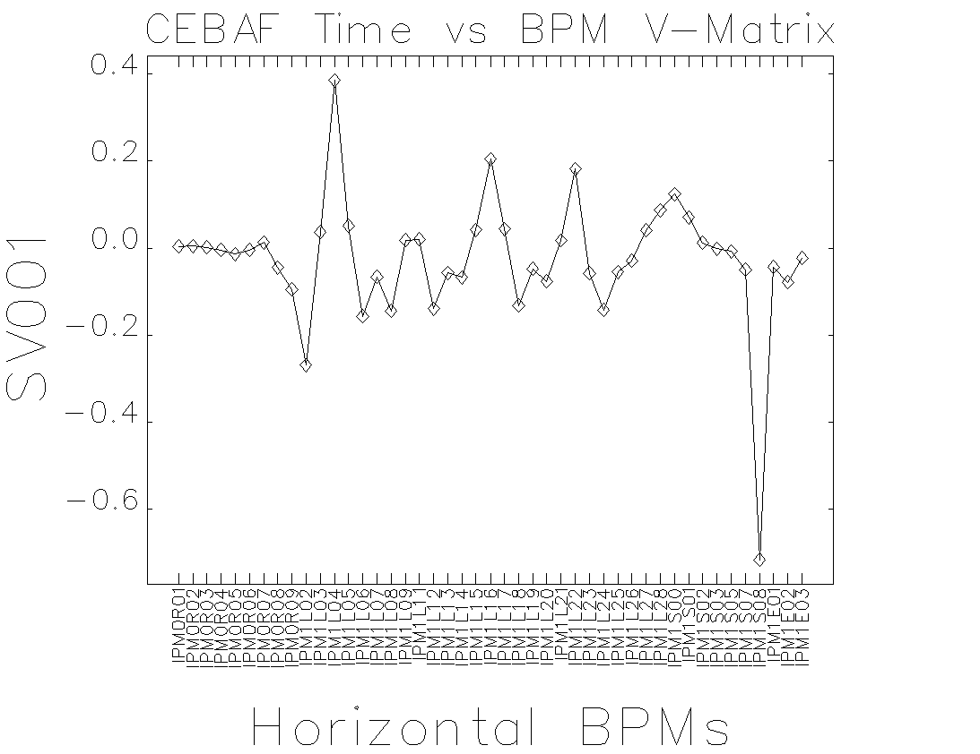
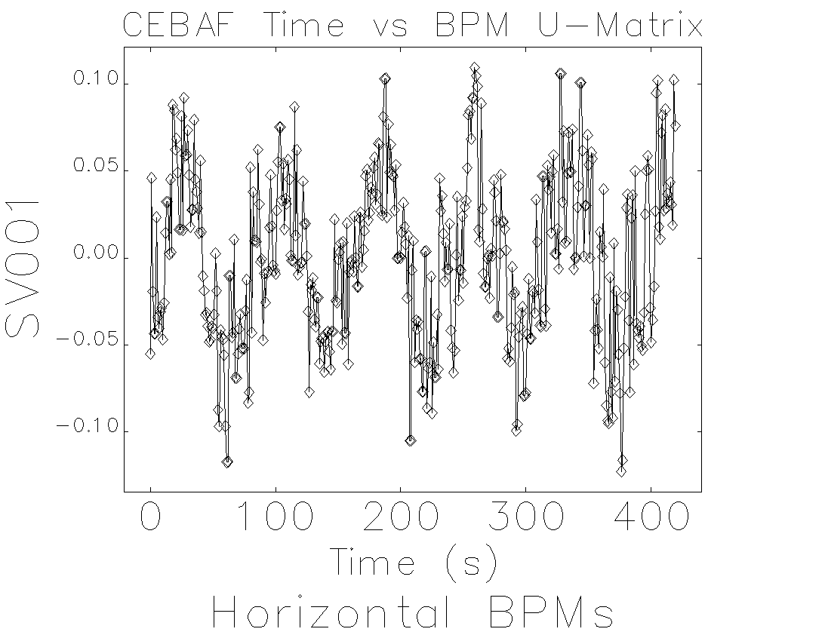
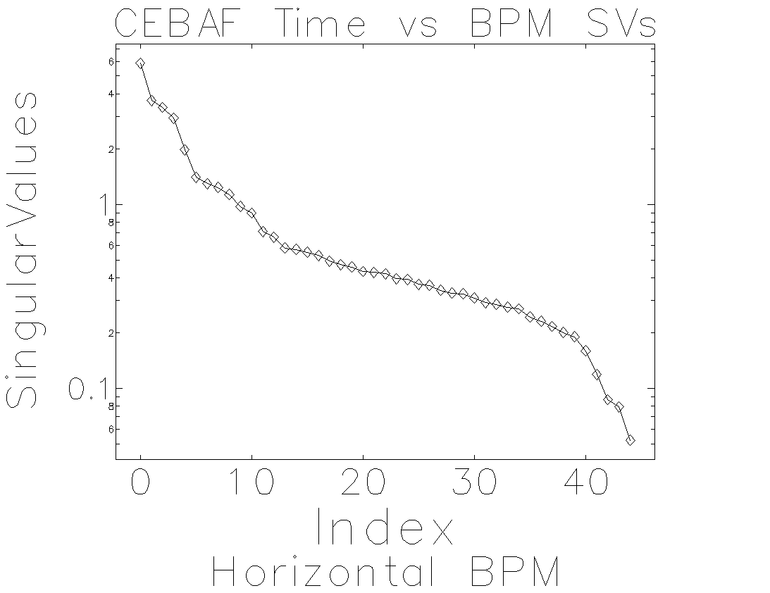
JLab Example: Slow 80 Second Oscillation Using Data Logger Data and SVD (Yves)
Use “mySampler” to extract bpm data from the data logger archive (540 seconds)
Used OAG/Tcl/Tk tools to create a csv file and use csv2sdds to convert to sdds
SVD is a form of principle component analysis
mySampler -b "2025-05-14 22:41:00" -s 1s -n 540 IPM0R01.XPOS IPM0R02.XPO … IPM1E02.XPOS IPM1E03.XPOS > INJ_NL_X_BPMs.txt
sddsconvert -pipe=out INJ_NL_X_BPMs.sdds \
-delete=col,Date,TimeOfDay,Time \
| sddsprocess -pipe \
-process=IPM*,average,%s_Avg \
"-redefine=col,%s,%s %s_Avg -,select=IPM*,units=mm" \
| sddspseudoinverse -pipe=in ${fileRoot}.inv \
-minimum=0.0 \
-oldColumnNames=BPMs \
-sFile=${fileRoot}.s \
-uMatrix=${fileRoot}.u \
-vMatrix=${fileRoot}.v
Remove the DC offset for each beam position before
calculating the singular values, U and V matrices
BPM singular vector for SV - 2
Time singular vector for SV - 2
Magnet with 1 mA, 80 s oscillation
Notes:
Guidelines: 6-8 bullets per slide; Use sentence fragments for bullets
To change the photo: Right-click on photo and select change photo

Slide 21
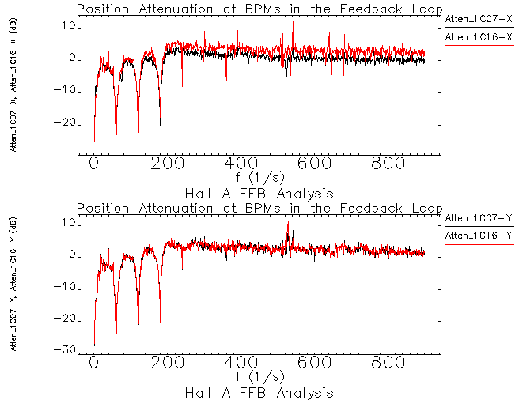
JLab Example: Hall A FFB Orbit/Trajectory Attenuation
BPM position/trajectory attenuation plots show effectiveness of feedback
Divide PSD Closed loop by PSD Open loop and express in dB
First look at in-loop BPMs 1C07 and 1C16
20-30 dB attenuation seen at 60, 120 and 180 Hz
Significant attenuation near DC too
No attenuation at 30 Hz
As expected not much suppression beyond ~200 Hz
Notes:
Guidelines: 6-8 bullets per slide; Use sentence fragments for bullets
To change the photo: Right-click on photo and select change photo

Slide 22
JLab Example: Hall A FFB Orbit/Trajectory Attenuation
sddsfft, sddsprocess and sddsenvelope are the primary toolkit programs used
sddsprocess FFB_BPM_Open_Mean.ifft FFB_BPM_Open_Mean_Atten.sdds \
"-redefine=col,PSD_1C07-X_Open,PSD_1C07-X" \
"-redefine=col,PSD_1C07-Y_Open,PSD_1C07-Y" …
sddsprocess FFB_BPM_Closed_Mean.ifft FFB_BPM_Closed_Mean_Atten.sdds \
"-redefine=col,PSD_1C07-X_Closed,PSD_1C07-X" \
"-redefine=col,PSD_1C07-Y_Closed,PSD_1C07-Y" …
sddsxref -pipe=out FFB_BPM_Open_Mean_Atten.sdds FFB_BPM_Closed_Mean_Atten.sdds \
"-take=f,PSD_1C07-X_Closed,PSD_1C07-Y_Closed, …
| sddsprocess -pipe=in FFB_BPM_Atten.sdds \
"-redefine=col,Atten_1C07-X,PSD_1C07-X_Closed PSD_1C07-X_Open / log 10.0 *,units=dB" \
"-redefine=col,Atten_1C07-Y,PSD_1C07-Y_Closed PSD_1C07-Y_Open / log 10.0 *,units=dB" …
Could use sddsconvert to change column names too
sddsfft FFB_BPM_<Open || Closed>.sdds FFB_BPM_<Open || Closed>.ifft \
"-col=Time,FB*" \
-suppress \
-psdOutput=plain,integrated
sddsenvelope FFB_BPM_<Open || Closed>.ifft FFB_BPM_<Open || Closed>_Mean.ifft \
-mean=f,*FB*
sddsfft takes the FFT, PSD of all bpm and corrector waveforms (columns across all pages
sddsenvelope takes the mean of each column row by row across all pages and outputs a file with 1 page with the mean of each column
sddsxref takes parameters, columns from one sdds file and adds them to another
sddsplot -layout=1,2 -same=y -graph=line,vary -leg \
-subticksettings=xDivisions=10 \
"-topline=Position Attenuation at BPMs in the Feedback Loop" \
"-title=Hall A FFB Analysis" \
FFB_BPM_Atten.sdds \
-col=f,Atten_1C07-X -leg=spec=1C07-X … -end \
-col=f,Atten_1C07-Y -leg=spec=1C07-Y …
PSDFB_A:BPM:N?:snap_XMean
PSDFB_A:BPM:N?:snap_YMean
Notes:
Guidelines: 6-8 bullets per slide; Use sentence fragments for bullets
To change the photo: Right-click on photo and select change photo

Slide 23
JLAB Example: Hall A BPM Data Analysis Algorithm
Hall A users have access to some bpms which they can sample with their own ADCs at a high rate (500 kHz)
The data is analyzed according to this algorithm:
The time domain position waveform is sliced into equal time slices (ADC)
Each time slice is averaged (ADC)
(Helicity) differences between adjacent time slices is histogrammed (offline)
The width of the histogram is a measure of the noise in the signal (offline)
This algorithm is performed at intervals from 0.5 ms to 33 ms (30 Hz to 2 kHz) depending on the helicity flip rate
Task, Use SDDS tools to simulate the algorithm and assess impact of aliasing and taking differences
Notes:
Guidelines: 6-8 bullets per slide; Use sentence fragments for bullets
To change the photo: Right-click on photo and select change photo

Slide 24
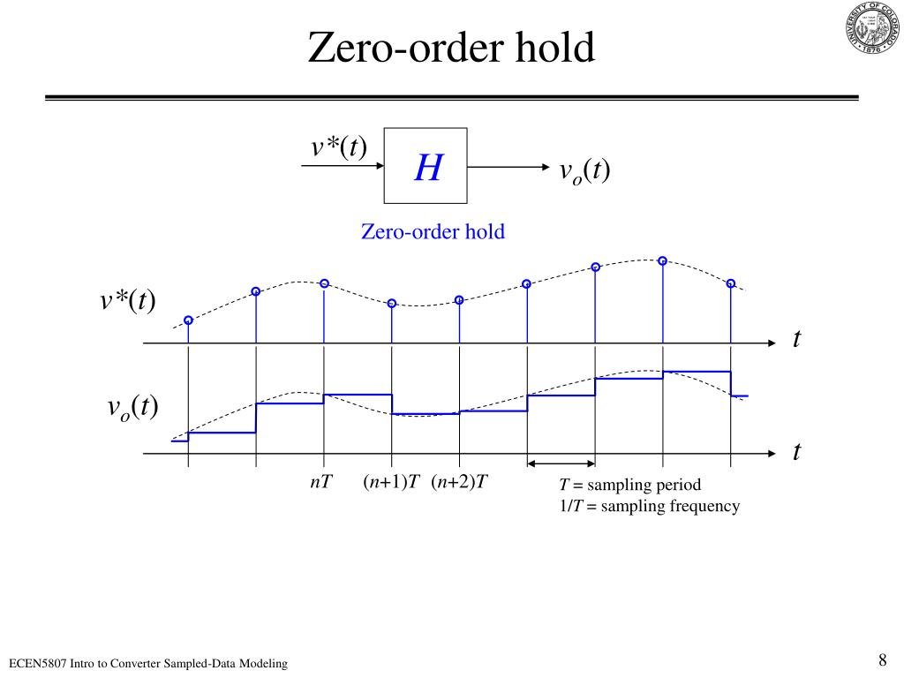
JLab Example: Hall A BPM Data Analysis Algorithm
This is very similar to the “sample and hold” function at a sampling frequency performed by ADCs (also called Zero-order hold)
The additional step is taking differences between adjacent samples and histogamming this difference
The histogrammed results will be impacted by aliasing of signals above frequencies = 1/(2 x Averaging Interval)
Numerical example follows
Notes:
Guidelines: 6-8 bullets per slide; Use sentence fragments for bullets
To change the photo: Right-click on photo and select change photo

Slide 25
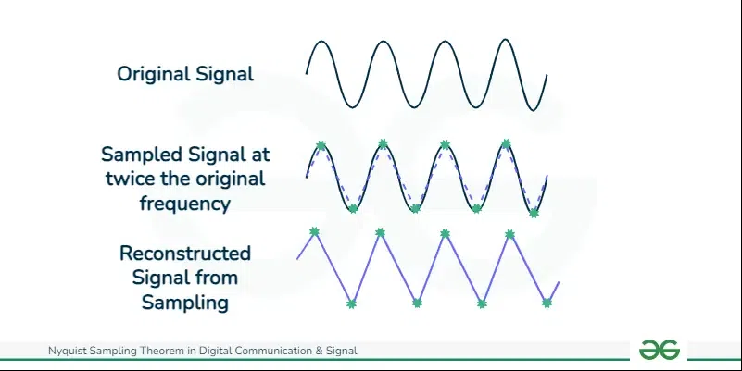
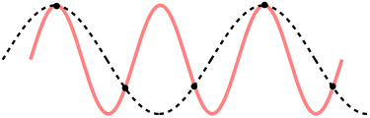


JLab Example: Hall A BPM Data Analysis Algorithm
The Shannon-Nyquist sampling theorem:
A signal must be sampled at a rate greater than twice its frequency to be resolved
Otherwise aliasing occurs
The sampled signal on the right has lowest fourier component at the frequency of the original signal
If you sample the signal on the right at its frequency, the digital signal is pure DC!
$$fs>2 f$$
$$fAlias=\left|f −nfs\right|<fs/2$$
Notes:
Guidelines: 6-8 bullets per slide; Use sentence fragments for bullets
To change the photo: Right-click on photo and select change photo

Slide 26
JLab Example: Hall A BPM Data Analysis Algorithm
Make up a 10 second numerical bpm signal sampled at 100 kHz:
Add 20 μm random noise (gaussian distribution)
Add sinusoidal frequencies at 85, 133 and 520 Hz with 250, 150 and 75 μm noise respectively
Break up this waveform into intervals of 33.333 ms (30 Hz)
Average each 33.333 ms waveform
Take the “time” of each average as the average time over the 33.333 ms slice (could also take the beginning or end…does not really matter)
Compare the PSD and RMS for original and 30 Hz “resampled” waveform
sddssequence -pipe=out -define=Index,type=double \
-sequence=begin=0.0,number=1.0e6,end=999999.0,delta=1.0 \
| sddsprocess -pipe=in Aliasing_Example.sdds \
"-redefine=col,Time,Index 1.0 100.0e3 / *,units=s,type=double" \
"-redefine=col,Waveform,grnd 0.02 *,units=mm" \
"-redefine=col,Waveform,Waveform 2.0 pi * 85.0 * Time * sin 0.25 * +,units=mm" \
"-redefine=col,Waveform,Waveform 2.0 pi * 133.0 * Time * cos 0.15 * +,units=mm" \
"-redefine=col,Waveform,Waveform 2.0 pi * 520.0 * Time * cos 0.075 * +,units=mm" \
-process=Waveform,rms,Waveform_RMS \
"-print=param,WaveformRMSString,\$gs\$r\$bWaveform\$n = %0.4f %s,Waveform_RMS,Waveform_RMS.units"
Signal and Noise Generation
Noise Generation Only
sddssequence -pipe=out -define=Index,type=double \
-sequence=begin=0.0,number=1.0e6,end=999999.0,delta=1.0 \
| sddsprocess -pipe=in Aliasing_Example_Noise.sdds \
"-redefine=col,Time,Index 1.0 100.0e3 / *,units=s,type=double" \
"-redefine=col,Waveform_Noise,grnd 0.02 *,units=mm" \
-process=Waveform_Noise,rms,Waveform_NoiseRMS \
"-print=param,Waveform_NoiseRMSString,\$gs\$r\$bWaveform_Noise\$n = %0.4f %s,Waveform_NoiseRMS,Waveform_NoiseRMS.units"
Notes:
Guidelines: 6-8 bullets per slide; Use sentence fragments for bullets
To change the photo: Right-click on photo and select change photo

Slide 27
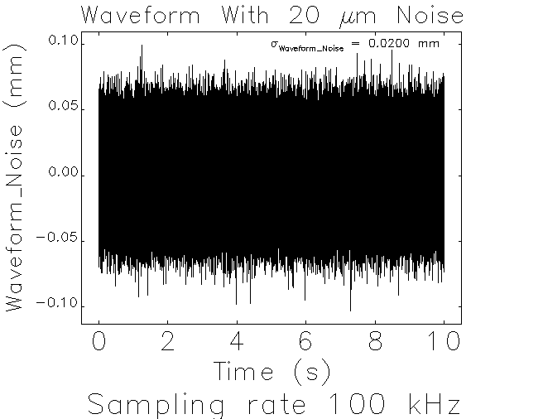
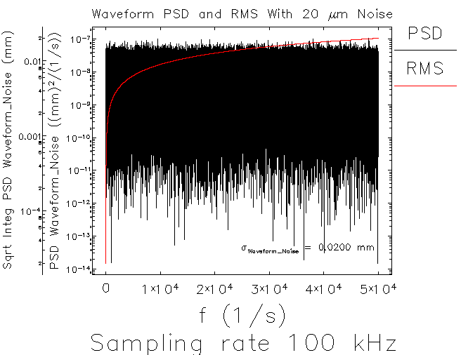
JLab Example: Hall A BPM Data Analysis Algorithm
Signal (gaussian) noise in the time and frequency domain pass sanity check (20 μm rms)
Nyquist frequency is 50 kHz
Notes:
Guidelines: 6-8 bullets per slide; Use sentence fragments for bullets
To change the photo: Right-click on photo and select change photo

Slide 28
JLab Example: Hall A BPM Data Analysis Algorithm
Signal (gaussian) noise in the time and frequency domain pass sanity check (20 μm rms)
Nyquist frequency is 50 kHz
sddsfft -pipe=out Aliasing_Example_Noise.sdds \
-col=Time,Waveform_Noise \
-full \
-psdOutput=plain,integrated \
| sddsprocess -pipe=in Aliasing_Example_Noise.psd \
-process=SqrtIntegPSDWaveform_Noise,maximum,SqrtIntegPSDWaveform_NoiseRMS \
"-print=param,SqrtIntegPSDWaveform_NoiseRMSString,\$gs\$r\$bWaveform_Noise\$n = %0.4f %s,SqrtIntegPSDWaveform_NoiseRMS,SqrtIntegPSDWaveform_NoiseRMS.units"
sddsplot Aliasing_Example_Noise.sdds \
"-topline=Waveform With 20 \$gm\$rm\$n Noise" \
"-title=Sampling rate 100 kHz" \
-col=Time,Waveform_Noise \
-string=@Waveform_NoiseRMSString,p=0.5,q=0.95 \
-dev=png,onwhite \
-output=Aliasing_Example_Noise_Time.png
sddsplot Aliasing_Example_Noise.psd -graph=line,vary \
-yscalesGroup=nameString \
"-topline=Waveform PSD and RMS With 20 \$gm\$rm\$n Noise" \
"-title=Sampling rate 100 kHz" \
-col=f,PSDWaveform_Noise "-leg=spec=PSD" -mode=y=log,y=spec \
-col=f,SqrtIntegPSDWaveform_Noise "-leg=spec=RMS" -mode=y=log,y=spec \
-string=@SqrtIntegPSDWaveform_NoiseRMSString,p=0.50,q=0.10 \
-dev=png,onwhite -output=Aliasing_Example_Noise_Freq.png
Notes:
Guidelines: 6-8 bullets per slide; Use sentence fragments for bullets
To change the photo: Right-click on photo and select change photo

Slide 29
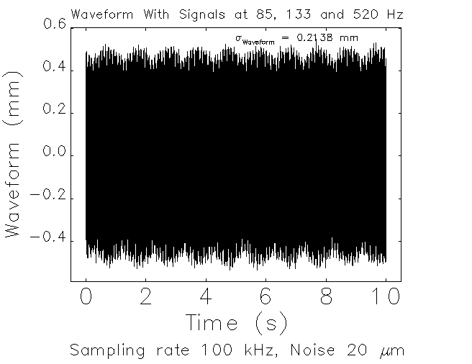
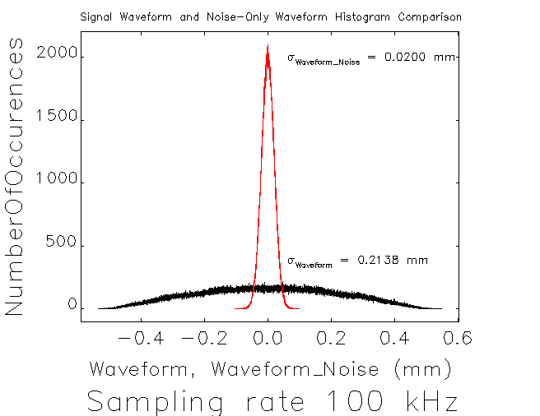
JLab Example: Hall A BPM Data Analysis Algorithm
Now add to the signal specific frequencies at 85, 133 and 520 Hz
Histogram and compare to 20 μm gaussian noise histogram
Notes:
Guidelines: 6-8 bullets per slide; Use sentence fragments for bullets
To change the photo: Right-click on photo and select change photo

Slide 30
JLab Example: Hall A BPM Data Analysis Algorithm
Now add to the signal specific frequencies at 85, 133 and 520 Hz
Histogram and compare to 20 μm gaussian noise histogram
sddshist Aliasing_Example_Noise.sdds Aliasing_Example_Noise.hist \
-dataColumn=Waveform_Noise \
-sizeOfBins=0.0001
sddshist Aliasing_Example.sdds Aliasing_Example.hist \
-dataColumn=Waveform \
-sizeOfBins=0.0001
sddsplot "-topline=Signal Waveform and Noise-Only Waveform Histogram Comparison" \
"-title=Sampling rate 100 kHz" -graph=line,vary \
-col=Waveform,frequency -string=@WaveformRMSString,p=0.55,q=0.20 Aliasing_Example.hist \
-col=Waveform_Noise,frequency -string=@Waveform_NoiseRMSString,p=0.55,q=0.90 Aliasing_Example_Noise.hist \
-dev=png,onwhite -output=Aliasing_Example_Time_Hist.png
Notes:
Guidelines: 6-8 bullets per slide; Use sentence fragments for bullets
To change the photo: Right-click on photo and select change photo

Slide 31
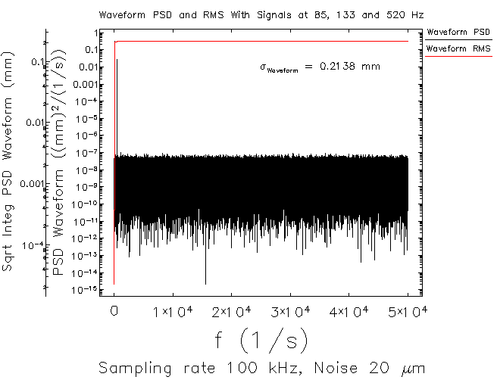
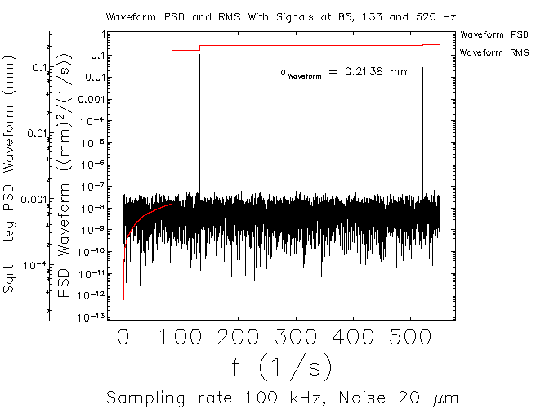
JLab Example: Hall A BPM Data Analysis Algorithm
RMS sanity check between time and frequency domains
Zoomed View
Notes:
Guidelines: 6-8 bullets per slide; Use sentence fragments for bullets
To change the photo: Right-click on photo and select change photo

Slide 32
JLab Example: Hall A BPM Data Analysis Algorithm
RMS sanity check between time and frequency domains
Plot full spectrum to 50 kHz Nyquist frequency
sddsplot Aliasing_Example.psd -graph=line,vary -yscalesGroup=nameString \
"-topline=Waveform PSD and RMS With Signals at 85\, 133 and 520 Hz" \
"-title=Sampling rate 100 kHz\, Noise 20 \$gm\$rm\$n" \
-col=f,PSDWaveform "-leg=spec=Waveform PSD" -mode=y=log,y=spec \
-col=f,SqrtIntegPSDWaveform "-leg=spec=Waveform RMS" -mode=y=log,y=spec \
-string=@SqrtIntegPSDWaveformRMSString,p=0.50,q=0.85 \
-dev=png,onwhite -output=Aliasing_Example_Signal_Freq.png
sddsplot Aliasing_Example.psd -graph=line,vary -yscalesGroup=nameString \
"-topline=Waveform PSD and RMS With Signals at 85\, 133 and 520 Hz" \
"-title=Sampling rate 100 kHz\, Noise 20 \$gm\$rm\$n" \
-limits=xMinimum=0.0,xMaximum=550.0 \
-col=f,PSDWaveform "-leg=spec=Waveform PSD" -mode=y=log,y=spec \
-col=f,SqrtIntegPSDWaveform "-leg=spec=Waveform RMS" -mode=y=log,y=spec \
-string=@SqrtIntegPSDWaveformRMSString,p=0.50,q=0.85 \
-dev=png,onwhite -output=Aliasing_Example_Signal_Zoom_Freq.png
Zoom command: Look only at abscissa values rom 0.0 to 550 Hz
Notes:
Guidelines: 6-8 bullets per slide; Use sentence fragments for bullets
To change the photo: Right-click on photo and select change photo

Slide 33
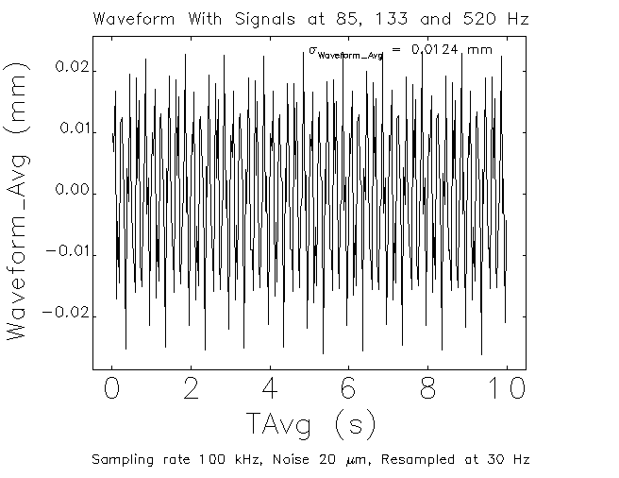
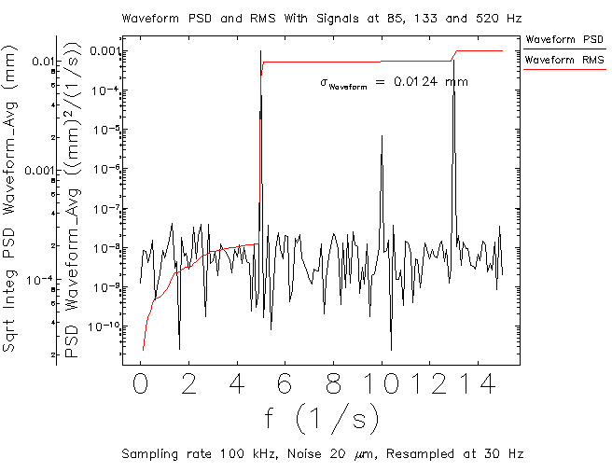
JLab Example: Hall A BPM Data Analysis Algorithm
Now, break the signal up in the time domain (at 30 Hz) and average the 33 ms slices
PSD in the frequency domain has rms motion at the aliased signals
85 Hz
133 Hz
520 Hz
Aliased Signals
Notes:
Guidelines: 6-8 bullets per slide; Use sentence fragments for bullets
To change the photo: Right-click on photo and select change photo

Slide 34
JLab Example: Hall A BPM Data Analysis Algorithm
Now, break the signal up in the time domain (at 30 Hz) and average the 33 ms slices (ADC)
PSD in the frequency domain has rms motion at the aliased signals
sddsbreak -pipe=out Aliasing_Example.sdds \
-changeOf=Time,amount=0.033333333333333 \
| sddsprocess -pipe \
-process=Waveform,average,Waveform_Avg \
-process=Time,average,TAvg \
| sddscollapse -pipe \
| sddsprocess -pipe=in Aliasing_Example_33ms_Avg.sdds \
-process=Waveform_Avg,rms,Waveform_AvgRMS \
"-print=param,WaveformAvgRMSString,\$gs\$r\$bWaveform_Avg\$n = %0.4f %s,Waveform_AvgRMS,Waveform_AvgRMS.units"
sddsfft -pipe=out Aliasing_Example_33ms_Avg.sdds \
-col=TAvg,Waveform_Avg \
-full \
-psdOutput=plain,integrated \
| sddsprocess -pipe=in Aliasing_Example_33ms_Avg.psd \
-process=SqrtIntegPSDWaveform_Avg,maximum,SqrtIntegPSDWaveform_AvgRMS \
"-print=param,SqrtIntegPSDWaveformAvgRMSString,\$gs\$r\$bWaveform\$n = %0.4f %s,SqrtIntegPSDWaveform_AvgRMS,SqrtIntegPSDWaveform_AvgRMS.units"
sddsplot Aliasing_Example_33ms_Avg.sdds \
"-topline=Waveform With Signals at 85\, 133 and 520 Hz" \
"-title=Sampling rate 100 kHz\, Noise 20 \$gm\$rm\$n\, Resampled at 30 Hz" \
-col=TAvg,Waveform_Avg \
-string=@WaveformAvgRMSString,p=0.5,q=0.95 \
-dev=png,onwhite -output=Aliasing_Example_33ms_Avg_Time.png
sddsplot Aliasing_Example_33ms_Avg.psd -graph=line,vary -yscalesGroup=nameString \
"-topline=Waveform PSD and RMS With Signals at 85\, 133 and 520 Hz" \
"-title=Sampling rate 100 kHz\, Noise 20 \$gm\$rm\$n\, Resampled at 30 Hz" \
-col=f,PSDWaveform_Avg "-leg=spec=Waveform PSD" -mode=y=log,y=spec \
-col=f,SqrtIntegPSDWaveform_Avg "-leg=spec=Waveform RMS" -mode=y=log,y=spec \
-string=@SqrtIntegPSDWaveformAvgRMSString,p=0.50,q=0.85 \
-dev=png,onwhite -output=Aliasing_Example_33ms_Avg_Freq.png
Notes:
Guidelines: 6-8 bullets per slide; Use sentence fragments for bullets
To change the photo: Right-click on photo and select change photo

Slide 35
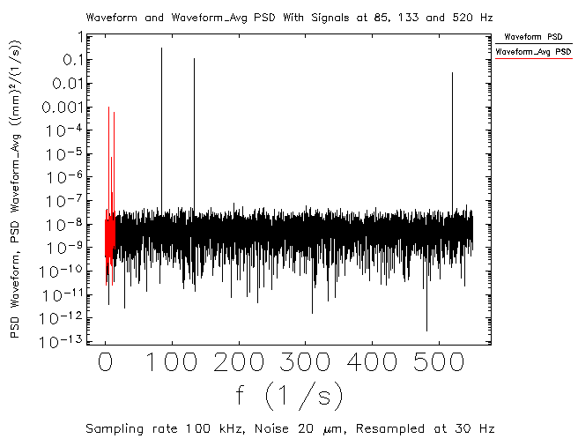
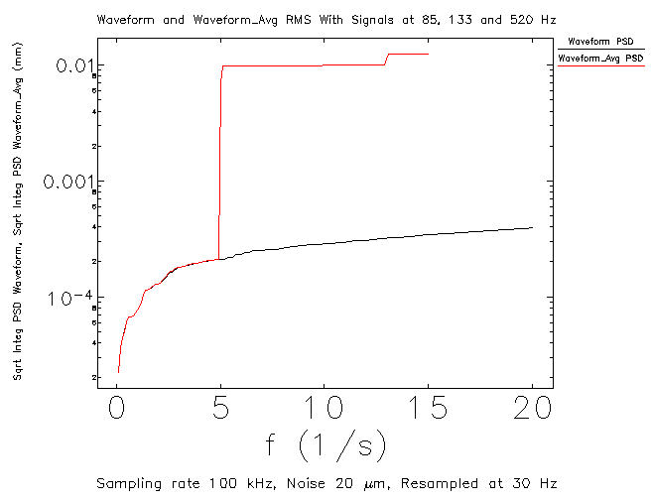
JLab Example: Hall A BPM Data Analysis Algorithm
Compare original signal and the 30 Hz sampled signal rms motion from 0 to 15 Hz
Aliasing results in a much larger rms from 0 to 15 Hz than is really in this band
85 Hz
133 Hz
520 Hz
Time slicing and averaging each slice removes all the noise above 15 Hz and reduces the amplitude of the aliased signals
Aliased Signal Impact on RMS Motion
Notes:
Guidelines: 6-8 bullets per slide; Use sentence fragments for bullets
To change the photo: Right-click on photo and select change photo

Slide 36
JLab Example: Hall A BPM Data Analysis Algorithm
Compare original signal and the 30 Hz sampled signal rms motion from 0 to 15 Hz
Aliasing results in a much larger rms from 0 to 15 Hz than is really in this band
sddsplot -graph=line,vary -mode=y=log,y=spec \
"-topline=Waveform and Waveform_Avg PSD With Signals at 85\, 133 and 520 Hz" \
"-title=Sampling rate 100 kHz\, Noise 20 \$gm\$rm\$n\, Resampled at 30 Hz" \
-limits=xMinimum=0.0,xMaximum=550.0 \
-col=f,PSDWaveform "-leg=spec=Waveform PSD" Aliasing_Example.psd \
-col=f,PSDWaveform_Avg "-leg=spec=Waveform_Avg PSD" Aliasing_Example_33ms_Avg.psd \
-dev=png,onwhite -output=Aliasing_Example_33ms_Avg_Freq_Comparison.png
sddsplot -graph=line,vary -mode=y=log,y=spec \
"-topline=Waveform and Waveform_Avg RMS With Signals at 85\, 133 and 520 Hz" \
"-title=Sampling rate 100 kHz\, Noise 20 \$gm\$rm\$n\, Resampled at 30 Hz" \
-limits=xMinimum=0.0,xMaximum=20.0 \
-col=f,SqrtIntegPSDWaveform "-leg=spec=Waveform PSD" Aliasing_Example.psd \
-col=f,SqrtIntegPSDWaveform_Avg "-leg=spec=Waveform_Avg PSD" Aliasing_Example_33ms_Avg.psd \
-dev=png,onwhite -output=Aliasing_Example_33ms_Avg_Freq_RMS_Comparison_Zoom.png
Notes:
Guidelines: 6-8 bullets per slide; Use sentence fragments for bullets
To change the photo: Right-click on photo and select change photo

Slide 37
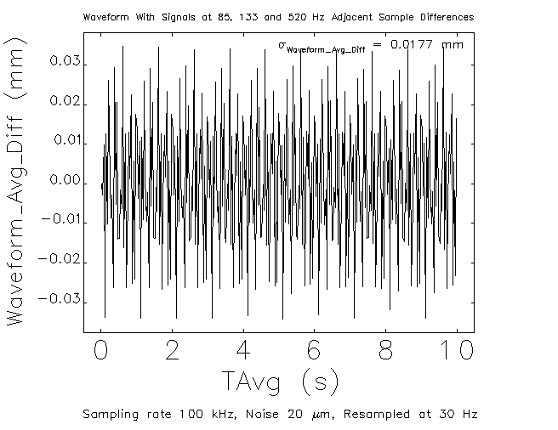
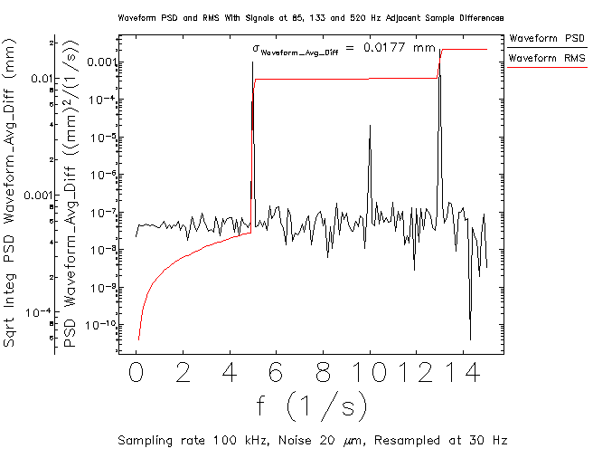
JLab Example: Hall A BPM Data Analysis Algorithm
Algorithm takes differences between adjacent time slides and histograms them
What does the time and frequency domain look like for this “Waveform Average Difference” signal (particularly rms)
85 Hz
133 Hz
520 Hz
Aliased Signal Impact on RMS Difference
Notes:
Guidelines: 6-8 bullets per slide; Use sentence fragments for bullets
To change the photo: Right-click on photo and select change photo

Slide 38
JLab Example: Hall A BPM Data Analysis Algorithm
Algorithm takes differences between adjacent time slides and histograms them
What does the time and frequency domain look like for this “Waveform Average Difference” signal (particularly rms)
sddsprocess Aliasing_Example_33ms_Avg.sdds Aliasing_Example_33ms_Avg_Diff.sdds \
"-redefine=col,Waveform_Avg_Neg_Shift,i_row 0.0 == ? Waveform_Avg : i_row 1 - &Waveform_Avg [ \$ ,units=mm" \
"-redefine=col,Waveform_Avg_Diff,Waveform_Avg Waveform_Avg_Neg_Shift -,units=mm" \
-process=Waveform_Avg_Diff,rms,Waveform_AvgDiffRMS \
"-print=param,WaveformAvgDiffRMSString,\$gs\$r\$bWaveform_Avg_Diff\$n = %0.4f %s,Waveform_AvgDiffRMS,Waveform_AvgDiffRMS.units"
Take the difference of adjacent 33 ms time slice samples
sddsfft -pipe=out Aliasing_Example_33ms_Avg_Diff.sdds \
-col=TAvg,Waveform_Avg_Diff \
-full \
-psdOutput=plain,integrated \
| sddsprocess -pipe=in Aliasing_Example_33ms_Avg_Diff.psd \
-process=SqrtIntegPSDWaveform_Avg_Diff,maximum,SqrtIntegPSDWaveform_AvgDiffRMS \
"-print=param,SqrtIntegPSDWaveformAvgDiffRMSString,\$gs\$r\$bWaveform_Avg_Diff\$n = %0.4f %s,SqrtIntegPSDWaveform_AvgDiffRMS,SqrtIntegPSDWaveform_AvgDiffRMS.units"
sddsplot Aliasing_Example_33ms_Avg_Diff.sdds \
"-topline=Waveform With Signals at 85\, 133 and 520 Hz Adjacent Sample Differences" \
"-title=Sampling rate 100 kHz\, Noise 20 \$gm\$rm\$n\, Resampled at 30 Hz" \
-col=TAvg,Waveform_Avg_Diff \
-string=@WaveformAvgDiffRMSString,p=0.5,q=0.95 \
-dev=png,onwhite -output=Aliasing_Example_33ms_Avg_Diff_Time.png
sddsplot Aliasing_Example_33ms_Avg_Diff.psd -graph=line,vary -yscalesGroup=nameString \
"-topline=Waveform PSD and RMS With Signals at 85\, 133 and 520 Hz Adjacent Sample Differences" \
"-title=Sampling rate 100 kHz\, Noise 20 \$gm\$rm\$n\, Resampled at 30 Hz" \
-col=f,PSDWaveform_Avg_Diff "-leg=spec=Waveform PSD" -mode=y=log,y=spec \
-col=f,SqrtIntegPSDWaveform_Avg_Diff "-leg=spec=Waveform RMS" -mode=y=log,y=spec \
-string=@SqrtIntegPSDWaveformAvgDiffRMSString,p=0.35,q=0.95 \
-dev=png,onwhite -output=Aliasing_Example_33ms_Avg_Diff_Freq.png
Notes:
Guidelines: 6-8 bullets per slide; Use sentence fragments for bullets
To change the photo: Right-click on photo and select change photo

Slide 39
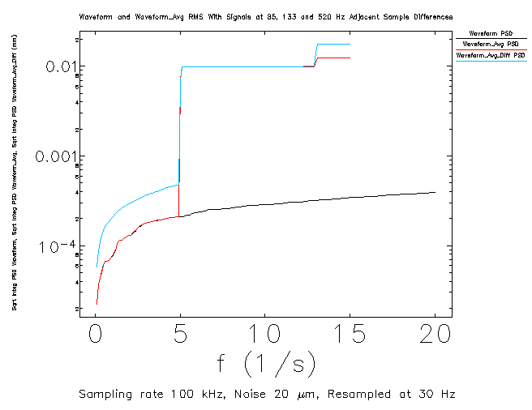

JLab Example: Hall A BPM Data Analysis Algorithm
Comparison with original signal, “Waveform Average” and “Waveform Average Difference” signal rms
RMS (noise) increases
This is from taking differences between each adjacent 33.333 ms samples since this operation is equivalent to differentiation
The PSD of a differentiated signal is amplified by a factor of f² compared to the original signal
85 Hz
520 Hz
133 Hz
Taking differences adds noise
Aliased Signal Impact on RMS Motion
And RMS Difference
Notes:
Guidelines: 6-8 bullets per slide; Use sentence fragments for bullets
To change the photo: Right-click on photo and select change photo

Slide 40
JLab Example: Hall A BPM Data Analysis Algorithm
Comparison with original signal, “Waveform Average” and “Waveform Average Difference” signal rms:
sddsplot -graph=line,vary -mode=y=log,y=spec \
"-topline=Waveform and Waveform_Avg RMS With Signals at 85\, 133 and 520 Hz Adjacent Sample Differences" \
"-title=Sampling rate 100 kHz\, Noise 20 \$gm\$rm\$n\, Resampled at 30 Hz" \
-limits=xMinimum=0.0,xMaximum=20.0 \
-col=f,SqrtIntegPSDWaveform "-leg=spec=Waveform PSD" Aliasing_Example.psd \
-col=f,SqrtIntegPSDWaveform_Avg "-leg=spec=Waveform_Avg PSD" Aliasing_Example_33ms_Avg.psd \
-col=f,SqrtIntegPSDWaveform_Avg_Diff "-leg=spec=Waveform_Avg_Diff PSD" Aliasing_Example_33ms_Avg_Diff.psd \
-dev=png,onwhite -output=Aliasing_Example_33ms_Avg_Freq_Diff_RMS_Comparison_Zoom.png
Notes:
Guidelines: 6-8 bullets per slide; Use sentence fragments for bullets
To change the photo: Right-click on photo and select change photo

Slide 41

JLab Example: Hall A BPM Data Analysis Algorithm Summary
The aliasing phenomena still occurs and affects the rms of the difference signal
The rms is larger since taking differences is essentially differentiation which amplifies noise in the signal
Suggestion: The ADC used to take the bpm data has a high enough sampling rate to obtain the motion spectrum out to 10’s of kHz
One could apply a low pass (anti-alias) filter to your data with 3dB rolloff point at half the ADC sampling rate and you will be able to see, uncorrupted, unaliased signals out to ~Nyquist frequency (no differentiation of the signal)
SDDS has a tool to do this: sddsdigfilter but one needs to design the filter and find the filter coefficients to input into sddsdigfilter (ie. Use the Matlab control system toolbox filter designer)
Notes:
Guidelines: 6-8 bullets per slide; Use sentence fragments for bullets
To change the photo: Right-click on photo and select change photo

Slide 42
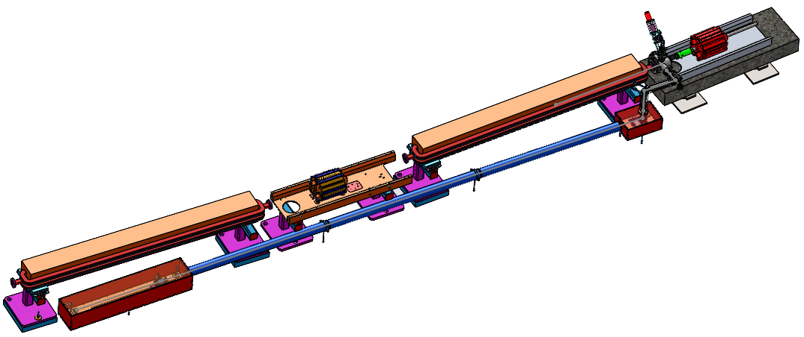
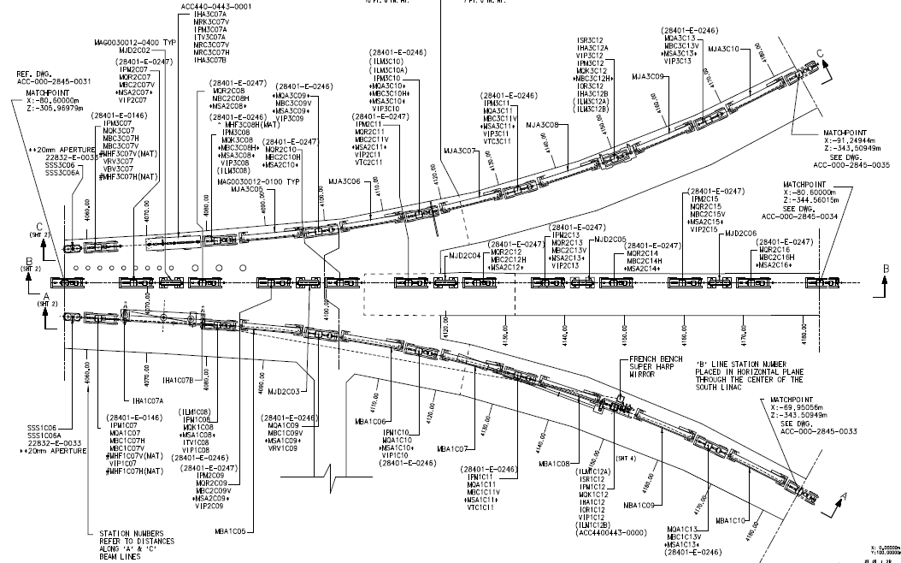
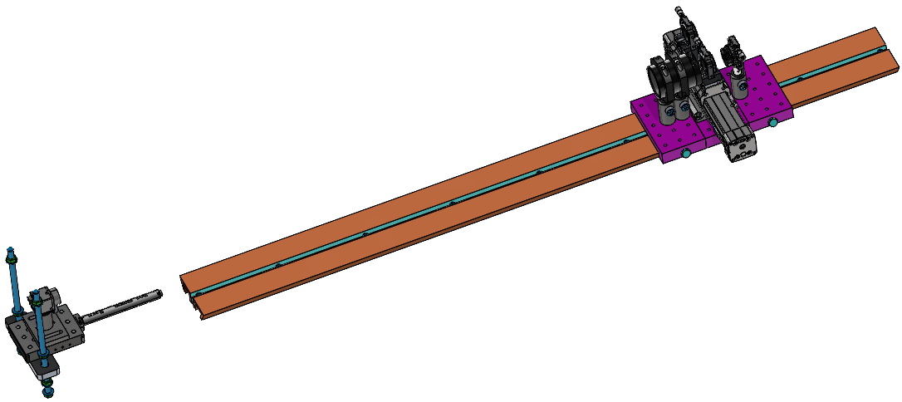
JLab Example: Synchrotron Light Interferometer (SLI) Interferogram Analysis
SYNCHROTRON RADIATION INTERFEROMETER (SRI)
INSERTABLE MIRROR
(AIR, SOLENOID & TWO LIMIT SWITCHES)
MJA3C08 DIPOLE
3C12 GIRDER
TURNING MIRROR
(TW0 AXIS SERVO)
SLIT STAGE
(AIR, SOLENOID & TWO LIMIT SWITCHES)
GigE CAMERA
(POE & ONE AXIS SERVO)
42
Notes:
Guidelines: 6-8 bullets per slide; Use sentence fragments for bullets
To change the photo: Right-click on photo and select change photo

Slide 43
JLab Example: Synchrotron Light Interferometer (SLI) Interferogram Analysis
Goal is to fit the interference pattern to obtain the beam size at the dipole source
Energy spread is obtained knowing the dispersion, beta functions and measured beam size
Use sddsgenericfit to fit data to an arbitrary function
Synchrotron radiation interferometry for beam size measurement at low current and in large dynamic range, PHYSICAL REVIEW ACCELERATORS AND BEAMS 25, 080702 (2022)
Reference gives the interference pattern fit functions
Notes:
Guidelines: 6-8 bullets per slide; Use sentence fragments for bullets
To change the photo: Right-click on photo and select change photo

Slide 44
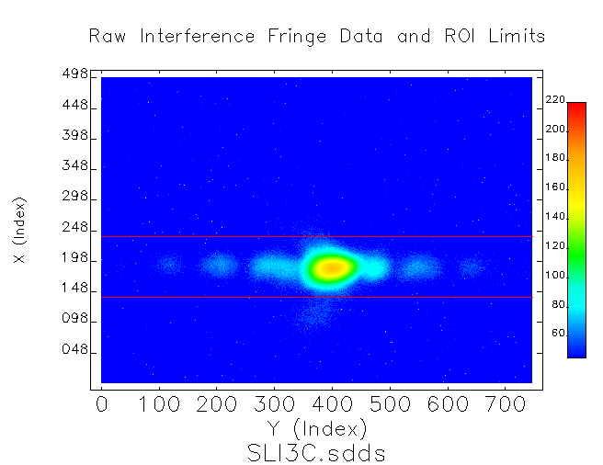
JLab Example: Synchrotron Light Interferometer (SLI) Interferogram Analysis
First interference pattern taken 9/3/2025
Limits determined automatically using sddsprocess and summing data in the plane without interference fringes
exec sddsconvert -pipe=out ${intDataFileRoot}.sdds \ - delete=col,Index,HLineLabel,VLineProfile \
| sddstranspose -pipe \
| sddsprocess -pipe \
-redefine=col,Index,i_row \
| sddsconvert -pipe \
-delete=col,OldColumnNames \
| sddsrowstats -pipe \
-sum=HProfile,1,Column* \
| sddsprocess -pipe=in ${intDataFileRoot}.henv \ - process=HProfile,baselevel,HProfileBaseLine \ "- redefine=col,HProfile,HProfile HProfileBaseLine -" \
-process=HProfile,maximum,HProfileMax \ - process=HProfile,maximum,HProfileMaxPos,functionOf=Index,position \
-process=HProfile,fwhm,HProfileFWHM,functionOf=Index \
"-redefine=param,lowLimit,HProfileMaxPos HProfileFWHM 2.0 / 2.5 * - int" \
"-redefine=param,highLimit,HProfileMaxPos HProfileFWHM 2.0 / 2.5 * + int" \
"-redefine=param,HProfileTMax,HProfileMax 10.0 /"
exec sddscontour ${intDataFileRoot}.sdds \
"-topline=Raw Interference Fringe Data and ROI Limits" \
-title=filenames \
"-yLabel=X \(Index\)" \
"-xLabel=Y \(Index\)" \
-shade -ystrings=edit=%/VLine0//,sparse=50 \
-col=Index,VLine???? \
-drawLine=x0Value=0,y0Value=${lowLimit},x1Value=747,y1Value=${lowLimit},linetype=1 \ -drawLine=x0Value=0,y0Value=${highLimit},x1Value=747,y1Value=${highLimit},linetype=1 \&
Notes:
Guidelines: 6-8 bullets per slide; Use sentence fragments for bullets
To change the photo: Right-click on photo and select change photo

Slide 45
JLab Example: Synchrotron Light Interferometer (SLI) Interferogram Analysis
Use scripting language tcl to assemble a list of columns to eliminate (create ROI limits)
if ${procData} {
set lowLimit [expr int([exec sdds2stream ${intDataFileRoot}.henv -param=lowLimit])]
set highLimit [expr int([exec sdds2stream ${intDataFileRoot}.henv -param=highLimit])]
# Use the limits calculated in the procLimits section to exclude
# all but the region of interest with the interference pattern.
# Center the peak on Index = 0 and normalize the distribution.
set VLineList ""
for {set i ${lowLimit}} {$i < [expr ${highLimit} + 1]} {incr i} {
set indexFormat [format %04d $i]
set VLineColumn VLine${indexFormat}
lappend VLineList ${VLineColumn}
}
set VLineList [join ${VLineList} , ]
# Create the vertical profile vs Index using sddsrowstats for the ROI
exec sddsconvert -pipe=out ${intDataFileRoot}.sdds \
-delete=col,* -retain=col,Index,HLineLabel,${VLineList} \
| sddsrowstats -pipe \
-sum=VProfile,1,VLine* \
| sddsconvert -pipe \
-delete=col,${VLineList} \
| sddsprocess -pipe=in ${intDataFileRoot}.env \
-process=VProfile,baselevel,VProfileBase \
"-redefine=col,VProfile,VProfile VProfileBase -" \
-process=VProfile,maximum,VProfileMax \
-process=VProfile,maximum,VProfileMaxPos,functionOf=Index,position \ "-redefine=col,VProfile,VProfile VProfileMax /" \
"-redefine=col,Index,Index VProfileMaxPos -"
}
Notes:
Guidelines: 6-8 bullets per slide; Use sentence fragments for bullets
To change the photo: Right-click on photo and select change photo

Slide 46
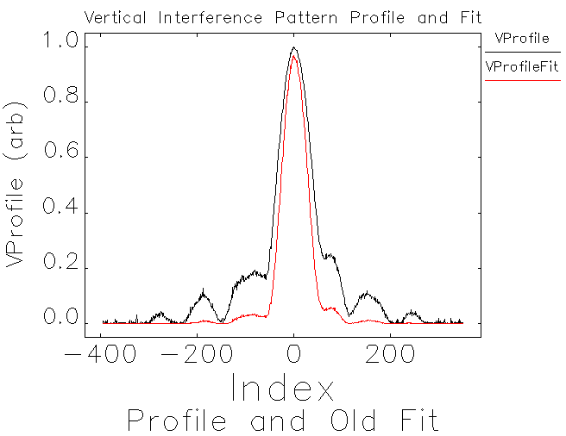
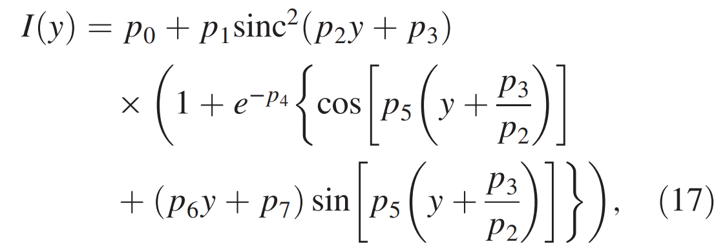
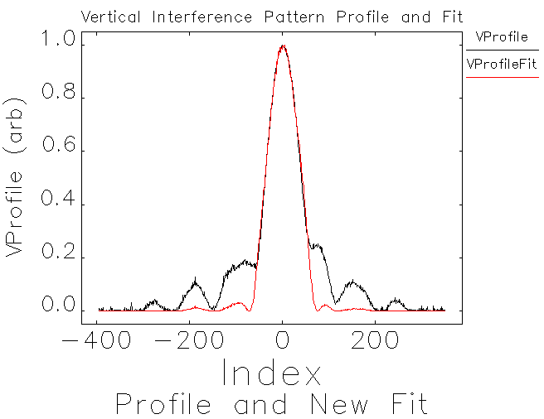
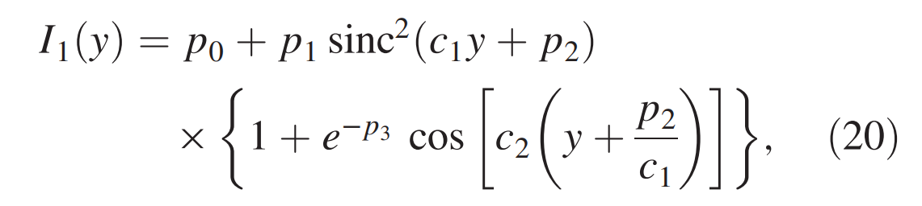
JLab Example: Synchrotron Light Interferometer (SLI) Interferogram Analysis
Fit two different models (“old” and “new”) to the data using sddsgenericfit
exec sddsgenericfit ${intDataFileRoot}.env ${intDataFileRoot}_New.fit \
-simplex=restarts=10,cycles=200,evaluations=100000 \
-col=Index,VProfile \
"-equation=p2 Index * p3 + sto f1 p5 Index p3 p2 / + * sto f2 p6 Index * p7 + sto f3 -1.0 p4 * exp sto V f1 0.0 == ? p0 p1 1.0 V f2 cos f3 f2 sin * + * + * + VProfile - sqr : p0 p1 f1 sin f1 / sqr * 1.0 V f2 cos f3 f2 sin * + * + * + VProfile - sqr \$" \
-variable=name=p0,start=0.0,lower=-0.005,upper=0.005,step=0.0005,heat=0.01 \
-variable=name=p1,start=5.0,lower=1.5,upper=10,step=0.5,heat=0.1 \
-variable=name=p2,start=0.01,lower=0.001,upper=0.5,step=0.001,heat=0.01 \
-variable=name=p3,start=0.0,lower=-0.5,upper=0.5,step=0.001,heat=0.1 \
-variable=name=p4,start=1,lower=.5,upper=5,step=0.1,heat=0.1 \
-variable=name=p5,start=0.015,lower=0.001,upper=0.025,step=0.005,heat=0.01 \
-variable=name=p6,start=0.01,lower=-0.02,upper=0.02,step=0.001,heat=0.01 \
-variable=name=p7,start=0.0,lower=-0.5,upper=0.5,step=0.001,heat=0.01
exec sddsgenericfit ${intDataFileRoot}.env ${intDataFileRoot}_Old.fit \
-simplex=restarts=10,cycles=200,evaluations=100000 \
-col=Index,VProfile \
"-equation=c1 Index * p2 + sto f1 c2 Index p2 c1 / + * sto f2 -1.0 p3 * exp sto V f1 0.0 == ? p0 p1 1.0 V f2 cos * + * + VProfile - sqr : p0 p1 c1 sin c1 / sqr * 1.0 V f2 cos * + * + VProfile - sqr \$" \
-variable=name=p0,start=0.0,lower=-0.005,upper=0.005,step=0.0005,heat=0.01 \
-variable=name=p1,start=0.1,lower=0.01,upper=2.0,step=0.001,heat=0.001 \
-variable=name=p2,start=0.0,lower=-0.005,upper=0.005,step=0.001,heat=0.01 \
-variable=name=p3,start=0.2,lower=0.01,upper=1.8,step=0.01,heat=0.1 \
-variable=name=c1,start=0.005,lower=0.001,upper=0.01,step=0.001,heat=0.001 \
-variable=name=c2,start=0.01,lower=0.001,upper=0.5,step=0.01,heat=0.01}
Notes:
Guidelines: 6-8 bullets per slide; Use sentence fragments for bullets
To change the photo: Right-click on photo and select change photo

Slide 47
SDDS Toolkit, EPICS Tools and Elegant Output
Toolkit and EPICS Tools to take sdds data (frequently used programs in red)
EPICS Tools
Manual Pages 4.1 csv2sdds 4.2 elegant2genesis 4.3 hdf2sdds 4.4 plaindata2sdds 4.5 raw2sdds 4.6 sdds2dpfit 4.7 sdds2math 4.8 sdds2plaindata 4.9 sdds2spreadsheet 4.10 sdds2stream 4.11 sddsbaseline 4.12 sddsbreak 4.13 sddscast 4.14 sddschanges 4.15 sddscheck 4.16 sddscliptails 4.17 sddscollapse 4.18 sddscollect 4.19 sddscombine 4.20 sddscongen 4.21 sddscontour 4.22 sddsconvert 4.23 sddsconvolve 4.24 sddscorrelate 4.25 sddsderiv
4.76 sddsshiftcor 4.77 sddssinefit 4.78 sddsslopes 4.79 sddssmooth 4.80 sddssort 4.81 sddssortcolumn 4.82 sddssplit 4.83 sddsspotanalysis 4.84 sddstdrpeeling 4.85 sddstimeconvert 4.86 sddstranspose 4.87 sddsunwrap 4.88 sddsvslopes 4.89 sddsxra 4.90 sddsxref 4.91 sddszerofind 4.92 SDDS Editing 4.93 rpn Calculator Module 4.94 SDDS Wildcard Conventions 5 Manual Pages for APS-Specific Programs 5.1 awe2sdds 5.2 col2sdds 5.3 sdds2mpl 5.4 mpl2sdds 6 Manual Pages for Synchrotron Radiation Programs 6.1 sddssyncflux
Manual Pages
burtrb
burtwb
knobconfig
toggle
sddsalarmlog
sddscaramp
sddscasr
sddscontrollaw
sddsexperiment
sddsfeedforward
sddsgencontrolbits
sddsglitchlogger
sddslogger
sddslogonchange
sddsmonitor
sddsoptimize
sddspvtest
sddssnapshot
sddsstatmon
sddssynchlog
sddsvexperiment
sddsvmonitor
sddswmonitor
squishPVs
4.26 sddsderef 4.27 sddsdigfilter 4.28 sddsdiff 4.29 sddsdistest 4.30 sddsendian 4.31 sddsenvelope 4.32 sddseventhist 4.33 sddsexpand 4.34 sddsexpfit 4.35 sddsfdfilter 4.36 sddsfft 4.37 sddsgenericfit 4.38 sddsgfit 4.39 sddshist 4.40 sddshist2d 4.41 sddsimageconvert 4.42 sddsimageprofiles 4.43 sddsinsideboundaries 4.44 sddsinteg 4.45 sddsinterp 4.46 sddsinterpset 4.47 sddsmakedataset 4.48 sddsmatrixmult 4.49 sddsmatrixop 4.50 sddsmatrix2column
4.51 sddsminterp 4.52 sddsmpfit 4.53 sddsmselect 4.54 sddsmultihist 4.55 sddsmxref 4.56 sddsnaff 4.57 sddsnormalize 4.58 sddsoutlier 4.59 sddspeakfind 4.60 sddspfit 4.61 sddsplot 4.62 sddspoly 4.63 sddsprintout 4.64 sddsprocess 4.65 sddspseudoinverse 4.66 sddsquery 4.67 sddsregroup 4.68 sddsremoveoffsets 4.69 sddsrowstats 4.70 sddsrunstats 4.71 sddssampledist 4.72 sddsselect 4.73 sddsseparate 4.74 sddssequence 4.75 sddsshift
Notes:
Guidelines: 6-8 bullets per slide; Use sentence fragments for bullets
To change the photo: Right-click on photo and select change photo

Slide 48
JLab SDDS EPICS/Database Tools
Written by Dennis Turner (CASA)
cs2sdds -
Converts control system setpoints to elegant units and creates an SDDS file suitable for loading the values into an elegant lattice with &load_parameters.
The setpoints can be retrieved from either the control system or the archiver by specifying –source=EPICS or –source=MYA, respectively.
The elements for which to fetch setpoints are read from the elegant deck specified with –ele_file. If linac elements are involved, lem2sdds is invoked.
The tool outputs the path to the SDDS file, along with the paths to the Wien filter MATR files if applicable.
ced2elegant (does not create sdds files…) -
Creates an elegant lattice file from elements in the CEBAF Element Database, along with an elegant command file.
Maybe more written by Yves and Dennis…or others
I want to use cs2sdds to compare the Elegant model response matrix for Hall A, C beamlines to the measured calibration (response matrix) data from FFB calibration tool
Notes:
Guidelines: 6-8 bullets per slide; Use sentence fragments for bullets
To change the photo: Right-click on photo and select change photo

Slide 49

Final Thoughts
Of course, please continue to use other tools in the control room (Matlab, Python etc.) you are comfortable using (there are Python, Matlab extensions for SDDS)
If you want to try to use sdds to analyze some control room or simulation data:
First outline the sdds file data structures you need: parameters, columns, pages
Then outline a flowchart of the processing algorithm you require to get a desired result
Come talk and we’ll put together sdds commands to execute the processing algorithm
I’ve put the examples used in this talk in: /a/devuser/nsereno/SDDS_Examples_Tcl_Scripts
Tar-balls are also in this directory if you want to copy and download to your accounts
Other people that can help with sdds are: Yves Roblin, Todd Satogata, Dennis Turner, Isurumali Neththikumara…maybe others
Notes:
Guidelines: 6-8 bullets per slide; Use sentence fragments for bullets
To change the photo: Right-click on photo and select change photo

