Slide 1
BAND Status Word Convention
Status | Definition
No status word bank exists

Slide 2
BMT Status Word Convention
Status | Definition
No status word bank exists

Slide 3
CND Status Word Convention
Status | Definition
0 | Fully functioning
1 | No ADC
2 | No TDC
3 | No ADC and no TDC (PMT is dead)
5 | Any other reconstruction problem
Full path: /calibration/cnd/status

Slide 4
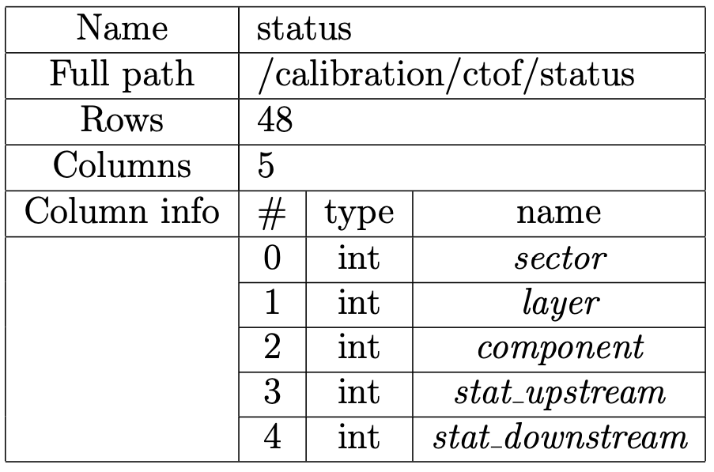
CTOF Status Word Convention
Status | Definition
0 | Fully functioning (PMT)
1 | No ADC
2 | No TDC
3 | No ADC and no TDC (PMT is dead)
5 | Any other reconstruction problem

Slide 5
DC Status Word Convention
Status | Definition
0 | Fully functioning (PMT)
1 | HV problem
2 | LV problem
3 | Signal connector problem
4 | Dead wire
5 | Hot wire
To be confirmed
Full path: /calibration/dc/status_tables/Bad_Wires

Slide 6
ECAL Status Word Convention
Status | Definition
0 | Fully functioning (PMT)
1 | No ADC
2 | No TDC
3 | No ADC and no TDC (PMT is dead)
5 | Any other reconstruction problem
Full path: /calibration/ec/status

Slide 7
FMT Status Word Convention
Status | Definition
No status word bank exists

Slide 8
FT Status Word Convention
Status | Definition (FT-Cal and FT-Hodo)
0 | Fully functioning (PMT)
1 | Noisy
2 | Dead
5 | Any other reconstruction problem
Full paths:
/calibration/ft/ftcal/status
/calibration/ft/fthodo/status

Slide 9
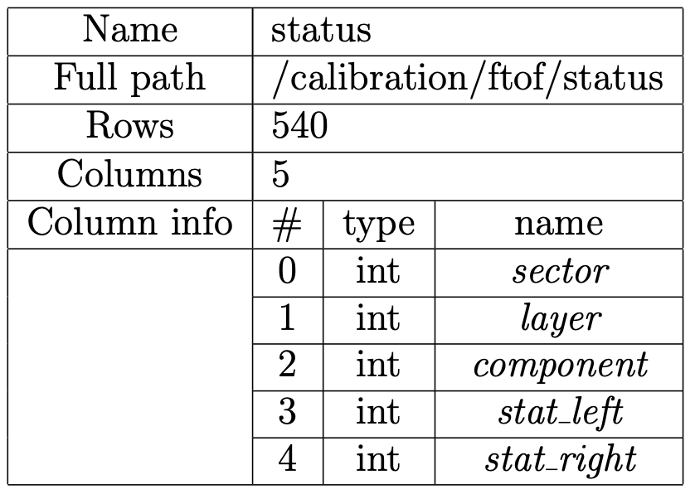
FTOF Status Word Convention
Status | Definition
0 | Fully functioning (PMT)
1 | No ADC
2 | No TDC
3 | No ADC and no TDC (PMT is dead)
5 | Any other reconstruction problem

Slide 10
HTCC Status Word Convention
Status | Definition
0 | Full functioning (PMT)
Full path: /calibration/htcc/status

Slide 11
LTCC Status Word Convention
Status | Definition
0 | Fully functioning (PMT)
1 | No ADC
2 | No TDC
3 | No ADC and no TDC (PMT is dead)
Full path: /calibration/ltcc/status

Slide 12
RICH Status Word Convention
Status | Definition
0 | Fully functioning
2 | Dead channel (no TDC)
5 | Hot channel (dark rate > 10 kHz)
6 | Very hot channel (dark rate > 1 MHz)
No status word bank exists

Slide 13
SVT Status Word Convention
Status | Definition
0 | Fully functioning (strip)
1 | Bad
Full path: /calibration/svt/status
To be confirmed

