Slide 1
Deeply Virtual Compton Scattering at 6.5 GeV and 7.5 GeV Polarized Electron Beam with CLAS12
Joshua Artem Tan
Kyungpook National University and Jefferson Lab
Latifa Elouadrhiri
Jefferson Lab
Francois Xavier-Girod
Jefferson Lab
on behalf of the CLAS Collaboration
2021 Fall Meeting of the APS DNP
October 14, 2021

Slide 2
Outline
Introduction
Experiment
Analysis
Preliminary Results
Summary

Slide 3
I. Introduction

Slide 4
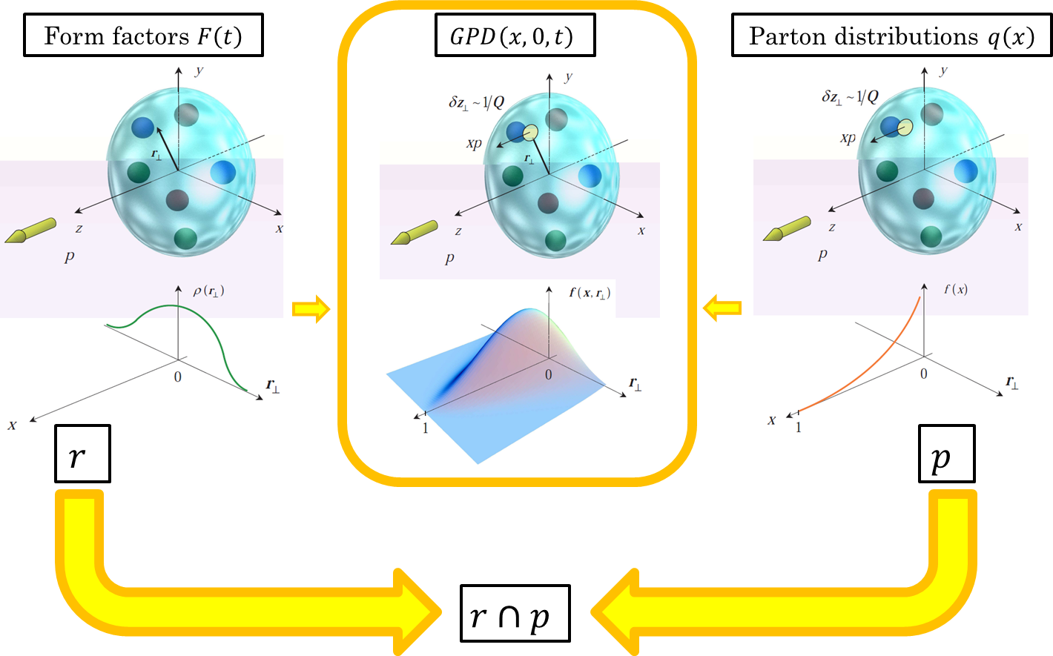
Generalized Parton Distributions
GPDs map the 3D nucleon structure as the quark’s longitudinal momentum correlated with its transverse spatial distributions.

Slide 5
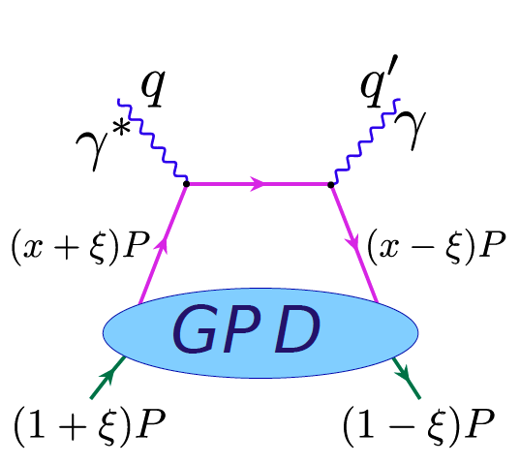
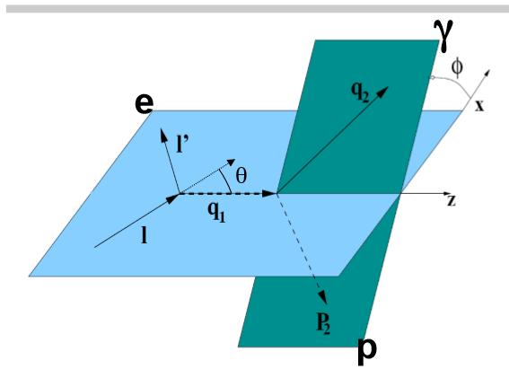
Deeply Virtual Compton Scattering
$$φ$$
$$q$$
$$q^{′}$$
$$q^{′}$$
$$k^{′}$$
$$θ$$
$$∙$$
$$\left(x+ξ\right)p$$
$$\left(x−ξ\right)p$$
$$q$$
$$p$$
$$k$$
$$p^{′}$$
$$\left(1+ξ\right)p$$
$$\left(1−ξ\right)p$$
DVCS accessing GPDs
DVCS kinematics: scattering plane (light blue) and reaction plane (cyan)
Deeply virtual Compton scattering (DVCS) provides the cleanest access to chiral-even GPDs: $H^{q}$ primarily, ${\tilde{H}}^{q}$ and $E^{q}$.

Slide 6
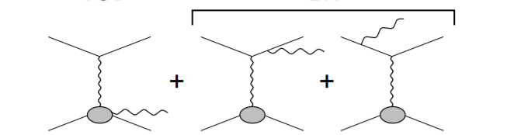
DVCS and Bethe-Heitler
DVCS
BH
Amplitude of photon production: $𝒯^{2}={\left|𝒯_{DVCS}+𝒯_{BH}\right|}^{2}$= ${\left|𝒯_{DVCS}\right|}^{2}$+ ${\left|𝒯_{BH}\right|}^{2}+ℐ$ Beam spin asymmetry for unpolarized target: $$A_{LU}\left(φ\right)∝s_{1,unp}^{ℐ}\sin\left(φ\right)$$ $$A_{LU}\left(φ\right)=\frac{dσ^{↑}\left(φ\right)−dσ^{↓}\left(φ\right)}{dσ^{↑}\left(φ\right)+dσ^{↓}\left(φ\right)}=\frac{1}{P}\frac{N^{↑}\left(φ\right)−N^{↓}\left(φ\right)}{N^{↑}\left(φ\right)+N^{↓}\left(φ\right)}$$ $$A_{LU}\left(φ\right)∝ℑ𝔪\left\{F_{1}ℋ+\frac{x_{B}}{2−x_{B}}\left(F_{1}+F_{2}\right)\tilde{ℋ}+\frac{t}{4M^{2}}F_{2}ℰ\right\}\sin\left(φ\right)$$ Compton form factors $ℋ$, $\tilde{ℋ}$ and $ℰ$: $$\left\{ℋ,ℰ\right\}\left(ξ,t,Q^{2}\right)=\sum_{q}{\int_{−1}^{1}{dxC_{q}^{\left(−\right)}\left(ξ,x\right)\left\{H^{q},E^{q}\right\}\left(x,ξ,t,Q^{2}\right)}}$$ $$\tilde{ℋ}\left(ξ,t,Q^{2}\right)=\sum_{q}{\int_{−1}^{1}{dxC_{q}^{\left(+\right)}\left(ξ,x\right){\tilde{H}}^{q}\left(x,ξ,t,Q^{2}\right)}}$$ DVCS measured at different beam energies allows the extraction of ${\left|𝒯_{DVCS}\right|}^{2}$ for which GPD enters through the Compton form factor $ℋ\left(ξ,t\right)$.
Amplitude of photon production: $𝒯^{2}={\left|𝒯_{DVCS}+𝒯_{BH}\right|}^{2}$= ${\left|𝒯_{DVCS}\right|}^{2}$+ ${\left|𝒯_{BH}\right|}^{2}+ℐ$ Beam spin asymmetry for unpolarized target: $$A_{LU}\left(φ\right)∝s_{1,unp}^{ℐ}\sin\left(φ\right)$$ $$A_{LU}\left(φ\right)=\frac{dσ^{↑}\left(φ\right)−dσ^{↓}\left(φ\right)}{dσ^{↑}\left(φ\right)+dσ^{↓}\left(φ\right)}=\frac{1}{P}\frac{N^{↑}\left(φ\right)−N^{↓}\left(φ\right)}{N^{↑}\left(φ\right)+N^{↓}\left(φ\right)}$$ $$A_{LU}\left(φ\right)∝ℑ𝔪\left\{F_{1}ℋ+\frac{x_{B}}{2−x_{B}}\left(F_{1}+F_{2}\right)\tilde{ℋ}+\frac{t}{4M^{2}}F_{2}ℰ\right\}\sin\left(φ\right)$$ Compton form factors $ℋ$, $\tilde{ℋ}$ and $ℰ$: $$\left\{ℋ,ℰ\right\}\left(ξ,t,Q^{2}\right)=\sum_{q}{\int_{−1}^{1}{dxC_{q}^{\left(−\right)}\left(ξ,x\right)\left\{H^{q},E^{q}\right\}\left(x,ξ,t,Q^{2}\right)}}$$ $$\tilde{ℋ}\left(ξ,t,Q^{2}\right)=\sum_{q}{\int_{−1}^{1}{dxC_{q}^{\left(+\right)}\left(ξ,x\right){\tilde{H}}^{q}\left(x,ξ,t,Q^{2}\right)}}$$

Slide 7
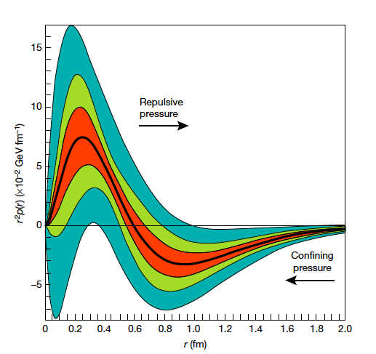
DVCS at Multiple Beam Energies
Nucleon Pressure Distribution
Projected measurement for DVCS with CLAS12
V.D. Burkert,
L. Elouadrhiri,
& F.X. Girod,
Nature,557 396 (2018)
With $H\left(x,ξ,t\right)$, the Dispersion Relations allow access to $D\left(t \right)$ term and eventually to the form factor $d_{1}$: $$d_{1}\left(t\right)=15M_{N}\int{d^{3}r\frac{j_{0}\left(r\sqrt{−t}\right)}{2t}p\left(r\right)}=5M_{N}\int{d^{3}r\frac{j_{2}\left(r\sqrt{−t}\right)}{t}s\left(r\right)}$$ Pressure $p\left(r\right)$ and shear force $s\left(r\right)$ distributions inside the nucleon may shed light on confinement mechanism.

Slide 8
II. Experiment

Slide 9
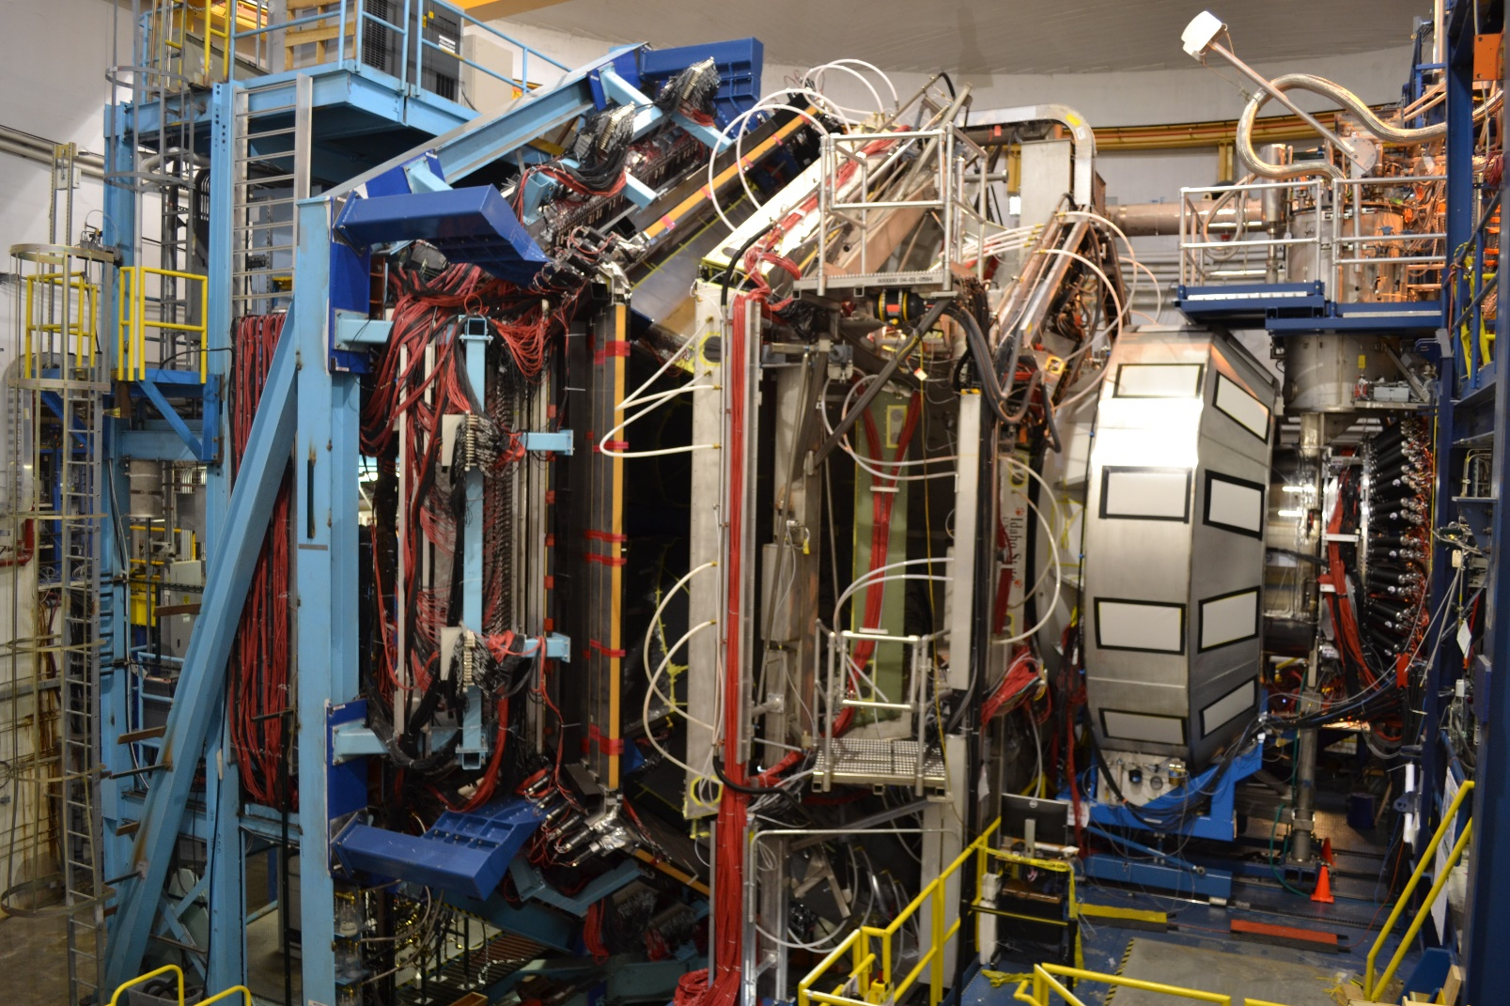
CEBAF at 12 GeV and CLAS12
First DVCS experiment with CLAS12 was performed in of 2018 at 6.5 GeV, 7.5 GeV, and 10.6 GeV polarized beam energies with ~87%
average polarization, employing liquid hydrogen as production target.

Slide 10
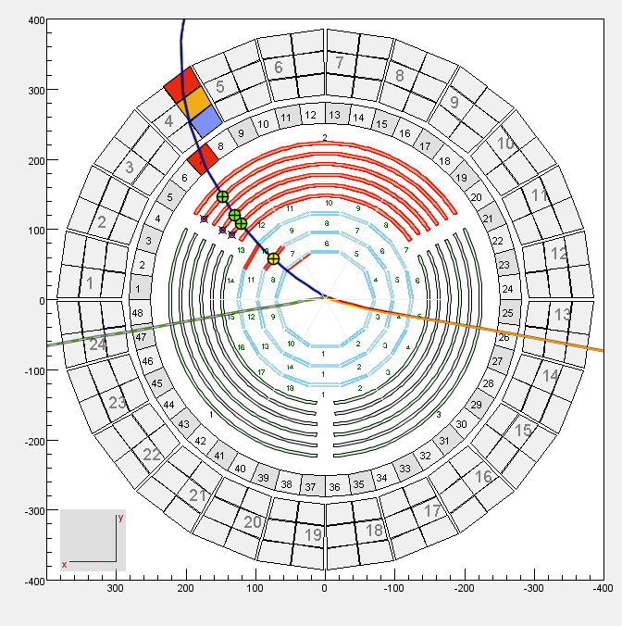
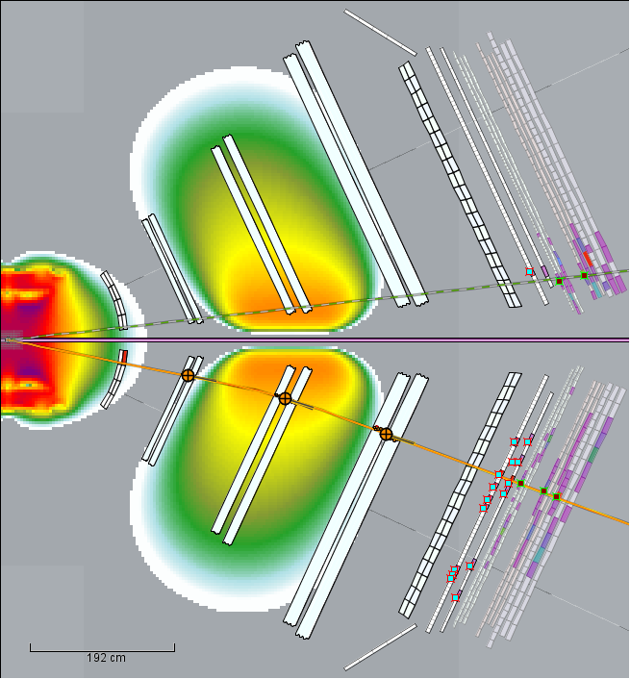
Detector-based $e^{′}p^{′}γ$ Selection
FD
FTOF
CD
$$p^{′}$$
CTOF
DC
SVT
CND
HTCC
$$γ$$
LTCC
$$e^{′}$$
$$γ$$
FT
$$e^{′}$$
MVT
ECAL
$p^{′}$ in CD Subsystem and $γ$ Hit in FT
$e^{′}γ$ in FD Subsystem
CLAS event display for a simulated DVCS event
DVCS sample selection requires 1 electron, 1 proton, and 1 photon as reconstructed in the Event Builder.

Slide 11
III. Analysis

Slide 12
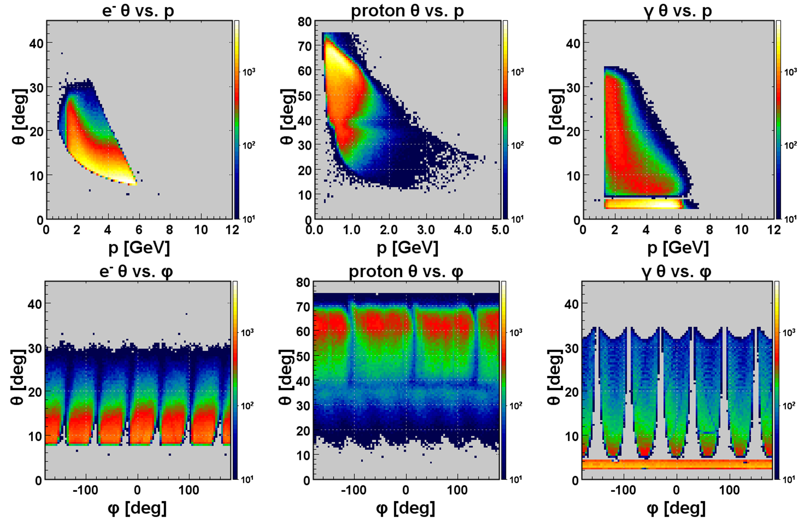
$e^{′}p^{′}γ$ Event Selection
Kinematic distributions of the selected particles reflect the detector topology.

Slide 13
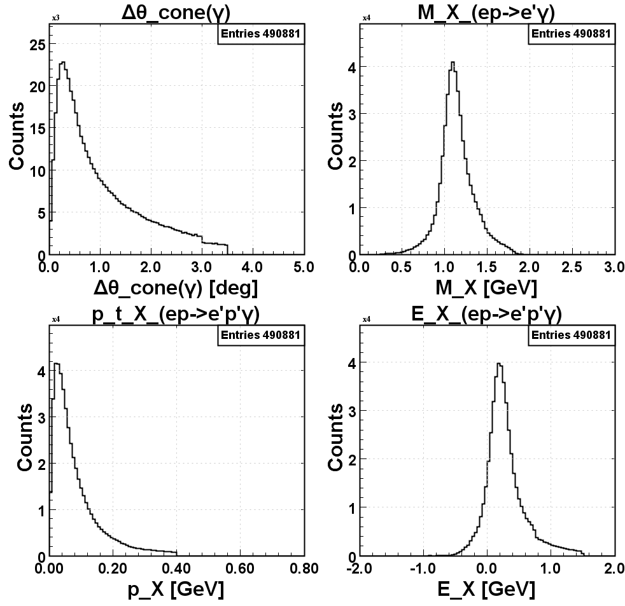
$ep→e^{′}p^{′}γ$ Exclusivity Cuts
$${∆θ}_{cone\left(γ\right)}=\cos^{−1}\left({\vec{q^{′}}∙\vec{X_{γ}}}/{\left|\vec{q^{′}}\right|\left|\vec{X_{γ}}\right|}\right)$$
$Q^{2}=−q^{2}$ above 1 GeV² and $W=\sqrt{{\left(q+p\right)}^{2}}$ above 2 GeV conditions are implemented as deep inelastic scattering (DIS) cuts.

Slide 14
IV. Preliminary Results

Slide 15
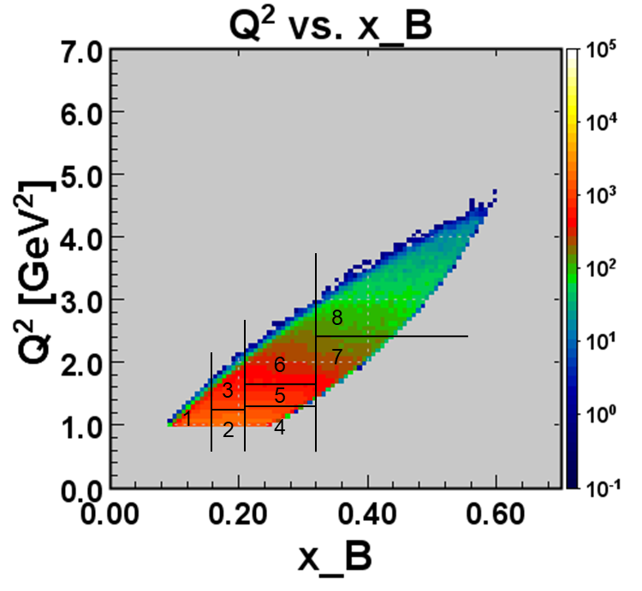
Integrated Raw Beam Spin Asymmetry I
6.5 GeV
α = 0.119 ± 0.003
β = -0.534 ± 0.025
χ²/ndf = 1.122
PRELIMINARY
Raw Beam Spin Asymmetry (BSA) is fitted with $BSA=\frac{α\sin{φ}}{1+β\cos{φ}}$ and statistical errors (only), at 6.5 GeV beam energy.

Slide 16
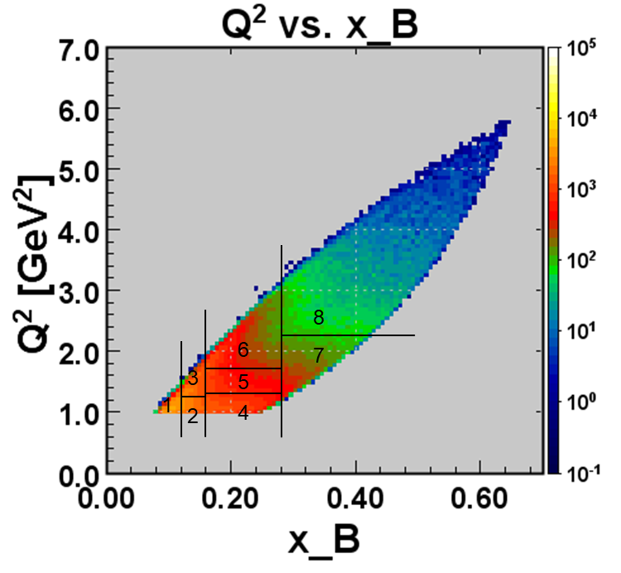
Integrated Raw Beam Spin Asymmetry II
7.5 GeV
α = 0.109 ± 0.003
β = -0.576 ± 0.024
χ²/ndf = 1.455
PRELIMINARY
Raw Beam Spin Asymmetry (BSA) is fitted with $BSA=\frac{α\sin{φ}}{1+β\cos{φ}}$ and statistical errors (only), at 7.5 GeV beam energy.

Slide 17
Raw Beam Spin Asymmetry and Beam Energy
6.5 GeV, $x_{B}$: 0.25, all $−t$
α = 0.058 ± 0.006
β = -0.792 ± 0.045
χ²/ndf = 0.957
α = 0.087 ± 0.007
β = -0.720 ± 0.051
χ²/ndf = 0.894
α = 0.178 ± 0.007
β = -0.520 ± 0.050
χ²/ndf = 1.164
Q² = 1.2 GeV²
Q² = 1.5 GeV²
Q² = 2.0 GeV²
PRELIMINARY
7.5 GeV , $x_{B}$: 0.21, all $−t$
α = 0.064 ± 0.007
β = -0.716 ± 0.060
χ²/ndf = 0.530
α = 0.112 ± 0.008
β = -0.588 ± 0.055
χ²/ndf = 1.055
α = 0.178 ± 0.010
β = -0.249 ± 0.070
χ²/ndf = 0.937
Q² = 1.2 GeV²
Q² = 1.6 GeV²
Q² = 2.4 GeV²
Results for sample bins show raw BSA dependence on beam energy.

Slide 18
Raw Beam Spin Asymmetry Observables
6.5 GeV
Q² = 1.2 GeV²
Q² = 1.5 GeV²
Q² = 2.0 GeV²
7.5 GeV
Q² = 1.2 GeV²
Q² = 1.6 GeV²
Q² = 2.4 GeV²
PRELIMINARY
PRELIMINARY
Together with the information from cross-section measurements, BSA observables eventually leads to the extraction of $D\left(t\right)$ term.

Slide 19
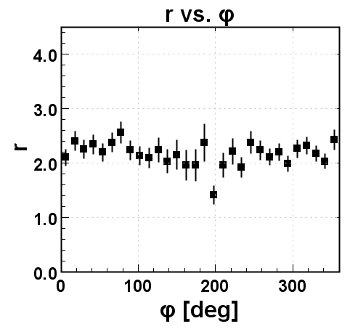
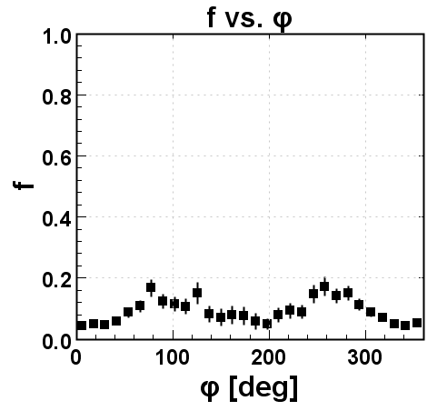
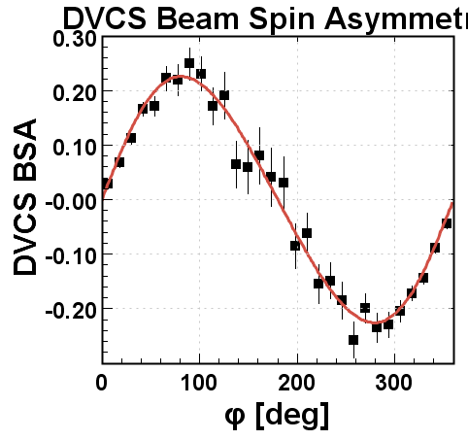
$π^{0}$ Contamination Subtraction I
α = 0.212 ± 0.007
β = -0.207 ± 0.043
χ²/ndf = 0.628
α = 0.173 ± 0.024
χ²/ndf = 1.553
$$r≡{\left.\frac{N_{π^{0}\left(γ\right)}}{N_{π^{0}\left(γγ\right)}}\right|}_{sim=dat}$$
PRELIMINARY
PRELIMINARY
$$A_{raw}=A_{epγ}$$
$$A_{π^{0}}=α\sin{φ}$$
$$f≡r_{sim}{\left.\frac{N_{π^{0}\left(γγ\right)}}{N_{epγ}}\right|}_{dat}$$
α = 0.223 ± 0.008
β = -0.158 ± 0.048
χ²/ndf = 0.915
PRELIMINARY
$$A_{DVCS}$$
$=\frac{A_{raw}−fA_{π^{0}}}{1−f}$
Shown is subtraction of DV$π^{0}$P contaminants from raw $epγ$ events at 7.6 GeV bean energy and $\frac{−t}{Q^{2}}$ less than 0.25.

Slide 20
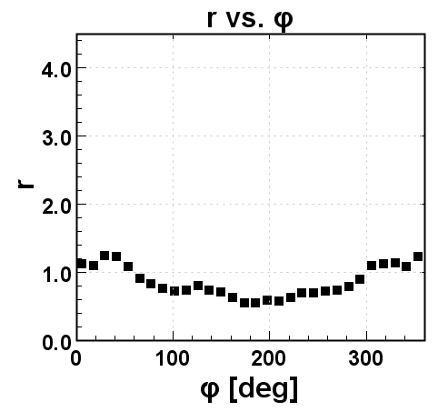
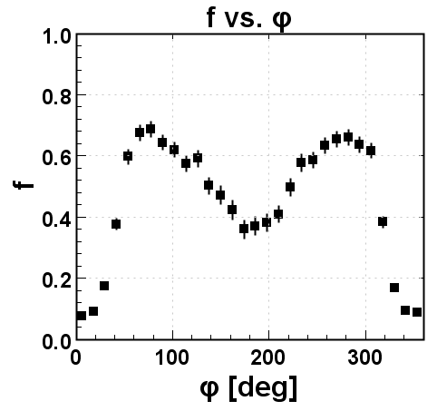
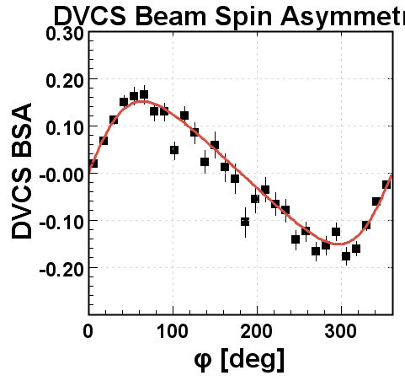
$π^{0}$ Contamination Subtraction II
α = 0.074 ± 0.004
β = -0.688 ± 0.029
χ²/ndf = 1.208
α = 0.045 ± 0.004
χ²/ndf = 1.233
$$r≡{\left.\frac{N_{π^{0}\left(γ\right)}}{N_{π^{0}\left(γγ\right)}}\right|}_{sim=dat}$$
PRELIMINARY
PRELIMINARY
$$A_{raw}=A_{epγ}$$
$$A_{π^{0}}=α\sin{φ}$$
$$f≡r_{sim}{\left.\frac{N_{π^{0}\left(γγ\right)}}{N_{epγ}}\right|}_{dat}$$
α = 0.136 ± 0.006
β = -0.443 ± 0.038
χ²/ndf = 1.848
PRELIMINARY
$$A_{DVCS}$$
$=\frac{A_{raw}−fA_{π^{0}}}{1−f}$
Shown is subtraction of DV$π^{0}$P contaminants from raw $epγ$ events at 7.6 GeV bean energy and $\frac{−t}{Q^{2}}$ greater than 0.25.

Slide 21
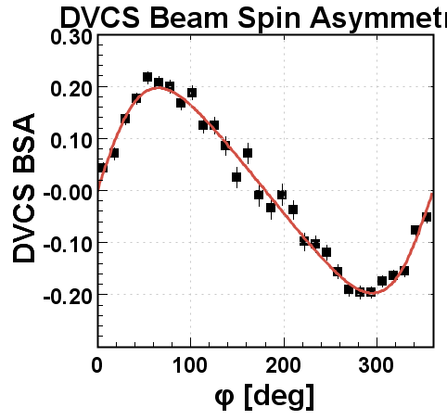
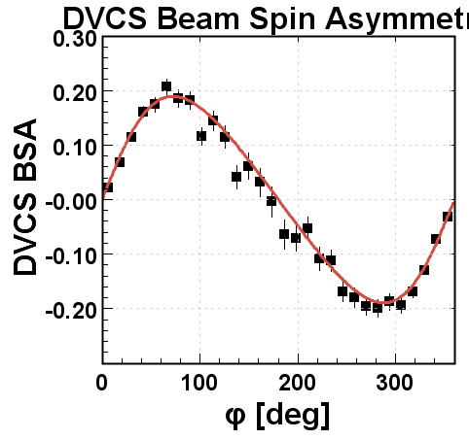
Integrated DVCS Raw Beam Spin Asymmetry
6.5 GeV
α = 0.179 ± 0.004
β = -0.421 ± 0.027
χ²/ndf = 1.584
7.5 GeV
α = 0.180 ± 0.005
β = -0.302 ± 0.029
χ²/ndf = 1.506
PRELIMINARY
PRELIMINARY
α_{raw} = 0.119 ± 0.003
β_{raw} = -0.534 ± 0.025
α_{π0} = 0.051 ± 0.003
α_{raw} = 0.109 ± 0.003
β_{raw} = -0.576 ± 0.024
α_{π0} = 0.049 ± 0.004
Integrated DVCS BSA after $π^{0}$ contaminant subtraction.

Slide 22
V. Summary

Slide 23
Summary
First DVCS beam spin asymmetry at 6.5 GeV and 7.5 GeV was measured with the goal of deepening our understanding on the GPD-modelled 3D structure of the proton and its mechanical properties.
Raw BSA was extracted from $epγ$ sample after implementing exclusivity cuts and correction was performed by eliminating DV$π^{0}$P contamination; bin by bin implementation will follow.
Kinematic and finite bin size corrections will be implemented after which, systematic errors will be estimated for the final BSA results.
Dependance of BSA to various kinematic observables will be studied in detail.
Together with DVCS cross-section measurements, the results of this analysis will be used to extract GPDs and map the proton pressure and shear force distributions.

Slide 24
Thank You!!!

