Slide 1
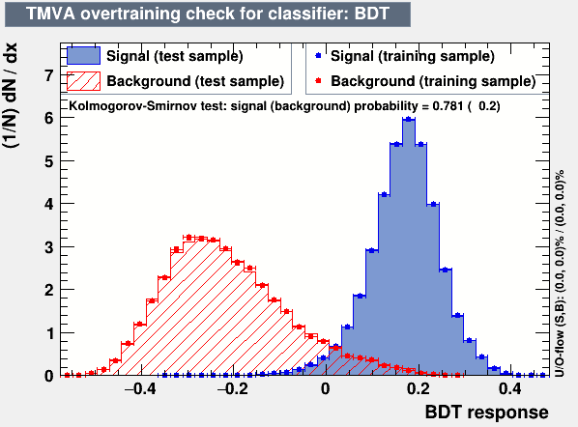
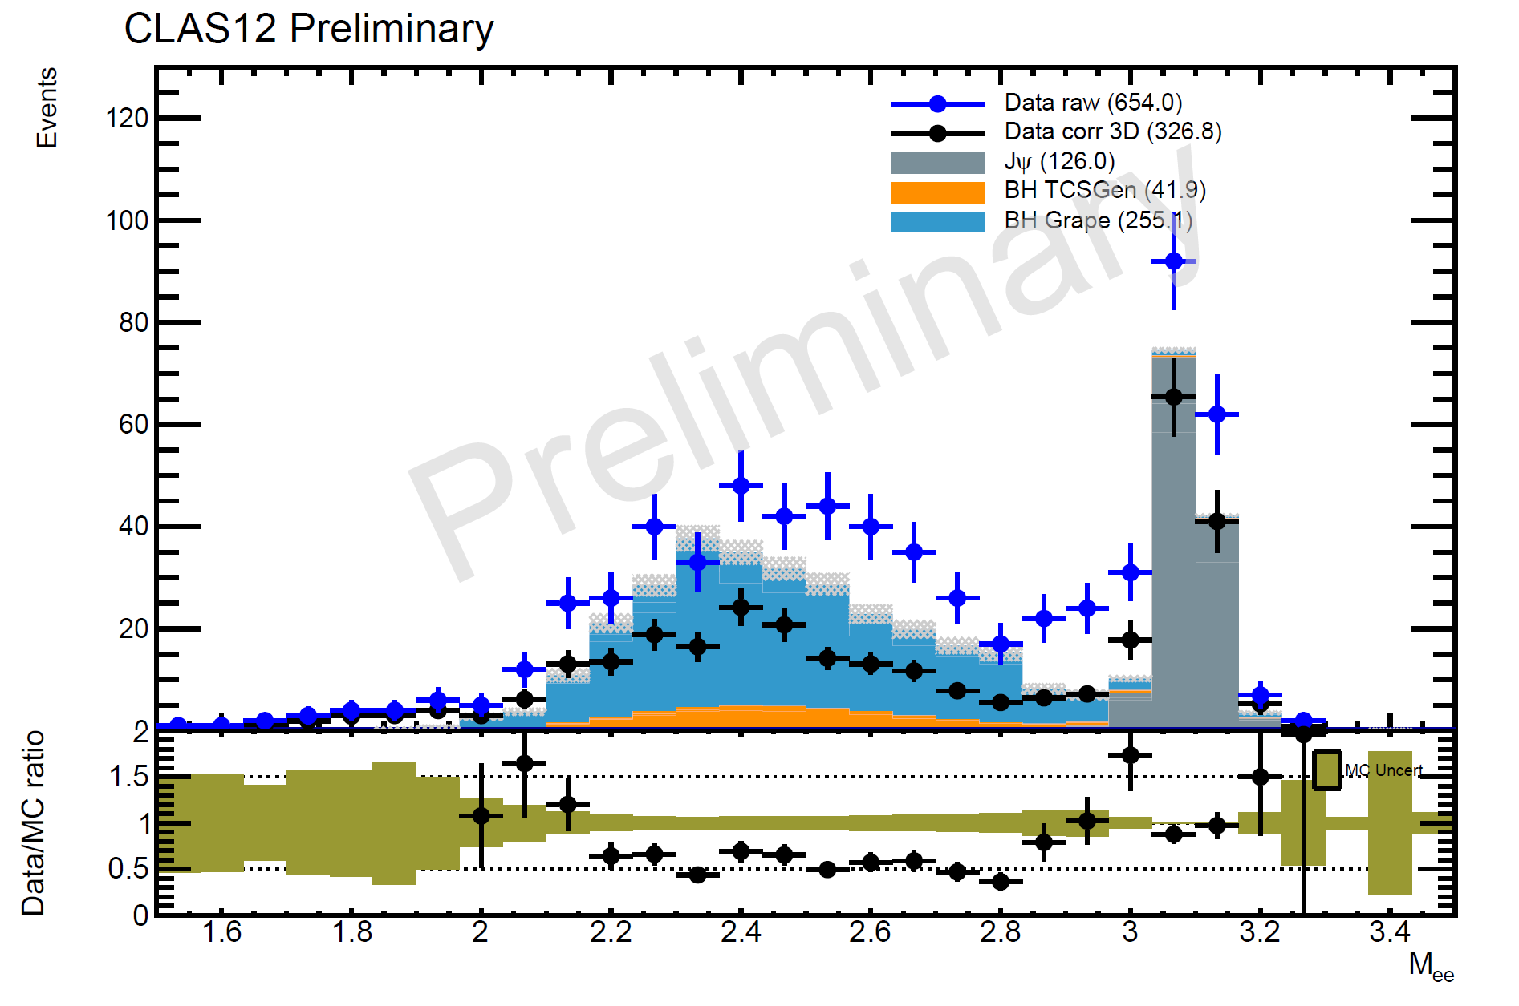
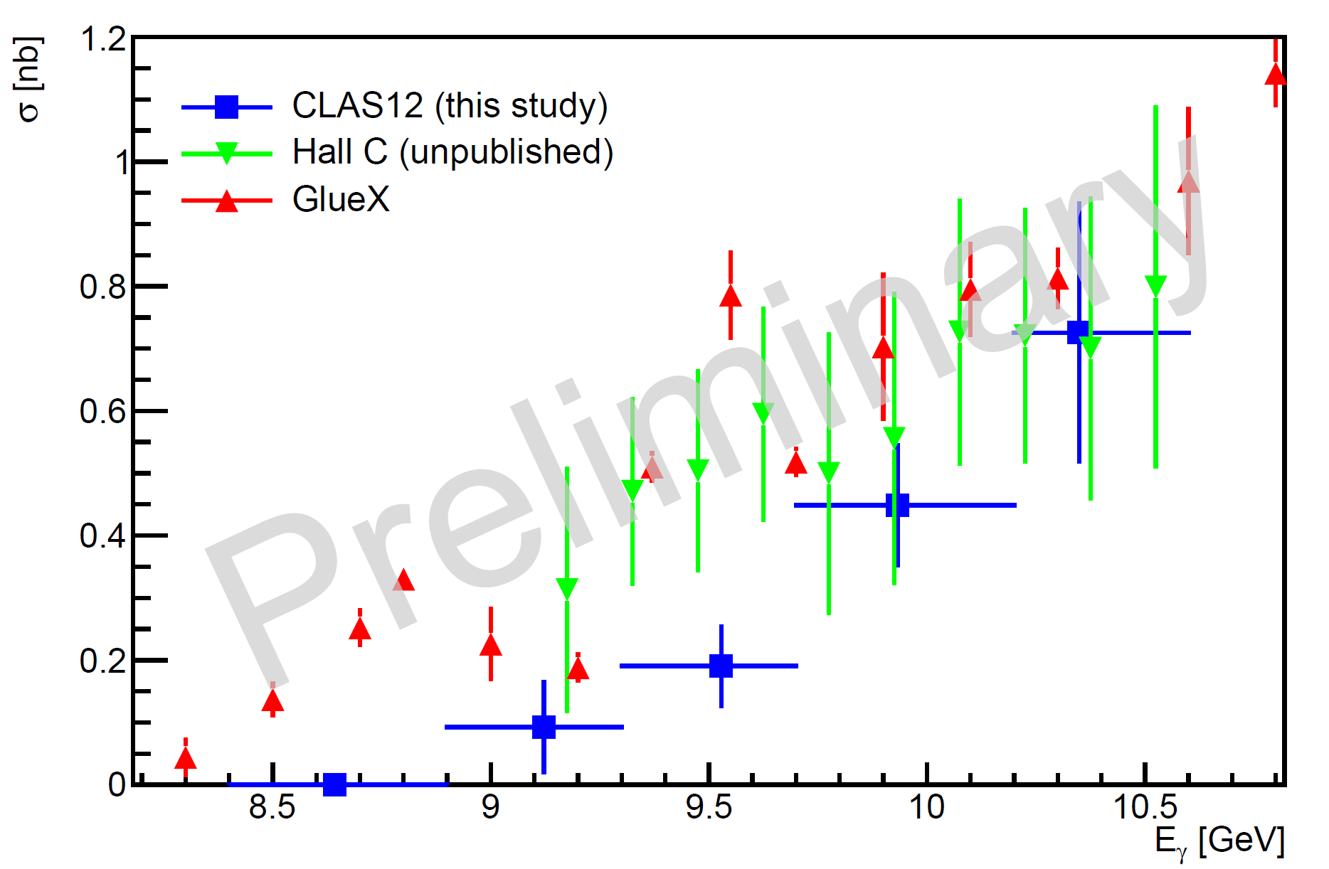
Measurement of the cross section of the J/ψ photoproduction on the proton
Pierre Chatagnon (Jefferson Lab)
Analysis status
Event selection and particle identification
Additional use of AI to identify leptons above 4 GeV
Irreducible backgrounds (from photon conversion and pion decays) are subtracted using same-charge lepton events
Overall normalization factors obtained from Bethe-Heitler events
Figure 1: Output spectrum of the BDT used to distinguished leptons from pions at momenta larger than 4 GeV. The BDT uses all information from the electromagnetic showers provided by the CLAS12 calorimeter.
Path forward
Ongoing studies to better understand the overall normalization, especially understand the particle detection efficiencies in both data and Monte-Carlo
Upcoming pass 2 data will provide greatly improved tracking efficiency, providing significantly more statistics
Systematic uncertainties remain to be studied
Figure 2: Invariant mass spectrum of the lepton pair after irreducible background subtraction, compared the normalized yields from Monte-Carlo simulation
Figure 3: Measured cross section using CLAS12 data, the points are compared with GlueX published data and Hall C unpublished data

