Slide 1
Timelike Compton Scattering on a polarized target with CLAS12, at Jefferson Lab
Kayleigh Gates, University of Glasgow, Scotland

Slide 2
Intro
Theory
The Timelike Compton Scattering (TCS) process
Generalised Parton Distributions (GPDs)
Observables accessible with TCS
Experimental Setup
Jefferson Lab and the Continuous Electron Beam Facility (CEBAF)
Hall B and The CEBAF Large Acceptance Spectrometer at 12 GeV (CLAS12)
Experimental Procedure
Preliminary Results

Slide 3
Timelike Compton Scattering (TCS)
High energy, exclusive scattering process.
A real photon interacts with the target nucleon, causing release of virtual photon which decays into a lepton pair.
$$ep→e^{′}p^{′}γ^{∗}$$
$$γ^{∗}→μ^{+}μ^{−} or e^{+}e^{−}$$
TCS gives access to Generalised Parton Distributions via cross section and polarization asymmetry measurements.
[1]
$Q^{2}=$virtuality of initial photon
${Q′}^{2}={q′}^{2}={\left(l^{+}+l^{−}\right)}^{2}$
$t={\left(p′(N′)−p(N)\right)}^{2}={\left(q−q′\right)}^{2}$
$x=$longitudinal momentum fraction of struck quark
$ξ=$ longitudinal momentum fraction gained/lost by struck quark
Notes:
On Q2 - since we have an electron beam, the initial photon is quasi-real, so it does have a small but non-zero virtuality

Slide 4
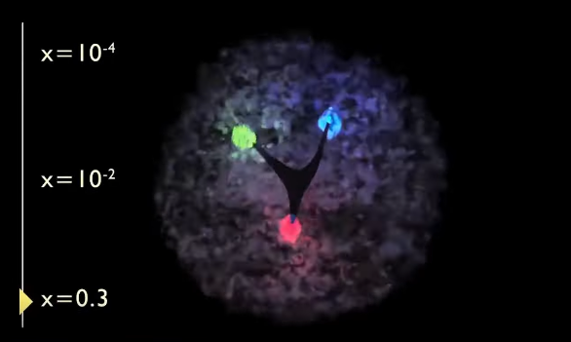
Generalised Parton Distributions
At high photon virtuality, TCS scattering amplitude can be factorized.
‘Hard’ part $→$ QED and perturbative QCD.
‘Soft’ part $→$ non-perturbative QCD, described by four Generalized Parton Distributions (GPDs) $H,\tilde{H}, E, \& \tilde{E}$.
$H$and $E$ are insensitive to quark helicity, $\tilde{H}$ and $\tilde{E}$ are helicity dependent.
GPDs relate the transverse positions of quarks and gluons to their longitudinal momentum.
This relation helps to provide a tomographic mapping of nucleon structure.
[1]
Hard
Soft
[2]
Notes:
For example H and E are insensitive to quark helicity, while H-tilde and E-tilde are helicity-dependent. Thus H(x) at t=0 and xi=0 is just the standard PDF, while H-tilde(x) at t=xi=0 is the helicity distribution. H integrates across x to give the Dirac FF, while E integrates to give the Pauli FF. The tilde ones integrate to give the axial and pseudo-scalar form factors, respectively -- these cannot be probed directly in EM interaction, but can be via the weak interaction channel. That's not for the slide, of course, just for information!

Slide 5
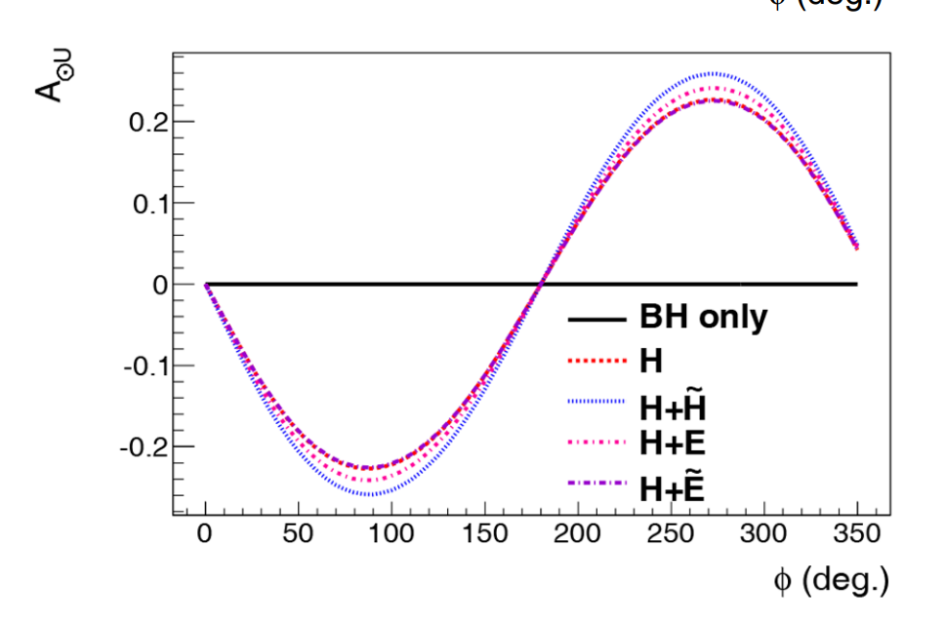
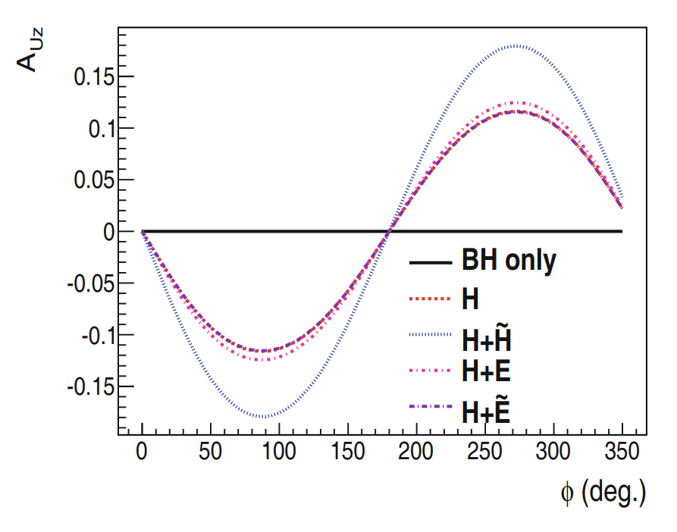
Observable Predictions
Beam Spin Asymmetry – $H$ dominates, first ever measurement of TCS in 2021^{[3]}, continuation of this effort on a polarized target.
Target spin asymmetry – Access to $H$ and $\tilde{H}$
Measurements accessing $H$ allow investigation into GPD universality, $\tilde{H}$ is less known, both Deeply Virtual Compton Scattering (DVCS) and TCS provide complementary access.
[4]
TSA
BSA
Notes:
BSA = beam spin asymmetry, TSA= target spin asymmetry, DSA= double spin asymmetry
BH stands for Bethe Heitler, which forms the background to our process

Slide 6
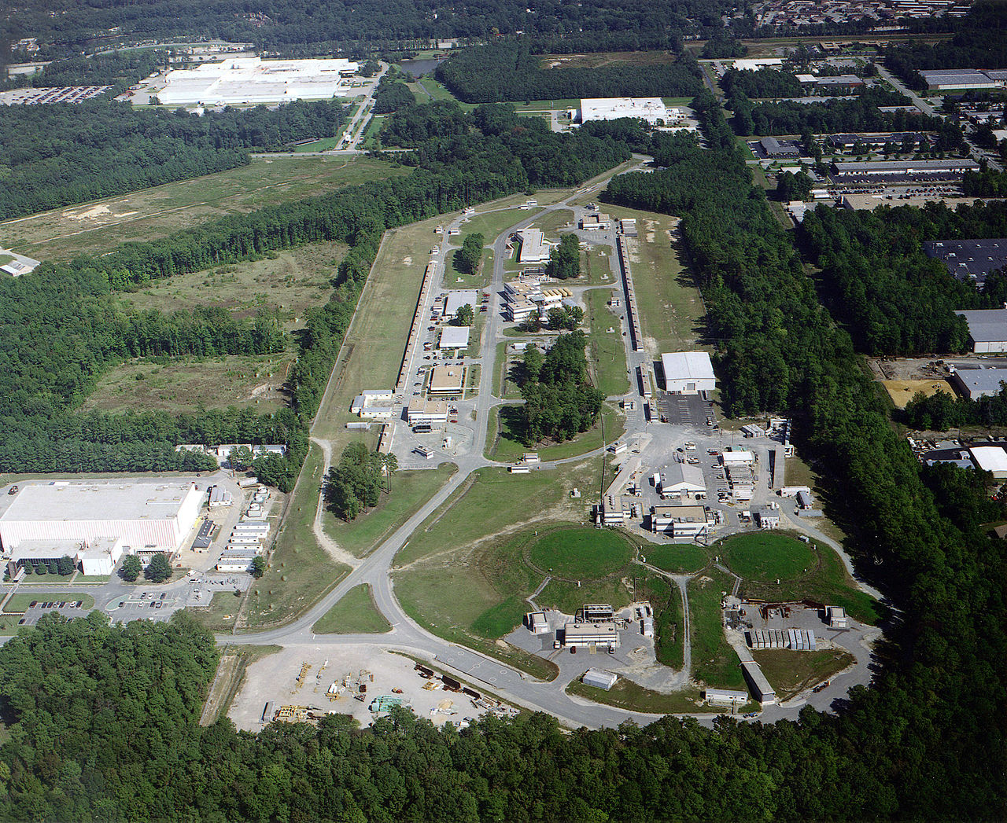
Jefferson Lab
CEBAF (the Continuous Electron Beam Accelerator Facility) provides an electron beam to four experimental halls housing fixed target experiments;
Hall A and C - high resolution, narrow acceptance spectrometers, able to handle large luminosities.
Hall B - houses the CEBAF Large Acceptance Spectrometer (CLAS12), where the data in this talk was taken.
Hall D - home of the GlueX (the Gluonic Excitation Experiment), and has a dedicated photon beamline.
[5]
Notes:
Continuous Electron Beam Accelerator Facility (CEBAF) provides an electron beam to four experimental halls, each hall with a dedicated physics program and detectors specialized for this.
Hall A and C narrow acceptance spectrometers and are able to handle large luminosities.
Hall B houses the CLAS12 (CEBAF Large Acceptance Spectrometer at 12GeV) and is where Run Group C (RGC) takes its data.
Hall D is dedicated to hadron spectroscopy and has a dedicated photon beamline.
The maximum beam energy delivered in Hall A, B and C (∼ 11 GeV) is obtained after a total of five passes around the accelerator. Hall D is one turn offset from A-C and thus can receive ~12GeV.

Slide 7
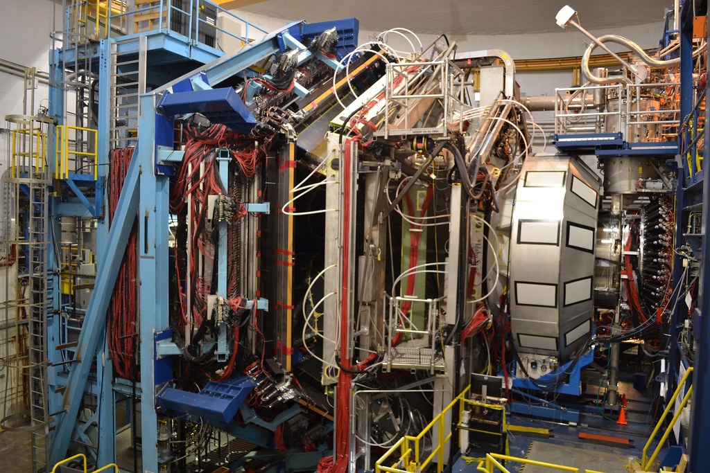
CLAS12 – Jefferson Lab
Close to full azimuthal angular coverage
Polar angle θ range 35◦ − 125◦ covered by the central solenoid magnet and detector
Forward polar angle range < 35◦ covered by the superconducting torus magnet and forward detector, including a forward tagger (FT) .
Allows for efficient detection of both charged and neutral particles.
[6]

Slide 8
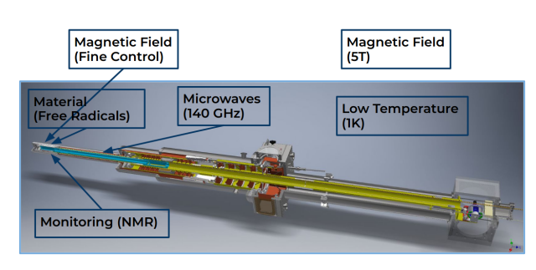
Longitudinally Polarized Target
Paramagnetic target material dynamically polarized using microwaves
Target material kept under conditions of low temperature and high magnetic field
Target polarisation monitored using NMR
Beam moved uniformly across surface of target material to prevent localized depolarization
[7],[8]
Notes:
NMR used to measure polarization real time via Measuring polarization in field B0 through change in inductance of coil (positioned at tip) at ω0 (213 MHz for p)

Slide 9
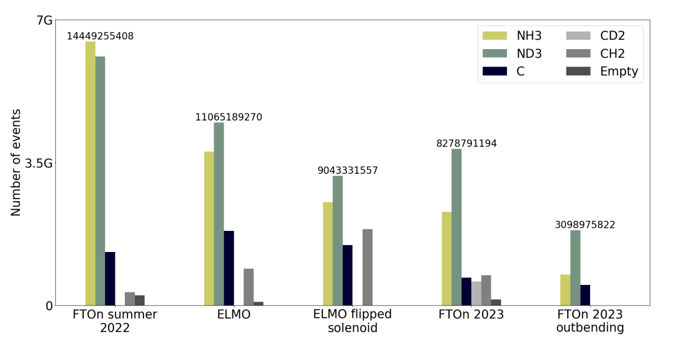
Experimental Procedure
Data taking finished on March 23rd
There were 6 target configurations – NH3 is the subject of my analysis
Total accumulated charge = 13.06mC
Current status of data = 28 runs processed for analysis $≈6\%$ of total dataset, equally split between $P_{t}^{+}$ and $P_{t}^{−}$
[7]
FTOn = Forward Tracker on
ELMO = Extra Large Möller Shield

Slide 10
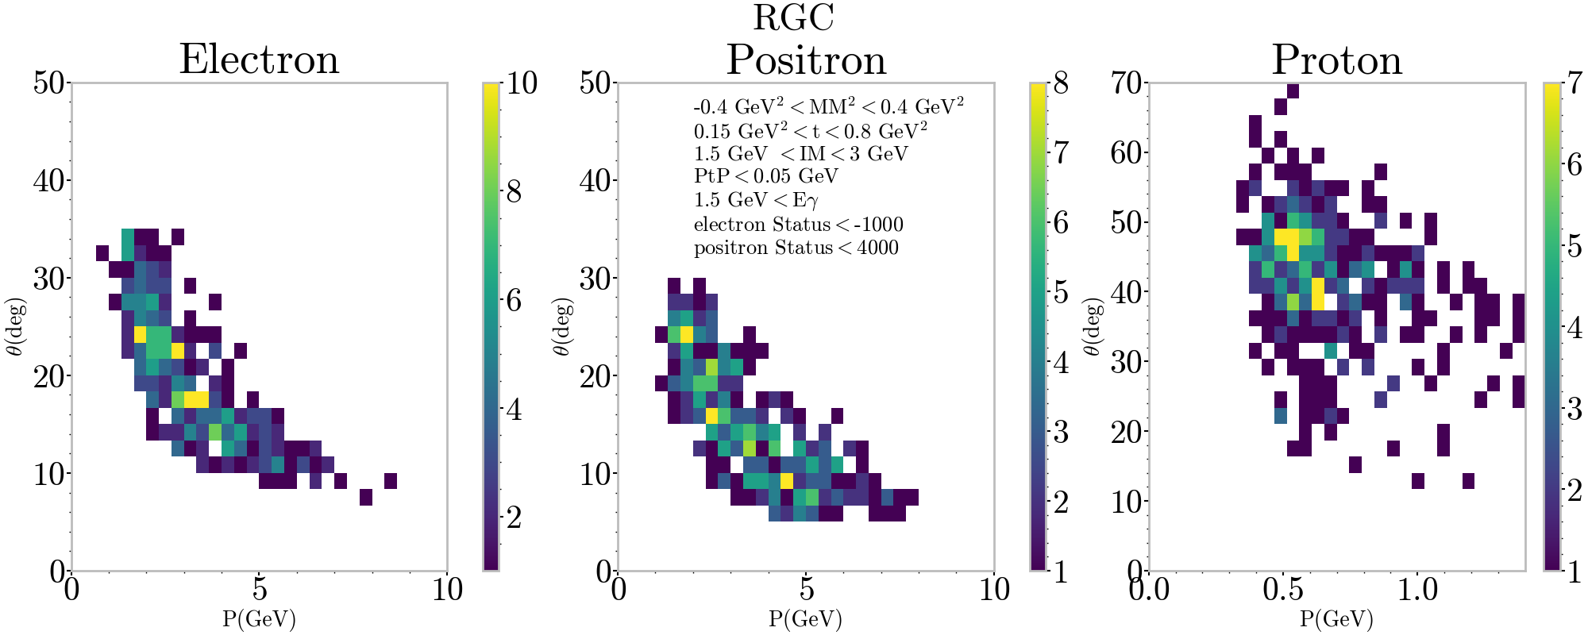
Final state particles
Three final state particle momentum vs theta full exclusivity (tight t cut $0.15 GeV^{2}<t<0.8 GeV^{2}$)
Follows shapes seen with first published TCS result on proton data^{[3]}
Preliminary
Preliminary
Preliminary

Slide 11
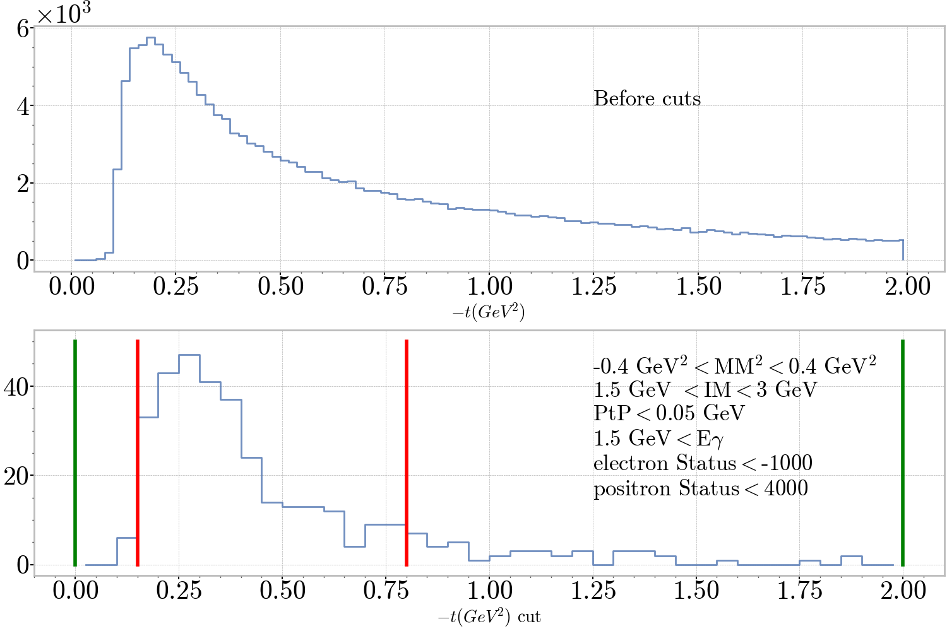
Preliminary Results: $−t$
Preliminary
$−t={\left(p′−p\right)}^{2}={\left(q−q′\right)}^{2}$ invaluable for accessing GPDs
For statistics purposes require
$$0{GeV}^{2}<−t<2GeV^{2}$$
Tight cut proposed at
$$0.15{GeV}^{2}<−t<0.8GeV^{2}$$
Preliminary
Notes:
"GPDs are functions of x, xi, t and Q2. t encodes information on the spatial distribution -- invaluable for accessing GPDs".

Slide 12
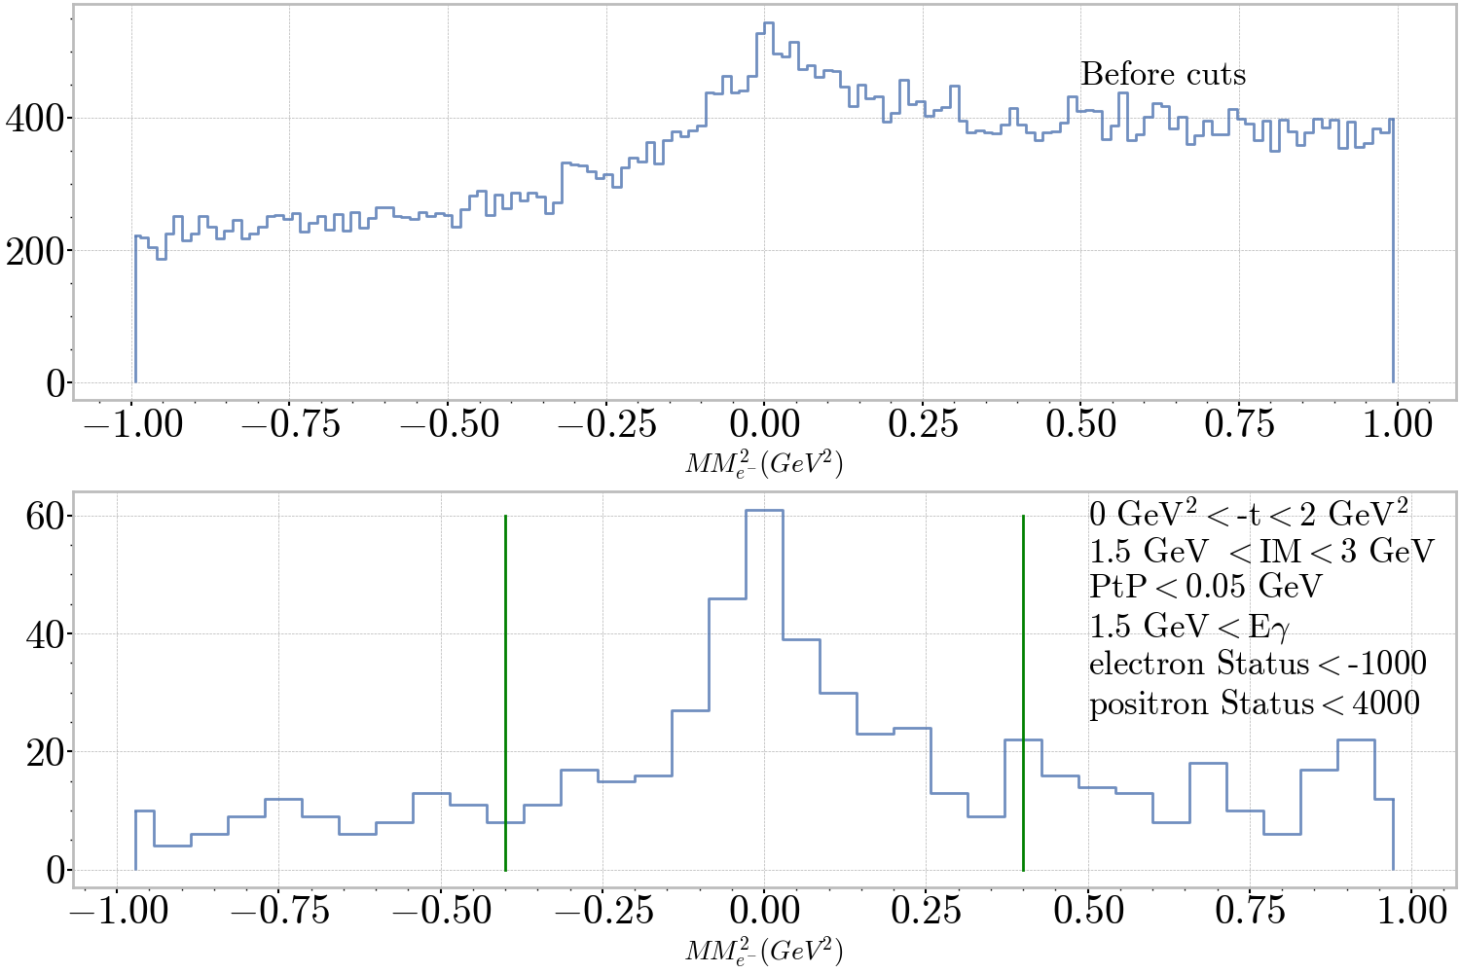
Preliminary Results: $MM_{e^{−}}^{2}$
Preliminary
$MM^{2}$ of scattered electron;
$ep→e^{′}p^{′}e^{+}e^{−}$
$ep→Xp^{′}e^{+}e^{−}$
$⇒$ $e+p−p′−e^{+}−e^{−}=X$
Large source of background after cuts attributed to $NH_{3}$ target
Cut proposed at $±0.4 GeV^{2}$
Preliminary

Slide 13
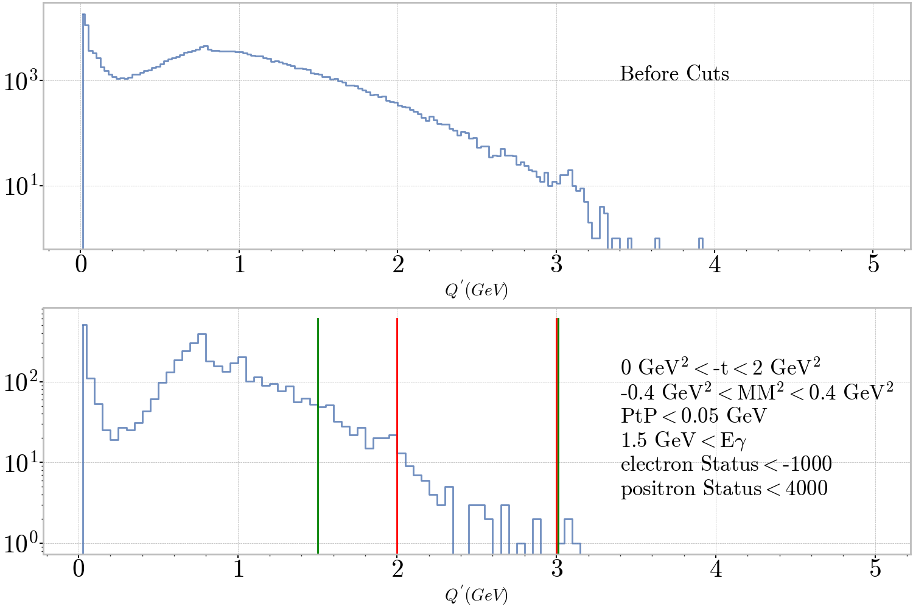
Preliminary Results: $Q′$
Q’ = Invariant Mass of decay lepton pair ($Q^{′}=e^{+}+e^{−}$)
Begin to see known meson peaks after cuts
Loose cut proposed at
$$1.5 GeV<Q^{′}<3 GeV$$
Tight cut proposed at
$$2 GeV<Q^{′}<3 GeV$$
Preliminary
$$ω,ρ$$
$$Φ$$
Preliminary
$$J/ψ$$

Slide 14
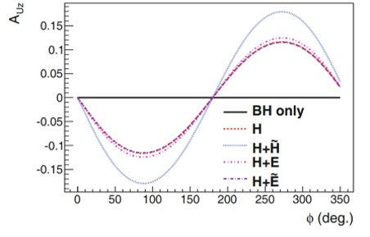
BSA and TSA – calculation procedure
$N^{\left\{ij\right\}}=$number of counts in $φ$ histogram with beam helicity $i$ and target polarization $j$
$Pt^{+}/Pt^{−}=$ Value of positive/negative target polarisation, calculated using elastic analysis (N.Pilleux)
$P_{b}=$beam polarization – taken to be 83% after averaging across Möller run measurements
$D_{f}=$ Dilution factor $≈1−\frac{C}{NH3}$
BSA
TSA
Notes:
Pb (varied 81%-83% between Moller runs but within Moller error )

Slide 15
Conclusions/Next Steps
Can see trends comparable to published TCS result at this stage, can pick out expected features in preliminary kinematic distributions.
New improvement in reconstruction included in most recent software mean that the next round of data processing is predicted to show improvements in many areas, notably reconstruction of the scattered proton.
Calibrations for this run period still in progress – these are progressing on schedule, some resolutions will be expected to improve when these are complete.
Simulation studies are the next step, before extraction of BSA and TSA observables on complete dataset.

Slide 16
REFERENCES
[1] Science Requirements and Detector Concepts for the Electron-Ion Collider: EIC Yellow Report e-Print: 2103.05419 [physics.ins-det]
[2] R. Milner, R. Ent (Jefferson Lab), C. Boebel, J McMaster (MIT), J. LaPlante: Visualising the proton. 2022 https://www.youtube.com/watch?v=e2FrALuacZ4&t=11s
[3] First Measurement of Timelike Compton Scattering. P. Chatagnon et al. (CLAS Collaboration)
Phys. Rev. Lett. 127, 262501 – Published 22 December 2021
[4] Boër, M., Guidal, M. & Vanderhaeghen, M. Timelike Compton scattering off the proton and generalized parton distributions. Eur. Phys. J. A 51, 103 (2015). https://doi.org/10.1140/epja/i2015-15103-3
[5] An aerial view of Jefferson Lab https://simple.wikipedia.org/wiki/Thomas_Jefferson_National_Accelerator_Facility#/media/File:Jlab_aerial1.jpg Accessed: 25/03/2023
[6] The CLAS12 Detector https://physics.uconn.edu/2020/09/16/ Accessed: 22/07/2022
[7] N. Pilleux RGC end of run report RG-C end of run and first look at physics (in2p3.fr) Accessed: 29/03/2023
[8] J. Brock Performances of the longitudinally polarized target for CLAS12 International workshop on CLAS12 physics and future perspectives at JLab (21-24 March 2023): Performances of the longitudinally polarized target for CLAS12 · IJCLab Events Directory (Indico) (in2p3.fr) Accessed: 29/03/2023

Slide 17
Thank you
Questions?

Slide 18
BACKUP

Slide 19
Asymmetries – Phi histograms
$0.4GeV^{2} > MM_{e^{′}}^{2} > −0.4GeV^{2}$
$3GeV>IM_{e^{+} e^{−} }> 1.5GeV$
$10.6 GeV> E_{γ}> 1.5GeV$
$0.8GeV^{2}>t{\left(p^{′}−p\right)}^{2}>0.15GeV^{2}$
Decay lepton pair in the FD
Vertex time difference between decay lepton pair (decay electron Vt – decay positron Vt) < 1ns

Slide 20
Internal Structure of Nucleons
The distribution of partons in a nucleon can be represented by three variables;
x – describes the longintudinal momentum fraction carried by the struck parton
kT – describes transverse momentum of partons
bT – describes the impact parameter
Integrating Wigner functions with respect to transverse momenta k_T(\rightarrow) gives Generalised Parton Distributions
Information on these variables can be accessed through scattering processes, using electrons as a probe to scatter off of target nucleons.
One such process is timelike compton scattering (TCS)

Slide 21
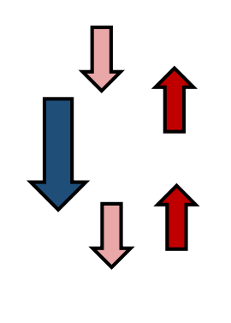
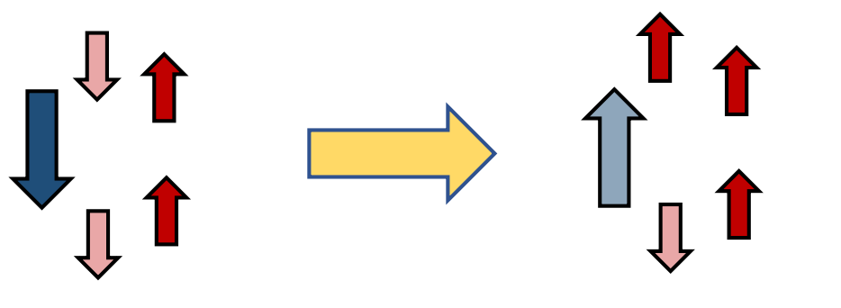
RGC Polarised target
Longitudinally polarized NH3 and ND3 targets give access to observables of interest
Target polarisation;
[7]
Notes:
Longitudinally polarized NH3 and ND3 targets give access to observables of interest
Target polarisation;
Unpaired electron spins implanted into target material and polarised under the conditions of a high magnetic field ($≈$5T provided by CLAS12 solenoid) and low temperature ($≈$ 1K liquid helium refrigerator system)
Nuclear spins at this temperature have very low polarisation -> Proton around 0.5% and deuteron about 0.1%
Electron and nuclear spin flipped by applying microwaves, electron returns rapidly to its ground state in $≈$ 100milliseconds, nucleus stays in flipped state for $≈1$hr.
Low microwave frequency electron flip transitions = positive polarisation, high frequency = negative polarisation.
The CEBAF electron beam decreases the polarization due to heating and radiation damage -> Use rastering to mitigate this. The latter also causes the optimum microwave frequency to change as dose accumulates on the sample -> Needs constant monitoring to ensure frequency remains optimised

Slide 22
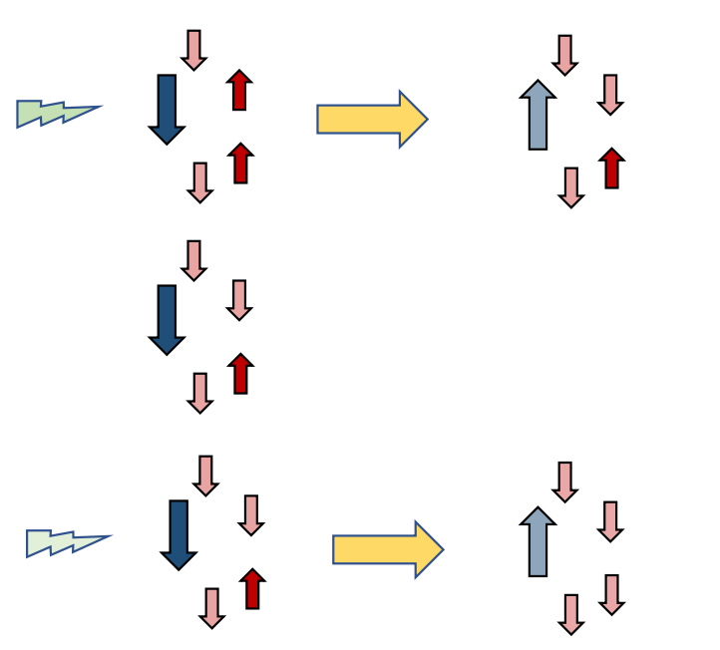
RGC Polarised target
Longitudinally polarized NH3 and ND3 targets give access to observables of interest
Target polarisation;
[7]
Notes:
Longitudinally polarized NH3 and ND3 targets give access to observables of interest
Target polarisation;
Unpaired electron spins implanted into target material and polarised under the conditions of a high magnetic field ($≈$5T provided by CLAS12 solenoid) and low temperature ($≈$ 1K liquid helium refrigerator system)
Nuclear spins at this temperature have very low polarisation -> Proton around 0.5% and deuteron about 0.1%
Electron and nuclear spin flipped by applying microwaves, electron returns rapidly to its ground state in $≈$ 100milliseconds, nucleus stays in flipped state for $≈1$hr.
Low microwave frequency electron flip transitions = positive polarisation, high frequency = negative polarisation.
The CEBAF electron beam decreases the polarization due to heating and radiation damage -> Use rastering to mitigate this. The latter also causes the optimum microwave frequency to change as dose accumulates on the sample -> Needs constant monitoring to ensure frequency remains optimised

