Slide 1
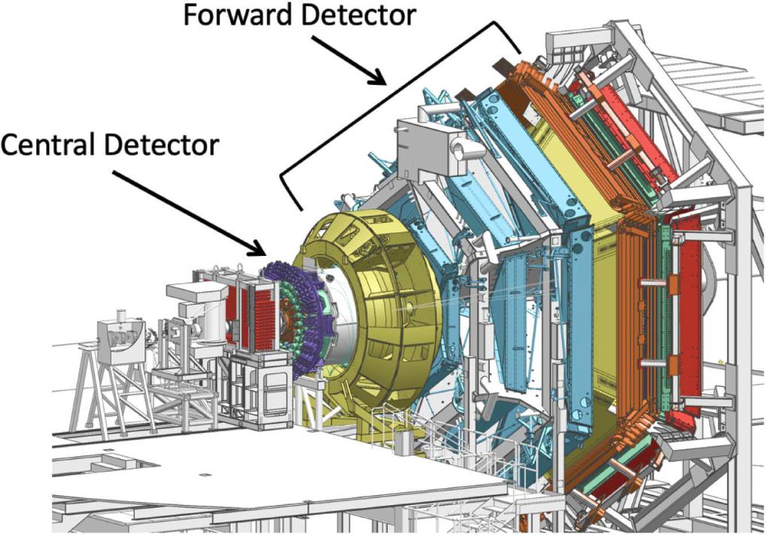

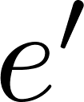



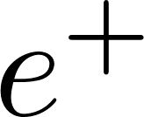
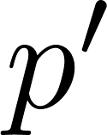
Timelike Compton Scattering and J/ψ Photoproduction (E12-12-001 and E12-12-001A)
Study exclusive lepton pair photoproduction on the proton target
𝜸p → l⁻l⁺p. l⁻l⁺ = e⁻e⁺ or 𝝁⁻𝝁⁺ .
Exclusivity is achieved through missing four momentum analysis.
Data sets:
  Fall 2018, Inbending and Outnebding: 10.6 GeV
  Spring 2019: 10.2 GeV
  Updates since the previous Jeopardy
Two PhD Theses complete: P. Chatagnon and J. Newton
One publication on TCS: Phys. Rev. Lett. 127152 (26 Dec. 2021), p. 262501
  First ever measurements of asymmetries in TCS
  Fall 2018 inbending data only.
J/psi analysis is nearly completed, expected to release analysis note by end of 2024.
Students and postdocs
P. Chatagnon and R. Tyson (JLab postdocs ), M. Tenorio Pita (ODU student)
Scattered electron escape detection, or detected in FT
Final state particles in the FD and CD (proton)

Slide 2
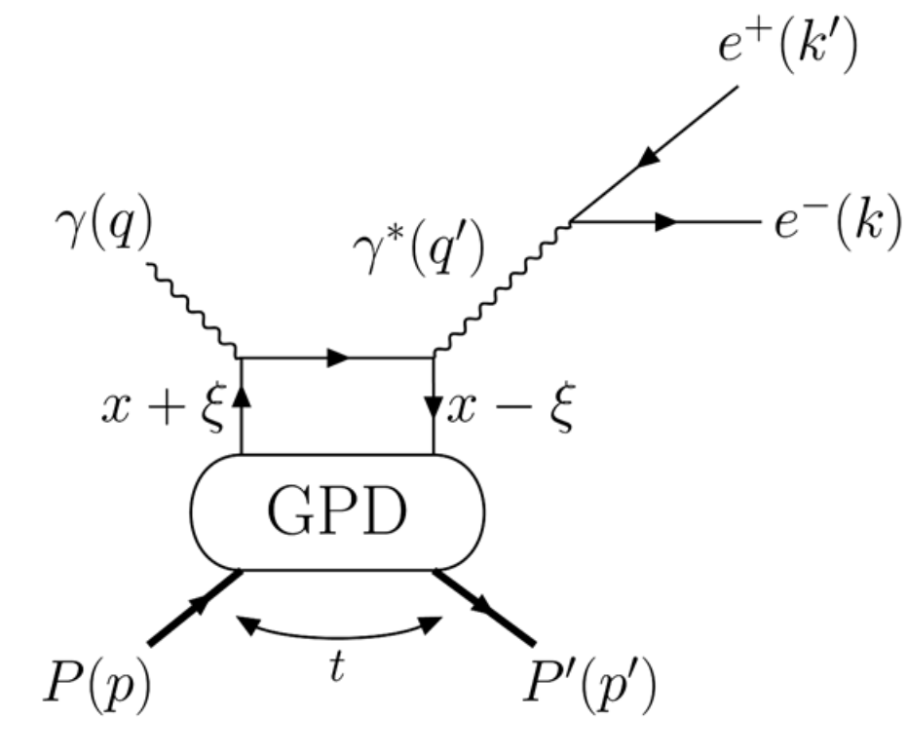
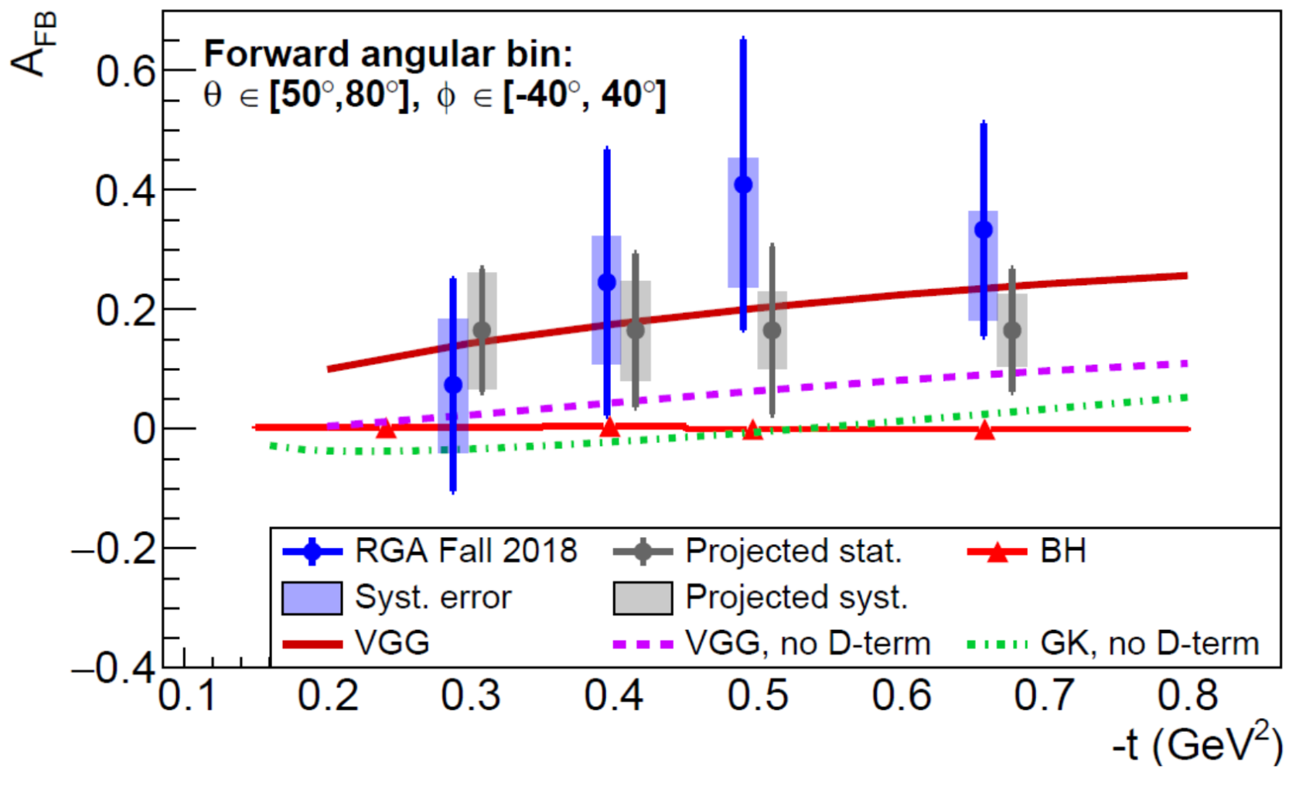
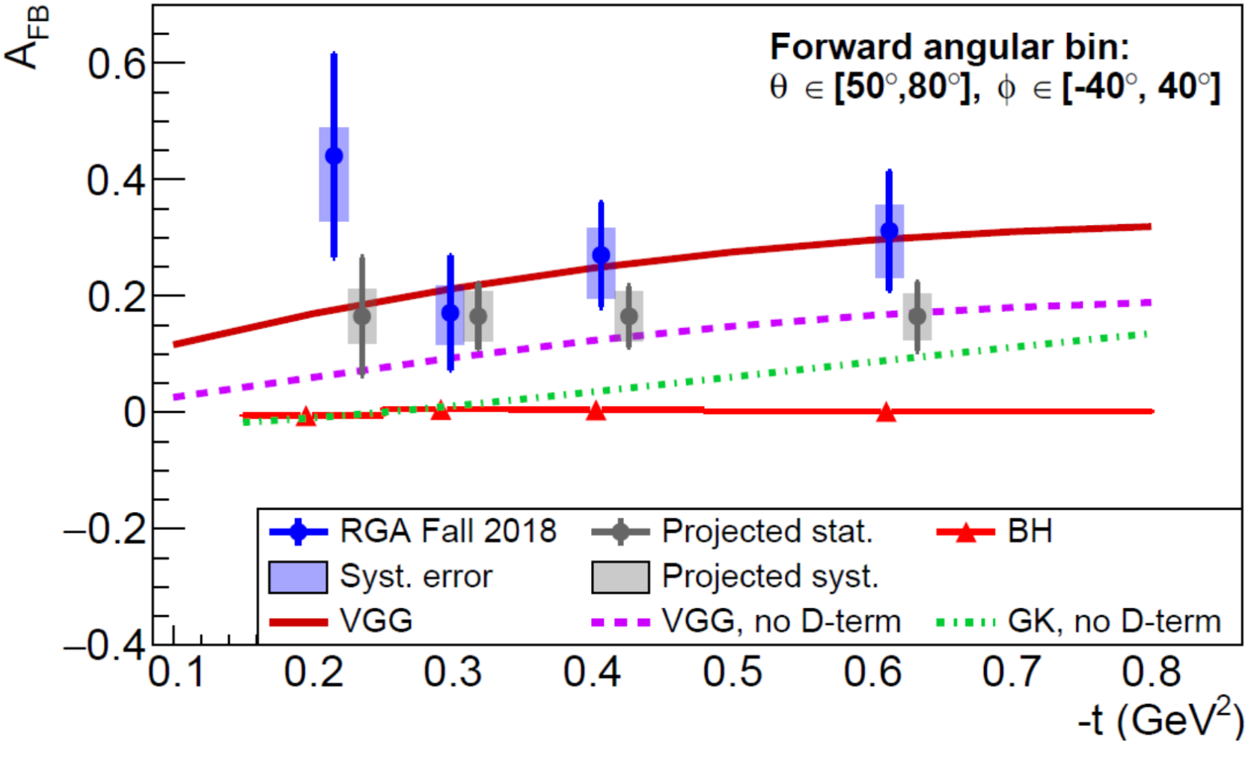
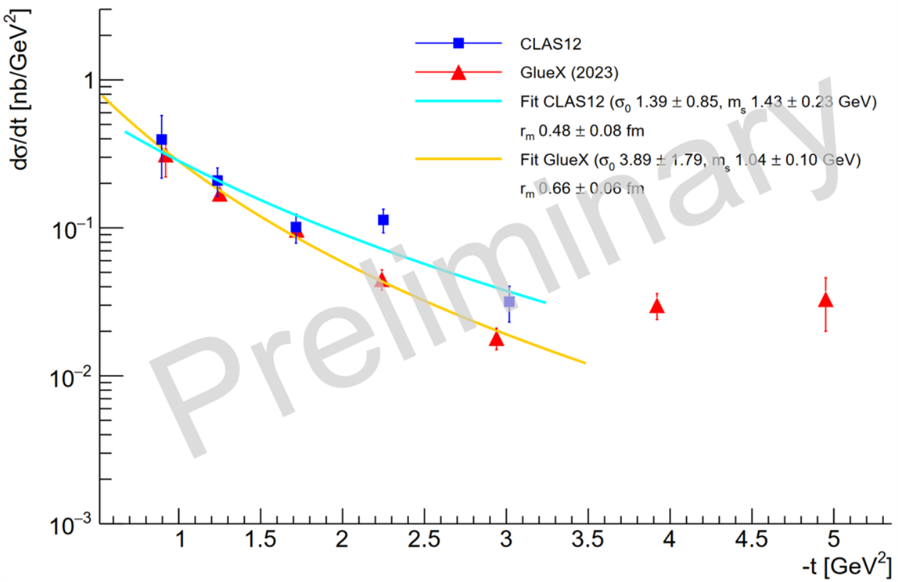
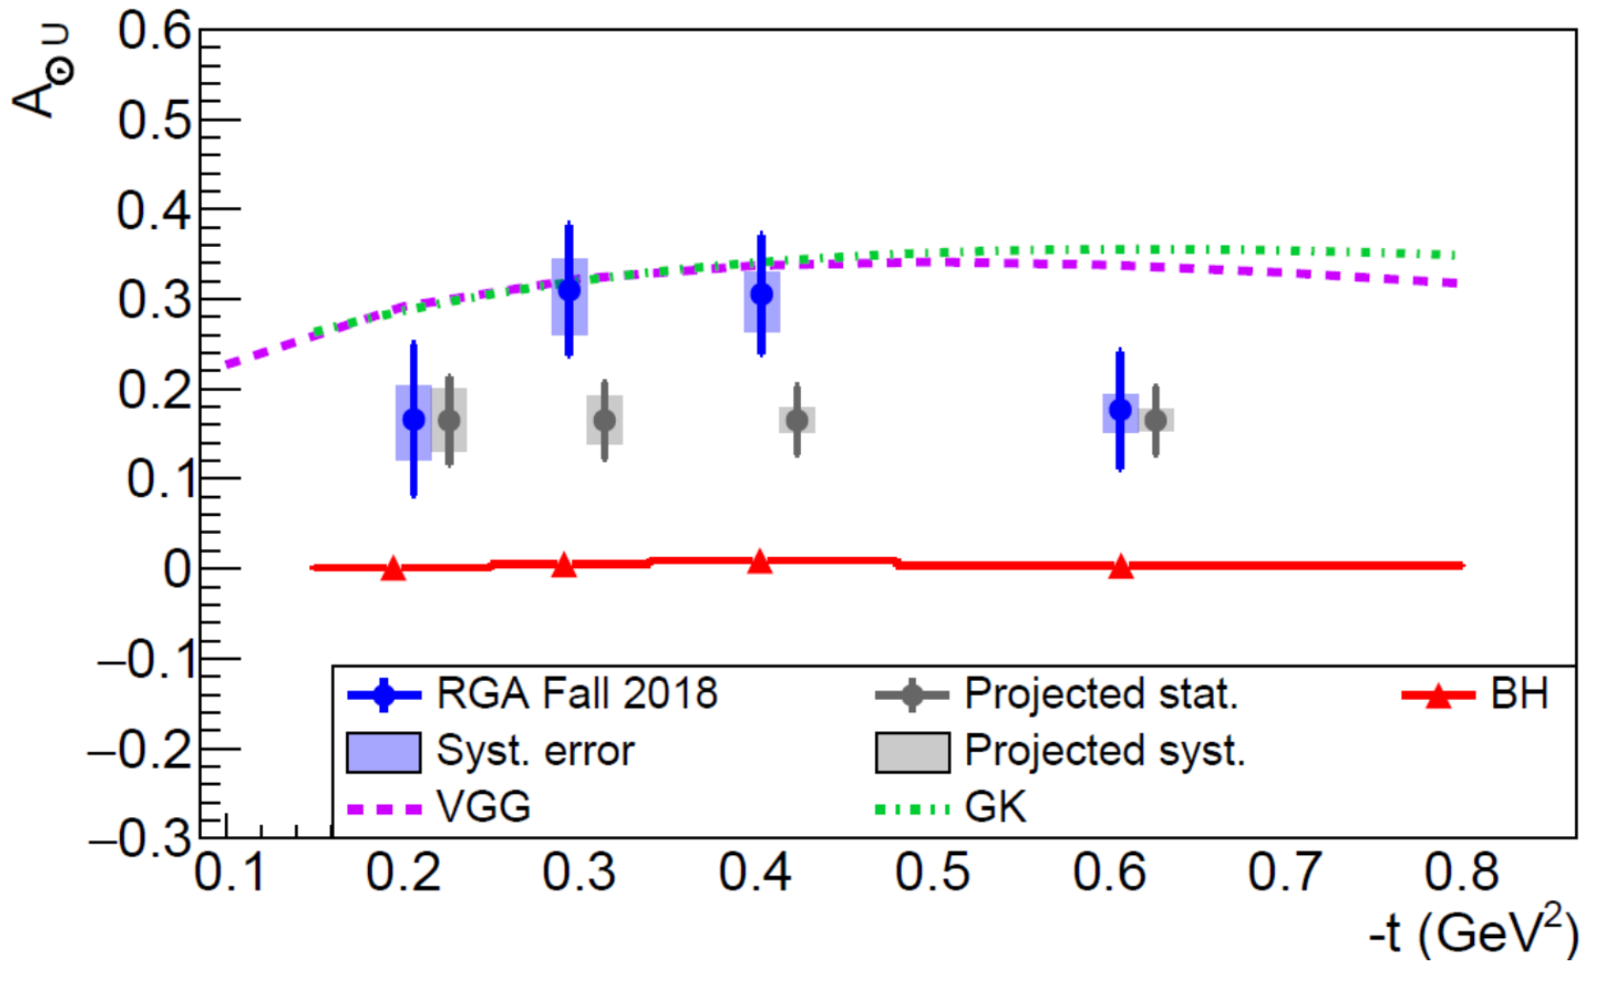
Timelike Compton Scattering and J/ψ Photoproduction (E12-12-001 and E12-12-001A)
Outgoing photon virtuality Q^{'2} sets the hard scale.
Photon polarization asymmetry measurement A_{⍟U} allows access Imaginary part of CFFs.
Forward Backward asymmetry A_{FB} allows to access Real part of CFFs.
First TCS measurement is in favor of universalities of GPDs.
TCS data is in better agreement with GPD model calculations that include D-term.
To meaningfully contribute into GPD extraction, more data bins with smaller uncertainties in Q^{'2} and s are needed.
In addition to the extraction of GPDs, a high precision A_{FB} measurements will be important inputs to currently ongoing efforts on extractions of GFFs.
E_{𝜸}=8.13 ± 1.23 GeV M=2.25 ± 0.2 GeV
E_{𝜸}=7.23 ± 1.61 GeV M=1.81 ± 0.26 GeV
The J/ψ meson photoproduction near the production threshold allows access gluon GFFs
In particular the t-dependence of the differential cross-section is sensitive to the mass radius of the proton.
Phys. Rev. D 104 (5 Sept. 2021), p. 054015
Phys. Rev. Lett. 127152 (26 Dec. 2021), p. 262501
E_{𝜸}=7.29 ± 1.55 GeV M=1.8 ± 0.26 GeV
Recently GlueX and Hall-C have released their results on near threshold production.
GlueX observed flattening behavior at high -t
At small –t CLAS12 uncertainties are comparable w/ GlueX data.
CLAS12 needs more data to verify the flattening behavior at high –t.

