Slide 1
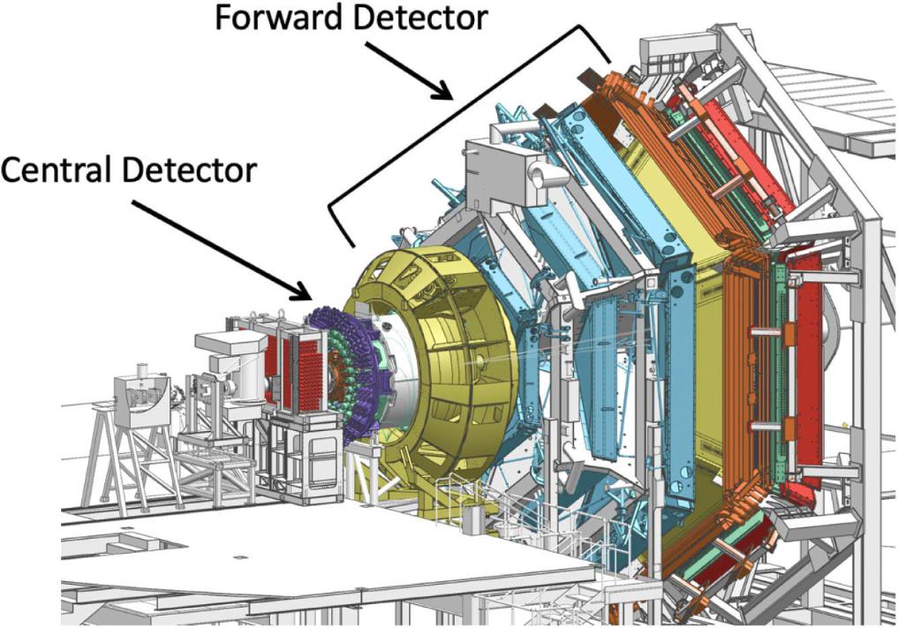





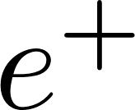

J/ψ Photoproduction (E12-11-003B)
Scattered electron escape detection, or detected in FT
Aims are to study coherent and incoherent J/ψ quasi-real photoproduction on the deuteron:
𝜸 d → J/ψ p n (incoherent production on p & n)
𝜸 d → J/ψ d (coherent production on d)
for J/ψ decaying to l⁻ l⁺ = e⁻ e⁺ or 𝝁⁻ 𝝁⁺ .
Exclusivity is achieved through missing four momentum analysis of the scattered electron.
Analysis of J/ψ photoproduction on proton and neutron is well advanced.
One Ph.D. Thesis on J/ψ photoproduction on proton and neutron.
Final state particles in the FD

Slide 2
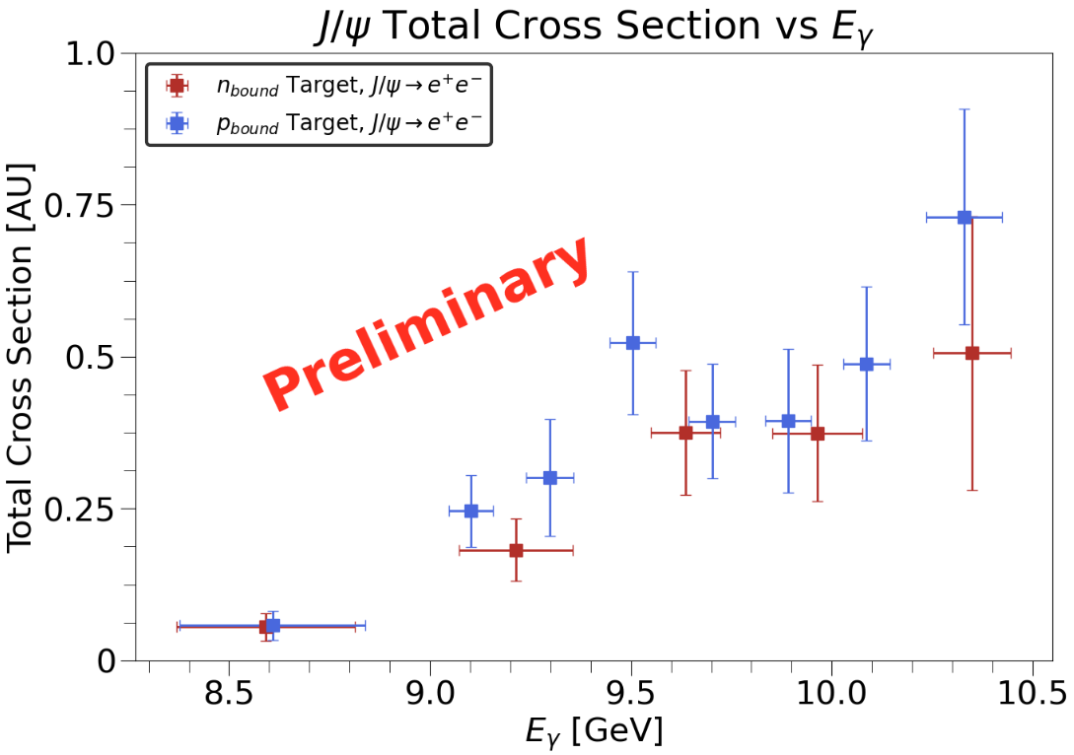
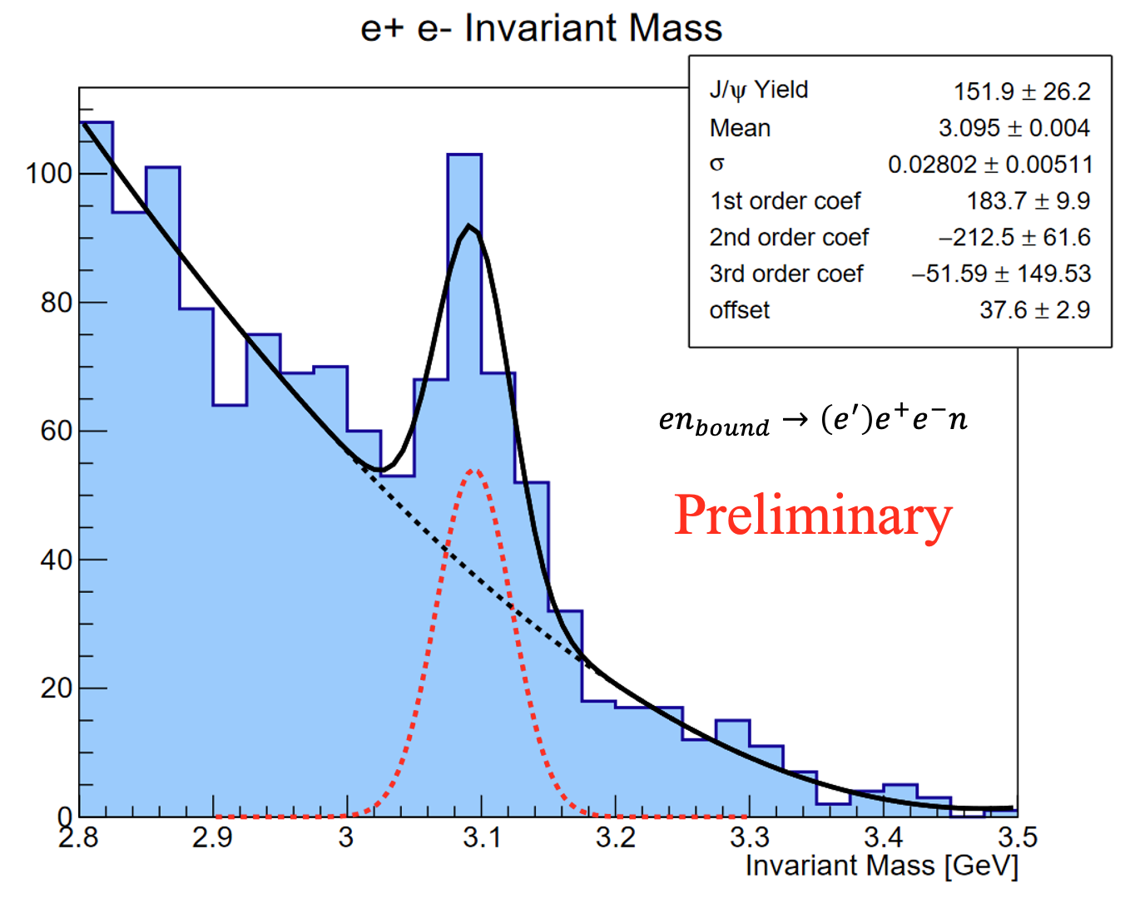
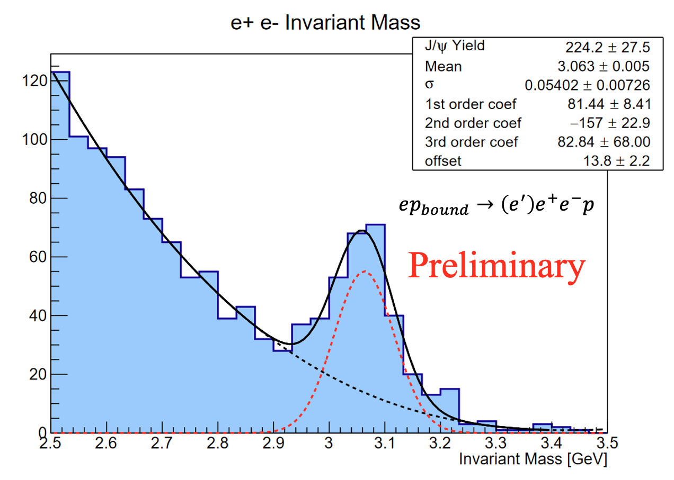
J/ψ Photoproduction (E12-11-003B)
Models based on VMD, holographic QCD and GPD frameworks relate J/ψ near-threshold photoproduction to the nucleon gravitational form factors (GFFs).
However, there are suggestions in GlueX and Hall C data that other production mechanisms may dominate the near-threshold region. This would complicate the extraction of GFFs.
First measurement of J/ψ photoproduction on neutron with RG-B can help establish isospin invariance of near-threshold production mechanism. Could also lead to estimate of neutron GFFs.
Results in AU as normalization is in progress.
Only using spring 2019 data (21.7 PAC days):
  ~ 56 % of collected beam time
  ~ 24% of allocated beam time

