Slide 1
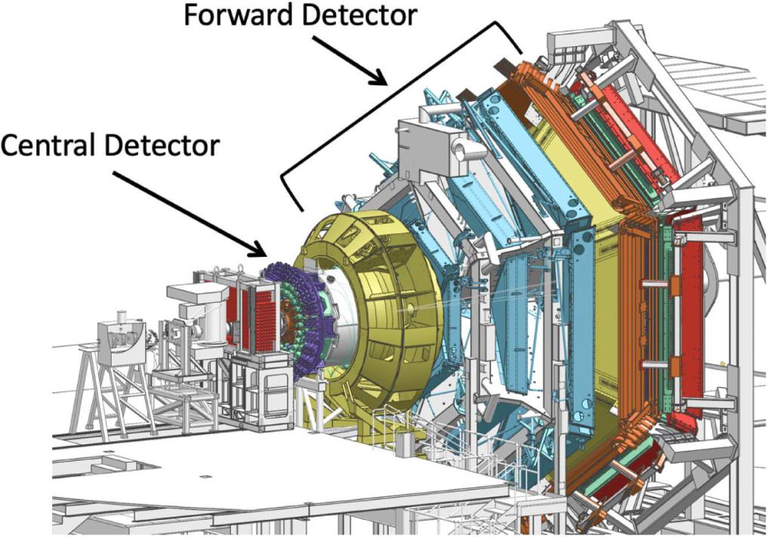

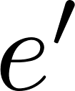



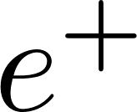
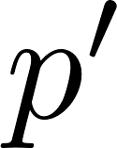
J/ψ Photoproduction (E12-11-003B)
The aim is to study coherent and incoherent J/ψ quasi-real photoproduction on the deuteron:
𝜸 N → J/ψ N’ (N=p,n incoherent production on p & n)
𝜸 d → J/ψ d’ (coherent production on d)
for J/ψ decaying to l⁻ l⁺ = e⁻ e⁺ or 𝝁⁻ 𝝁⁺ .
Exclusivity is achieved through missing four momentum analysis of the scattered electron.
Analysis of J/ψ photoproduction on proton and neutron is well advanced.
One Ph.D. Thesis on J/ψ photoproduction on proton and neutron (R. Tyson, Uni. of Glasgow).
Scattered electron goes undetected
,n,d
,n’,d’
Final state particles in the FD

Slide 2
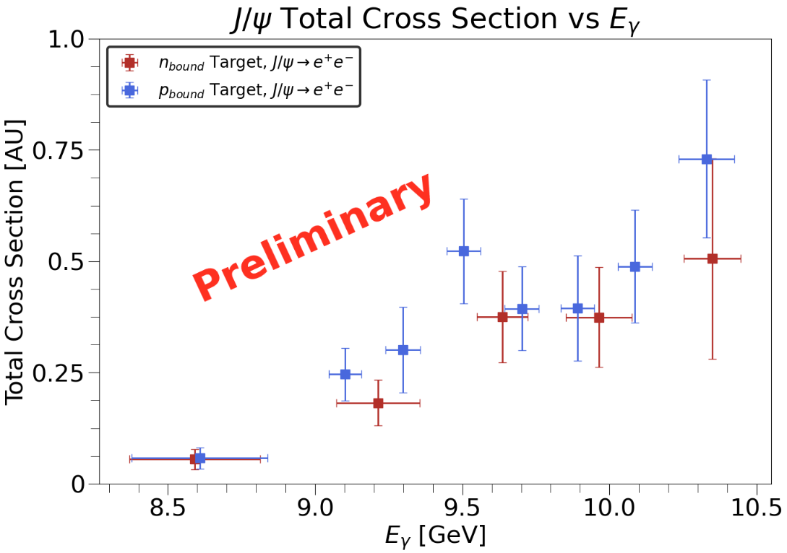
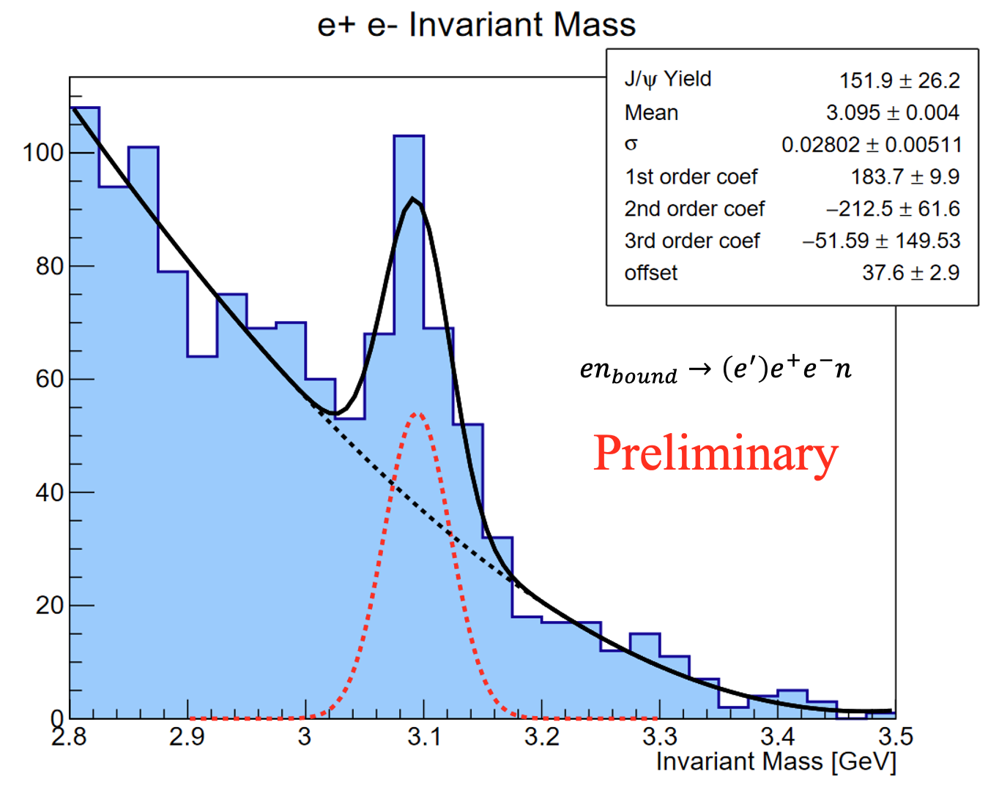
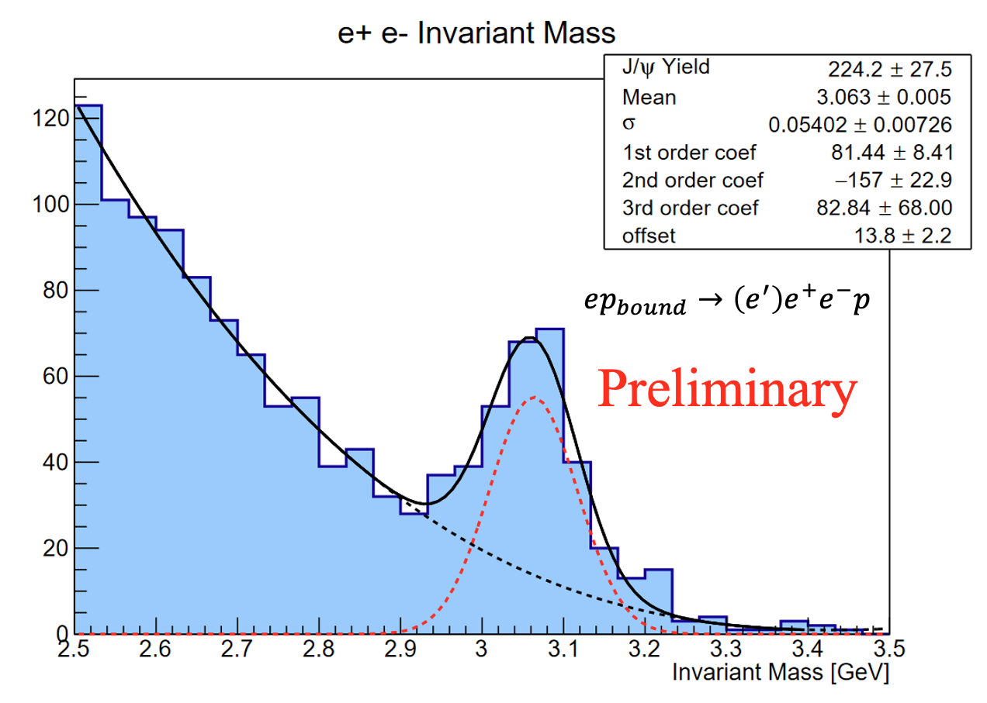
J/ψ Photoproduction (E12-11-003B)
Models based on VMD, holographic QCD and GPD frameworks relate J/ψ near-threshold photoproduction to the nucleon gluonic gravitational form factors (gGFFs).
( D. Kharzeev, Phys. Rev. D 104 054015 (2021),
Y. Hatta, D.-L. Yang, Phys. Rev. D 98 074003 (2018)
Y. Guo, X. Ji, Y. Liu, Phys. Rev. D 103, 096010 (2021) ).
There is some disagreement within the theoretical community on the validity of estimating the gGFFs from J/ψ photoproduction. There are also suggestions in GlueX data that other production mechanisms may dominate the near-threshold region.
( L. Tang, Y.-X. Yang, Z.-F. Cui, C. D. Roberts arXiv:2405.17675
M.-L. Du, V. Baru, F.-K. Guo, C. Hanhart, U.-G. Meißner, A. Nefediev, I.Strakovsky, Eur. Phys. J. C 80 1053 (2020)
D. Winney, et. al. (JPAC), Phys. Rev. D 108, 054018 (2023) ).
A first measurement of J/ψ photoproduction on the neutron with RG-B data can help establish the isospin invariance of the near-threshold production mechanism. This could also lead to estimates of the neutron gGFFs.
Higher precision data is needed to clarify the validity of relating J/ψ photoproduction to the gGFFs.
Results in AU as normalization is in progress.
Only using spring 2019 data (21.7 PAC days):
  ~ 56 % of collected beam time
  ~ 24% of allocated beam time

