Slide 1
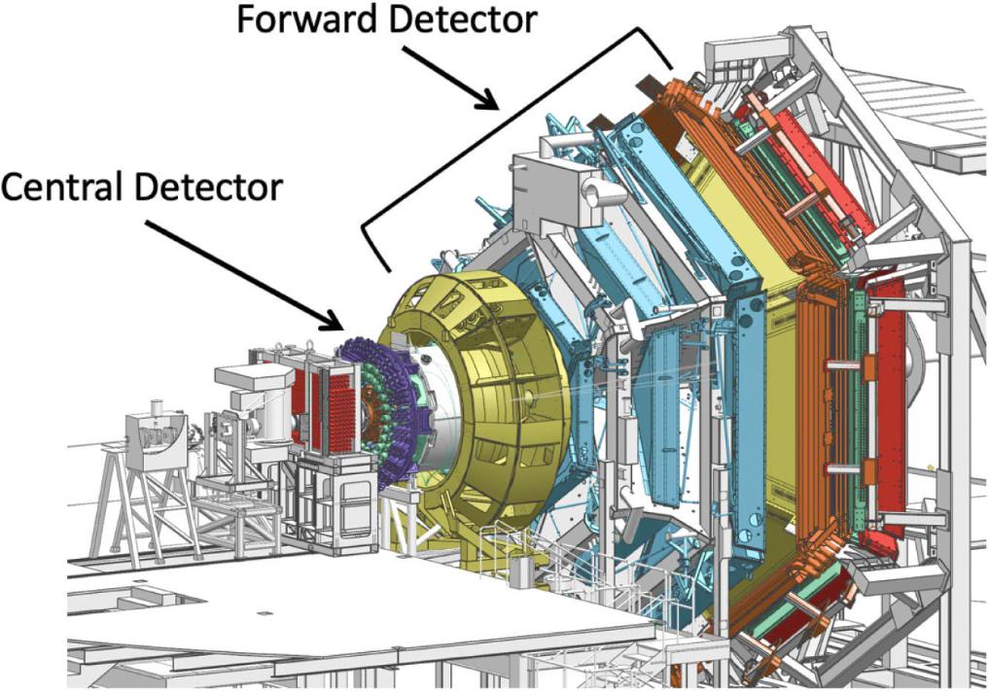

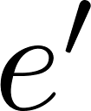



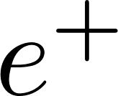
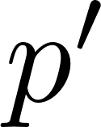
J/ψ Photoproduction (E12-11-003B)
The aim is to study coherent and incoherent J/ψ quasi-real photoproduction on the deuteron:
𝜸 N → J/ψ N’ (N=p,n incoherent production on p & n)
𝜸 d → J/ψ d’ (coherent production on d)
for J/ψ decaying to l⁻ l⁺ = e⁻ e⁺ or 𝝁⁻ 𝝁⁺ .
Exclusivity is achieved through missing four momentum analysis of the scattered electron.
Analysis of J/ψ photoproduction on proton and neutron is well advanced.
One Ph.D. Thesis on J/ψ photoproduction on proton and neutron (R. Tyson, Uni. of Glasgow).
Scattered electron goes undetected
,n,d
,n’,d’
Final state particles in the FD

Slide 2
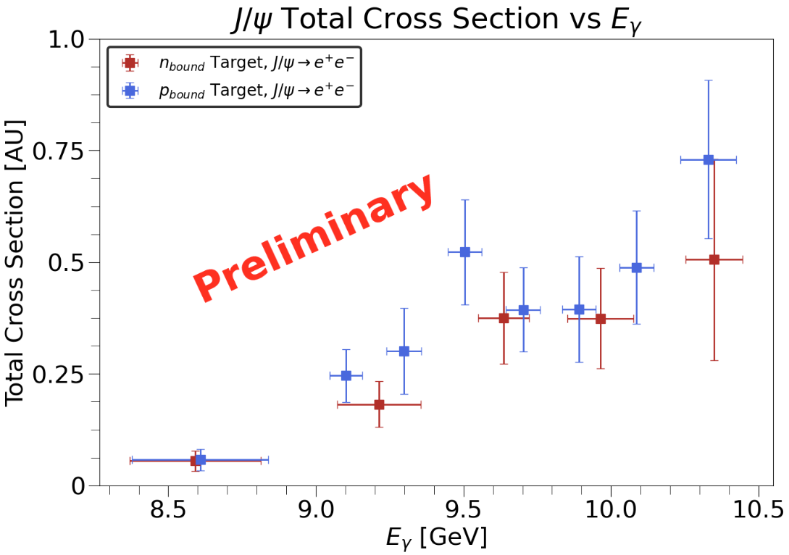
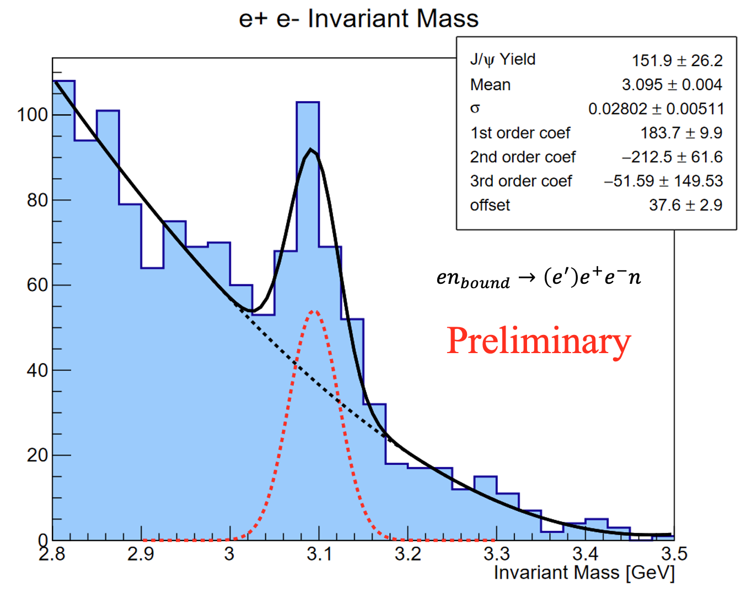
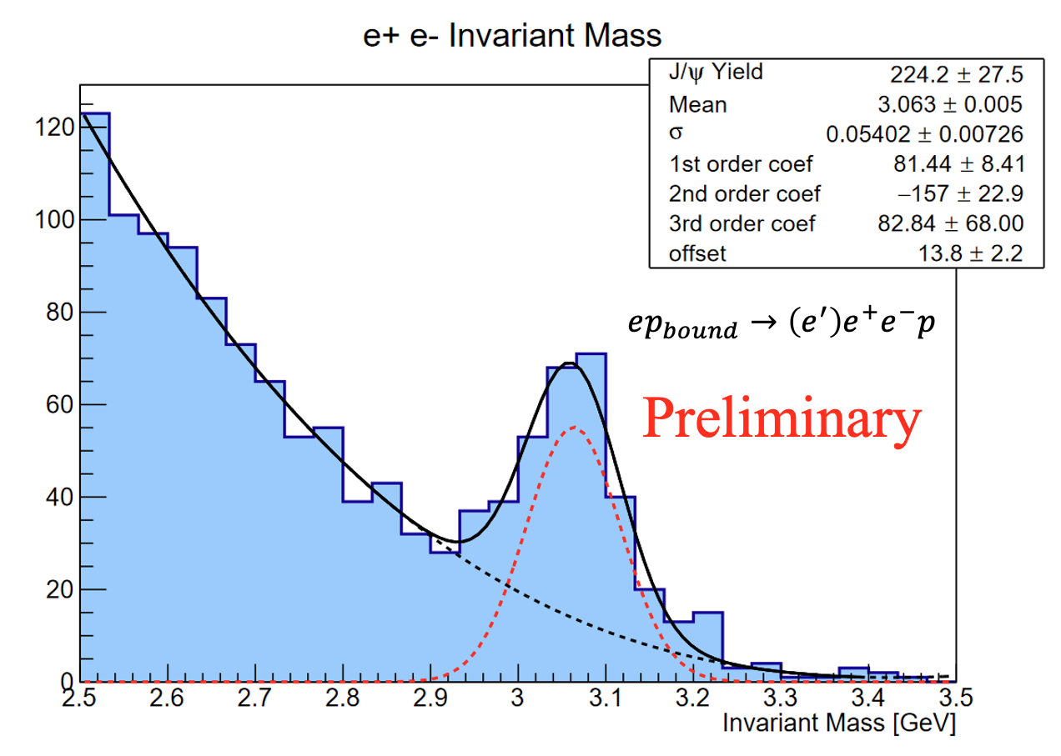
J/ψ Photoproduction (E12-11-003B)
Models based on VMD, holographic QCD and GPD frameworks relate J/ψ near-threshold photoproduction to the nucleon gluonic gravitational form factors (gGFFs) [1-3].
There is some disagreement within the theoretical community on the validity of estimating the gGFFs from J/ψ photoproduction. There are also suggestions in GlueX data that other production mechanisms may dominate the near-threshold region [4-6].
A first measurement of J/ψ photoproduction on the neutron with RG-B data can help establish the isospin invariance of the near-threshold production mechanism. This could also lead to estimates of the neutron gGFFs.
Higher precision data is needed to clarify the validity of relating J/ψ photoproduction to the gGFFs [4-6].
Results in AU as normalization is in progress.
Only using spring 2019 data (21.7 PAC days):
  ~ 56 % of collected data
  ~ 24% of allocated beam time
[1] D. Kharzeev, Phys. Rev. D 104 054015 (2021),
[2] Y. Hatta, D.-L. Yang, Phys. Rev. D 98 074003 (2018)
[3] Y. Guo, X. Ji, Y. Liu, Phys. Rev. D 103, 096010 (2021)
[4] L. Tang, Y.-X. Yang, Z.-F. Cui, C. D. Roberts arXiv:2405.17675
[5] M.-L. Du, et. al. , Eur. Phys. J. C 80 1053 (2020)
[6] D. Winney, et. al. (JPAC), Phys. Rev. D 108, 054018 (2023)

