Slide 1
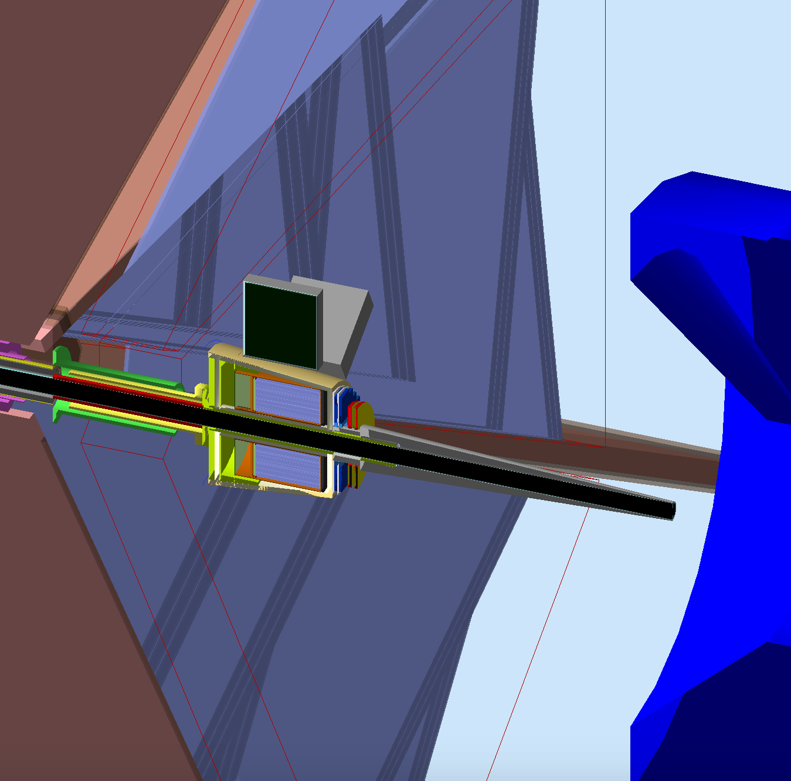
FT Moller shield design
The Moller Shield for operation with the Forward Tagger was designed studying the transverse size of the beam halo as a function of the distance from the target
Assumptions:
The shield is shaped as a truncated cone, pointing to to the CLAS12 center
The shield is made of a single material, i.e. tungsten
To maximize the FT acceptance, the cone angle should be as low as possible compatibly with the CLAS12 and FT operation at L=10³⁵ cm⁻²s⁻¹
The z coordinate of cone entrance face should be chosen to minimize background on the FT and CLAS12

Slide 2
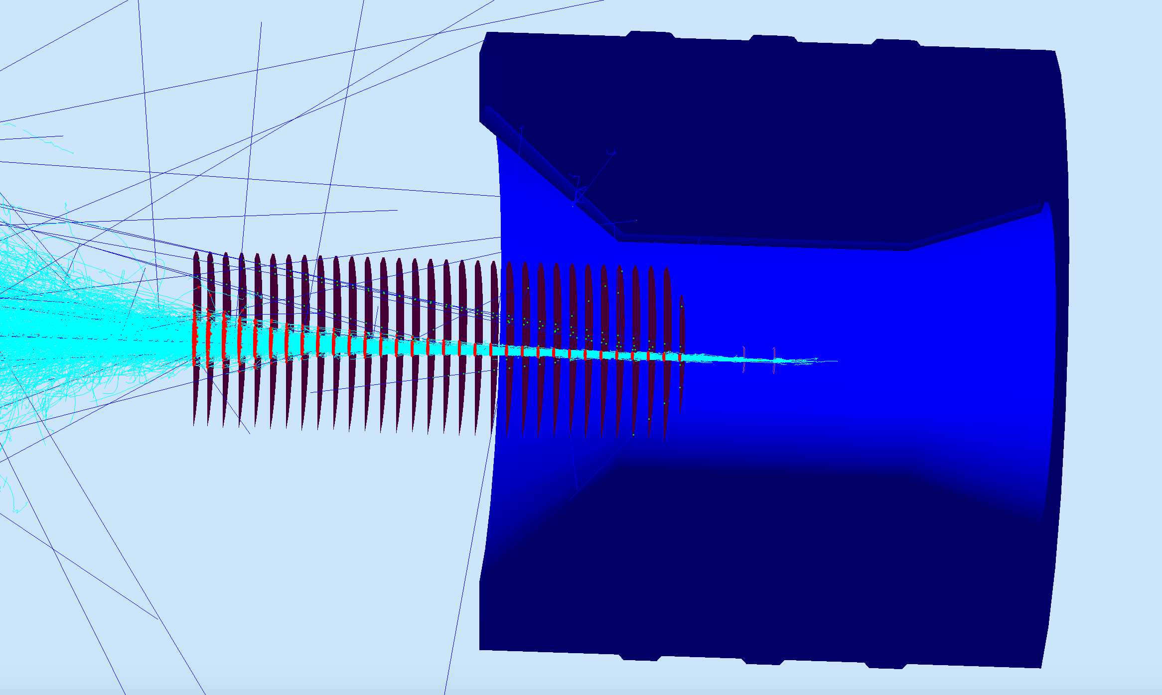
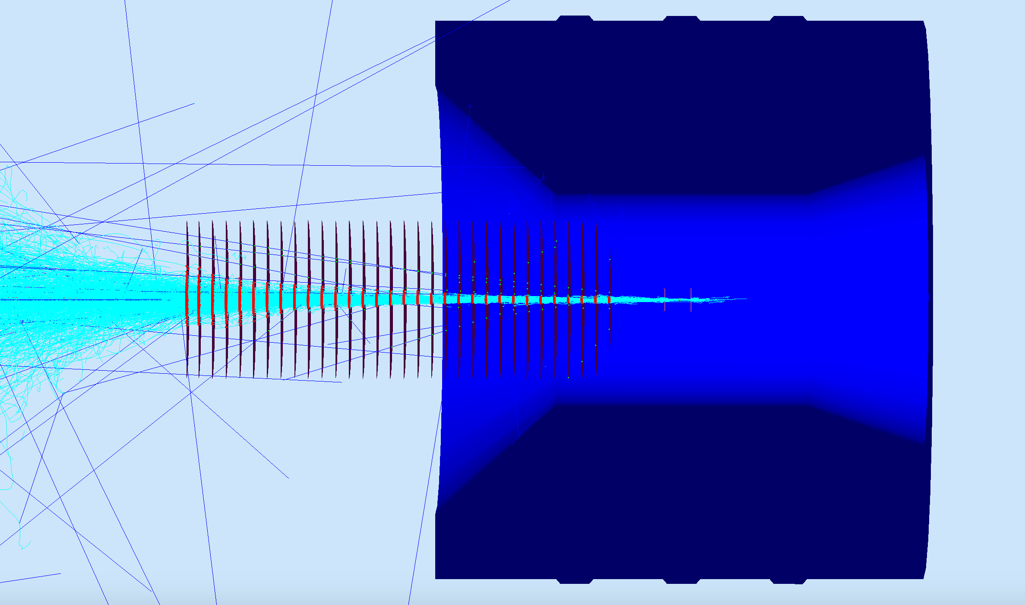
Beam Halo Size
The transverse size of the beam halo (“moller sausage”) was studied in GEMC, using “flux” detectors to sample the beam spot at different positions in z
GEMC configuration:
Solenoid field at nominal (max) intensity
Air in the Hall
“flux” detectors

Slide 3
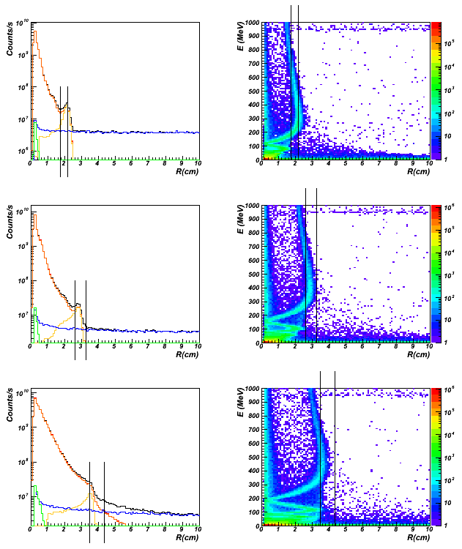
Beam Halo
The moller spot is always larger than the size of a 2 deg cone
A 2.5 deg. cone can contain most of the background
Optimal z of the cone entrance is at 75 cm from the target
z=50 cm
z=75 cm
All particles
Electrons
Moller electrons
Moller electrons E>200 MeV
Photons
Others
The lines indicate the size of a cone with 2 deg. and 2.5 deg. aperture
z=100 cm

Slide 4
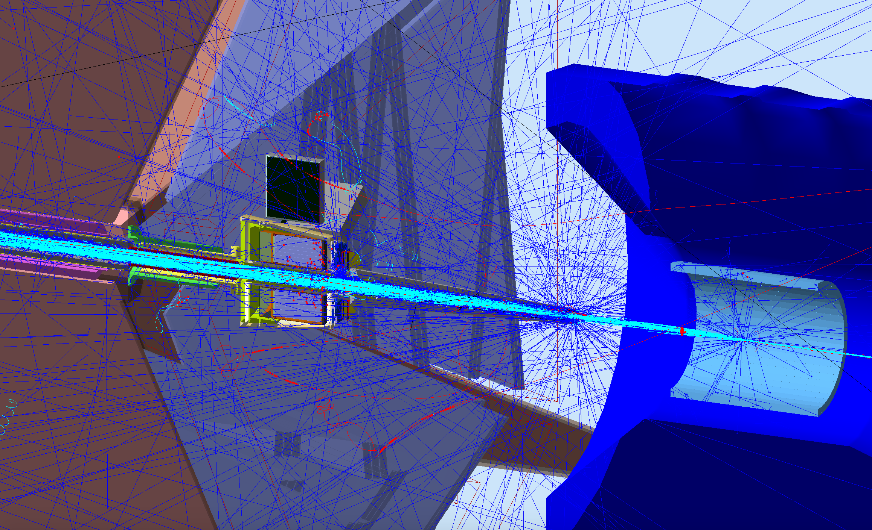
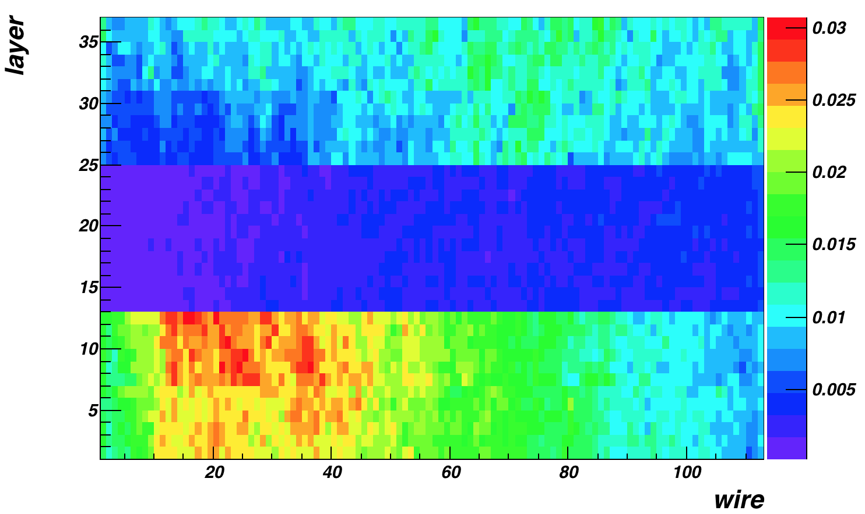
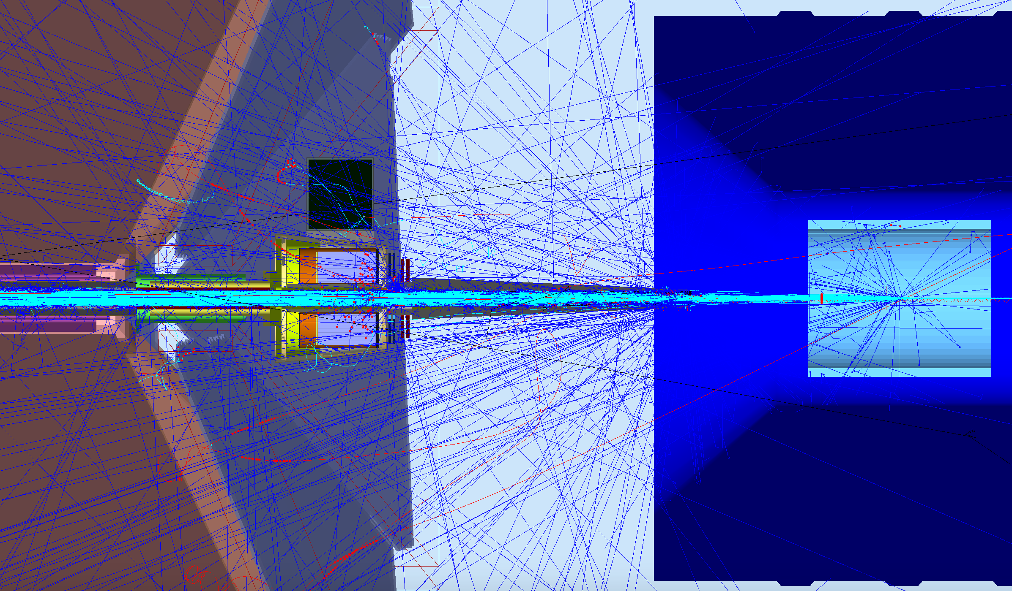
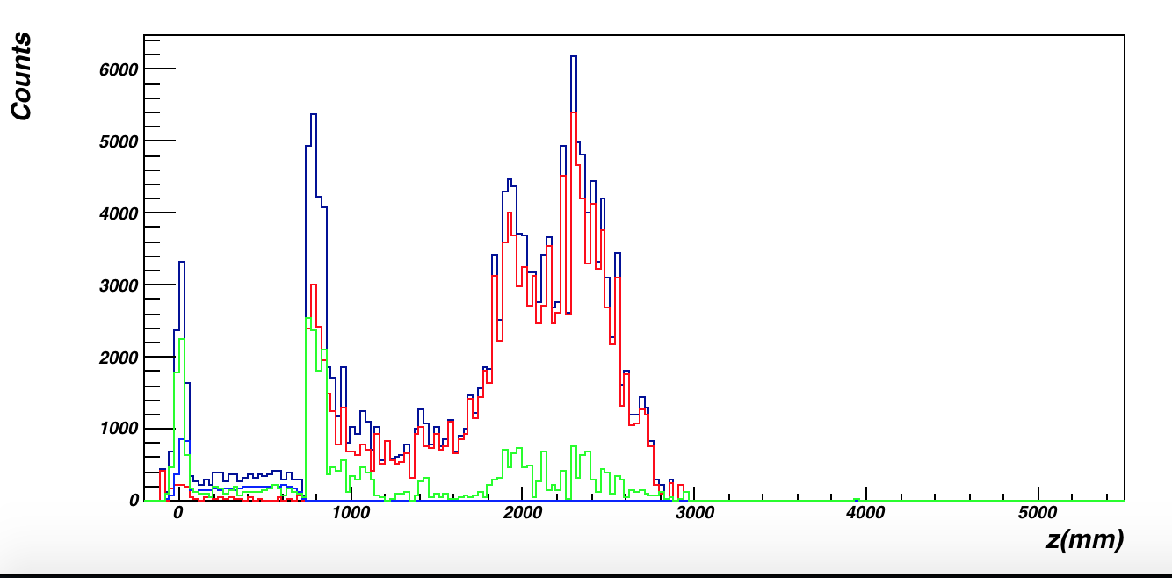
Final Configuration
DC occupancy
R1 background origin

Slide 5
Configurations Studied (So far)
No FT Original Design, corrected. It’s the “Baseline”.
No FT. Lead in place of FT.
FT Not Operational, as shielding. Lead in front of FT Cone
FT Configuration
FT Cone

Slide 6
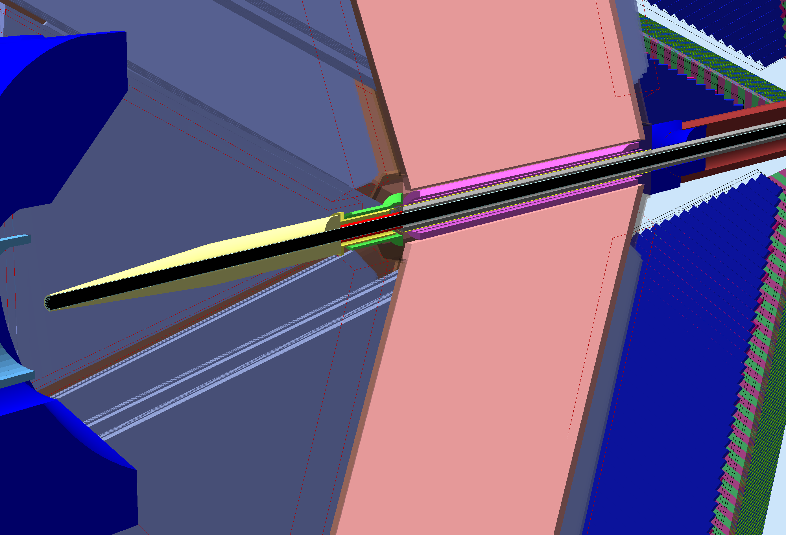
New (Corrected) Baseline
Realistic (Straight) beamline pipe
Mount to torus
Downstream shield in installed position
Nose to downstream shield
Tungsten Shield around beampipe inside torus
Torus Warm Bore
Torus Warm Bore Shield
Torus Cold Hub

Slide 7
New (Corrected) Baseline
Realistic (Straight) beamline pipe
Mount to torus
Downstream shield in installed position
Nose to downstream shield
Tungsten Shield around beampipe inside torus
Torus Warm Bore
Torus Warm Bore Shield
Torus Cold Hub

Slide 8
New (Corrected) Baseline
Realistic (Straight) beamline pipe
Mount to torus
Downstream shield in installed position
Nose to downstream shield
Tungsten Shield around beampipe inside torus
Torus Warm Bore
Torus Warm Bore Shield
Torus Cold Hub

Slide 9
New (Corrected) Baseline
Realistic (Straight) beamline pipe
Mount to torus
Downstream shield in installed position
Nose to downstream shield
Tungsten Shield around beampipe inside torus
Torus Warm Bore
Torus Warm Bore Shield
Torus Cold Hub

Slide 10
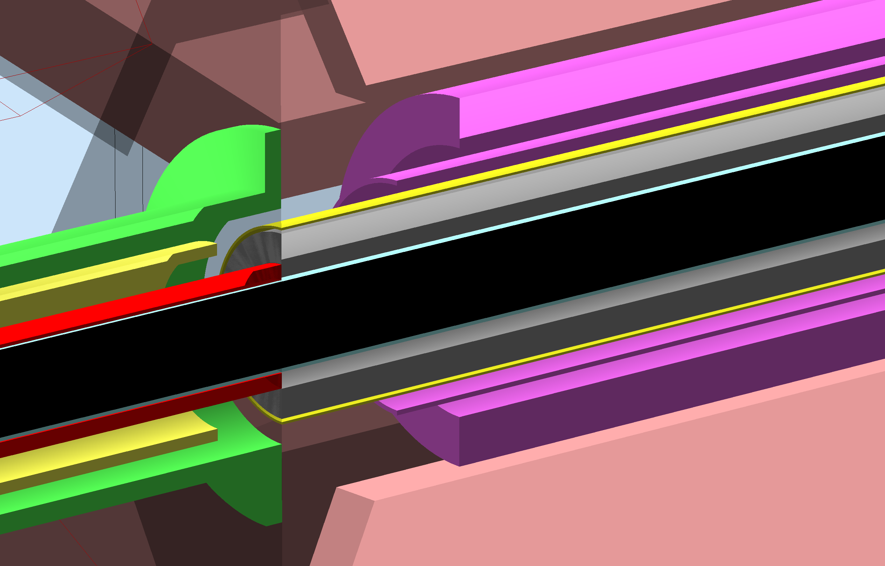
New (Corrected) Baseline
Realistic (Straight) beamline pipe
Mount to torus
Downstream shield in installed position
Nose to downstream shield
Tungsten Shield around Al beampipe inside torus, 2cm, 12 cm OD
Torus Warm Bore
Torus Warm Bore Shield
Torus Cold Hub
Also: torus vacuum jacket, plates, coils box and coils

Slide 11
New (Corrected) Baseline
90 mm at z=1390mm: 3.7º
Torus Start: z=2753mm
Mount Start: z=2270mm
30mm at z=420mm: 4º

Slide 12
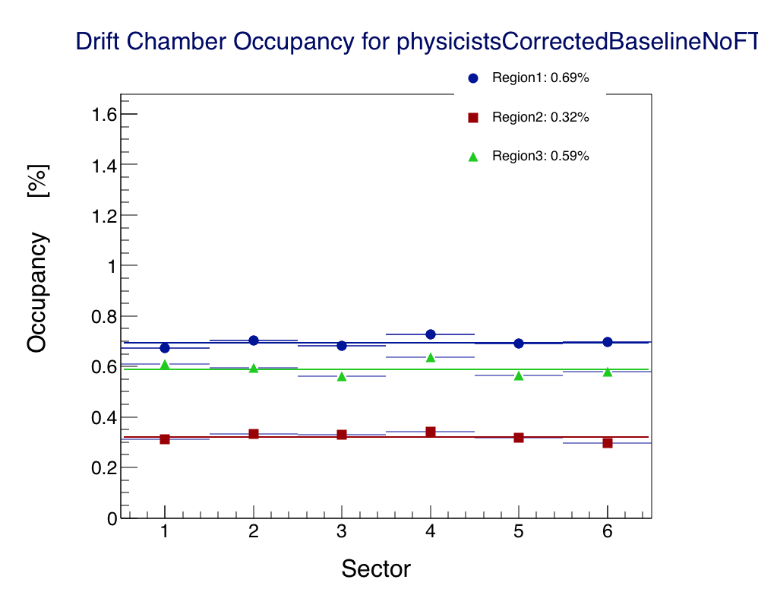
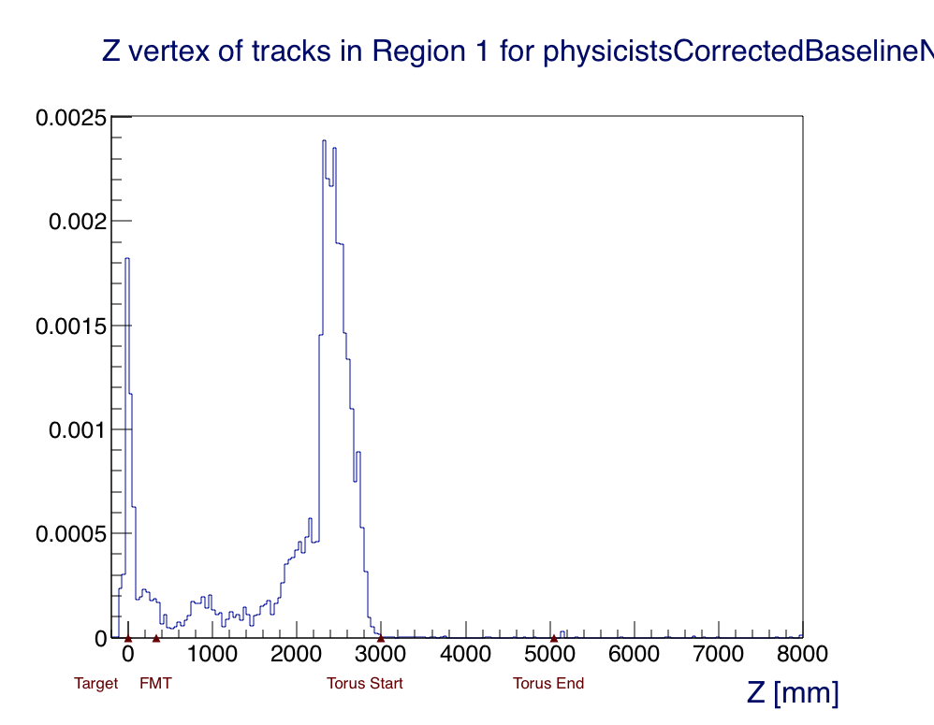
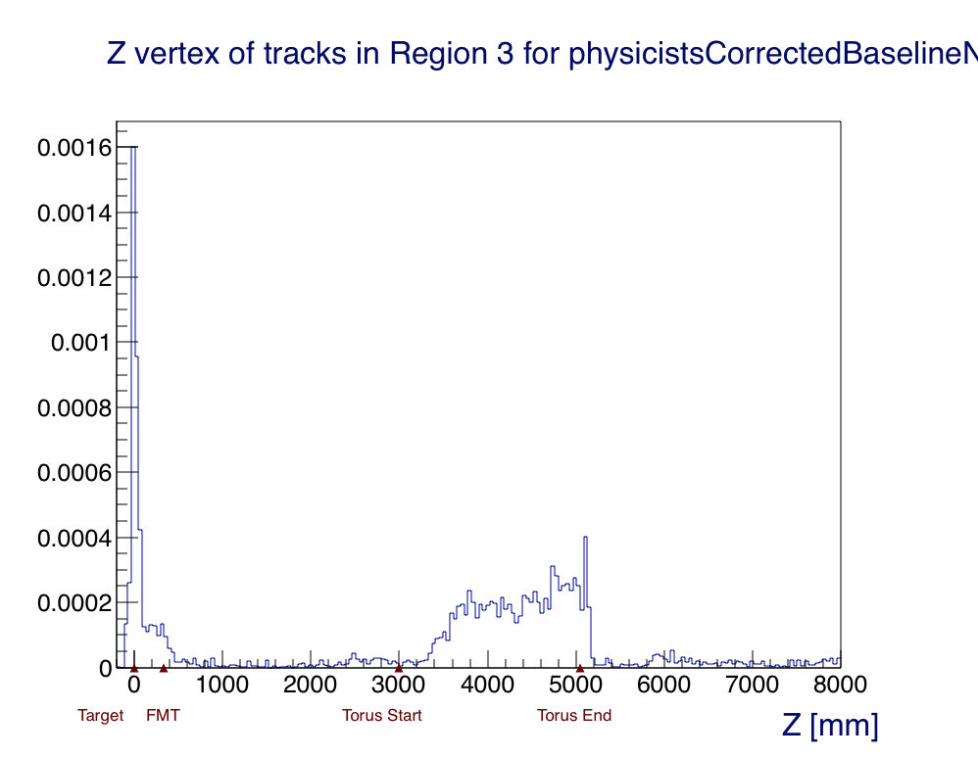
New (Corrected) Baseline
R1 Background Source
R3 Background Source

Slide 13
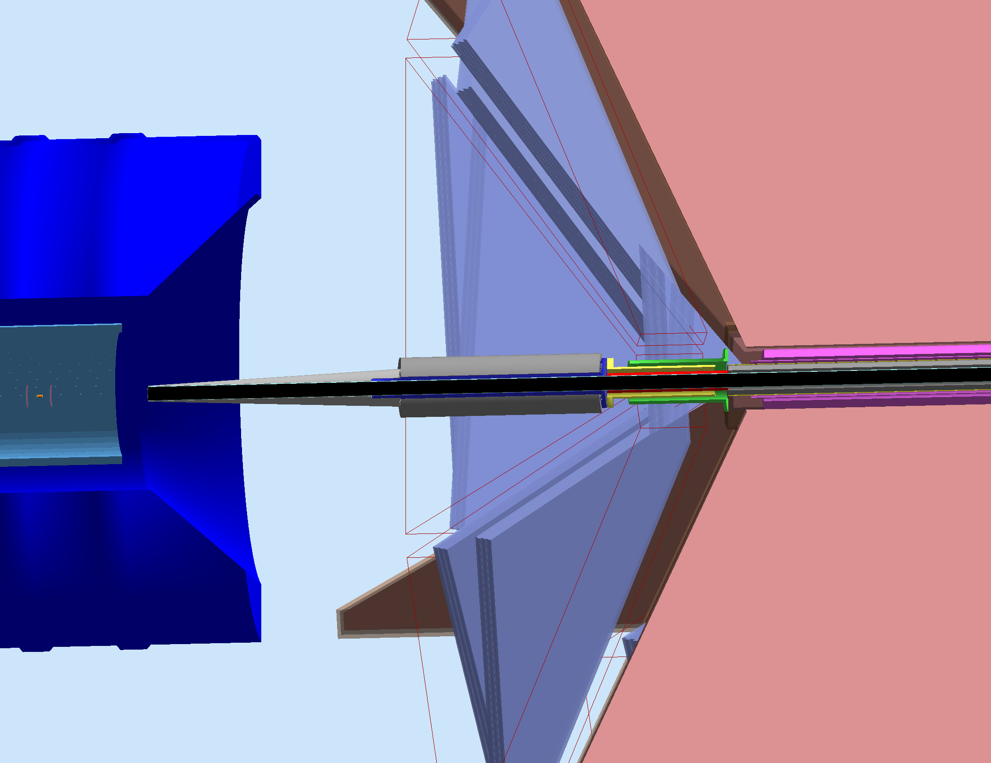
FT Cone. No FT. Lead in place of FT.
FT Cone moved upstream
Lead Shielding instead of FT
Same Mount
Same configuration downstream

Slide 14
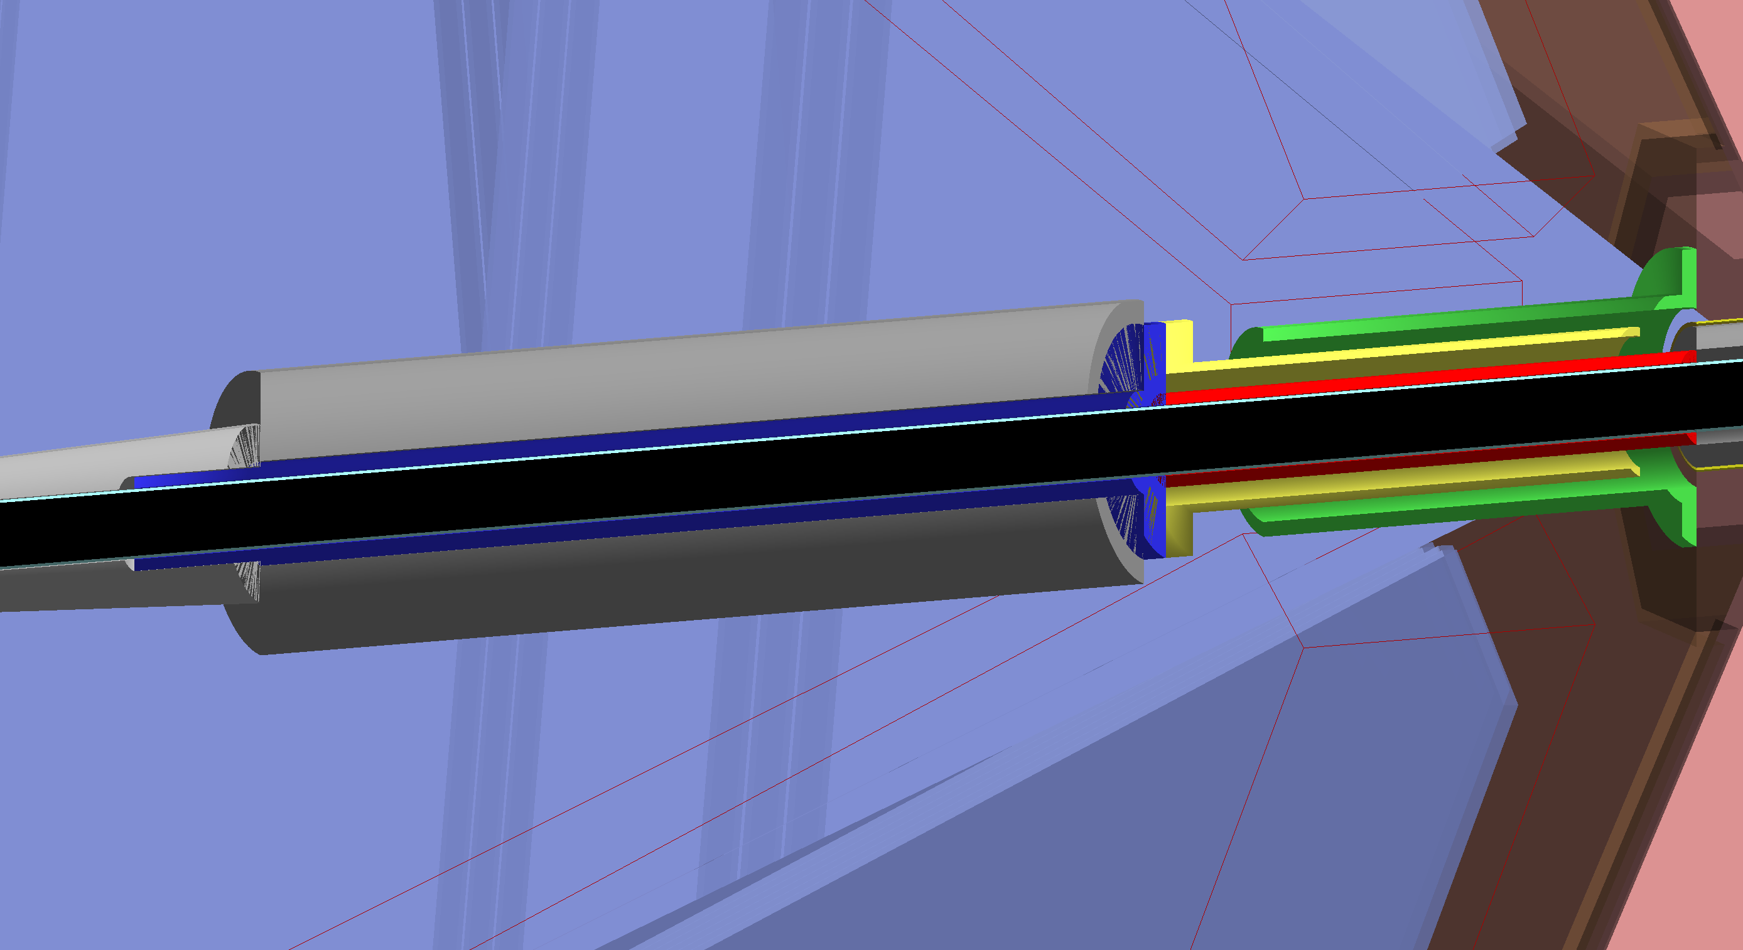
FT Cone. No FT. Lead in place of FT.
R=120 at z=1444mm: 4.75º
Torus Start: z=2753mm
Mount Start: z=2270mm
SST Support inside tube and cone

Slide 15
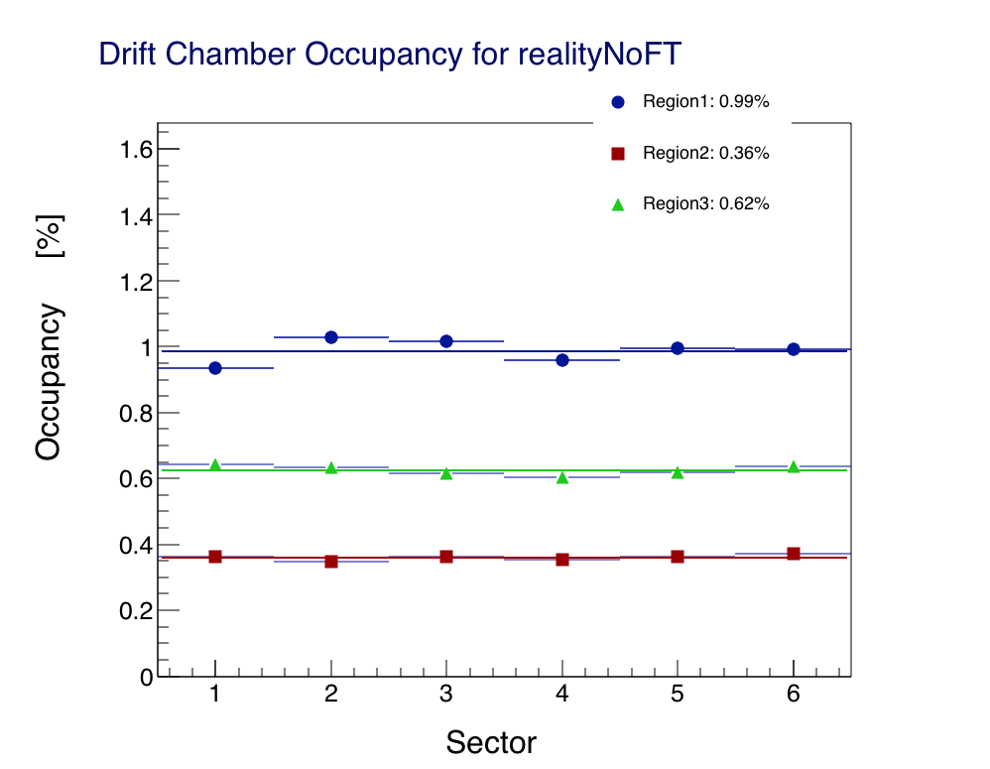
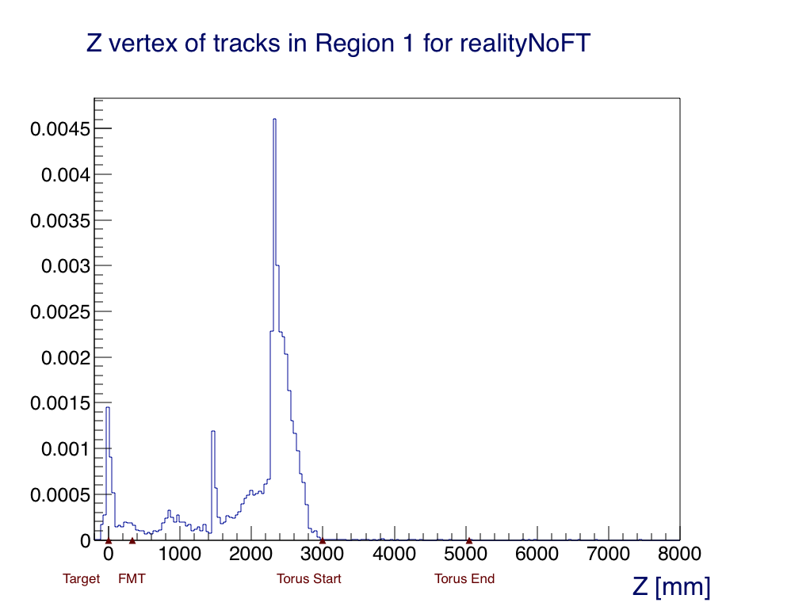
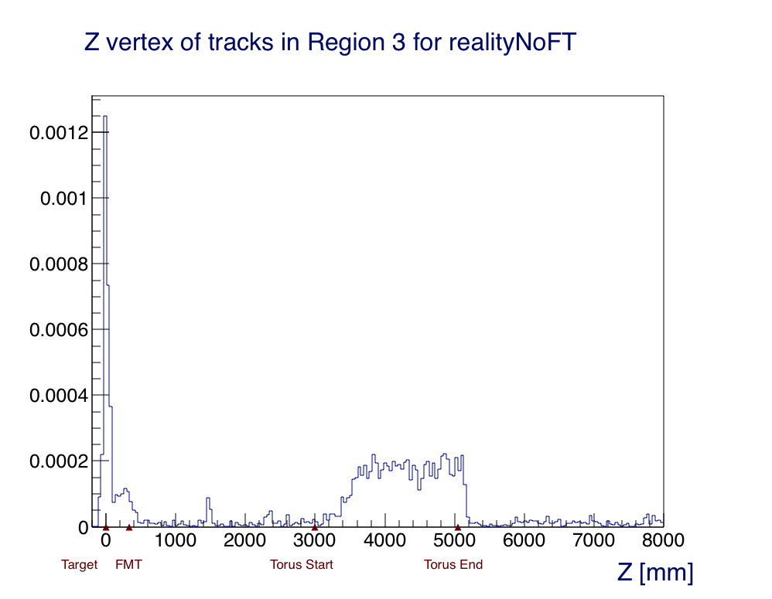
FT Cone. No FT. Lead in place of FT.
R1 Background Source
R3 Background Source

Slide 16
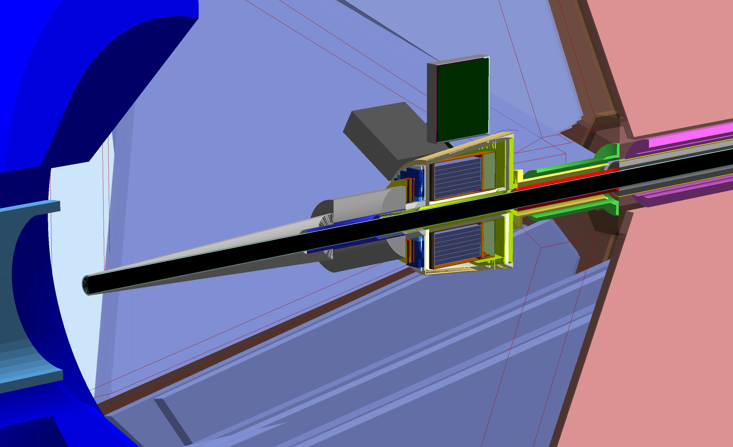
FT not operational, as shielding.
FT Cone moved upstream
Lead Shielding upstream of FT
Same Mount
Same configuration downstream

Slide 17
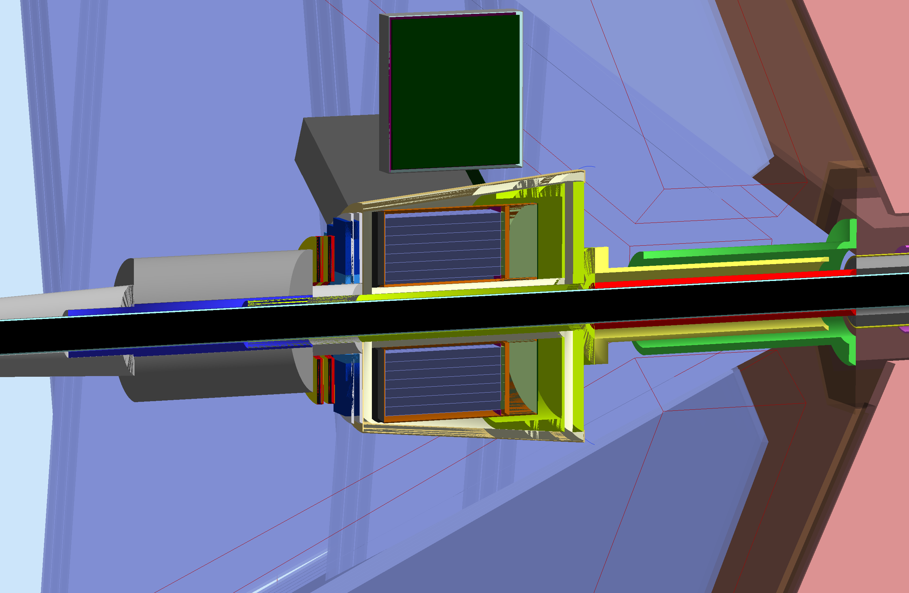
FT not operational, as shielding.
R=120 at z=1444mm: 4.75º
Torus Start: z=2753.8mm
Mount Start: z=2269.6mm

Slide 18
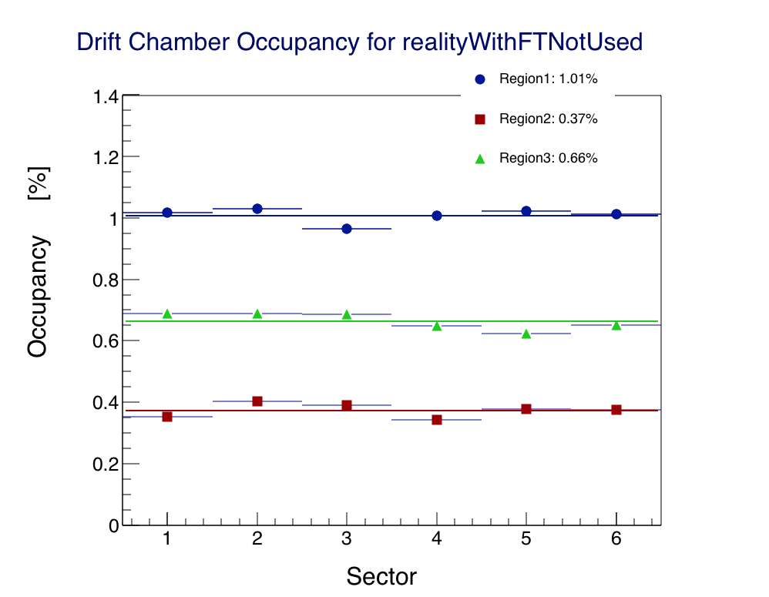
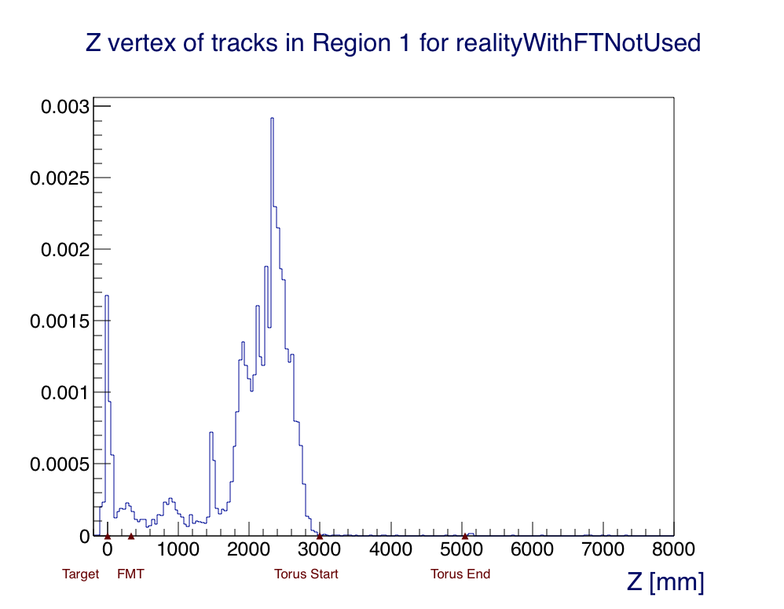
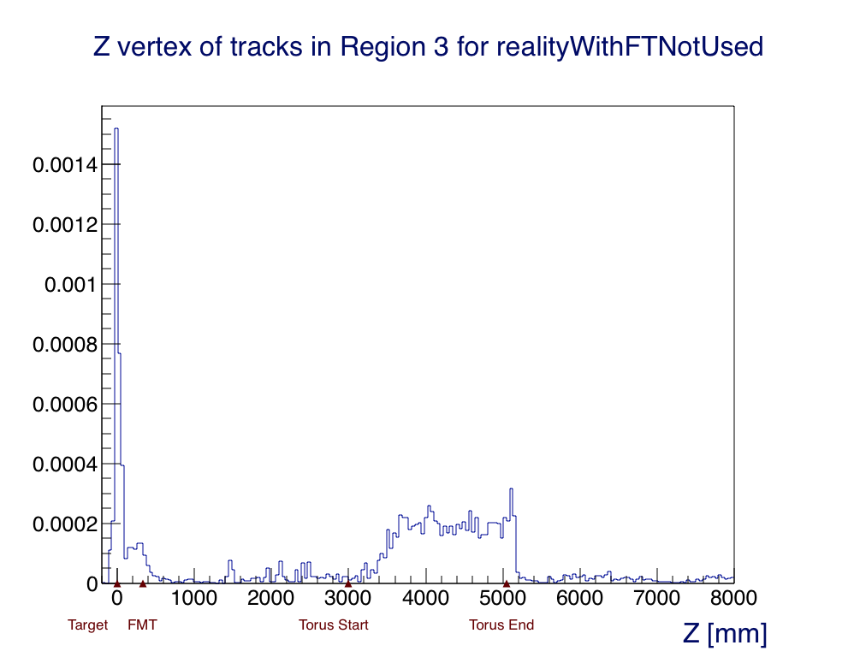
FT not operational, as shielding.
R1 Background Source
R3 Background Source

Slide 19
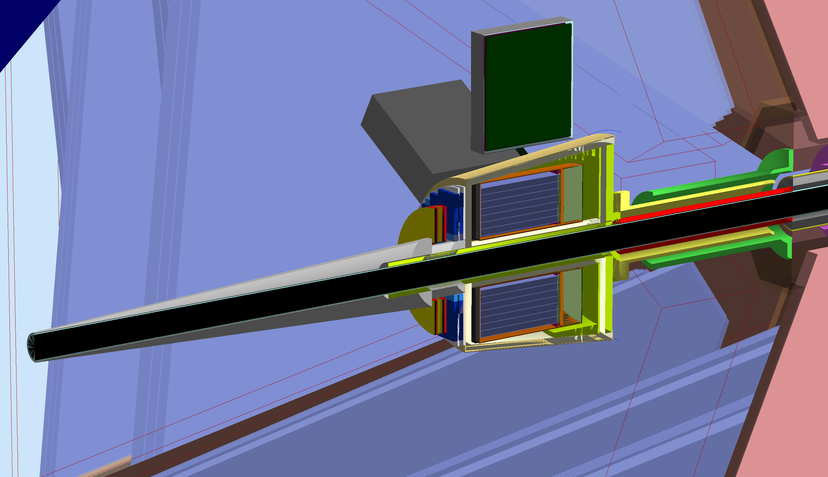
FT Configuration
FT Cone in its nominal position
Same Mount
Same configuration downstream

Slide 20
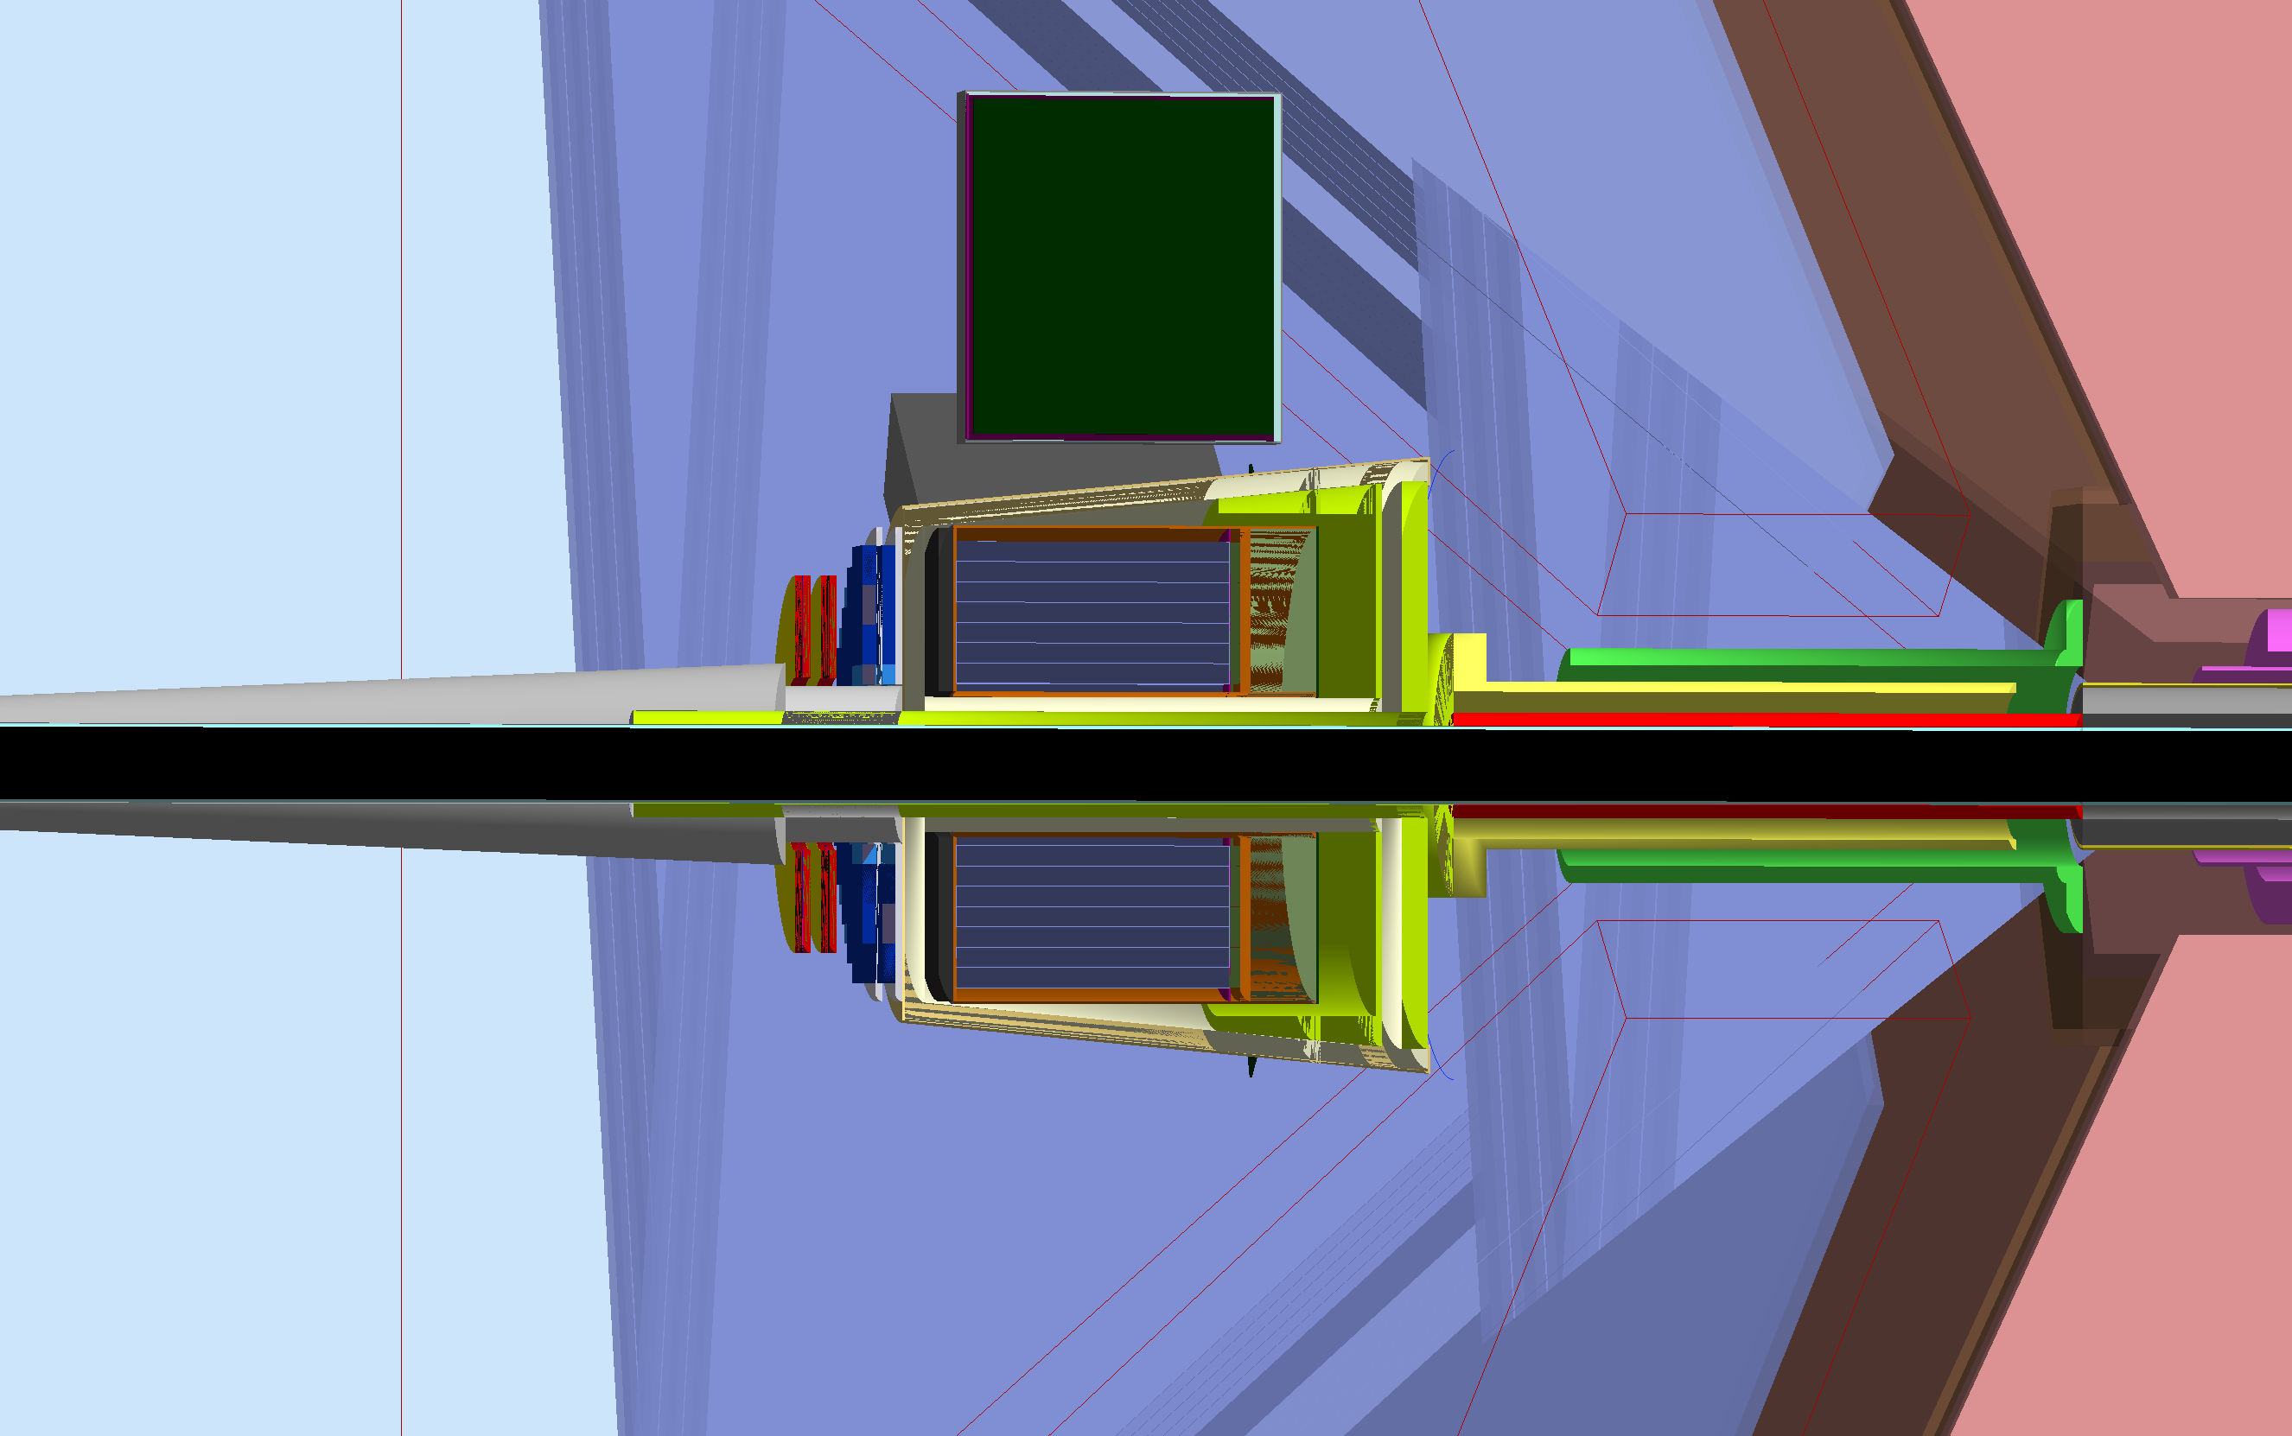
FT Configuration
R=76mm at z=1760mm: 2.5º
Torus Start: z=2753mm
Mount Start: z=2270mm

Slide 21
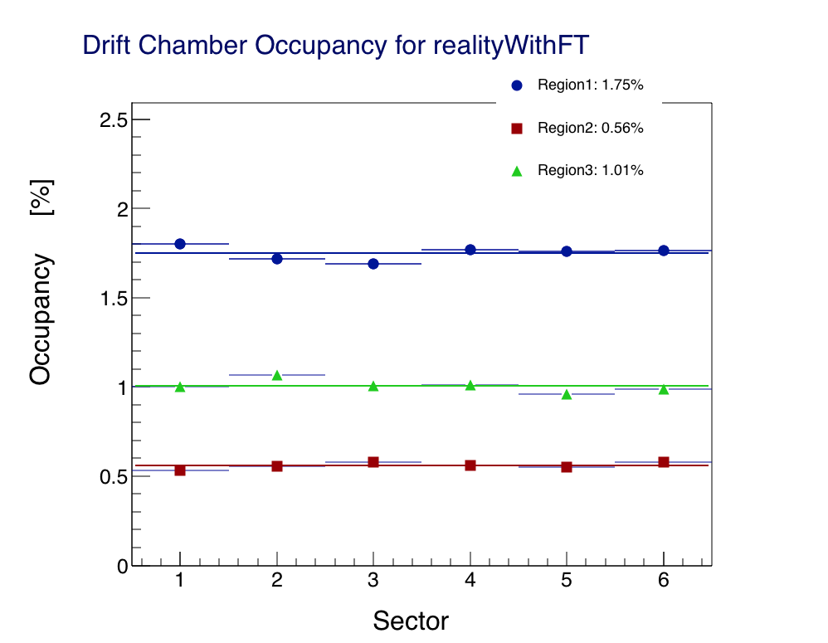
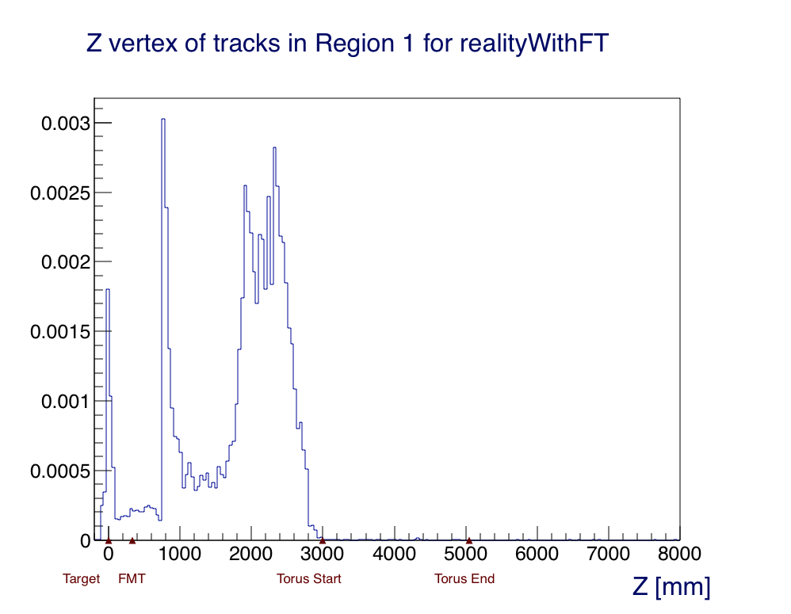
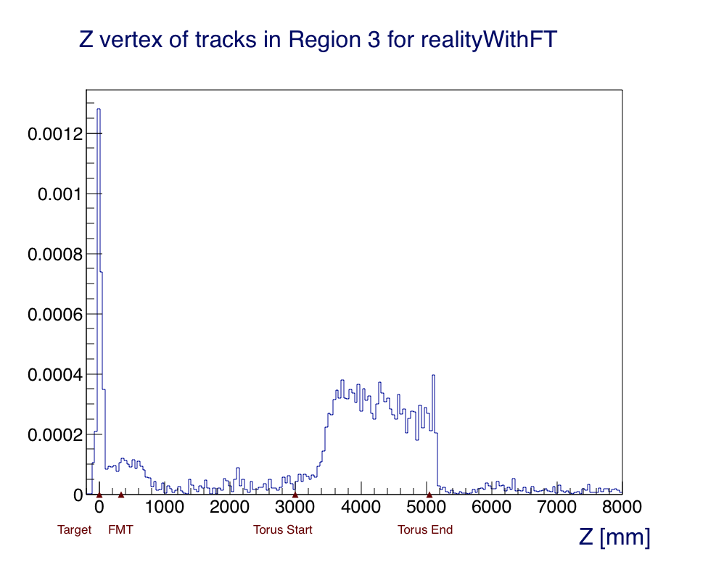
FT Configuration
R1 Background Source
R3 Background Source

