Slide 1
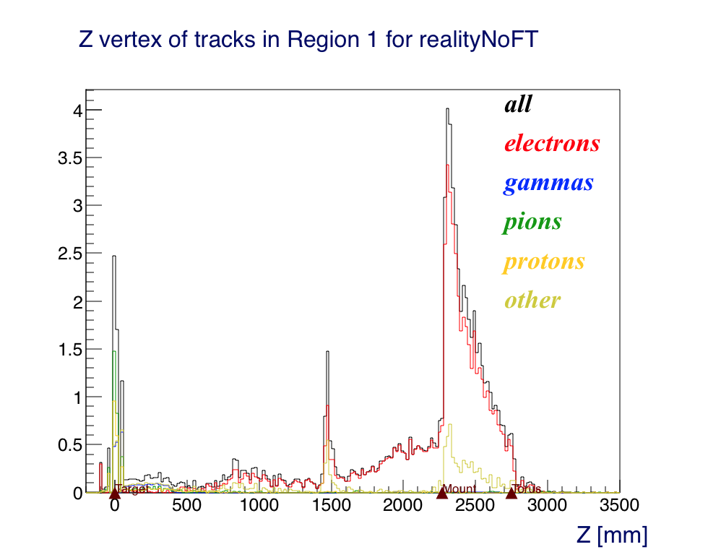
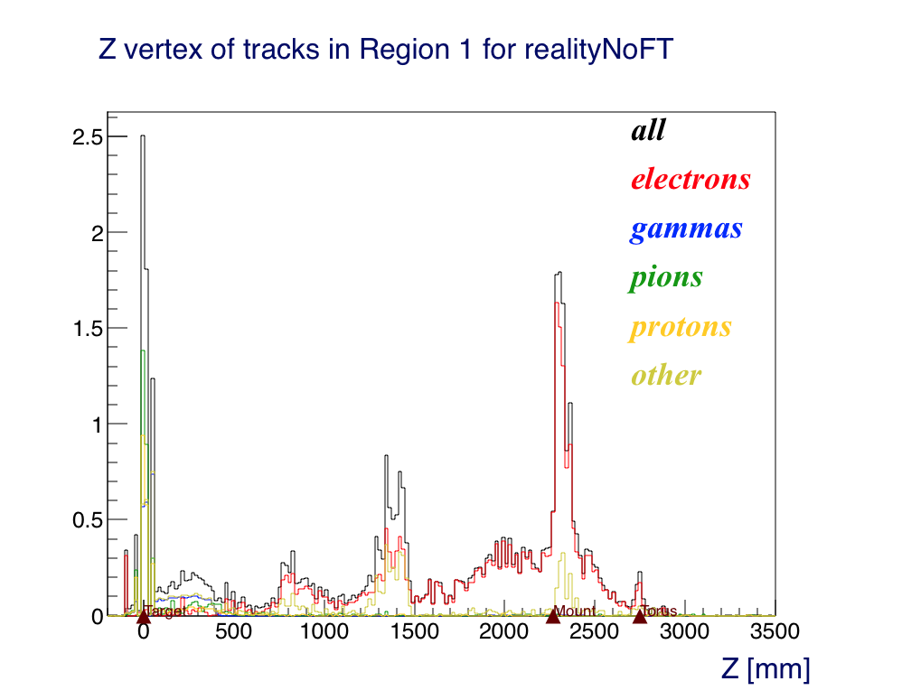
Reality, No FT
Mount Start: 2270
Torus Start: 2750
FT Cone END: 1444
Before
After

