Slide 1
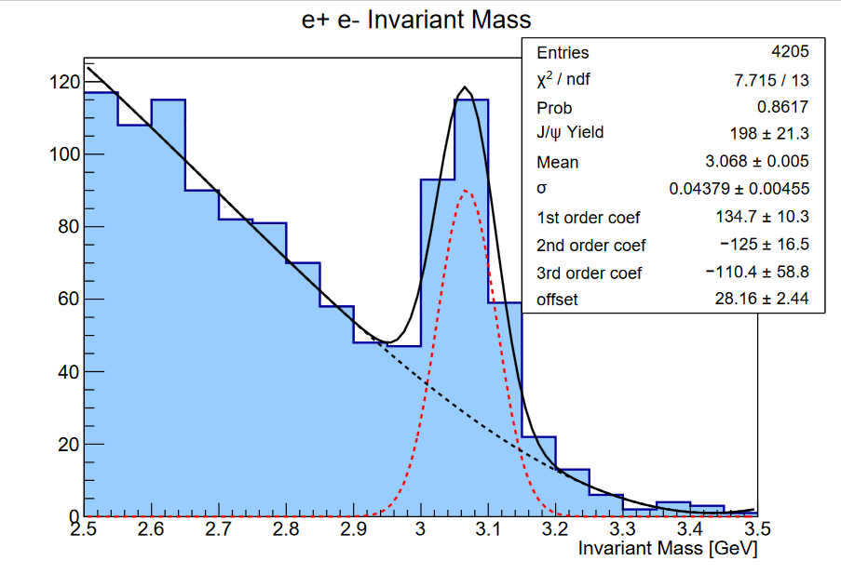
J/Ψ in e+ e- p channel
Channel: ed → (e’)$e^{+}e^{−}$p
Motivation:
Verify the LHCb pentaquark results.
Study the production mechanism of J/𝜓 near threshold and the distribution of color charge in the nucleon.
Have well defined PID and exclusivity cuts.
Next step is calculating the J/𝜓 near threshold cross section.

