Slide 1
Projections for pDVCS in RGH: TTSA
S. Alvarado, A. H., S. Niccolai
Goal: Produce expected Transverse Target Spin Asymmetry, with the proper error bars.
Count-rates estimate:
Use RGA data: we know luminosity and beamtime
Rescale expected events in RGA, in a given binning scheme, by acceptance ratio (from MC) and luminosity ratio (from RGA yields using expected lumi nad beam time of RGH).
Acceptance ratio:
Generate pDVCS events on NH3
Reconstruct the same generated events using RGA configuration and RGH configuration
Acceptance ratio =The ratio of the reconstructed events in RGH to than in RGA
Yield(RGH) = Yield(RGA)*Acc_ratio(RGH/RGA)*Lumi_ration(RGH/RGA)*beamtime(RGH/RGA) *(3/17)
RGA: lumi=0.8*10^35 ; beamtime 16,3 days (took only fall2018 inbending with 43.4489 mC)
RGH: lumi= 5*10^33 ; beamtime 100 days
Once we have this yield, we use it to compute the error bars for each bin:
Error_TTSA = 1/pol * sqrt((1-(pol*TTSA)^2)/Yield) with polarization at 75%
Evaluate TTSA from VGG and attach the error bars to it.

Slide 2
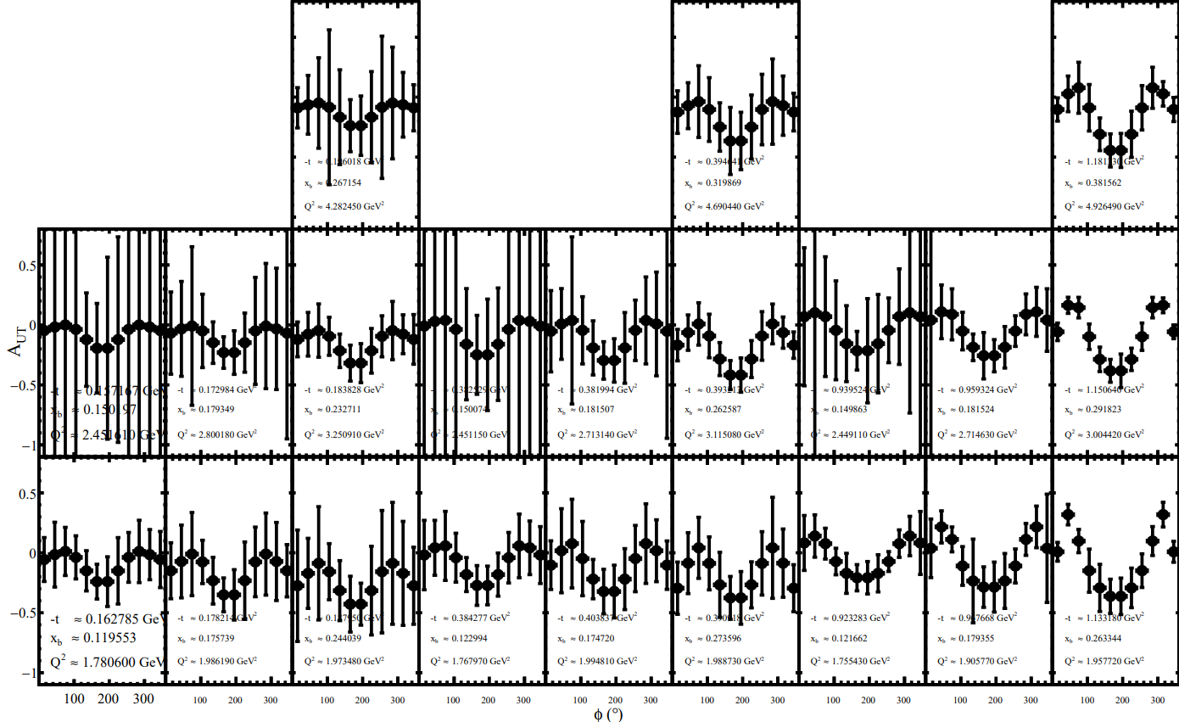
First t bin
second t bin
third t bin
Q2
Xb

Slide 3
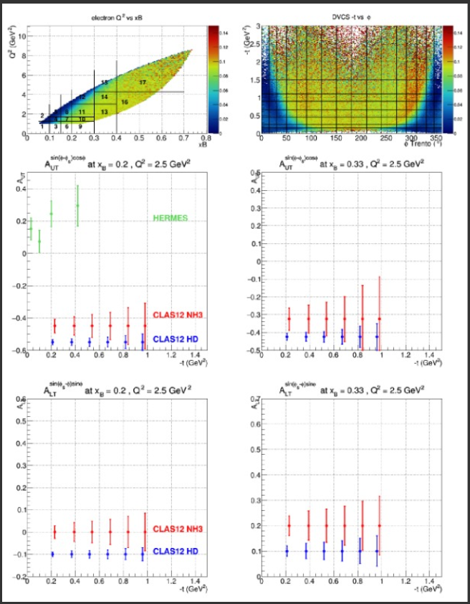
Bin 2
Bin 1
$$f\left(x\right)=a Sin\left(φ−φ_{s}\right)Cos(φ)$$

Slide 4
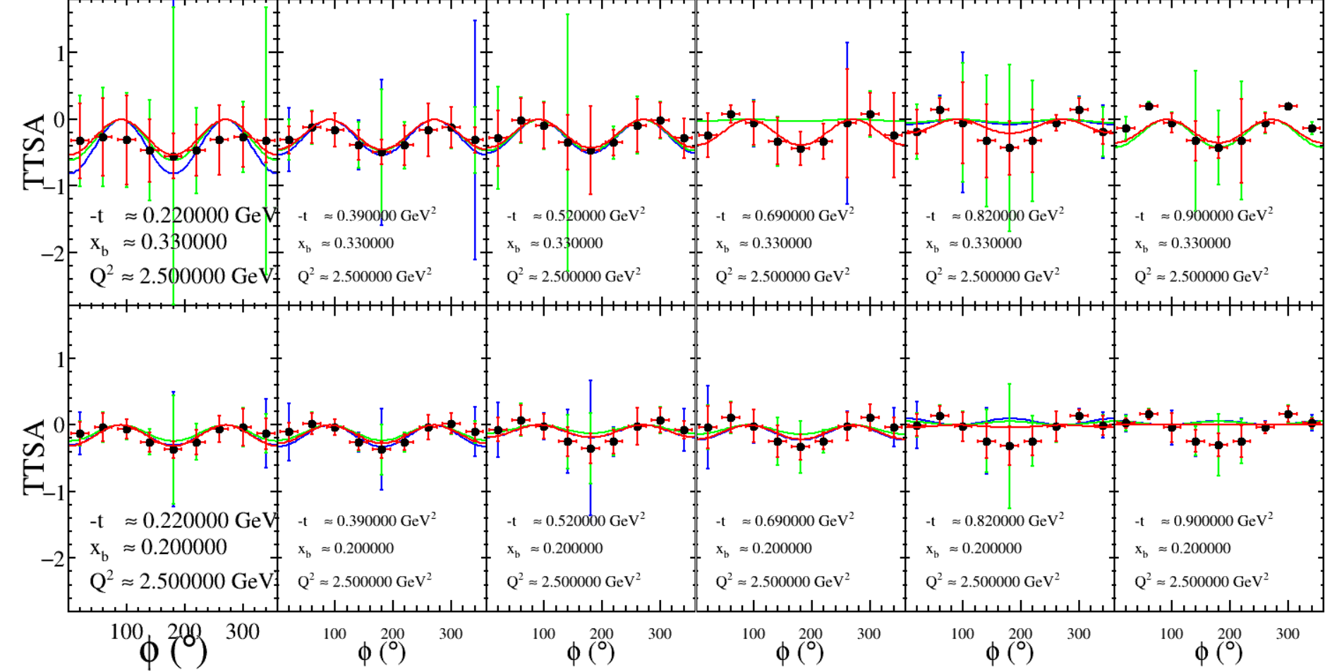
Blue: without sector 4 for electrons and photons
Red: with sector 4
Blue: without sector 4 for electrons
Bin 2
Bin 2
Bin 2
Bin 2
Bin 2
Bin 2
Bin 1
Bin 1
Bin 1
Bin 1
Bin 1
Bin 1

Slide 5
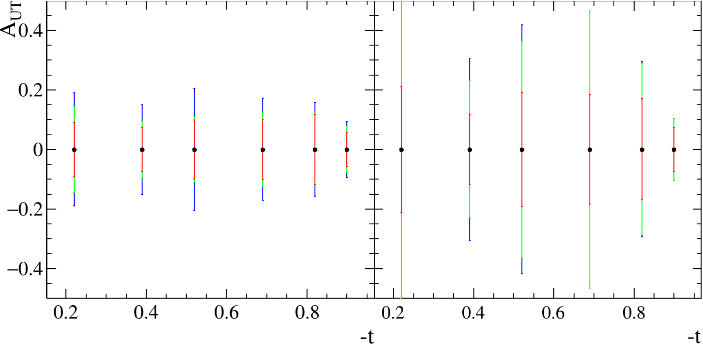
Bin 1
Bin 2
Blue: without sector 4 for electrons and photons
Red: with sector 4
Blue: without sector 4 for electrons
Comparison with previous projections (with sector 4):
at lower –t: error bars almost doubled
at higher –t: new estimations seem to show similar to better statistical errors prjections

