Slide 1
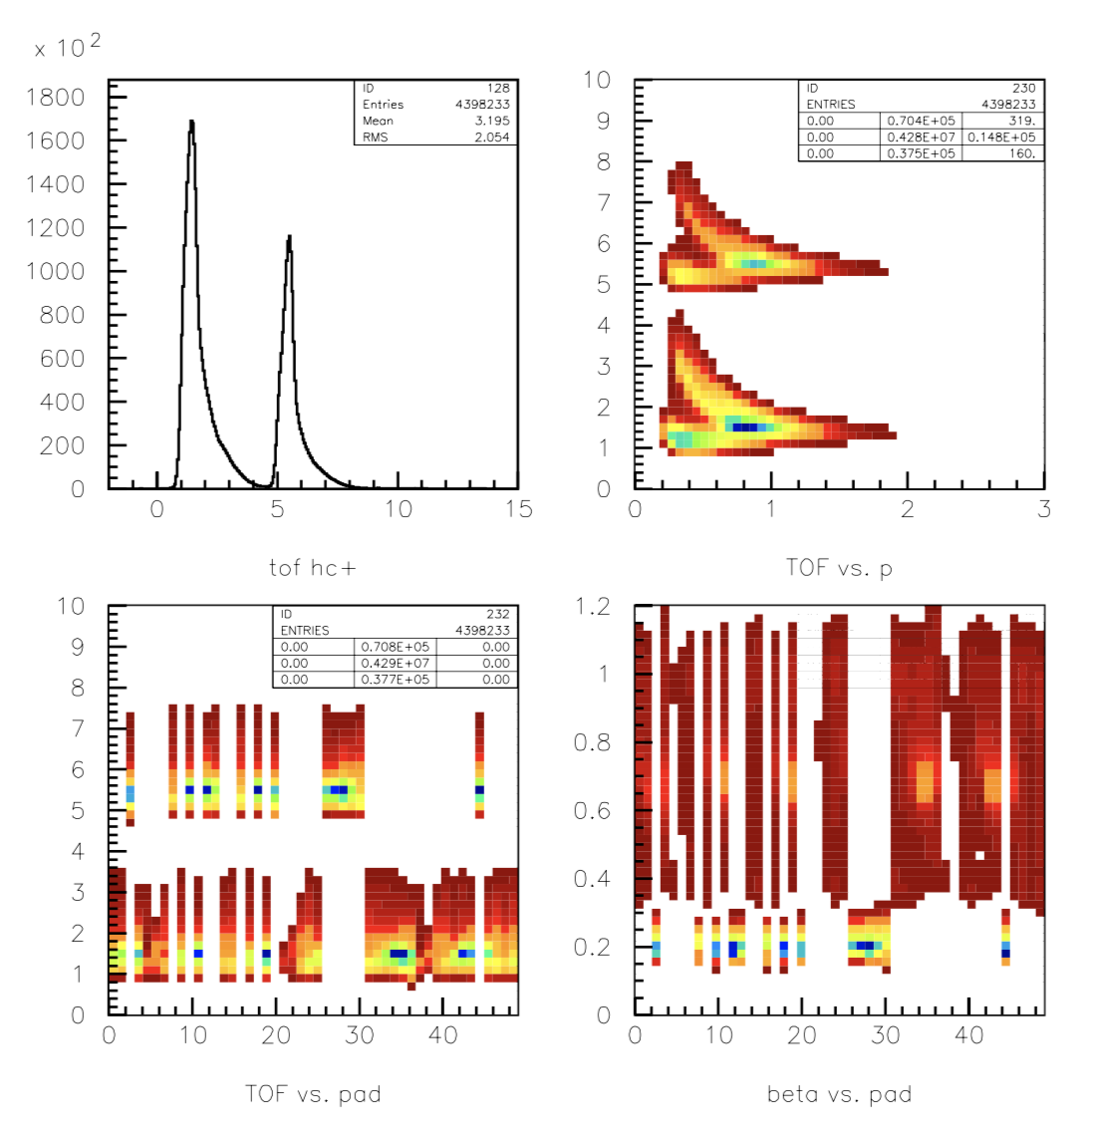
good TOF
bad TOF
RG-K Data

Slide 2
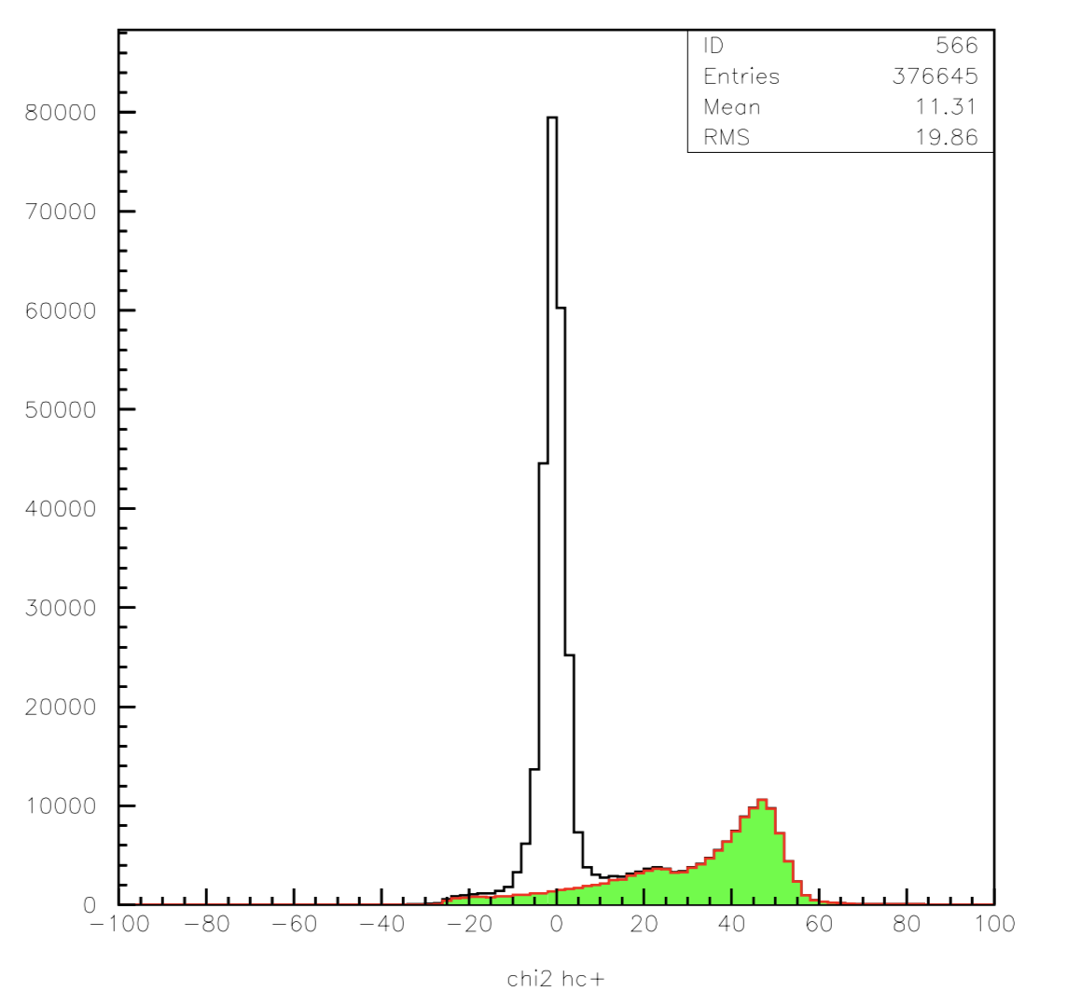
good TOF
RG-K Data
bad TOF

