Slide 1
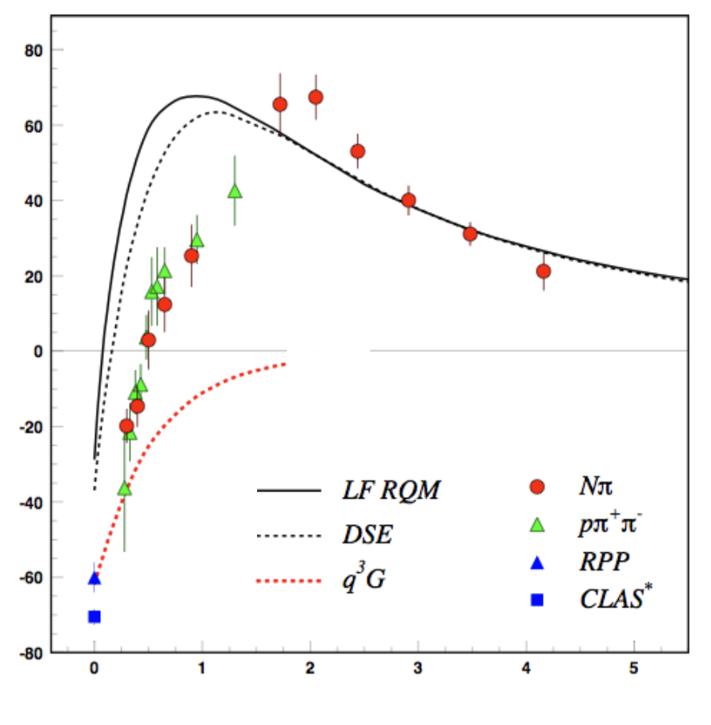
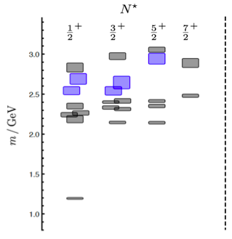
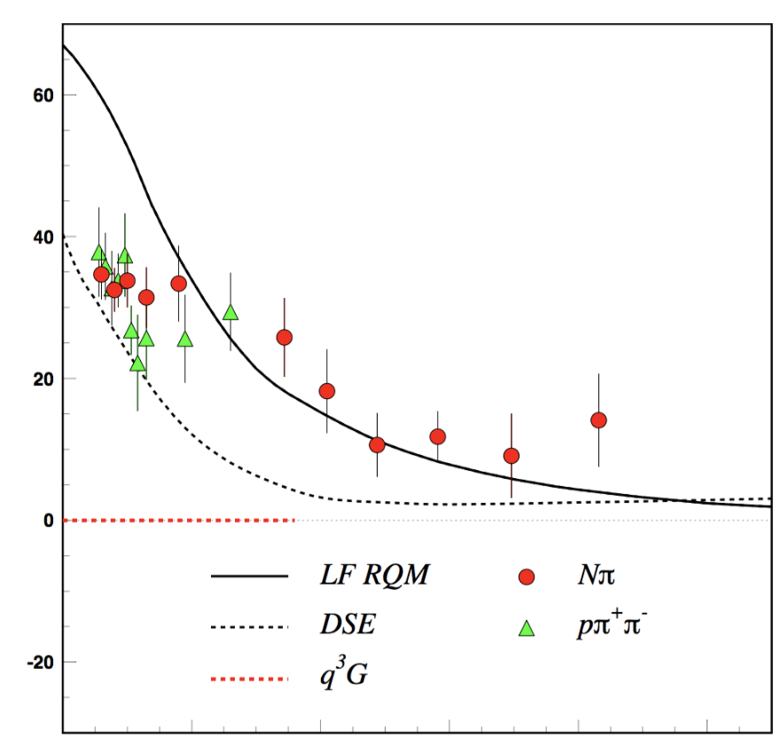
Hunting for Glue in Excited Baryons
Can glue be a structural component of excited baryon states??
N* spectrum from Lattice QCD predicts the existence of hybrid baryons
The hybrid nature of baryons appears in the Q² evolution of their transition amplitudes
N*
A_{1/2}
N(1440)1/2⁺
q³
S_{1/2}
q³g
m/GeV
Electroexcitation Amplitude
0 1 2 3 4 5
Q² (GeV²)
1.3 GeV
regular states
Black curves: q³ model
0 1 2 3 4 5
Q² (GeV²)
hybrid states
Red curves: q³g model
N
CLAS12 is the ideal laboratory to perform search
JLab LQCD group results
m_{π}=396 MeV

