Slide 1
Overview of CLAS12 Run Group K Experiments
Joshua Artem Tan
on behalf of CLAS Collaboration Run Group K
JLAB User’s Group Meeting
July 11, 2019
Notes:
.

Slide 2
Outline
Introduction to CLAS12 Run Group K
$N^{∗}$ Studies via $KY$ Electroproduction
Search for Hybrid Baryons
Deeply Virtual Compton Scattering

Slide 3
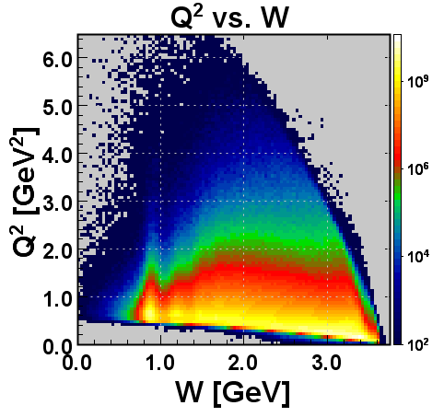
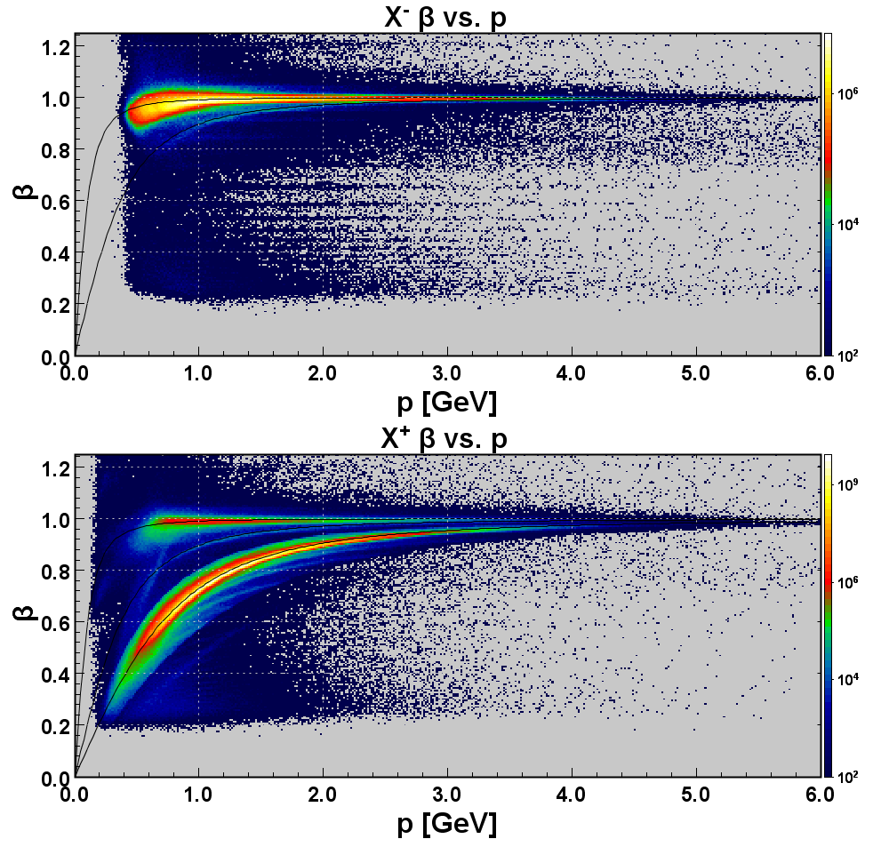
Introduction to CLAS12 Run Group K
$$π^{−}$$
$$Κ^{−}$$
$$π^{+}$$
$$Κ^{+}$$
$$p$$
Inclusive Spectrum:
$$Q^{2}=−q^{2}$$
$$W=\sqrt{{\left(q+p\right)}^{2}}$$
Particle ID
Run Group K:
Run at 6.5 GeV and 7.5 GeV in Dec. 2018
Acquired 7% of approved beam time
Longitudinally polarized electrons on unpolarized H₂ target

Slide 4
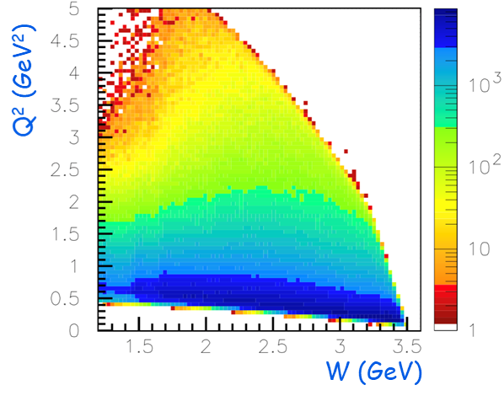
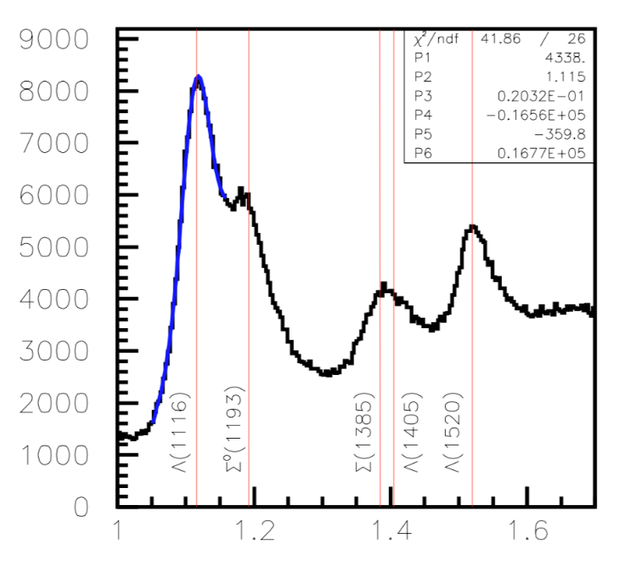
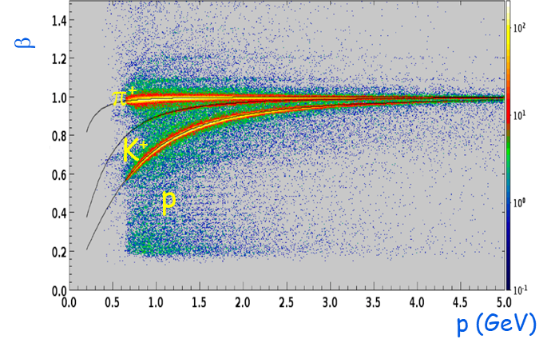
$N^{∗}$ Studies via $KY$ Electroproduction
Kinematic Coverage
$$MM\left(e^{′}K^{+}\right)$$
Particle ID
Run Group K:
Extraction of $γ_{v}pN^{∗}$electrocouplings from $KY$ electroproduction off protons.
Comparison with the results from $Nπ$, $π^{+}π^{−}p$electroproduction off protons.
Explore the interplay between meson-baryon and quark degrees of freedom in the $N^{∗}$ structure.
Shed light on dynamics of dressed quark mass generation and di-quark correlations in different excited nucleon states.
A unique experimental input on many facets of strong QCD in generation of the excited nucleon states of different structural features.

Slide 5
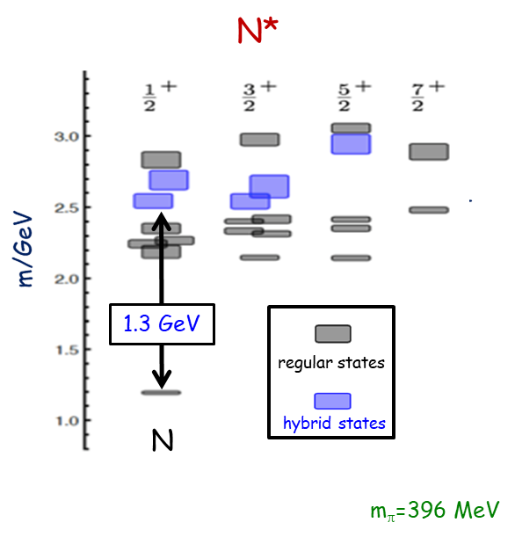
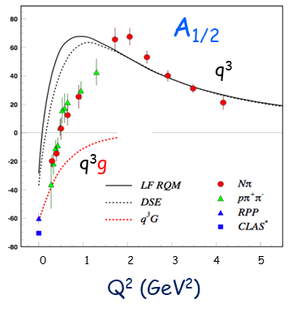
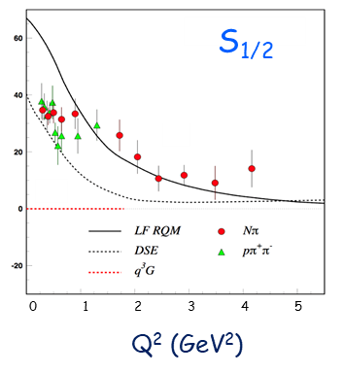
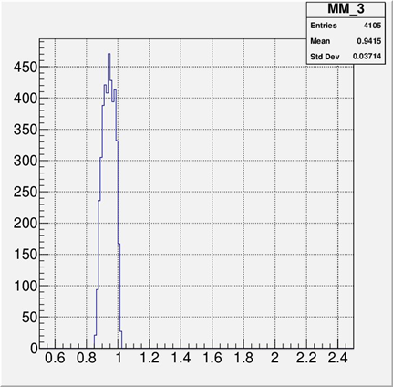
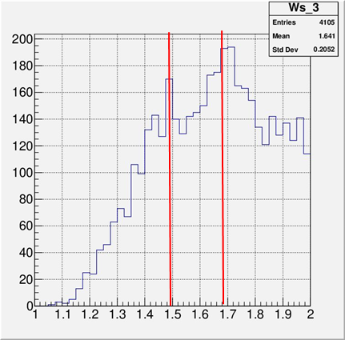
Search for Hybrid Baryons
Results and Predictions for $N\left(1440\right){1/2}^{+}$
$Q^{2}$ > 3.5 GeV²
$MM\left(n\right)$ [GeV]
$W$ [GeV]
JLAB LQCD Group Results
$MM(n)$ and $W$ distributions of $π^{+}n$ Exclusive Events
Search for hybrid baryons with CLAS12:
$N^{∗}$ spectrum from Lattice QCD predicts the existence of hybrid baryons.
Glue is a possible structural component of excited baryon states
$W$ distributions from $π^{+}n$ exclusive events demonstrate the structures corresponding to the 2nd and 3rd resonance regions.

Slide 6
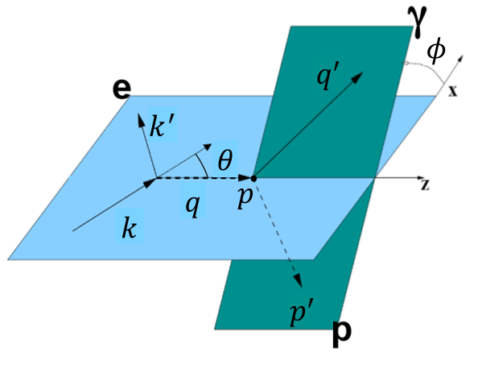
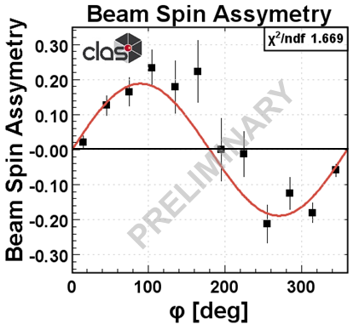
Deeply Virtual Compton Scattering
DVCS Kinematics:
$$A_{LU}\left(φ\right)∝s_{1,unp}^{ℐ}\sin\left(φ\right)$$
$$A_{LU}\left(φ\right)=\frac{1}{ε}\frac{N^{↑}\left(φ\right)−N^{↓}\left(φ\right)}{N^{↑}\left(φ\right)+N^{↓}\left(φ\right)}$$
Kinematic Coverage
Beam Spin Asymmetry
Deeply virtual Compton scattering (DVCS) at 6.5 and 7.5 GeV polarized electron beam:
Measure beam spin asymmetry describing DVCS and Bethe-Heitler (BH) interference term for unpolarized target
Access chiral-even GPDs: $H^{q}$, ${\tilde{H}}^{q}$, and $E^{q}$

Slide 7
Thank You!!!

