Slide 1
Overview of CLAS12 Run Group K Experiments
Joshua Artem Tan
on behalf of CLAS Collaboration Run Group K
JLAB User’s Group Meeting
July 11, 2019
Notes:
.

Slide 2
Outline
Introduction to CLAS12 Run Group K
$N^{∗}$ Studies via $KY$ Electroproduction
Search for Hybrid Baryons
Deeply Virtual Compton Scattering

Slide 3
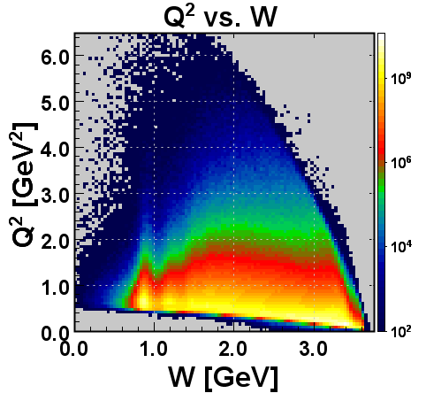
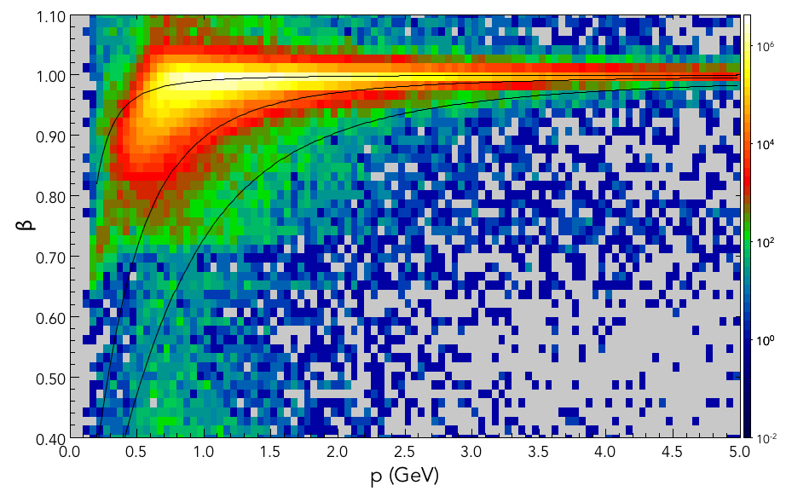
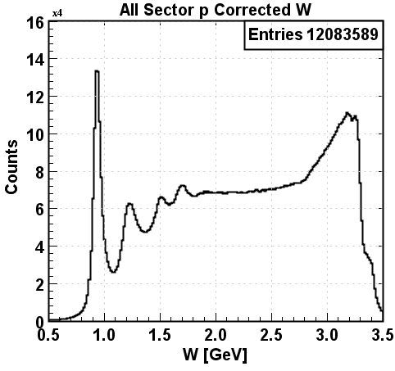
Introduction to CLAS12 Run Group K
π⁺
π⁻
K⁺
p
positives
negatives
p (GeV)
p (GeV)
p
6.5 GeV
7.5 GeV
Large acceptance spectrometer covers broad range in Q² and W
p(e,e’)X
p
p(e,e’)X
Δ⁺(1232)
Δ⁺(1232)
3rd N* Region
3rd N* Region
2nd N* Region
2nd N* Region
Run Group K:
Run at 6.5 GeV and 7.5 GeV in Dec. 2018
Acquired 7% of approved beam time
Longitudinally polarized electrons on unpolarized H₂ target

Slide 4
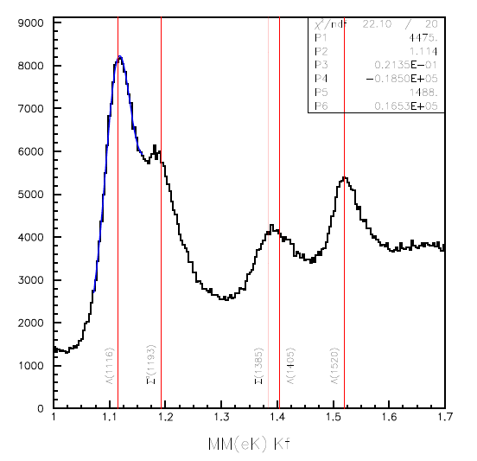
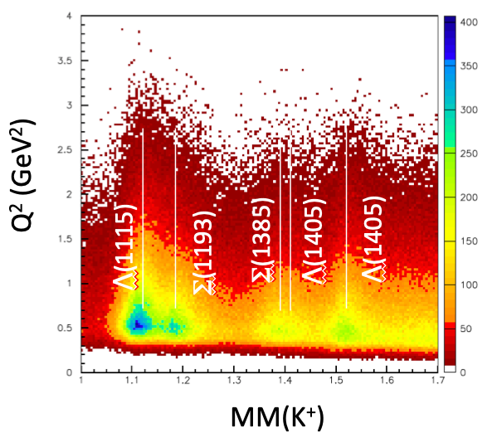
Studies via Electroproduction
Λ(1115)
Σ(1193)
Λ(1405)
Λ(1520)
Σ(1385)
MM(K⁺)
Run Group K:
Extraction of γ_{v}pN* electrocouplings from KY electroproduction off protons.
Comparison with the results from Nπ, π⁺π⁻p electroproduction off protons.
Explore the interplay between meson-baryon and quark degrees of freedom in the N* structure
Shed light on the dynamics of dressed quark mass generation and di-quark correlation in different excited nucleon states.
A unique experimental input on many facets of strong QCD in the generation of excited nucleon states of different structural features.

Slide 5
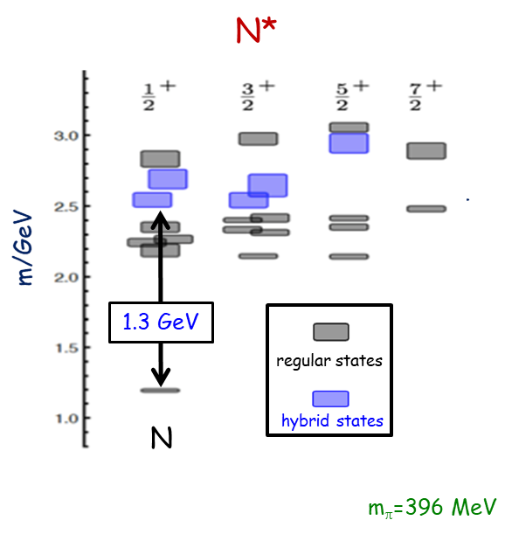
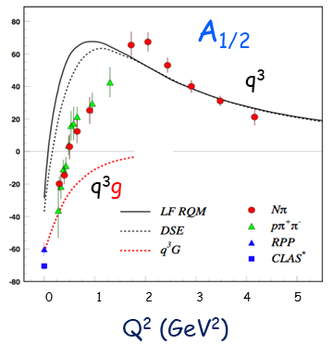
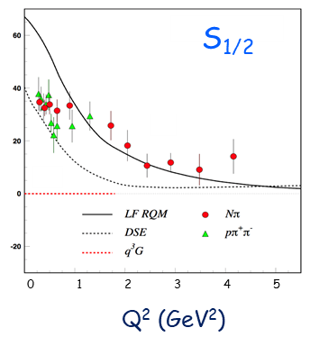
Search for Hybrid Baryons
JLAB LQCD Group Results
Results and Predictions for $N\left(1440\right){1/2}^{+}$
Search for hybrid baryons with CLAS12:
$N^{∗}$ spectrum from Lattice QCD predicts the existence of hybrid baryons.
Glue is a possible structural component of excited baryon states
$W$ distributions from $π^{+}n$ exclusive events demonstrate the structures corresponding to the 2nd and 3rd resonance regions.

Slide 6
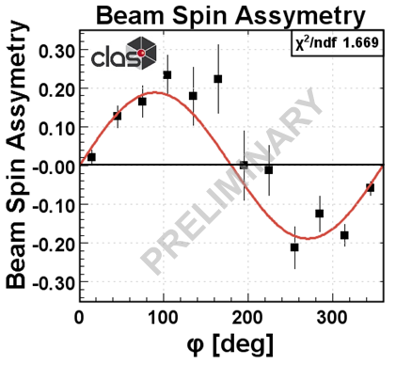
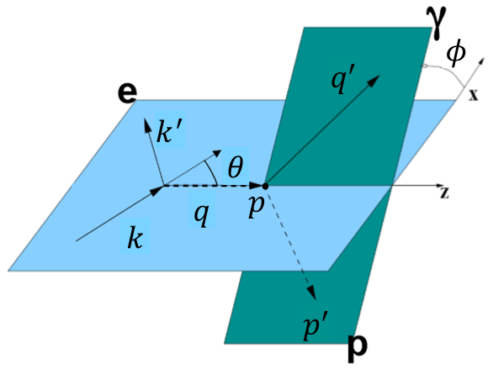
Deeply Virtual Compton Scattering
ep → e'p'γ
Beam Spin Asymmetry
DVCS Kinematics:
$$A_{LU}\left(φ\right)∝s_{1,unp}^{ℐ}\sin\left(φ\right)$$
$$A_{LU}\left(φ\right)=\frac{1}{ε}\frac{N^{↑}\left(φ\right)−N^{↓}\left(φ\right)}{N^{↑}\left(φ\right)+N^{↓}\left(φ\right)}$$
Deeply virtual Compton scattering (DVCS) at 6.5 and 7.5 GeV polarized electron beam:
Measure beam spin asymmetry describing DVCS and Bethe-Heitler (BH) interference term for unpolarized target
Access chiral-even GPDs: $H^{q}$, ${\tilde{H}}^{q}$, and $E^{q}$

Slide 7
Thank You!!!

