Slide 1
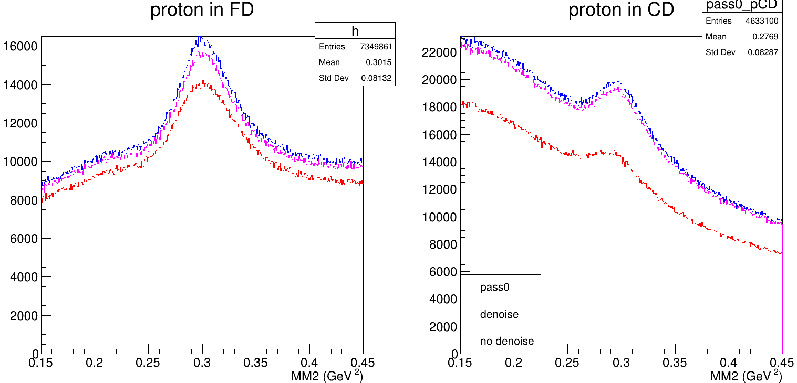
Comparison pass1 vs denoise vs no denoise
pass1_pCD
RGK 6.5 GeV
Started with DST files
Applied analysis & fiducial cuts
Final states ep -> e’pX
Focus on η mass² range
Comparing these runs across all 3 categories: 5901, 5906, 5913, 5920, 5986, 5990
Fits were not applied to determine signal yield… These are just entries in the TH1D
pass1_pFD
denoise_pCD
denoise_pFD
no_denoise_pFD
no_denoise_pCD
Category | Entries |  | percent change from pass1
 | proton in FD | proton in CD | proton in FD | proton in CD
pass1 | 6453264 | 4633100
pass2 | 7349861 | 6759848 | 13.9 | 45.9
pass2_D | 7719502 | 6997774 | 19.6 | 51.0
What should be looked at to better explore the difference between no denoising and denoising?
What else should be investigated?

Slide 2
Ratio of missing mass squared distributions
Final states where ep -> epX
Top row: proton in FD
Bottom row: proton in CD
Columns left to right: ratio of pass 2 with denoising to pass1, ratio of pass2 without denoising to pass1, ratio of pass 2 with denoising to no denoising

Slide 3
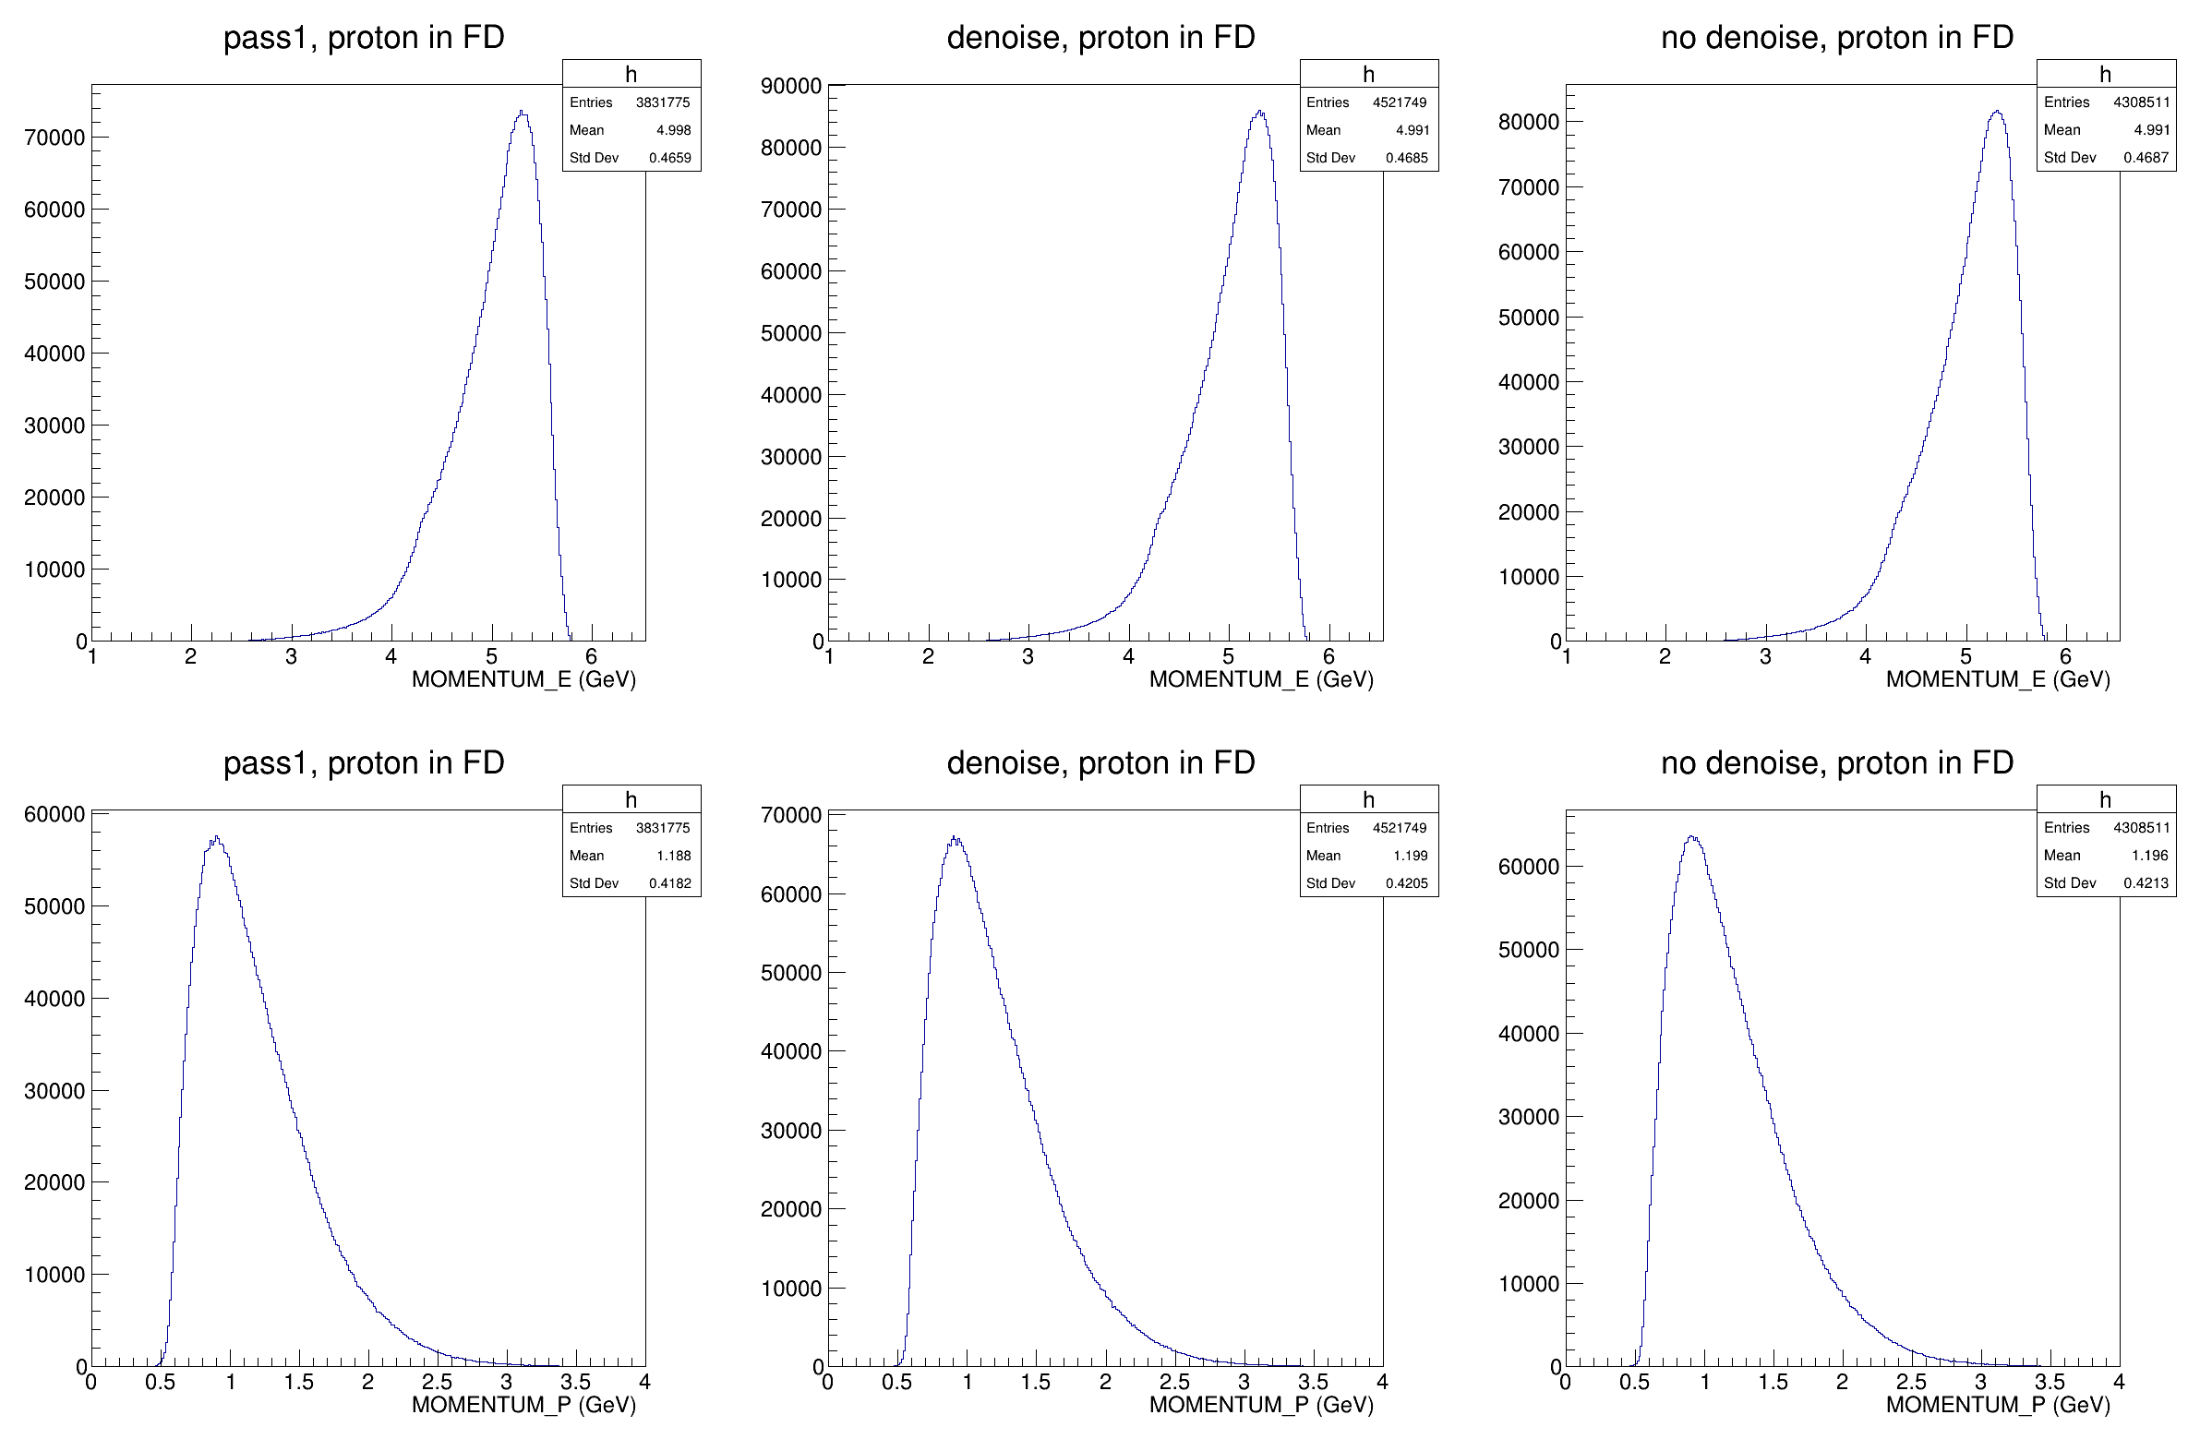
Momentum distributions
Final states where ep -> epX
Proton in FD
Top row: electron momentum
Bottom row: proton momentum
Columns left to right: pass1, pass2 with denoising, pass2 without denoising

Slide 4
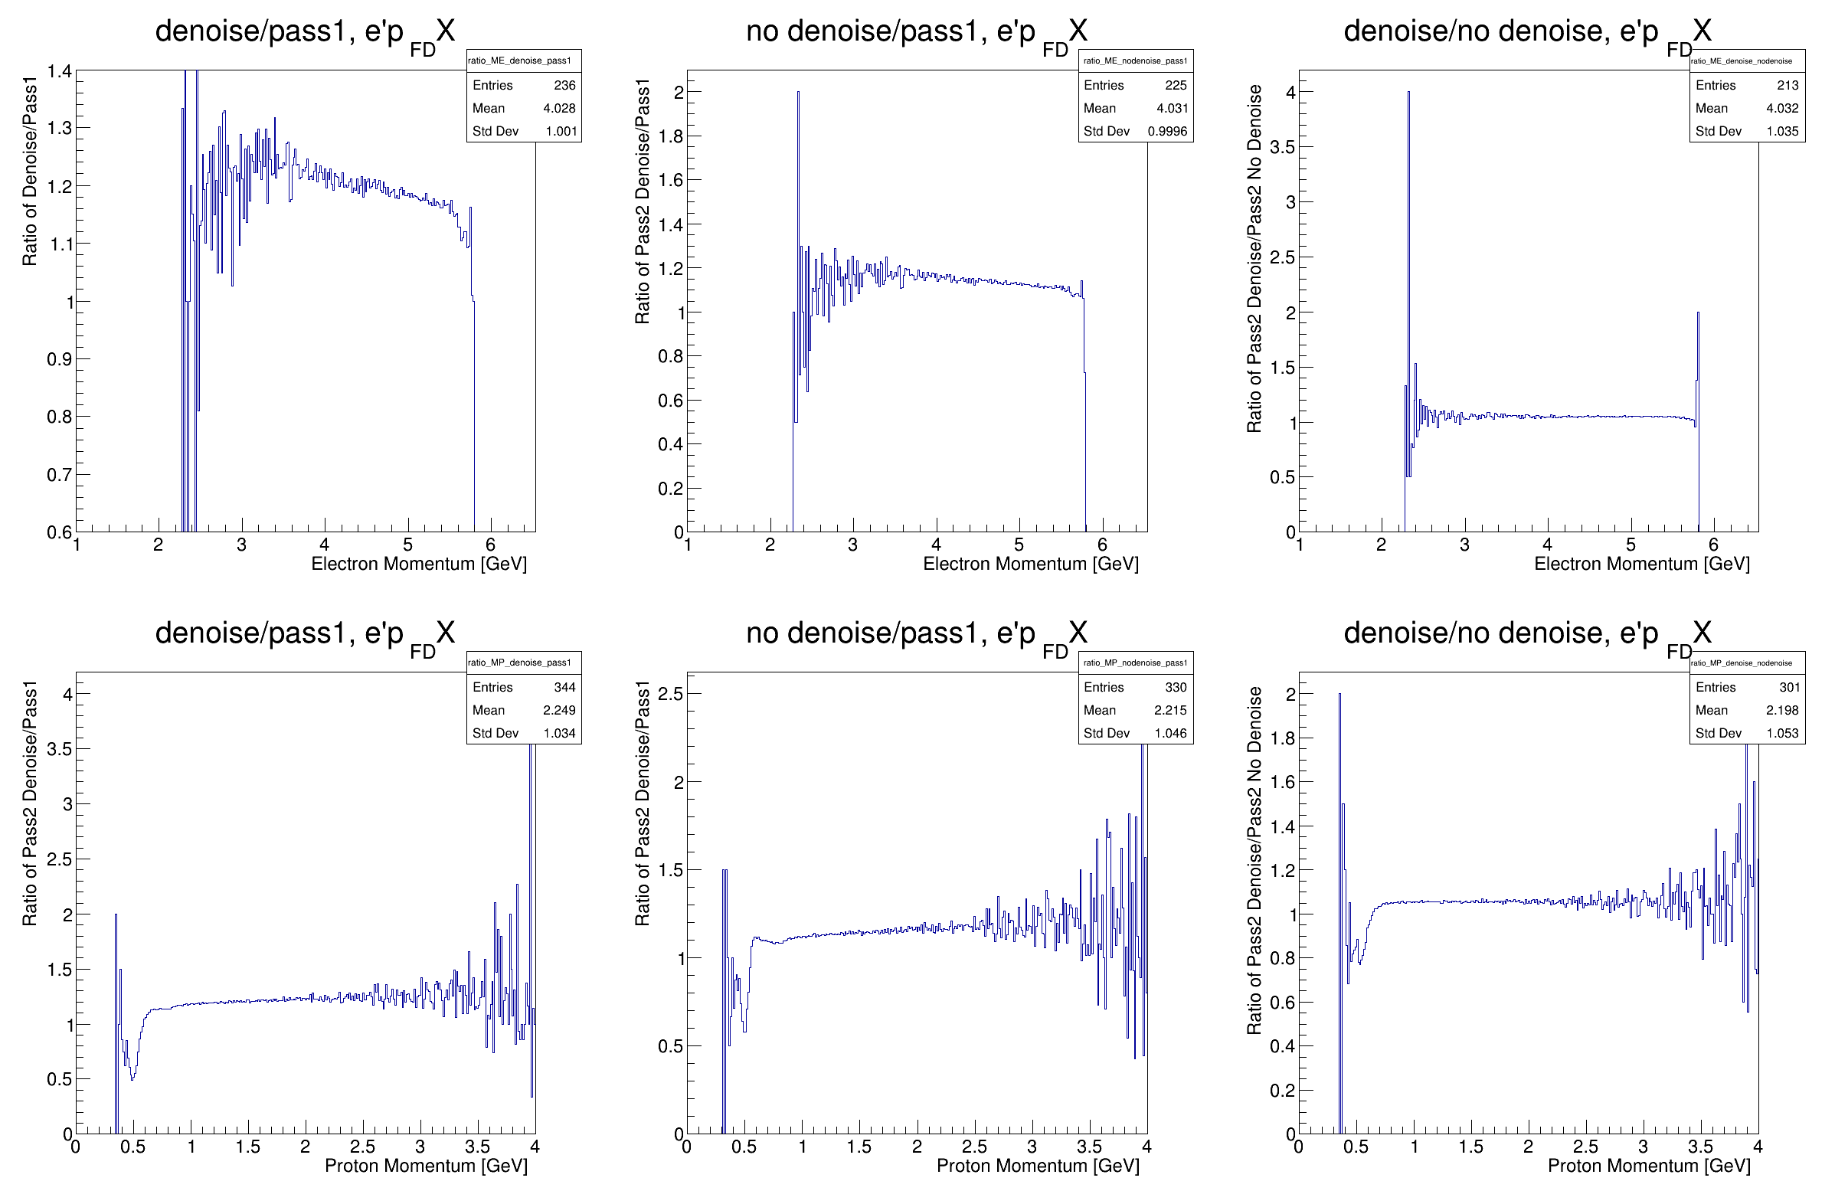
Ratio of momentum distributions
Final states where ep -> epX
Proton in FD
Top row: electron momentum
Bottom row: proton momentum
Took distributions from previous slide and divided them

Slide 5
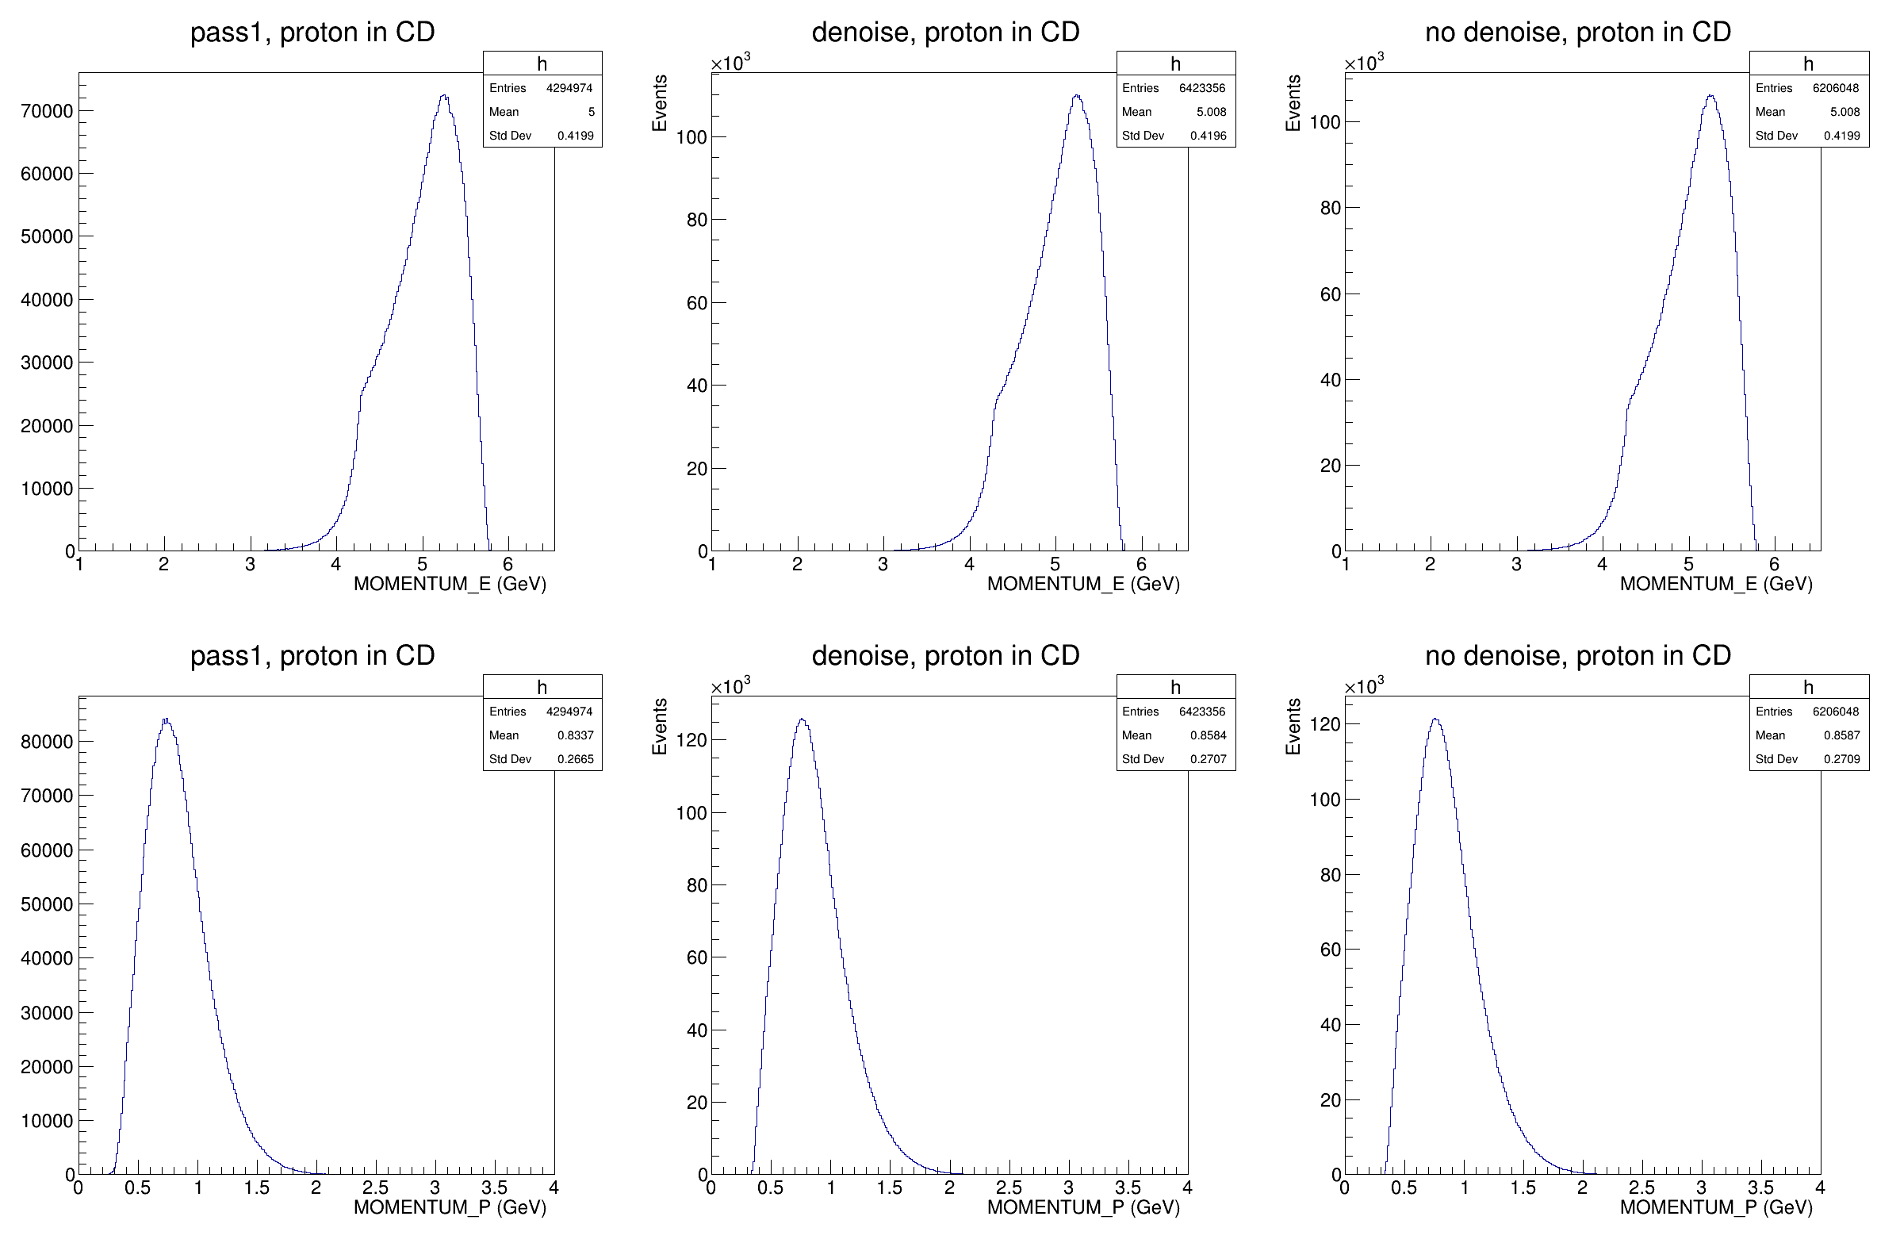
Momentum distributions
Final states where ep -> epX
Proton in CD
Top row: electron momentum
Bottom row: proton momentum
Columns left to right: pass1, pass2 with denoising, pass2 without denoising

Slide 6
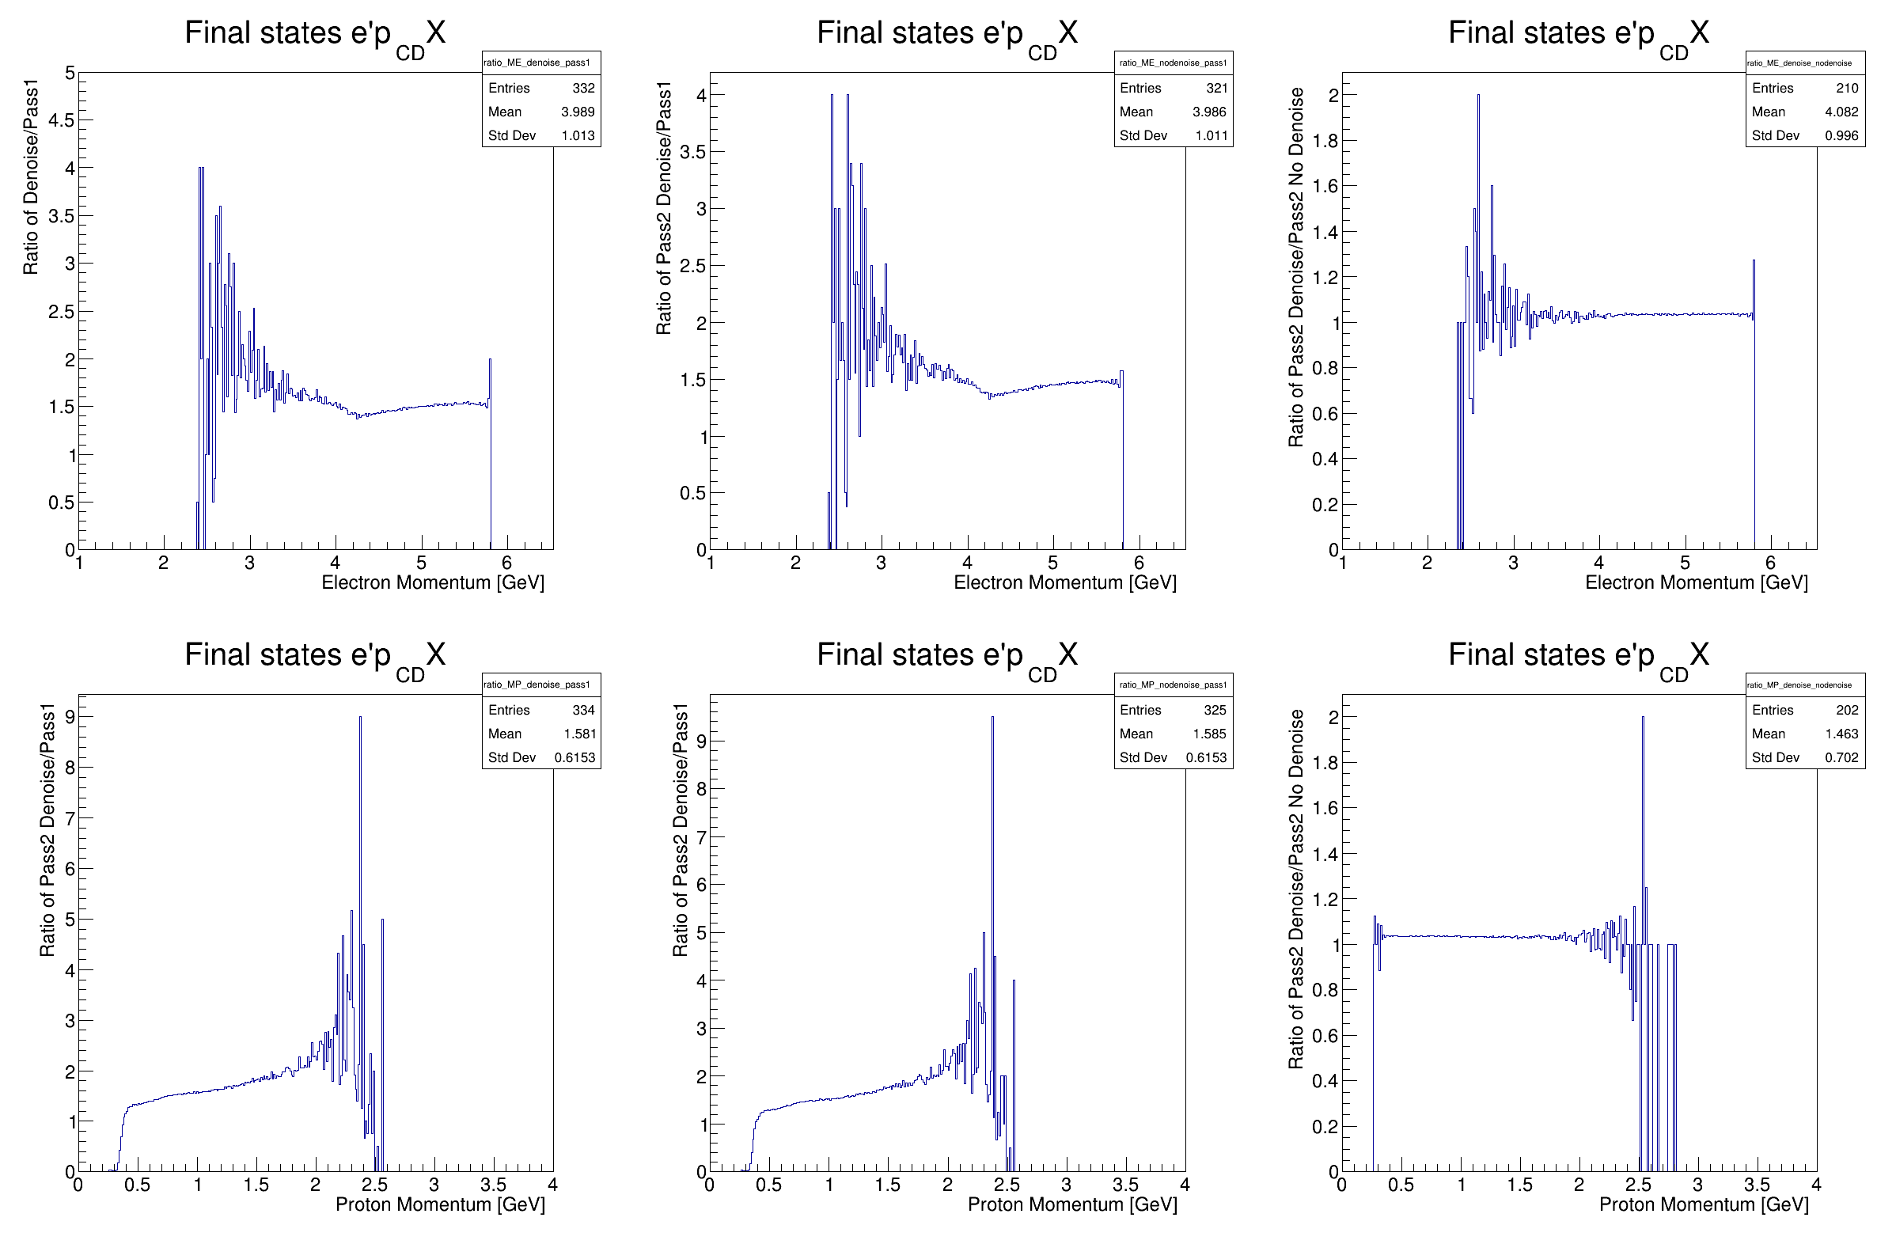
Ratio of momentum distributions
Final states where ep -> epX
Proton in CD
Top row: electron momentum
Bottom row: proton momentum
Took distributions from previous slide and divided them

