Slide 1
Clas12 Reconstruction and Analysis Framework
V. Gyurjyan S. Mancilla

Slide 2
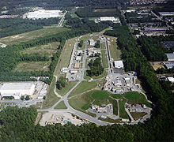
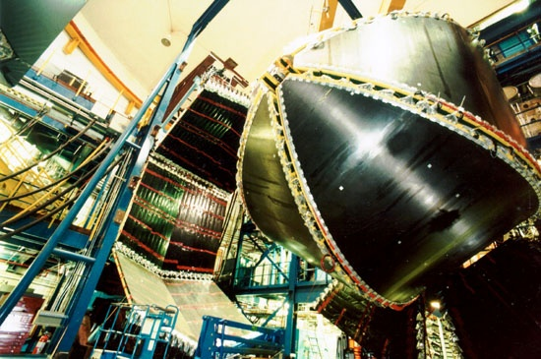
JLab
Thomas Jefferson National Accelerator Facility (TJNAF), commonly called Jefferson Lab or JLab, is a U.S. national laboratory located in Newport News, Virginia
Superconducting RF technology based accelerator will provide a 12 GeV continuous electron beam with a bunch length of less than 1 picosecond.
Nuclear physics experiments in 4 end- stations (A,B,C,D)
CLAS is a large acceptance spectrometer installed in Hall B to study
  Quark-gluon interactions with nuclei
  Nucleon-nucleon correlations
  Nucleon quark structure imaging,
  etc.

Slide 3
CLAS12 Computing Requirements
Enhance utilization, accessibility, contribution and collaboration
  Reusability of components
  On-demand data processing.
  Location independent resource pooling.
  Software agility
Utilization of multicore processor systems
  Multi-threading
Ability to expand computing power with minimal capital expenditure
  Dynamic elasticity.
  Utilization of IT resources of collaborating Universities.
  Take advantage of available commercial computing resources.

Slide 4
Ideas Adopted From GAUDI
Clear separation between data and algorithms
Services encapsulate algorithms
Services communicate data
Three basic types of data: event, detector, statistics
Clear separation between persistent and transient data
No code or algorithmic solution was borrowed.

Slide 5
Computing Model and Architecture Choice
ClaRA is an implementation of the SOA
Data processing major components as services
  Multilingual support
    Services can be written in C++, Java and Python
Physics application design/composition based on services
Supports both traditional and cloud computing models
  Single process as well as distributed application design modes
  Centralized batch processing
  Distributed cloud processing
Multi-Threaded
Notes:
Services and information bound to those services can be further abstracted to process layers and composite applications for developing various analyses solutions.

Slide 6
Attributes of ClaRA Services
Communicate data through shared memory and /or pub-sub messaging system
  Well defined, easy-to-use, data-centric interface
Self-contained with no dependencies on other services
  Loose coupling. Coupled through communicating data.
Always available but idle until requests arrival
Location transparent
  Services are defined by unique names, and are discovered through discovery services
Combine existing services into composite services or applications
  Services can also be combined in a single process (run-time environment), communicating data through shared memory (traditional computing model).

Slide 7
ClaRA Design Architecture
Orchestration Layer
Rule invocation
Identification
Filtration
Control Layer
Data flow control
Load balancing
Error recovery
Security, validation and auditing
Managing errors and exceptions
Service Inventory
Administration SaaS, IaaS, DaaS
Registration
Service
Service layer
PDP Service Bus (pub-sub and/or shared-memory)

Slide 8
ClaRA Components
Platform
(cloud controller)
DPE
C
S
DPE
DPE
C
S
C
Orchestrator
S

Slide 9
Platform (Cloud Controller)
ClaRA administration
Service registration and discovery.
Keeps an inventory of all running DPEs and all deployed services.
Used by orchestrators to discover and check services availability and distribution.
Platform
Cloud Controller
Service Bus (pub-sub server)
Registration
Discovery
Administration
Governing
Cloud Control Node

Slide 10
Data Processing Environment (DPE)
Main ClaRA processes.
Each node acts as a DPE.
All services are deployed and executed by threads inside the DPE process.
Global memory to share data between services.
DPE
Service deployment
Service removal
Monitoring
Service recovery
Administration
Service Bus
Pub-sub server
Computing Node 1

Slide 11
Service Container
Group and manage services in a DPE
Can be used as namespaces to separate services.
  The same service engine can be deployed in different containers in the same DPE.
Handle service execution and its output.
Service container presents a user engine as an SOA service (SaaS implementation).
Service
Engine
Message processing
Engine interface

Slide 12
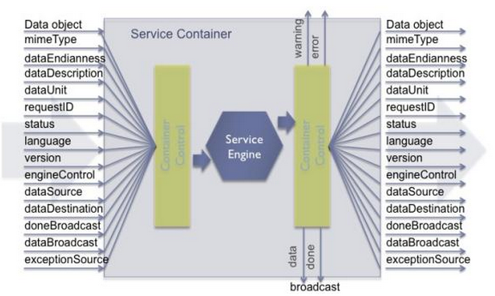
Transient Data Envelope

Slide 13
Transient Data Object
EVIO 4.1 is the default event format.
  Data is just a byte buffer (avoid serialization).
  Complete API (Java, C++,Python) to get data from the buffer.
  A set of wrappers to work with the common CLAS12 bank format.

Slide 14
Service Communication
Java DPE
Transient Data Storage
Service Bus
Computing Node 1
Service 1
Service 2
Service N
Service Bus
Service Bus
Computing Node 2
Service 1
Service 2
Service N
Transient Data Storage
Service Bus
C++ DPE
Computing Node N
Computing Node 1

Slide 15
Service Engine
The fundamental unit of ClaRA based application.
Receives an input data in an envelope, and generates an output data.
  The data envelope is the same for all services.
Implements ClaRA standard interface
  A configure method
  An execute method.
  Several description/identification methods.
Must be thread-safe.
  The same service engine can be executed in parallel multiple times.

Slide 16
Orchestrator
Design and control ClaRA applications
Coordinate services execution and data flow.
Usually run outside of the DPE.
Deploy services to DPEs.
  Each deployed service is identified by the following canonical name:dpe_name/container_name/service_engine_name
Link services together.
  The output of a service is sent as the input to its linked service.

Slide 17
Orchestrator
Request services execution.
  Async requests: service output is sent to all its linked services.
  Sync request: service output is returned to the requester.
Monitor services execution.
  Data, done, warning and error monitoring.
  Run custom callback code when a notification is received.

Slide 18
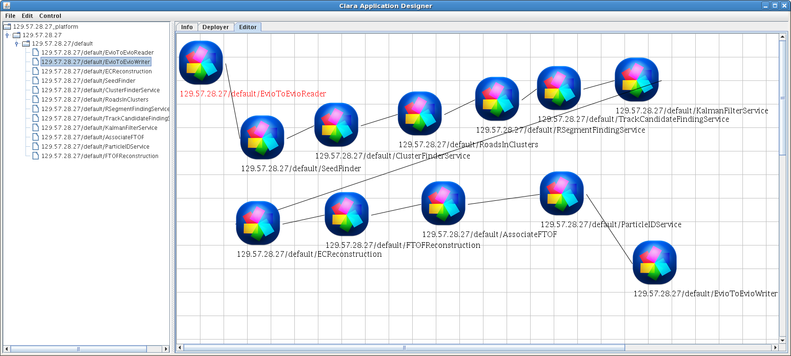
Application Graphical Designer

Slide 19
Single Event Reconstruction
R
S1
S2
SN
W
Read EVIO events from input file.
Events pass from service to service in the chain.
  Services add more banks to the event.
Write events to output file.

Slide 20
Multi-Core Reconstruction
O
DPE
S1
S2
SN
R
S1
S2
SN
W
S1
S2
SN

Slide 21
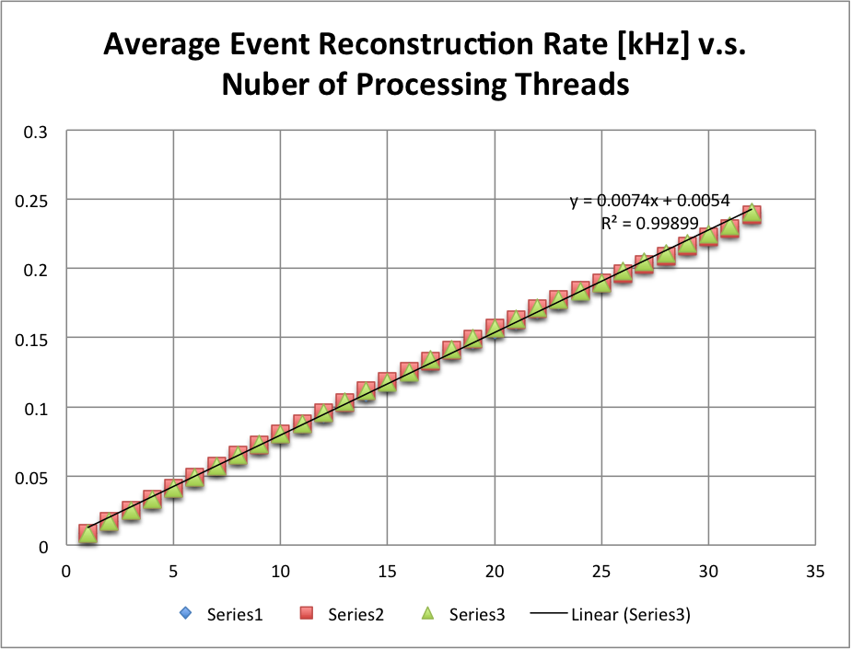
Multi-Core Reconstruction

Slide 22
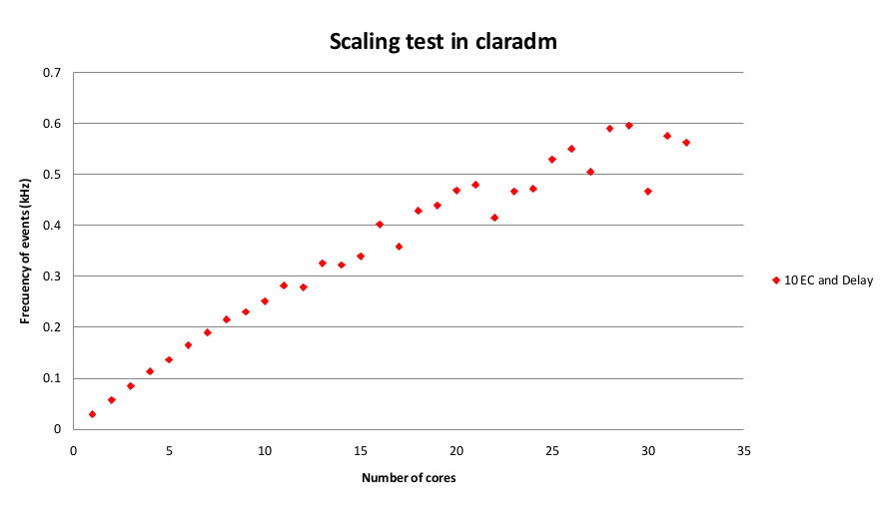
Multi-Core Reconstruction

Slide 23
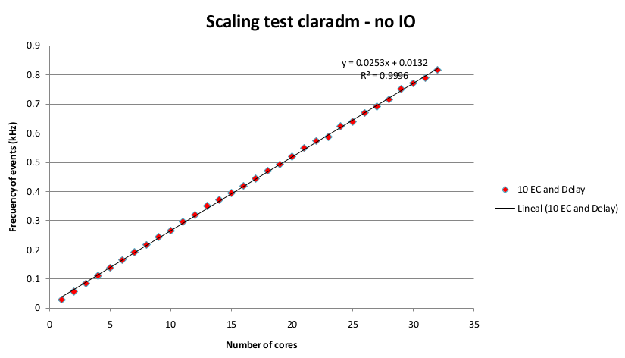
Multi-Core Reconstruction

Slide 24
Multi-Node Reconstruction
MO
DPE1
S1
S2
SN
S1
S2
SN
S1
S2
SN
DPE2
DPEio
R
S1
S2
SN
W
S1
S2
SN
S1
S2
SN
DO
DPEn
S1
S2
SN
S1
S2
SN
S1
S2
SN
MO

Slide 25
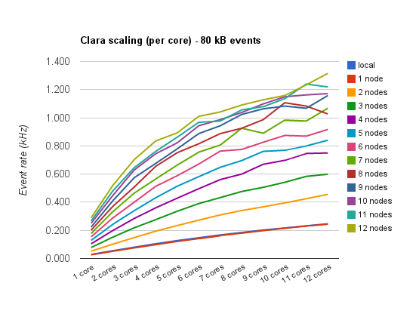
Multi-Node Reconstruction

Slide 26
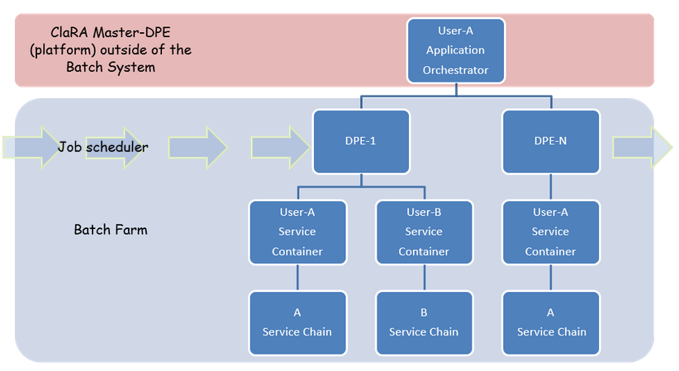
Batch Deployment

Slide 27
Online Farm
Offline University Cloud 1
Clas12 Detector
Electronics
Trigger
ET
Online Transient Data Storage
Online Monitoring
Services
Service Registration
Service Registration
Conditions
Database
Slow Controls
Online
EB
Services
Event
Visualization
Services
Permanent
Data Storage
Cloud Control
Cloud Control
Run Conditions
Services
Permanent
Data Storage
Online
Calibration
Services
Geometry
Calibration
Services
Calibration
Database
Online Application
Orchestrator
Service Control
Service Control
Conditions
Database
Calibration
Database
Cloud Scheduler
Run Conditions
Services
Physics Data Processing
Application Orchestrator
Geometry Calibration Services
Service Registration
Service Registration
Conditions
Database
Permanent
Data Storage
Cloud Control
Permanent
Data Storage
Geant 4
EB
Services
Calibration
Services
Cloud Control
DST
Histogram
Visualization
Services
Service Control
Service Control
Calibration
Database
GEMC
Simulation
Permanent
Data Storage
Analysis
Services
Offline JLAB Farm
Offline University Cloud n

Slide 28
Challenges
Increases author and user pools.
  Management and administration. Strict service canonization rules
Workloads of different clients may overwhelm a single service.
  Service and Cloud governance
Network security
  Client authentication and message encryption

Slide 29
Summary and Conclusion
A multi-treaded analyses framework, based on SOA
PDP application based on specialized services
  Small, independent
  Easy to test, update and maintain
  Building and running PDP application does not require CS skills.
List of applications has been developed using the framework
  Charge particle tracking (central, forward)
  EC reconstruction
  FTOF reconstruction
  PID
  HTCC
  PCAL
  Detector calibration
  Event Building
  Histogram services
  Database application
    Geometry, calibration constants and run conditions services
ClaRA supports both traditional and cloud computing
models and if need be we are ready for cloud deployment.

Slide 30
Links
https://clasweb.jlab.org/wiki/index.php/CLAS12_Software
https://clasweb.jlab.org/wiki/index.php/CLARA
https://clas12svn.jlab.org/repos/

Slide 31
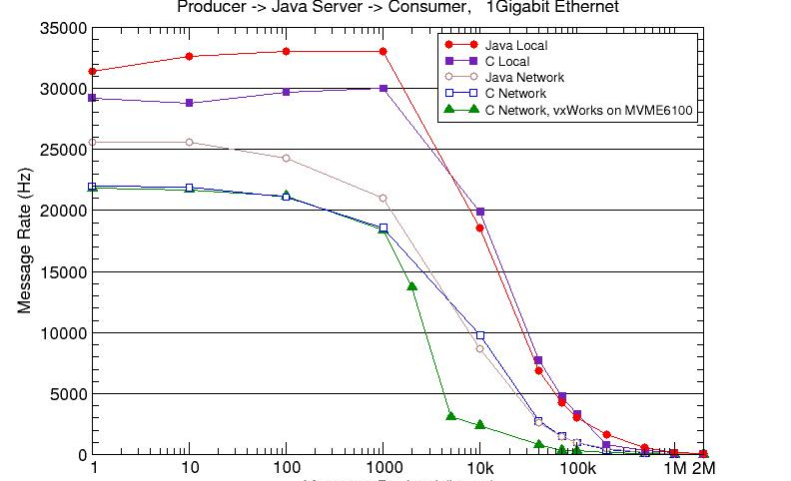
Service Bus Performance measurements
Control messages only
<0.03ms/message

Slide 32
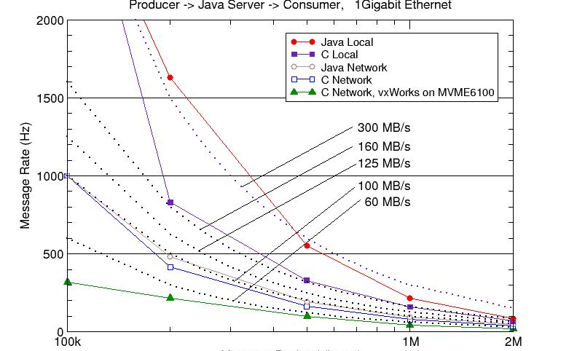
Service Bus Performance measurements

