Slide 1
FT Electron Corrections for New Callibration

Slide 2
File Path: Old correction from: /volatile/clas12/users/devita/2pi/rga-pass1v0/skim3/ New correction from : /volatile/clas12/users/devita/ft/vertex/dst/recon/005038/
Reaction Channel:
ep->e’p$π^{+}π^{−}$

Slide 3
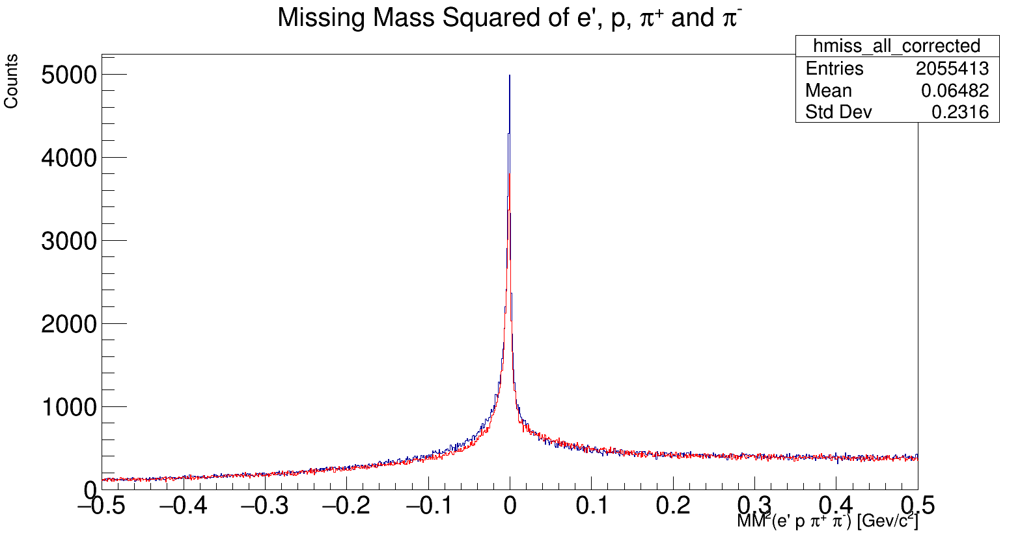
New correction from : /volatile/clas12/users/devita/ft/vertex/dst/recon/005038/
Corrected
Original

Slide 4
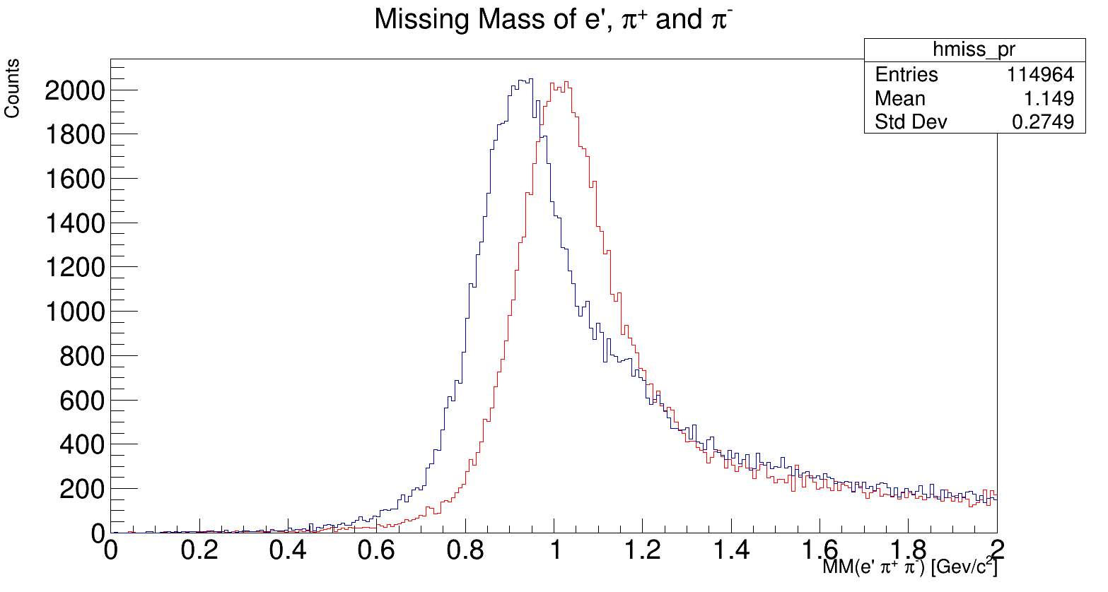
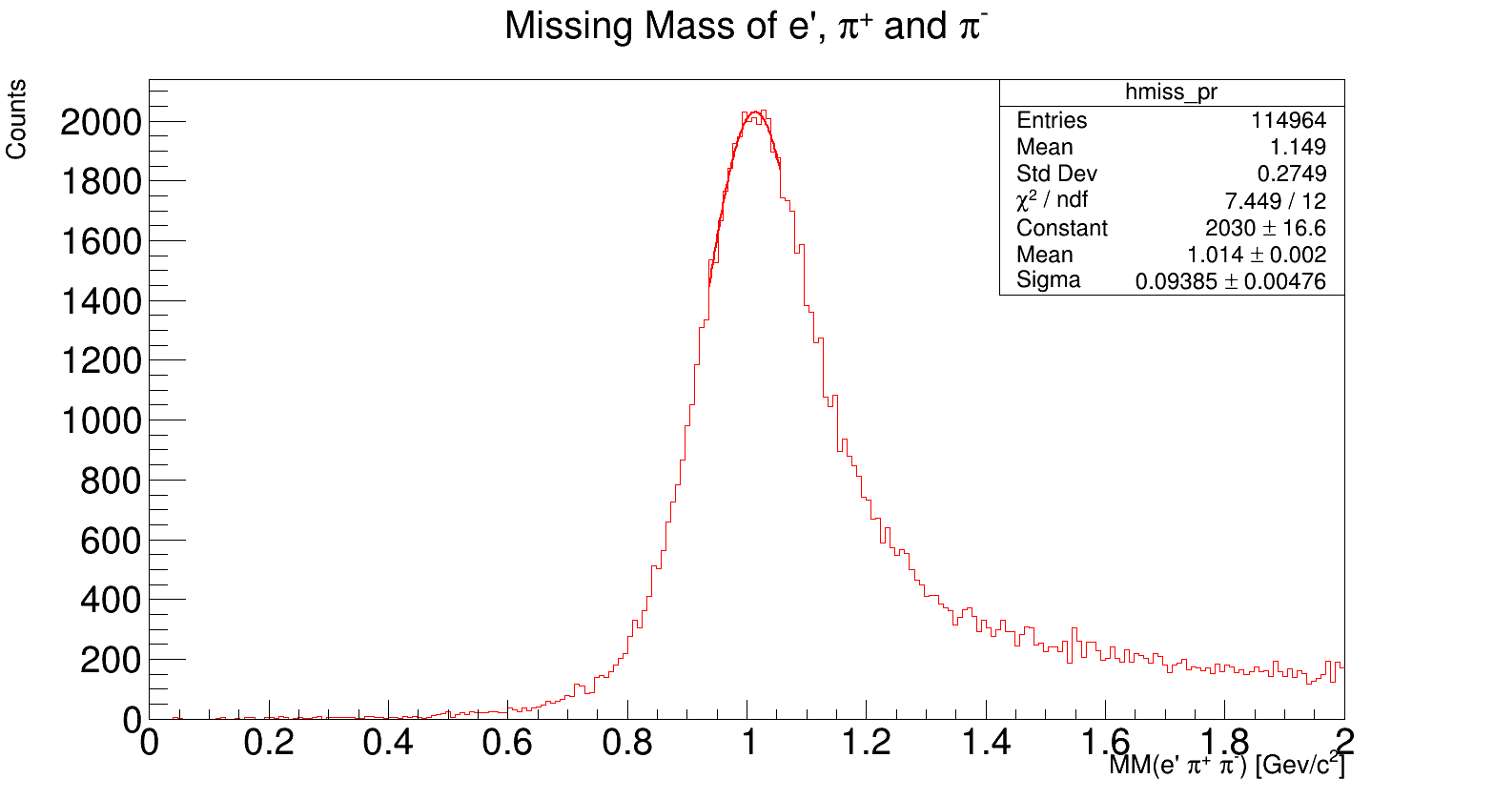
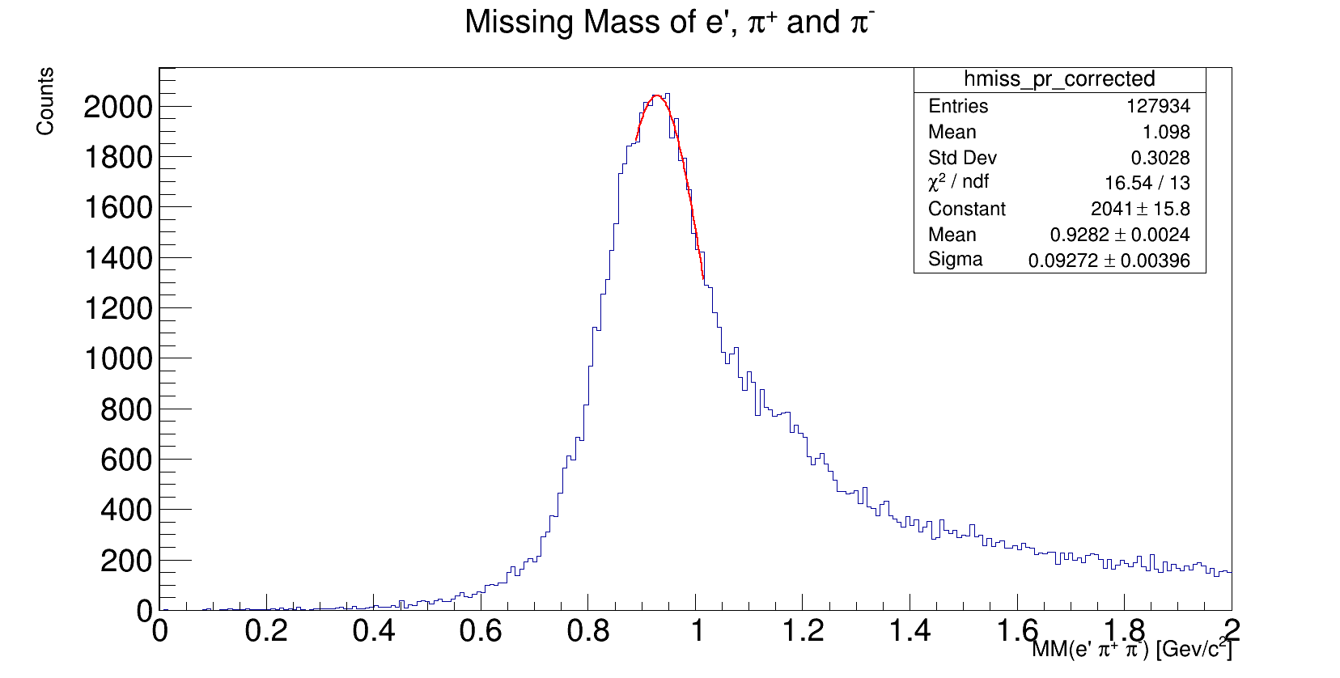
Corrected
Original
New correction from : /volatile/clas12/users/devita/ft/vertex/dst/recon/005038/
Before correct
After correct

Slide 5
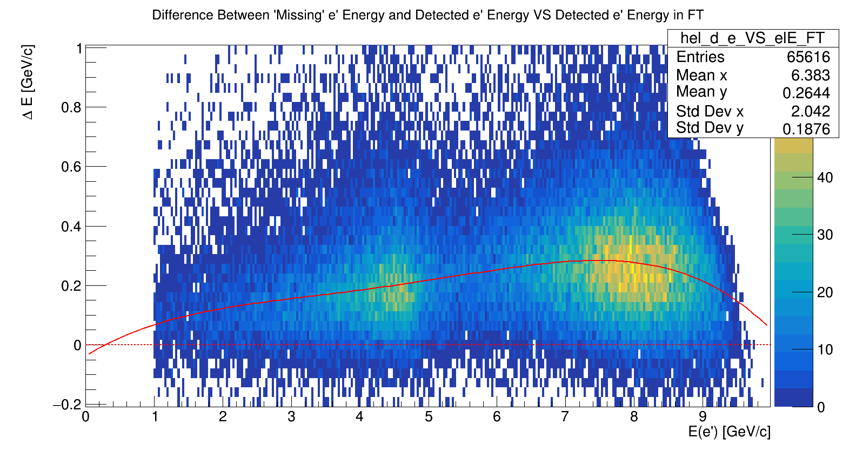
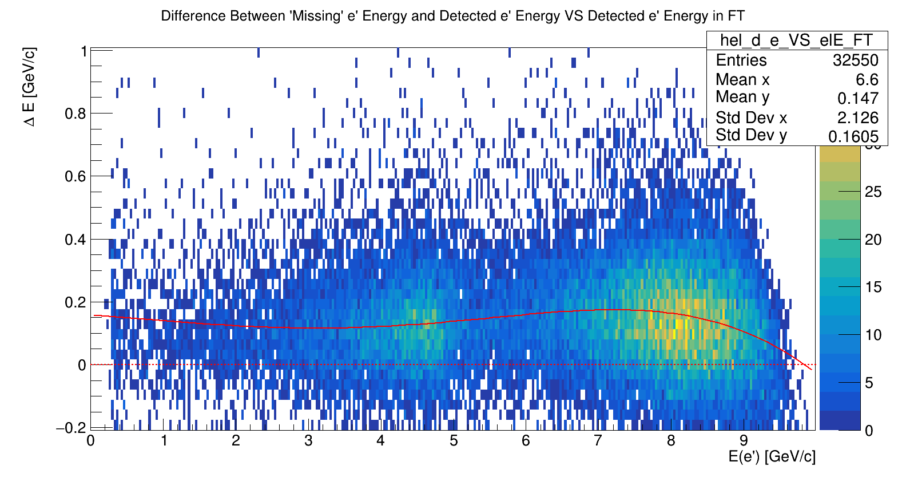
Old correction from: /volatile/clas12/users/devita/2pi/rga-pass1v0/skim3/
New correction from : /volatile/clas12/users/devita/ft/vertex/dst/recon/005038/

Slide 6
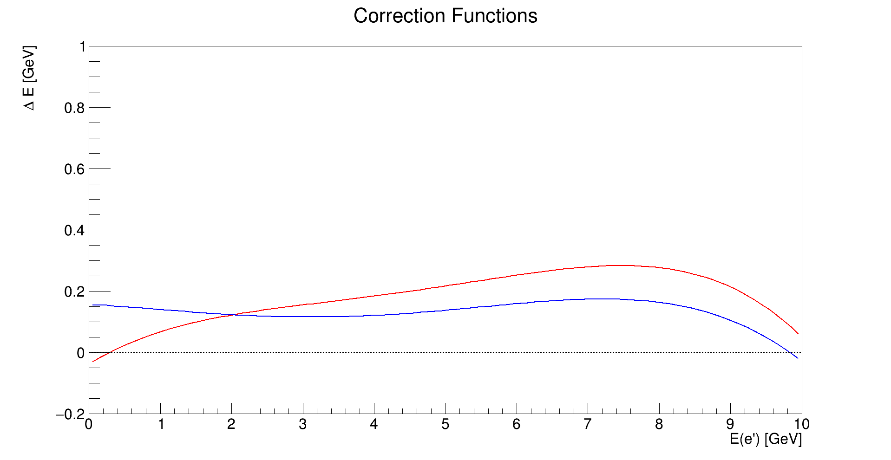
Old correction from: /volatile/clas12/users/devita/2pi/rga-pass1v0/skim3/
New correction from : /volatile/clas12/users/devita/ft/vertex/dst/recon/005038/

