Slide 1
Detached vertices validation
Generated ${\text{ep} →e^{′}k}^{+}Λ;$ $Λ →pπ^{−}$exclusive reaction using EdGen phase space generator
Coatjava tag 6c.6.3 used for running simulation/reconstruction
Common vertices information for any two charged tracks in REC:: Particle bank are stored in REC::VertDoca bank
Detected e’, k+, p, pi- in the final state in FD only
e’, k+ has a common vertices and p, pi- has another common vertices
Configuration used :: rga_fall2018

Slide 2
Calculate flight time for Lambda
Vector3D vtx_ppim = new Vector3D(x’, y’, z’);
Vector3D vtx_ekp = new Vector3D(x, y, z);
vtx_ppim.sub(vtx_ekp );
tof_Λ(ns) = vtx_ppim.mag()/29.97
p
$$e^{′}$$
(x’, y’, z’)
$$π^{−}$$
$${\text{ep} →e^{′}k}^{+}Λ;$$
$Λ →pπ^{−}$
(x1, cx1, y1, cy1, z1, cz1)
tof_Λ
(x,y,z)
(x2, cx2, y2, cy2, z2, cz2)
$$k^{+}$$
REC::VertDoca information
(x, y, z) :: common vertex of e’ and k+ (mid point of DOCA )
(x1, y1, z1)/(cx1, cy1, cz1) :: position/direction vector of the first track (e’) at the DOCA point (cm)
(x2, y2, z2)/(cx2, xy2, cz2) :: position/direction vector of the second track (k+) at the DOCA point (cm)
(x’, y’, z’) :: common vertex of p and pi- (mid point of DOCA ) and we also have position/direction vector of proton and pi- tracks at the DOCA point

Slide 3
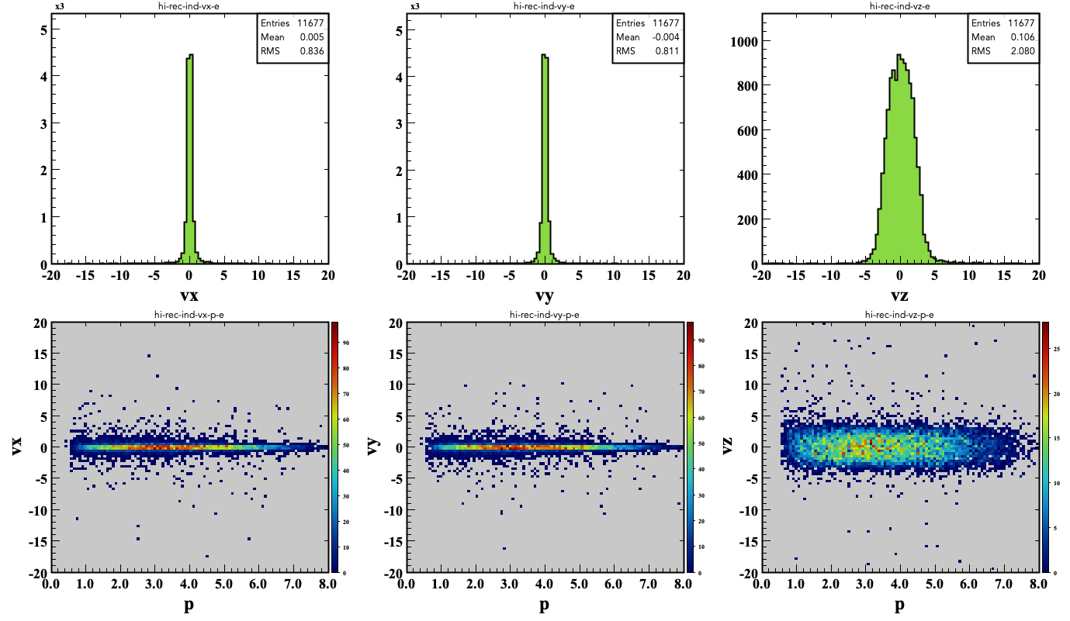
electron

Slide 4
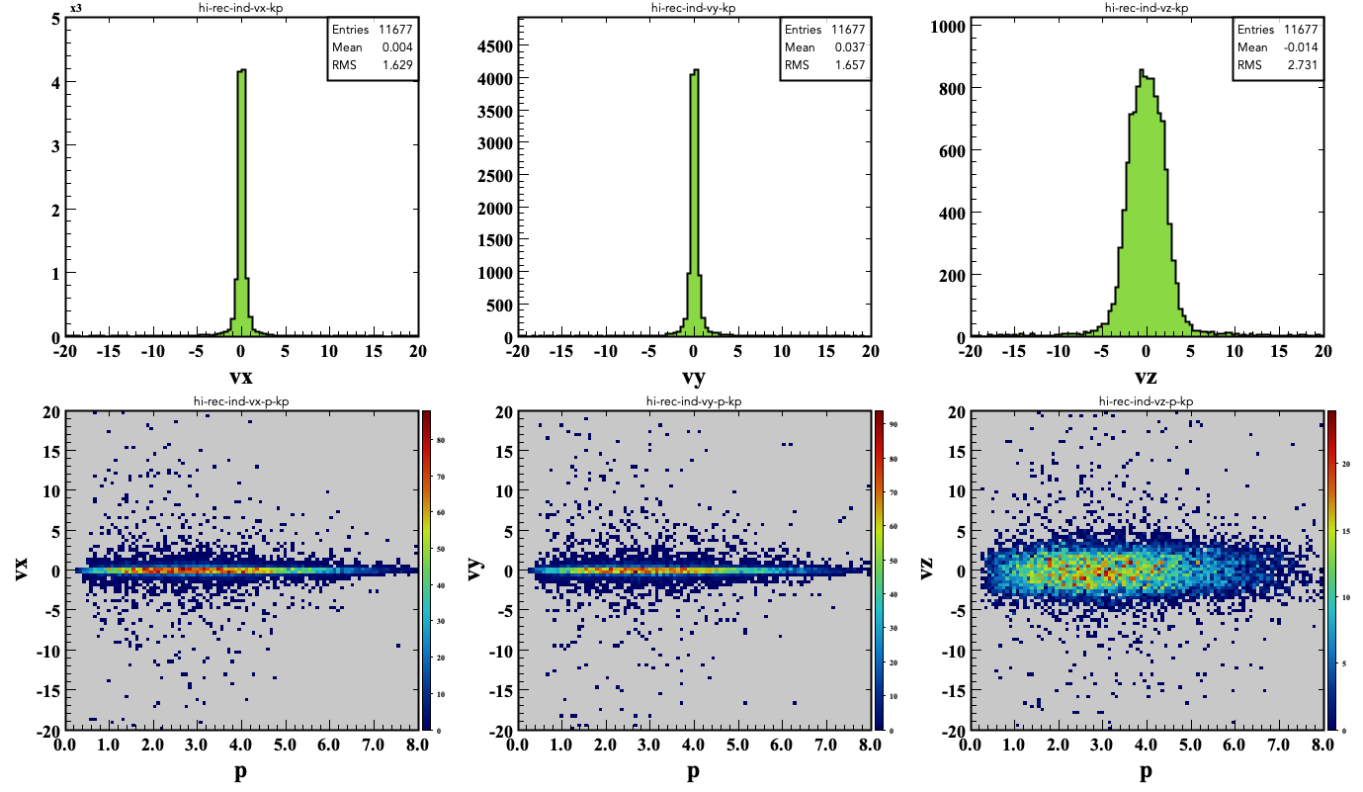
k+

Slide 5
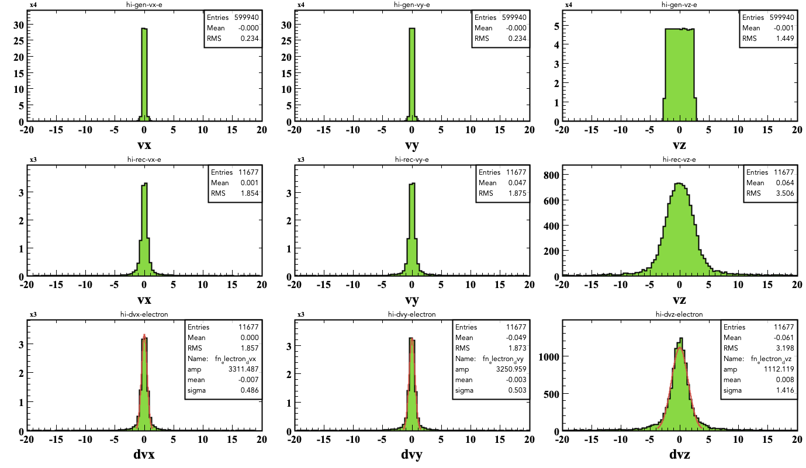
ek+ common vertices

Slide 6
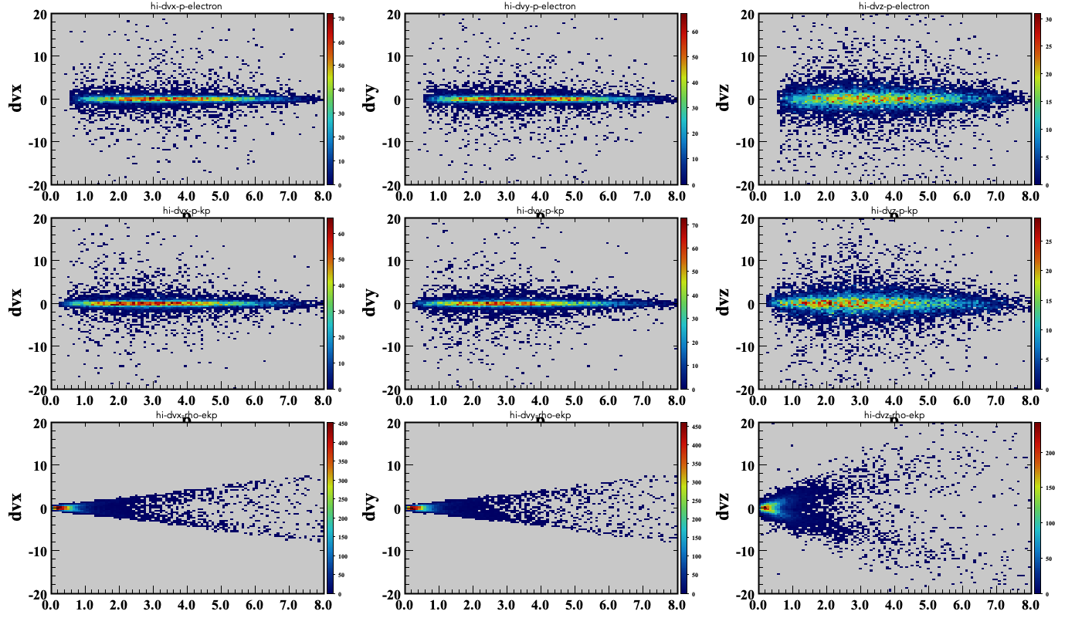
ek+ common vertices
e
k+
P (GeV)
x
x
r = sqrt(vx2 + vy2)

Slide 7
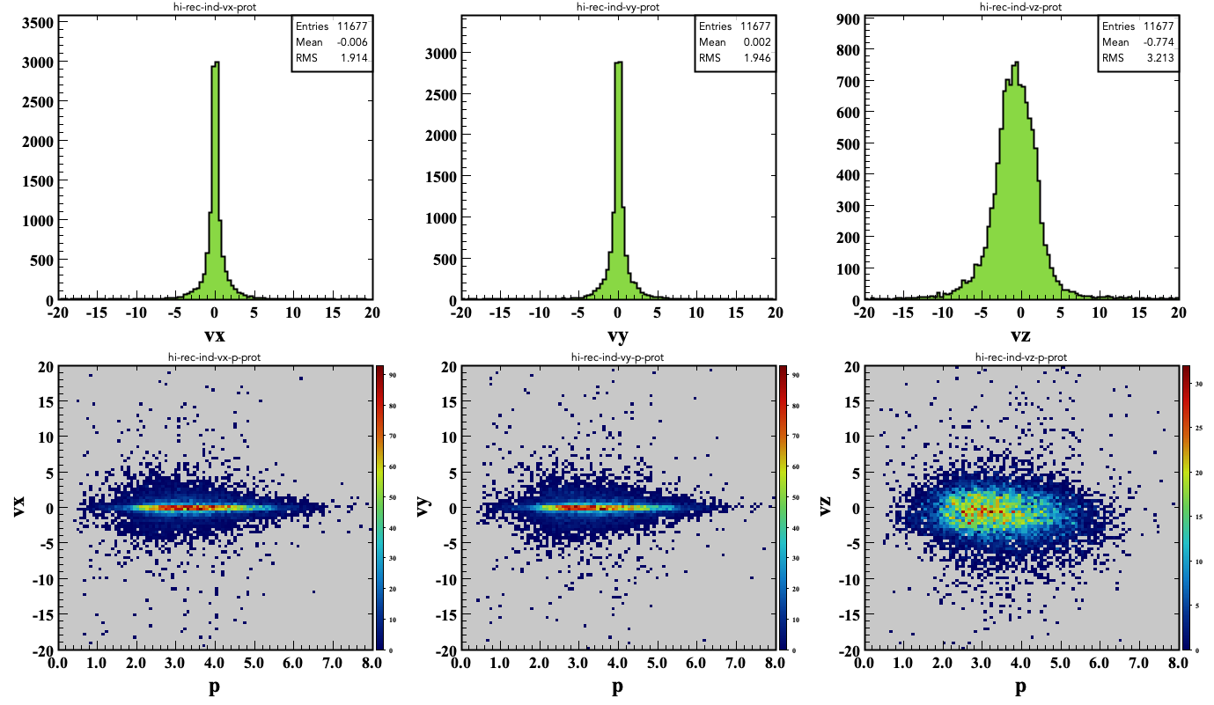
proton

Slide 8
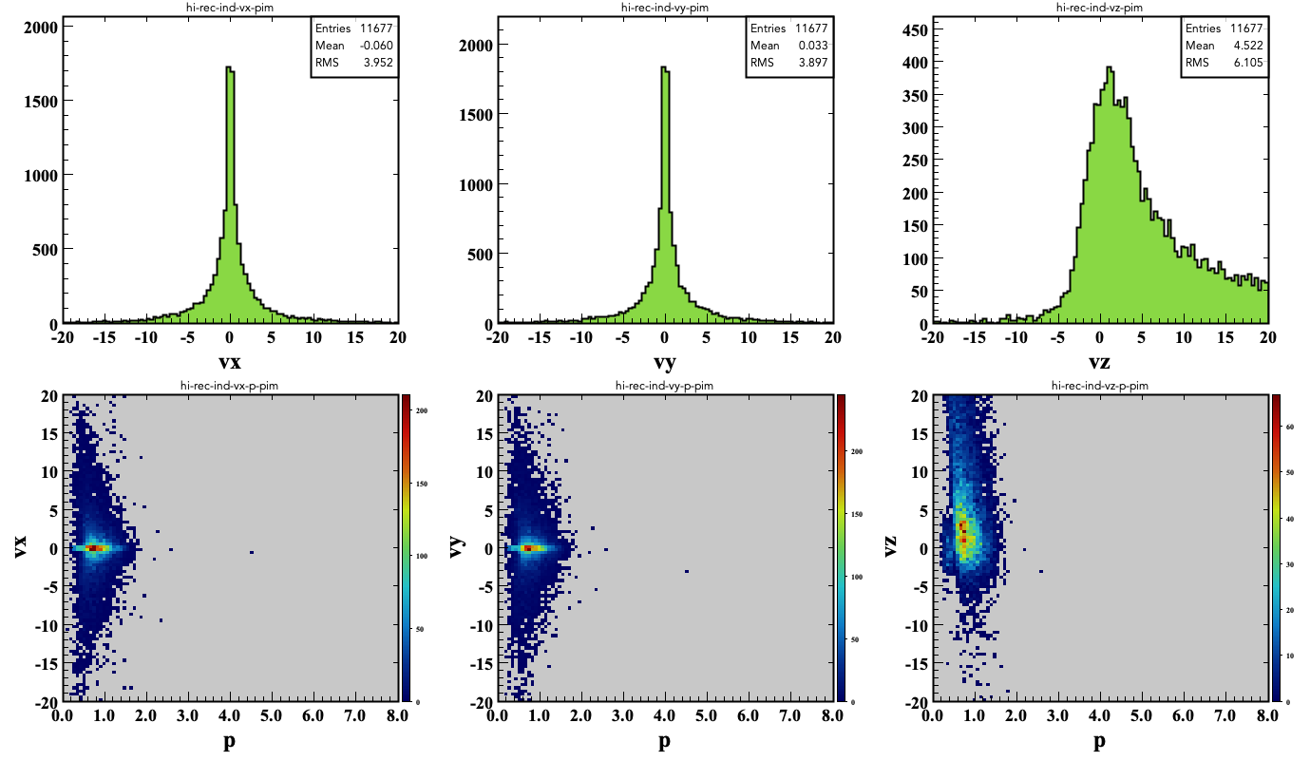
pi-

Slide 9
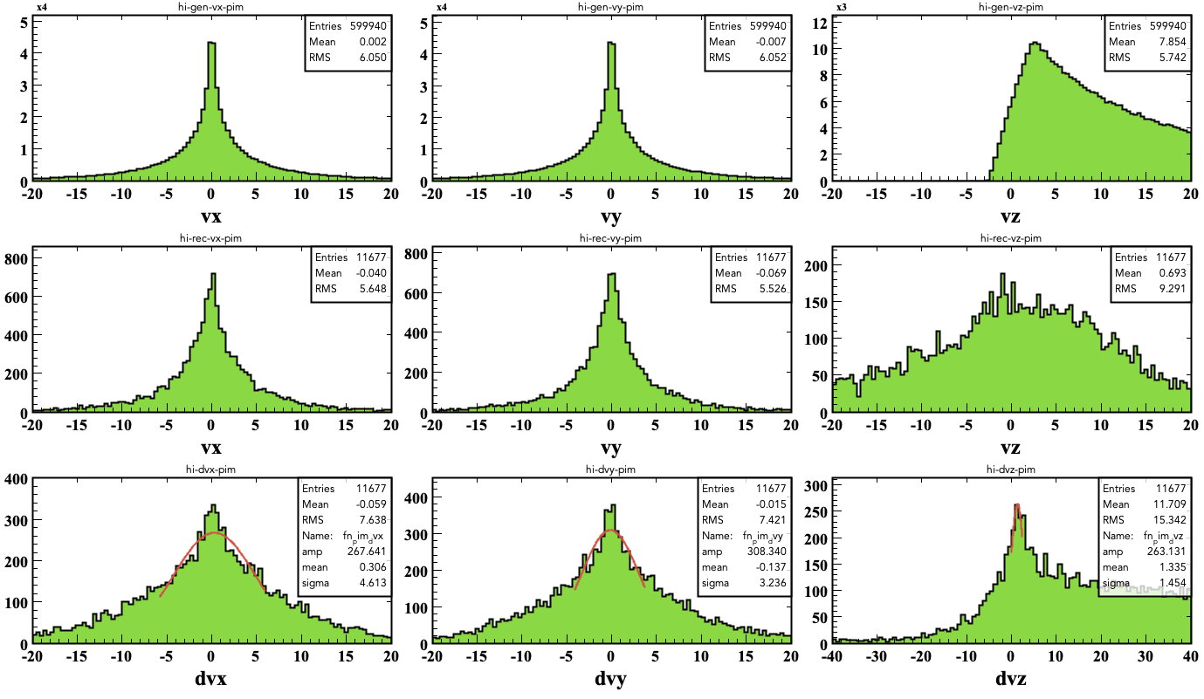
ppi- detached vertices

Slide 10
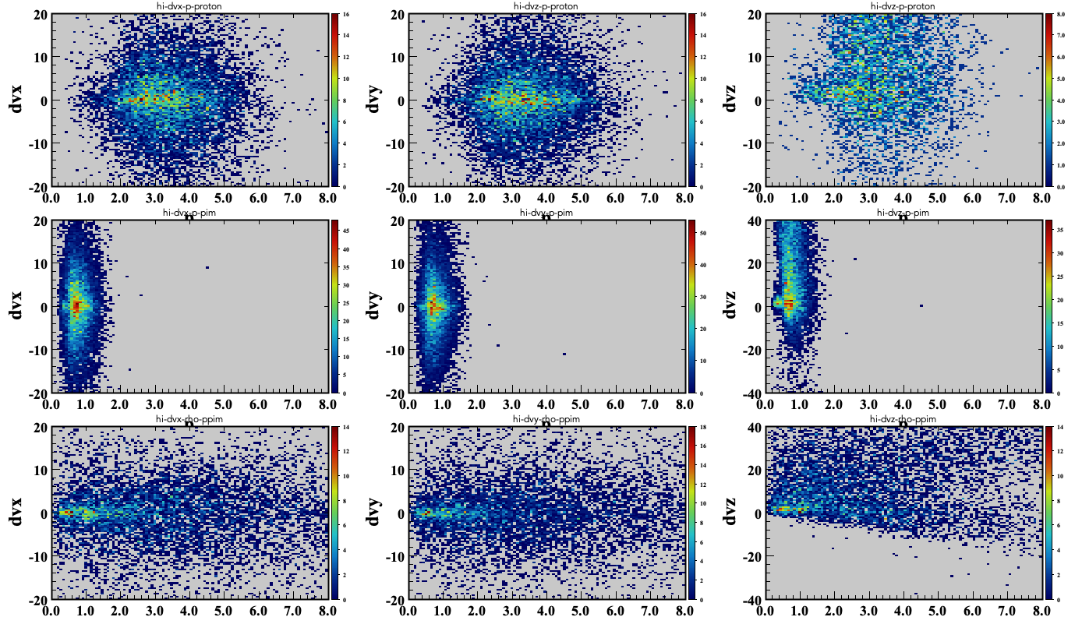
ppi- detached vertices
proton
pi-
P (GeV)
x
x
r = sqrt(vx2 + vy2)

Slide 11
e(FD)k+ppi-(CD)

Slide 12
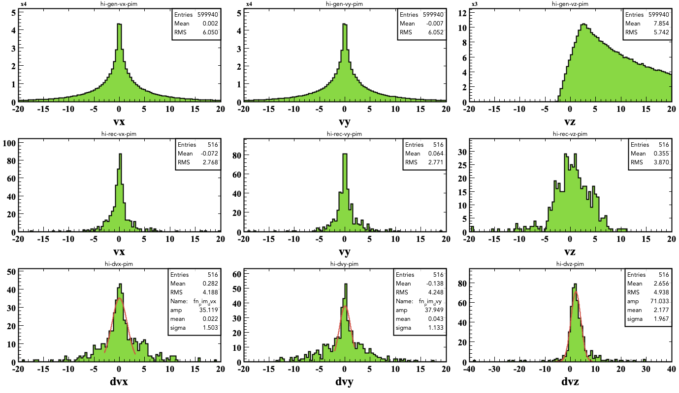
ppi- detached

Slide 13
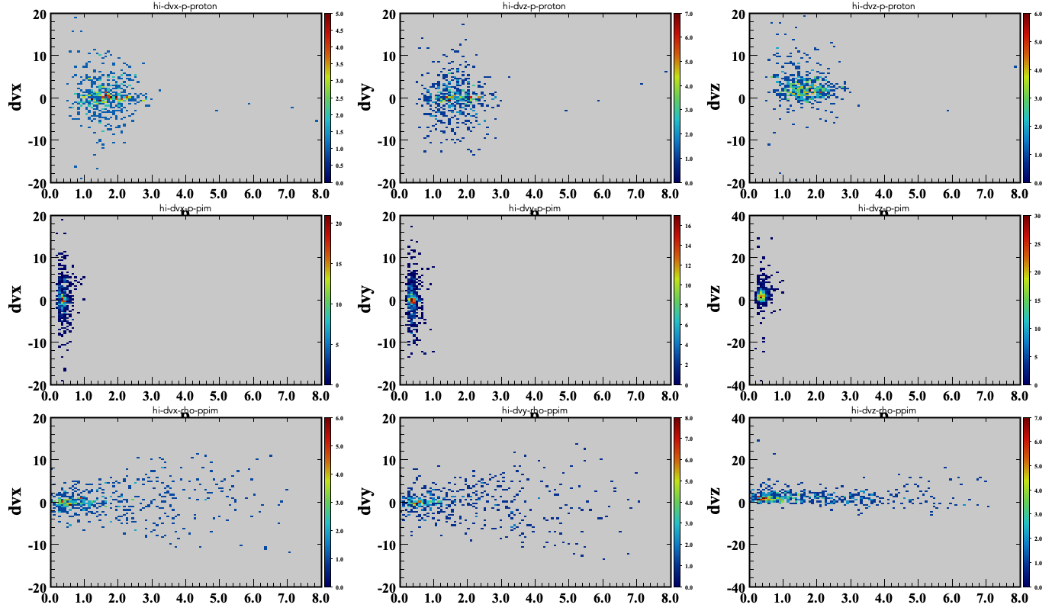
ppi- detached

Slide 14
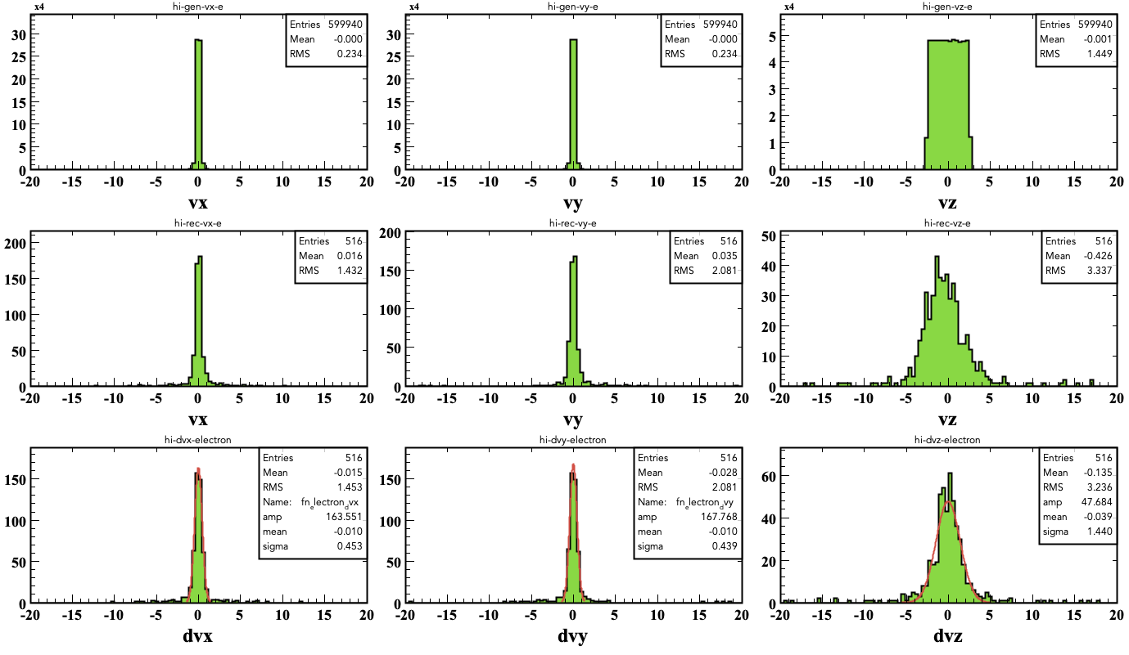
ek+

Slide 15
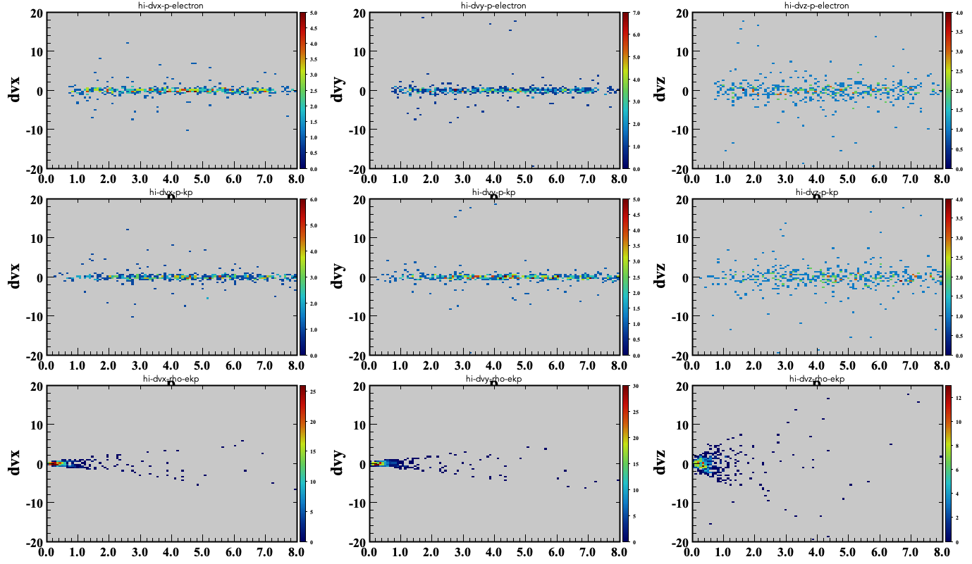
ek+

