Slide 1


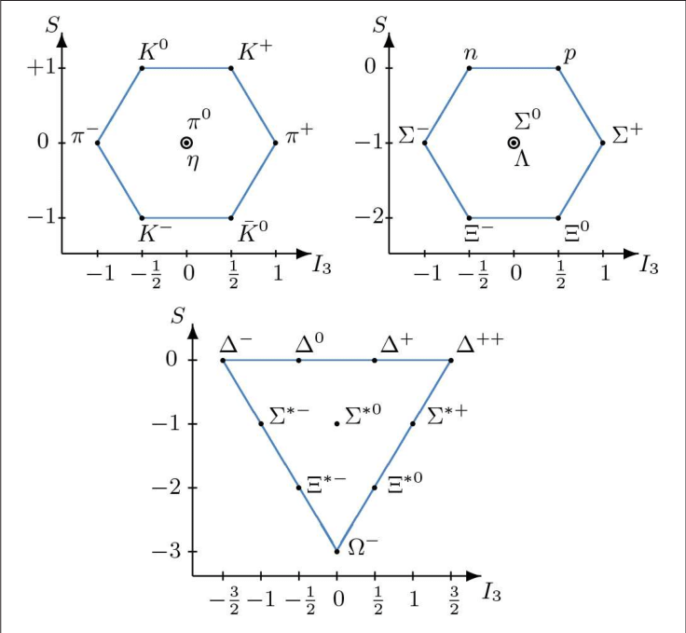
CLAS Collaboration Meeting, Summer 2024
From Strange to Very, Very Strange
Trevor Reed
On behalf of the Very Strange Group
This research was funded in part by the U.S. Department of Energy, Office of Nuclear Physics under contract No. DE-SC0013620

Slide 2
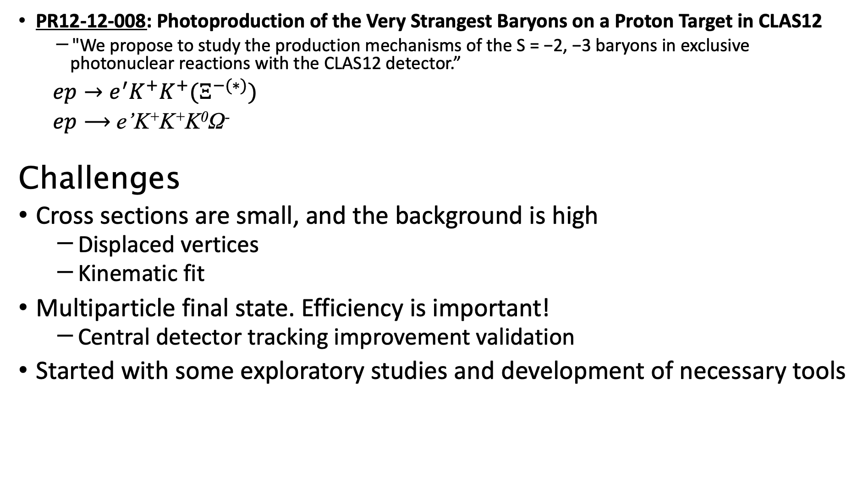
Overview
PR12-12-008: Photoproduction of the Very Strangest Baryons on a Proton Target in CLAS12
  "We propose to study the production mechanisms of the S = −2, −3 baryons in exclusive photonuclear reactions with the CLAS12 detector.”
  $ep→e^{′}K^{+}K^{+}(Ξ^{−(∗)})$
  $ep⟶$ e’K⁺K⁺K⁰Ω⁻
Challenges
Cross sections are small, and the background is high
  Displaced vertices
  Kinematic fit
Multiparticle final state. Efficiency is important!
  Central detector tracking improvement validation
Started with some exploratory studies and development of necessary tools

Slide 3
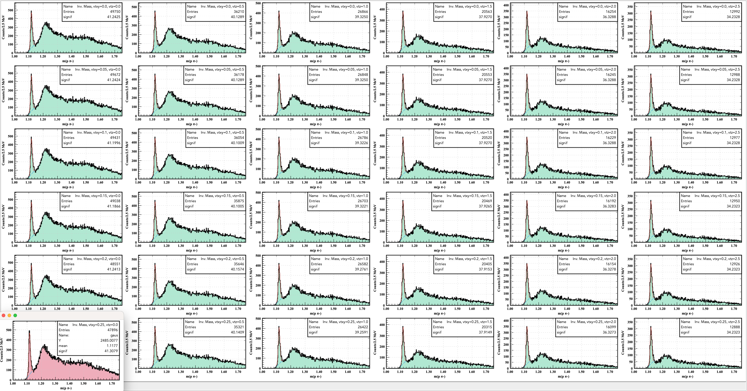
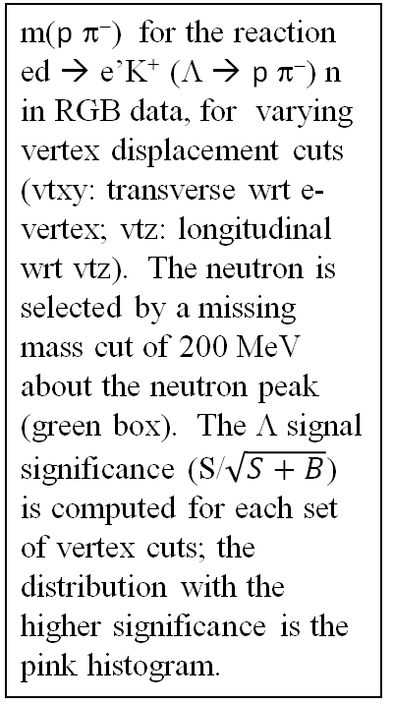
ed → e’K⁺ (Λ ◊ p π⁻) n in RGB data
Vertex displacement cut optimization
Veronique
Increasing longitudinal vertex cut
m(p π⁻) for the reaction ed → e’K⁺ (Λ ◊ p π⁻) n in RGB data, for varying vertex displacement cuts (vtxy: transverse wrt e- vertex; vtz: longitudinal wrt vtz). The neutron is selected by a missing mass cut of 200 MeV about the neutron peak (green box). The Λ signal significance (S/$\sqrt{S+B}$) is computed for each set of vertex cuts; the distribution with the higher significance is the pink histogram.
Increasing transverse vertex cut

Slide 4
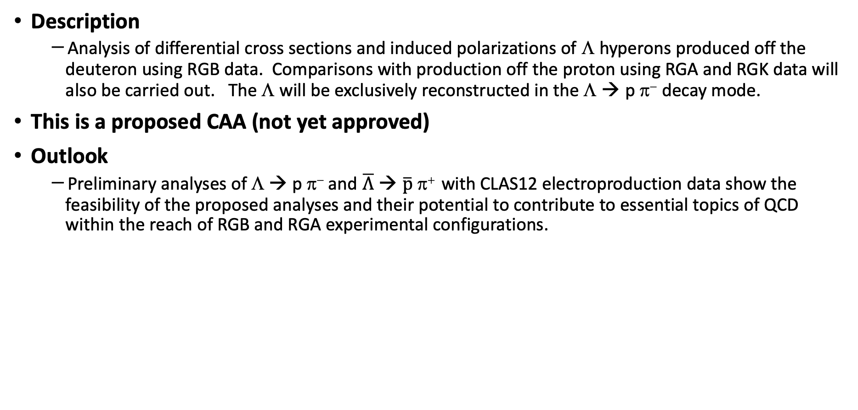
Outline
Description
  Analysis of differential cross sections and induced polarizations of Λ hyperons produced off the deuteron using RGB data. Comparisons with production off the proton using RGA and RGK data will also be carried out. The Λ will be exclusively reconstructed in the Λ ◊ p π⁻ decay mode.
This is a proposed CAA (not yet approved)
Outlook
  Preliminary analyses of Λ → p π⁻ and $\overline{Λ}$ ◊ $\overline{p}$ π⁺ with CLAS12 electroproduction data show the feasibility of the proposed analyses and their potential to contribute to essential topics of QCD within the reach of RGB and RGA experimental configurations.
Veronique

Slide 5
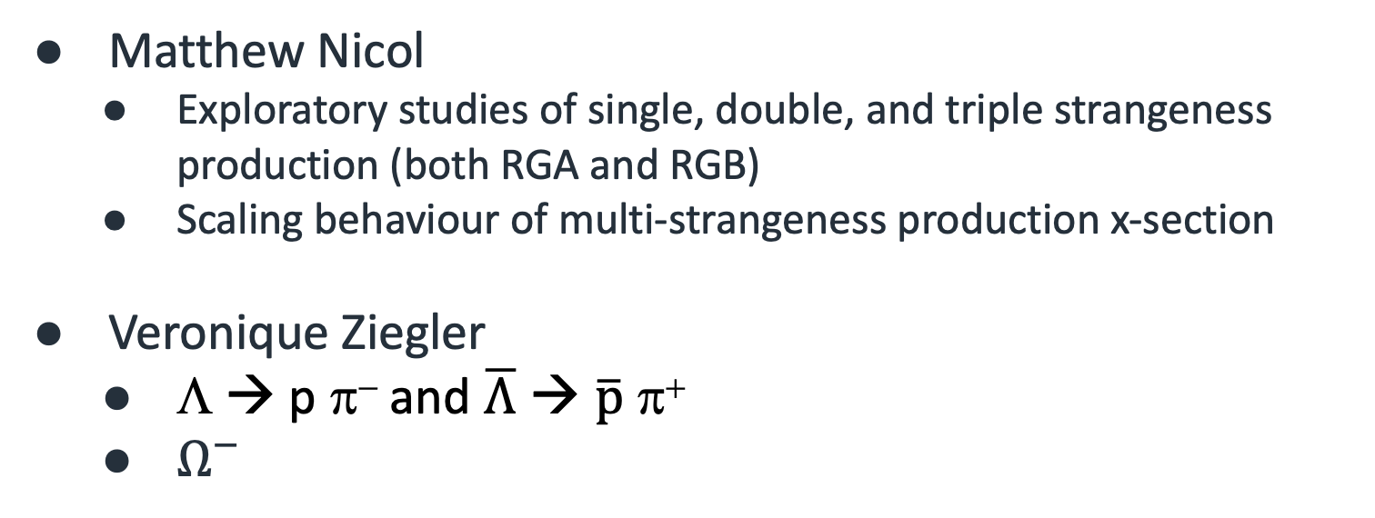
Exploratory Studies
Matthew Nicol
  Exploratory studies of single, double, and triple strangeness production (both RGA and RGB)
  Scaling behaviour of multi-strangeness production x-section
Veronique Ziegler
  Λ → p π⁻ and $\overline{Λ}$ ◊ $\overline{p}$ π⁺
  $Ω^{−}$
Identified issues:
Statistics
Resolution

Slide 6
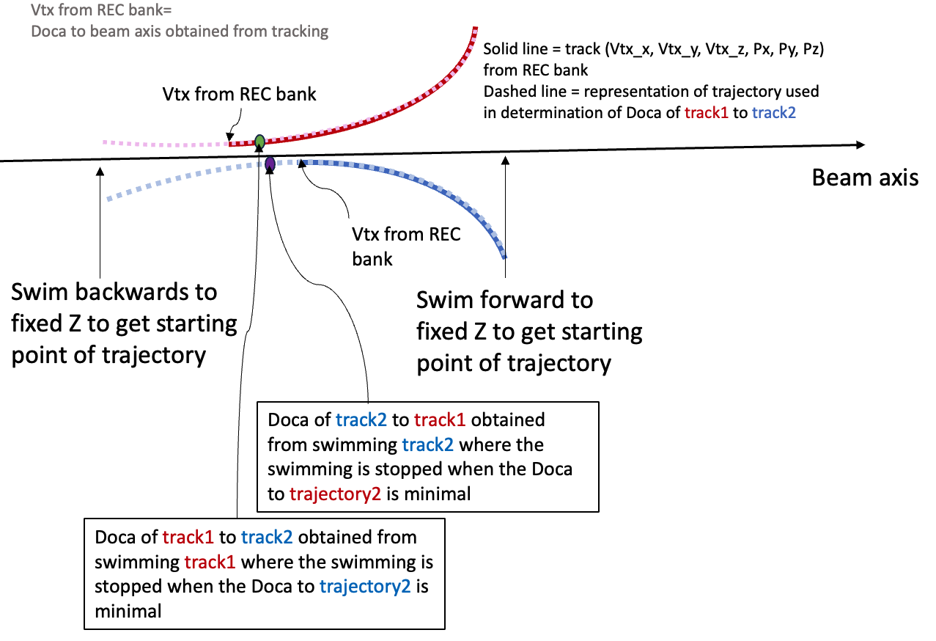
Study of Lambda production off the proton and off the deuteron using displaced vertex reconstruction
Analyses of the reactions
ed → e’ K+ Λ(→ pπ− ) (X) 70% of RGB Pass-2 Spring 2019 dataset
ep → e’ K+ Λ(→ pπ− ) (X) 25% of RGA Pass-2 Spring 2019 dataset
ep → e’ K+ Λ(→ pπ− ) (X) 95% of RGK Pass-2 Fall 2018 7.5 GeV dataset
Analysis based on the following reconstruction
  Exclusive reconstruction of Λ candidate into pπ− decay mode
  Pass-2 datasets
  Using vertexing package to select Λ candidates
  Set of cuts include
    chi2PID
    Vertex DOCA between the p π− tracks
    Vertex displacement cuts to e- vertex (Vtxy: transverse; Vtz:longitudinal)
    Requirement of tracks (p, π, K) to be in CD or FD
Veronique

Slide 7
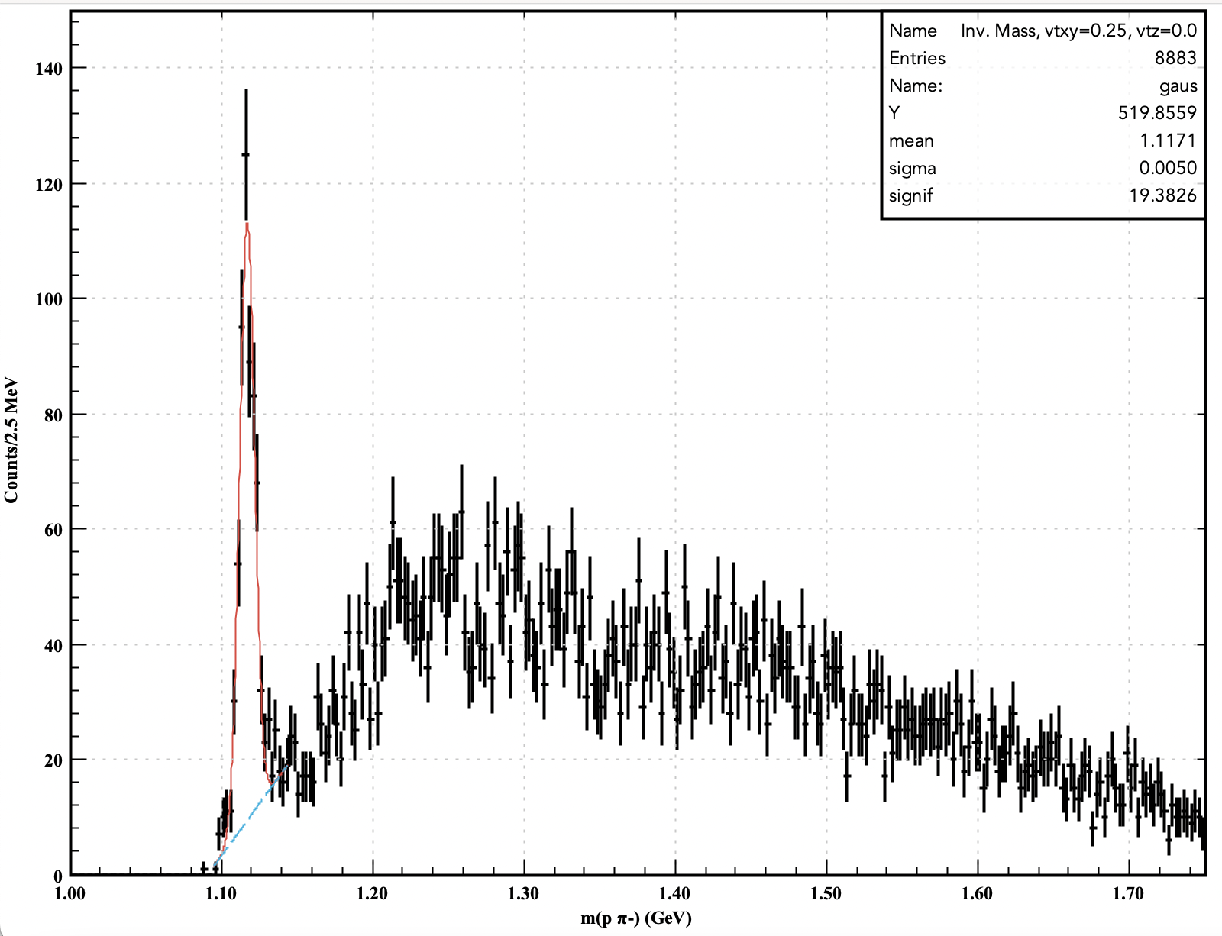
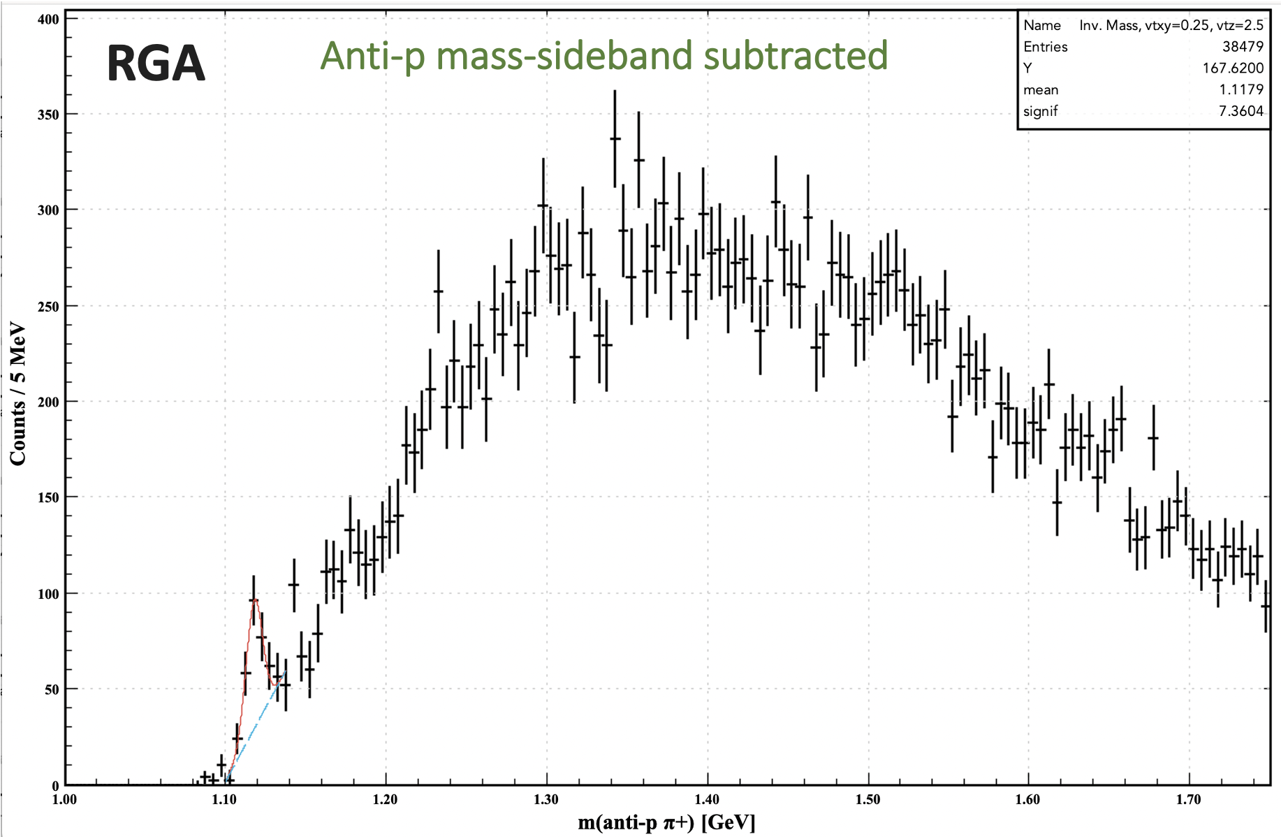
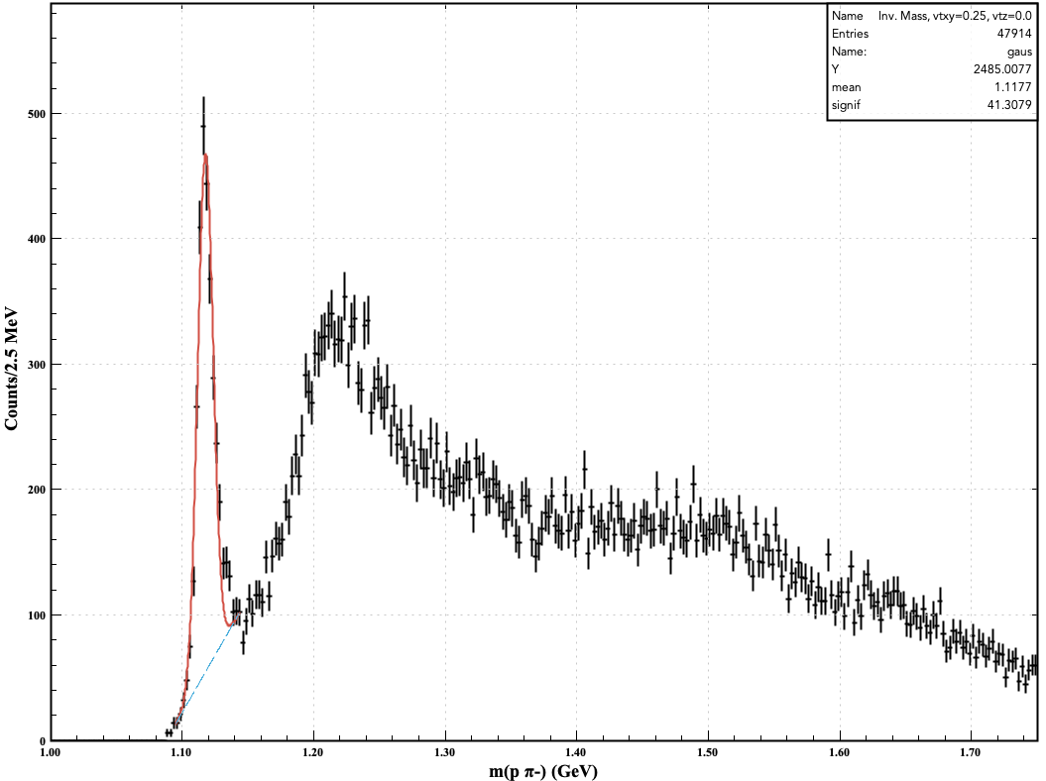



Study of exclusive Λ→ pπ⁻ and $\overline{Λ}$ ◊ $\overline{p}$ π⁺ production in RGA & RGB data
Veronique
Integrated over all Q²
85% of Spring 2019 Dataset
RGA
$M(pπ^{−})$ [GeV]
Integrated over all Q²
$M(\overline{p}π^{+})$ [GeV]
Outlook
  These preliminary analyses show the feasibility of the proposed analyses and their potential to contribute to essential topics of QCD within the reach of RGB and RGA experimental configurations.
RGB
Cut on MM(e-K+p π−) to select the neutron
$M(pπ^{−})$ [GeV]

Slide 8
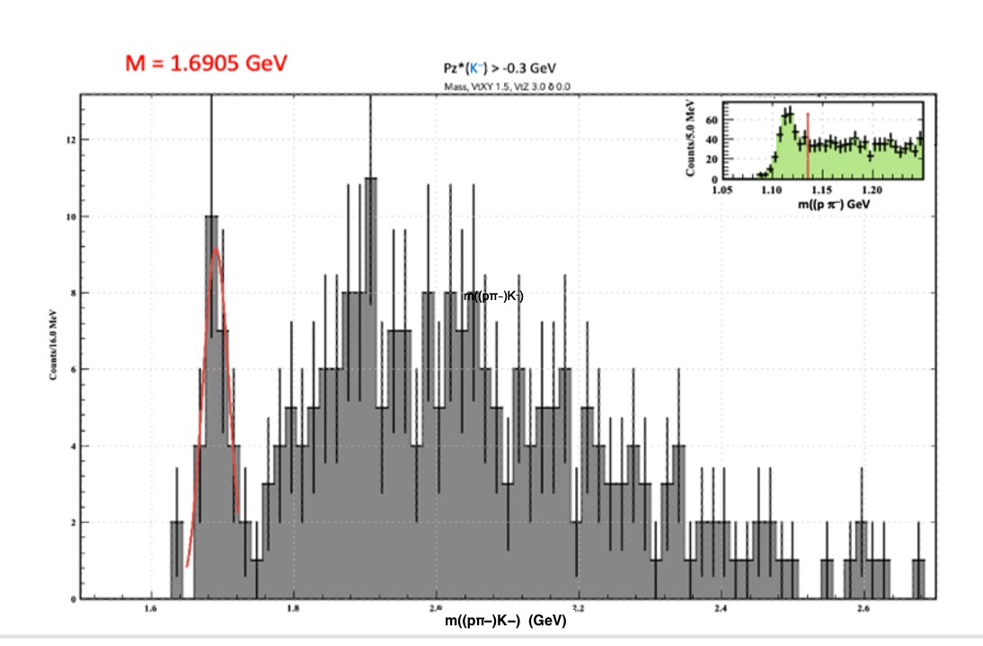
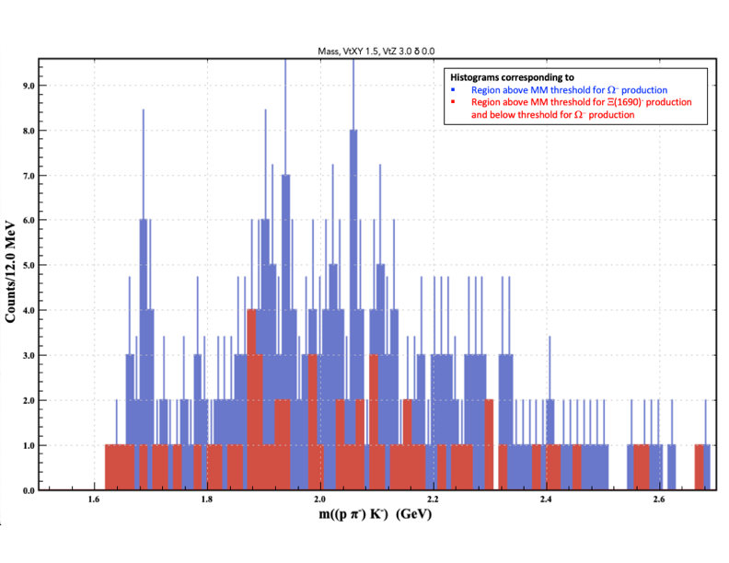
Search for Ω⁻
Search for the Ω⁻ in the reaction ep → e′ΛK⁻(X), Λ → pπ⁻ using the RG-A fall 2018 and spring 2019 datasets.
  Select events containing at least one proton, one negative pion, and one negative kaon.
  Algorithm estimating the position of the Λ hyperon detached vertex used to improve the signal-to-background ratio.
An excess of events in the expected Ω⁻ region is observed with a statistical significance close to 3σ.
Possible ambiguity for an observed signal in the expected Ω region: The Ξ⁻(1690) resonance also decays to ΛK⁻.
MM threshold (0.85 GeV) for doubly strange Ξ⁻(1690) is lower than that for Ω⁻. We compare m((pπ⁻)K⁻) spectra corresponding to Ξ⁻(1690) and Ω⁻ production thresholds to study possible contamination from Ξ⁻(1690) to the peak Ω⁻.
Need for more statistics to resolve ambiguity.
Within the remaining approved RG-A beam time, we expect to collect several times more statistics for this reaction.
If the signal is confirmed, it will constitute the first observation of the Ω⁻ in electroproduction.
Preliminary
Preliminary

Slide 9
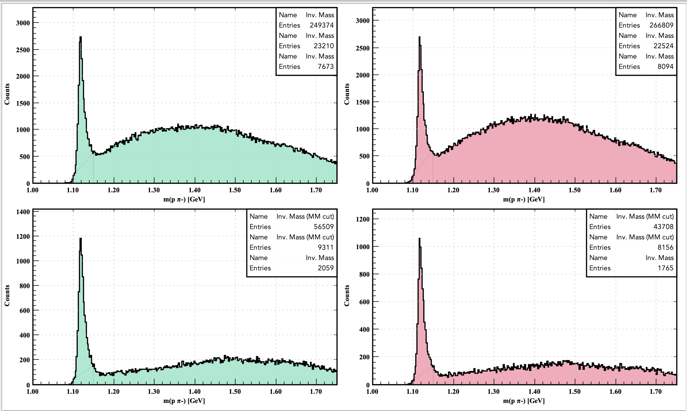
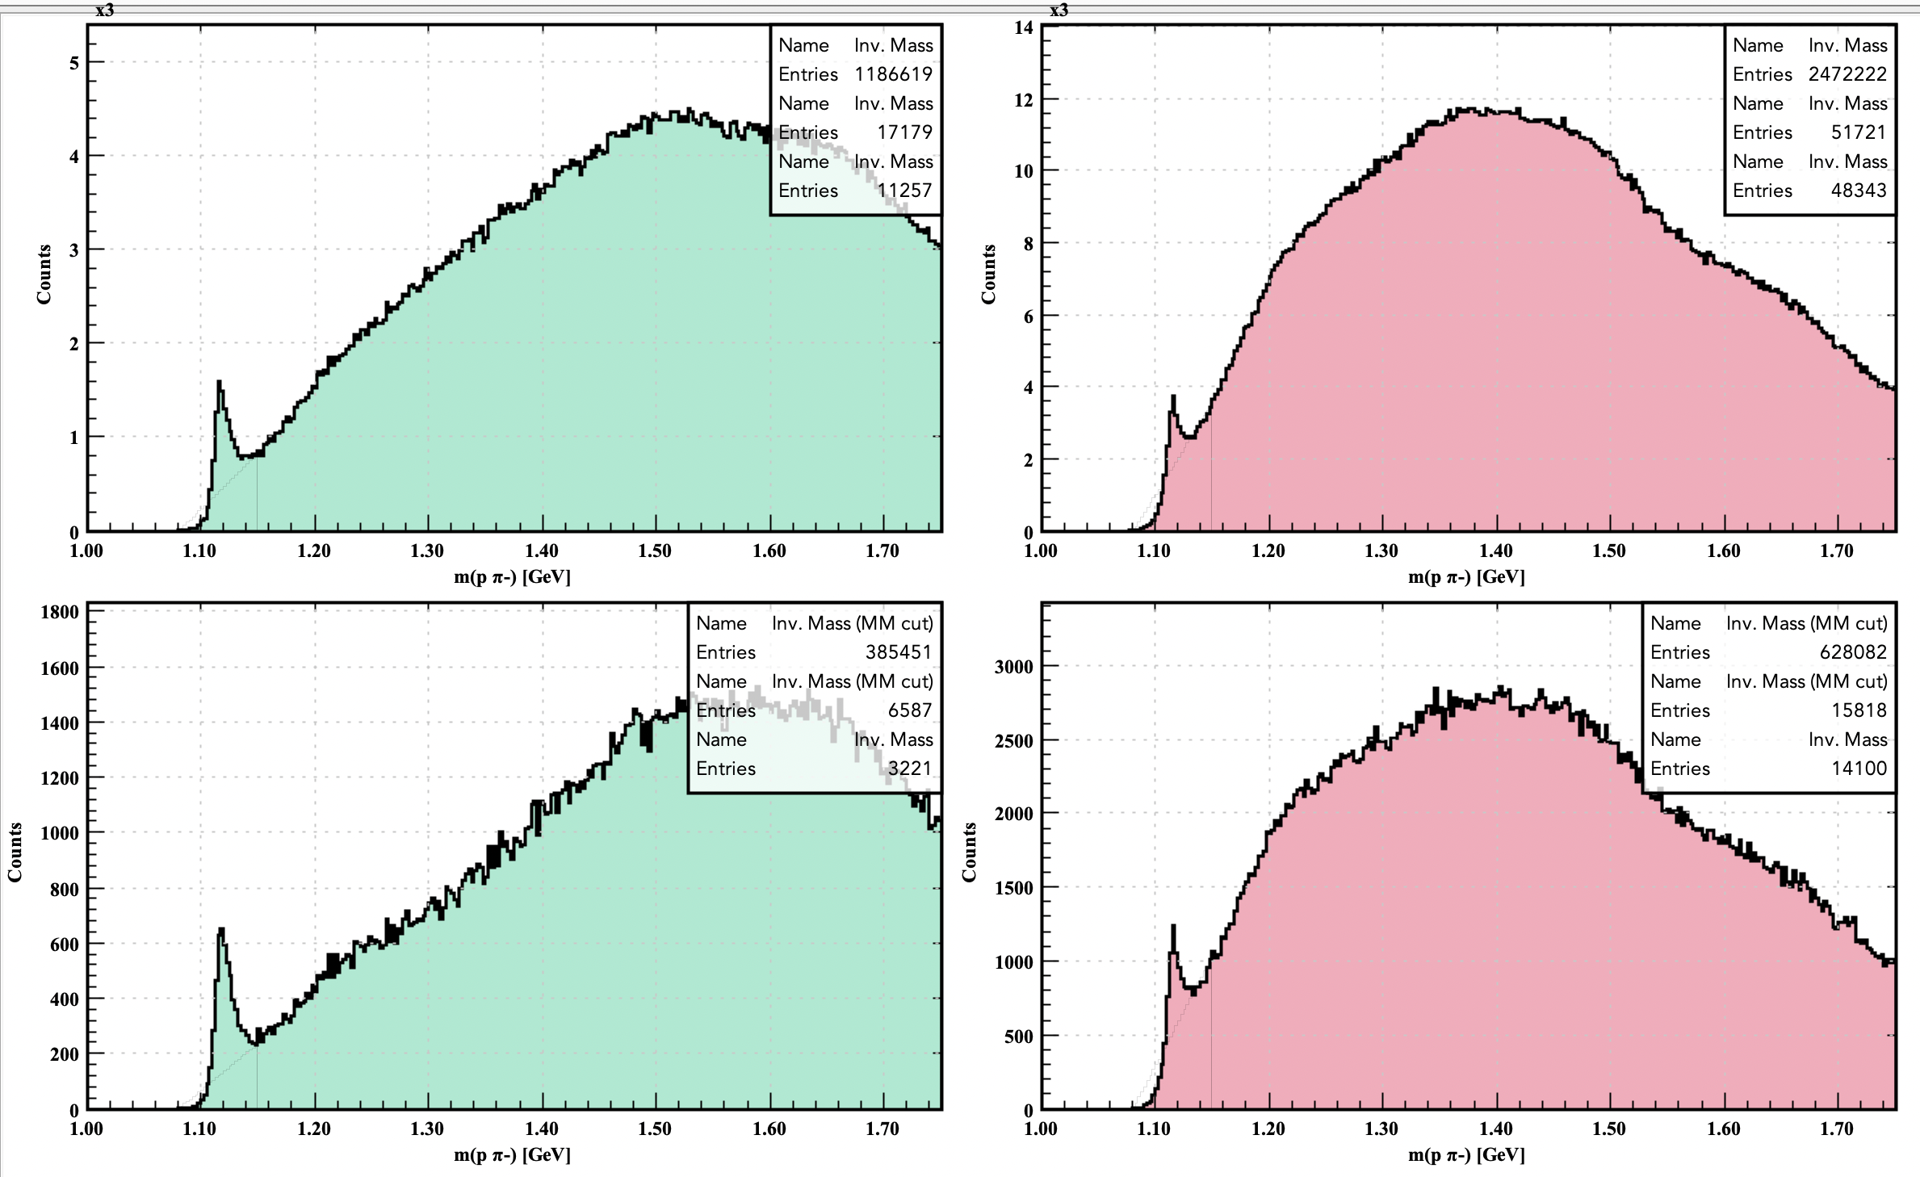
Study of exclusive Λ→ pπ⁻ production in RGK 7.5 GeV data
p in FD or CD, π⁻ in FD or CD, K in FD
p in FD or CD, π⁻ in FD or CD, K in CD
e- in FT e- in ECAL
e- in FT e- in ECAL
Bottom row: cut on MM(e-p π⁻) to select the K+ in the reaction e p → e-K⁺ p π⁻
Veronique

Slide 10
Search for Λ → p π⁺ using 85% of the Spring-2019 Pass-2dataset
The anti-proton mass-sideband subtracted m($\overline{p}$ π⁺ ) distribution.
Veronique

Slide 11
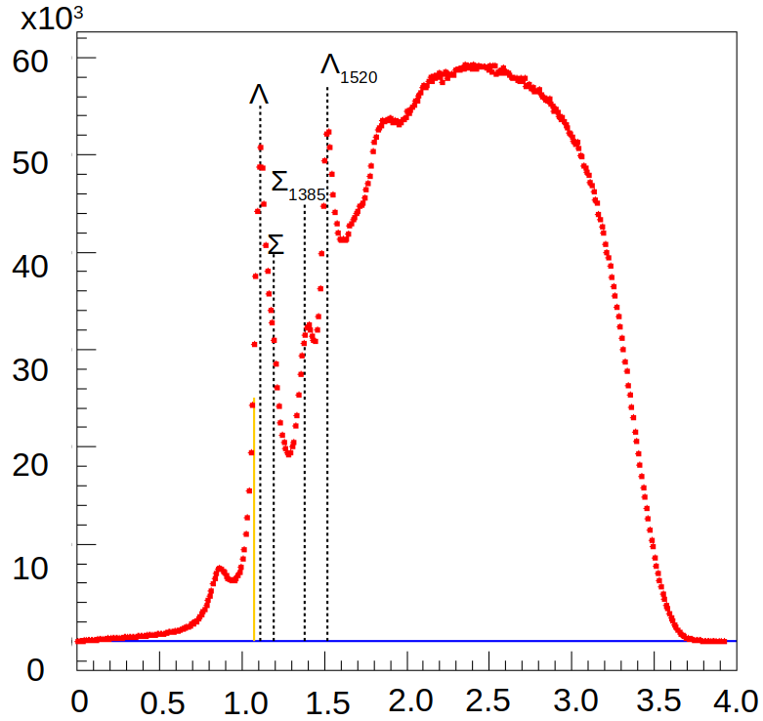
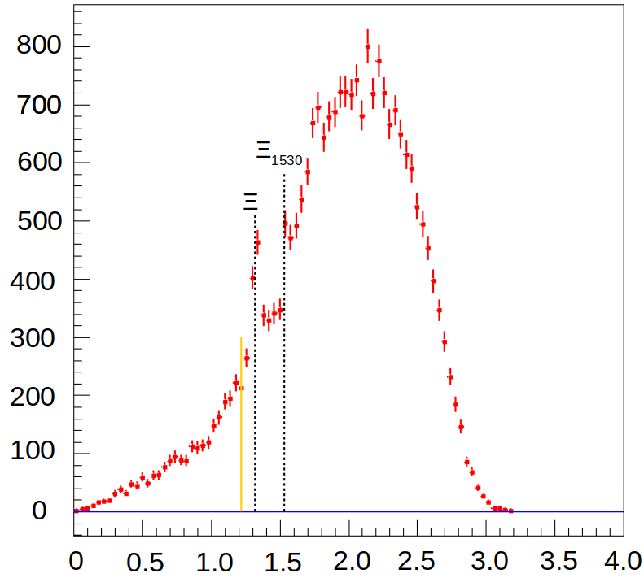
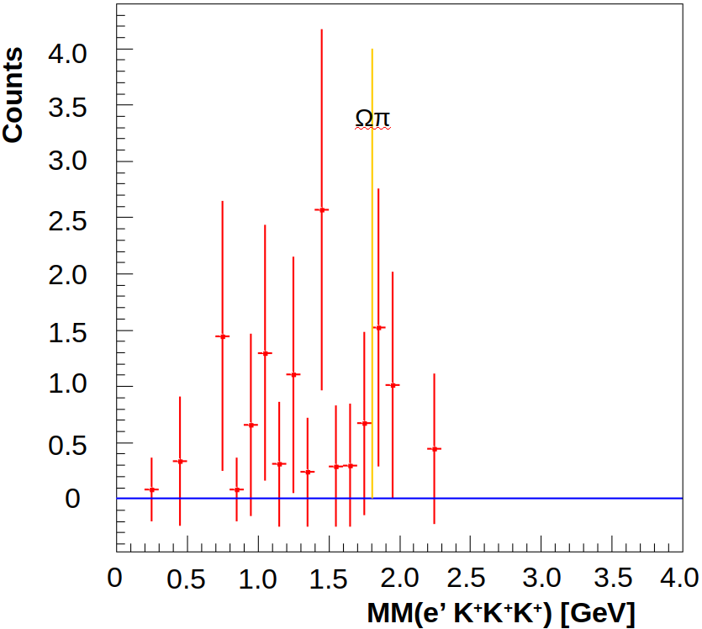
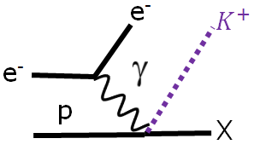
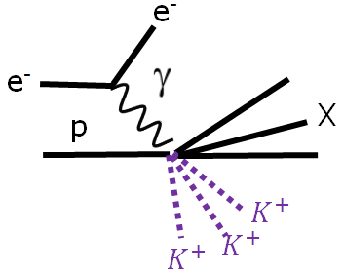
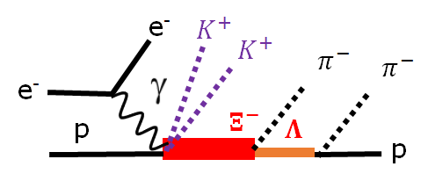
Exploratory studies of strangeness production
Counts
preliminary
MM(e’ K⁺ X) [GeV]
MM(e’ K⁺ K⁺ K⁺ X) [GeV]
MM(e’ K⁺ K⁺ X) [GeV]
*
*
*

Slide 12
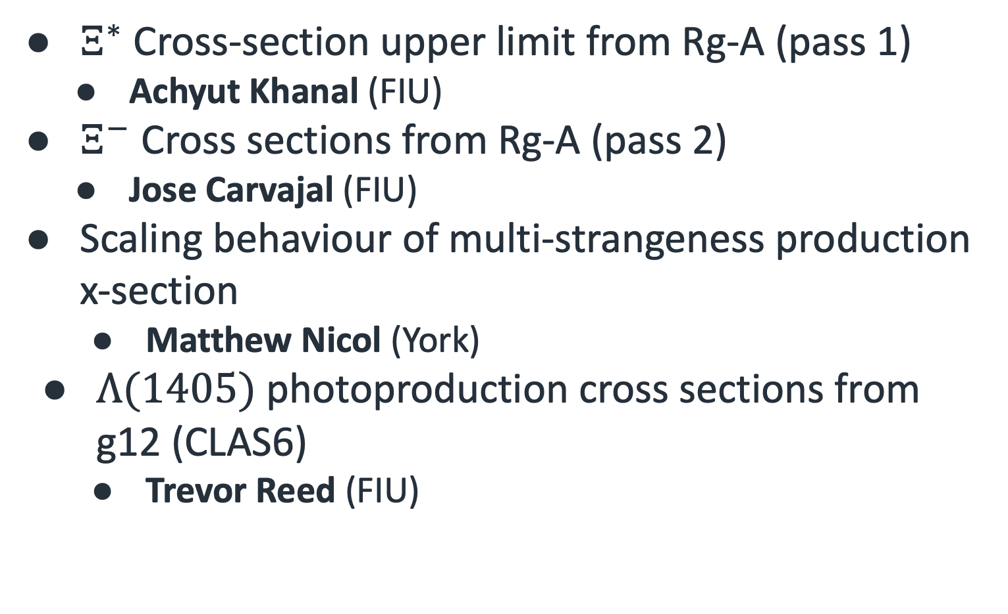
Recent Work
$Ξ^{∗}$ Cross-section upper limit from Rg-A (pass 1)
  Achyut Khanal (FIU)
$Ξ^{−}$ Cross sections from Rg-A (pass 2)
  Jose Carvajal (FIU)
Scaling behaviour of multi-strangeness production x-section
  Matthew Nicol (York)
$Λ(1405)$ photoproduction cross sections from g12 (CLAS6)
  Trevor Reed (FIU)

Slide 13
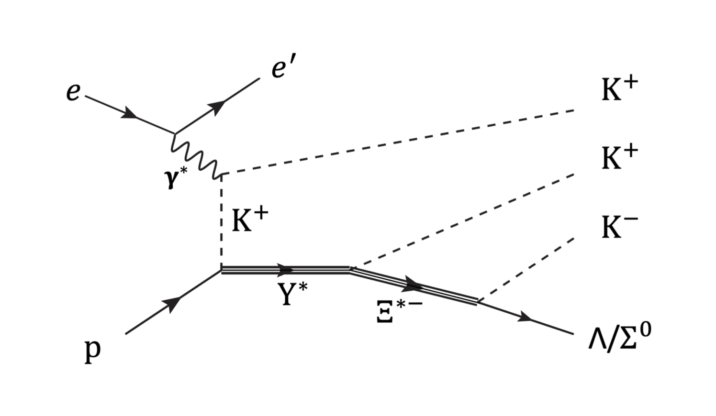
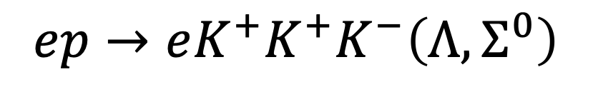
$Ξ^{∗}$ Cross-Section Upper Limit
Results for RGA pass1
$$ep→eK^{+}K^{+}K^{−}\left(Λ, Σ^{0}\right)$$
Achyut Khanal (FIU)

Slide 14
Upper Limit for Excited Cascades Yields
Fall 18 Outbending Fall 18 Inbending Spring 19 Inbending
Electron
in FD
Electron
in FT
Background shape defined by mixed-events

Slide 15
Excited Cascades Cross-Section Upper Limit from RGA
Fall 18 outbending Fall 18 Inbending Spring 19 Inbending
Electron
in FD
Electron
in FT

Slide 16
RGA Results: Differential Cross Section
Fall 18 outbending Fall 18 Inbending Spring 19 Inbending
Electron
in FD
Electron
in FT

Slide 17
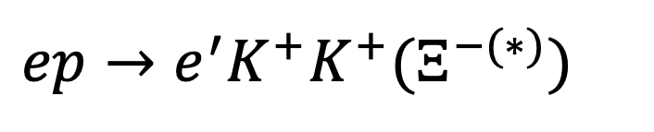
$Ξ^{−}$’s Analysis: Pass1 and Pass2 data
$ep→e^{′}K^{+}K^{+}(Ξ^{−(∗)})$
Jose Carvajal, FIU

Slide 18
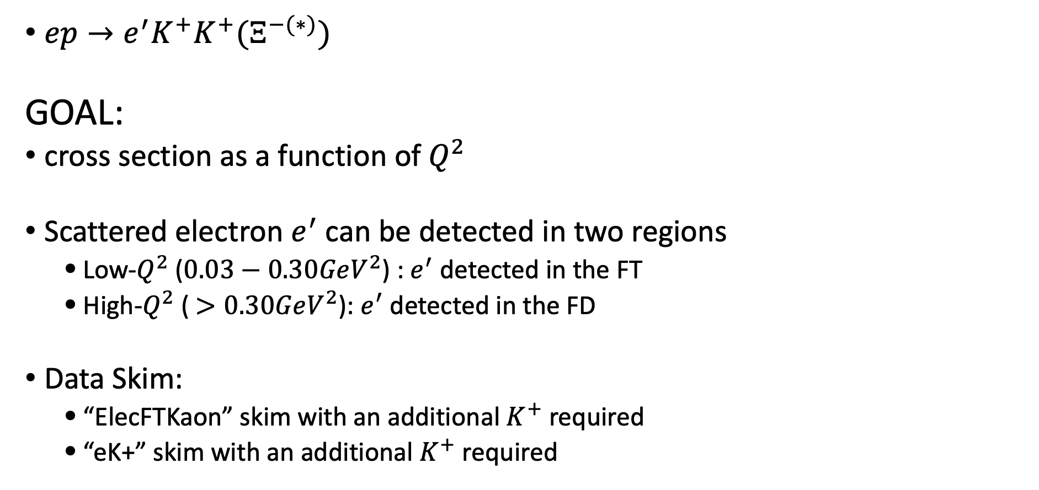
Reaction Channel and Event Selection
$ep→e^{′}K^{+}K^{+}(Ξ^{−(∗)})$
GOAL:
cross section as a function of $Q^{2}$
Scattered electron $e^{′}$ can be detected in two regions
  Low-$Q^{2}$ ($0.03−0.30GeV^{2}$) : $e^{′}$ detected in the FT
  High-$Q^{2}$ ( $>0.30GeV^{2}$): $e^{′}$ detected in the FD
Data Skim:
  “ElecFTKaon” skim with an additional $K^{+}$ required
  “eK+” skim with an additional $K^{+}$ required

Slide 19
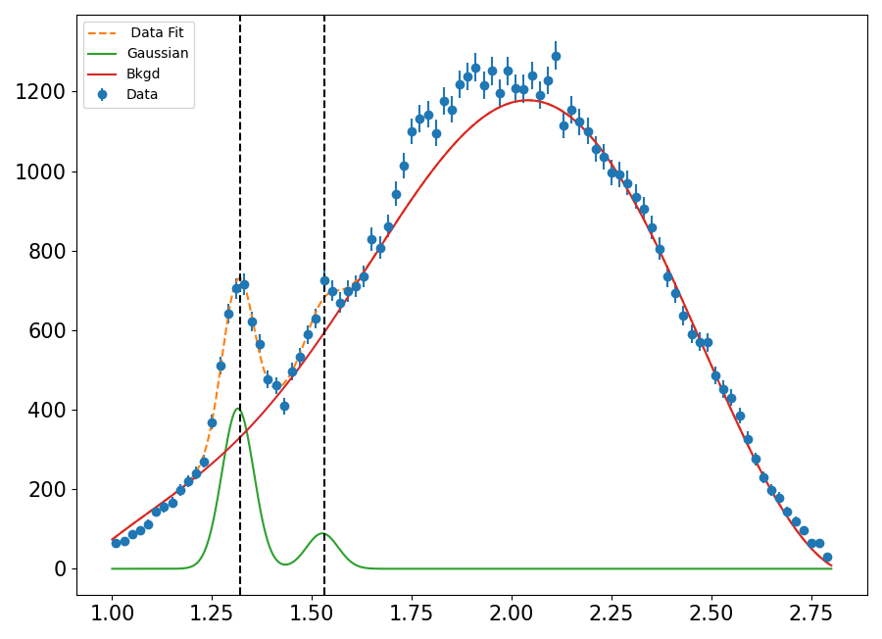
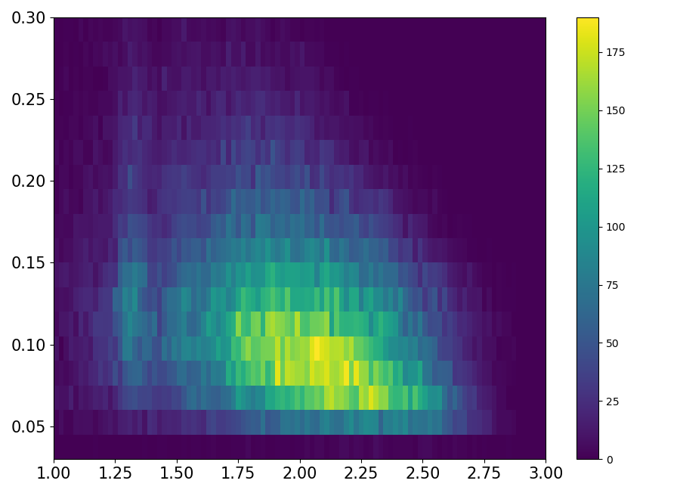






$ep→e^{′}K^{+}K^{+}(Ξ^{−(∗)})$ , ELECTRON in FT
$μ_{1}=1.314±0.0016[GeV]$
$μ_{2}=1.526±0.0074[GeV]$
$σ=39.47±1.65[MeV]$
$$Q^{2}[GeV^{2}]$$
Counts / $20MeV$
$$MM(e^{′}K^{+}K^{+})[GeV/c^{2}]$$
Background shape fixed by mixed events technique
Both Gaussians are fit to have the same resolution
Event excess seen around 1.8 GeV region
1.7-2.1 GeV region excluded from the fit
$$MM(e^{′}K^{+}K^{+})[GeV/c^{2}]$$

Slide 20
$ep→e^{′}K^{+}K^{+}(Ξ^{−(∗)})$
Spring 19 FT electron
Spring 19 FD electron
Preliminary
Preliminary
First-time measurement for cascade ground state cross sections in electroproduction
Background determined using mixed events techniques.
  We expect to collect several times more statistics within the remaining approved RG-A beam time. This is critical for higher mass cascades. It will also allow us to measure decay branching and decay angular distributions necessary for determining the quantum numbers.

Slide 21
Cross Sections: $Ξ^{−}$ and $Ξ^{−}(1530)$
FT
Preliminary
FD

Slide 22
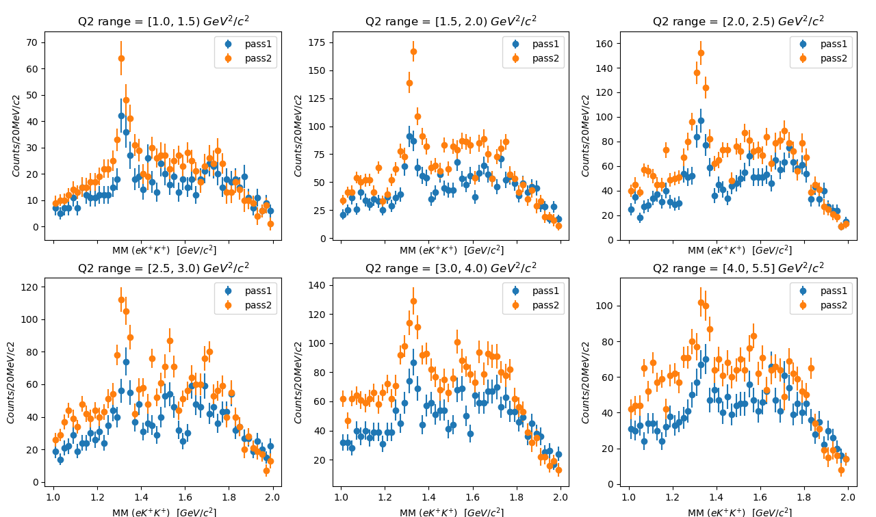
FD: pass1 vs pass2
Based on ElecFDKPlusWagon
  1.3 < W < 3.2
Future work will remove the W cut
Clear improvements over pass1 data

Slide 23
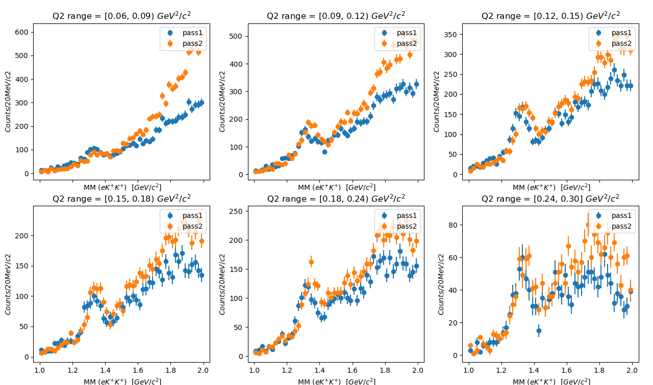
FT: pass1 vs pass2
Based on ElecFTkaonWagon
No electron energy correction derived yet for pass2
Ground state statistics are comparable to pass1, excited states may see the benefit

Slide 24
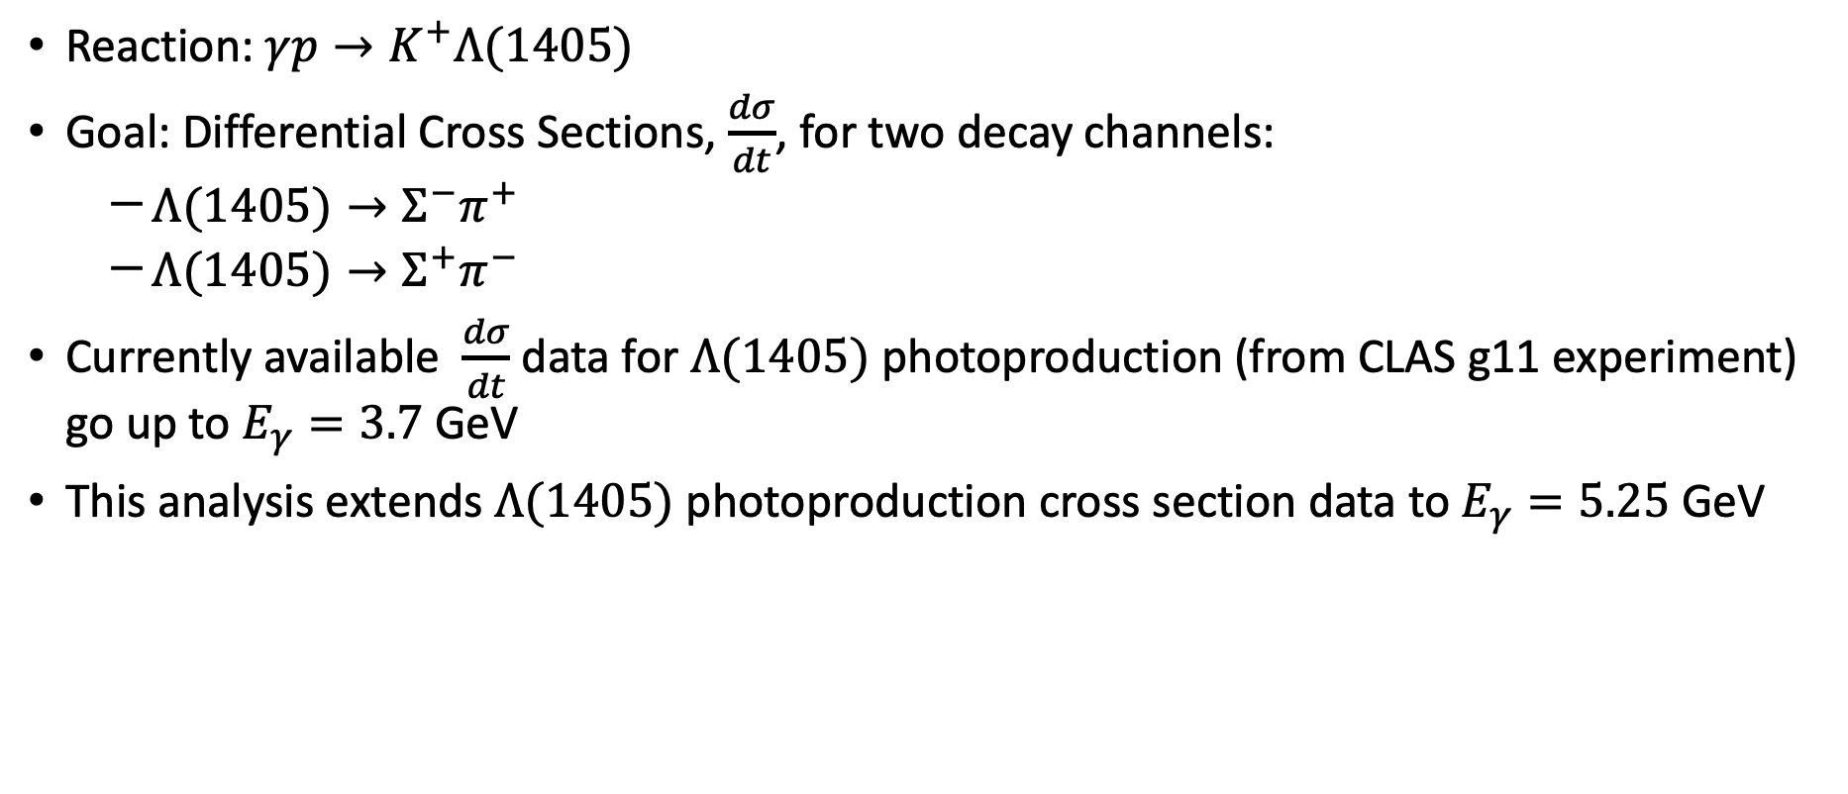
CLAS g12 Experiment (photoproduction)
Reaction: $γp→K^{+}Λ(1405)$
Goal: Differential Cross Sections, $\frac{dσ}{dt}$, for two decay channels:
  $Λ(1405)→Σ^{−}π^{+}$
  $Λ(1405)→Σ^{+}π^{−}$
Currently available $\frac{dσ}{dt}$ data for $Λ(1405)$ photoproduction (from CLAS g11 experiment) go up to $E_{γ}=3.7$ GeV
This analysis extends $Λ(1405)$ photoproduction cross section data to $E_{γ}=5.25$ GeV
Trevor Reed, FIU

Slide 25
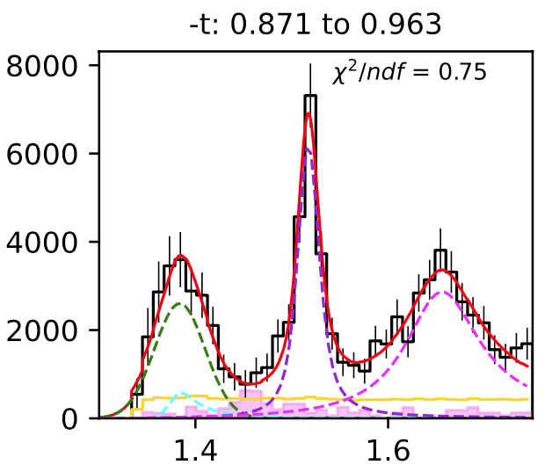
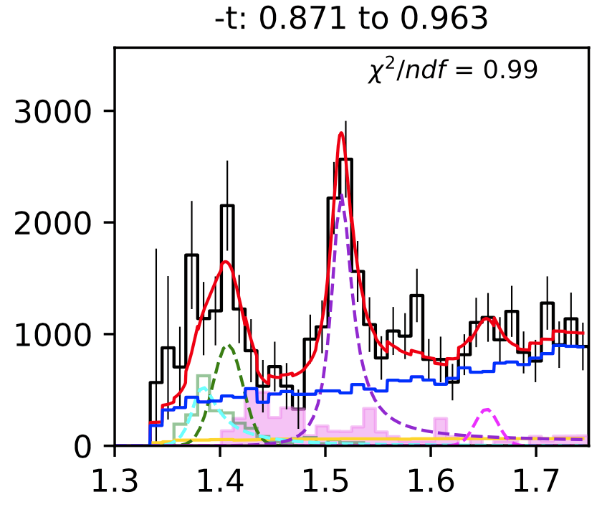
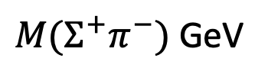
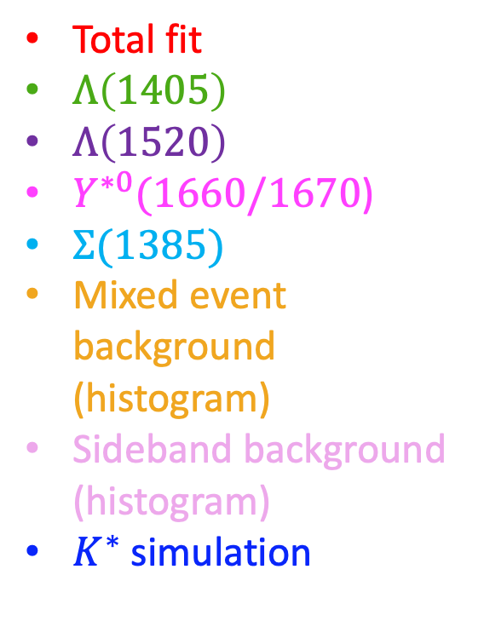
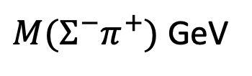
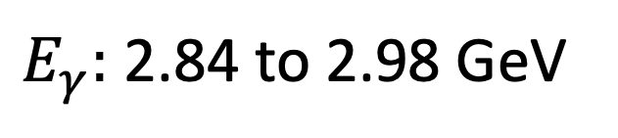
Invariant Mass $(Σ^{−}π^{+})$
$E_{γ}:$ 2.84 to 2.98 GeV
Total fit
$Λ\left(1405\right)$
$Λ\left(1520\right)$
$Y^{∗0}(1660/1670$)
$Σ(1385)$
Mixed event background (histogram)
Sideband background (histogram)
$K^{∗}$ simulation
$M(Σ^{−}π^{+})$ GeV
$M(Σ^{+}π^{−})$ GeV

Slide 26
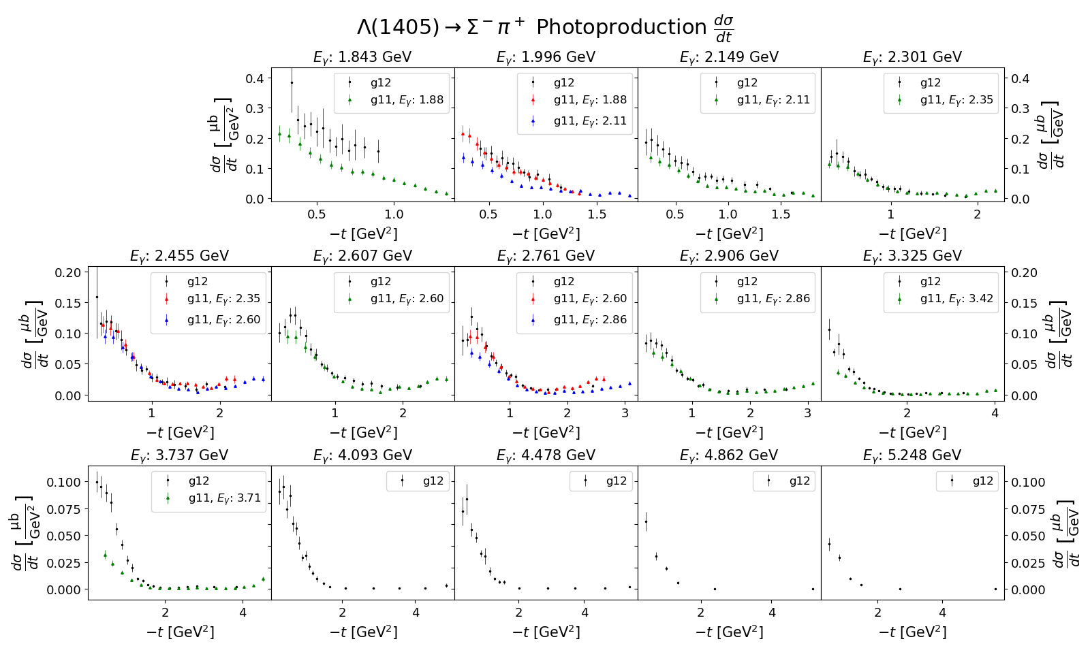
Cross Sections: $Σ^{−}π^{+}$ Decay Mode
Preliminary

Slide 27
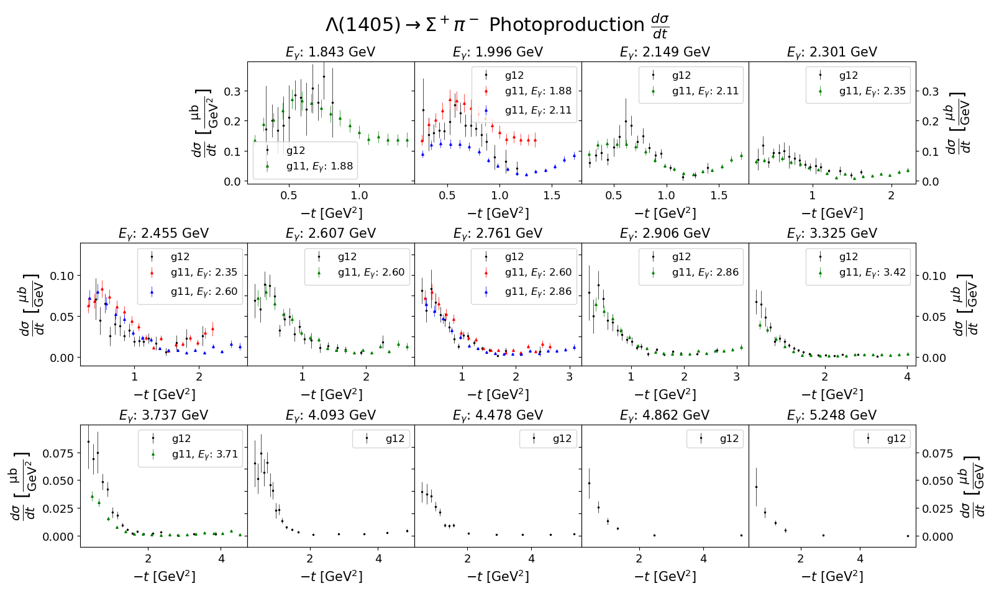
Cross Sections: $Σ^{+}π^{−}$ Decay Mode
Preliminary

Slide 28
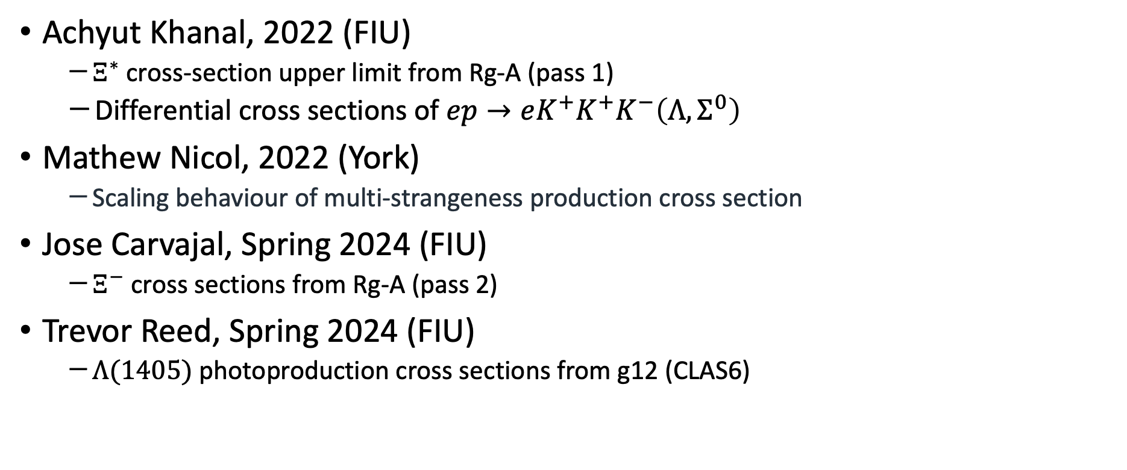
Recently Graduated with “Very Strange” Analyses
Achyut Khanal, 2022 (FIU)
  $Ξ^{∗}$ cross-section upper limit from Rg-A (pass 1)
  Differential cross sections of $ep→eK^{+}K^{+}K^{−}\left(Λ, Σ^{0}\right)$
Mathew Nicol, 2022 (York)
  Scaling behaviour of multi-strangeness production cross section
Jose Carvajal, Spring 2024 (FIU)
  $Ξ^{−}$ cross sections from Rg-A (pass 2)
Trevor Reed, Spring 2024 (FIU)
  $Λ(1405)$ photoproduction cross sections from g12 (CLAS6)

Slide 29
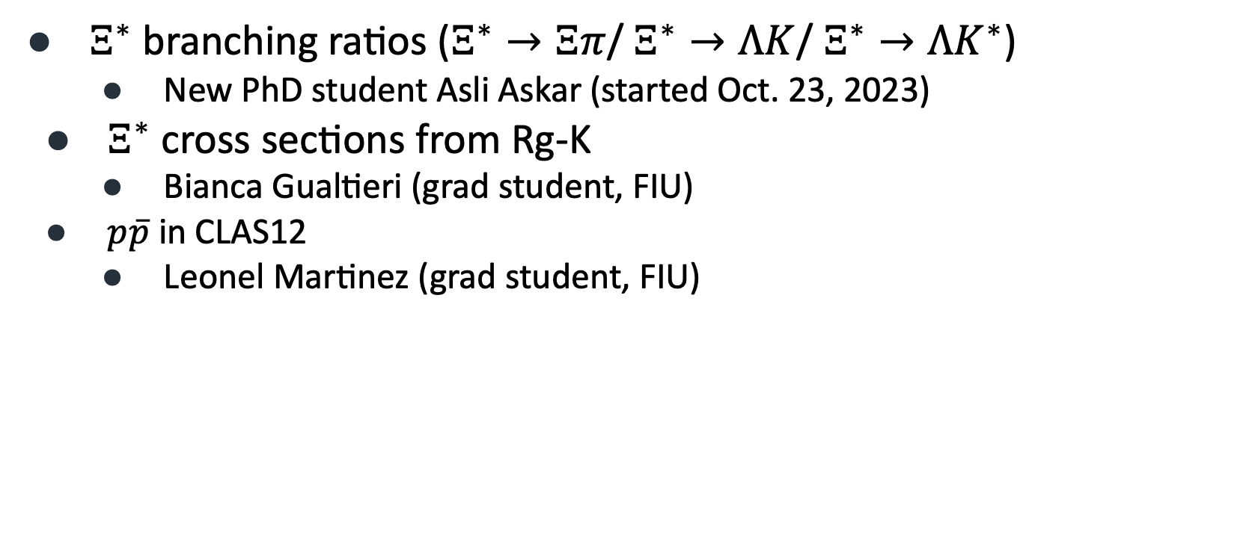
Ongoing/Upcoming Work
$Ξ^{∗}$ branching ratios ($Ξ^{∗}→Ξπ$/ $Ξ^{∗}→ΛK$/ $Ξ^{∗}→ΛK^{∗}$)
  New PhD student Asli Askar (started Oct. 23, 2023)
$Ξ^{∗}$ cross sections from Rg-K
  Bianca Gualtieri (grad student, FIU)
$p\overline{p}$ in CLAS12
  Leonel Martinez (grad student, FIU)

Slide 30
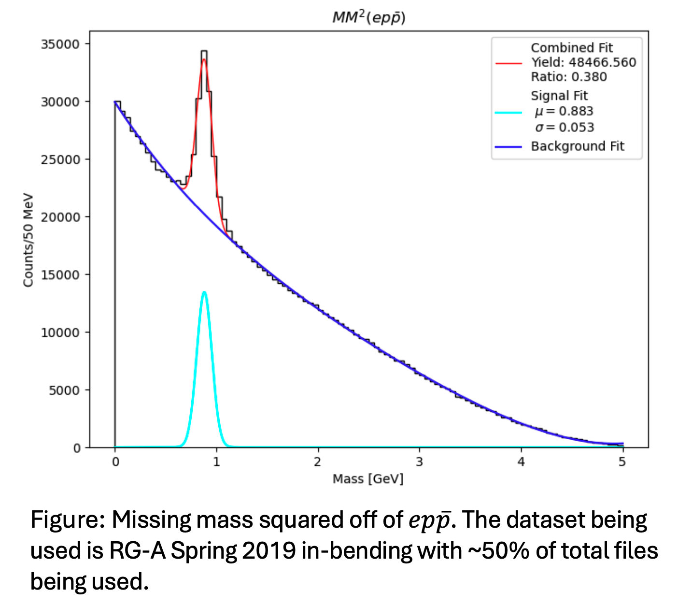
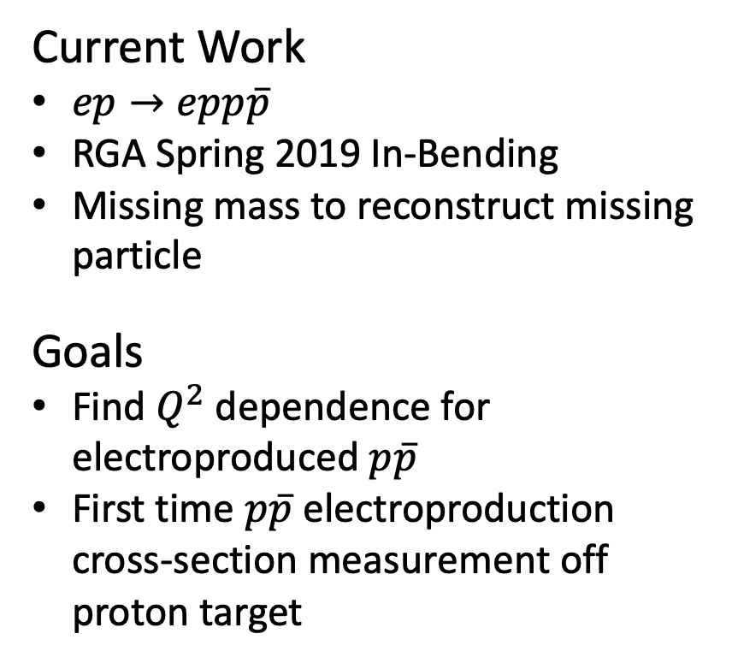
$p\overline{p}$ Electroproduction off Protons in CLAS12
Leonel Martinez
Current Work
$ep→epp\overline{p}$
RGA Spring 2019 In-Bending
Missing mass to reconstruct missing particle
Goals
Find $Q^{2}$ dependence for electroproduced $p\overline{p}$
First time $p\overline{p}$ electroproduction cross-section measurement off proton target

Slide 31
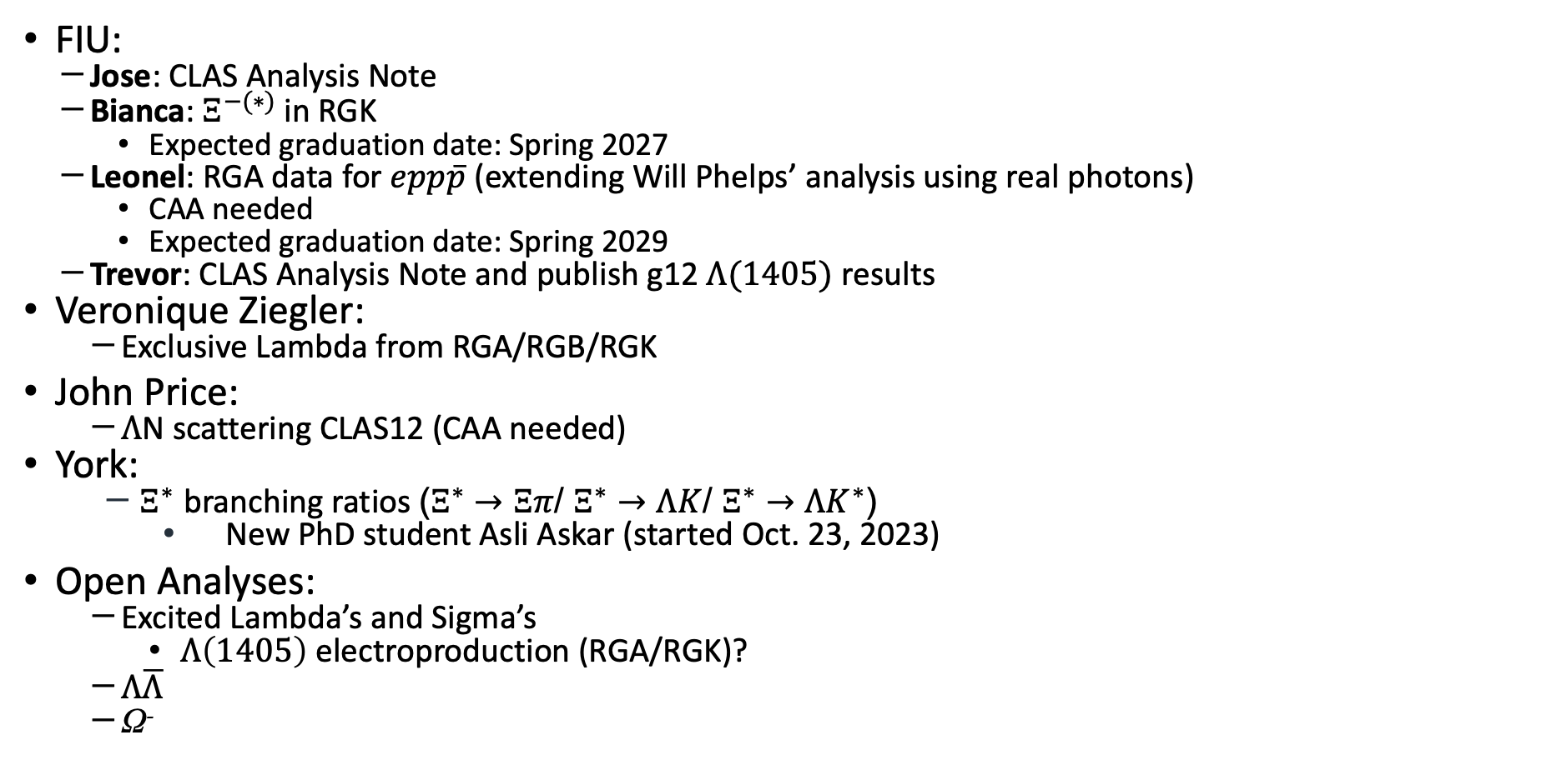
2024 and Beyond
FIU:
  Jose: CLAS Analysis Note
  Bianca: $Ξ^{−(∗)}$ in RGK
    Expected graduation date: Spring 2027
  Leonel: RGA data for $epp\overline{p}$ (extending Will Phelps’ analysis using real photons)
    CAA needed
    Expected graduation date: Spring 2029
  Trevor: CLAS Analysis Note and publish g12 $Λ(1405)$ results
Veronique Ziegler:
  Exclusive Lambda from RGA/RGB/RGK
John Price:
  $Λ$N scattering CLAS12 (CAA needed)
York:
  $Ξ^{∗}$ branching ratios ($Ξ^{∗}→Ξπ$/ $Ξ^{∗}→ΛK$/ $Ξ^{∗}→ΛK^{∗}$)
    New PhD student Asli Askar (started Oct. 23, 2023)
Open Analyses:
  Excited Lambda’s and Sigma’s
    $Λ\left(1405\right)$ electroproduction (RGA/RGK)?
  $Λ\overline{Λ}$
  Ω⁻
This research was funded in part by the U.S. Department of Energy, Office of Nuclear Physics under contract No. DE-SC0013620

Slide 33
Missing mass distributions (electron in FT):
Fall 18 outbending Fall 18 Inbending Spring 19 Inbending
Identifying
missing
hyperon

Slide 34
Background shape comparison example
Fall 18 Inbending
Different backgrounds were tried;
Event mixing proved to mostly
be consistent
with other methods ---- used for
upper limit yield extraction;
Other methods (side band events) suffer
From low statistics

Slide 35
Missing mass distributions (electron in FD):
Fall 18 outbending Fall 18 Inbending Spring 19 Inbending
Identifying
missing
hyperon

Slide 36
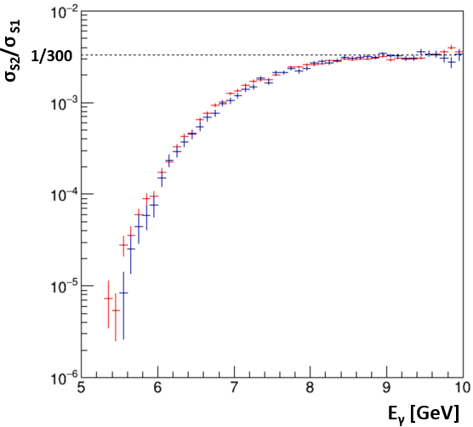

To do with Pass2
Finalising scaling behaviour of multi-strangeness production x-section
  Matt. Nicol (defended PhD, currently a postdoc, in SC)
$Ξ^{∗}$ branching ratios ($Ξ^{∗}→Ξπ$/ $Ξ^{∗}→ΛK$/ $Ξ^{∗}→ΛK^{∗}$)
  New PhD student Asli Askar (started Oct 23)

