Slide 1
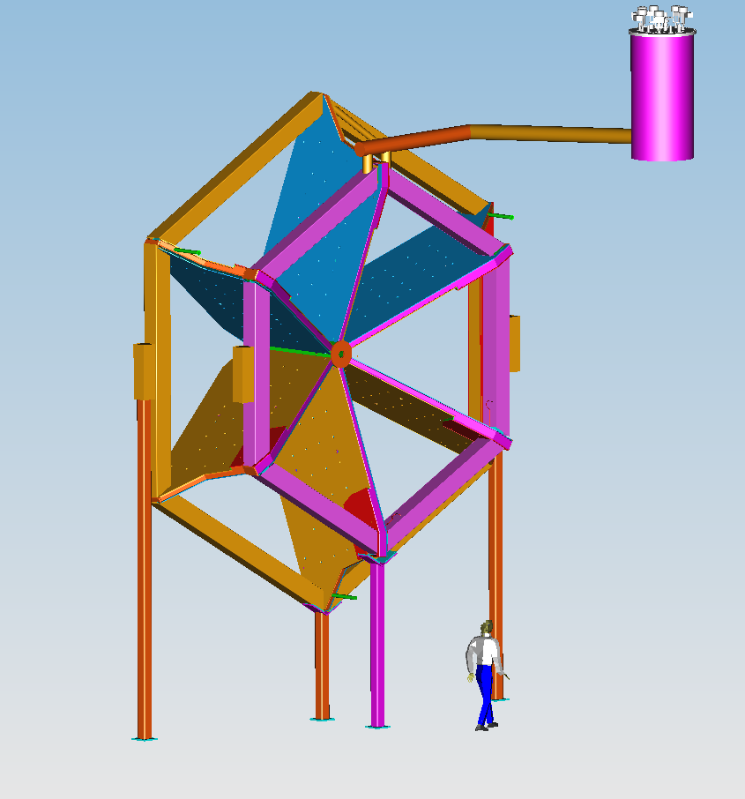
CLAS12 - TORUS Magnet
The CLAS12 Toroid is based on six super-conducting coils around the beam line to produce a field primary in the f direction. The choice of this configuration leads to an approximate toroidal field distribution around the beam
axis. It has been driven by the following physics
requirements:
Uniform coverage
Good Momentum resolution
Low background from electromagnetic processes
Symmetry around the beam axis
Compatibility with operation of polarized target
TORUS - TECHNICAL PARAMETERS
PARAMETER | DESIGN VALUE
Magnet Type | Toroidal Field Geometry
Number of Coils | 6
Coil structure | Double pancake
Number of turns per pancake | 117
Number of turns per coil | 234
S.C. cable | SSC 36 strands
Nominal current (A) | 3770
Ampere turns | 882,180
Peak Field (T) | 3.58
Peak Field Location | Inner turn near warm bore adjacent to cooling tube
B-Symmetry | Yes
∫Bdl @ nominal current | 2.78 T @ 5 degree , 0.54 T @ 40 degree
Inductance (H) | 2.00
Stored Energy (MJ) | 14.2
Warm bore ∅ (mm) | 124
Total weight (KG) | 28,000
Cooling mode | Supercritical He-Gas conduction
Supply temperature | 4.6K
Temperature margin | Min 1.62 (@5.3 K) to Sharing temperature 7.391K
Conductor Used | SSC outer dipole w 20x2.5mm copper channel
Turn to Turn Insulation | 0.003” E-Glass Tape ½ Lap

Slide 2
Construction Strategy and Project Leadership:
Significant dates
Project Status
Contact: D. Kashy Lead Engineer (kashy@jlab.org) 757-269-7275,
L. Elouadrhiir Control Account Manager (latifa@jlab.org) 757-269-7303
G. Young Associate Project Manager for Physics (young@jlab.org) 757-269-6904
V. D. Burkert Hall B leader (burkert@jlab.org) 757-269-7540

