Slide 1
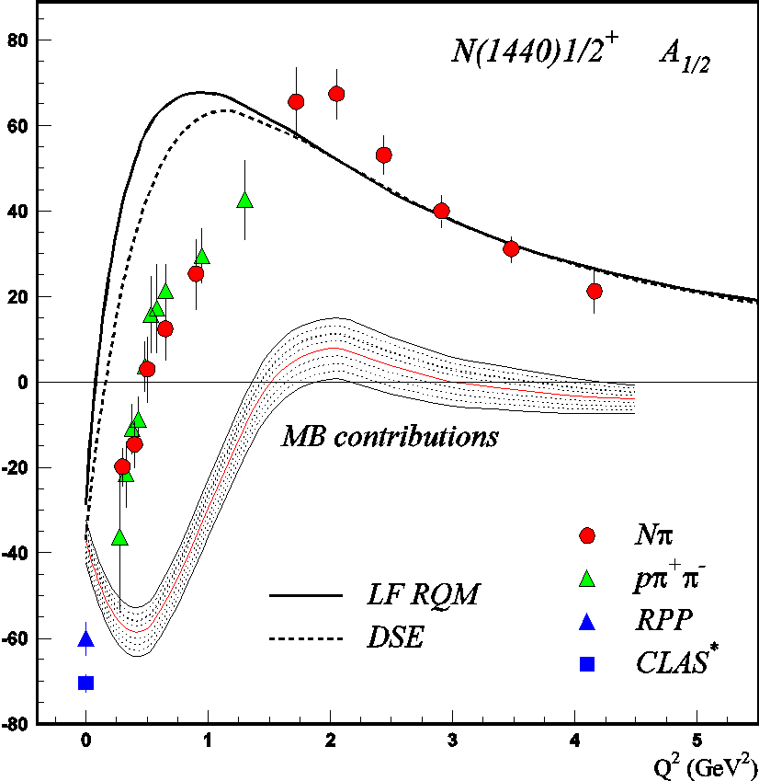
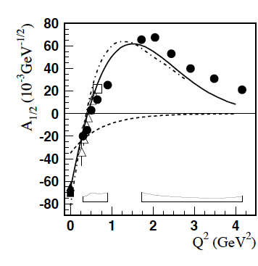
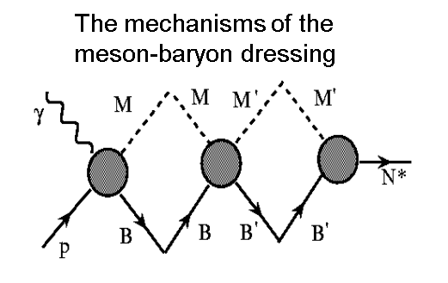
Meson-Baryon Cloud and Quark Core in the N* Structure
I.T. Obukhovsky et al., Phys. Rev. D89, 014032 (2012).
LC QM+Nσ
Nσ
LF RQM-Light Front relativistic quark model:
V.D. Burkert, I.G. Aznauryan, Phys . Rev. C85,
055202 (2012); Phys. Rev. C95, 065207 (2017).
See the talk by V.D.Burkert, Session D3.
CLAS data in the range of Q²<5.0 GeV² revealed the structure of N(1440)1/2⁺ as a complex interplay
between inner core of dressed quarks in the first radial excitation and external MB cloud
Accounting for the MB cloud offers better description of N(1440)1/2⁺ A_{1/2} amplitude at Q²<1.0 GeV²

Slide 2
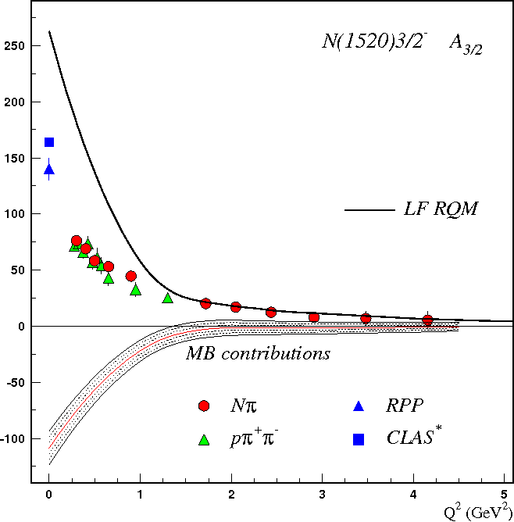
Meson-Baryon Cloud and Quark Core in the N* Structure
I.G. Aznauryan, V.D. Burkert,
PRC 92, 015203 (2015).
The structure of all studied resonances is determined by a complex interplay between inner core of
dressed quarks and external MB cloud. Their relative contributions depend from the resonance
quantum numbers.
Relative contributions from MB cloud decreases with Q².

