Slide 1
Major Directions in Studies of N* Spectrum and Structure with CLAS
The experimental program on studies of the N* spectrum and structure in exclusive meson photo- and electroproduction with CLAS seeks to determine:
Photo- and γ_{v}pN* electrocouplings at photon virtualities up to 5.0 GeV² for most of the excited proton states by analyzing all relevant meson electroproduction channels in the nucleon resonance region
Extend knowledge of N*-spectrum and on resonance hadronic decays from the data for photo- and electroproduction reactions
A unique source of information on many facets of strong QCD in generating different excited nucleon states
Review papers:
I.G. Aznauryan and V.D. Burkert, Prog. Part. Nucl. Phys. 67, 1 (2012).
I.G. Aznauryan et al., Int. J. Mod. Phys. E22,1330015 (2013).
V.D. Burkert, Few Body Syst. 57, 873 (2016).
C.D. Roberts, J. Phys. Conf. Ser. 706, 022003 (2016).
Notes:
Исследования электромагнитных форм факторов N* являются единстрвенным истичником информации о различных проявлениях сильного взаимодействия в непертурбативной области больших величин (~1.0) бегущего параметра квар-глюонного взаимодеиствия в формировании
возбужденных состояний нуклонов с различными квантовыми числами

Slide 3
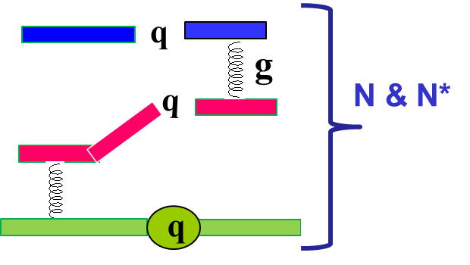
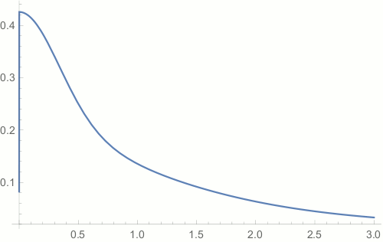
Excited Nucleon States and Insight into Strong QCD Dynamics
Baryon resonance impact on early Universe evolution
Dressed Quark Borromeo Binding in Baryons
C.D. Roberts, J. Segovia, Few Body Syst. 57, 1067 (2016)
Correlation of net strangeness with net baryon
number fluctuations over the second cumulant
of net strangeness fluctuations
LQCD
g
Dressed Quark Mass Function
C.D. Roberts, Few Body Syst. 58, 5 (2017)
The full complement of resonances expected from the quark
models employing SU(6) spin-flavor symmetry (solid line) is
needed for consistency with the LQCD description of the
phase transition (colored area with symbols).
CLAS12
range
mass composition
<2% Higgs mechanism (HM)
>98% non-perturbative
strong interaction
Studies of full baryon spectrum are
needed
confinement (approaching
constituent quark mass)
Dressed Quark Mass, GeV
N* structure studies address:
Nature of > 98% of hadron mass
Confinement and color charge emergence from QCD
Full complexity of qq- and 3-dressed-quark interactions in baryons
approaching bare HM mass
Quark Momentum, GeV
Determined from QCD with the scale set by Λ_{QCD}

