Slide 1
Hall B Meeting RGC RC Report June 27 - July 4
Monday 6/27 Warming up polarized target to repair deuteron NMR
Tuesday 6/28 Target insert repair of deuteron cold NMR in EEL
Wednesday 6/29 Re-installation of target insert
  Target purging and cooling down over night
Thursday 6/30 Load freshly pre-irradiated ND₃ (15 mm diameter cell)
  Cold NMR worked well, very small deuteron signal due to small filling factor
  Found polarizing microwave frequency farther away from central frequency
    ND₃ was seem to have received a very high pre-irradiation dose
    Will probably need to be annealed
  Polarization enhancement with microwaves of about 0.15 to 0.2
  Cold NMR heater broke when trying to stabilize

Slide 2
Hall B Meeting RGC RC Report June 27 - July 4
Friday 7/1 Load NH₃ (15 mm diameter cell)
  Target TE calibration during day shift (no beam because of Hall C tuning)
  Polarize proton target to about +0.7
  Start data taking (4.0 nA, HWP OUT) around 20:30
  Move beam position vertically up by about +3 mm (2H01) because beam is hitting bottom of target cell
Saturday 7/2 Data taking on NH₃
  Change HWP to IN during evening shift
Sunday 7/3 Data taking on NH₃
  Change target polarization from positive to negative (3.5 hrs, 2 hrs BANU)
  Intermittent beam in the morning (RF instabilities) and afternoon (T-storms)
Plan
  Data taking on NH₃

Slide 3
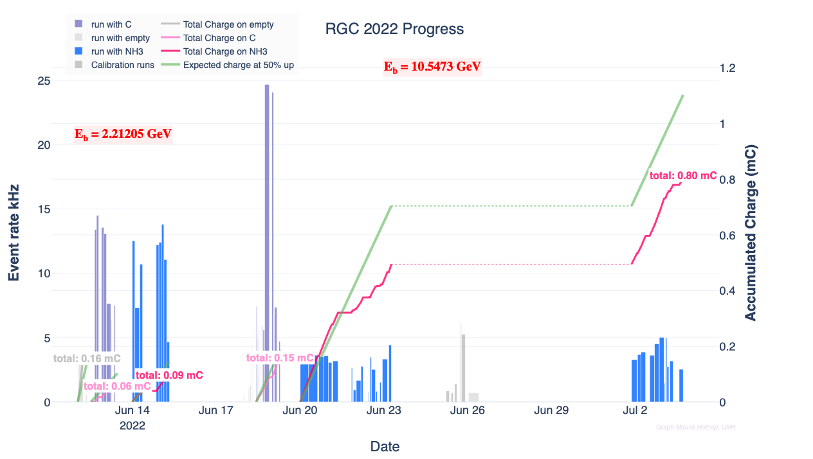
C
C
1H
1H
MT
1H

