Slide 1
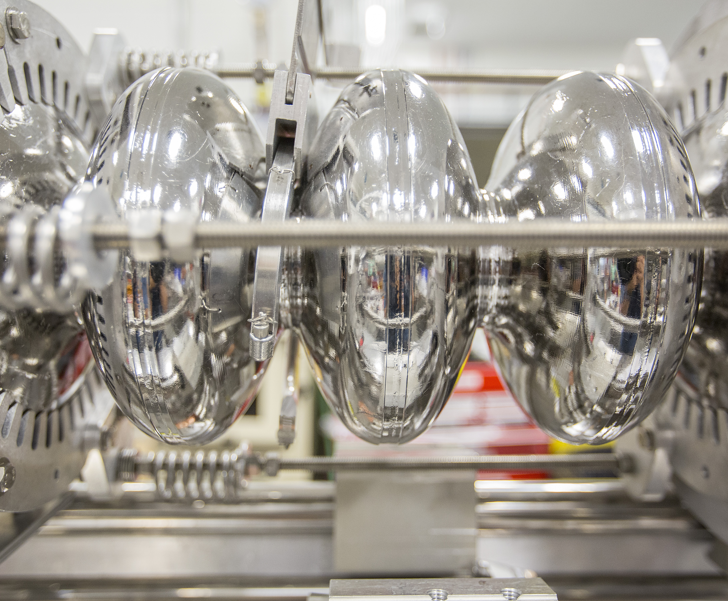
Cryomodule Test Facility Operator Training
CMTF Operator Training
for work under
DOE Order 420.2D
(SAF808T)
M. McCaughan
Rev. 0

Slide 2
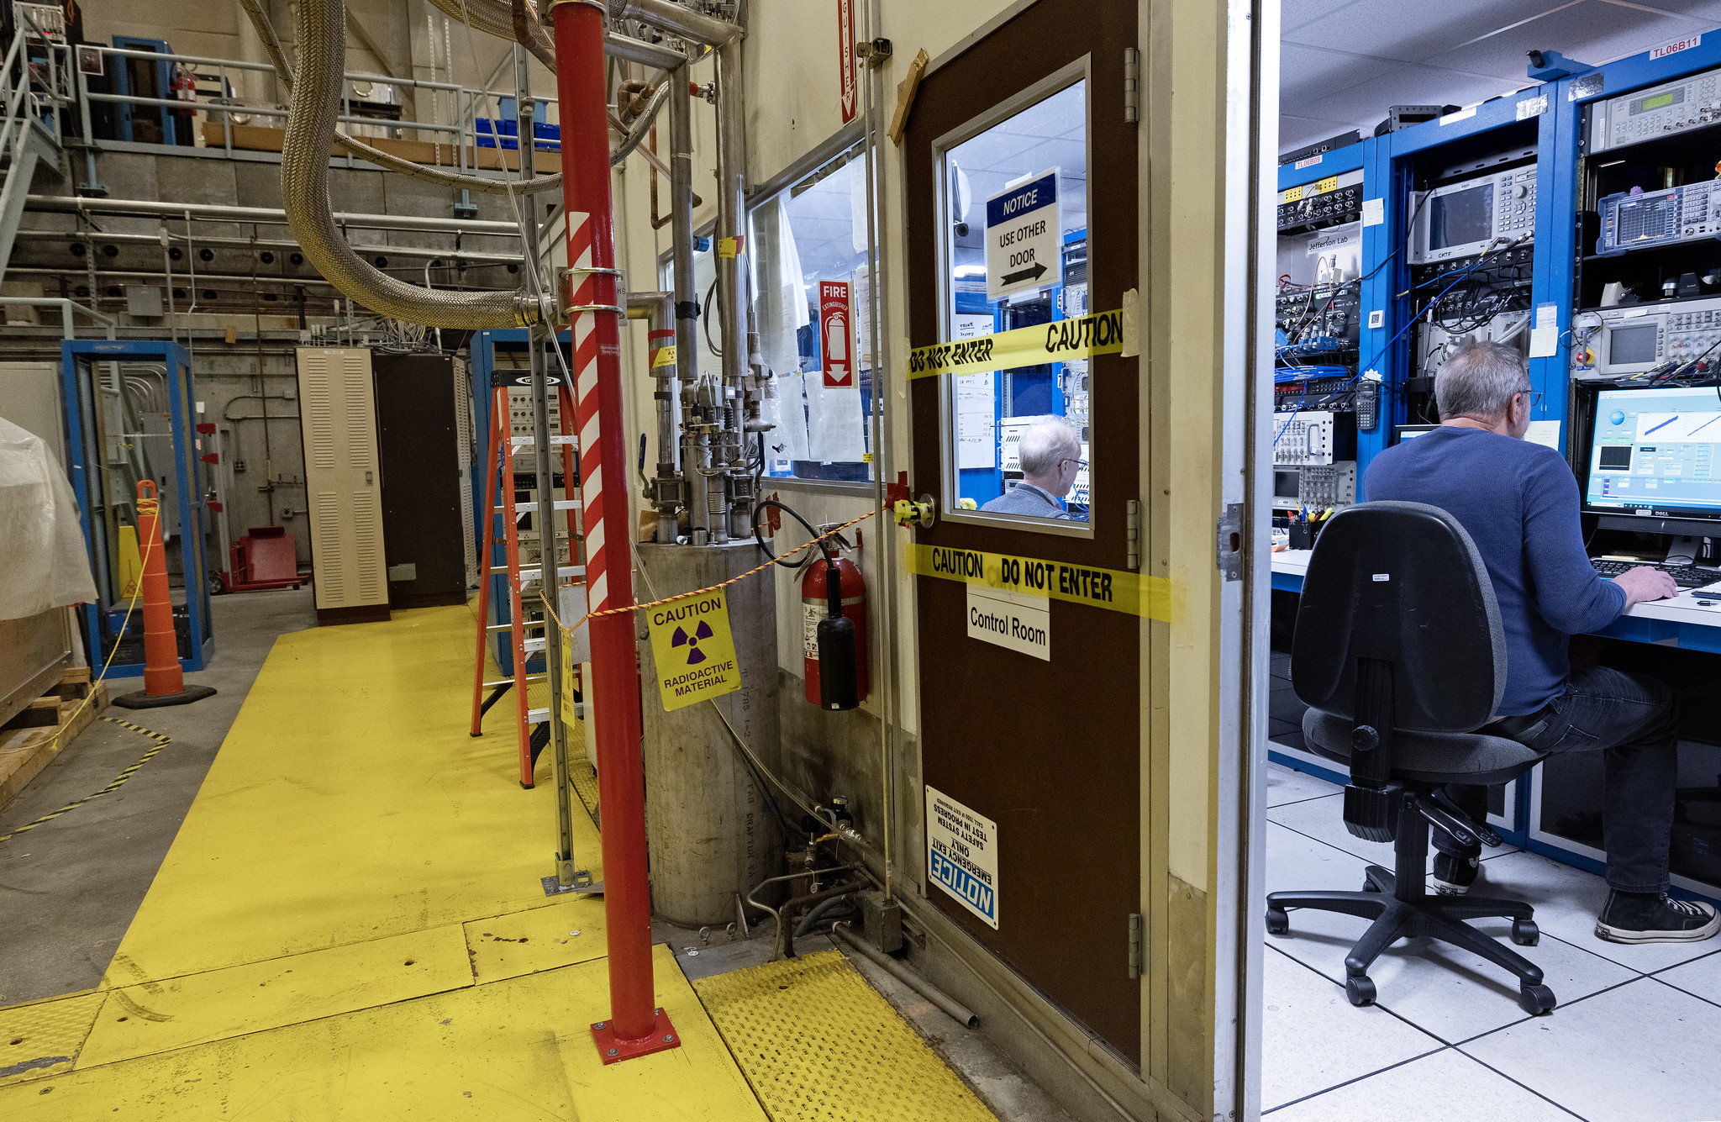
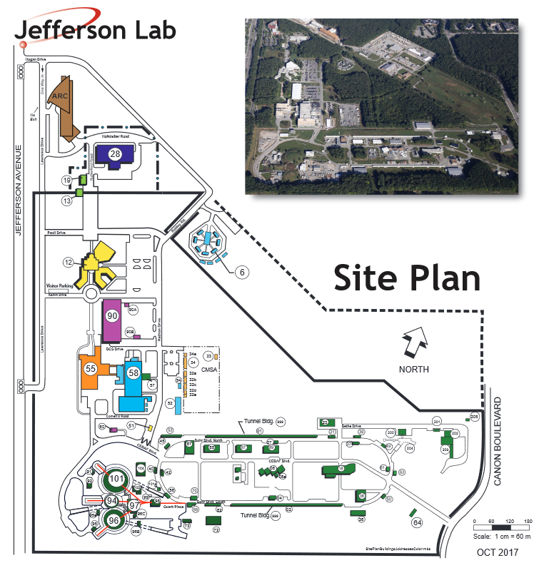
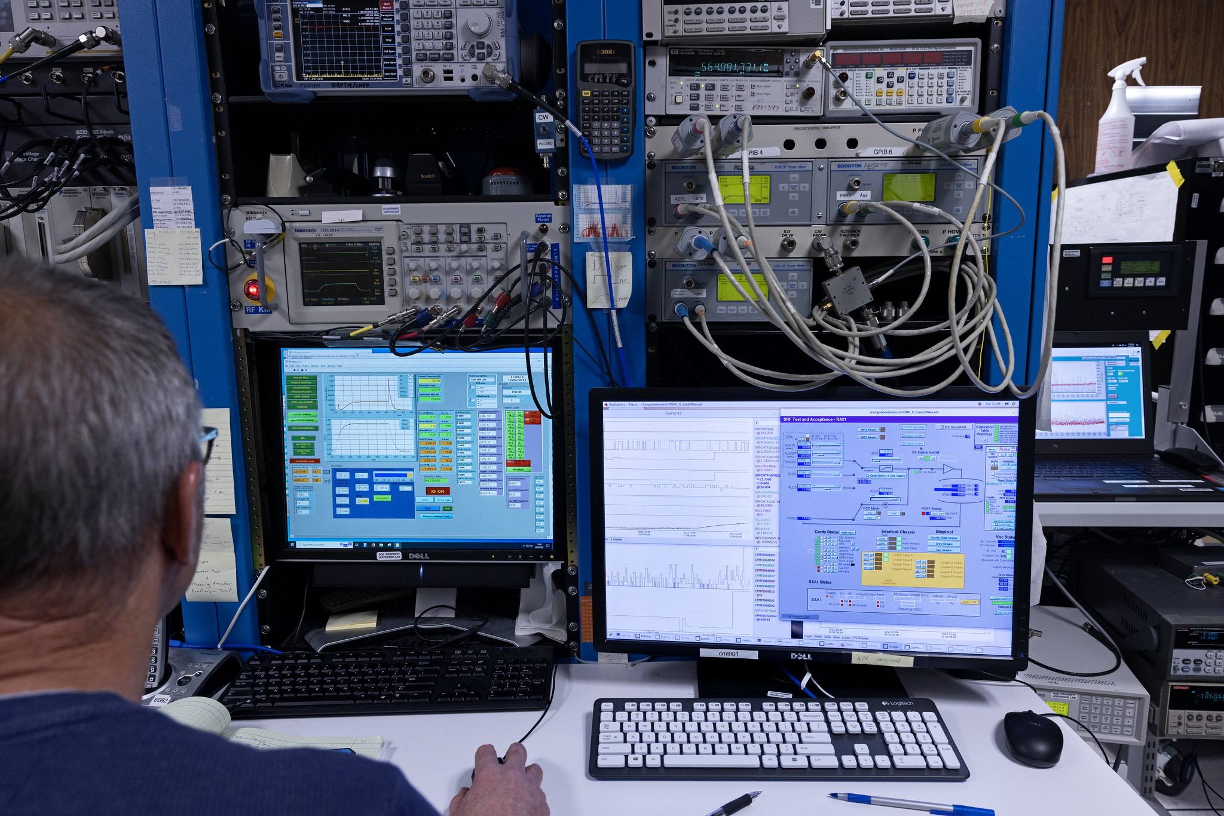
CMTF – Location & History

Slide 3
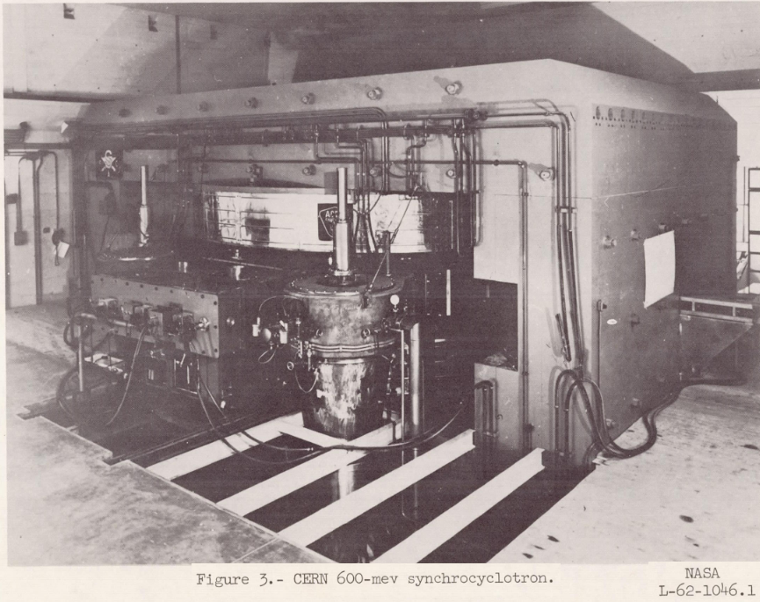
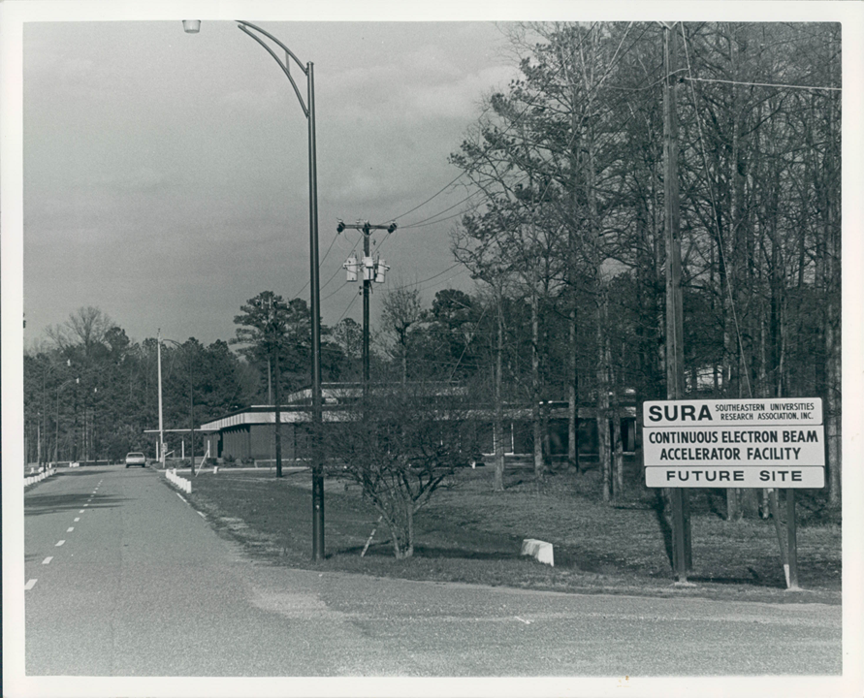
Test Lab (CMTF/VTA) – Location & History
1962-1965: NASA designs and constructs Space Radiation Effects Lab (SREL) on-site. VA Associate Research Campus (VARC) site management by consortium of universities, including William & Mary.
  Site contains:
    0.5 - 3 MeV e⁻ Dynamitron
    1 - 10 MeV e⁻ warm RF Linac
    600 MeV H⁺ Synchrocyclotron [after CERN design]
1967: Site management transferred solely to W&M by governor as additional universities join and complicate structure.
1978: SREL loses funding with other facilities on the rise;
VARC used by W&M as remote campus.
1980: McCarthy design group + W&M form Southeastern Universities Research Association (SURA), which later wins 1984 bid to build the nuclear research facility recommended in the 1979 Nuclear Science Advisory Committee (NSAC) plan.
1985: H. Grunder appointed first permanent lab director, with C. Leeman leading accelerator physics. CEBAF design change from warm RF to SRF technology with R&D funded by DOE, SURA, and Virginia. New CDR to DOE in 1986.
March 1986: Four vendors contracted to make 7 cavities –
2 tested at time of reporting to Congress/DOE both exceeded specifications. CEBAF construction funds appropriated in earnest for FY87.

Slide 4
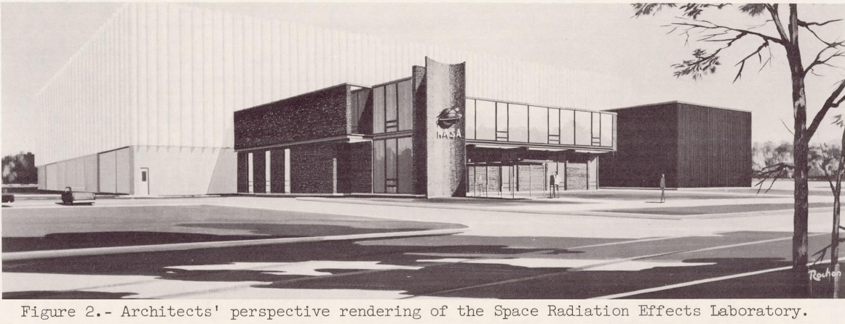
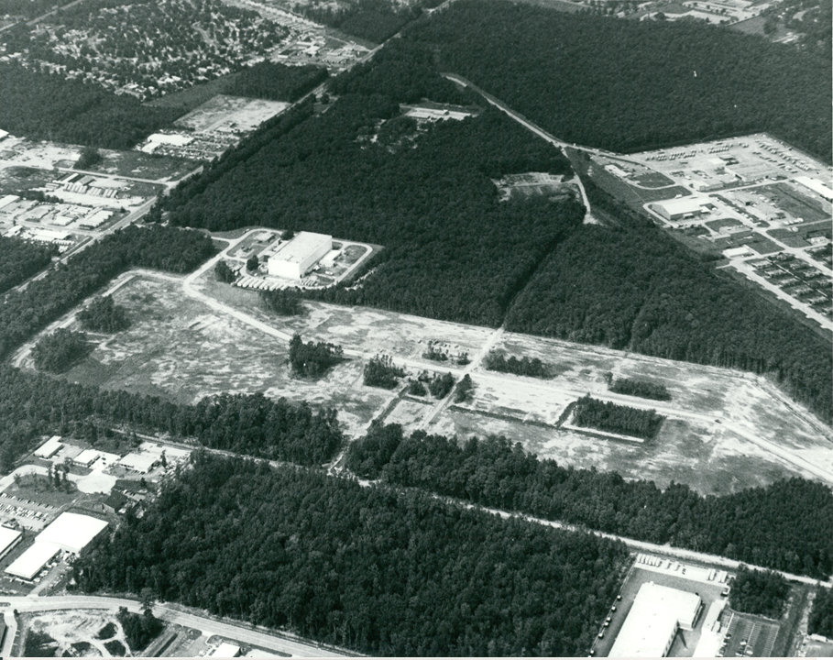
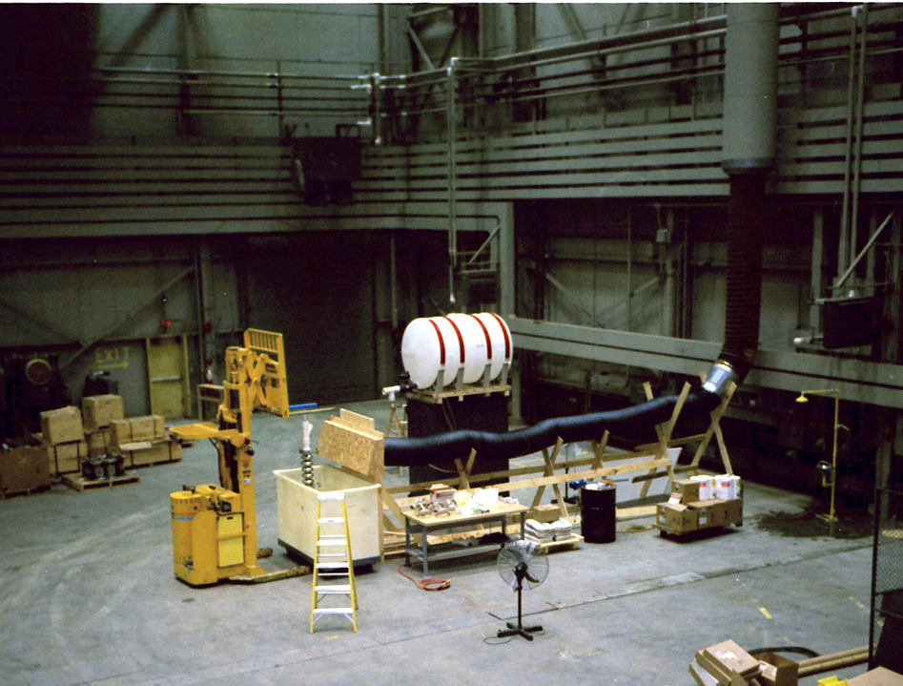
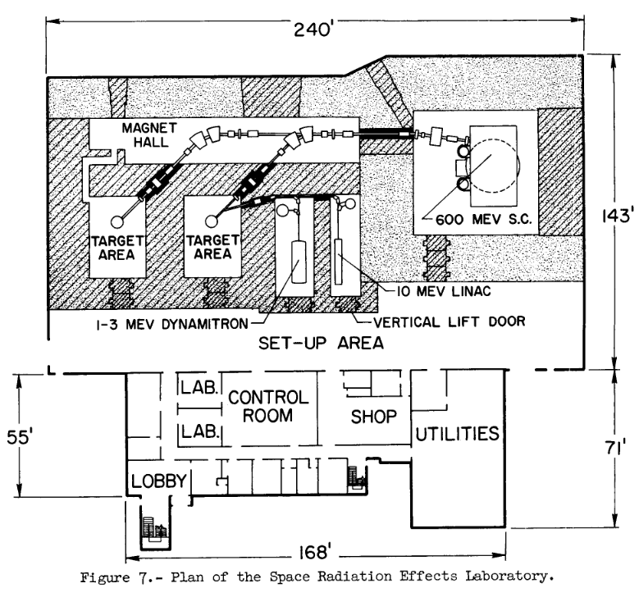
Test Lab (CMTF/VTA) – Location & History
First SRF Tested Cavity in Test Lab (1986)

Slide 5
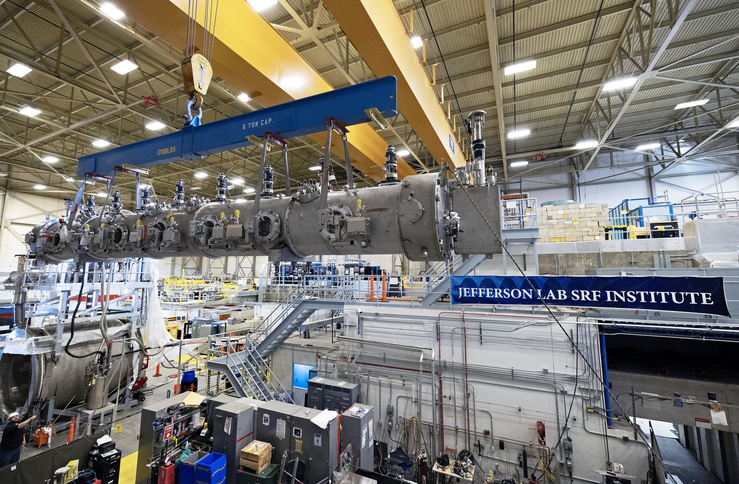
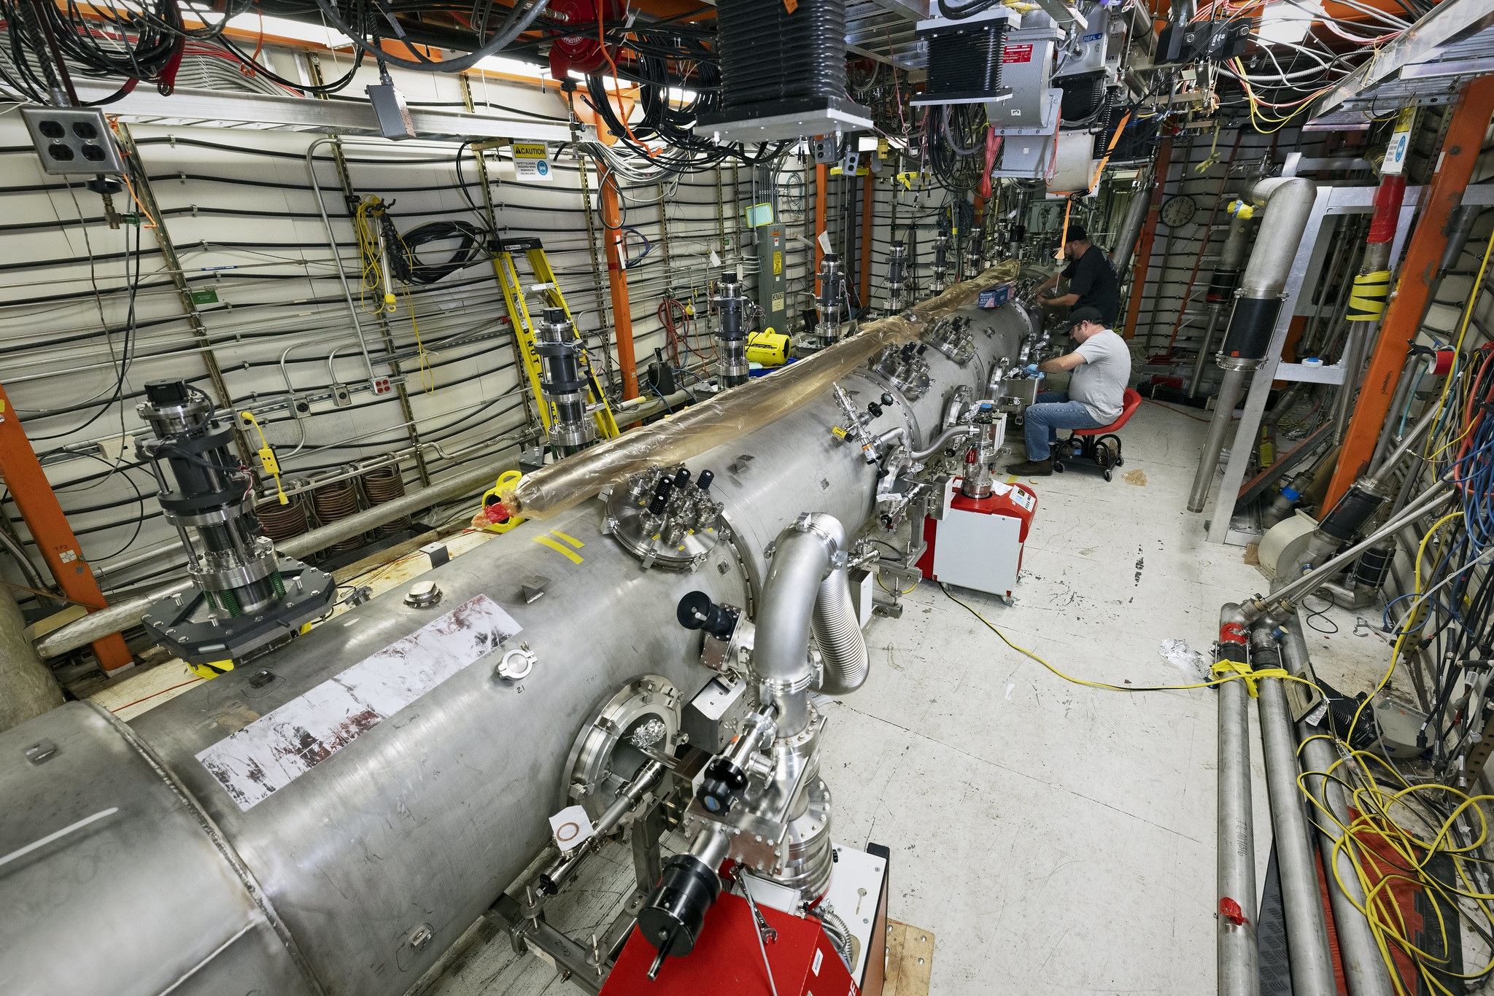
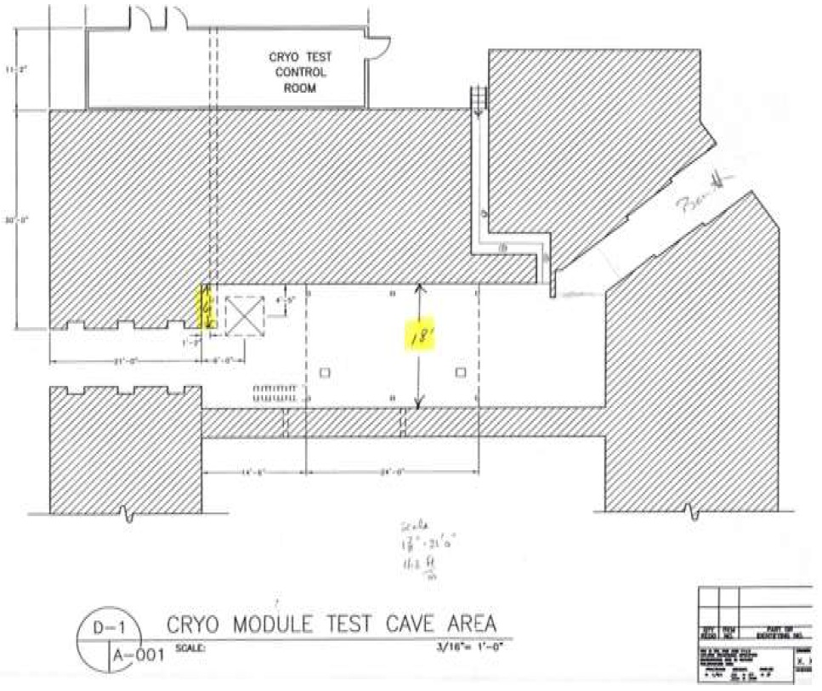
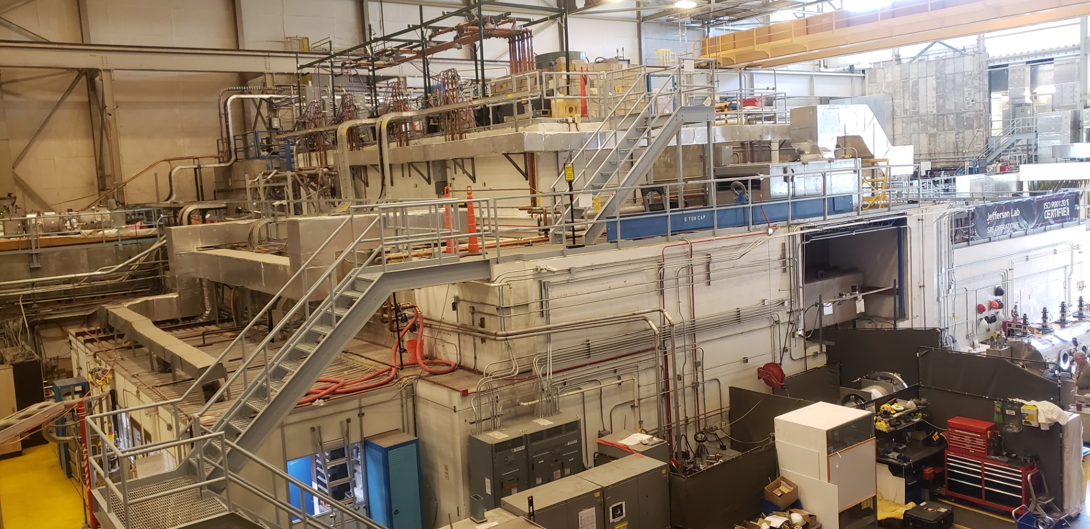
The CMTF Today:

Slide 6
Program Control: Cryomodule Test Facility (CMTF)
Responsible for the safe and effective operation, maintenance and improvement of facility in accordance with DOE Order 420.2D & Integrated Safety Management Program.
CMTF is a testing facility only; no Physics Division experiments are conducted there.
Scope of Operations: Two broadly definable programs: Cryomodule Acceptance Testing & Research & Development Activities
SRF Operations Project Execution & Production processes define these as follows:
Projects:
  CEBAF Support: Refurbishment of CEBAF cryomodules through projects or service agreements controlled by the JLab Accelerator Division.
  Multi-Lab Partnership: Fabrication, testing & delivery of SRF components to external customers through projects controlled by the JLab MLP office with liaising SRF staff.
  Work for Others/R&D: Fabrication and delivery of SRF components and/or data to external customers through projects managed through SRF Ops., Lab Directed Research & Development projects, or projects from SRF Science & Technology.
Services:
  CEBAF Support Services: SRF Ops maintains CEBAF cryomodules and components through project/service agreements administered by the Accelerator Division.
  Lab Service Requests: SRF Ops provides labor, equipment, products, or data for Work for Others projects controlled by S&T and other JLab organizations.

Slide 7
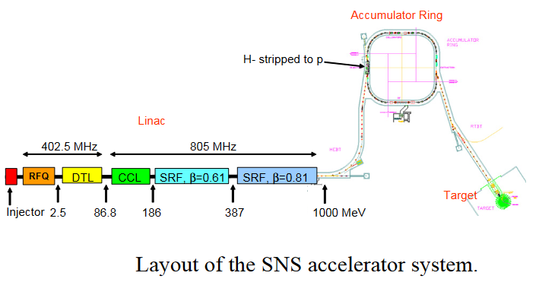
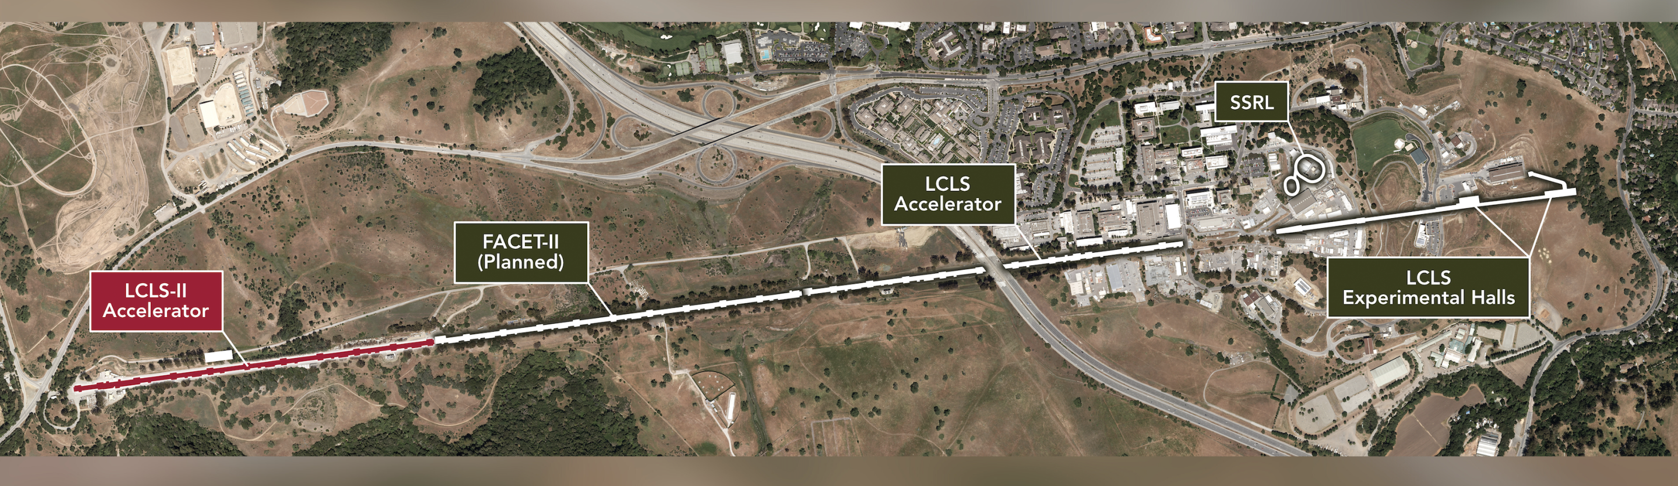
Projects & Services:
CEBAF:
50 “Original CEBAF” modules and rebuilds (including 3 quarter cryomodules)
13 C20-to-C50 cryomodule conversions +
a C50 refurbishment
Built 10 C100 modules + 3 prototypes and refurbished 5 of the C100s & the 3 prototypes
4 C20-to-C75 cryomodule conversions
Countless R&D, repair, and support activities
SLAC:
LCLS-II: 10 1.3 GHz cryomodules built at Jlab; L1 linac built in LERF.
LCLS-II HE: Additional 10 higher gradient/lower FE cryomodules built + 1 refurbished
Additional LCLS-II modules coming back to Jlab for refurbishment
ORNL:
SNS: Fabricated 11 805 MHz medium-β (0.61) + 1 medium-β prototype & 12 high-β (0.81) cryomodules, shipped to SNS, & installed in the linac section of the accelerator.
PPU: 7 additional 4-cavity High-b 805 MHz Cryomodules (+1 spare) to double target beam energy from 1.4 to 2.8 MW (by increasing the beam energy to 1.3 GeV)

Slide 8
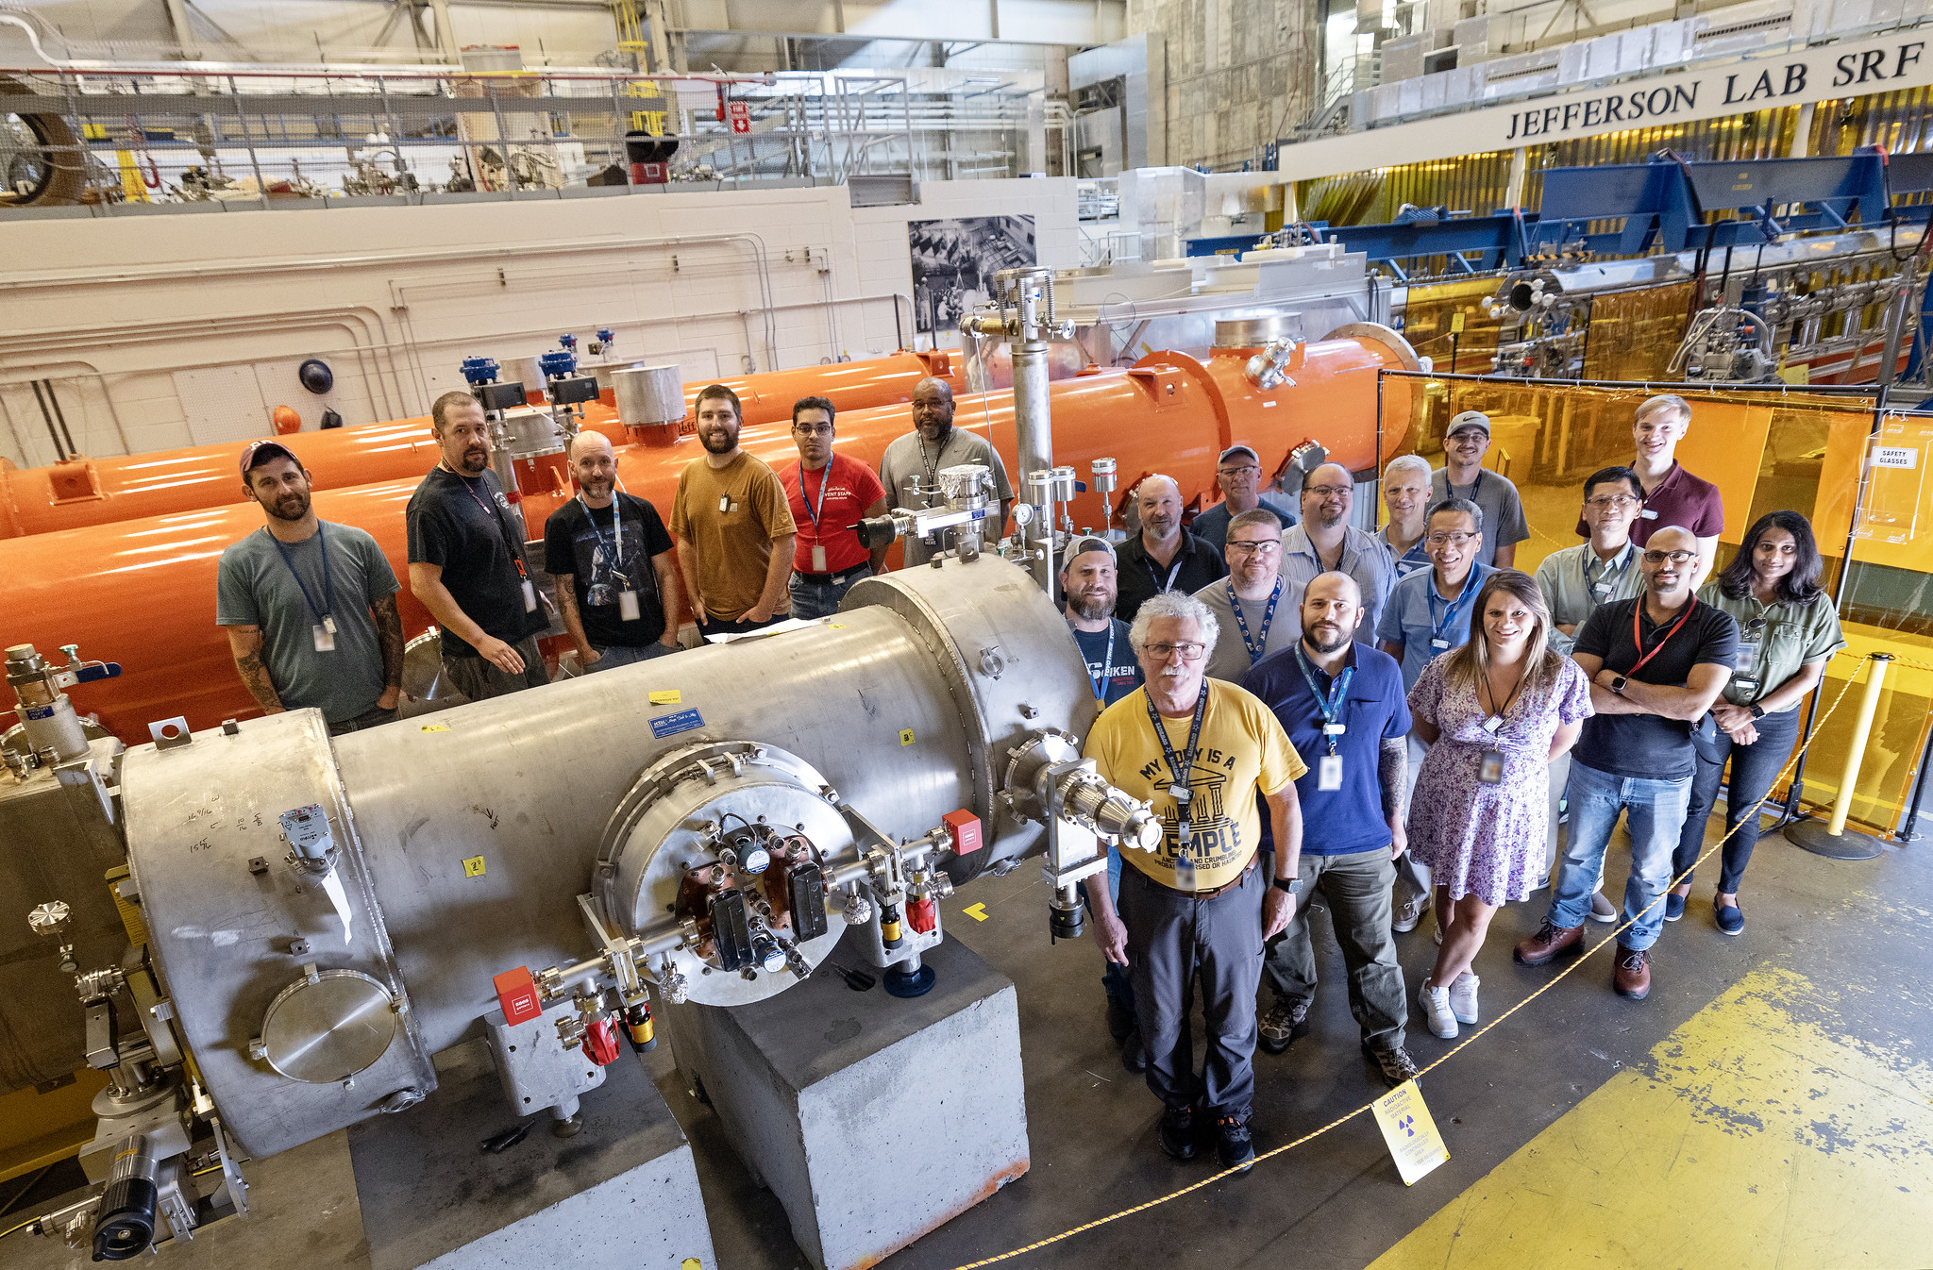
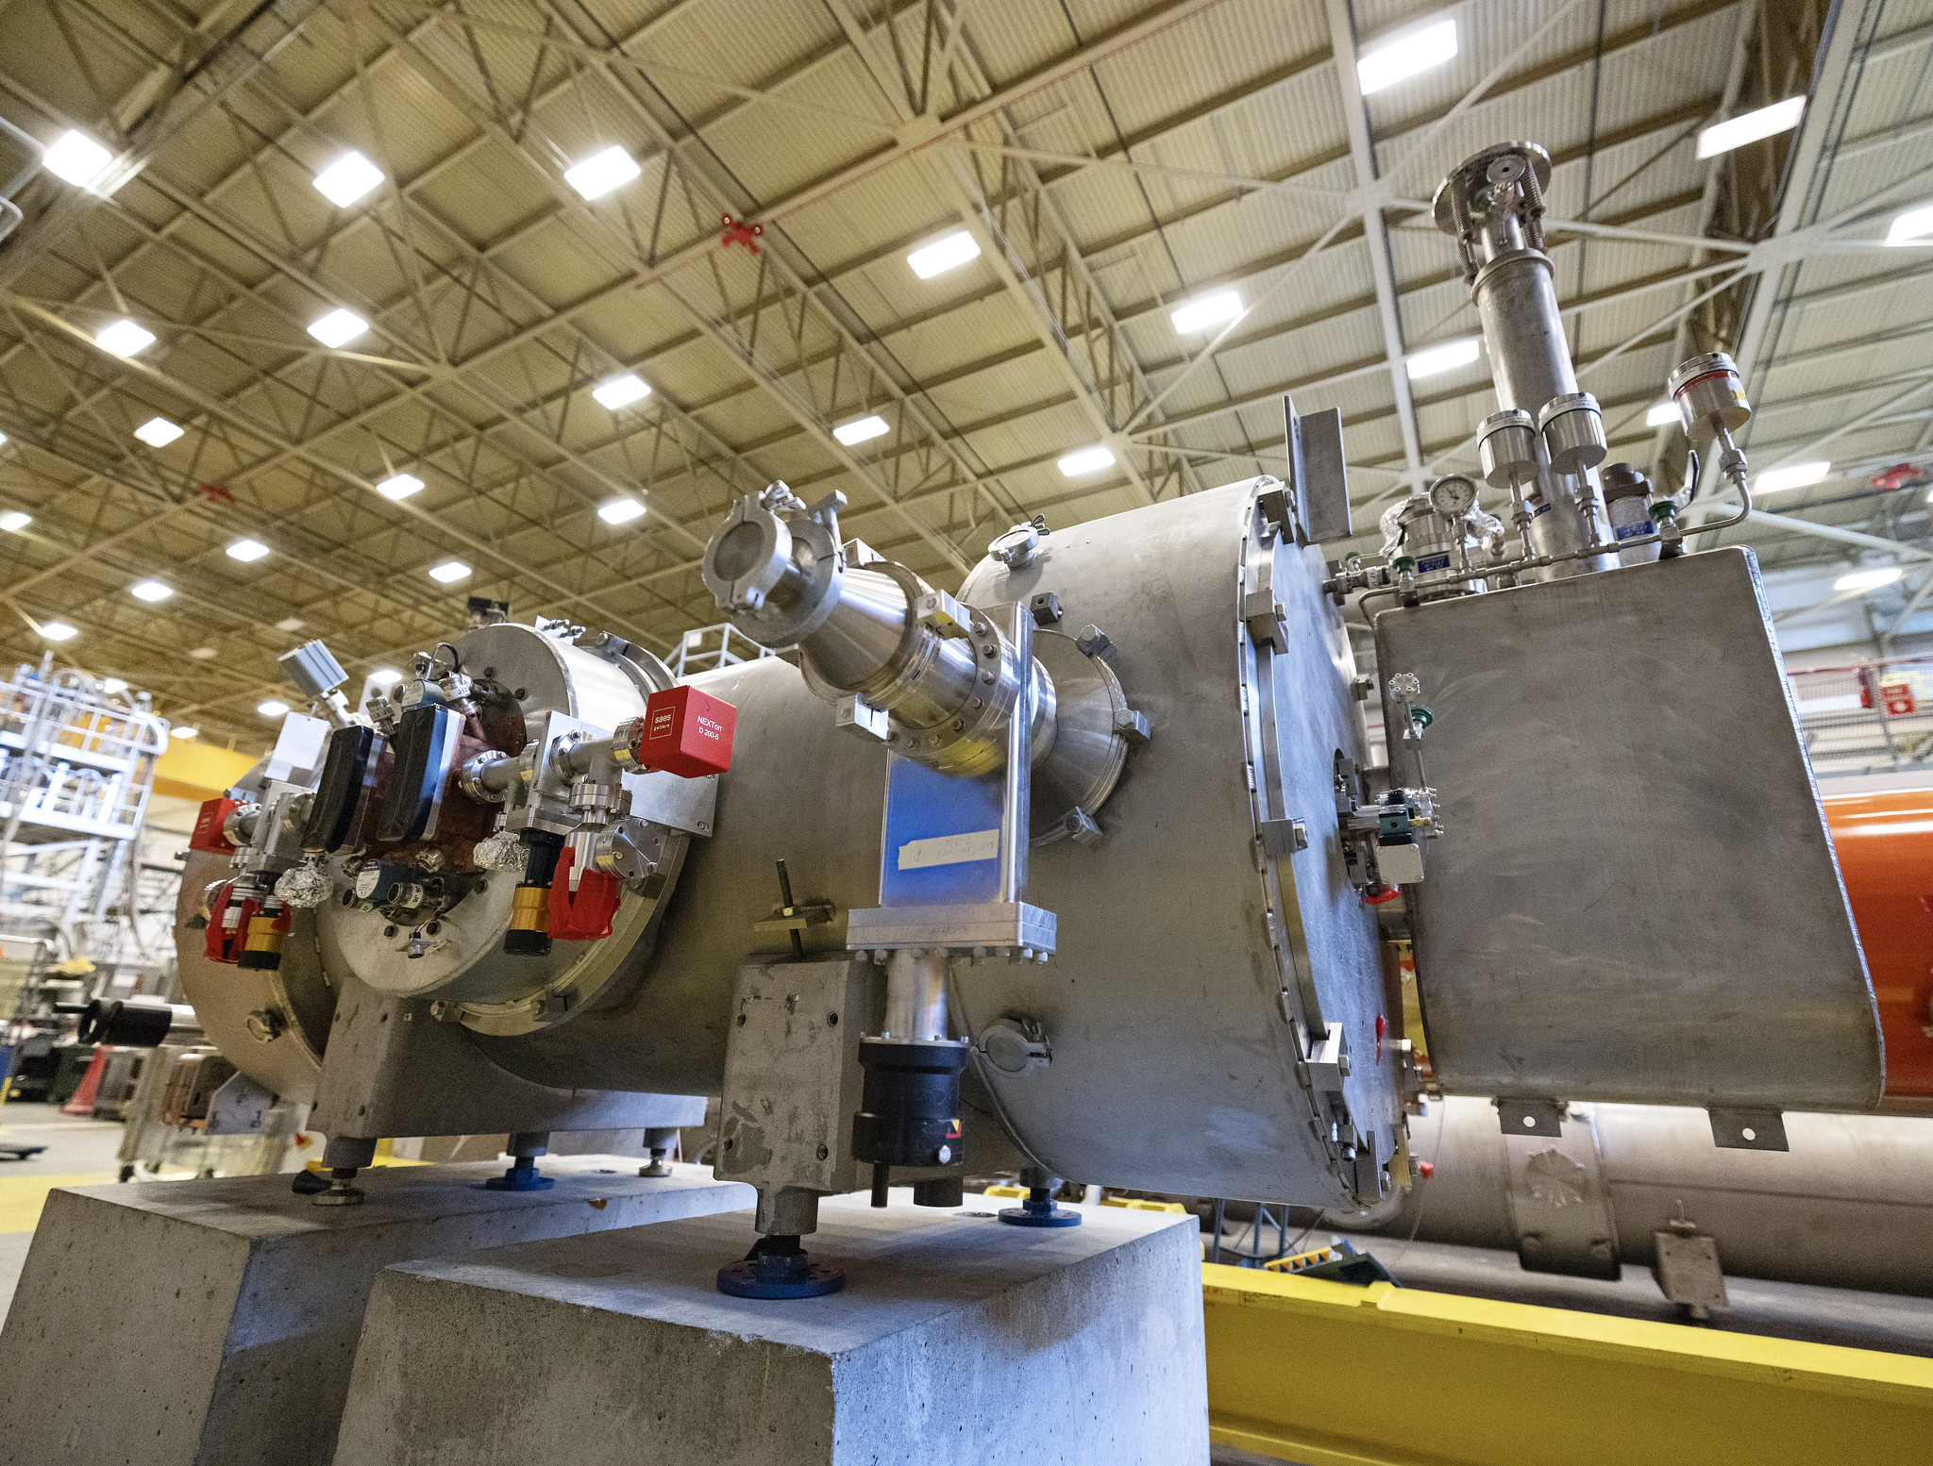
Work for Others/R&D
Tradition of SRF cavity treatment/process development: Cavity preparations possible with gradients x10 larger than original CEBAF.
Various technologies developed to reach: materials research, mechanical/chemical/ electrical polishing, surface treatments, doping and infusions, etc.
Many new module types and designs developed in collaboration with the world SRF community. (Modules for linacs, “crabbing” at IPs, etc.)
Latest research – 4K operation:
Nb3Sn-film on Nb substrate module reaches
10+ MeV
Conduction-cooled cryomodule w/ Gen. Atomics
Gradient development/best practices in Operations:
Field emission research
Improve vacuum techniques and cleanliness
In-situ processing techniques using helium and other plasmas

Slide 9
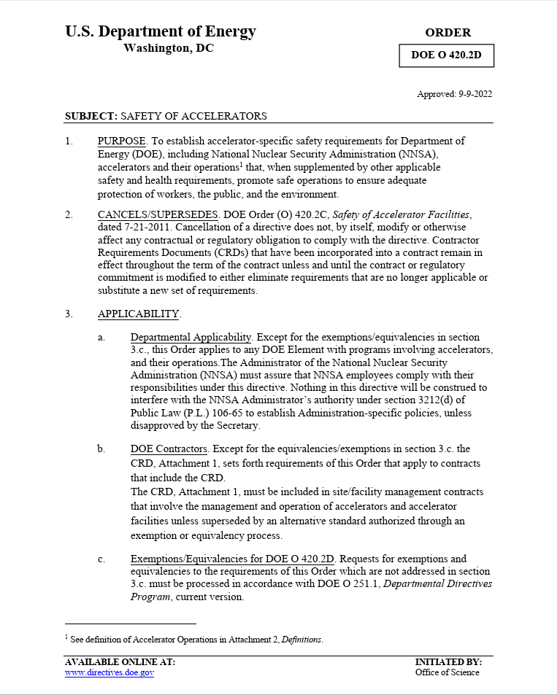
What is DOE Order 420.2D?
Dept. of Energy Implements regulatory controls
through orders.
Order 420.2 covers the safe operation of particle accelerator facilities in the United States, and what controls are required to do so.
In moving from version C to D of this document, the definition of what an accelerator is was changed.
Now: If facility can make a 10+ MeV particle (i.e. could potentially generate neutron radiation…) – it’s a particle accelerator
CMTF and VTA are reclassified from test stands (as they have been for ~35 years) by advances in SRF technology.

Slide 10
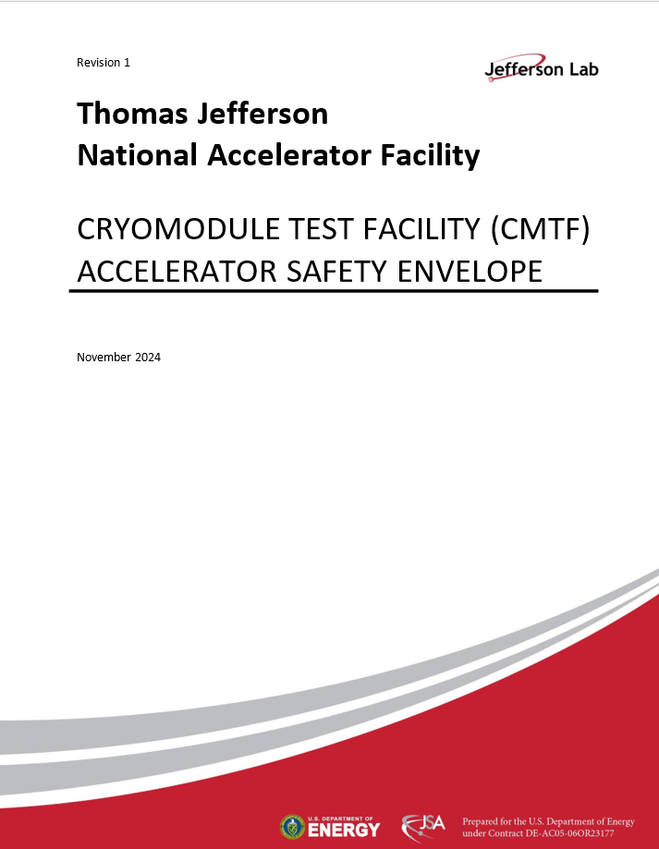
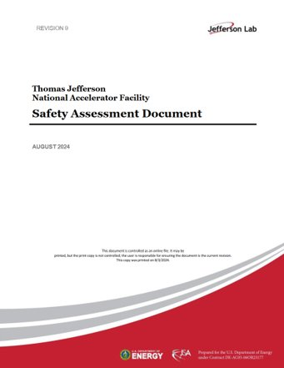
What are these documents?
TJNAF Safety Assessment Document (SAD)
The SAD contains descriptions of the laboratory, its facilities, and all of the accelerators present. It also analyzes possible personnel hazards due to operation and establishes controls in order to mitigate them – defining the credited controls included into each of the ASEs.
Dept. of Energy Order 420.2D
Defines what an accelerator is and the regulatory framework in order to run one established by the Department of Energy in the United States government.
CMTF Accelerator Safety Envelope (ASE)
Defines controls that must be in place in order to safely operate the facility. These are known as credited controls as these are the minimum things that must be in place in order to run, as agreed to both by the DOE and the Lab. These are reviewed internally & externally on a rotating basis. This document is our ‘driver’s license’ to operate from the government.

Slide 11
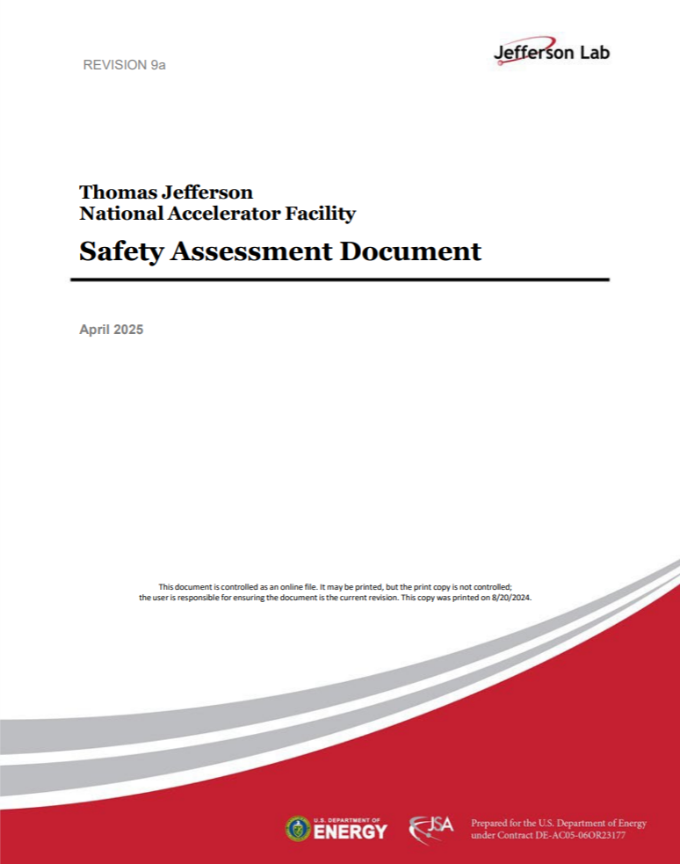
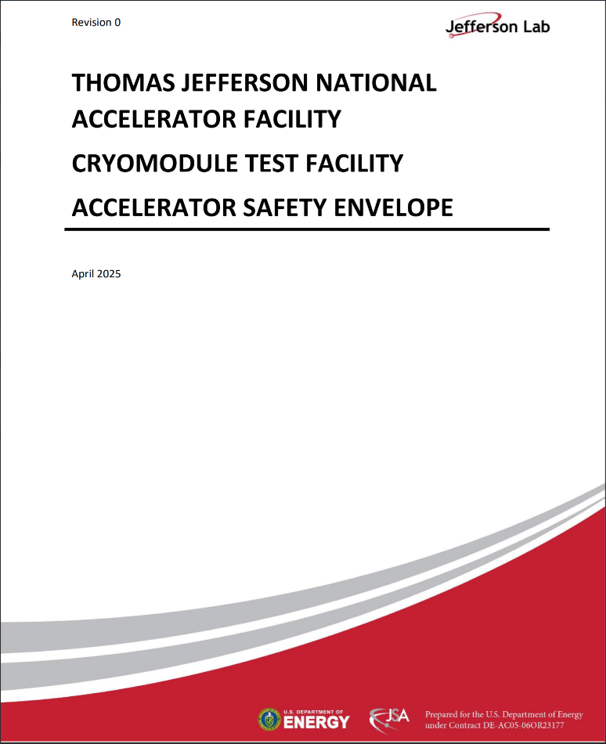
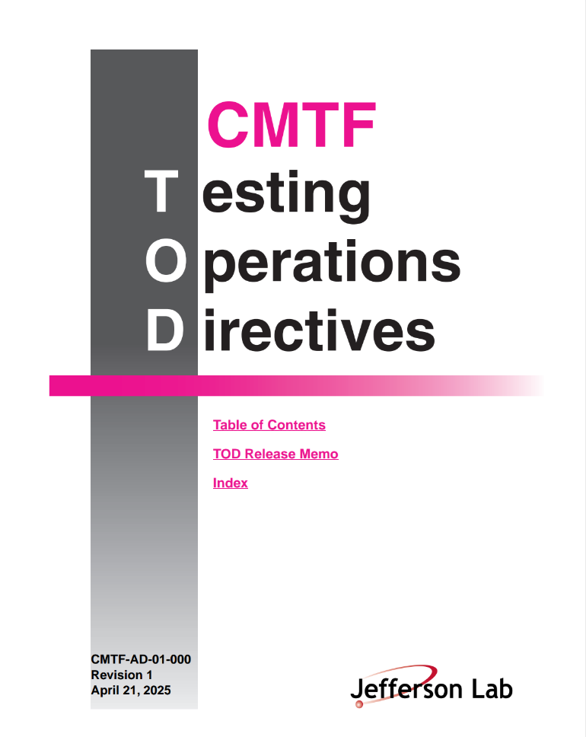
CMTF Governing Documentation
SAD updated for DOE O 420.2D
Accelerator Safety Envelope (ASE)
Safety Assessment Document (SAD)
CMTF Testing Operations Directives (TOD)
Establishes the conduct of CMTF Operations
Analyzes hazards associated with JLab accelerator operations
Defines the set of facility-specific controls for CMTF
Establishes accelerator-specific safety requirements for Department of Energy (DOE)
DOE Order 420.2D - Safety of Accelerators
Once approved:
https://www.jlab.org/eshq/ProgramDocs

Slide 12
How Do We Do Business? Described in the TOD
https://www.jlab.org/esh/ProgramDocs
Similar to the CEBAF AOD, but less complicated as the CMTF is less complicated:
  CMTF accelerator enclosure is contained in one common space that cannot be occupied when the accelerator is ON, whereas the CEBAF accelerator beamline leads to many spaces that can be occupied when the accelerator is ON. In addition, CMTF is solely a testing facility and not a user facility.
Four chapters of TOD:
Chapter 1: Program Control
Describes how safety is integrated into CMTF program execution
and establishes how the program is defined and executed
Chapter 2: Configuration Management
Outlines how configuration management standards and work practices are applied as part of CMTF operations
Chapter 3: CMTF Operations
Specifies directives for how the CMTF program is carried out, including the safety responsibilities of the control room staff and the role of safety organizations
Chapter 4: Maintenance & Tracking
Describes the planning, scheduling, and coordinating of maintenance activities to maintain and improve CMTF availability
(Documents all newly created for CMTF & VTA)

Slide 13
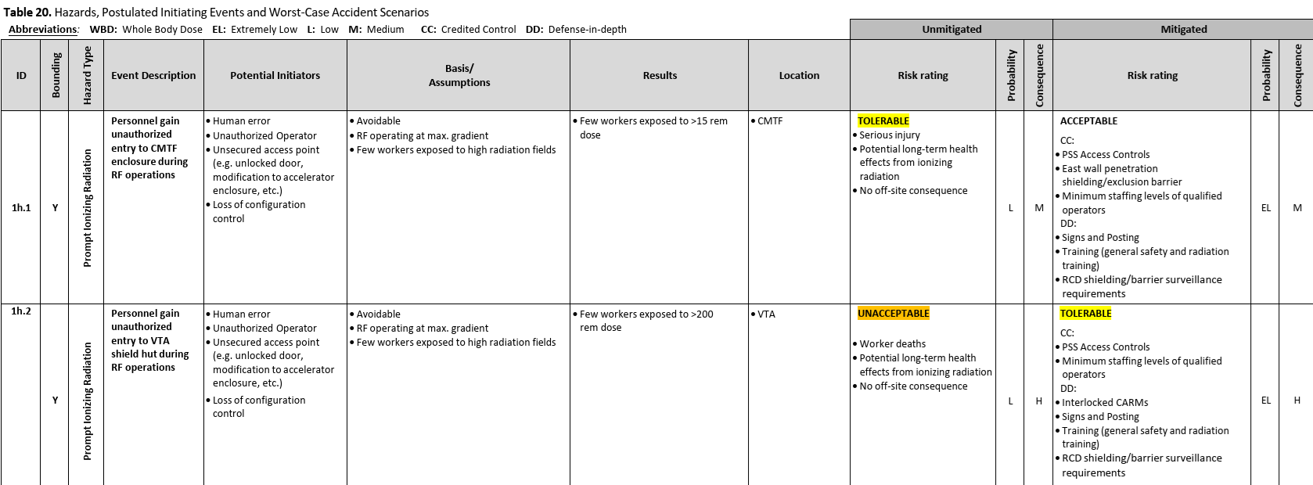
Credited Controls – What are they?
Safety Assessment Document (SAD) examines possible risks due to worst-case hazards (sometime called Maximum Credible Incidents, or MCIs), along with their probability & consequences and then places appropriate controls in place to mitigate those risks for personnel and facility safety. These controls are called Credited Controls, as we take credit for these keeping the facility safe to operate.
The SAD does this for all the accelerators on site. Controls are categorized, summarized, and broken out by accelerator in the SAD and referenced to the MCIs they mitigate.
Credited controls for each facility documented separately in an Accelerator Safety Envelope (ASE), which is agreed to & signed by JLAB and the DOE.

Slide 14
Hazard Analysis & Mitigation: Credited Controls
Hierarchy of Controls:
CMTF Credited Controls
Full description is in CMTF ASE
Hazard assessment and process in Safety Assessment Document (SAD).
Controls in place to eliminate, control, or mitigate identified hazards.
Credited controls are specified in ASE.
A credited control is determined through hazard evaluation to be essential and necessary for safe operation directly related to the protection of personnel or the environment.
Credited controls are assigned a higher degree of operational assurance than other controls.
Controls may be engineered or administrative.
If a credited control is altered, the USI process is followed.
Must be in place & verified in order to run.
Passive Engineered Controls
Permanent shielding, including labyrinths, penetration routing
Movable shielding
ODH vents and facility configuration
Active Engineered Controls
ODH system controls
Administrative Controls
Doors, gates, fences and other barriers
CMTF staffing during PSS Sweep Procedure
CMTF staffing during operations
Personnel Safety System (PSS) access controls

Slide 15
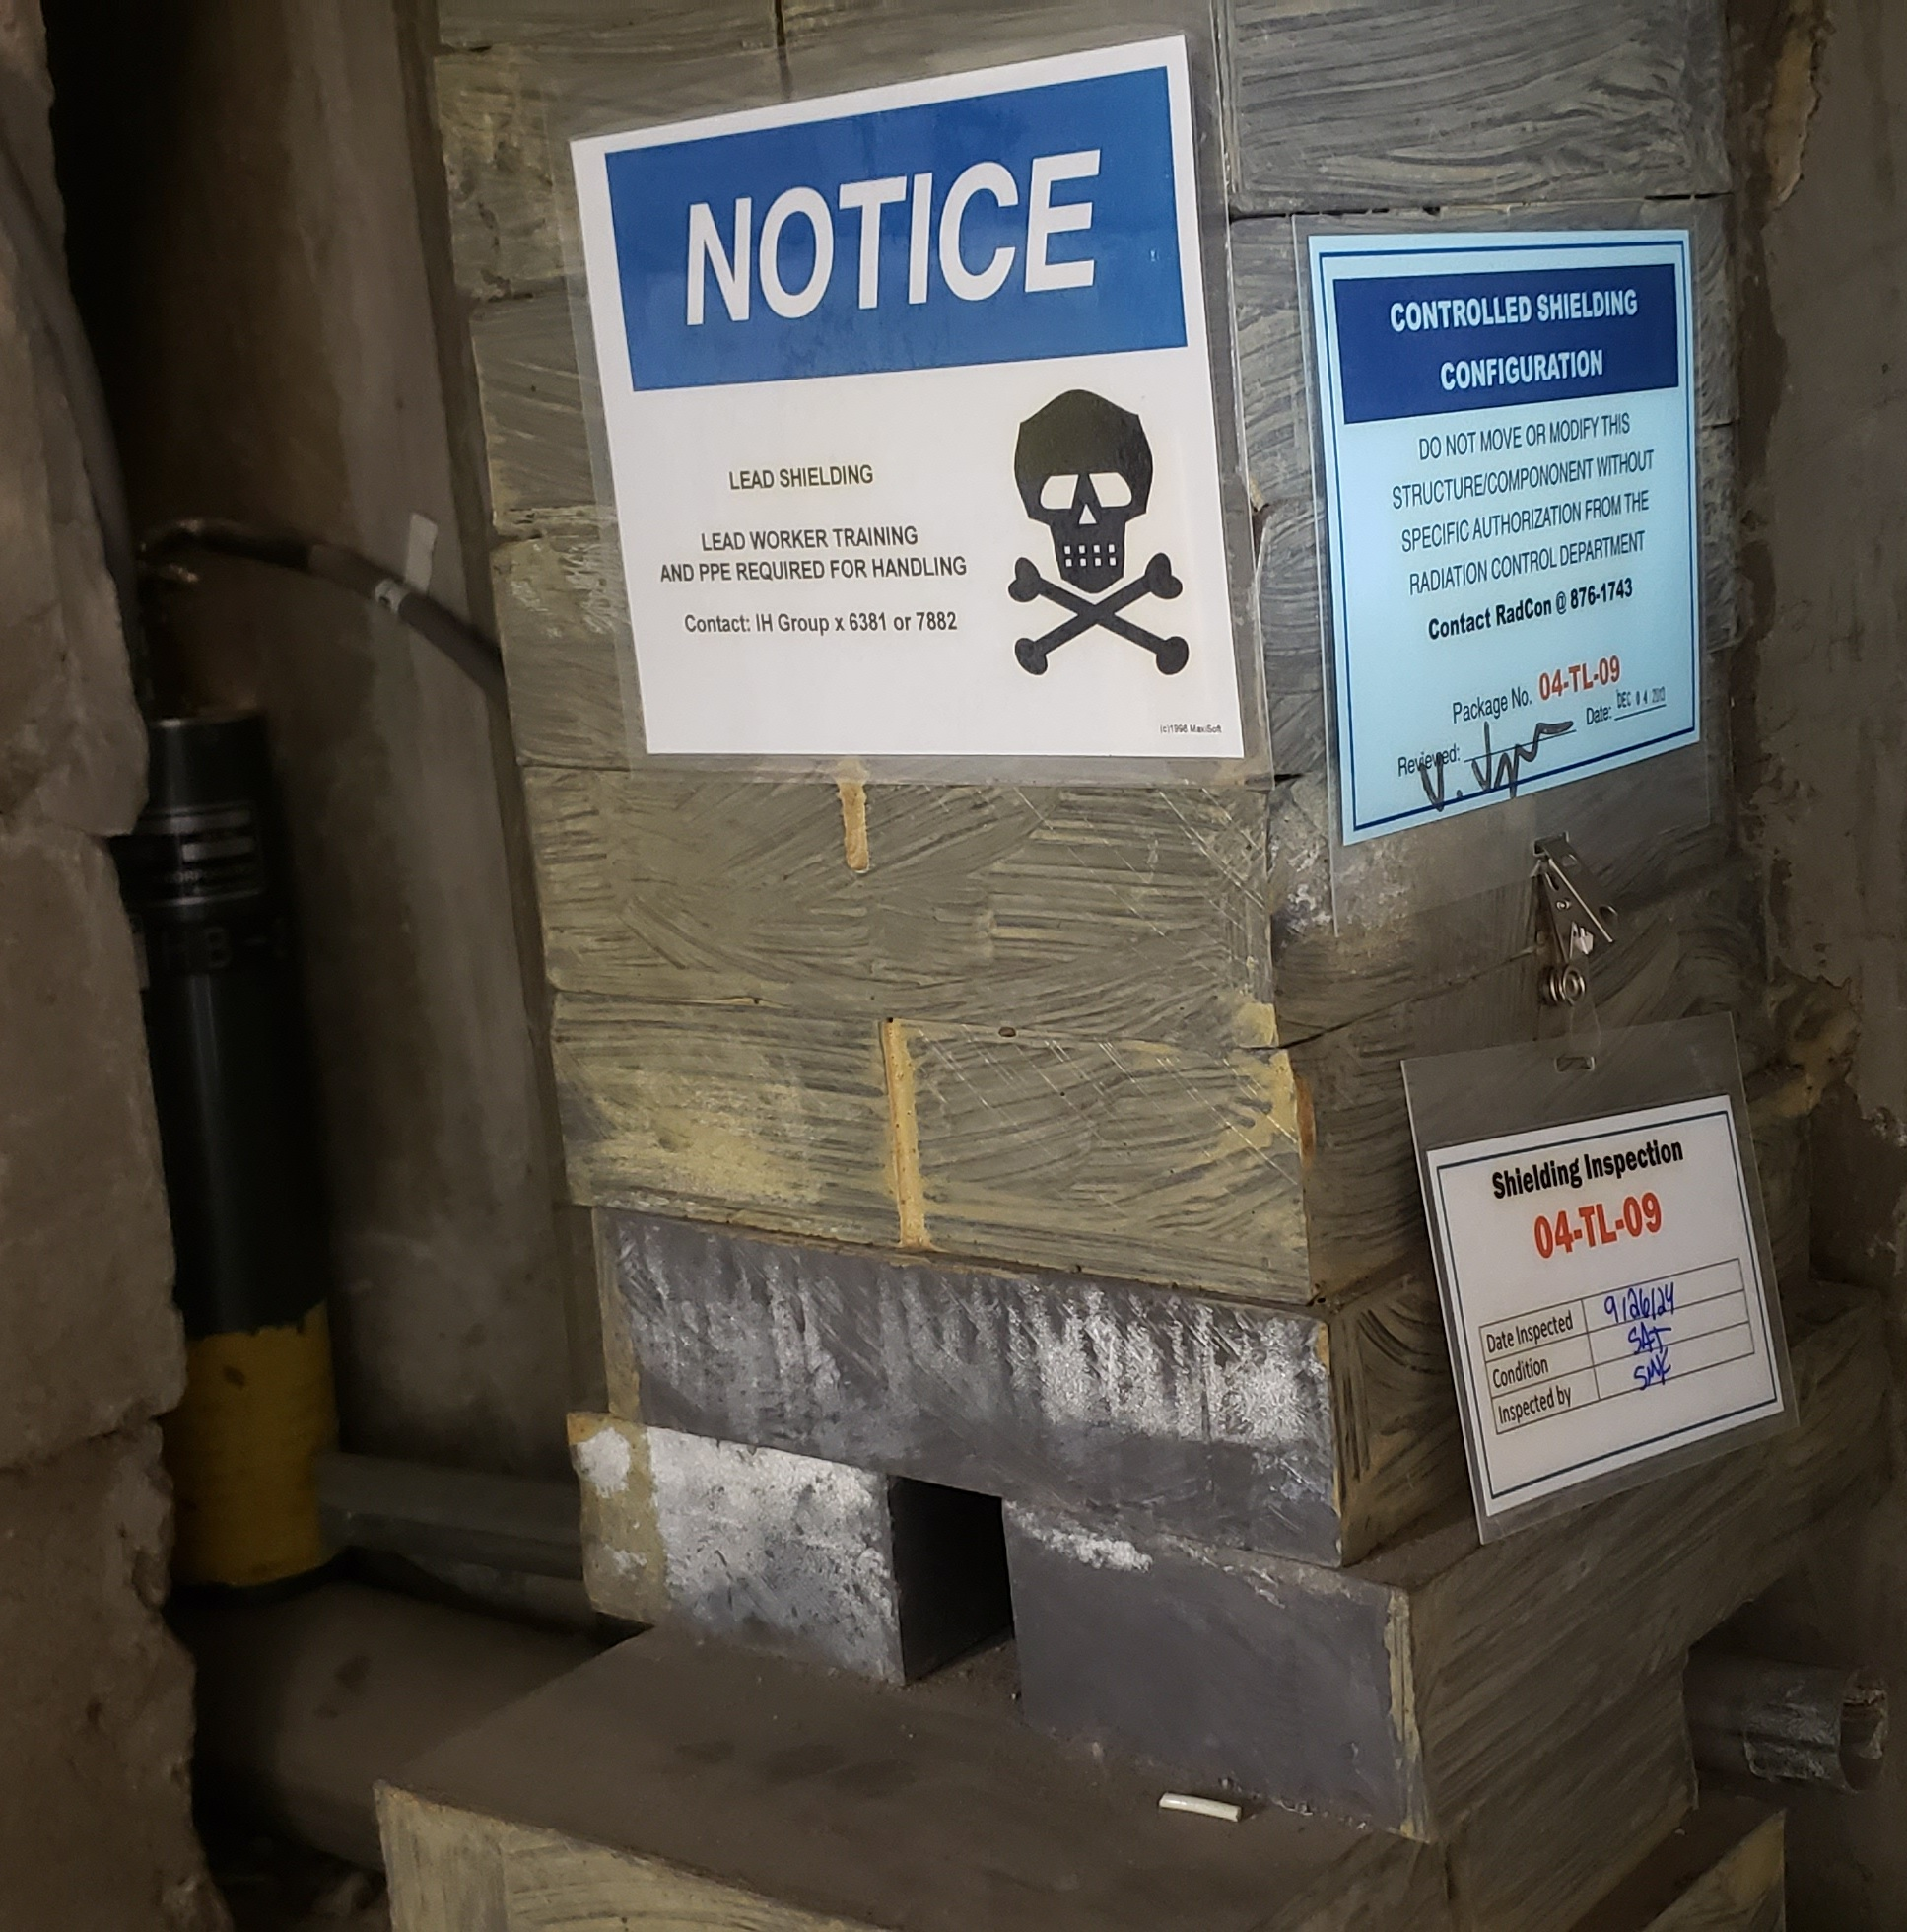
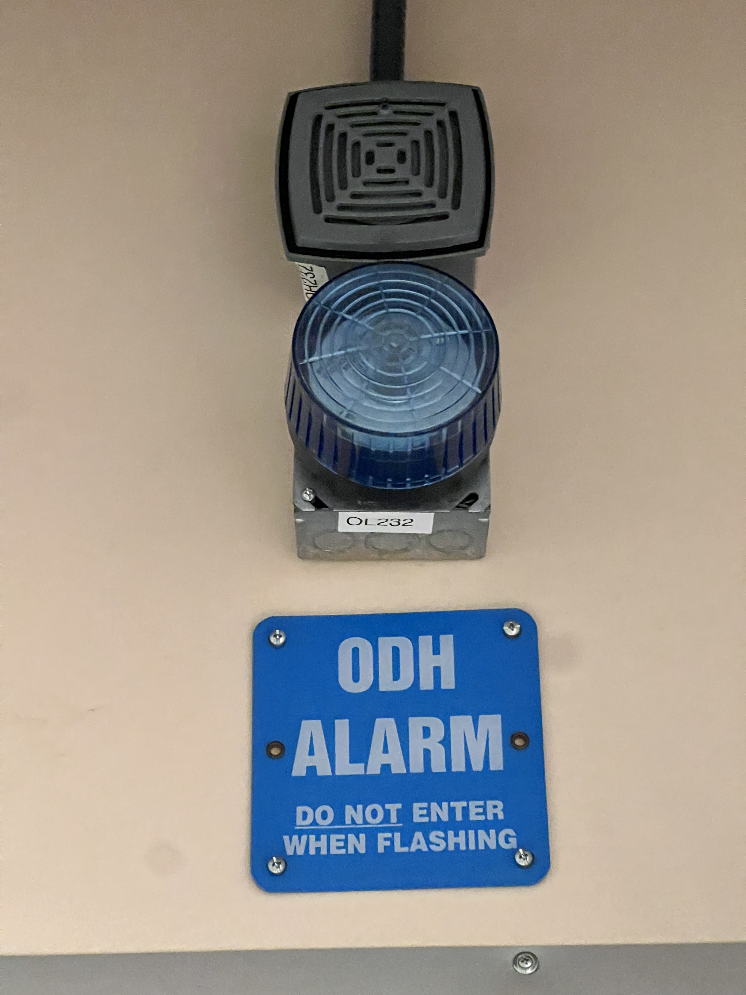
Credited Controls (CMTF) – Passive Engineered Controls
ASE 4.1.1: Permanent shielding:
  CMTF Enclosure; Shielding Policy for Ionizing Radiation.
  Certified every 5 years by Facilities through Radcon.
ASE 4.1.2: Movable shielding:
  Shielding packages (All 6 are in RCG Shielding Tacking Database
  & Credited for CMTF / VTA ARR):
  04-TL-08: CMTF Mezzanine: Exhaust fan/SSA waveguide penetration
  04-TL-09: Personnel Labyrinth Entrance
  06-TL-10: Cryogenic penetration CMTF-to-VTA
  06-TL-11: Partial Wall: Personnel Entrance/E Wall
  24-CMTF-01: Cable trench cave to control room.
  24-CMTF-02 Concrete/Lead shield wall in Cryogenic Penetration of East Wall
  Configuration verified through Radcon checklist. (~1/module test)
ASE 4.1.3: ODH Vents & Facility Configuration: (biennial SSG certification)
  4’x4’ CMTF enclosure ceiling vent (Passive)
  Defense-in-depth measure: Active venting. 35000 cfm fan.
  Defense-in-depth measure: Sealed penetrations: Trench to CMTF control room, all on 2nd floor, and Cryo penetration to VTA (on the VTA-side)
  ODH assessment (JLAB-TN-07-066; 11/14/24 revision contains new junction box.)

Slide 16
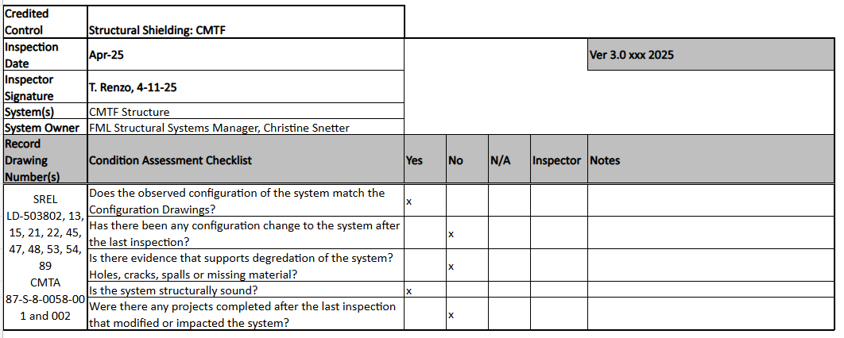
Example FML Structural Shielding Checklist:

Slide 17
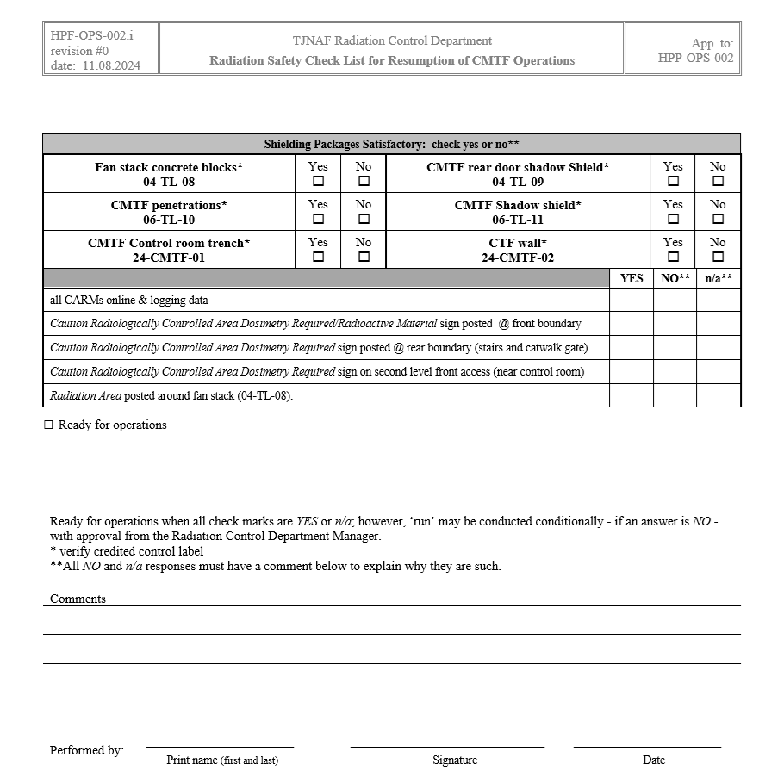
Example CMTF Radcon Checklist:

Slide 18
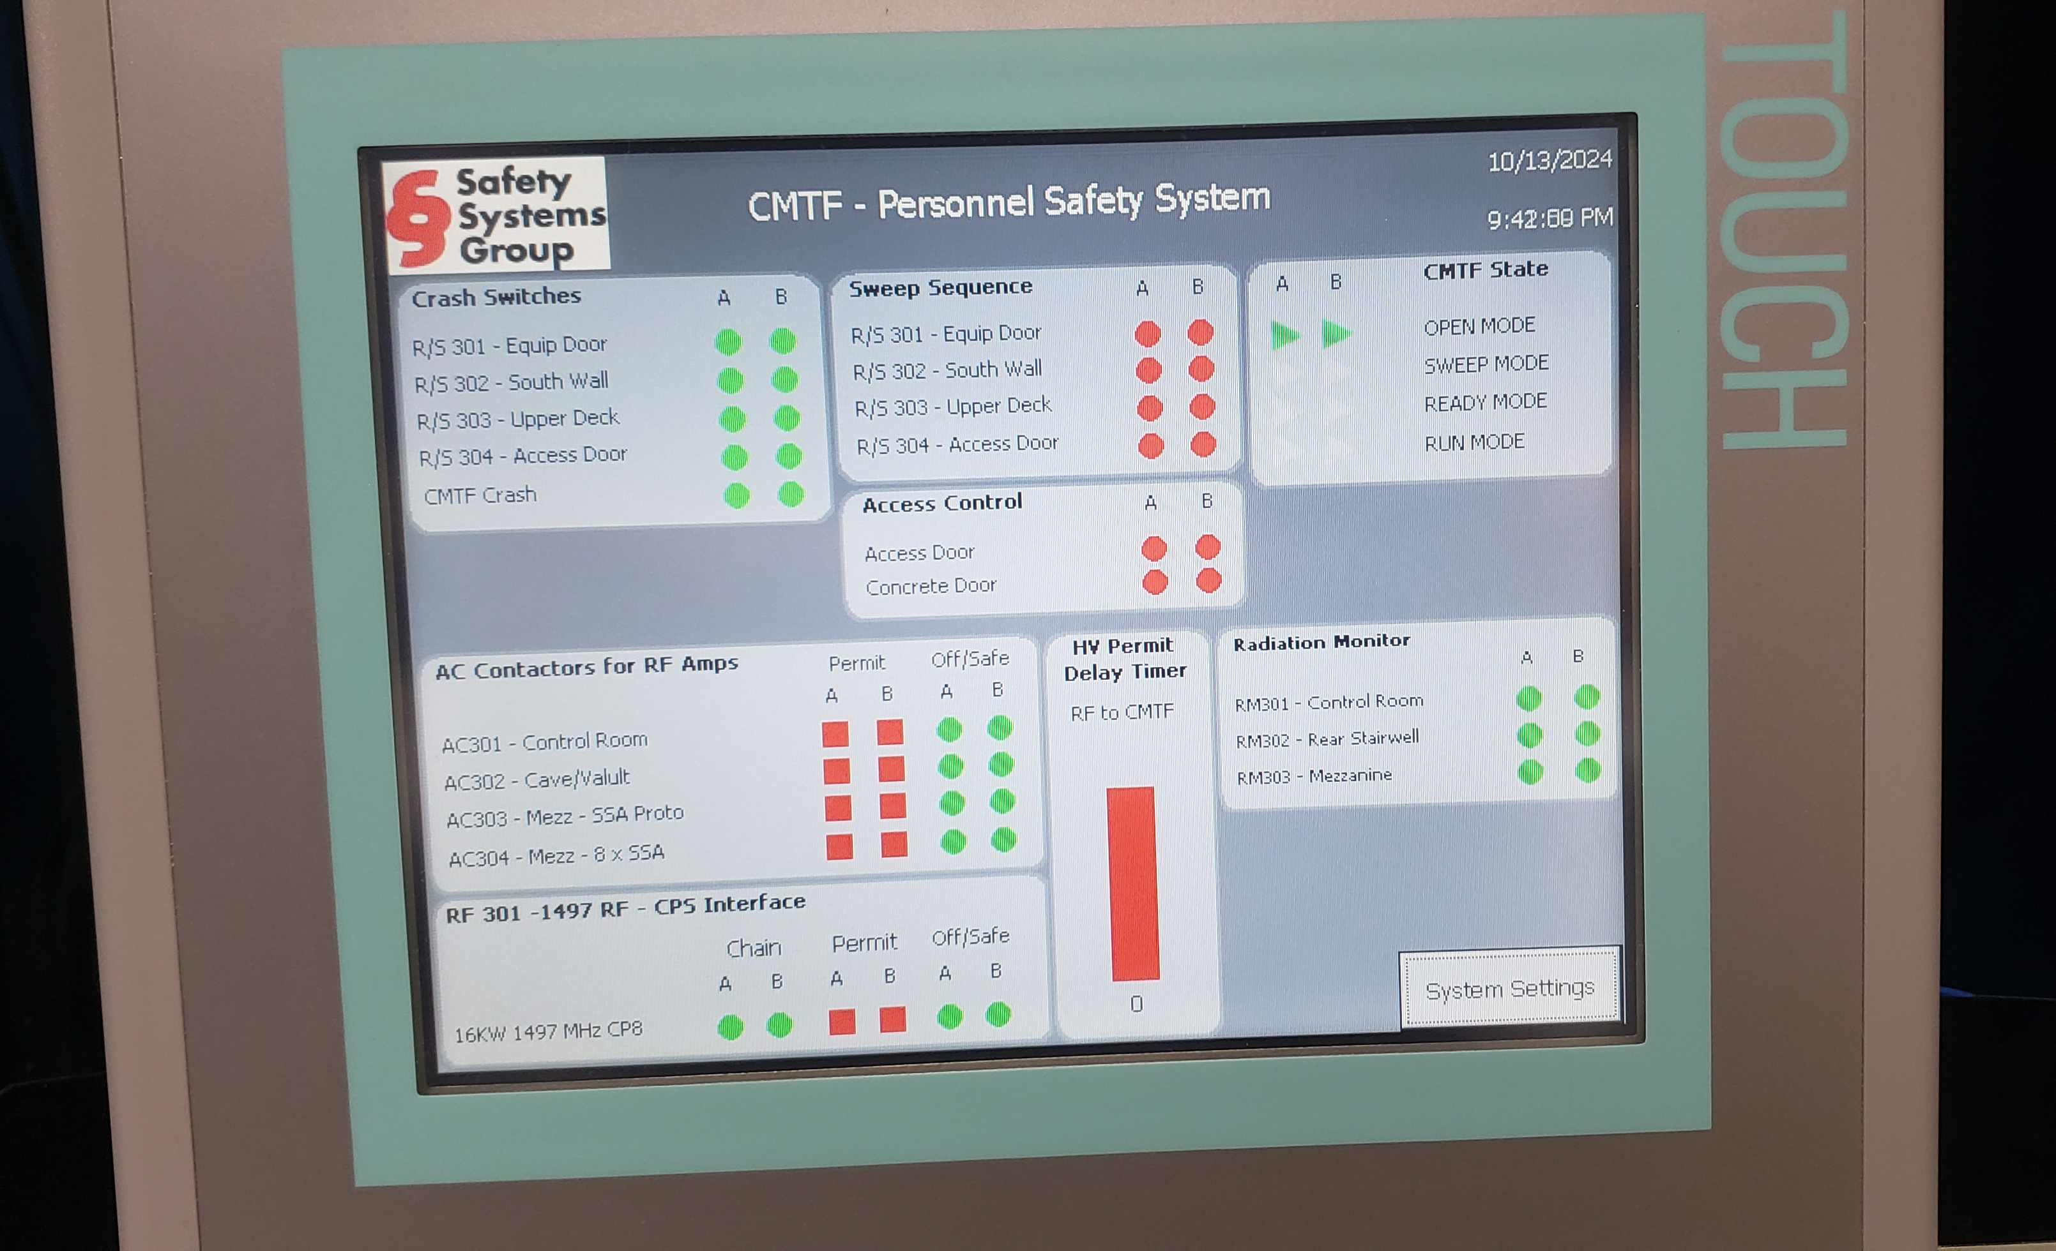
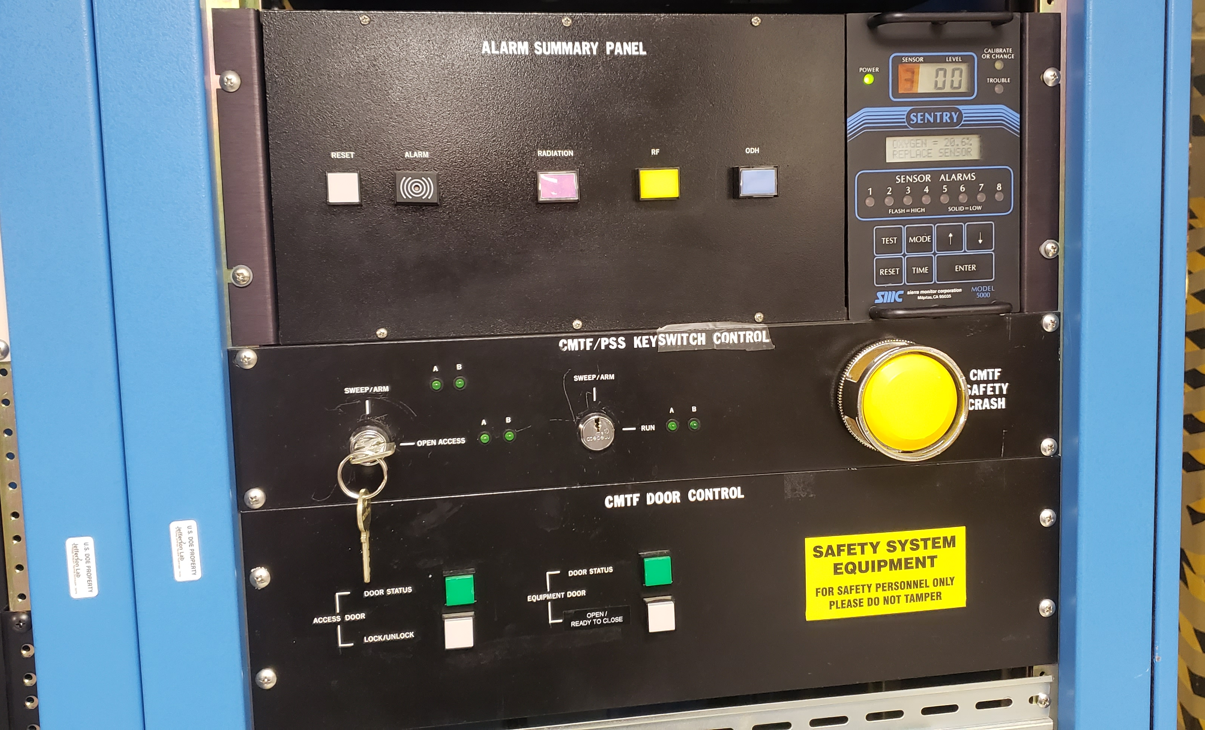
Credited Controls (CMTF) – Active Engineered Controls
ASE 4.2.1: PSS Access Controls:
  Certified at least annually; certification will be Safety System SRM check-off
  (& Credited) to ensure system is functional and working as designed.
  See static & functional certification procedures
  Description later in presentation
ASE 4.2.2: ODH System Controls:
  Certification process maintained by SSG
  ODH sensors located along ceiling and floor of CMTF enclosure
  System Readiness Manager components:
    ODH sensors/beacons/klaxon horns
  Description later in presentation
PSS Human-Machine Interface
PSS Alarm Summary, key/door control, & ODH panels

Slide 19
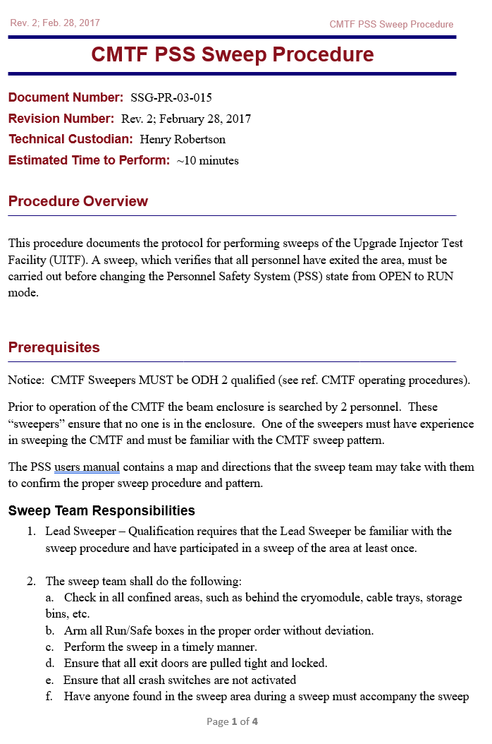
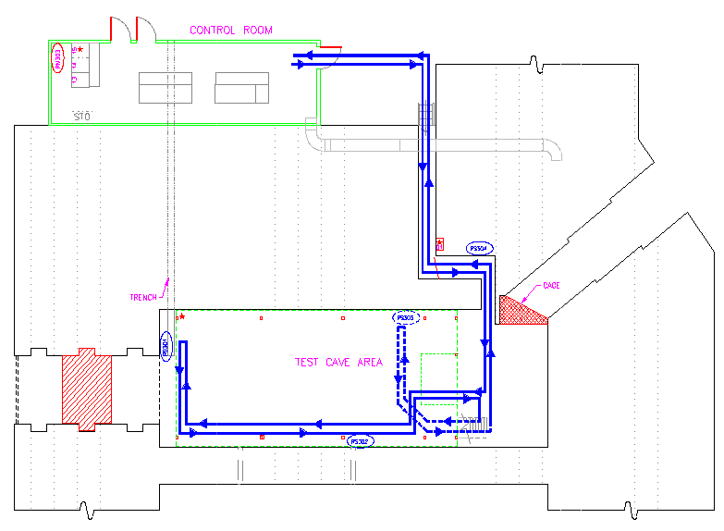
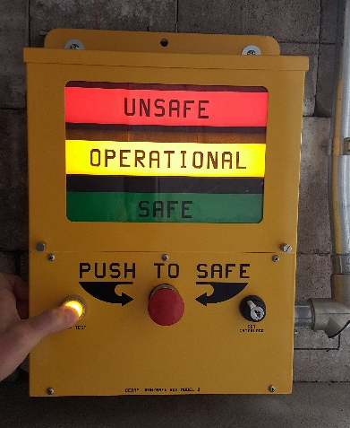
Credited Controls (CMTF) – Administrative Controls
ASE 4.3.1: Doors, Gates, Fences, & Other Barriers
ASE 4.3.2: CMTF Staffing – Sweep
  Sweep Procedure / Diagram
  Qualified Sweeper List
ASE 4.3.3: CMTF Staffing – Operations
  Staffing / PSS Run Modes on upcoming slide

Slide 20
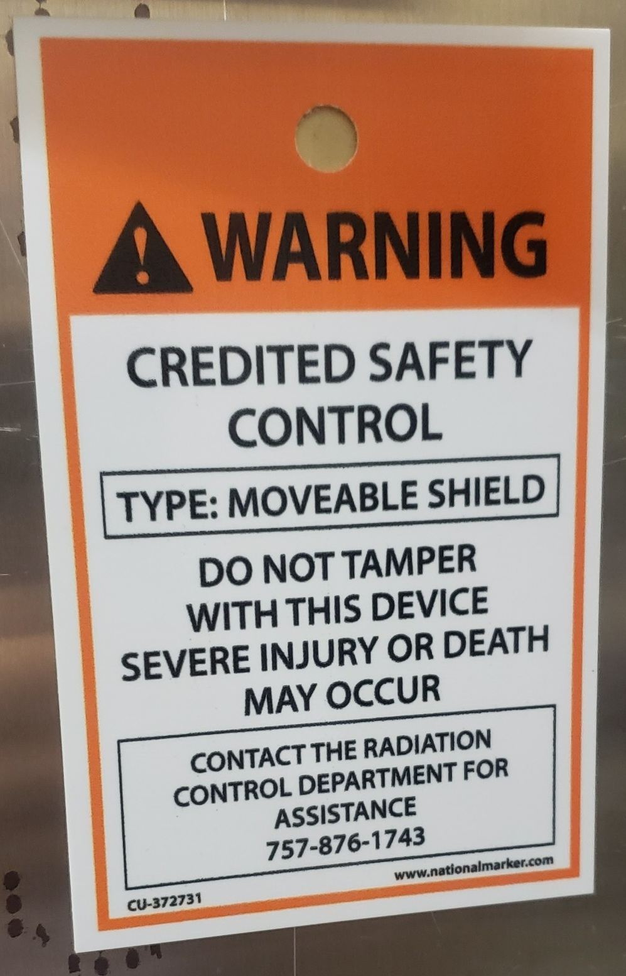
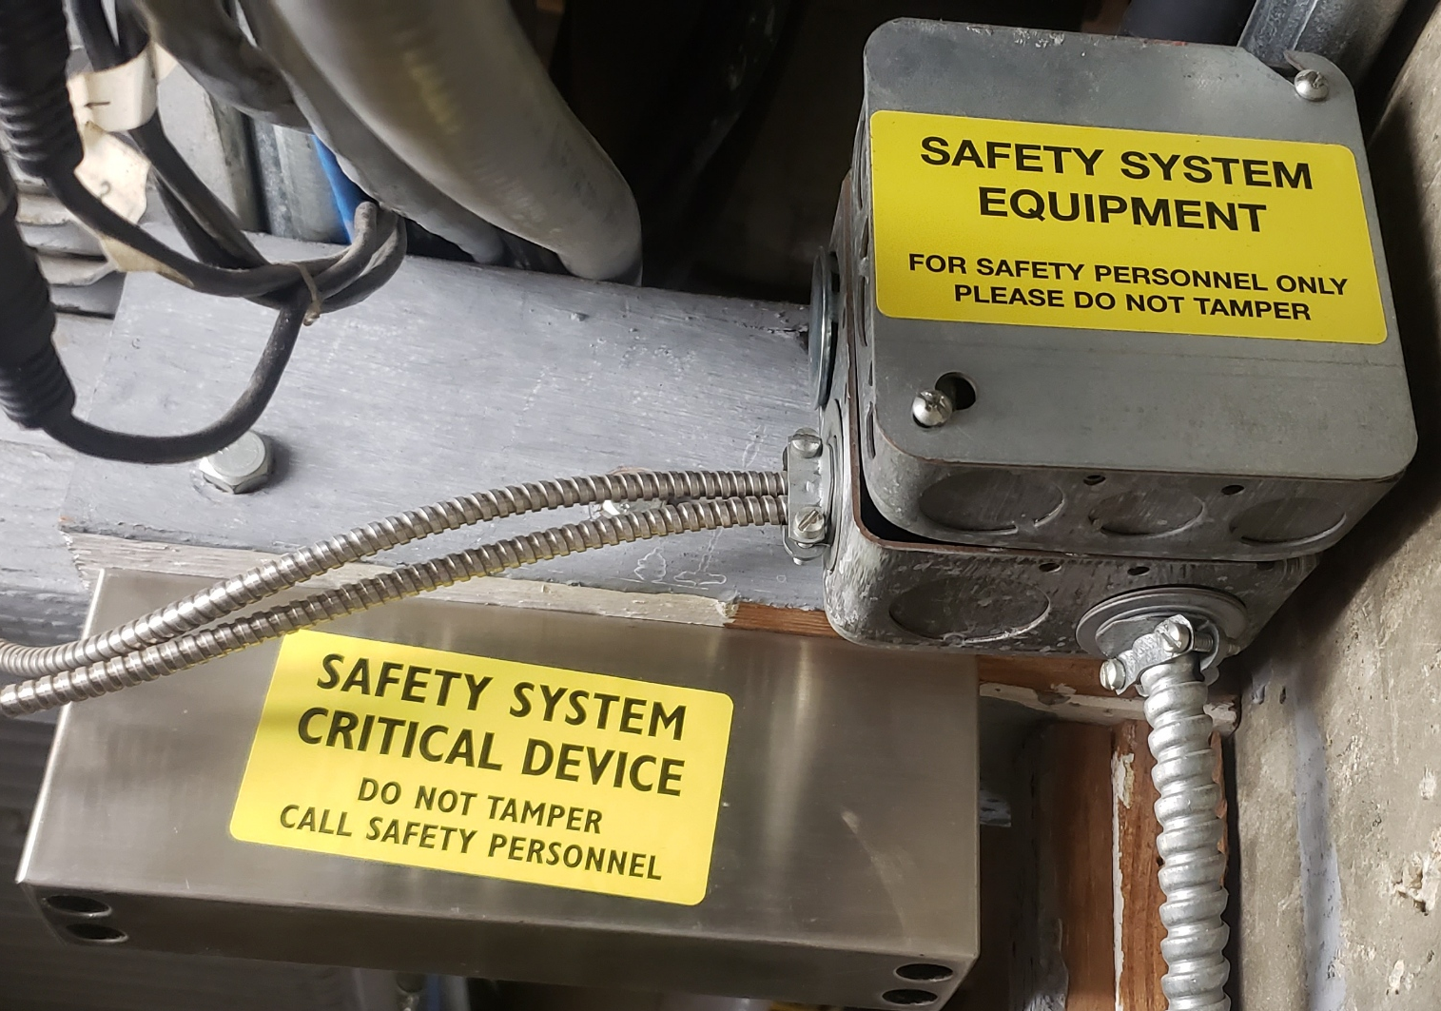
Credited Control Labeling:
Radiation Control and Safety System Group credited control labeling
More standardized labeling inconsistency is something the lab will be looking into in the near future…

Slide 21
Unreviewed Safety Issue (USI) Process ​
Process administered by Safety Configuration Management Board (SCMB) and applies to all accelerators on-site.
Process used when:​
Conditions inconsistent with the SAD or ASE are discovered
The Department of Energy Thomas Jefferson Site Office identifies accelerator​ operations as being in violation of its ASE​
New or proposed changes to accelerator equipment installation, configuration, or operational activities are proposed
Work stops, hazards are assessed & mitigated if necessary, and requirements to resume operations are established between the lab & the site office.
Safety Concern Form & Unreviewed Safety Issue (USI) Procedure:
https://www.jlab.org/about/management/coo_office/perf_assur/pro_prog
Actions/findings as a result of the above processes (as well as many others) are tracked via the Corrective Action Tracking System (CATS):
https://mis.jlab.org/ehs
(Accessible from laboratory networks only)
“Unreviewed” doesn’t necessarily mean that a hazard was never considered.

Slide 22
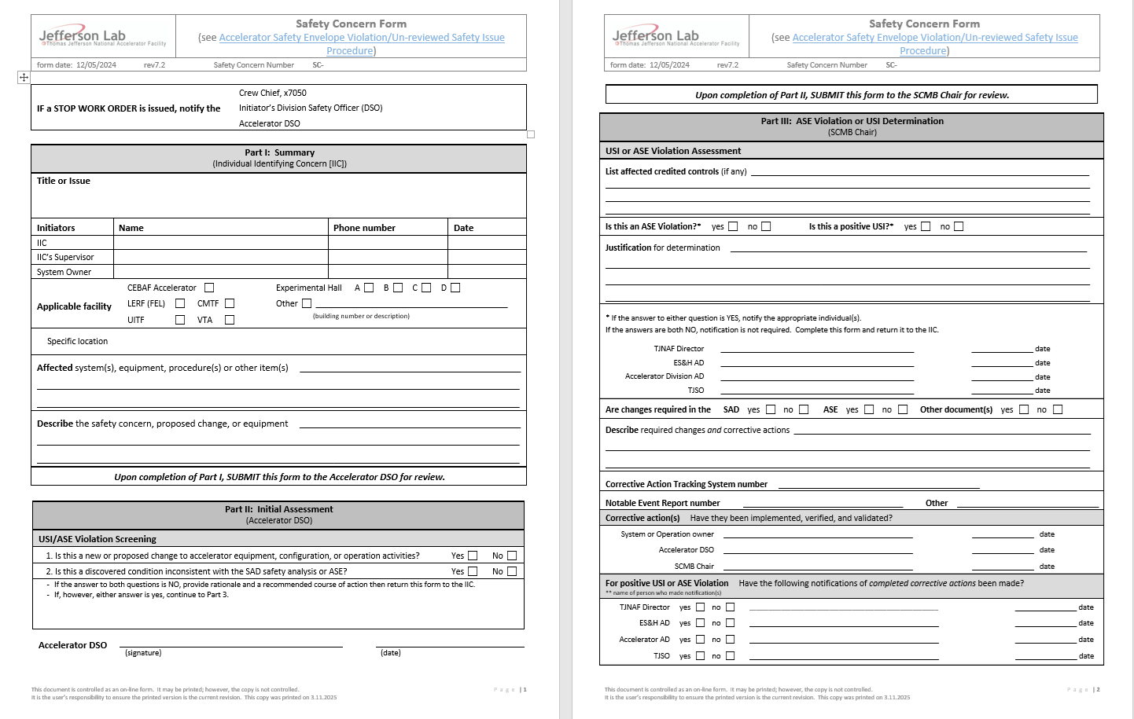
Safety Concern Form:
Initiates the USI process with the Accelerator Division Safety Office (DSO):

Slide 23
PSS System Overview

Slide 24
CMTF PSS: Hazard and Mitigation
The CMTF PSS is a credited active engineered control that helps protect personnel from exposure to prompt ionizing radiation during cryomodule testing in the test cave. As an active engineered system, the PSS is one of several methods of hazard mitigation, working in conjunction with passive engineered systems and supplemented by administrative measures.
The system design is based on two complementary principles:
Keep people away from hazards.
Detection of any access control violation, such as opening the personnel access door during Run Mode, results in immediate shutoff of the RF amplifiers and other interlocked devices.
Keep hazards away from people.
Detection of ionizing radiation outside the CMTF cave during operation results in immediate shutoff of the RF HPA, eliminating the potential prompt ionizing radiation hazard to personnel around the area.
HAZARD | MITIGATION
Prompt ionizing radiation exposure from field emission | PSS access control, warning lights and horns
Oxygen deficiency hazard | ODH system with audible and visible alarms, exhaust vent fan interlocked with ODH system

Slide 25
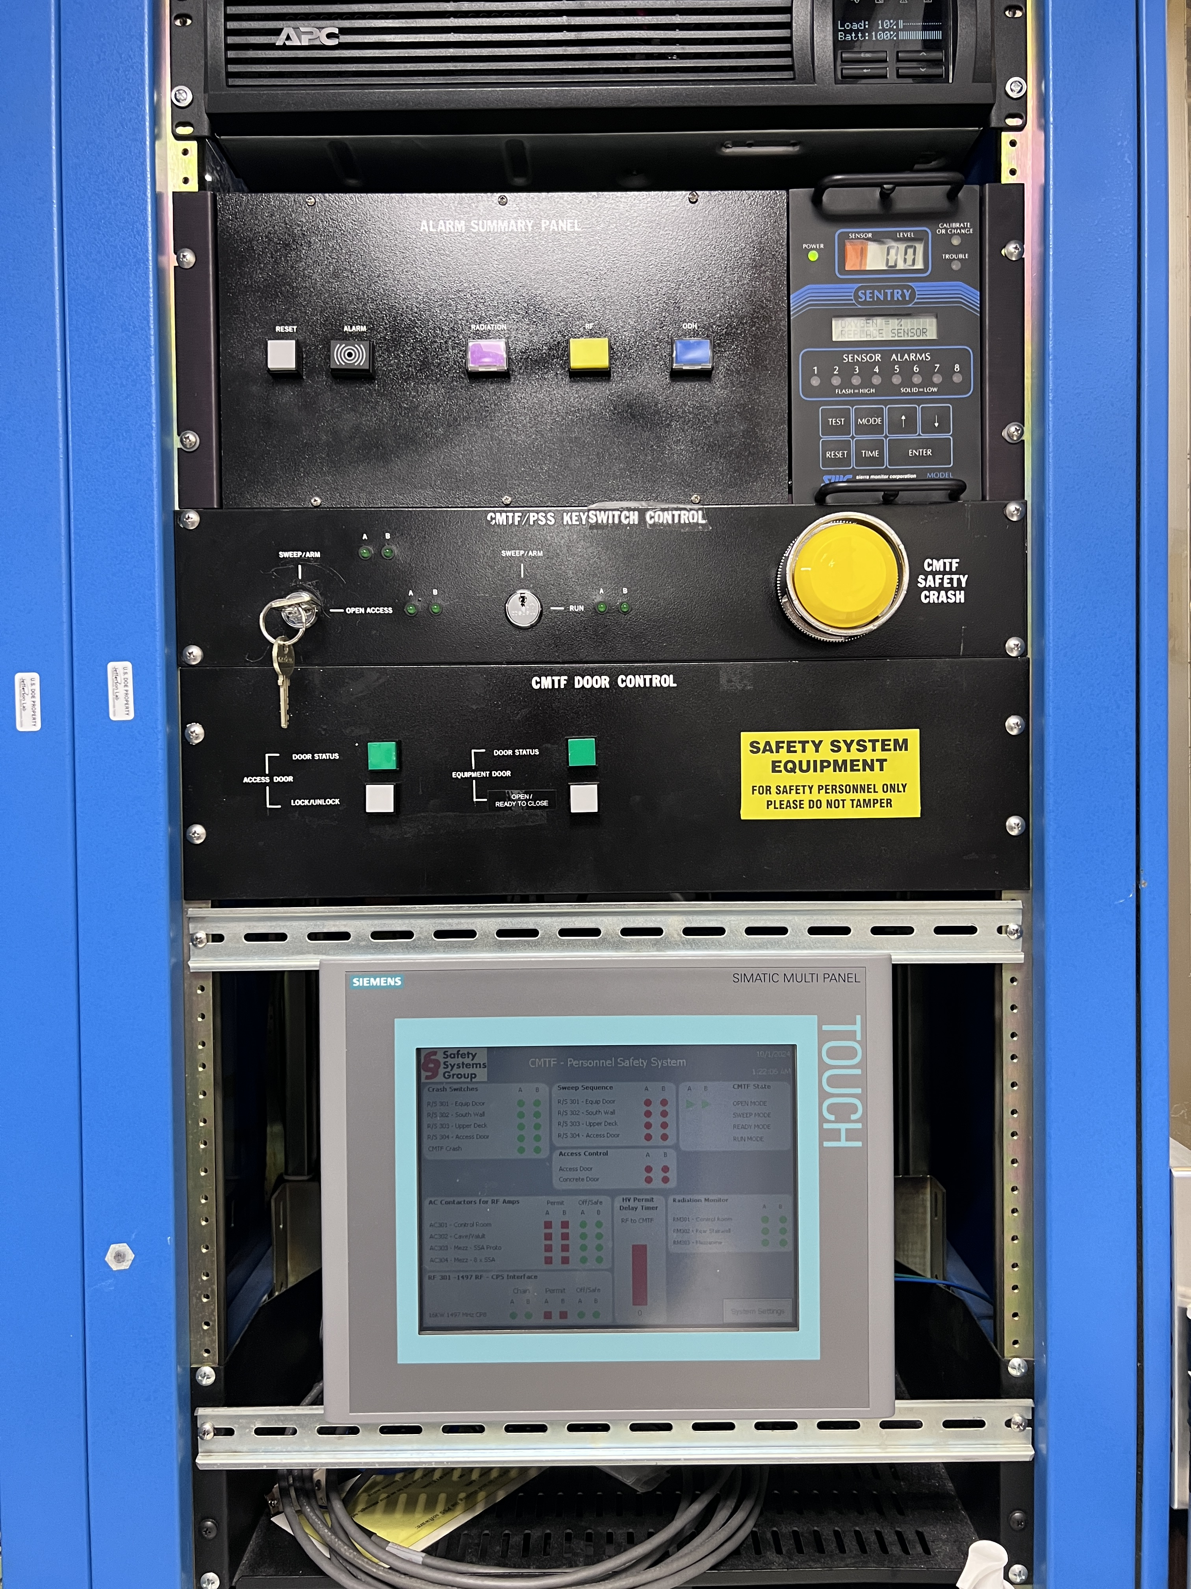
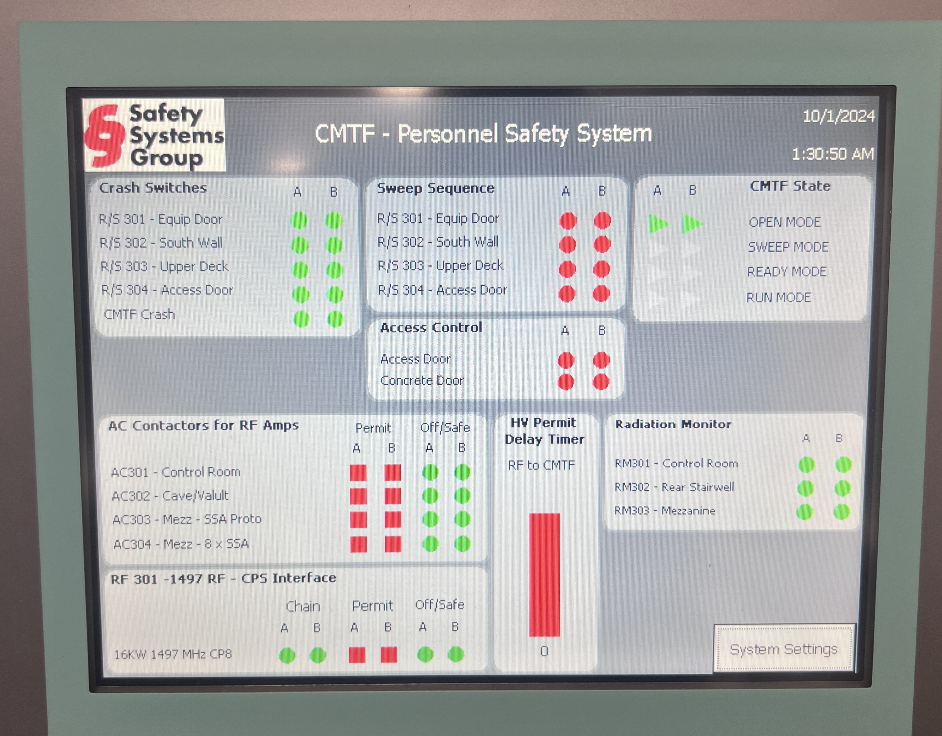
CMTF PSS OVERVIEW
  Personnel Safety System
    Test Cave Access Control
    RF Power Safety Interlock
    RF Amplifiers AC Contactors
    Interlocked CARMs
    Warning Lights and Horns
  Oxygen Deficiency Hazard Monitoring System
    ODH Monitors, Transmitters, and Alarming Devices
CMTF PSS HMI (Rack TL06B15)

Slide 26
CMTF PSS: SAFETY INTERLOCKS
RF Power Sources:
  Two sets of paired 8 kW 1497 MHz klystrons, each set with its own waveguide delivering approximately 12 kW to the cave – only one set of klystrons operates at a time to power a single SRF cavity in a cryomodule.
  AC contactor interlocks for portable RF sources.
  Interface for control of eight 6 kW 1.3 GHz solid-state amplifiers (currently not installed).
System Scope:
  The PSS only enables RF HPA operations when the cave is secured.
  PSS logic determines test cave status to permit or inhibit RF operation.
CARM Interfacing:
  CARMs are directly interfaced (dry contacts) to the PSS PLC.
  A CARM alarm opens a contact to the PSS, causing it to drop from Run mode to Ready mode.
  The alarm also triggers the radiation alarm buzzer on the PSS Alarm Summary Panel in the Control Room.

Slide 27
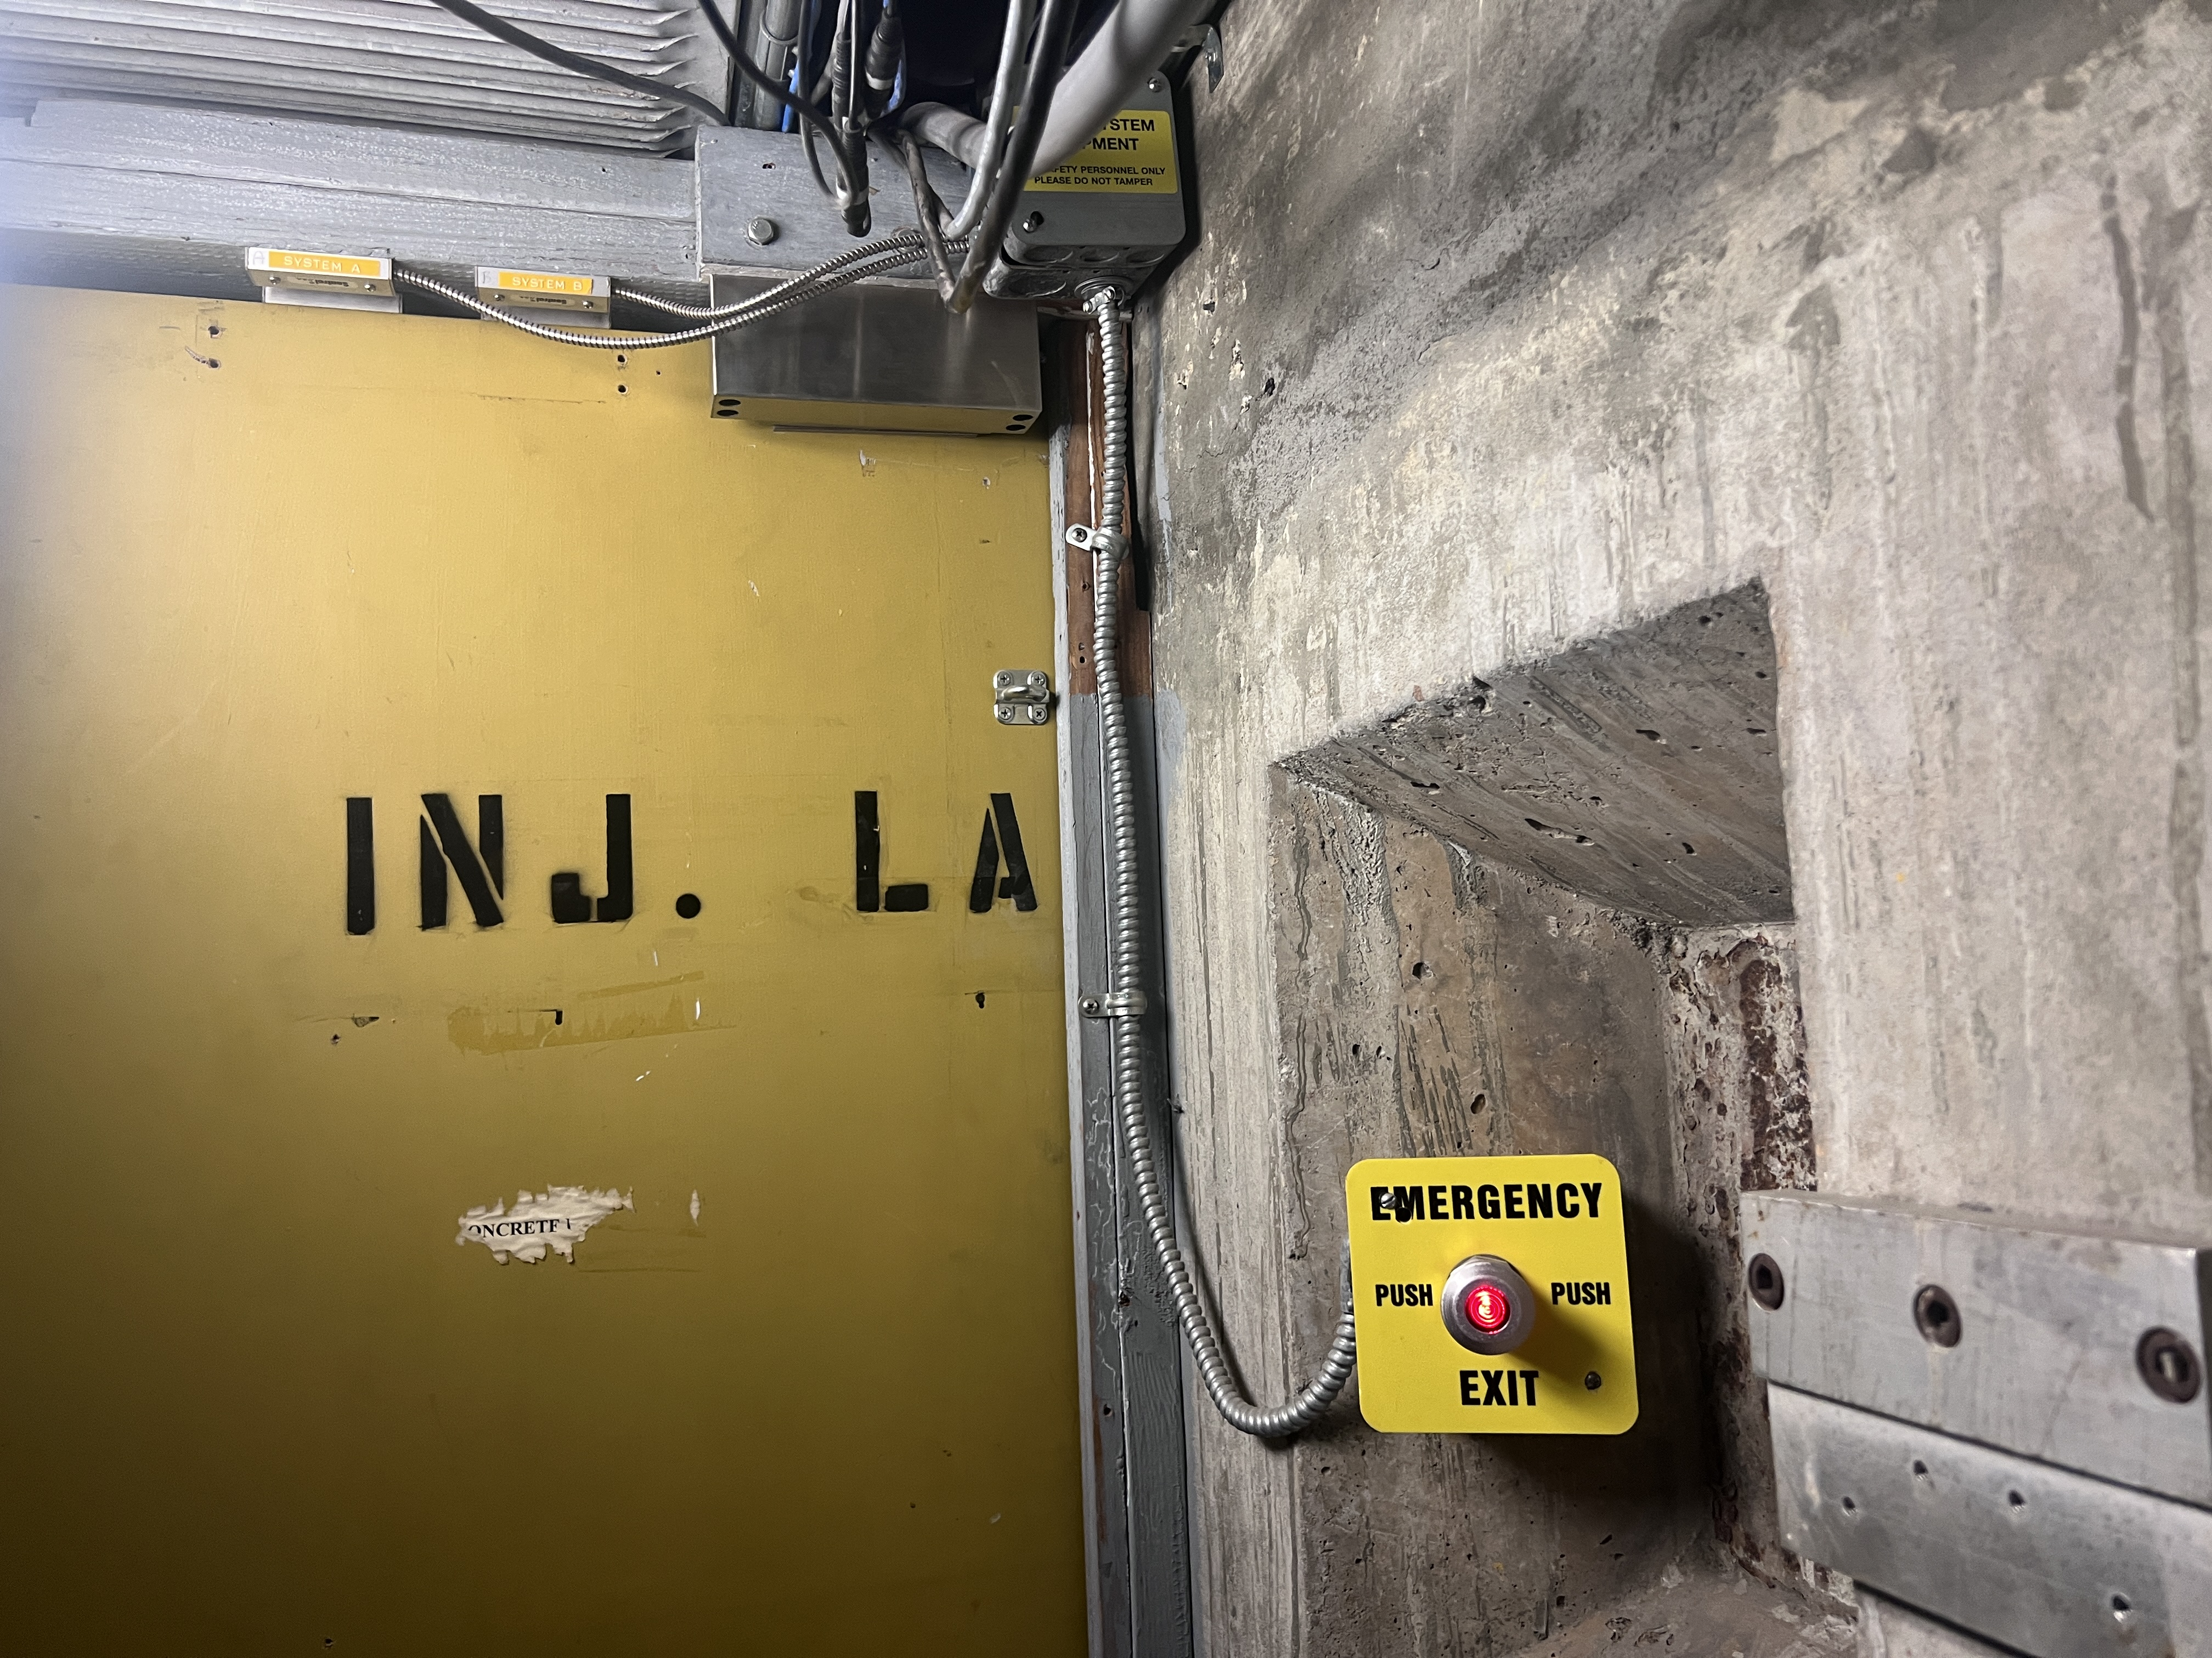
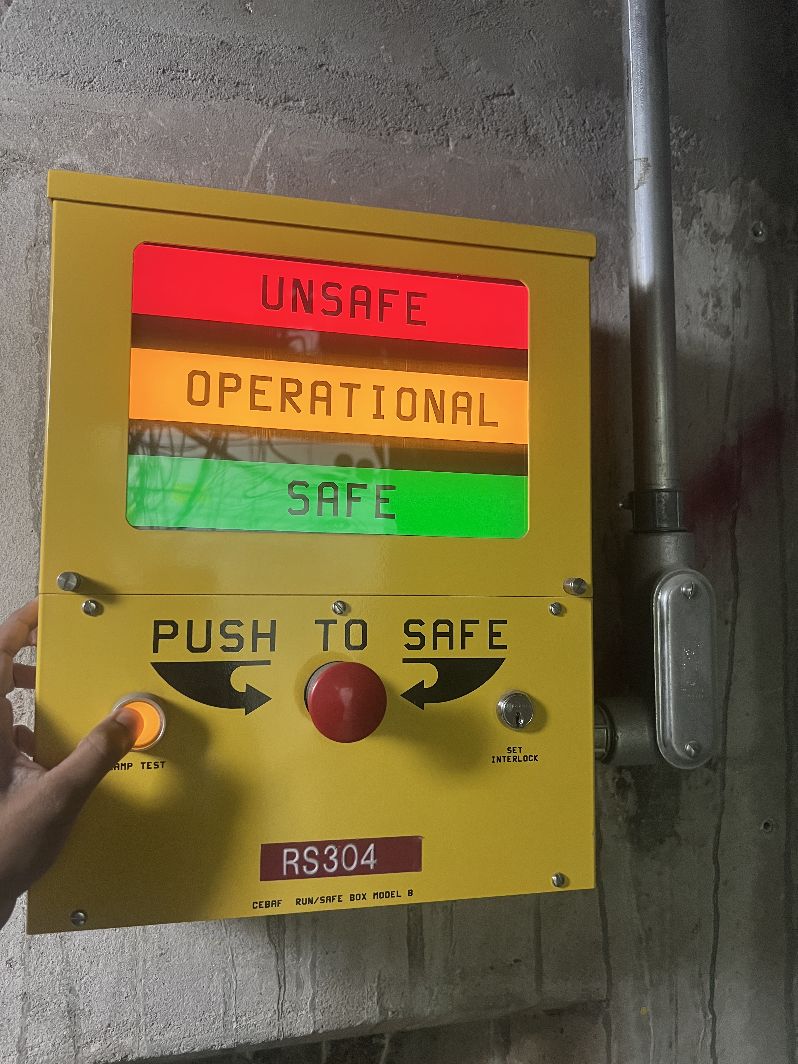
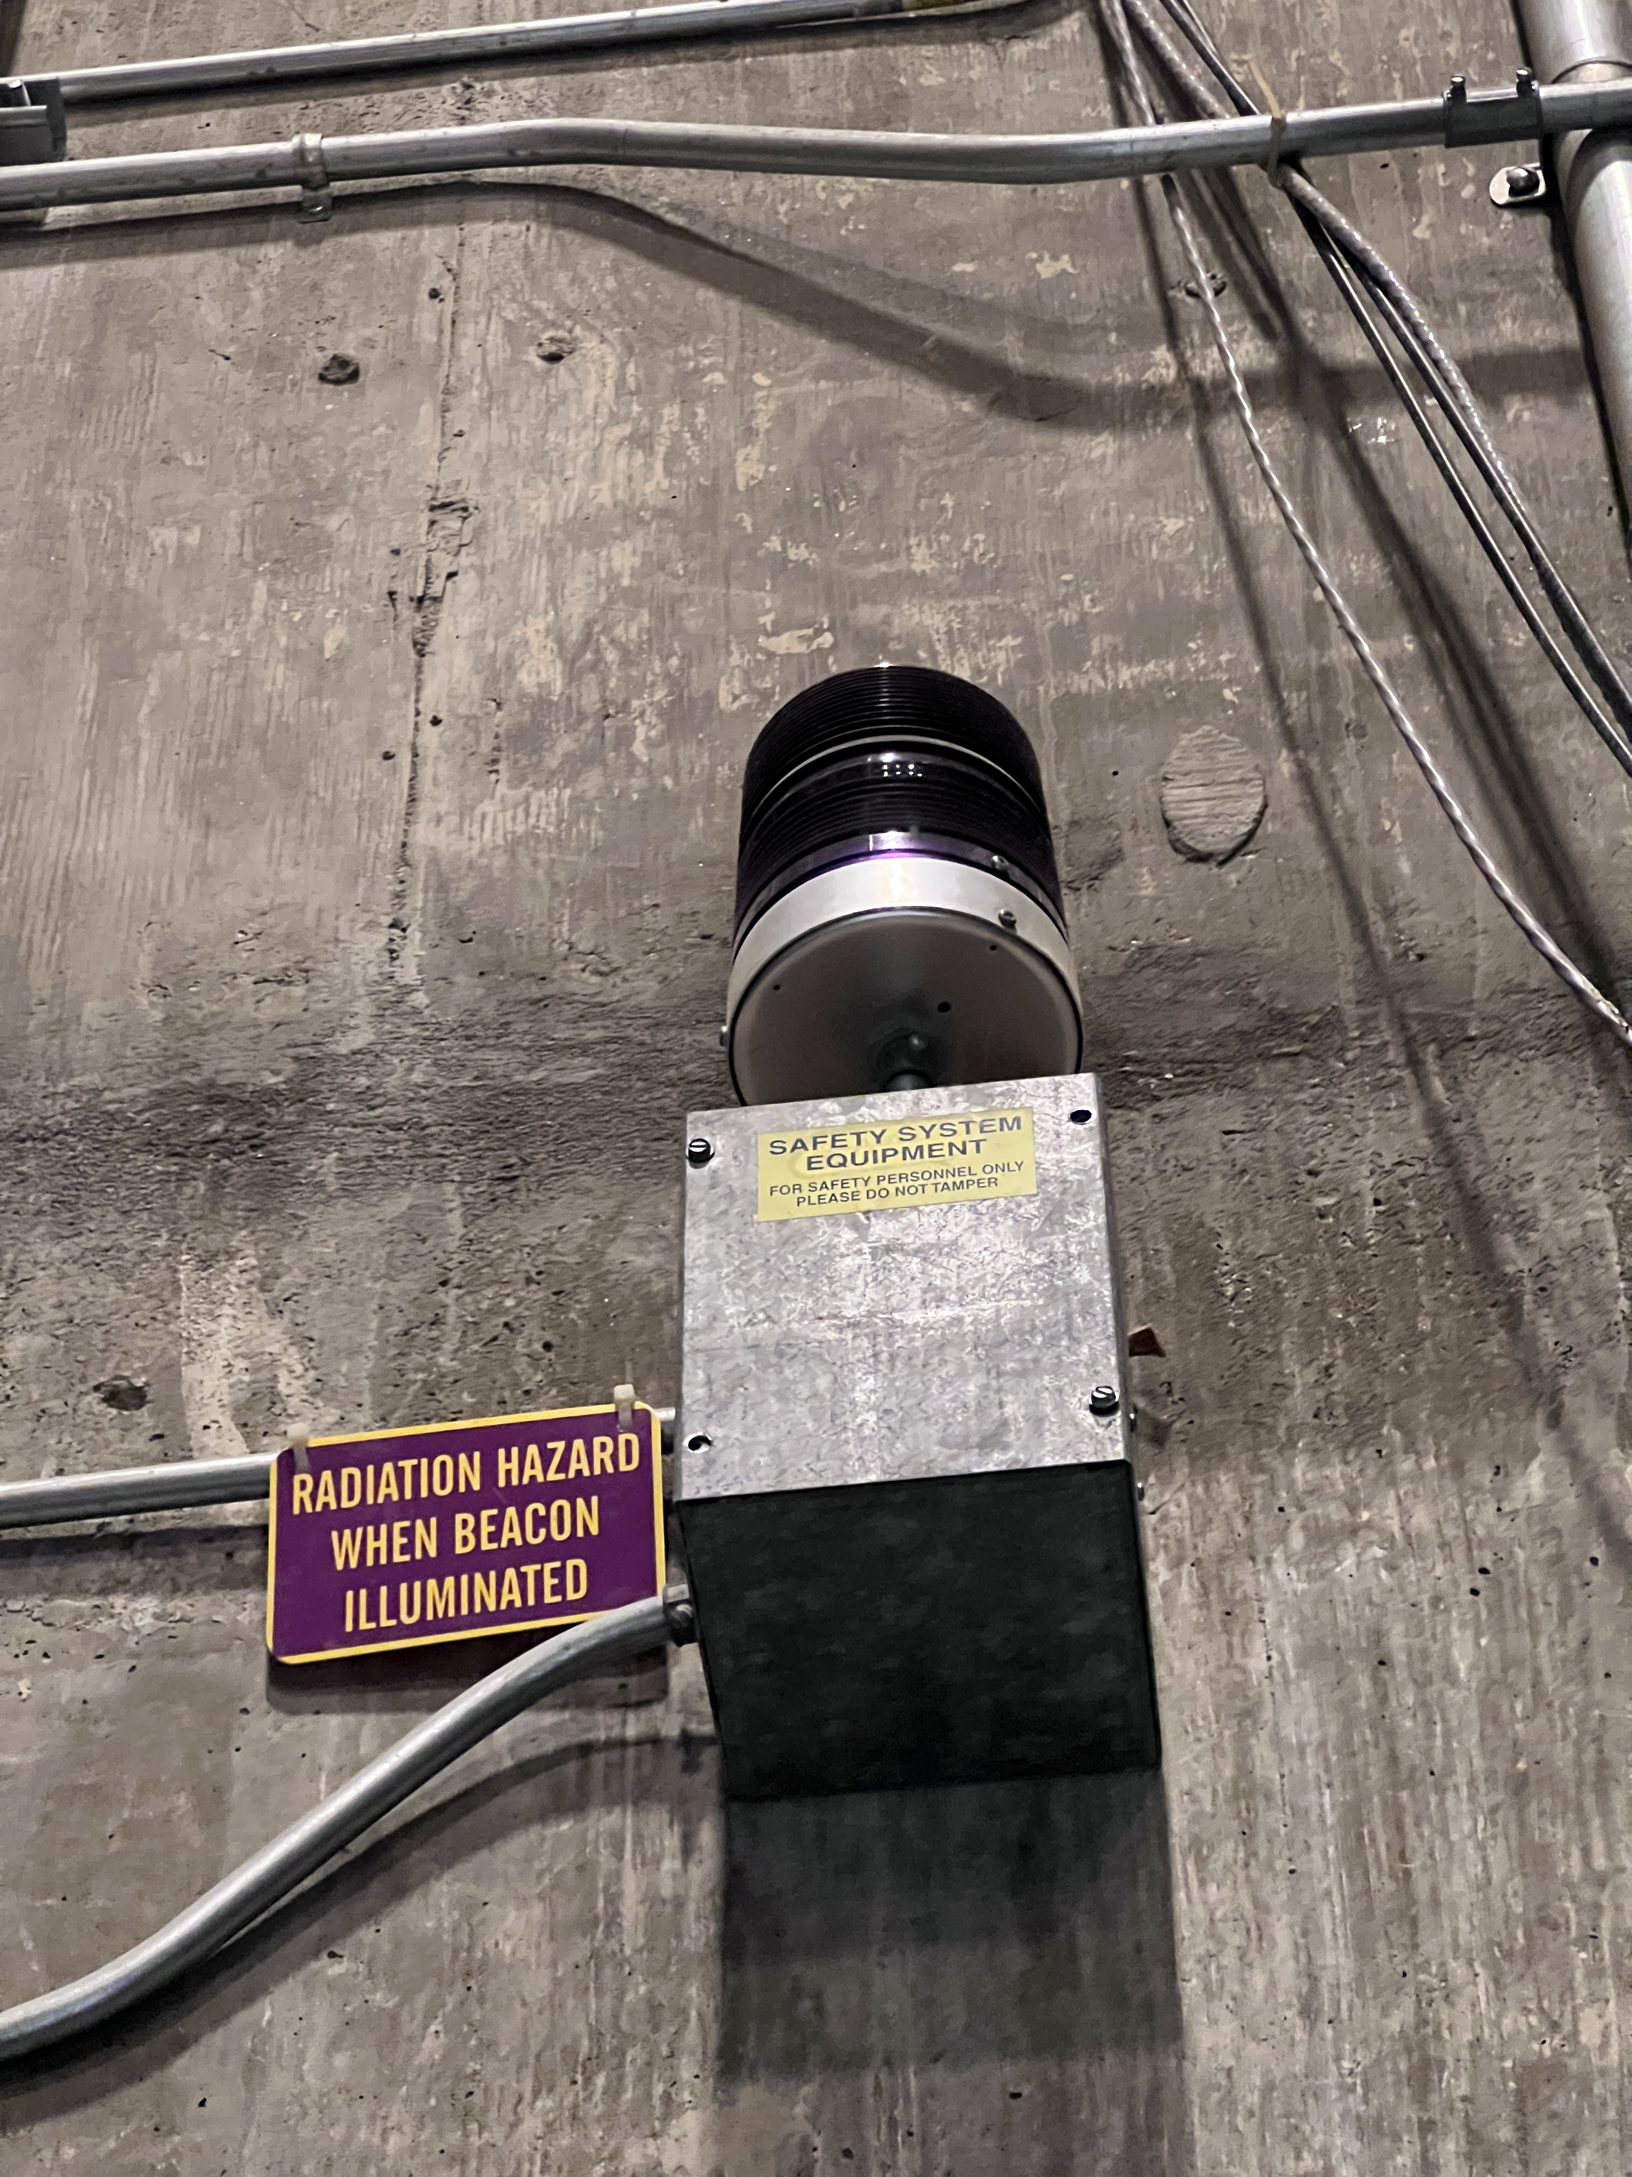
CMTF PSS: ACCESS CONTROL
Test Cave Access Control:
Door Type | Door Status | Control Details
Personnel Access Door | Monitored | Magnetic Lock Manual control from the control room Automatically locks when sweep completed
Concrete Equipment Door | Monitored | PSS can open the door, but not close it Active controls – must have AC to open PSS E-stop switches will open the door

Slide 28
CMTF PSS: ACCESS CONTROL STATES
PSS STATE | DESCRIPTION
OPEN | - Cave is open No high-voltage or high-power RF permitted
SWEEP | Only qualified sweepers are permitted inside the Cave No high-voltage or high-power RF permitted Sweep is time-limited Personnel door locks after the last RSB is armed, and the sweepers exit within 20 seconds.
SWEEP COMPLETE / READY | System transitions to Ready State as soon as sweep is complete No personnel allowed inside the Cave Doors are closed and personnel door is locked with maglock No high-voltage or high-power RF permitted
RUN | No personnel allowed inside the Cave Visible warning (continuous) at all access points Audible warnings (30 second) High-voltage and high-power RF permitted

Slide 29
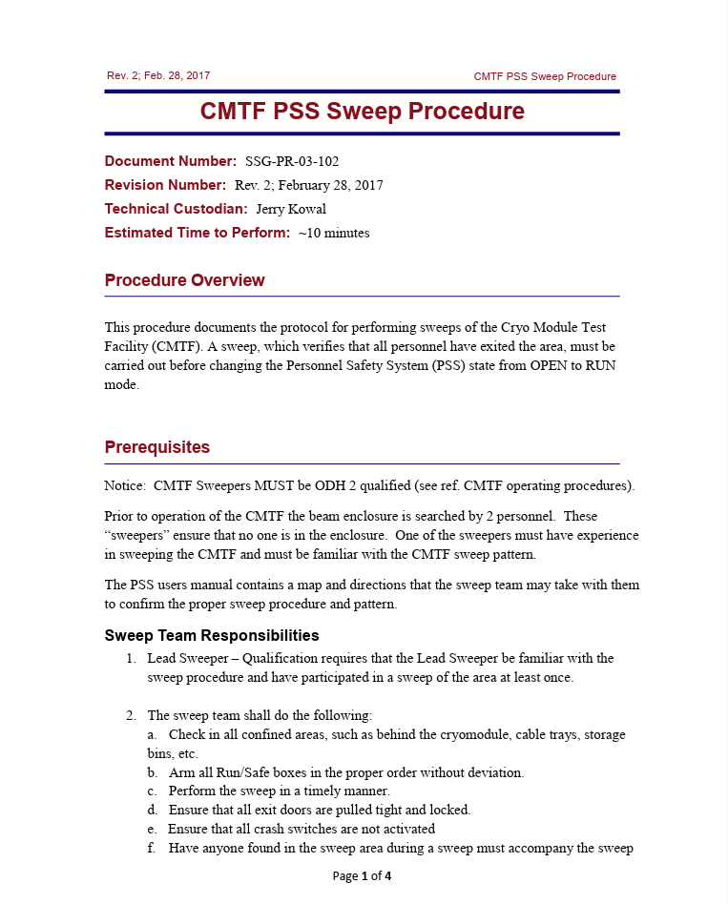
CMTF PSS: SWEEP
CMTF Qualified Sweepers must have an ODH 2 training.
Pre-Sweep:
  Identify two ODH 2 qualified personnel as the sweep team.
  Sweepers must carry personal oxygen monitors and 5-minute escape packs.
  Inform all occupants to leave the CMTF enclosure.
  Verify that all access room crash switches are not activated.
  Close both doors completely.
  Confirm PSS screen indicates doors are closed and LEDs read “Sweep Mode.”
  Confirm magenta beacons are flashing (indicating system is ready for sweep).
Sweep:
  Put the system in Sweep mode by turning the key in the PSS control panel.
  Once sweep is started, personnel have 10 minutes to complete the sweep.
  Enter through the personnel door.
  Following the sweep pattern, arm the Run Safe Boxes accordingly
  At the end of the sweep, return to the control room and insert the sweep key in the PSS control panel key switch.

Slide 30
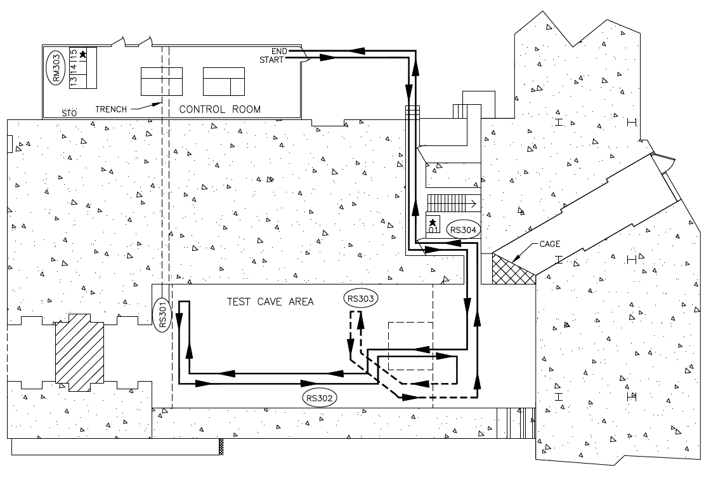
CMTF PSS: SWEEP MAP
Personnel Access Door
Concrete Equipment
Door

Slide 31
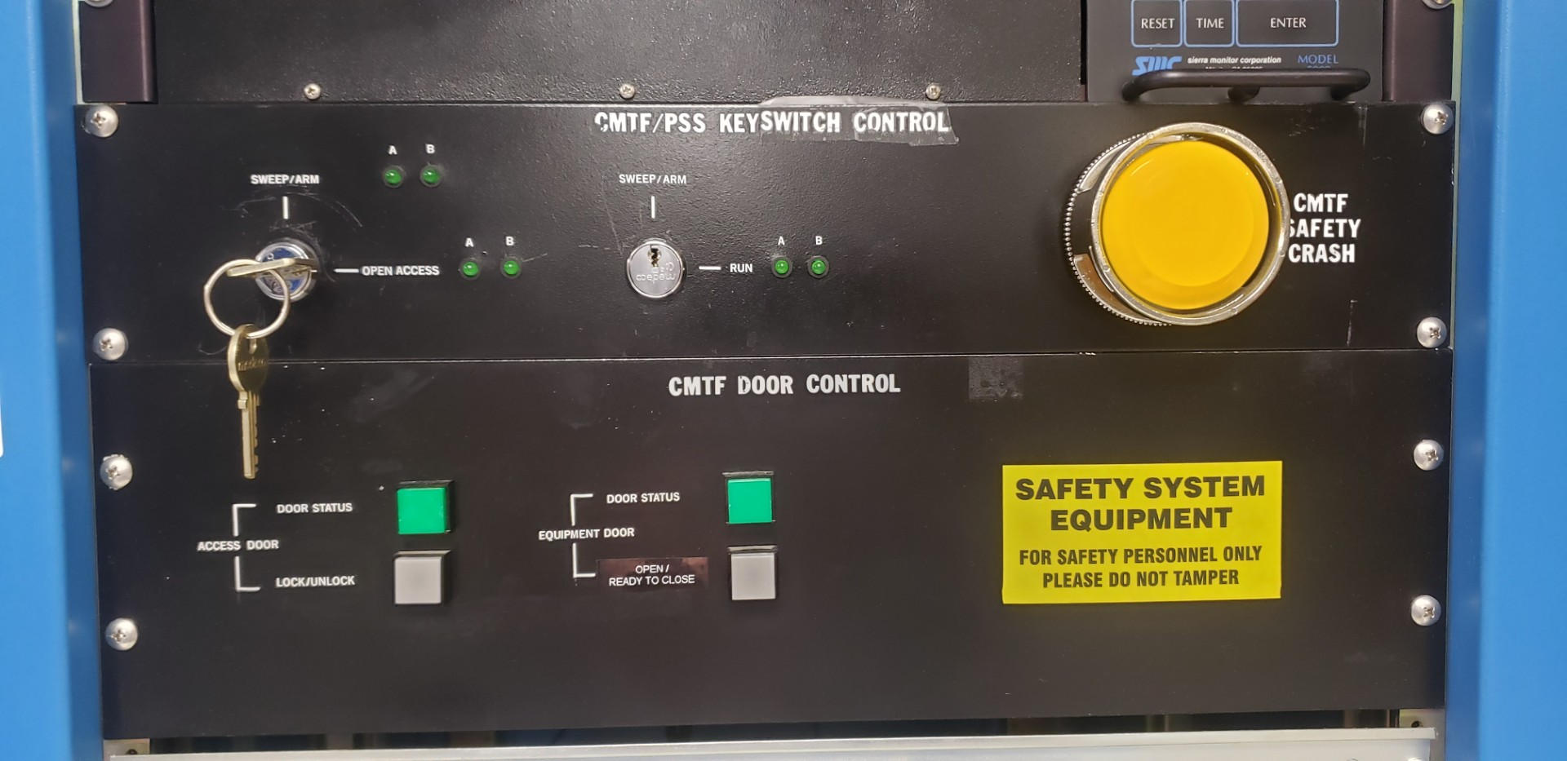
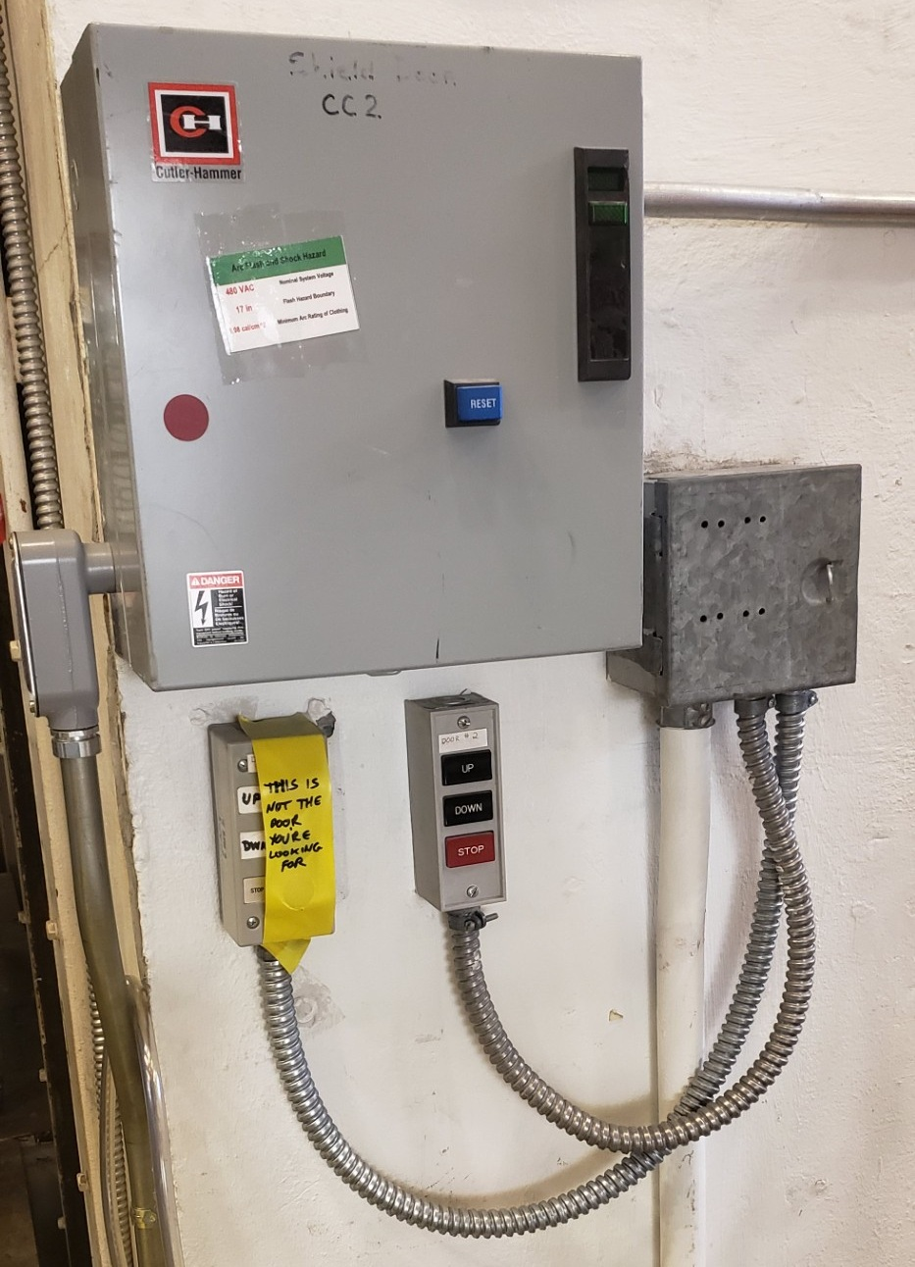
Concrete Roll-up door instructions
1
Press white button under ‘Equipment Door’. This engages magnetic sensors & limit switches. The green beacon should blink.
Walk from CTMF control room to equipment door. On right hand side of entrance, verify door is clear and press ‘UP’ button. Door will stop automatically upon reaching appropriate height.
If door starts to descend on its own, and the green beacon is still blinking – consult SSG. Otherwise, cave is now ODH-1 and one may prepare to sweep.
2

Slide 32
CMTF PSS: CERTIFICATION
According to Accelerator Safety Envelope (ASE), the CMTF PSS shall be recertified annually. [Credited Control: PSS Access Controls]
In practice, system certified biannually: every 6 months +/- 2 months
Certification tests (Static and Functional tests) are performed by SSG members under the supervision of the Test Director, who is a representative of CMTF Operations.
During certification, each input is exercised, and the outputs are observed.
Both PSS systems A and System B are verified independently.
Any part of the PSS that is disconnected, repaired, or replaced must be certified. The recertification includes any logic associated with the device and any other devices connected to or dependent upon the device in question.
To run to window test stand: Jumper request with valid PSS certification required for re-configuration.

Slide 33
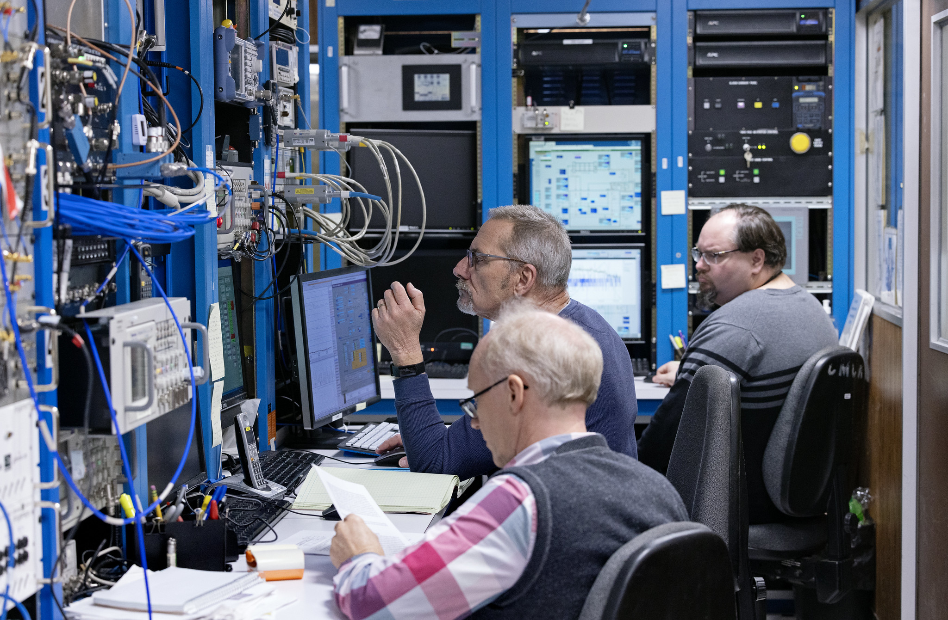
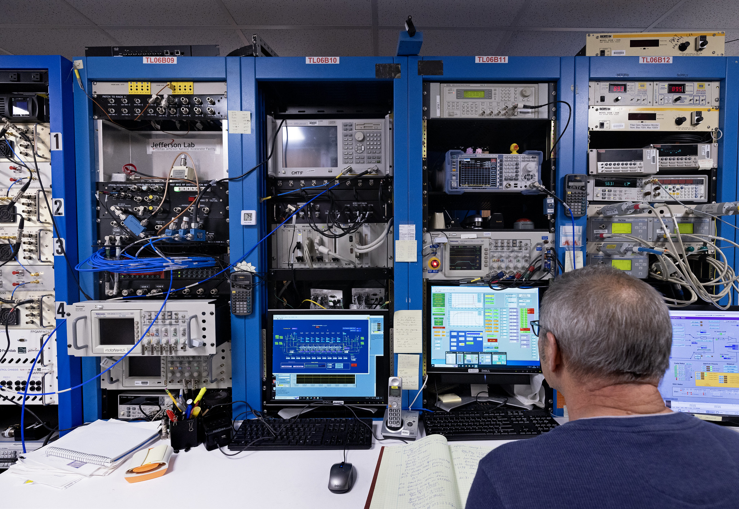
CMTF Ops: Control Room Personnel & Responsibilities
Scope: 16 hr/day, with 2 8-hour shifts starting 8 am & 4 pm
Turnover meeting between shifts; Operating Plan briefing by Facility Manager or Testing Coordinator at start of each shift
Control Room Staff
  Facility Manager
  Test Coordinator
  Principal Investigator(s) (if applicable)
  Duty Operators: [JLab or Visiting]
    RF Operator
    Cryogenic Operator
  Safety Systems Group
    Supporting PSS certification activities
  Radiation Control Group
    Supporting PSS certification activities or CARM alarm response
Also includes:
  SMEs
  Engineers
  ES&H Support (industrial hygiene, etc.)
  Others who operate the accelerator controls to commission new hardware or software, diagnose problems, and perform equipment-specific tests, plans, or studies.
Accelerator-Site security guards available for emergency response

Slide 34
CMTF Operations: RF Operator
Program execution by the CMTF RF Operator
  Deemed sufficiently trained by the CMTF Manager.
  Knowledge of PSS, leaves CMTF in safe state at end of activity.
  Ensures safe operation of CMTF, in accordance with the requirements outlined in the ASE, SAD, and TOD.
  Reads and understands all approved CMTF-specific SOPs and WCDs.
  Requests Radiation Control Department conduct a radiation survey of the enclosure after prompted by CARM response (or while assessing new conditions).
  Responds appropriately to all PSS and MPS faults and conducts critical event response.
  Makes detailed entries in SRFLog, paper logbook, and other WCDs.
  Responds to off-normal events.
Average Testing Frequency: ~3 modules/year; ~200 hours total RF-on.

Slide 35
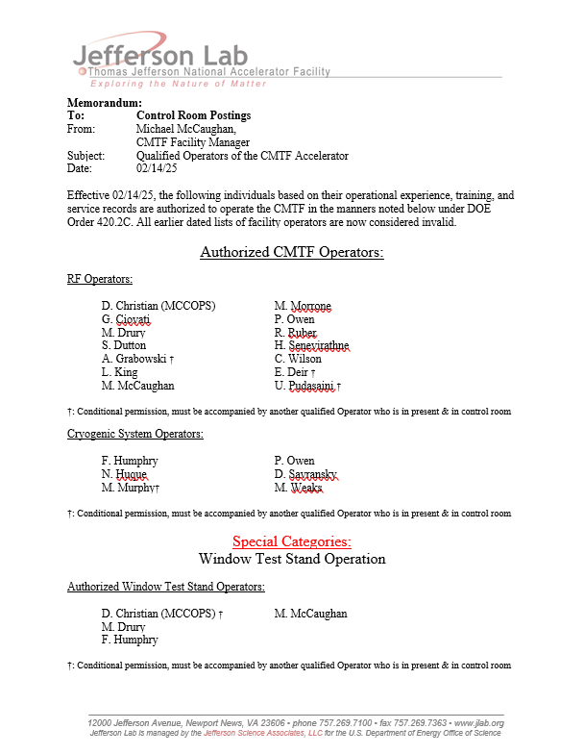
CMTF Operations: Qualified CMTF Operators
Training & Qualifications (RF/Cryo Ops):
  SAF801C/P/T: Rad Worker 1
    Requires:
    SAF800: General Employee Radiation Knowledge
    SAF801kd: General Access Radiation Work Permit
  ODH-2 Work Qualified:
    MED13: ODH-2 & Respirator Medical Certification
    SAF103: Oxygen Deficiency Hazard
    SAF210: 5-minute Escape Pack Use
  ESC001: Basic Electrical Safety
    Class 1 electrical tasks not requiring LOTO
    Plug in-hand work (V ≤ 24 VDC) [e.g. Connect arc detectors etc.]
    Buttons / Control screens; but no breaker manipulation [e.g. Turn on/off vacuum pump power supplies, but NOT touch HV cabling]
  Knowledge Comprehension Documents:
    SAF808kd: CMTF-specific RWP + Briefing (RWP2025-S000)
    SAF808T: CMTF Operator Training (This training)
    SAF808.SAD: TJNAF Safety Assessment Document (SAD)
    SAF808.ASE: CMTF Accelerator Safety Envelope (ASE)
    SAF808.TOD: CMTF Testing Operations Directives (TOD)
  Revised USI Training: SAF705 / SAF705kd
  SAF808/808.RF/808.CRYO: On-the-job Training (OJT)
  Approval of the Facility Manager
Specific procedures may require more:
  480V breaker switching supplying RF source has own procedure.
  Specifies Qualified Electrical Worker training (ESC001 - ESC008 + SAF603B.KD) for that subset of trained individuals in addition to OJT & valid ePAS permits.

Slide 36
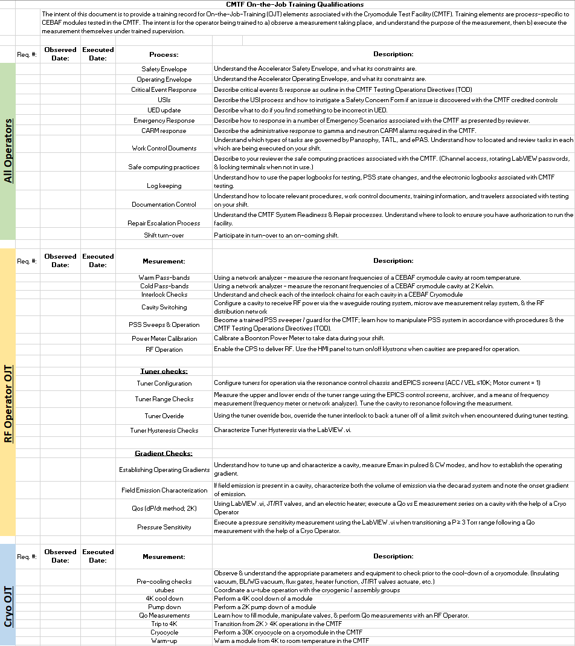
CMTF Operations: Qualified CMTF RF & Cryo Operators
On-the-Job-Training (OJT) Qualification:
Spend at least one shift observing each type of measurement – noted at right.
Spend at least one shift being observed performing each type of measurement
Trainer / Observer should notify Facility Manager if they believe trainee is ready to perform each measurement type on their own.
Facilities managers will have a training sign-off (SAF808, SAF808.RF, SAF808.CRYO) when process completed.
Separate sign-offs for RF Operators and Cryo Operators
SAF808.CRYO SAF808.RF SAF808

Slide 37


New CMTF RF & Cryo Operator Training Competencies
+SAF705: ASE Credited Controls & USI
+SAF808kd: CMTF RWP + Briefing
+SAF705: ASE Credited Controls & USI
+SAF808kd: CMTF RWP + Briefing
+SAF808T: This training

Slide 38

Job Task Analysis (JTA) Questionnaire Modifications:
Under Q10:
Assigned to accelerator division? Yes
  CMTF
  Add Question 10.7: Is this person an RF operator of the Cryomodule Test Facility?
  Add Question 10.8: Is this person a Cryo operator of the Cryomodule Test Facility?
    - Add appropriate training requirements from the previous slides.
  VTA
  Add Question 10.9: Is this person an RF operator of the Vertical Test Area?
  Add Question 10.10: Is this person a Cryo operator of the Vertical Test Area?
    - Add appropriate training requirements from the previous slides.
Training competency requirements will be updated in your SRL as the training office and your supervisor’s complete the JTA updates.

Slide 39
Shift Turn-over Policies:
The shift-turnover meetings are held between consecutive shifts so that the off-going staff can transfer information to the oncoming staff. As CMTF typically only operates 2 shifts per day while testing, this occurs when day shift hands operations off to swing shift.
The shift-turnover meetings are held in the CMTF Control Room and usually last less than fifteen minutes, though 30 minutes is allocated.
On-coming shift arrives 15 minutes before the start of shift.
On-coming Operators are responsible for having completed pre-shift reading:
  Review Logbook entries from the previous shift (Paper, SRFLog, etc.)
  System Readiness Manager (SRM) Status: No newly disabled equipment…
  Jlab Authorization Manager (JAM) Status : Credited controls + run authorization…
  Be familiar with testing documentation for shift: Procedures, SOPs, Pansophy Travelers, etc.
  Know where to locate work control documents for activities to be executed on your shift: ePAS, TATL, Pansophy
Receive the Communicated Operations Plan from the CMTF Test Coordinator or their designee OR from the off-going Day shift.
Off-going shifts should allot 15 minutes at the end of their shift to brief the on-coming shifts OR submit summary logbook entries summarizing your shift.
Time before or after your required shift should be charged against the tested project. If you are hourly the time before/after shift may be considered overtime.

Slide 40

CMTF Operations: PSS States & Staffing Requirements
RF ON: CMTF in RUN state with high voltage ON to klystron or solid-state amplifiers
RF OFF here == CMTF incapable of delivering RF due to the high voltage to the RF source being off (regardless of having or not having RF/HV permit from PSS)
OPEN: Self-explanatory; no RF/HV permits available to run
SWEEP: Timed PSS sweep procedure in-process prior to potential operation
RF (HV) ON or OFF & PSS State: RUN – RF operator required in control room
READY: PSS sweep completed; state from READY to RUN. Attempt to access enclosure drops sweep (and enclosure OPEN state). No RF / HV permit in this mode. MPS trips (CARM, etc.) drop to this state.
PSS system may be dropped from RUN to READY mode (exclusion state; prevents personnel access. No RF/HV permit):
    Key control: Remove PSS key from chassis and store in key station (CPS key removed and stored as well by procedure); keys may be on Operator’s person if they remain in the test lab for meal / bathroom breaks etc.
    Prevents possible operation
    Operator may leave JLAB site if key control is maintained via key box
    Allows one to forgo sweep the following day and resume operations after retrieving keys; useful for facility efficiency as it reduces staffing need and replaces sweep time with operations the following day
CMTF has four PSS states: OPEN, SWEEP, READY (an exclusion state, when the state when the PSS Sweep has been completed), and RUN.
Whenever CMTF Operator changes occur for any reason, the oncoming staff members must receive a summary of the shift activities and receive task assignments from the off-going CMTF operator.
Control room staffing is an ASE-credited control, with minimum staffing requirements summarized in TOD sxn 3.6.2.1 & above.
Failure to meet staffing requirements constitutes an ASE violation and provokes a critical event response if the facility is not shut down in advance of the issue.

Slide 41

CMTF Control Room Key Box
Located adjacent to RM-301 (behind rack TL06B14)
To be used when Operator leaves test lab for PSS / CPS Keys
If in test lab (but not control room) Operator may personally maintain key control. [Contact CMTF Manager for key box code]

Slide 42
CMTF-Specific Hazards
Hazards and their assessments are summarized in the Safety Assessment Document (SAD)
On-site Hazards
Electrical Hazards: high current, high voltage
Nonionizing radiation: static magnetic fields, RF, etc.
Cryogenic liquids and gases
Pressure and vacuum systems
Off-site Hazards
(Evaluated; but not applicable)
Offsite dose from prompt ionizing radiation (sky shine).
Prompt ionizing radiation exposure
Oxygen-displacing gas
SAD (Rev. 9) - Section 4.4.2.4

Slide 43

TOD – Program Control (Safety Features)
As required by DOE Order 420.2D, Safety of Accelerator Facilities, two documents address the hazards
associated with CMTF operations:
  CMTF Accelerator Safety Envelope (ASE)
  JLab Safety Assessment Document (SAD)
Additional safety features:
  Machine Protection System (MPS) [RF Interlocks]
  CMTF-Specific Standard Operating Procedures
  Channel Access Security
Means of Communication:
  SRFLog (electronic logbook)
  Work planning & control tools:
    TATL (Test lab Area Task List)
    ePAS (Electronic Permit Administration System)
    Pansophy
  OPS-PR (Operations Problem Reporting)
  CATS (Corrective Action Tracking System)
  USI (Unreviewed Safety Issue) Process

Slide 44
Defense-in-Depth – Additional Safety Controls​ (Not Credited)
Machine Protection System (MPS)
An active engineered system designed to turn off RF/High Voltage whenever an off-normal condition is detected and before significant damage occurs. [CARMS, Arc & IR Detectors, Quench detection circuit, etc.]
Channel Access Security
Operational Envelope
An active engineered system that establishes a security protocol limiting individuals’ ability to access electronic process variables used to control the accelerator. [EPICS]
Administrative limits and operating parameters for specific CMTF systems.
Run Authorization
Facility Manager examines component and credited control readiness via the System Readiness Manager (SRM) & Jlab authorization manager (JAM).
Safe Computing Practices
LabView access via Group login with rotating password, retrieved in-person from administrator.
Lock computers when not in use.
Other Administrative Controls
Authorization to run issued by Head of SRF Operations on the recommendation of facility manager.
Work control documents & procedures
Training
Signs & Postings

Slide 45
Operating Envelope
The Operations Envelope provides administrative boundary within the Safety Envelope which is not to be exceeded. By establishing these thresholds for facility operation - including energy maximums - variations outside the Operations Envelope, but within the Safety Envelope, are not treated as a DOE-reportable occurrences but DO require specific administrative action as described below.
If an Operations Envelope violation occurs, RF and High Voltage operations must be terminated and the CMTF Manager, Head of SRF Operations, the Safety Systems Group Leader (for PSS-related violations), and the Accelerator Division Safety Officer must be notified as soon as possible. CMTF Operations must not resume until the Head of SRF Operations gives direct approval to the CMTF Manager.
The present CMTF Operating Envelope is as follows (see TOD Section 3.5.2):
  Presently focused on CEBAF-style cryomodules; Operating Envelope energy limit for tests: E ≤ 145.6 MeV (26 MV/m [C100 admin] x 0.7 m length x 8 cavities).
  Activation of any cryomodule pressure relief.
  Sustained vacuum pressure excursions (t > 30s) of beam line / waveguide vacuum: P ≥ 5e-7 Torr.
  Sustained insulating vacuum pressure excursions: P ≥ 1E-4 Torr.
  Transient vacuum pressure excursions resulting in a sudden step change in pressure of 2+ decades.
  Inability to maintain liquid level with the JT valve fully open.

Slide 46
Program Control Critical Personnel and Their Responsibilities
    Head of SRF Operations Department
      Ultimately responsible for facility operations
      Reviews status of credited control readiness (through JAM), Hot Checkout (through SRM), and (with the recommendation of the Facility Manager) authorizes operations.
CMTF Facility Manager
      Authorizes who can operate at CMTF
      Develops schedule in conjunction with Lab Management and Principal Investigators
      Approves schedule deviations and return to work following critical event response
      Maintains documentation, operating guidelines, and issues recommendation to run to Head of SRF Operations on completion of System Readiness Manager check-out.
    CMTF Principal Investigator (if applicable…)
      Supplies all activity-specific information necessary for design and safety review processes
      Coordinates with Facility Manager, Testing Coordinator, and RF Operators for the installation
      of equipment and beam tests
    CMTF Testing Coordinator
      Liaises with Facility Manager and Principal Investigators
      Sets day-to-day test staffing and schedule, performs online data analysis, and ensures adequate documentation of testing process
    CMTF Work Coordinator
  Approves proposed work control document tasks submitted via Test Lab Accelerator Task List (TATL), electronic Permit Authorization System (ePAS), or Pansophy as Work Coordinator
  Coordinates internal and external work to ensure tests are performed safely and successfully, involving the Radiation Control Group when necessary

Slide 47

CMTF Program Authorization
Operations authorization process follows DOE O 420.2D requirements
ASE, CAS, SAD, USI, and Shielding Policies developed by JLab and reviewed by DOE
DOE authorizes operations after ARR verifies all conditions are met
CMTF Program Authorization
(Testing Operations Directives; Sect. 1.2)

Slide 48
CMTF Program Communication and Feedback
Schedule communication
  Long-term (12 month) Experimental Schedule is developed by the Physics & Accelerator Division with input from others.
  Deliverables to support the program are negotiated between Director of SRF Operations & Director of Accelerator Operations, informed by budget, production schedule, etc.
  Module production and acceptance testing schedule developed with input from SRF work centers & executed by facility manager.
  Daily Operational Plan communicated by Facility Manager or Testing Coordinator to those on duty at start of shift.
  Schedule feedback to Facility Manager/Testing Coordinator via email, SRF Logs, paper logbook entries, and Ops-PRs.
Program meetings to coordinate progress and provide feedback
  Daily 8:30 SRF Work Center Meeting to summarize progress and coordinate activities for the day.
  Daily 15:30 Progress Meeting to iterate over the morning plan and coordinate work for the next day.
  Weekly Fri. 1:30 Production, Coordination, & Priorities manager meeting to review milestones for the next week.
  Weekly Monday 9:30 Work Center Planning manager meeting to plan the upcoming week’s work at a high level.
SRFLOG and paper logbook are used to communicate and record operational and other important information
Failure tracking and feedback to SMEs
  OPS-PR system is used to communicate failures to system owners and monitor repair status.
Corrective Action Tracking System (CATS) – lab-wide formal action-item tracking system

Slide 49

Conduct of Operations at CMTF
CMTF Conduct of Operations
(Testing Operations Directives; Sect. 1)

Slide 50


CMTF Configuration Management: UED
UED = UITF Element Database:
Similar to CEBAF Element Database (CED) used at CEBAF
Database of elements, physical positions, and associated properties
Why UED and not a new database?
Significant overhead in maintenance of each database deployment for high level apps/software
UED deployment able to handle the needs of all the test lab accelerators

Slide 51

CMTF Configuration Management: UED Revision Process
From TOD Section 2.0:
“Consistency between the installed equipment configuration and the information contained in the UED is critical, making appropriate application of configuration management principles of paramount importance for accelerator operations.”
Accurate database yields:
  On-demand up-to-date controls and screens
  “Free” tools/applications already deployed at CEBAF, LERF, and UITF
  Existing system readiness/ configuration management process
UED Revision Process
UED Revision Process
(Testing Operations Directives; Sect. 2.1.1)

Slide 52
CMTF Configuration Management (Continued)
Ultimately, a list of accelerator components in correct order, with specific locations assigned.
Physics modeling and simulation tools can export information from UED.
System readiness manager is based on UED, helps satisfy part of DOE O420.2D requirement for accelerator configuration control.
UED is exceptionally useful for software development, e.g., on-the-fly epics control screens, macros, many analysis tools, high- and low-level apps from CEBAF readily exportable once in place for CMTF/VTA (big example – alarm handler) and used to denote IOC configuration.
Combination of the above allows for rapid troubleshooting – no more waiting around for a week to realize you have the wrong IOC configuration after a power outage, spotting something wrong in data stream during analysis, and having to repeat tests.
Survey and alignment uses as a record of where things are physically located.
System owners are responsible for conveying UED information to Software Group; Epics screens automatically populated with every UED configuration.
UITF administrator (designated by CMTF/VTA facility managers) is responsible for making sure the UED is correct for each accelerator (Mike McCaughan for CMTF/VTA during implementation).

Slide 53



Configuration Management: System Readiness Manager
System readiness tracked in tool; gets component inventory directly from UED
Paradigm: Staff check SRM prior to operating hardware
SMEs) update element readiness status in SRM (components, controls, etc.)
Facility manager to downgrade elements as needed, with input from knowledgeable staff and SMEs
SRM used to assess system readiness pre-Operations:
  Credited controls status will be monitored through tool and upgraded/downgraded as needed
  Granularity of check-offs at discretion of facility manager, plus individual system owners
  Systematic downgrade of systems and frequency envisioned only with major utility interruptions (e.g., IOCs with power outages, cryomodule/dewars if CTF goes down for maintenance)
  Not the same for both facilities:
    VTA: Near-continuous operation
    CMTF: Probably downgrade PSS when switching between Window test stand running with the jumper request and recertification
  Final authorization to run sign-off by facility manager. Credited controls must be in place to run.
Example:

Slide 54

JLab Authorization Manager (JAM)
JLab Authorization Manager (JAM) available from ‘useful links’ portion of logbooks.jlab.org

Slide 55

JLab Authorization Manager (JAM)
JLab Authorization Manager (JAM) available from ‘useful links’ portion of logbooks.jlab.org

Slide 56


JLab Authorization Manager (JAM)
Able to drill down by specific credit control, and then status to view verification
All credited controls MUST be in place to operate
Verifications done by individual System Owners
Final authorization to run issues by either:
  Director of Operations (CEBAF, LERF, &UITF)
  Head of SRF Operations (CMTF & VTA)

Slide 57

JLab Authorization Manager (JAM)
JLab Authorization Manager (JAM) available from ‘useful links’ portion of logbooks.jlab.org

Slide 58
CMTF Operations: Critical Event Response
TOD Section 3.5
Safety Envelope Violations
Personnel Safety System (PSS) Malfunctions
PSS designed to protect personnel from harm using administrative and engineered controls.
Machine Protection System
If malfunction is perceived, RF/HV operations are halted and system owner is contacted.
Facility Manager must re-authorize RF/HV operations.
Emergency Response
The duty operator contacts the Safety System Group Leader.
If the Safety System Group Leader determines that a malfunction has occurred, then the USI process is followed.
If credited controls violated, safety envelope violation process must also occur.
Most incidents: RF/HV off, PSS to safe state, and follow ES&H emergency management guidance.
Specific procedures for responding to radiation exposures, ODH alarms and response, and power outage response are located in CMTF SOPs.
  Safety envelope defined by CTMF ASE Credited Controls.
  If a safety envelope violation is suspected, RF/HV operations will halt and an immediate investigation will take place.
  The ES&H Reporting Officer, AD of Accelerators, CMTF Facility Manager, Head of SRF Operations, Safety System Group Leader (for PSS-related violations), and Accelerator Division Safety Officer must be notified as soon as possible.
  Process is defined in ES&H manual, Section 5200: Notable Events.
  No operations permitted until reauthorized by Associate Director of Accelerator Division and the Facility Manager.
Operations Envelope Violations
  Those within the safety envelope are not treated as DOE reportable – see TOD section 3.5.2.
  The CMTF Facility Manager, Head of SRF Operations, Safety System Group Leader (for PSS-related violations), and Accelerator Division Safety Officer must be notified as soon as possible.
  RF/HV operations must be reauthorized by the Director of SRF Operations and the Facility Manager.

Slide 59

Test Lab (Building 58) Emergency Response Map

Slide 60


CMTF Operations: Control System Interaction
Experimental Physics and Industrial Control System (EPICS) – A set of software tools and applications that provide a software infrastructure for use in building distributed control systems.
EPICS has a huge support base spanning the globe. See https://epics.anl.gov/sites.php for a list of facilities that use EPICS as their chosen control system.
Typical EPICS Client-Server Relationship
EPICS Channel Access Security
Channel access is restricted approved operators using host machines in the CMTF control room for RF Operations.
CMTF cryogenic operators may operate remotely at the discretion of the Facility Manager & Testing Coordinator.
Control room staff have the authority to close and open channel access for specific devices or systems.
Image taken from EPICS training slides, by Andrew Johnson (https://epics.anl.gov/docs/APS2014/05-CA-Concepts.pdf)
Safe Computing Practices
LabView controls only accessible via Group login with
a regularly rotating password, retrieved in-person from administrator.
Use Lock feature of all computers when not actively in use.

Slide 61




CMTF Duty Operator Shift Preparation (TOD Sxn 1.1.5)
Prior to being on shift, CMTF Duty Operators must review and understand:
  Electronic (SRFLOG, CLOG) and paper logbooks
  Facility status, credited controls, authorization status in System Readiness Manager & JLab Authorization Mgr.
In addition to receiving:
  Operational Plan from Facility Manager or Testing Coordinator
  Shift turn-over briefing, if applicable
Paper Logbook
Applicable Work Control Documents
Electronic Logbook (SRFLOG)
(Pansophy, TATL, ePAS, & SRM)

Slide 62
CMTF Maintenance and Tracking
We typically operate CMTF during day/swing shifts (i.e., no 24/7 round-the-clock operation)
Equipment usually repaired by System Owners on day shift (no back-shift maintenance, beyond what can be performed by operators themselves – equipment resets, power cycling, etc.)
Maintenance and repairs documented via OPS-Problem Report, ePAS, and Test lab Area Task List (TATL) and documented in SRFLog, the paper logbook, and Pansophy.
Maintenance and repair responsibilities shared by Facility Manager/Work Coordinator, SRF Work Centers, and Accelerator Engineering Service (AES).
Elements will be tracked, upgraded, and downgraded in the System Readiness Manager, with Facility manager authorizing operations.
Updates to UED as appropriate
Safety guidelines for maintenance work outlined in:
  ES&H Manual, Section 3000, Work Planning and Control Processes

Slide 63

Work Planning & Controls: Pansophy (TOD Sxn 3.6.9)
Pansophy lays out the agreed-upon vetted and discussed testing process and the order of tests for acceptance testing (and other) processes.
  Level is work control – not procedural:
  Ex. Do Qo measurements from gradients X-to-Y in MV/m steps & record results.
  No information on how to perform the measurement itself – delegated to SOPs.
  Includes several hold and data review points in addition to Quality Control.

Slide 64

Work Planning & Controls: Test lab Area Task List (TATL)
TATL is used for work planning and coordination during running and scheduled downs.
All maintenance done to the CMTF will have an associated TATL Task, which may also interface to the electronic Permit Authorization System (ePAS) for work planning and control purposes.
CMTF work coordinator is responsible for understanding the overall schedule and work scheduling via TATL.
Users (e.g., operators, system owners) can log in and comment
on tasks.
TOD Sxn 3.6.6

Slide 65

Work Planning & Controls: ePAS and Everything Else…
ePAS work planning and control tool entries for CMTF
Broadly – 2 parts: Permits to Work and Isolation Certificates
Permits describes work process; isolation certificates are hazardous energy lock-out points – may be referenced by multiple simultaneous work permits.
Standard Operating Procedures, ODH assessments, and other safety and work control documentation also exist.

Slide 66

System Readiness and Repairs Process

Slide 67


Operations Problem Reports (OPS-PRs)
OPS-PR (Operations Problem Report): [Non-immediate Issues]
Electronic tracking and reporting system for corrective action requests. (Made via logbook entry interface.)
Describe the problem & select from the lists of systems, groups, and regions to categorize the problem.
For some common problems, SME guidance for a solution may be presented shortly after the entry is made.
Files can be attached, and the entry can also be associated with other similar entries.
Logbook(s) where the entry will appear can also be specified. When the entry is submitted, system owner & other subscribed personnel automatically receive the entry via email; other recipients can also be entered. Once generated, an OPS-PR can be reassigned by the system owner and comments can be added as progress is made toward resolution. When a repair has been completed, an OPS-PR may be marked ‘No attention required’.

Slide 68


Operations Problem Reports (OPS-PRs) (Cont.)

Slide 69
CMTF Repair Protocol [Immediate Issues]
Accelerator repairs are made whenever hardware or software problems interrupt the primary program. The following guidelines describe the repair process:
  The Duty Operator determines whether the problem can be corrected quickly by SRF or control room staff or if external on-call help is required. If on-call help is required, the Duty Operator uses the protocol established by the Web On-Call tool.
  The Duty Operator shall update the Ops Problem Report with the details of the repair (if known), and record any notifications there associated with program interruptions.
  Escalations for Program Interruptions:
    T ≥ 2-hr: Duty Operator notifies the CMTF Testing Coordinator.
    T ≥ 4-hr: Duty Operator notifies the CMTF Manager.
    T ≥ 8-hr: Duty Operator shall update the CMTF Testing Coordinator, CMTF Manager, and apprise the Head of SRF Operations of the issue.
    If the repair takes longer than eight hours or spans two or more shifts worked by repair personnel, then the component must be downgraded in the System Readiness Tool, either by the technician or the Duty Operator.
On-Call lists are used to summon support staff to carry out immediate repairs or to perform repairs that require specific expertise. Support Group Leaders are ultimately responsible for organizing their on-call

Slide 70

Web On-call:
Web On-call available from ‘useful links’ section of logbooks.jlab.org
Excellent for repair escalation & critical event reporting.

Slide 71


CMTF Operations: Documentation Control
SRF Operations Documentation
(e.g., procedures, directives, drawings)
is stored in local and web-based databases.
  Docushare
  Various SharePoints
  (\\JLABSGRP) M:\asd\asddata
SRF Operations documentation is maintained by Technical Custodians.
Quarterly Quality Review Meetings include Documentation and Records Management processes, retention of organizational knowledge, and corrective actions.
Process owner prompts technical custodians for periodic reviews and revisions of controlled documents.
Strict revision process is implemented.
Engineers, operators, and relevant technical personnel review and provide corrections to procedures.
All SRF Operations staff have access to the database of officially released procedures, though these may be organized and stored by each specific work center.

Slide 72
ODH System Overview

Slide 73



CMTF ODH SYSTEM
ODH Sources:
  Liquid and gaseous helium
  Gaseous nitrogen
Passive Engineered Controls:
  Credited: Ceiling vents, Facility Design
  Defense-in-depth: Penetration sealing, etc.
Active Engineered Controls:
  Credited: ODH monitoring system, warning lights, and horns
  Defense-in-depth: 35,000 CFM Ceiling exhaust fan interlocked with the ODH system
Administrative Controls:
  ODH signage, ODH training
Scope: Oxygen monitors in the Test Cave detect helium or nitrogen leaks. If the detected oxygen levels drop below 19.5%, ODH alarms activate in the control room and Test Cave. ODH alarms also activate the exhaust vent fan in the Test Cave.

Slide 74
CMTF ODH SYSTEM: ODH ASSESSMENT
Conditions | Concrete Equipment Door | Test Cave 1st Floor | Test Cave 2nd Floor
No liquid in Cryomodule, No U Tube Stabbed | Open | ODH 0 | ODH 2
No liquid in Cryomodule, No U Tube Stabbed | Closed | ODH 1 | ODH 2
Cryomodule in Cave with liquid, U Tube Stabbed | Open | ODH 1 | ODH 2
Cryomodule in Cave with liquid, U Tube Stabbed | Closed | ODH 2 | ODH 2
Reference: CMTF ODH Assessment, JLAB-TN-07-066, 2024
ODH-2 conditions require the use of a 5-minute escape pack and oxygen monitoring while in those areas.

Slide 75



CMTF ODH SYSTEM
ODH Controller:
  Sentry: microprocessor-based controller
  Supports up to 8 sensors and global calibration
  Analog input card and relay board for alarming
ODH Sensor/Transmitter:
  Galvanic sensor similar to LINACs and Halls
  Transmitter enclosed in explosion-proof housing
  Lifespan up to 32 months
  Sensor changeout every 18 months

Slide 76
CMTF ODH SYSTEM: System Block Diagram
ODH alarm lights are located at all access points to the CMTF Test Cave.
ODH horns are located at the access area
of the CMTF and inside the Cave.
ODH system in CMTF certified biennially. Certification schedule can be found here, or via logbook ‘useful links’.
Alarm condition investigation and response (to include the potential bypassing of ODH heads) will be executed by the Jefferson Lab Safety Systems Group.

Slide 77

CMTF ODH SYSTEM: Sensor Locations

Slide 78
Summary
SRF Institute has been operating in the Test Lab continuously for nearly 40 years, with the CMTF operating for more than 30 of those to safely meet the acceptance testing needs of CEBAF and other national laboratories as well as supporting a vibrant R&D program.
Relevant safety basis documentation and processes have been established:
  SAD
  ASE
  USI process
  Effective configuration management program
Accelerator-specific hazards are identified, assessed, and mitigated by credited controls.
A mature Conduct of Operations approach,​ with appropriate administrative processes related to accelerator safety (e.g., training, procedures)​ has been established, supporting efficient operation, maintenance, and repair of CMTF.
Trained personnel (you guys) are in place to support the safe operation, maintenance, and repair of CMTF.

Slide 79

M. McCaughan
Office: x5572
michaelm@jlab.org

Slide 80
References
Site History
Godson, Susan et. al, The College of William & Mary: A History, vol. 2, King and Queen Press, Williamsburg, Va., pg. 818-819, 852-853.
J. Duberg & E. Rind, NASA Space Radiation Effects Laboratory, Presented at the Symposium on Protection Against Radiation Hazards in Space, Accession#: N65-21474 (NASA Document ID: 19650011873), Gatlinberg, TN. 5-7 Nov 1962.
D.R. Johnson, NASA Facility for the Study of Space Radiation Effects, Presented at the Institute of Electrical and Electronics Engineers Region 3 Meeting, Accession#: N63-15165 (NASA Document ID: 9630005289), Richmond, VA. 24-26 April 1963.
https://scrc-kb.libraries.wm.edu/virginia-associated-research-campus
C. Westfall, The Founding of CEBAF: 1979-1987, CEBAF, 12000 Jefferson Ave., Newport News, VA. Sep 1994.
M. McCaughan, Accelerator Readiness Review: CMTF Facility Review, Jefferson Laboratory, 12000 Jefferson Ave., Newport News, VA. 19 Nov. 2024.
A. Stavola, CMTF-VTA ARR – Radiation Controls, Jefferson Laboratory, 12000 Jefferson Ave., Newport News, VA. 20 Nov. 2024.
S. Anbazhagan, CMTF/VTA Accelerator Readiness Review: CMTF PSS Overview , Jefferson Laboratory, 12000 Jefferson Ave., Newport News, VA. 20 Nov. 2024.

