Slide 1
D& I Council Meeting

Slide 2
Agenda
Welcome new member, Shirley Yang! Logo Metrics Status of Supervisory D&I Training Integrated D&I Management Status of D&I Policy
Inclusion Examples

Slide 3
Logo/Back

Slide 4
Logo/Front

Slide 5
Metrics
Understanding if we are Increasing D&I awareness
Tools & Data Available to Us
Recommended Metrics and Approaches

Slide 6
Understanding if we are Increasing D&I Awareness
Objective was to recommend metrics to:
measure progress and
measure effectiveness of our efforts in raising D&I awareness, both internally and externally
Metrics require data
We have some good data sources in use – both internal and external; others will need to be developed and analyzed
1

Slide 7
Tools & Data Available to Us
INTERNAL:
2014 D&I baseline survey, plus comments
Possible to segment this by division and/or position type. This will allow us to identify the high impact areas
Interview Panels and Hiring Managers
Conduct D&I training; survey them before and after and compare results
EXTERNAL:
HR data on qualified applicants by position type (i.e., gender, ethnicity etc. for physicists, engineers, etc). Quick accumulation of data
Turnover vs new hire groups
Another area to segment by division and/or position type
New hire surveys (beginning-of-day 1 vs end-of-year 1)
External perception vs internal perception; provides both Lab-wide and division level pictures. Gradual accumulation of data
2

Slide 8
Recommended Metrics and Approaches
Continue D&I surveys
Use 2014 as a baseline
Parse data by division, gender, ethnicity, etc.
Compare over time
Implement hiring process and applicant metrics
Measure progress in efforts to raise awareness of interview panels and hiring managers
Develop KPI’s for tracking Diversity & Recruitment
Implement new hire perception survey
Beginning-of-day 1 vs End-of-Year 1
Parse data by division, gender, ethnicity, etc.
3

Slide 9
Supervisory D&I Training
Launched a more comprehensive Management Development curriculum January 2016
This was piloted in Fall 2015
Content delivery is a blend of web-based training and classroom sessions with scenarios – emphasis on situational based learning vs lecture
Curriculum comprised of 4 sections
Policies and resources
Responsibilities (transitioning from peer to supervisor/delegation, etc.)
Leadership
Communication related to gender, cultural background and implicit bias

Slide 10
What is Integrated Diversity/Inclusion Management?
Borrowing Heavily from ISM
Policy
Admin Manual
Leadership Engagement/Involvement
Montage
Line Management Responsibility
HR working with Interview panels
Line organizations attend job fairs
Training
Planned supervisory and OFCCP training
Resources to Implement
Accountability
Core Expectations revisions
Feedback & Improvement

Slide 11
Integrated Safety Management
Borrowing Heavily from ISM
https://www.jlab.org/ehs/ISM/
https://www.jlab.org/ehs/ISM/docs/Integrating%20Safety%20into%20Work%20at%20JLab.pdf
https://www.jlab.org/ehs/ISM/FUNCTIONS.html
But most importantly: Integrated Diversity & Inclusion Management requires Motivated people, who understand that diversity and inclusion are everybody’s responsibility

Slide 12
Integrated Diversity & Inclusion Management
Overarching goal: develop innate understanding of how to implement and reinforce (within oneself) Integrated Diversity & Inclusion Management
What is meant is how to implement IDIM in people’s activities
These activities can for example be:
A hiring process
A meeting
A conversation
Workforce planning
Succession planning
Professional development
New employment orientation
…

Slide 13
Integrated Safety Management Poster

Slide 14
Text for Integrated D & I Management Poster
We All Contribute to Integrated Diversity & Inclusion Management
Expectations for all employees | Additional expectations for managers and supervisors | Additional expectations for senior management
Make an active effort to include all your co-workers in activities where appropriate. Diversity and inclusion starts with yourself. | Set, demonstrate and enforce high performance standards with emphasis on diversity & inclusion principles and personal conduct | Foster an environment where we can take full advantage of the strengths of a diverse group of people working in an inclusive manner
Learn from your experiences – both good and bad; apply these lessons to integrate D&I into your activities | Recognize and reward individual and team performance for activities integrating diversity and inclusion principles. | Challenge the status quo; actively seek ways to remove barriers towards diversity and inclusion and question “why”
Avoid becoming complacent with routine activities; take a step back and reassess if you are inclusive in all facets of these activities. | Take immediate action to stop inappropriate behavior | Set and hold your employees and yourself accountable to expectations regarding a diverse and fully inclusive workforce working with respect to all
Help find better, more inclusive ways to do JLab activities; challenge the status quo | Learn from both positive and negative experiences; use them as teaching opportunities | Develop your managers and employees understanding of how to implement and reinforce Integrated Diversity and Inclusion Management
 | Encourage and allow participation of staff in job fairs and other recruitment efforts

Slide 15
Integrated D & I Management – Core Functions
Overarching goal: develop innate understanding of how to implement and reinforce (within oneself) Integrated Diversity & Inclusion Management
Core Functions
Define the Scope of Activity | Plan Activities; Make a simple Diversity & Inclusion Consideration List to assist people in their thinking about activities?
Analyze the Activity | Are the proper considerations made to address diversity & inclusion principles? Was anyone left out? Did everybody get an equal chance?
Develop and Implement Controls | If the answer to the above was no, implement corrective measures to rectify.
Perform Activity within Controls | Create a simple protocol for concluding that steps 1-3 were taken and properly considered, and results were not biased.
Provide Feedback and Continuous Improvement (Lab Wide) | Any lessons learned regarding diversity and inclusion principles from this activity? Feedback to employee during performance appraisal period. Feedback to HR based on supervisor comments and examples.

Slide 16
Diversity & Inclusion Consideration List - Meeting
EXAMPLE FOR MEETING (DRAFT) – These D&I Consideration Lists are just cheat sheets to raise awareness and ensure proper inclusion of everybody
YES/NO Were you inclusive in your invitation list for this meeting?
YES/NO Did you make an effort to have all representatives from underrepresented groups state their opinion?
YES/NO Did you ensure that all representatives who were interrupted got a chance to express themselves later on?
YES/NO Did you make an effort to credit the first person to come up with an idea?
YES/NO Did you reach out to ensure nobody thought they had this idea first and
did not receive proper credit?
YES/NO Were the ideas and opinions of all representatives properly folded into the outcome of the meeting?
YES/NO If the meeting resulted in follow-up work or discussion, do the people chosen for this follow-up represent a wide and diverse group?
YES/NO …

Slide 17
D & I Consideration List – Succession Planning
EXAMPLE FOR SUCCESSION PLANNING (DRAFT) – These D&I Consideration Lists are just cheat sheets to raise awareness and ensure proper inclusion of everybody
YES/NO Have you identified those positions critical to your organization?
YES/NO Did you identify criteria for success in those positions?
YES/NO For each position, have you identified potential internal candidates within your organization?
YES/NO Did you make an effort to consider all potential candidates based upon pre-established criteria?
YES/NO Did you make an effort to consider all potential candidates from underrepresented groups?
YES/NO Did you make an effort to identify those candidates who, perhaps may not be “ready” to step into a position at this time, but certainly can meet the criteria for success with some development/mentoring (See Professional Development Consideration List)

Slide 18
D & I Consideration List – Professional Development
EXAMPLE FOR PROFESSIONAL DEVELOPMENT (DRAFT) – These D&I Consideration Lists are just cheat sheets to raise awareness and ensure proper inclusion of everybody
YES/NO Did you actively ensure your organization provides a work place where all employees can thrive and develop without worries about harassment?
YES/NO Did you make an effort to be aware of the career development desire of all employees in your organization?
YES/NO Did you make an effort to be aware of the potential for development of all employees in your organization?
YES/NO Did you discuss the options and a possible path forward on professional development with those employees who have the desire and/or potential for such development? Did you point all viable candidates to the Lab’s Education Reimbursement Program and/or Job Related Training program (209.01)
YES/NO Did you make an active effort to develop/mentor those candidates?
YES/NO Did you make an effort to consider all potential candidates for promotions, actively folding in those from underrepresented groups?
YES/NO Did you make an effort to ensure you made an unbiased decision amongst all employees in your organization based on objective criteria for promotion?

Slide 19
Integrated D & I Management - Principles
Overarching goal: develop innate understanding of how to implement and reinforce (within oneself) Integrated Diversity & Inclusion Management
Guiding Principles | Example Implementation Methods
Line management is Responsible | D&I policy is clear and consistent Line Management (down to the individual employee) is held accountable to foster an environment that takes full advantage of the strengths of a diverse group of people working in an inclusive manner. This is accomplished by incorporating D & I management metrics into the performance appraisal system.
Clear Roles & Responsibilities | D&I policy and implementing guidance are clear and consistent Roles and responsibilities for processes are identified throughout the Diversity & Inclusion Consideration Lists.
Competency Commensurate with Responsibilities | Culture, Gender, & Implicit bias training for supervisors Culture, Gender, & Implicit bias training for interview panel Awareness for all through D&I Consideration Lists

Slide 20
Integrated D & I Management - Principles
Overarching goal: develop innate understanding of how to implement and reinforce (within oneself) Integrated Diversity & Inclusion Management
Guiding Principles | Example Implementation Methods
Balanced Priorities | Resources (staff, funds) are available for recruiting (job fairs, etc.) We understand our biases and work to overcome them Actively seeking out a diverse candidate population when recruiting and interviewing
Identification of Standardized Processes | All hiring requests and authorization process include lab-wide, divisional, and a skills diversity status identification matrix. All new hires have a follow-up discussion arranged with their mentors to judge inclusion in the work force.
Tailored Program | Jefferson Lab processes and tools governing activities of Jefferson Lab employees, subcontractors, and the user community all require appropriate awareness of diversity & inclusion principles and mitigation measures be designed into all activities.

Slide 21
D&I Policy
Policy drafted
Next steps
HR and D&I Co-Chairs Review
Solicit feedback from D&I Council
Propose to Lab Leadership and Lab Director for review/concurrence
Introduce to Lab population via various venues (weekly briefs, Montage, all staff email, training)

Slide 22
Inclusion Examples
The Walking Dead - There are several main characters who are from minority groups, as well as representation from the LGBT Community. There are also examples of interracial relationships: Maggie and Glenn (European American and Asian American), Abraham and Rosita (European American and Latin American/Latina), Rick and Michonne (European American and African American) Tyreese and Karen (African American and Latin American/Latina). Jefferson Lab - In my nearly 10 years here at the Lab I've been exposed to more individuals from different walks of life than at any other job I've ever had. The diversity ranges in age, gender, race, and educational/vocational background. This is not to insinuate that the role of the Diversity and Inclusion Council is frivolous, merely pointing out J-Lab is already on its way to be more representative of the demographic of the United States (but still very much populated with European American males disproportionate to that groups make-up of the general population). A Pantene commercial from the Philippines https://www.youtube.com/watch?v=-K2kfgW7708

Slide 23
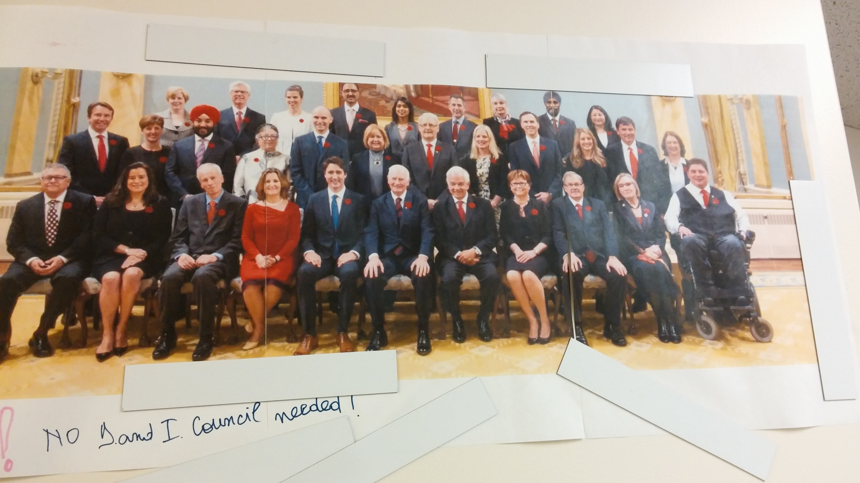
On door of female scientist office
15/30 females

Slide 24
Inclusion Examples
Jefferson Lab - There is a female technician with more experience and tenure here at Jefferson Lab that has yet to make promotion to Tech 3 after several males in her immediate work group and surrounding work groups in her division have made Tech 3 after starting after she did. She is an asset to the success of several major projects.
Example of a negative "inclusion in action" was from a statement made by someone in a group meeting recently: "Users are mumbling into their beards rather than screaming bloody murder." This statement was made by a person during a meeting in regards to issues with that we were having with the CEBAF machine. To me this implied that only men were the Physics Users and disregarded any female users or their thoughts on the situation with the machine.
Example of positive inclusion not work related: Grammy awards show. Noticed a mix of people with different ethnicity working together and different genre artists performing together on stage. Also just general support of the artists supporting each other because of the common love of music.
Like a girl https://www.youtube.com/watch?v=XjJQBjWYDTs

Slide 25
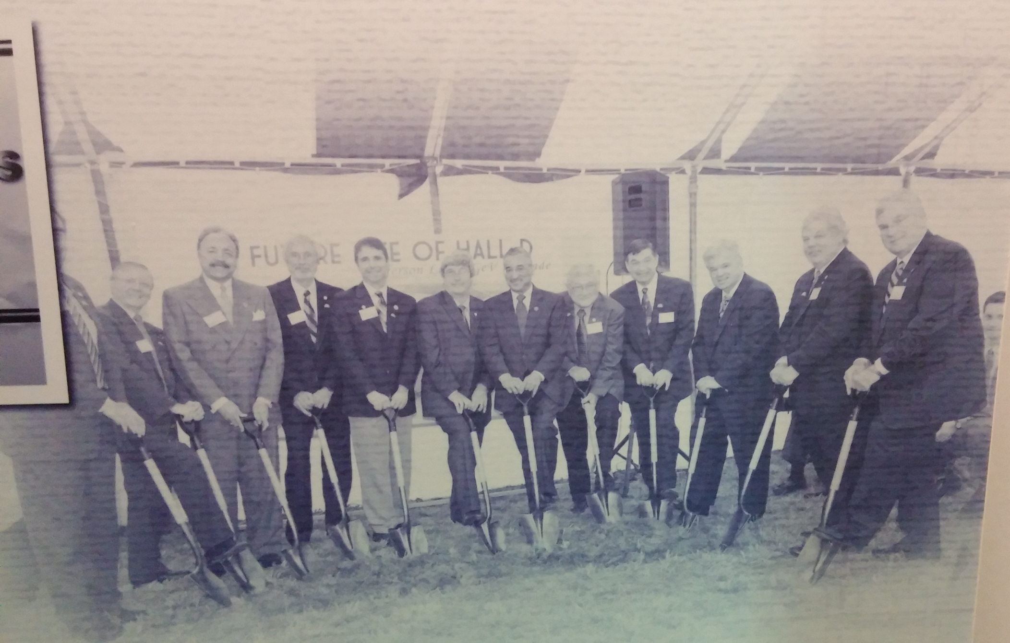
12 GeV/Hall D Groundbreaking

Slide 26
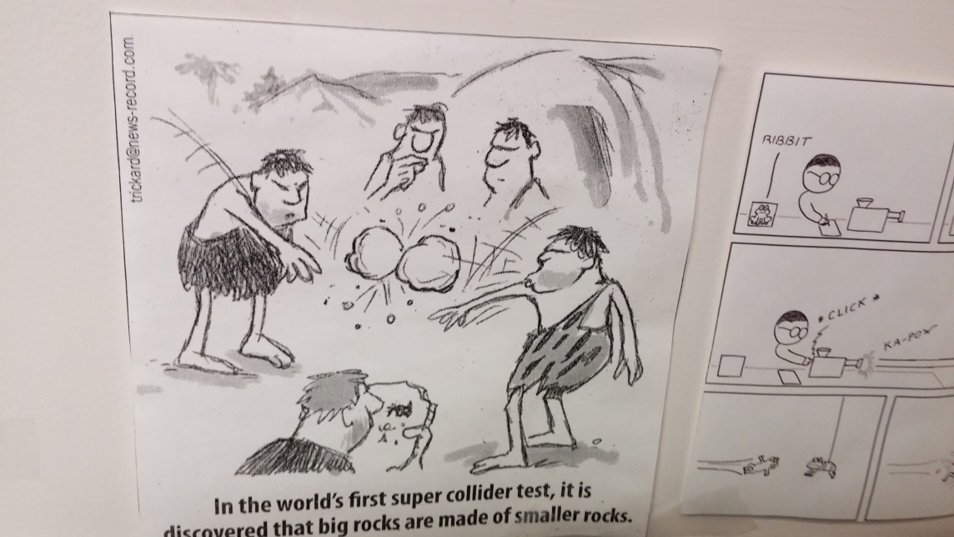
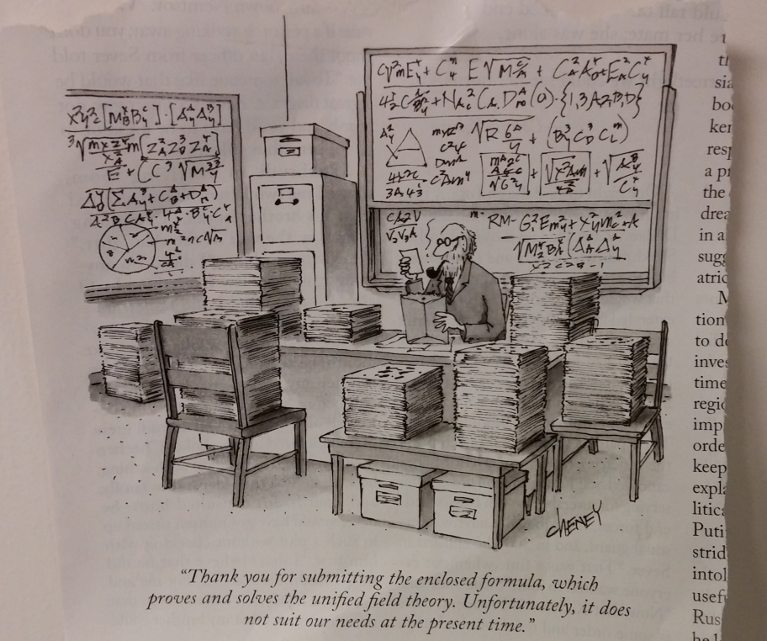
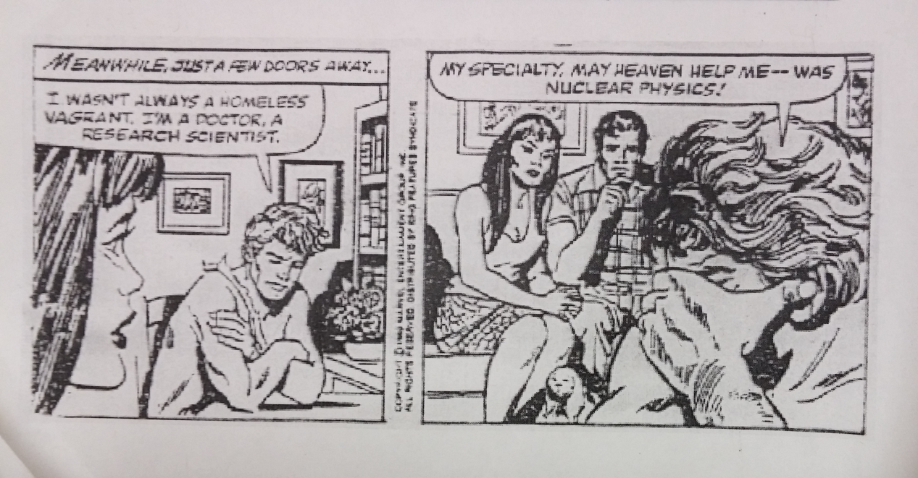
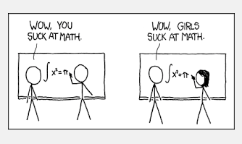
Scientists in Comics
And as contrast…

Slide 27
Scientists in Comics: The Other Side

Slide 28
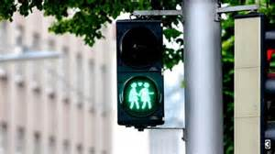
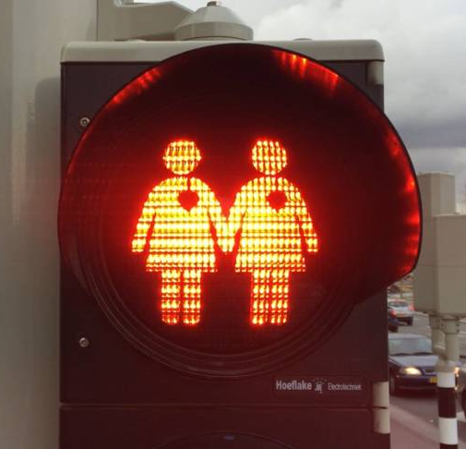
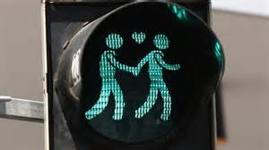
Traffic Lights in Utrecht/Netherlands

