Slide 1
D&I Council Meeting Agenda
1. Photo Op (Deb Magaldi) - 5 minutes
2. D&I Policy (Mary Logue) - 5 minutes
3. D&I Survey (Rhonda Barbosa) - 5 minutes
4. D&I Poster (Rhonda Barbosa) – 5 minutes
5. Supervisory Training (Rhonda Barbosa) – 10 minutes
6. Metrics Proposal (Mary Logue) – 10 minutes
7. New Hire Sourcing Analysis Review (Rhonda Barbosa) – 10 minutes
8. Guidance for Performance Reviews (Rhonda Barbosa) – 5 minutes
9. 2nd Annual D&I Joint Meeting with Lab Directors, September 2016 – (Rhonda Barbosa) – 5 minutes

Slide 2
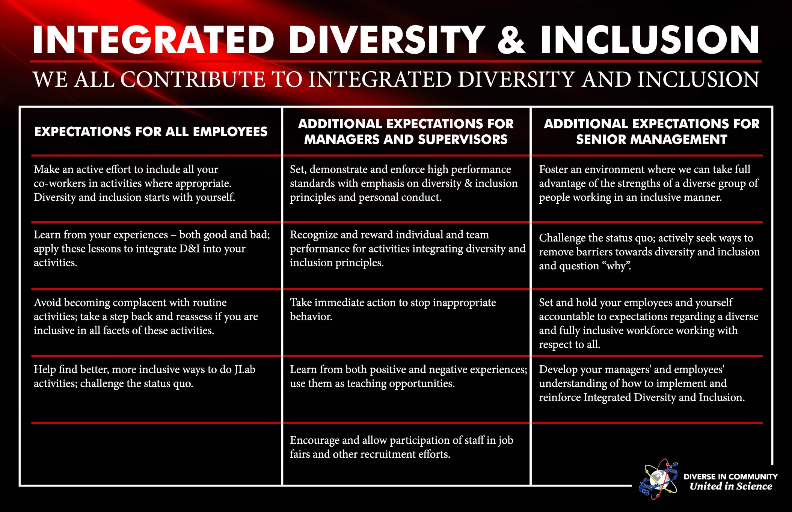
D&I Poster

Slide 3
D&I Poster

Slide 4
Proposed Itinerary for
Management Diversity Training

Slide 8
Metrics Proposal

Slide 9
Lab-wide D&I Survey Responses, 1 of 2
What: Are we getting appropriate D&I representation in our survey responses?
Who: Lab Employees
Note: Individual question responses, next page

Slide 10
Lab-wide D&I Survey Responses – Agree / Strongly Agree, 2 of 2
Benchmark Survey – same as used in 2014 | Female, Technical or Scientific |  | Male, Technical or Scientific |  | Female, non-technical or scientific |  | Male, non-technical or scientific
 | 2014 | 2016 | 2014 | 2016 | 2014 | 2016 | 2014 | 2016
4. I see value in having a workforce composed of racial, ethnic, age and gender diversity.
5. JLab provides a professional, ethical, tolerant and respectful work environment in which everyone can contribute to the mission according to her or his talents.
6. JLab is committed to recruiting, hiring and advancing members of groups that are under-represented in scientific and technical fields, such as women and minorities
7. Sometimes a woman’s ideas or opinions are ignored when the same ideas or opinions from a man would not be
8. Sometimes a person’s cultural or ethnic background causes his or her ideas to be discounted
9. I may have a bias or preference for one group over another.
10. I’m aware of the bias or preference I have and try to consciously overcome it.
11. I have seen (or experienced) bias at JLab.
12. I feel my contributions to the Lab’s mission are valued.
13. Increasing awareness about both the presence and effects of bias and preference is well worth everyone’s time and effort

Slide 11
What: As a Lab, are our job postings attracting qualified D&I applicants? Are they being selected for interviews and final hire?
Who: External applicants
Qualified: meets job posting minimum qualifications

Slide 12
What: By position type, are our job postings attracting qualified D&I applicants? Are they being selected for interviews and final hire?
Who: External applicants

Slide 13
TURNOVER AND NEW HIRE NET IMPACTS, LAB-WIDE
What: How is our overall D&I composition changing over time?
Who: Employees who leave the previous 12 months; New hires by last 12 months

Slide 14
NEW HIRE TO PERMANENT EMPLOYEE TRANSITION
What: Is our D&I culture positively influencing new hires?
Who: New hires
 | Female, Tech or Scientific |  | Male, Tech or Scientific |  | Female, non-tech or scientific |  | Male, non-tech or scientific
Revised Questions, March 2016 | Day 1 | Day 365 | Day 1 | Day 365 | Day 1 | Day 365 | Day 1 | Day 365
4. Success in the workplace is dependent on a professional, ethical, tolerant, and respectful work environment.
5. Increasing the workforce population’s awareness of both the presence and effects of bias and preference is well worth everyone’s time and effort.
6. Sometimes a woman's ideas or opinions are ignored when the same ideas or opinions from a man would not be.
7. Sometimes a person's cultural or ethnic background causes his or her ideas to be discounted.
8. There was little or no bias among my previous co-workers.
9. I have neither bias nor preference for one group over another.
10. I am aware I have some unconscious biases or preferences, but I know what they are and consciously try to overcome them.
11. I have seen (or experienced) bias in the last year.
12. Increasing awareness about both the presence and effects of bias and preference is well worth everyone's time and effort.
13. I would be interested in helping the Lab's Diversity and Inclusion Council increase the diversity of our workforce and ensure everyone's contributions to our scientific mission are valued.

Slide 15
Outreach 2016*
*Based on applicant flow for period 10/1/2015 – 03/31/2016 using date applied

Slide 16
Source of Applicants
2153 Applicants
* Indicates less than 1% of applicants

Slide 17
Source of Hires

Slide 18
% of Applicants to Hires*
Diversity makeup of the 2153 applicants
Diversity of the 139 applicants interviewed
Diversity of the 32 applicants Hired

Slide 19
Hires by Classification
29% of Hires were T/D
AO

Slide 20
Hires by Classification Series

Slide 21
Hires by Classification (Minority Analysis)
32 Hires | Other People of Color | White or Declined | Protected Minority
Hires to 3.31.16 | 16% | 52% | 32%
Classification
AC | 0% | 0% | 3%
AO | 0% | 0% | 3%
AS | 0% | 3% | 10%
PD | 3% | 0% | 0%
PSS | 3% | 0% | 0%
SA | 0% | 13% | 3%
SE | 3% | 13% | 0%
SS | 3% | 3% | 0%
ST | 0% | 3% | 0%
Student | 0% | 0% | 3%
TD | 3% | 16% | 10%

Slide 22
Hires by Classification (Gender Analysis)
32 Hires | Female | Male or Declined
Hires to 3.31.16 | 26% | 74%
Classification
AC | 0% | 3%
AO | 0% | 3%
AS | 6% | 6%
PD | 0% | 3%
PSS | 0% | 3%
SA | 10% | 6%
SE | 3% | 13%
SS | 3% | 3%
ST | 0% | 3%
Student | 0% | 3%
TD | 3% | 27%

Slide 23
Hires by Classification (Veteran Analysis)
32 Hires | Does not Identify as a Veteran | Protected Veteran
Hires to 3.31.16 | 84% | 16%
Classification
AC | 0% | 3%
AO | 0% | 3%
AS | 10% | 3%
PD | 3% | 0%
PSS | 3% | 0%
SA | 16% | 0%
SE | 16% | 0%
SS | 6% | 0%
ST | 3% | 0%
Student | 3% | 0%
TD | 23% | 6%

Slide 24
Hires by Classification (Individuals with Disability)
32 Hires | Does not Identify | Individual with Disability
Hires to 3.31.16 | 100% | 0%
Classification
AC | 3% | 0%
AO | 3% | 0%
AS | 13% | 0%
PD | 3% | 0%
PSS | 3% | 0%
SA | 17% | 0%
SE | 17% | 0%
SS | 6% | 0%
ST | 3% | 0%
Student | 3% | 0%
TD | 30% | 0%

