Slide 1
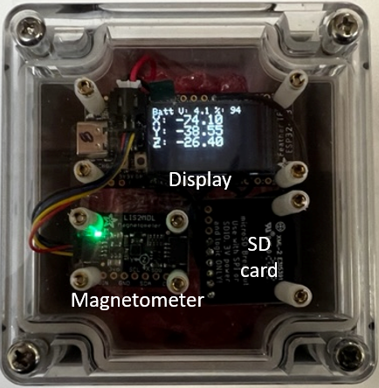
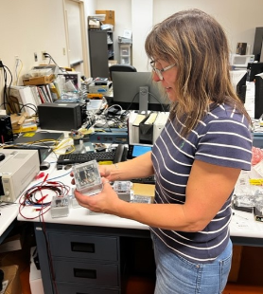
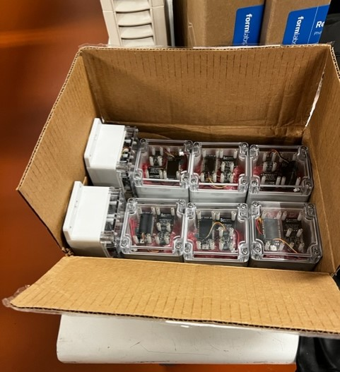
CLEO Field Mapping Units
Local display and storage of magnetic field (X, Y, Z) inside self contained units
Battery powered to last minimum of 24 hours of continuous data taking (sampled at 10 Hz averaged/saved at 1 Hz)

