Slide 1
Marc McMullen Weekly Report: 2023-10-17
Hall A – ECAL
Database file has been uploaded to the IOC
Added EPICS shared variables to project file
Completed controls GUI which can be used from any LabVIEW PC on the Hall A subnet to control and monitor the ECAL heater controls

Slide 2
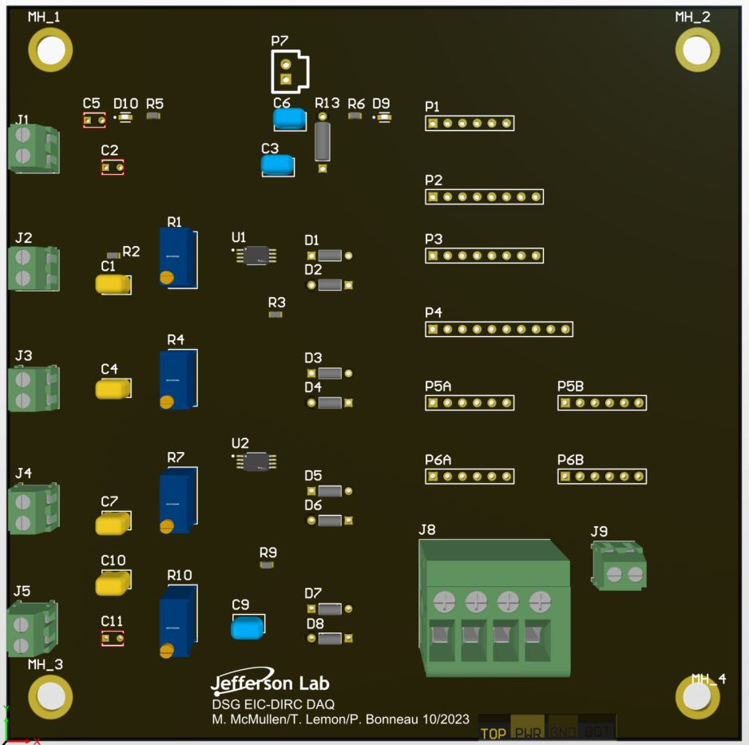
Marc McMullen Weekly Report: 2023-10-17
EIC – DIRC
Attended weekly meeting
Continued component placement for the data acquisition PCB
5V input
Ch. 1_input
Op Amps
Output heaters
Ch. 2_input
Ch. 3_input
Ch. 4_input

Slide 3
Marc McMullen Weekly Report: 2023-10-17
DSG
Attended DSG weekly status meeting
Attended Fcal/Ansys meeting
Attended Phoebus alarm system meeting

