Slide 1


ECAL Heater Controls Safety System Diagram
Marc McMullen
​ ​​
​ ​​
Thursday, December 5, 2024

Slide 2
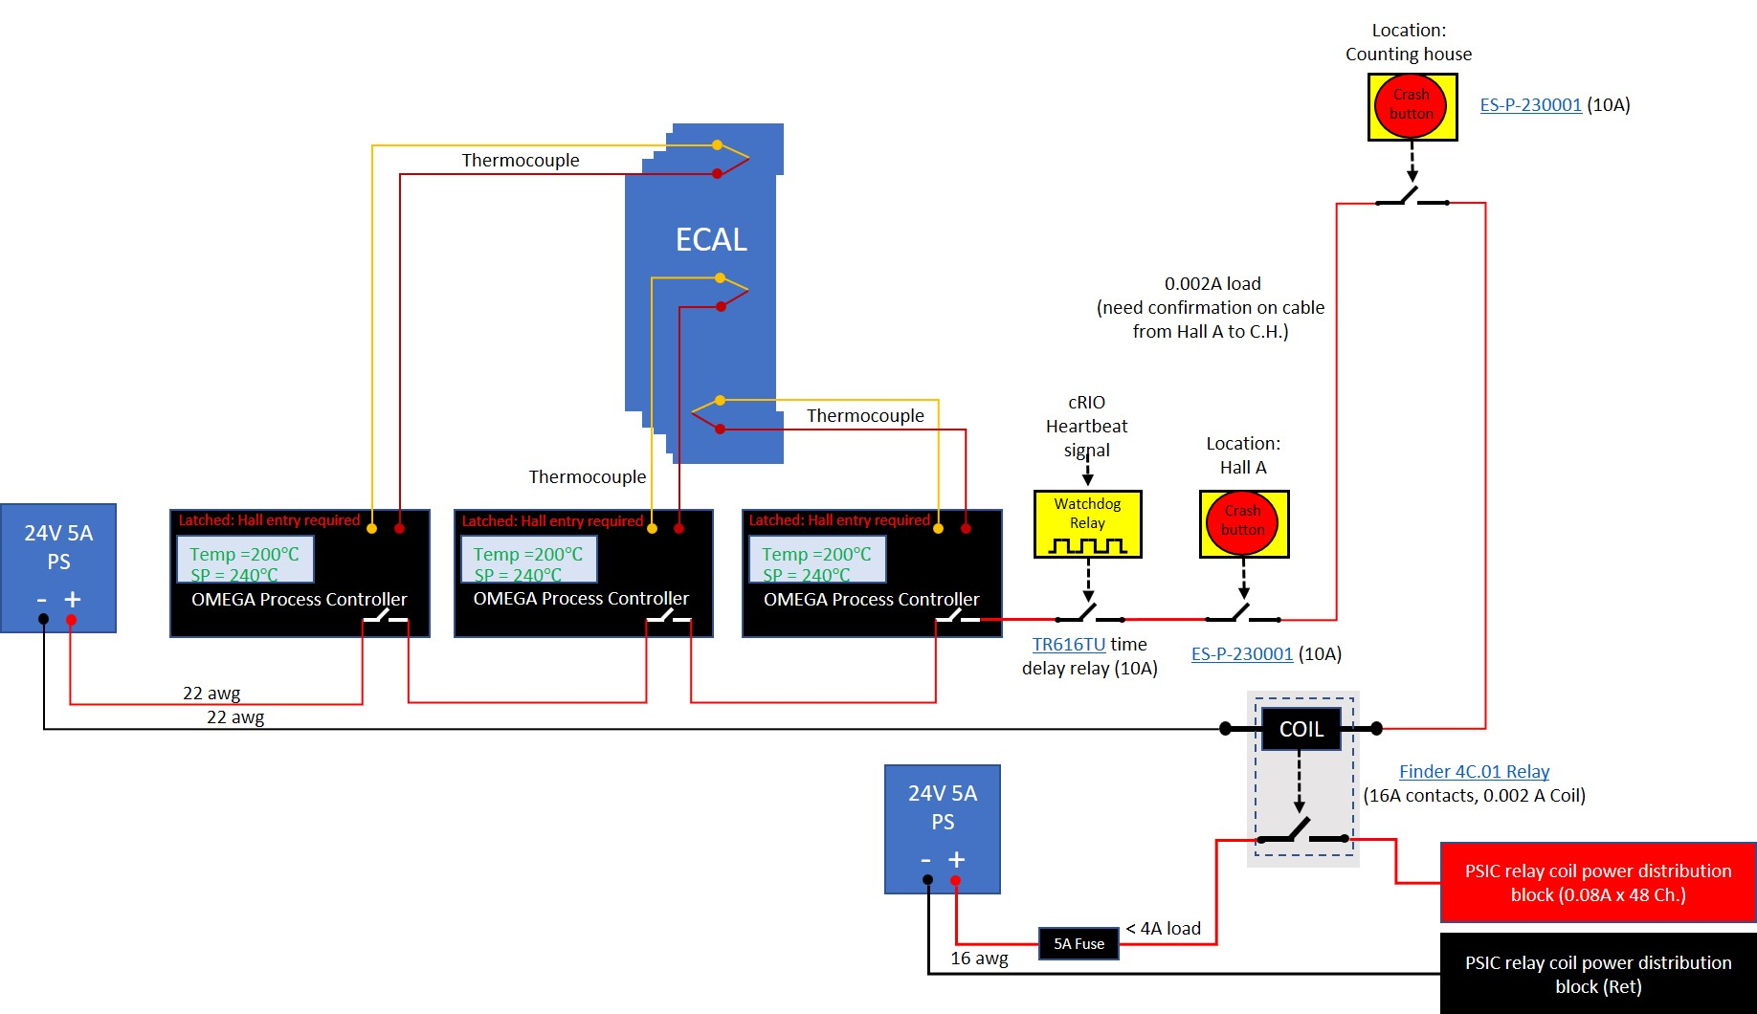
ECAL Safety System
The system is independent of the controls and removes relay coil power for all heater channels when interlocked
Omega process controllers monitor over-temperature conditions of the ECAL’s heated volume in three location
Watchdog relay interlocks during loss of signal from the cRIO’s heartbeat
Crash buttons mechanically latch and must be turned to close the contacts

