Slide 1
Hall A SBS/BB Gas Distribution
Marc McMullen
Detector Support Group
08/06/19

Slide 2
Contents
SBS/BB GEM gas needs
Hall A SBS/BB gas distribution diagram
UVA GEM testing in EEL 124

Slide 3
SBS/BB GEM GAS Needs for Gen + Gen-RP
INFN GEM
18 GEM modules
Requires 2.4 L/h
6 Front Tracker Layers @ 3 module per layer
1 additional spare line (7 total gas lines)
One gas line per layer
UVA GEM
44 GEM modules
Requires 3.4 L/h
10 Back Tracker Layers @ 4 modules per layer
+ 4 additional spare layers
One gas line per module
All modules will use Ar/CO₂ (70:30)
Mixing system developed by Hall A
Distribution system developed by DSG

Slide 4
GMn + GEn-RP Experiment Gas Distribution
All modules require 5 volume exchanges per hour
Forward Tracker (2.4 L x 5 vol. exchanges = 12 L/h). Each layer gets its own gas line
Back Tracker (3.4 x 5 vol. exchanges = 17 L/h). Each module gets its own gas line
Total flow is 964 L/h
All module/layer supply lines will be ¼” nylon. Manifold supply lines will be ½”.
Big Bite Arm
4 Forward Tracker Layers
12 modules (4 gas lines)
144 L/h (5 vol. exchanges)
1 Back Tracker Layer
4 modules (4 gas lines)
68 L/h (5 vol. exchanges)
Super Big Bite Arm
2 Forward Tracker Layers
6 modules (2 gas lines)
72 L/h (5 vol. exchanges)
10 Back Tracker Layer
40 modules (40 gas lines)
680 L/h (5 vol. exchanges)

Slide 5
Hall A GEM Gas Distribution

Slide 6
Hall A SBS/BB Gas Distribution Estimate
Component | Part# | Description | # of units | Cost per unit | Total Cost
PR1 | McMaster 1888k1 | 0-15 psi low pressure regulator | 1 | $94.00 | $94.00
PI1 | McMaster 3846k99 | 0-15 psi gauge on PR1 out | 2 | $18.13 | $36.26
PT1 | 626-07-GH-P1-E4-S1 | 0-15 psig transducer | 2 | $135.00 | $270.00
Manifold 1 | McMaster 5975k19 | 1/2 NPT to 6 of 3/8 NPT out (1/2 tube) | 1 | $33.06 | $33.06
Panel 1 | GUESTIMATE | Holds manifold 1, PR1, PI1-2, PT1-2 | 1 | $100.00 | $100.00
Manifold 2 | McMaster 5975k15 | 3/8 npt to 5 of 1/4 npt out (FWD) | 2 | $23.95 | $47.90
Panel 2 | GUESTIMATE | Holds manifold 2, FMV/FT, needle valves | 1 | $250.00 | $250.00
Manifold 3 | McMaster 5975k36 | 1/2 npt to 3 of 3/8 npt (2nd and 3rd) | 4 | $29.28 | $117.12
Panel 3 | GUESTIMATE | Holds manifold 3 | 1 | $100.00 | $100.00
Manifold 4 | McMaster 5975k12 | 3/8 npt into 4 of 1/4 npt out | 12 | $21.20 | $254.40
Panel 4 | GUESTIMATE | Holds Manifold 4, FMV and FT | 12 | $150.00 | $1,800.00
FMV1 to 10 | Dwyer RMA-13-ssv | For the larger volume GEMs | 10 | $48.00 | $480.00
FMV11 to 58 | Dwyer RMA-12-ssv | GEMs | 48 | $48.00 | $2,304.00
1/8 npt to 1/4" push loc | McMaster 5779k108 | For FMV connections | 120 | $3.16 | $379.20
FT11 to 58 | Honeywell Zephyr | 0-400 sccm flow transducer | 48 | $91.66 | $4,399.68
FT1 to 10 | Honeywell Zephyr | 0-750 sccm flow transducer | 10 | $95.36 | $953.60
1/4 npt to 1/2" comp | B-810-1-4 | PR1 in and out | 2 | $13.00 | $26.00
1/4 npt to 1/4 posh lok | Mcmaster 5779k108 | For gauges and transducers | 64 | $3.16 | $202.24
1/2" npt plug | McMaster 4464k564 | 1/2" npt plug | 12 | $2.70 | $32.40
1/4 FNPT union | 5078k92 | gauge and transducer connections | 4 | $1.50 | $6.00
1/4 push lok Tee | 5779k34 | gauge and transducer connections | 2 | $4.88 | $9.76
3/8 npt to 1/2 push lok | McMaster 5779k121 | for 1/2" tubing runs | 36 | $7.80 | $280.80
3/8 npt plug | McMaster 4464k563 | for unused 3/8 npt openings | 16 | $2.00 | $32.00
1/4" push lok union | McMaster 5779k14 | for flow transducer connections | 120 | $3.20 | $384.00
1/2 npt to 1/2 push loc | McMaster 5779k122 | 1/2" npt to 1/2" push lock | 12 | $8.20 | $98.40
1/4" push lok caps | McMaster 5779k473 | push lok cap for tubing | 24 | $2.18 | $52.32
1/4" push lok plugs | McMaster 5779k54 | push lok plug for fitting | 24 | $1.18 | $28.32
1/4" tubing |  | guestimate of 40 ft per line | 2400 | $0.48 | $1,152.00
Tygon 1/4" | 1/4" OD x 3/16 ID tygon | guestimate of 0.5 ft per line | 25 | $0.98 | $24.50
1/2" tubing |  | guestimate of 40 ft per line | 200 | $1.61 | $322.00
Panel supports |  |  | 15 | $50.00 | $750.00
misc |  |  | 1 | $1,500.00 | $1,500.00
labels |  |  | 1 | $450.00 | $450.00
Readback cables and electronics |  |  |  |  | $5,000.00
 |  | FMV System Estimate |  |  | $11,616.68
 |  | FMV plus FT System Estimate |  |  | $21,969.96

Slide 7
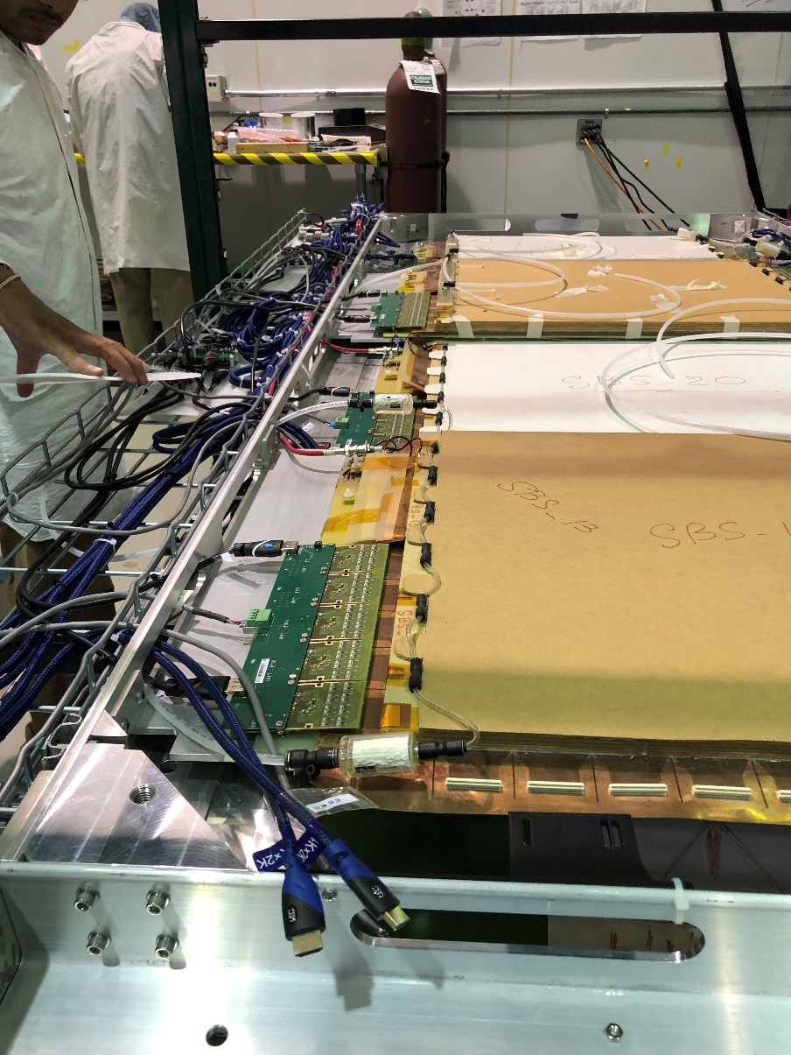
UVA GEM Testing in EEL 124 Clean Room
Gas distribution using rotameters
¼” tube supply to GEM module using push-lock connection
Gas supply to manifold

Slide 8
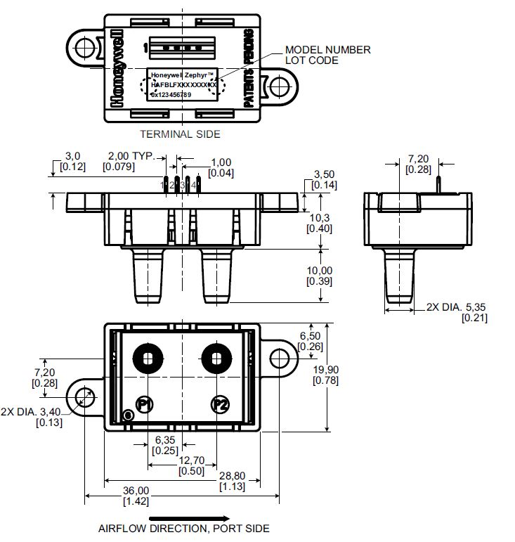
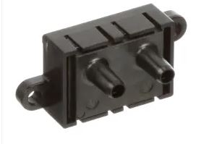
Flow Control and Monitoring
Hall A requires monitored flow for all distribution circuits (48).
DSG has identified a viable option on market to measure mass flow and provide an output signal that can be monitored and used in EPICS for alarms.
DSG design will include individual manual valves for each line.

Slide 9
Honeywell Zephyr Evaluation

Slide 10
Conclusion
DSG will design and build the Hall A gas distribution system
SBS/BB gas distribution has multiple configurations. Gas distribution system will need to be designed to support changes.
This will include flow control and remote monitoring for each GEM module.
DSG is developing cost list for material and equipment.
Flow sensors have arrived and are being tested.

