Slide 1
Hall A GEM Gas Distribution Rack
George Jacobs
Detector Support Group
09/04/2019

Slide 2
Hall A GEM Gas Distribution System Details
Single Rack Layout
Front Panel Location For all Pressure and Flow Controls
Rear Panel Location For all Gas Line Connections
Layout Minimizes Tubing and Cable Lengths ( Minimizes Cost)
Provides 58 Total Gas Supply Channels
10 High Flow (100-1000sccm) Channels
48 Standard Flow (50-500sccm) Channels
All 58 Channels Can be Routed as Desired

Slide 3
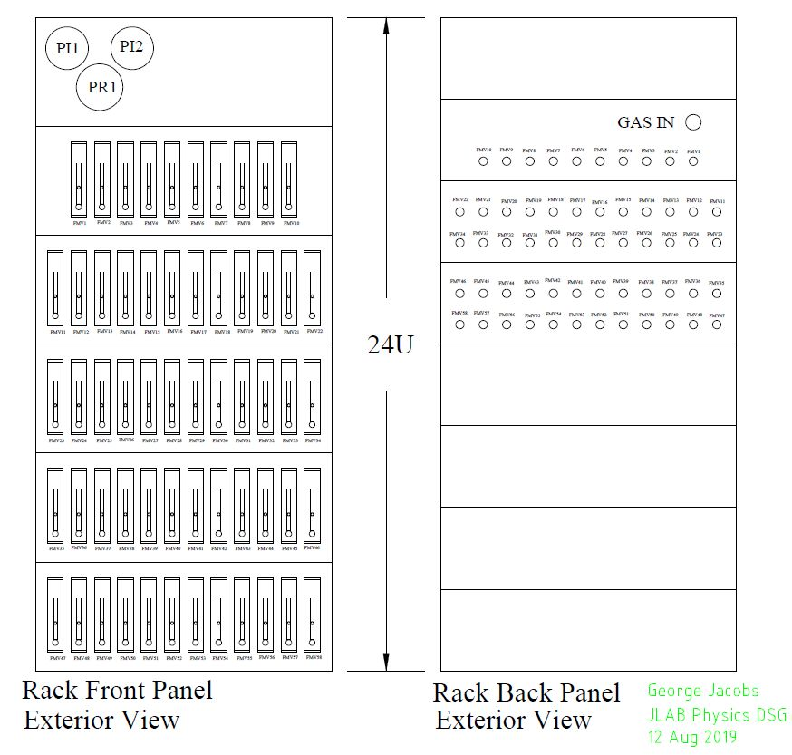
GEM Gas Distro Rack External View

Slide 4
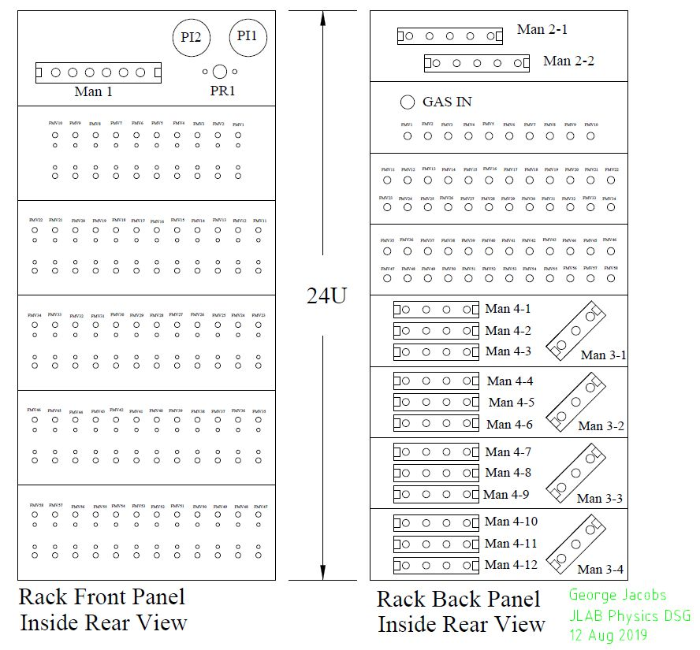
GEM Gas Distro Rack Internal View

Slide 5
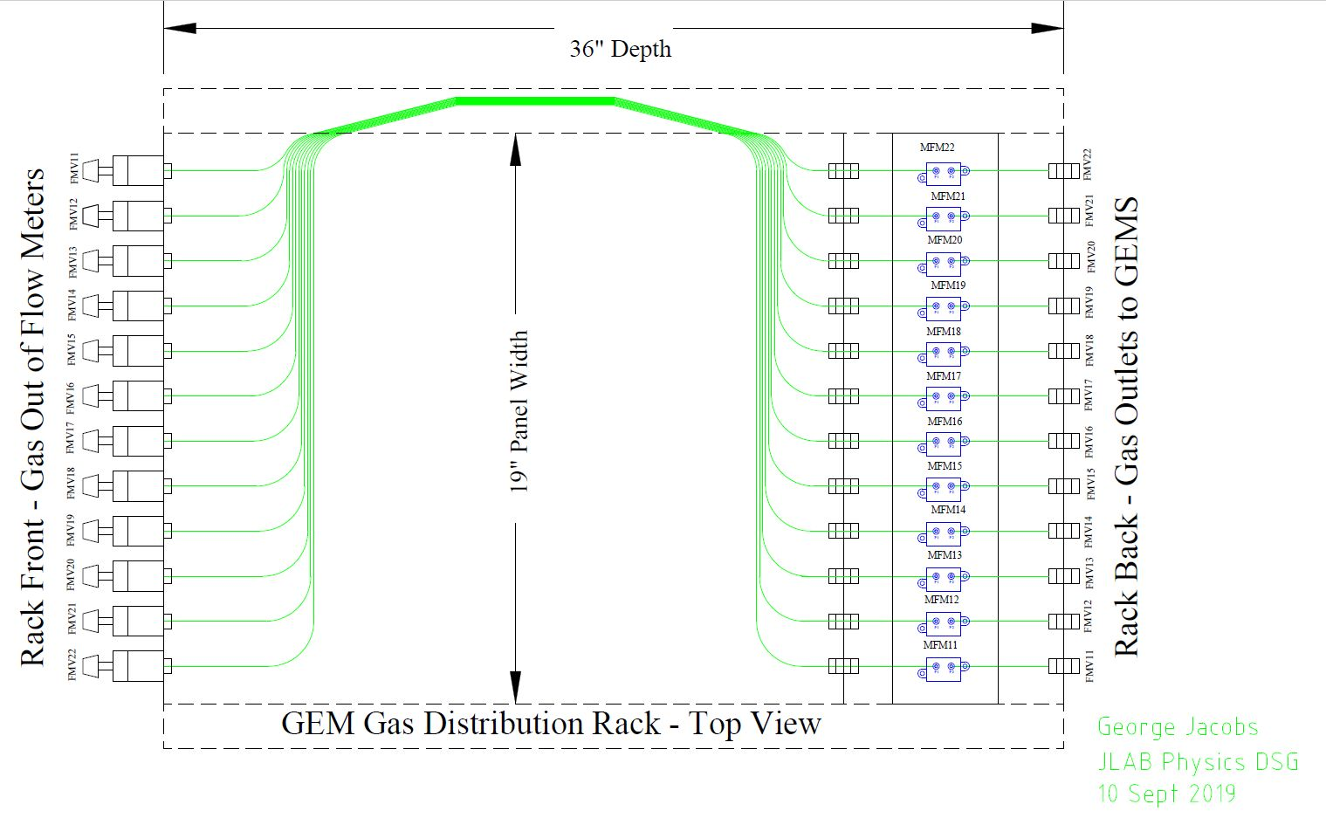
GEM Gas Distro Rack Internal Tubing Runs

Slide 6
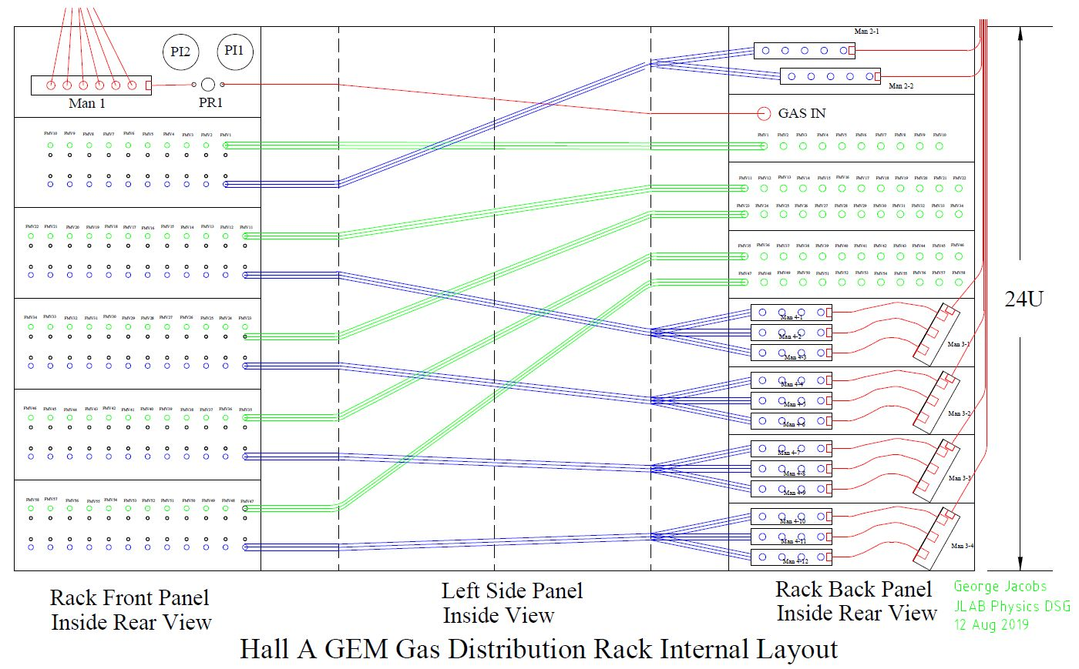
GEM Gas Distro Rack Internals Unfolded

Slide 7
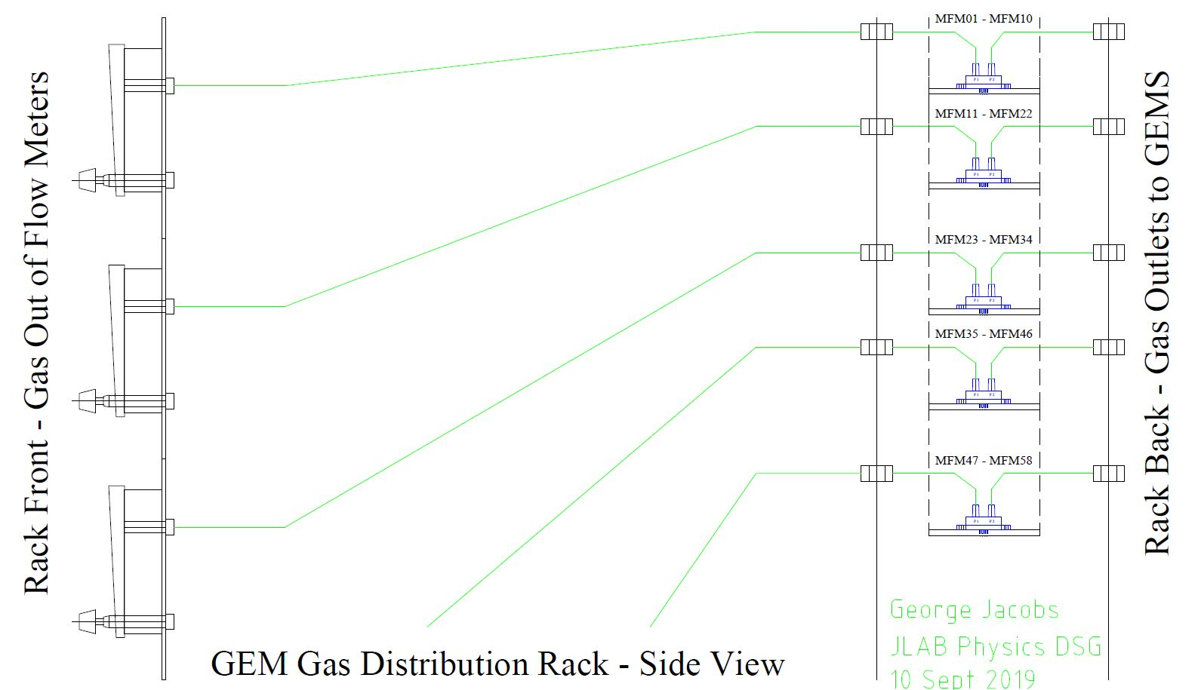
GEM Gas Distro Rack Transducer Plumbing

Slide 8
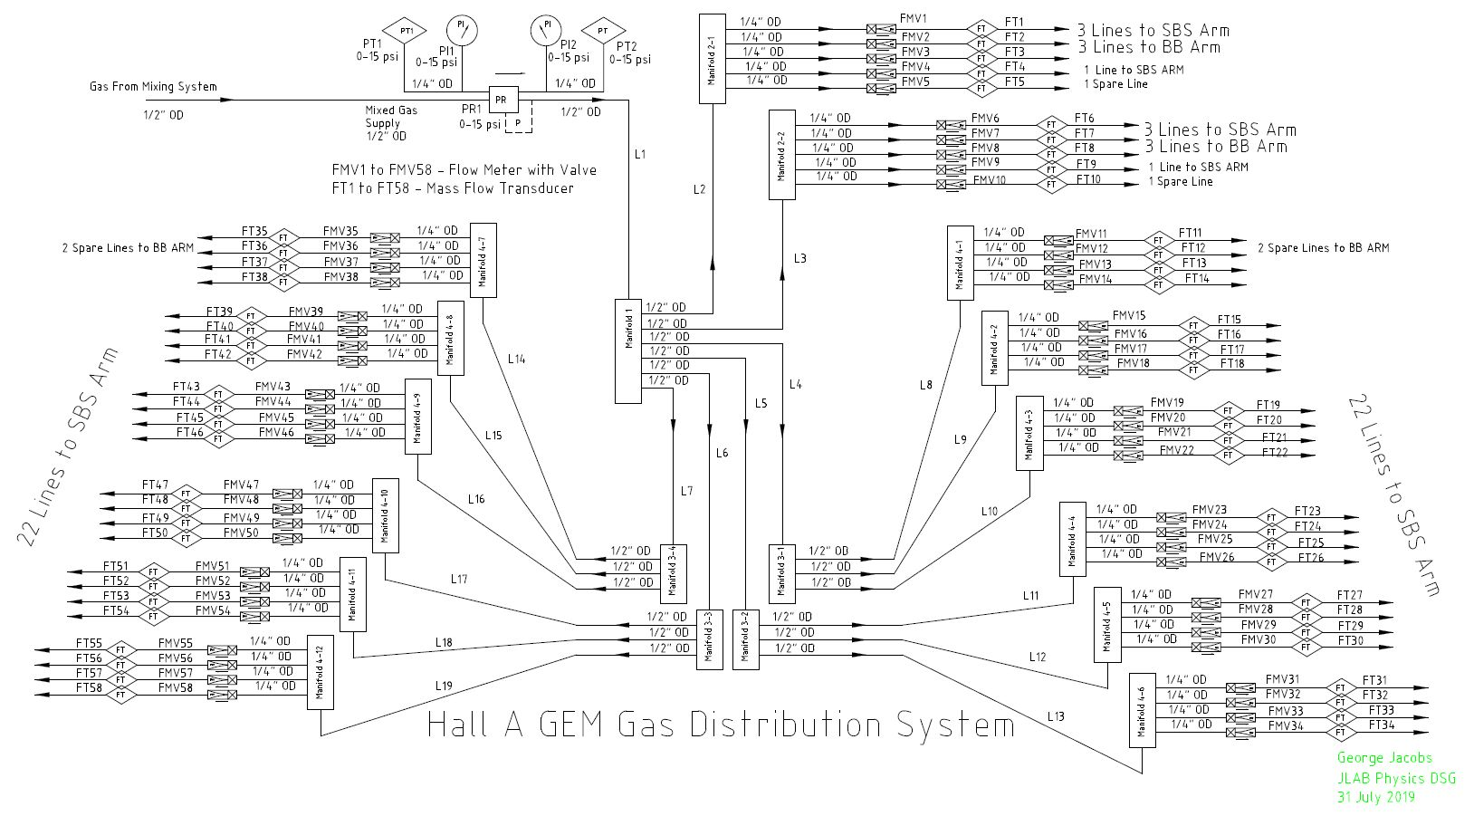
GEM Gas Distro System P&I Diagram

Slide 9
Conclusion
Portable High Density Single Rack Layout
Front Panel Location For all Pressure and Flow Controls
Rear Panel Location For all Gas Line Connections
High Density Layout Minimizes Cost
Provides 58 Total Gas Supply Channels
10 High Flow (100-1000sccm) Channels
48 Standard Flow (50-500sccm) Channels
All 58 Channels Can be Routed as Desired to Meet Current and Future Requirements

Slide 10
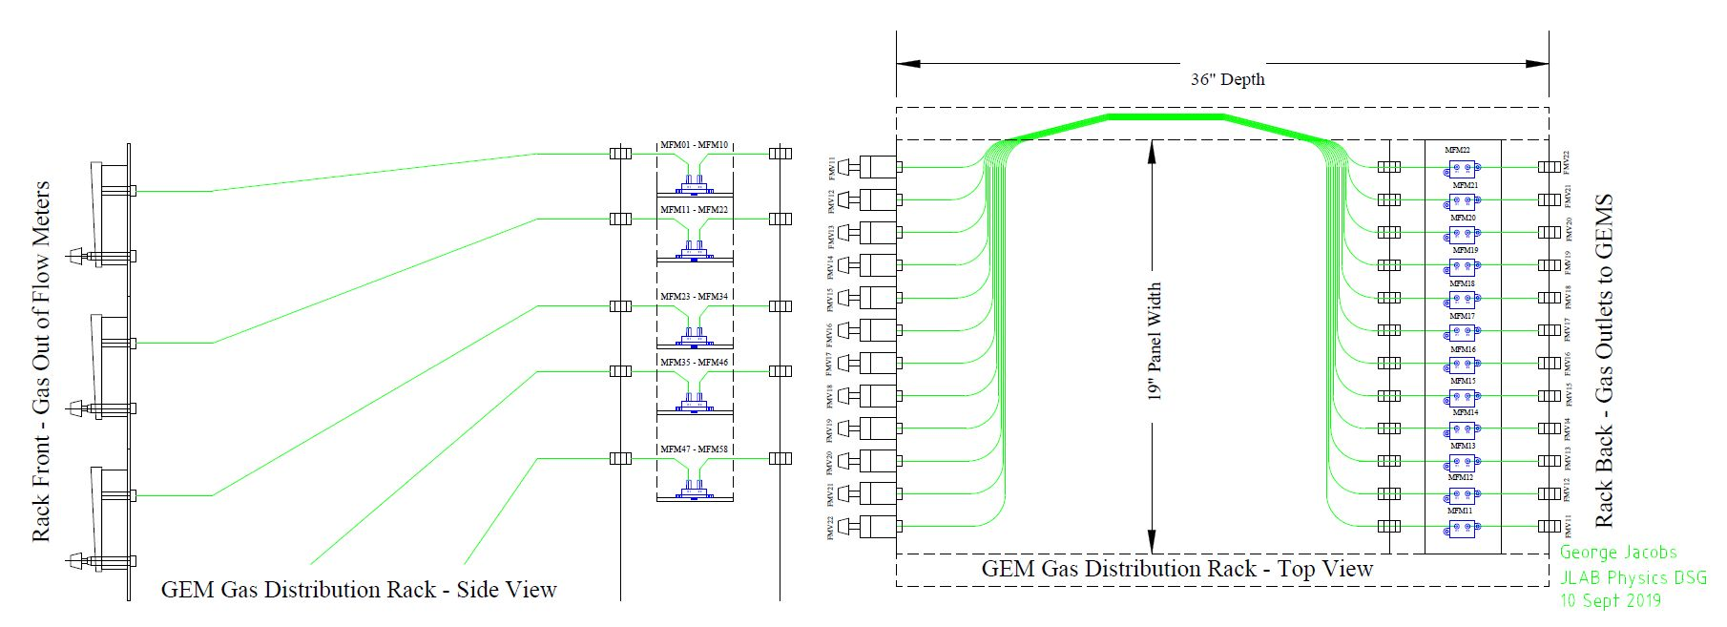
Mass Flow Transducer Installation

Slide 11
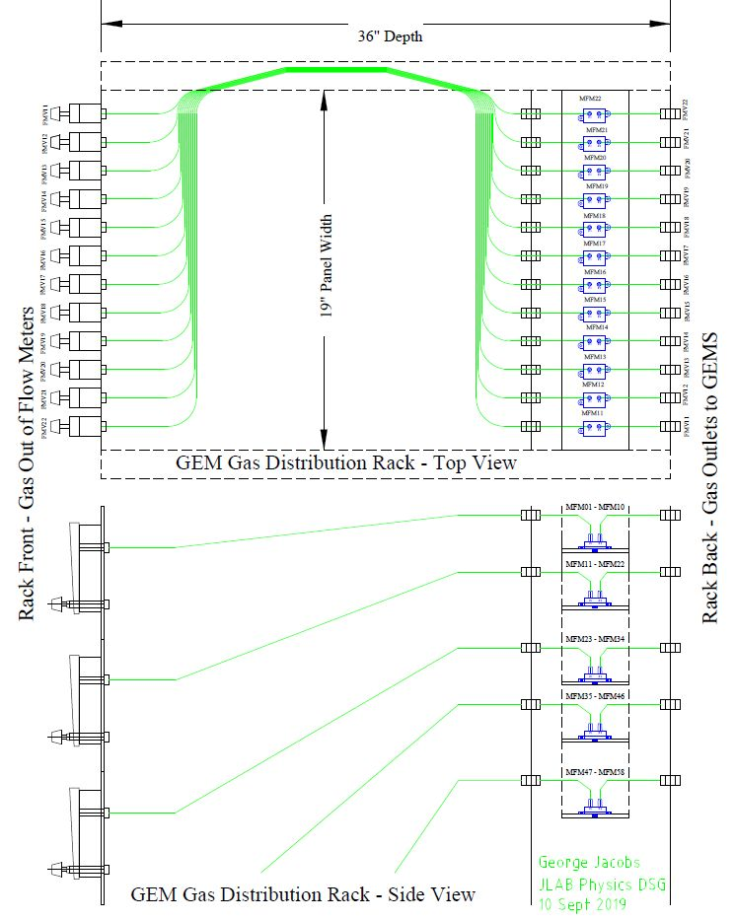
Mass Flow Transducer Installation

Slide 12
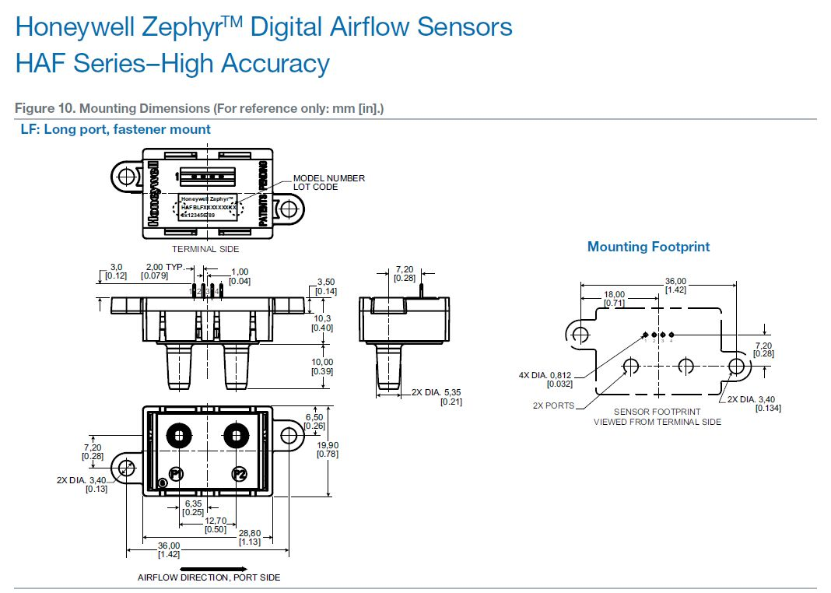
Honeywell Zephyr Digital Air Flow Sensors

Slide 13
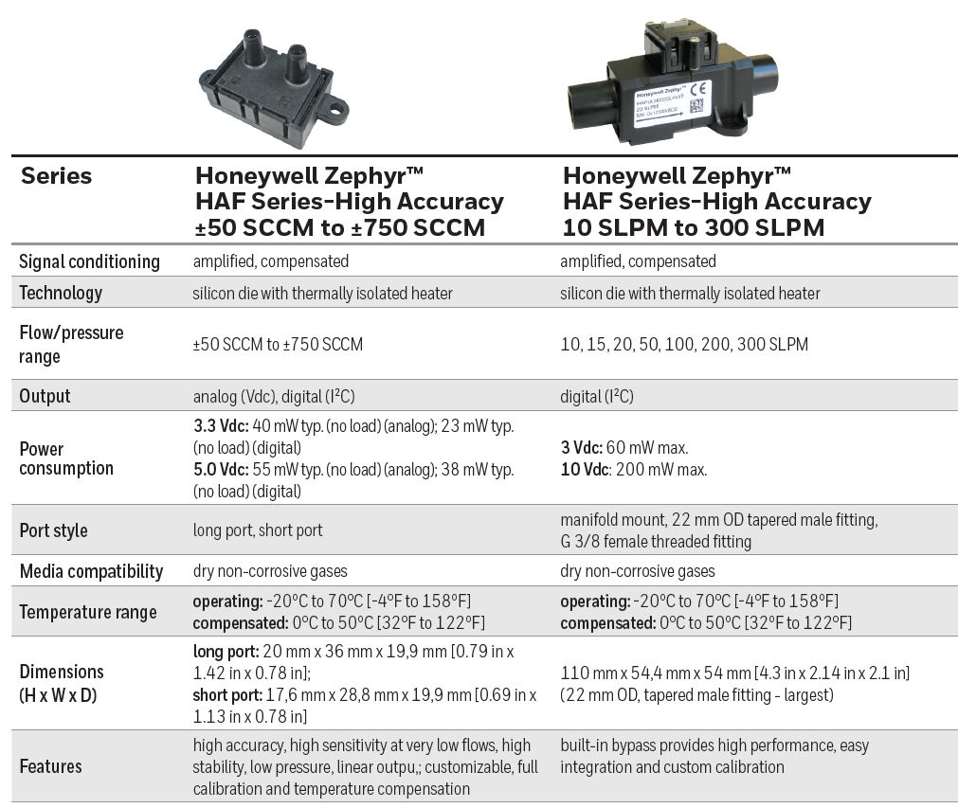
Digital Air Flow Sensors Specifications

