Slide 1

Hall A GEM Gas Distribution
George Jacobs
Detector Support Group
02/14/2020

Slide 2
Hall A GEM Gas Distribution System Details
Two Rack Layout
  Front Panel Location For all Pressure and Flow Controls
  Rear Panel Location For all Gas Line Connections
  Layout Minimizes Tubing and Cable Lengths ( Minimizes Cost)
Provides 50 Total Gas Supply Channels
  6 High Flow (100-1000sccm) Channels
    4 on BB Panel and 2 on SBS
  44 Standard Flow (50-500sccm) Channels
    4 on BB Panel and 40 on SBS

Slide 3
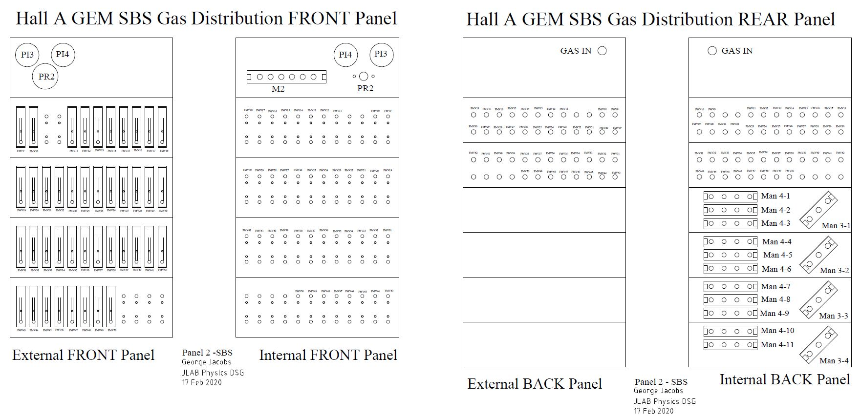
SBS GEM Gas Distro Rack

Slide 4
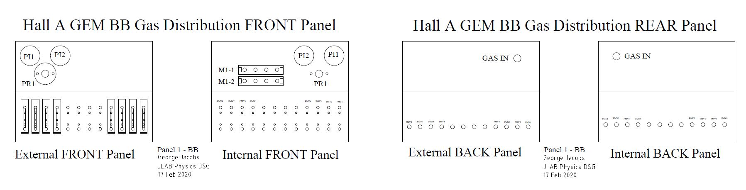
BB GEM Gas Distro Rack

Slide 5
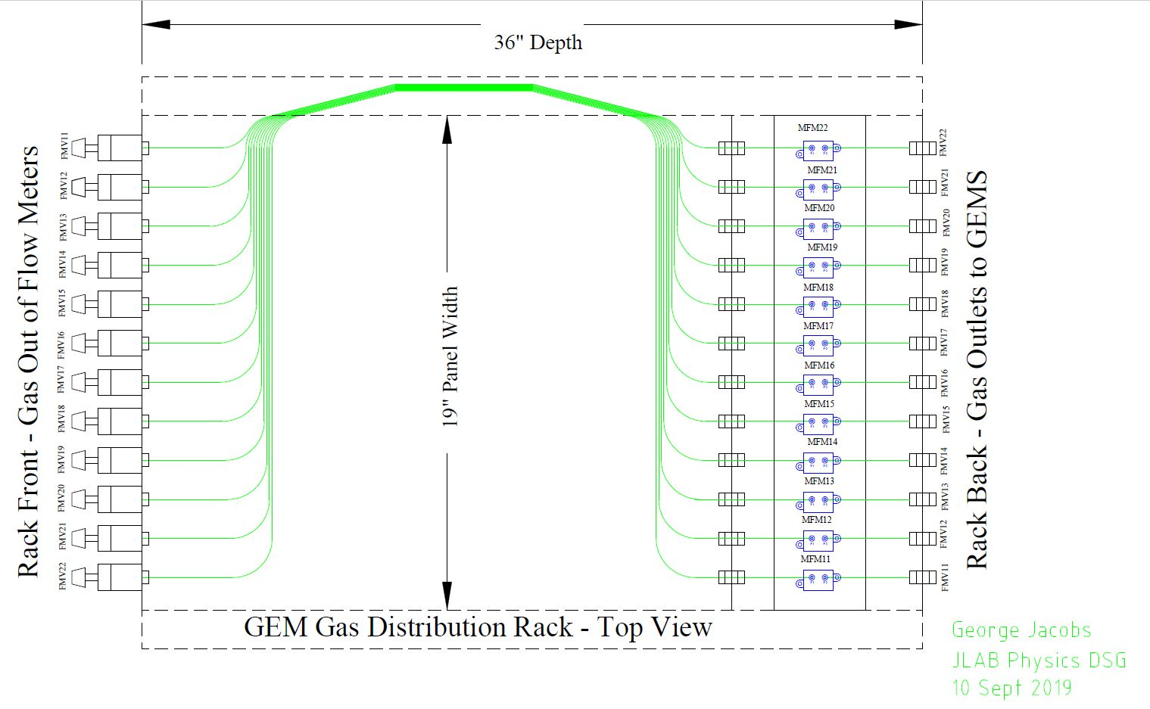
GEM Gas Distro Rack Internal Tubing Runs

Slide 6
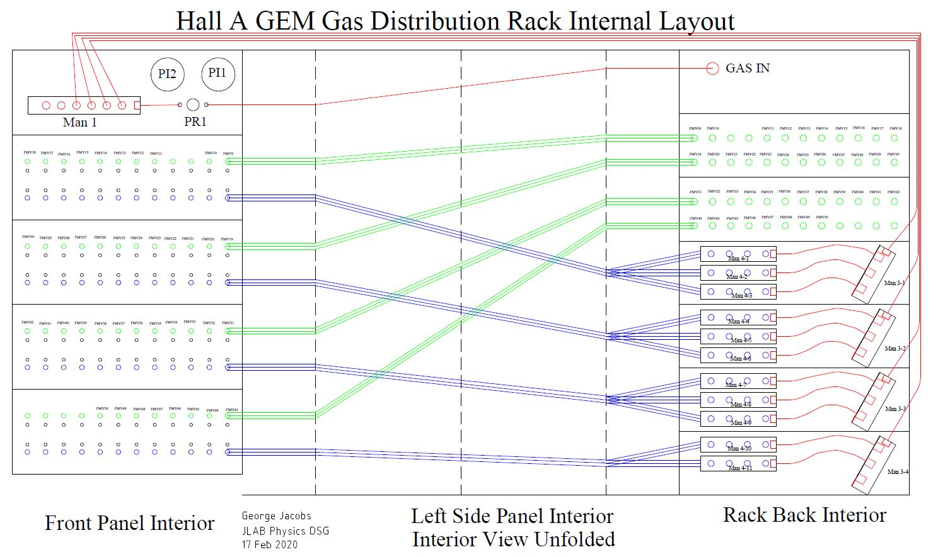
GEM Gas Distro Rack Internals Unfolded

Slide 7
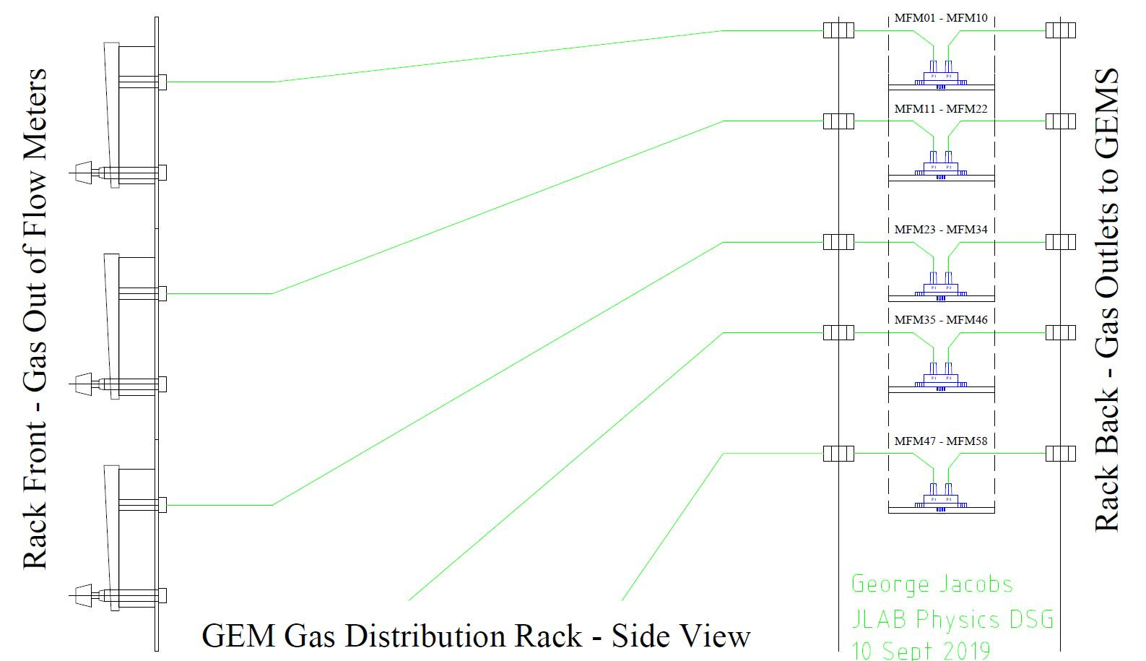
GEM Gas Distro Rack Transducer Plumbing

Slide 8
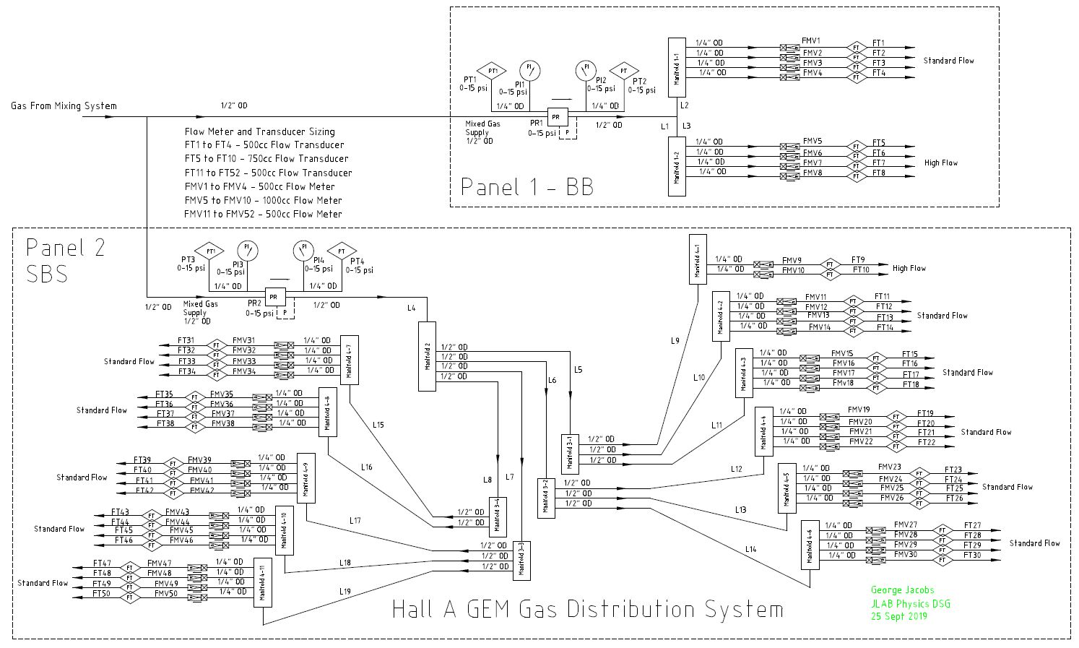
GEM Gas Distro System P&I Diagram

Slide 9
Conclusion
Portable High Density Two Rack Layout
  Front Panel Location For all Pressure and Flow Controls
  Rear Panel Location For all Gas Line Connections
  High Density Layout Minimizes Cost
Provides 50 Total Gas Supply Channels
  6 High Flow (100-1000sccm) Channels
    4 on BB and 2 on SBS
  44 Standard Flow (50-500sccm) Channels
    4 on BB and 40 on SBS

Slide 10
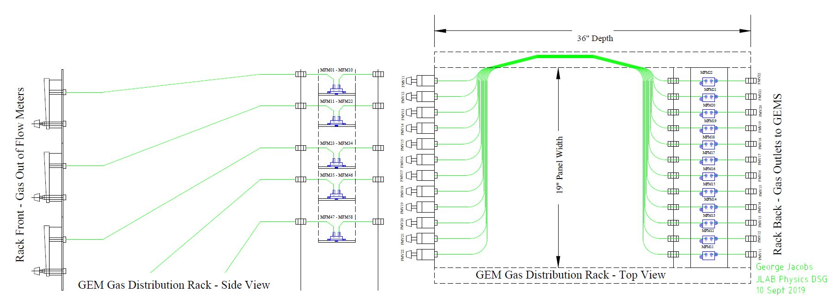
Mass Flow Transducer Installation

Slide 11
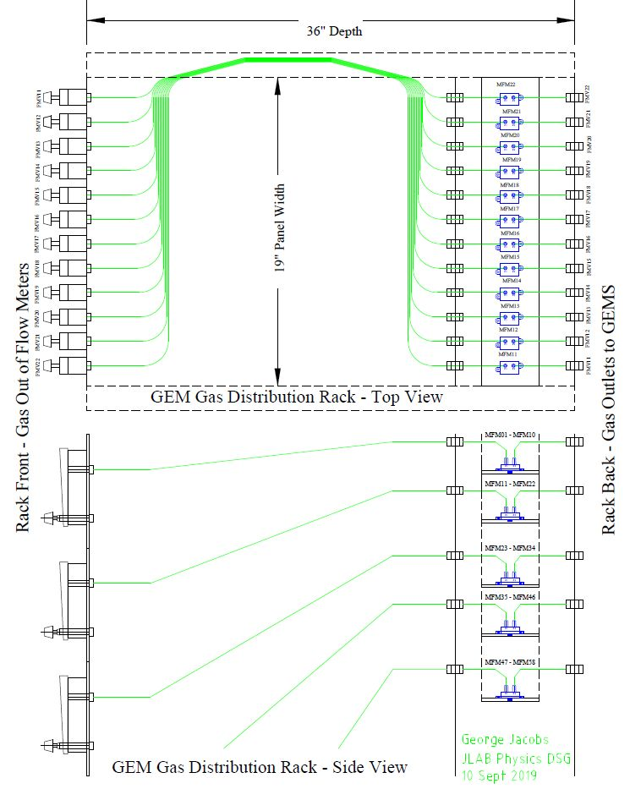
Mass Flow Transducer Installation

Slide 12
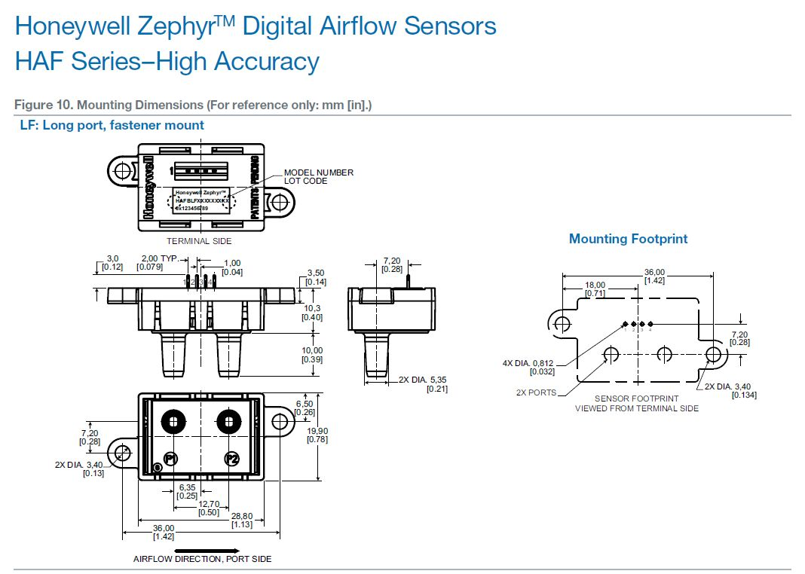
Honeywell Zephyr Digital Air Flow Sensors

Slide 13
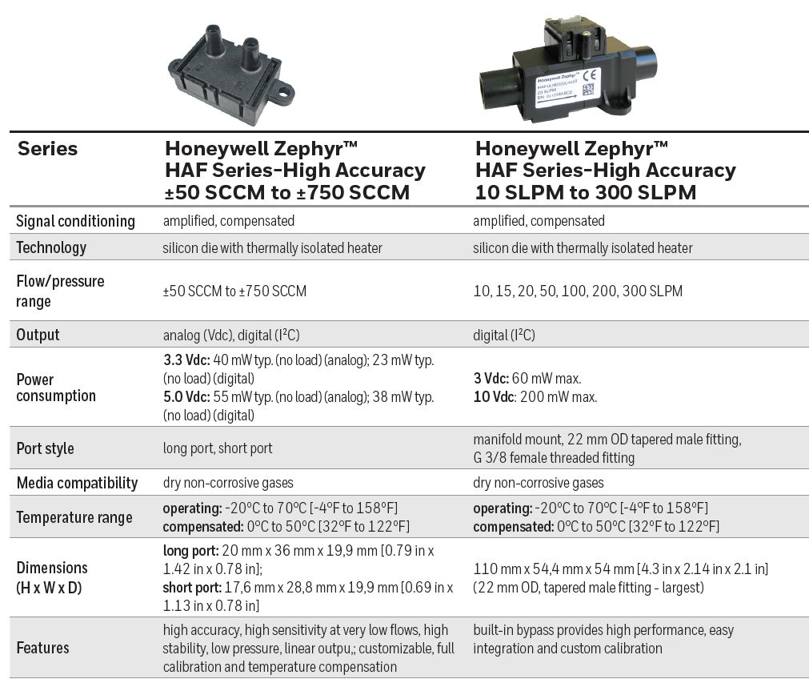
Digital Air Flow Sensors Specifications

