Slide 1
Hall A GEM Gas Distribution Parts Procurement Status
George Jacobs
Detector Support Group
03/04/2020

Slide 2
PRs, e-Commerce, and Credit Card Purchases
Dwyer Instruments - PR392544 - $3566.60 - Order Sent 3/5
RMA-12-SSV – 50-500 sccm flow meters, 48 units
RMA-13-SSV – 100-1000 sccm flow meters, 8 units
0-15 psi Pressure Transducers, 4-20 ma, 6 units
E-Commerce
Dibert Valve - Swagelok fittings - $520.50 - Received

Slide 3
PRs, e-Commerce, and Credit Card Purchases
McMaster Carr Credit Cards Orders
2/21 Order - $1466.90 - Received
2/26 Order – $940.25 - Received
3/3 Order – $1152.05 - Received
E-Commerce
Dibert Valve - Swagelok fittings

Slide 4
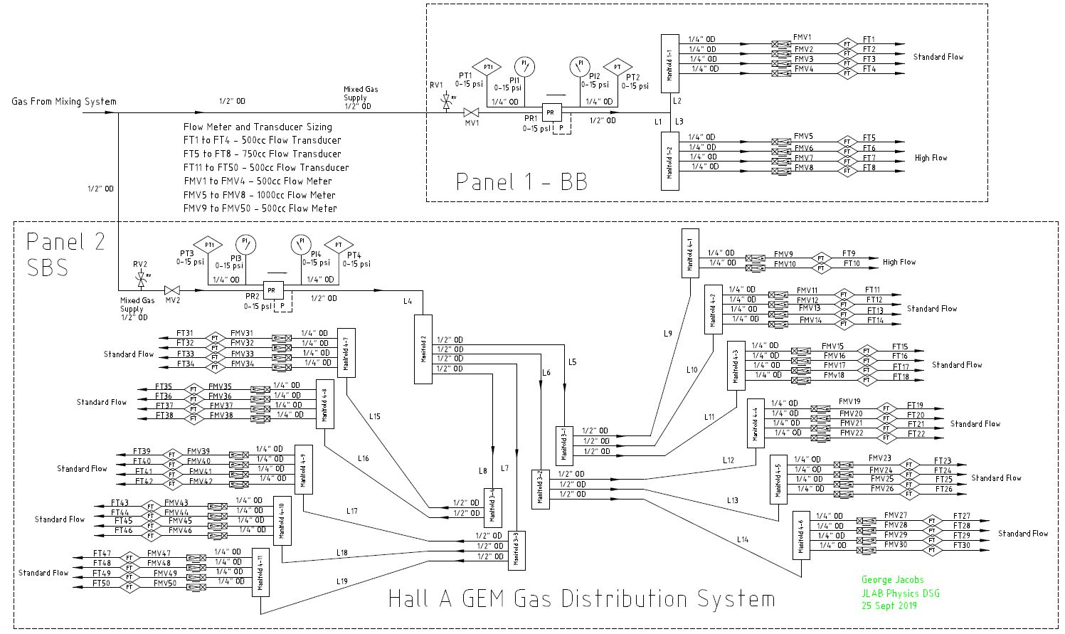
Updated P&I Diagram

Slide 5
Gas Tubing and Gas Panel Components
Tubing Order on Hold
Need a reasonable guestimate of overall lengths of the ½” and ¼” Tubing
Gas Panel Components Order on Hold
Need New Concept for Gas Panel
Location of Panels and GEMs required to estimate tubing lengths

Slide 6
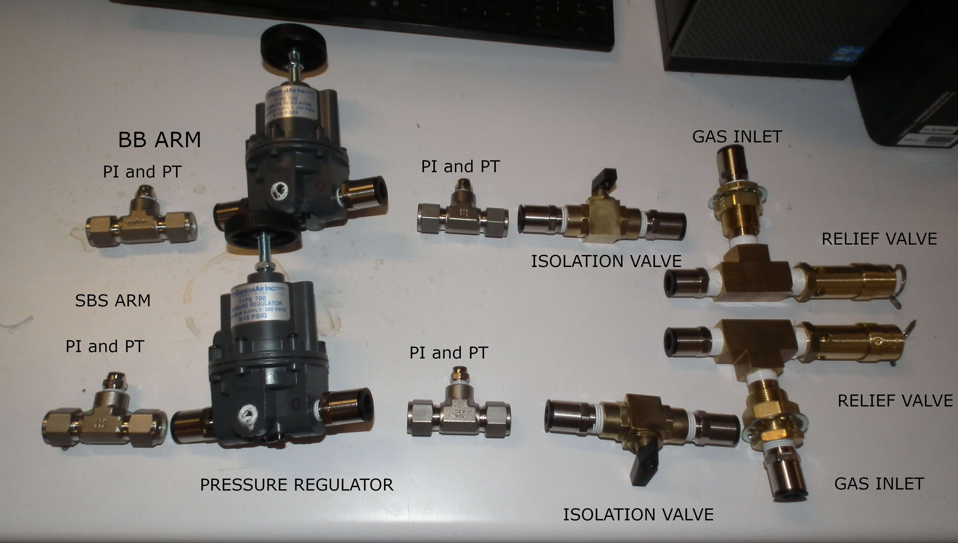
Gas Supply Component Sub-assembly

Slide 7
Manifold Sub-assemblies

Slide 8
Conclusion
Tubing Order on Hold
Need an Estimate of Tubing Lengths to Make Order
Gas Panel Components Order on Hold
Need Hall Location and Footprint Info to Design Panel
Gas Supply and Manifold Components Sub-assemblies Ready for Panel Attachment

