Slide 1
Hall A GEM N2 Gas Maintenance Panel Concept
George Jacobs
Detector Support Group
02/25/2021

Slide 2
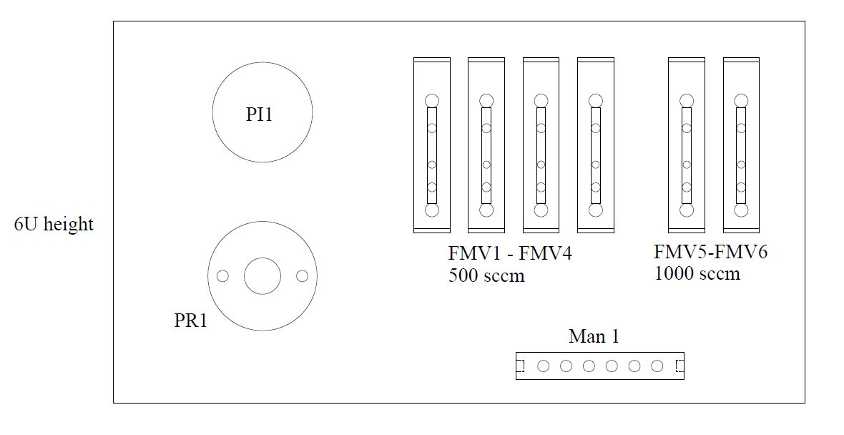
Front Panel Concept

Slide 3
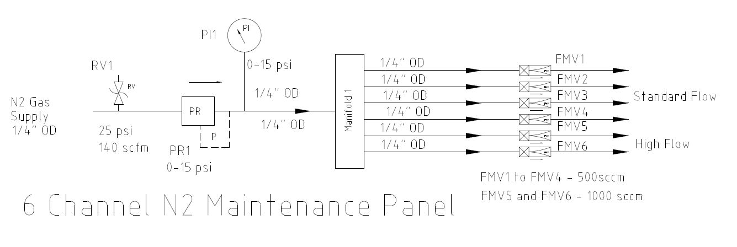
6 Channel N2 Panel P&I DIAGRAM

Slide 4
Conclusion
Current design is for a portable chassis
Four standard flow channels at 500 sccm
Two high flow channels at 1000 sccm
No remote monitoring capabilities
Discussing timeline

Slide 5
Thank You

