Slide 1
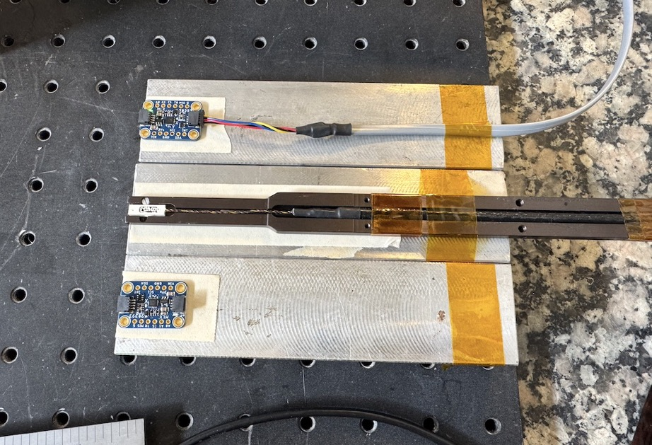
Moller Magnet Sensor Tests
Evaluation of MXL90393 Magnetometers
ePAS PTW-5232 generated by Joe Meyers
Performed on 10/30/2024
Brian Eng / Detector Support Group

Slide 2
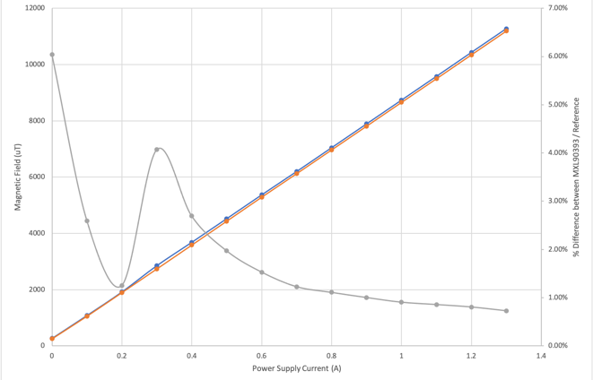
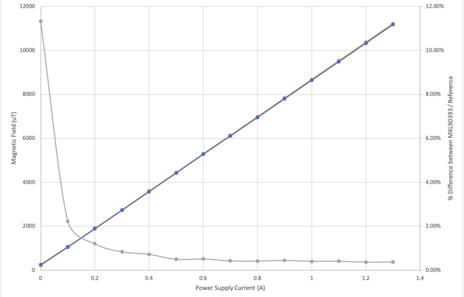
Redo of Sensor #2 Walk Test (0-1.3 A in 0.1 A steps)
Test done on 10/24 had a noticeable “bump” in reference data at 0.3 A
Repeated test on 10/30
Verified that output current of power supply was within 5 mA of setpoint
  Generally within 1 mA, verified with both internal power supply readback and external probe
Top image = 10/24 data
Bottom image = 10/30 data

Slide 3
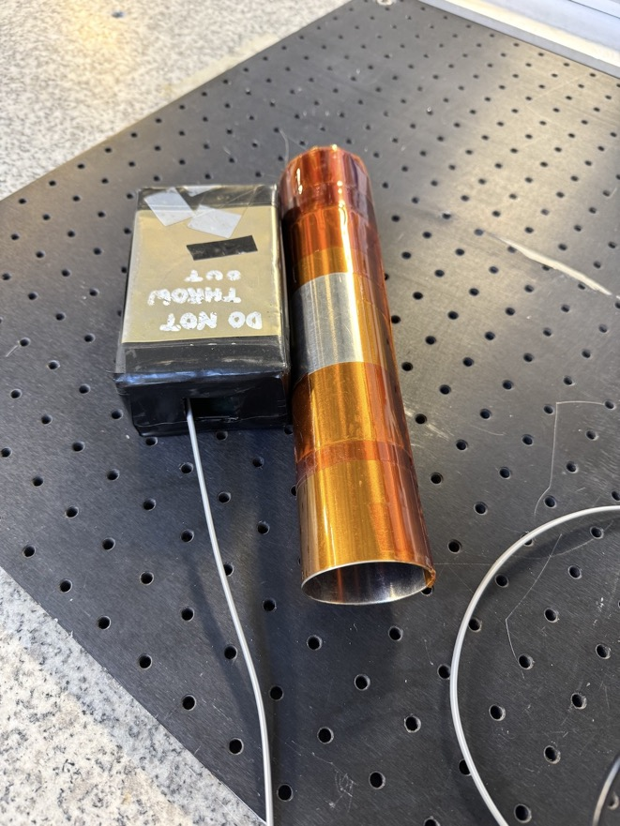
Shield Test
Placed sensors inside mu-Metal containers
  “Box” and “Rod” shaped containers
  Not 100% enclosed
    Box has cutout on one side to insert sensor
    Rod had one open end, other end capped
See plots on next slide
  Both containers had similar performance
  For both sensors after placing and removing from shield container the ”ambient” field measurement was lower than directly after reset
“Box”
“Rod”

Slide 4
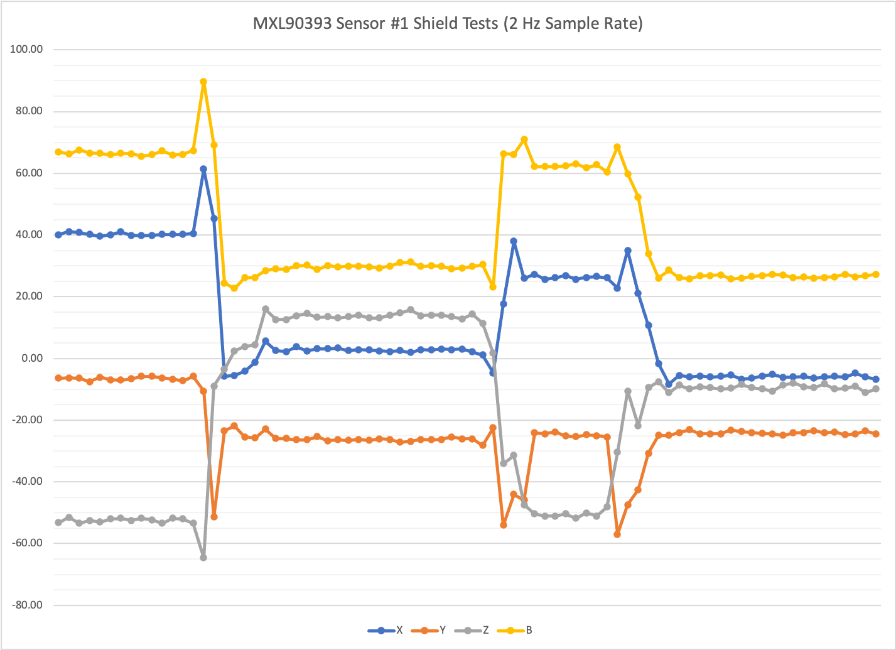
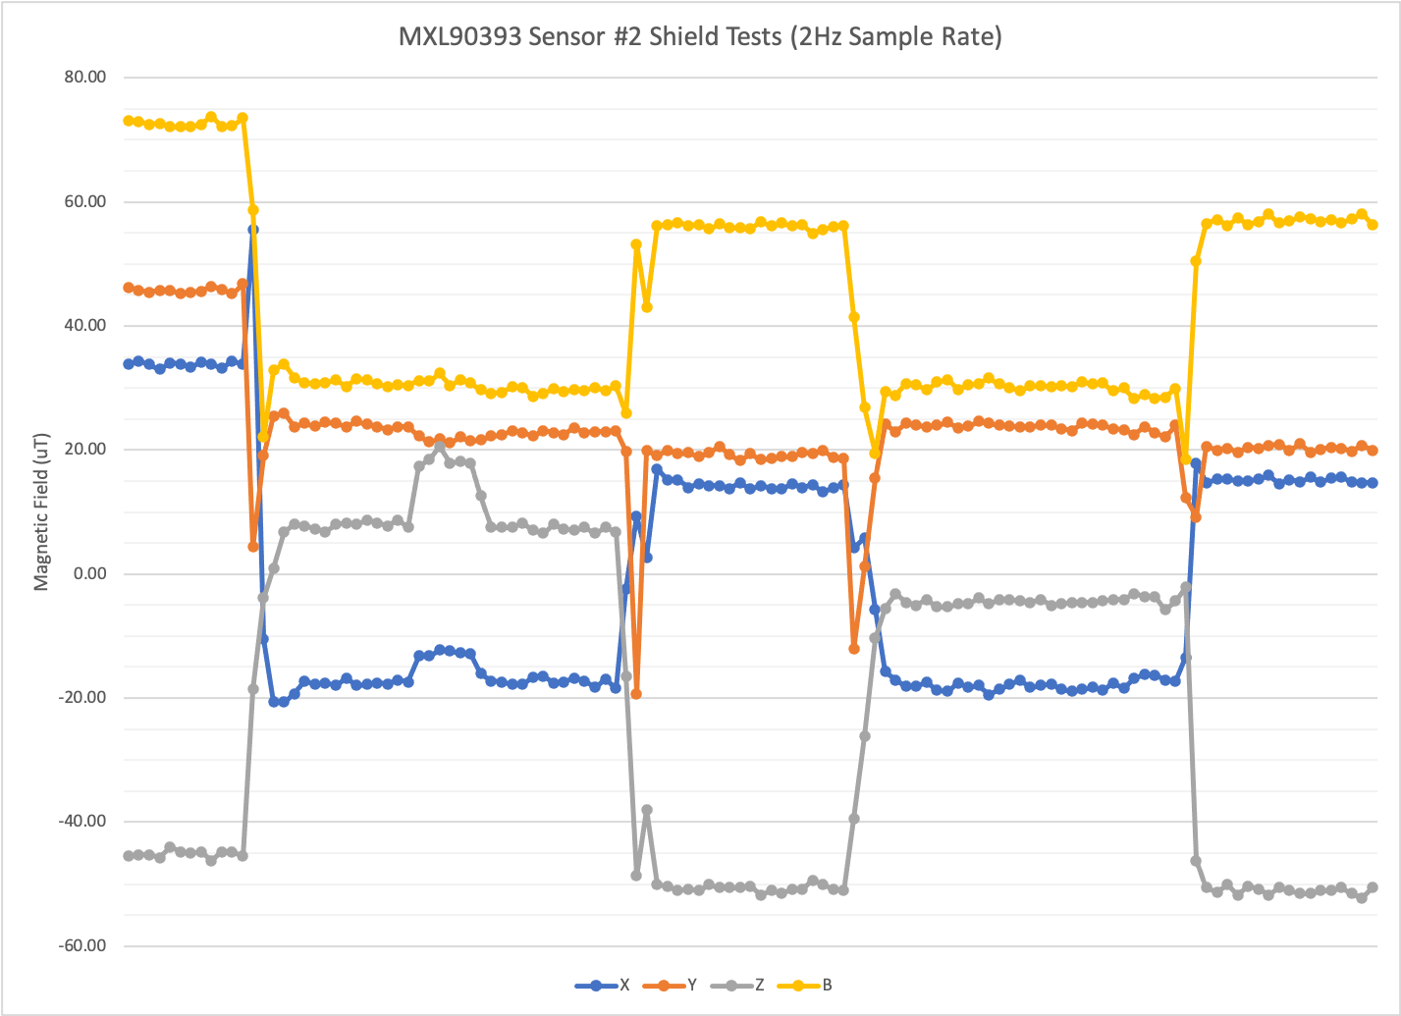
Shield Test Results
Moved sensor around inside container
Reset
Inside “Rod”
On Table
Inside “Box”
Reset
Inside “Rod”
On Table
Inside “Box”
On Table

Slide 5
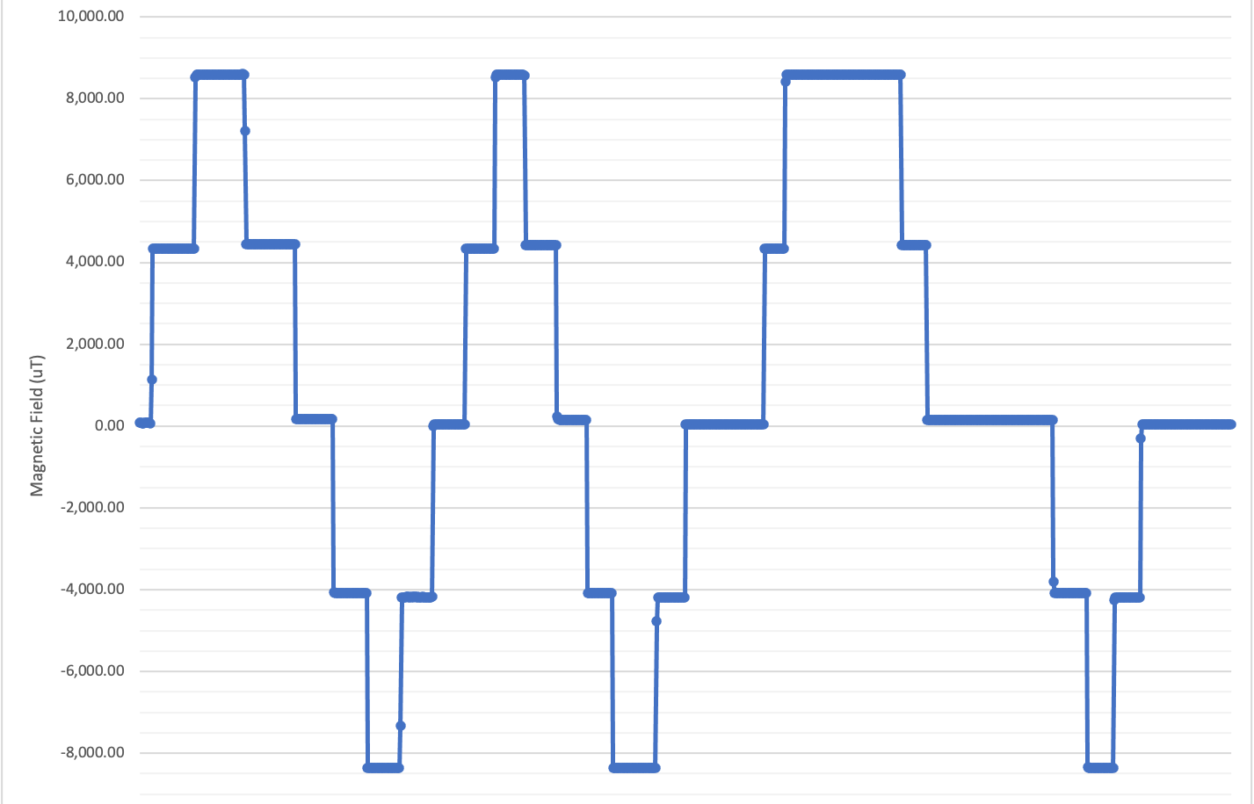
Ramp Test with Sensor #2 (using 2x gain setting)
Ramp power supply in steps
  0.0 → 0.5 → 1.0 → 0.5 → 0.0
  0.0 → -0.5 → -1.0 → -0.5 → 0.0
Previous setpoint determines
return to zero value
  Positive output ≈ 160 μT
  Negative output ≈ 60 μT
Current (A) | Field (μT)
0 | 84
0.5 | 4339
1 | 8595
0.5 | 4435
0 | 170
-0.5 | 4082
-1 | 8369
-0.5 | 4185
0 | 64
0.5 | 4335
1 | 8589
0.5 | 4427
0 | 161
-0.5 | 4092
-1 | 8370
-0.5 | 4188
0 | 63
0.5 | 4332
1 | 8590
0.5 | 4425
0 | 156
-0.5 | 4096
-1 | 8370
-0.5 | 4189
0 | 62
1.0 A
0.5 A
0.0 A
-0.5 A
-1.0 A

Slide 6
Next Steps
Evaluate alternative MXL90393 libraries
  Adafruit provided library missing some chip functionality
    Namely no way to enable temperature compensation (disabled by default)
Additional measurements?

