Slide 1
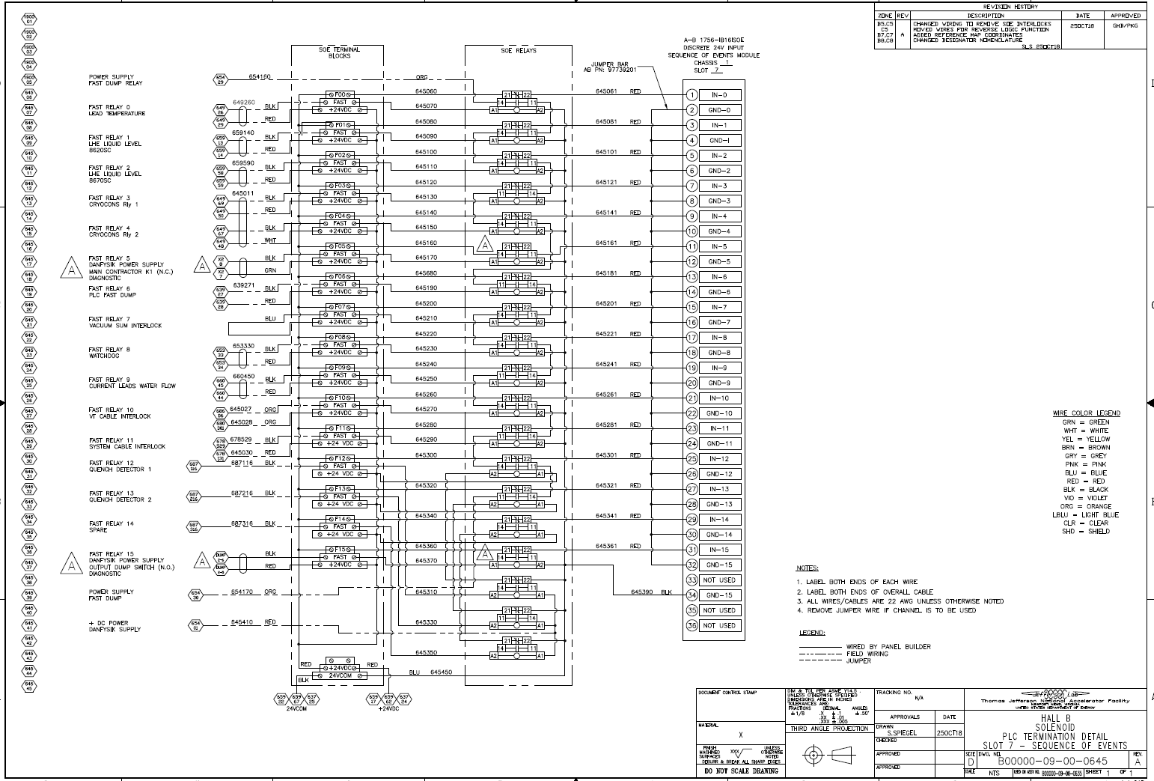
XXXX
XX
SIEMENS SIMATIC S7-1500
DI 32X24VDC HF (6ES7521-1BL00-0AB0)
DIGITAL INPUT MODULE
CHASSIS 1
SLOT 2
PLACE
XXXX
XX
FOR ALL
INTERLOCK
TERMINAL BLOCKS
INTERLOCK RELAYS
POWER SUPPLY
EXTERNAL INTLCK CONTACTS
XXXX
XX
XXXXX
RELAY 0
LCW FLOW
TM0 – TM4
XXXX
XX
XXXXXX
XXXXXX
XXXXXX
IN—CH0
XXXX
XX
XXXXXX
IN—CH1
RELAY 1
LCW TEMPERATURE
TM0 – TM4
Do not need all these jumpers
IN—CH2
Repeat this wiring with the two polygons per each interlock signal
PLACE
XXXXXX
FOR ALL
IN—CH3
ALL TOROUS MAGNETS
RELAY 2
PLC HARDWARE WATCHDOG
IN—CH4
IN—CH5
RELAY 3
WINDOW SHUTTER
TM0 – TM4
IN—CH6
IN—CH7
RELAY 4
TM0 POWER SUPPLY
INTLCK STATUS
NOT USED
NOT USED
RELAY 5
TM0
RTD CABLE DISCONNECTION
IN—CH8
IN—CH9
RELAY 6
TM0
VOLTAGE TAP CABLE DISCONNECTION
IN—CH10
IN—CH11
RELAY 7
TM0
QUENCH DETECTOR UNITS
IN—CH12
IN—CH13
RELAY 8
TM1 POWER SUPPLY
INTLCK STATUS
IN—CH14
IN—CH15
RELAY 9
TM1
RTD CABLE DISCONNECTION
1L+
1M
RELAY 10
TM1
VOLTAGE TAP CABLE DISCONNECTION
IN—CH16
IN—CH17
RELAY 11
TM1
QUENCH DETECTOR UNITS
IN—CH18
IN—CH19
RELAY 12
TM2 POWER SUPPLY
INTLCK STATUS
IN—CH20
IN—CH21
IN—CH22
REPEAT THIS FOR SIGNALS FOR TM 3 AND TM4
RELAY 13
TM2
RTD CABLE DISCONNECTION
IN—CH23
RELAY 14
TM2
VOLTAGE TAP CABLE DISCONNECTION
NOT USED
NOT USED
RELAY 15
TM2
QUENCH DETECTOR UNITS
IN—CH24
Need a total 24 Terminal Blocks one per interlock signal
IN—CH25
IN—CH26
Put this in circles same as other channels
IN—CH27
POWER SUPPLY
EXTERNAL INTLCK CONTACTS
Note: (label goes below “TM3 QUENCH DETECTOR UNIT: signal)
IN—CH28
4. 1L+ AND 2L+ ARE SUPPLY VOLTAGE 24 VDC
37
IN—CH29
5. 1M AND 2M ARE GROUND
Keep this extra TB but move it below the 24th terminal block
38
IN—CH30
Need a total 24 identical relays
39
IN—CH31
40
2L+
This wire “COM” goes to pin 20 and 40
2M
Keep this WIRE but move it below the 24th INTERLOCK which will be TM3 QUENCH DETECTOR UNITS
HALLL A
MOLLER
SLOT 2 - DIGITAL INPUT MODULE
XXXXXX….XXXX

