Slide 1
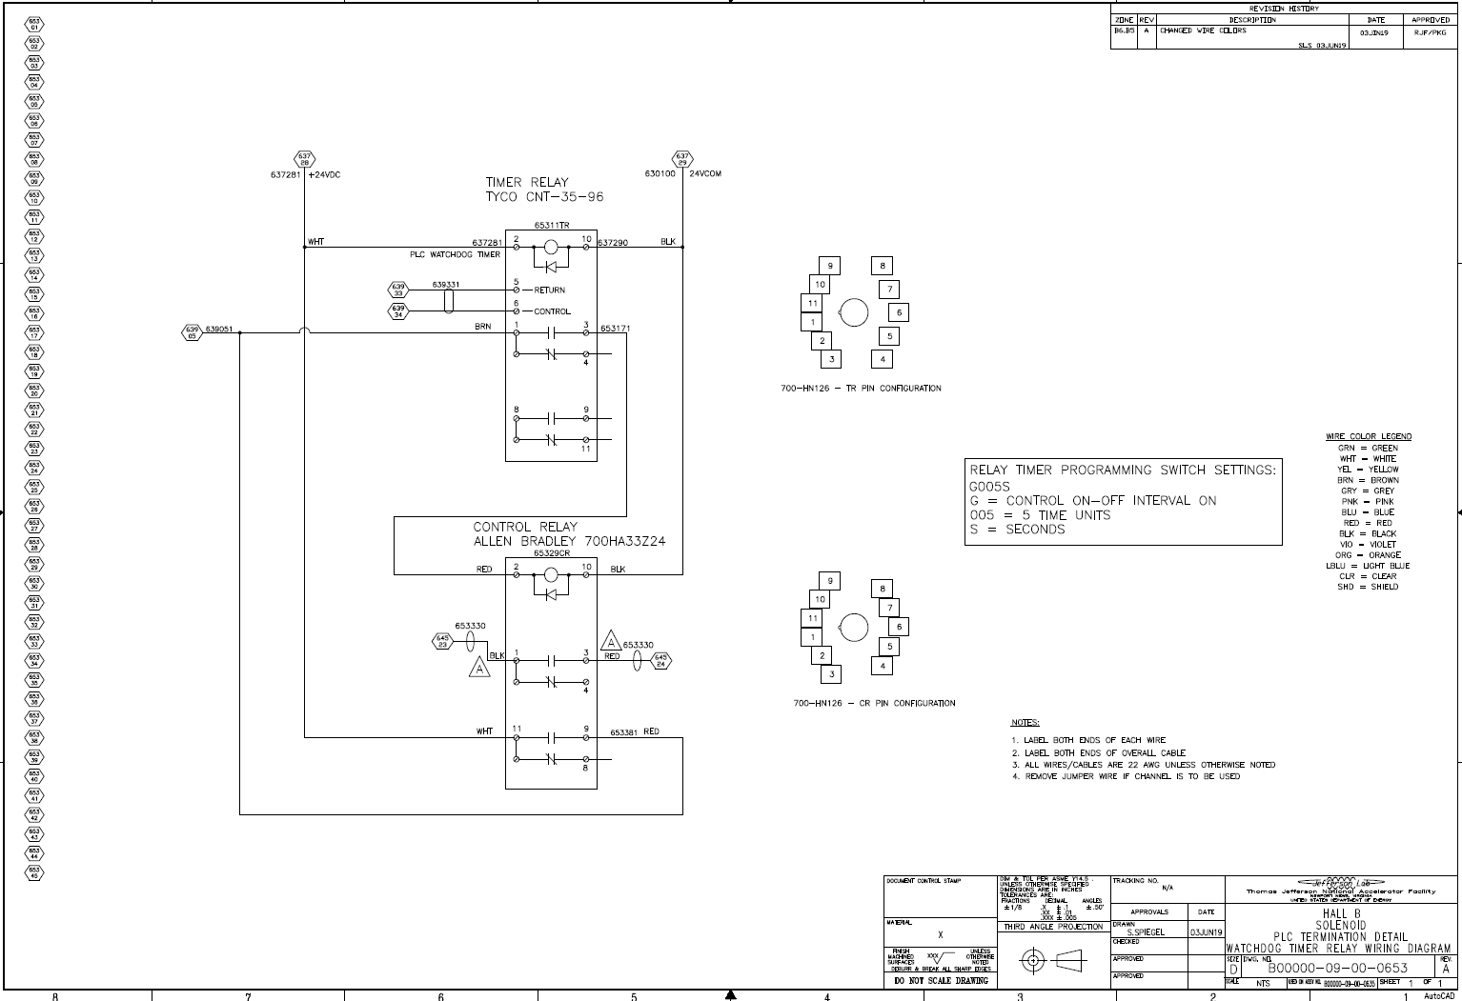
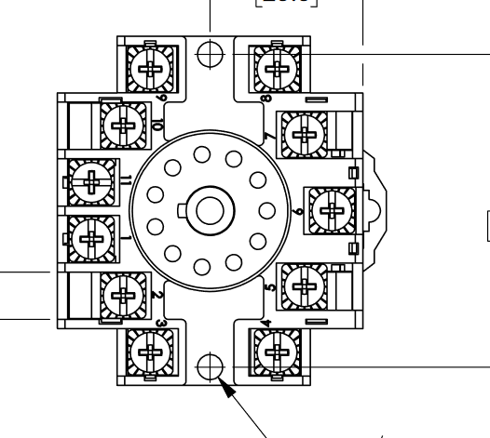
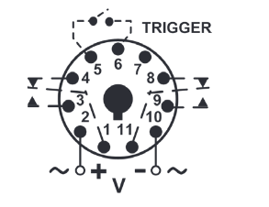
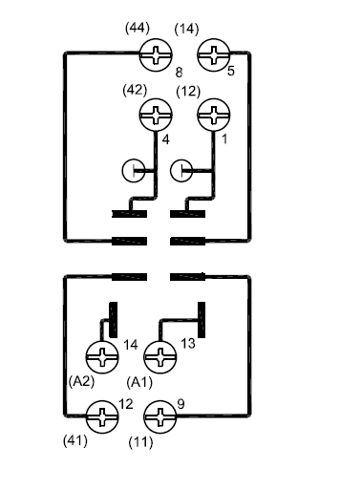
Do this for all polygon on the drawing, but not with the ones on the title box side
XXXX
XX
TIMER RELAY
PROSENSE – TRM-10-D-24AD SERIES DIGITIAL SET TIME RELAY
XXXXXX
Change pinout (pin numbers) to match this pic
XXXXXX
XXXXXX
FROM PLC
RELAY MOD.
XXXXXX
XXXXXX
XXXXXX
TRM-10-D-24AD, 11-PIN CONFIGURATION
11
70170-D - RELAY SOCKET, 11-PIN CONFIGURATION
8
CONTROL RELAY
AUTOMATION-DIRECT – 782-2C-24D
Change wiring diagram representation and pinout (pin numbers) to match this pic
A 1
A 2
1 3
1 4
XXXXXX
9
5
XXXXXX
1
782-2C-SKT RELAY SOCKET, 8-PIN CONFIGURATION
1 2
8
4
HALL A
MOLLER

