Slide 1
Cleo
CCR and Current Lead stack figures

Slide 2
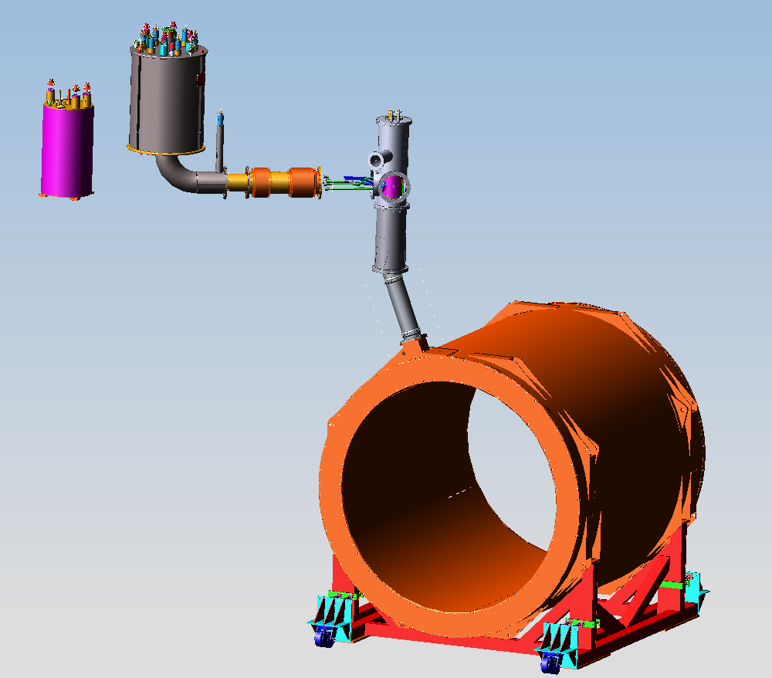
CCR
Current Lead Stack
Heat Exchanger
CLEO-II Cryostat

Slide 3
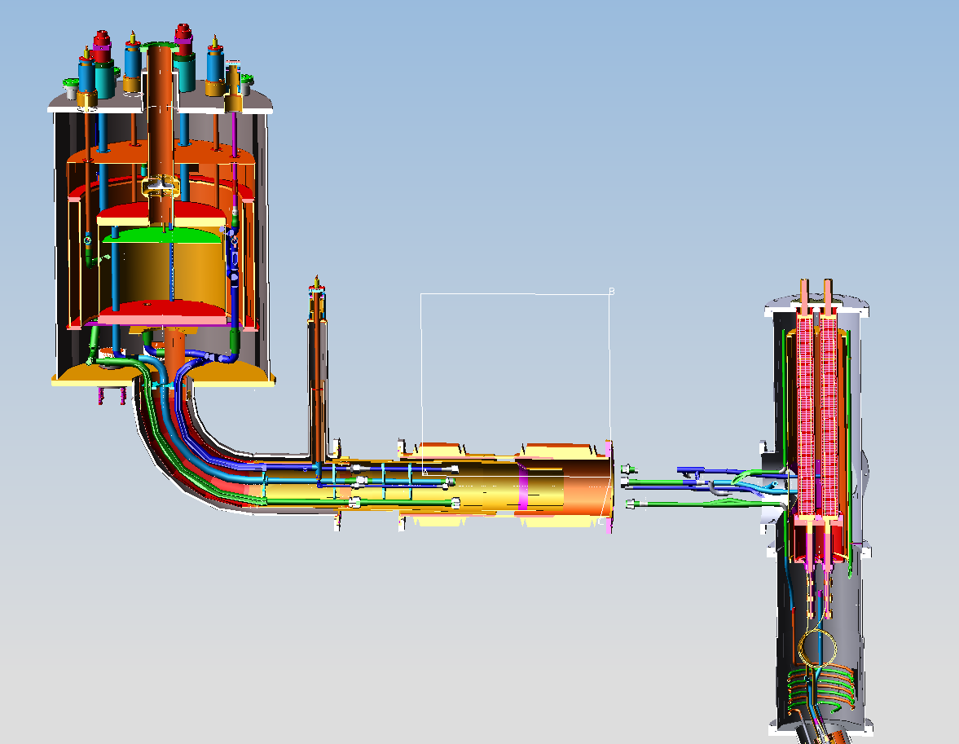
Section cut through CCR and Current Lead Pot

Slide 4
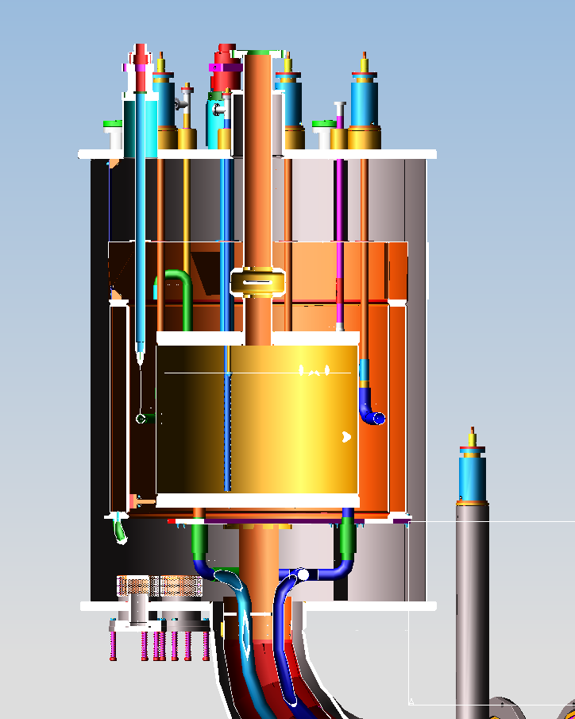
CLEO-II CCR Cut Through
With Liquid level probe
LN2 Tank Annulus surrounds He Tank
Has liquid level probe also

Slide 5
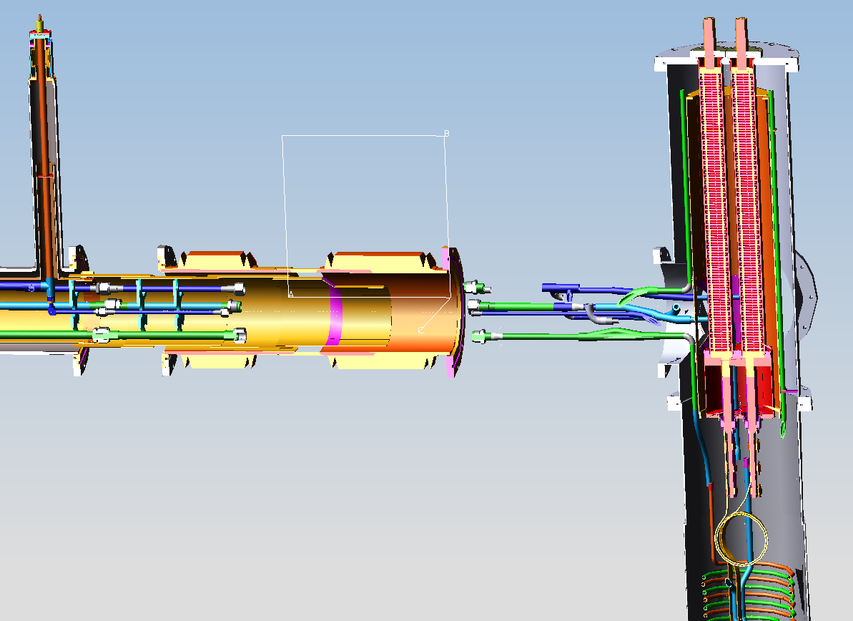
Current Lead stack
JT Valve #7
For Controlling He to Current Lead Cooling/Reservoir Pot
Current Lead Cooling and Reservoir Pot
No Liquid level probe here.

Slide 6
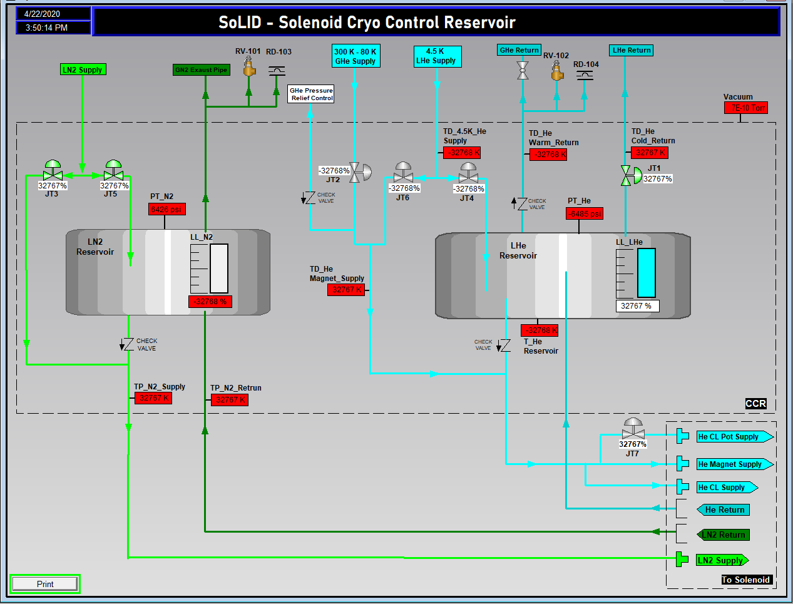
HMI Cryo screen suggestions
JT1 LN2 Cooldown
JT2 LN2 Top Fill
JT3 He Cooldown
JT4 He Bottom Fill
JT5 He Top Fill
JT6 He Cold Return
Warm return Valve
JT7 He CL Pot

Slide 7
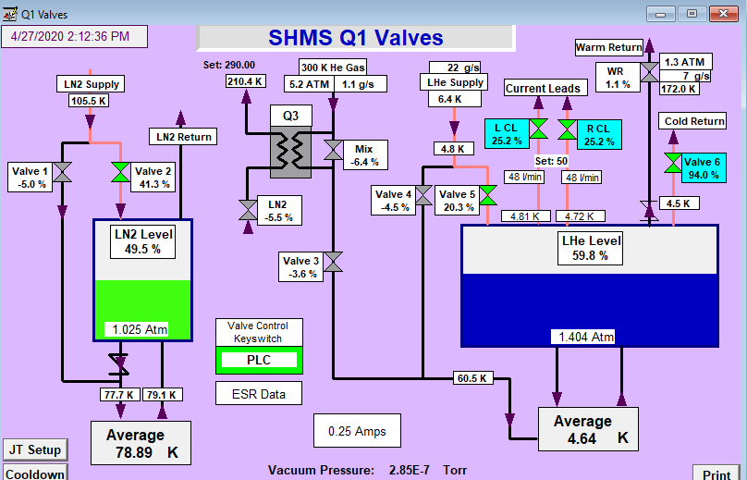
SHMS Q1 HMI example
Epic variables from Cryo Plant.
CLEO’s Current leads will be on another can.
300K to 80K Heat exchanger
Magnet’s Average temperature

