Slide 1
CLEO_II Drawing Updates 4/24/2023 A few more to follow on 4 wire temperature sensors being converted to three wires.

Slide 2
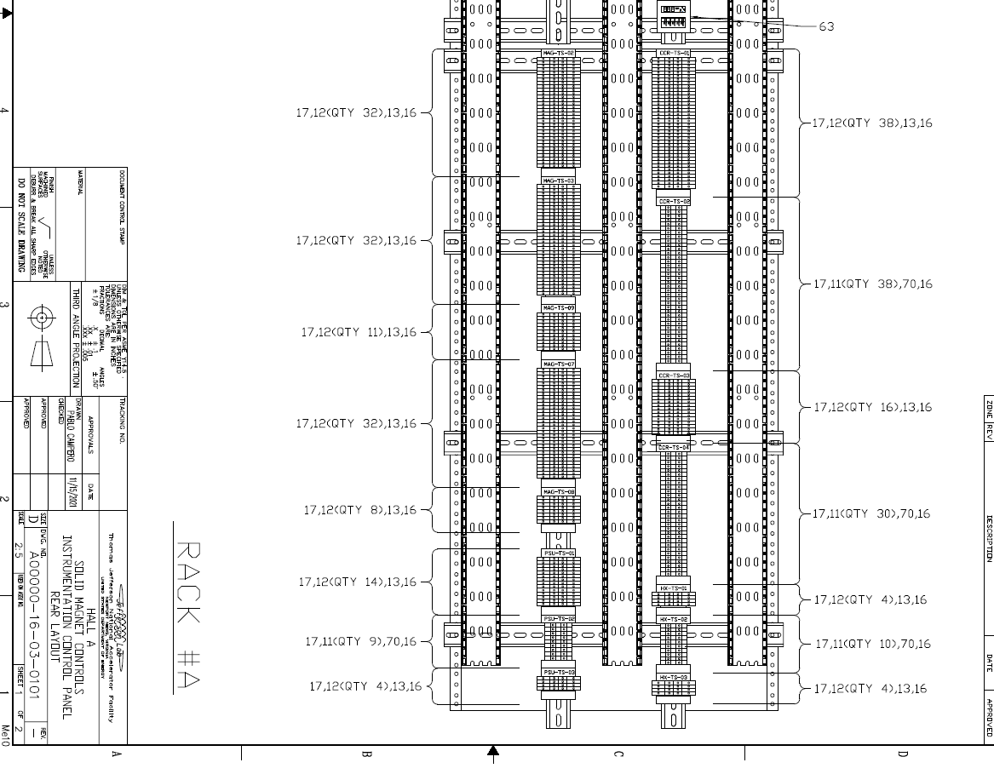
MAG-TS-01
MAG-TS-02

Slide 3
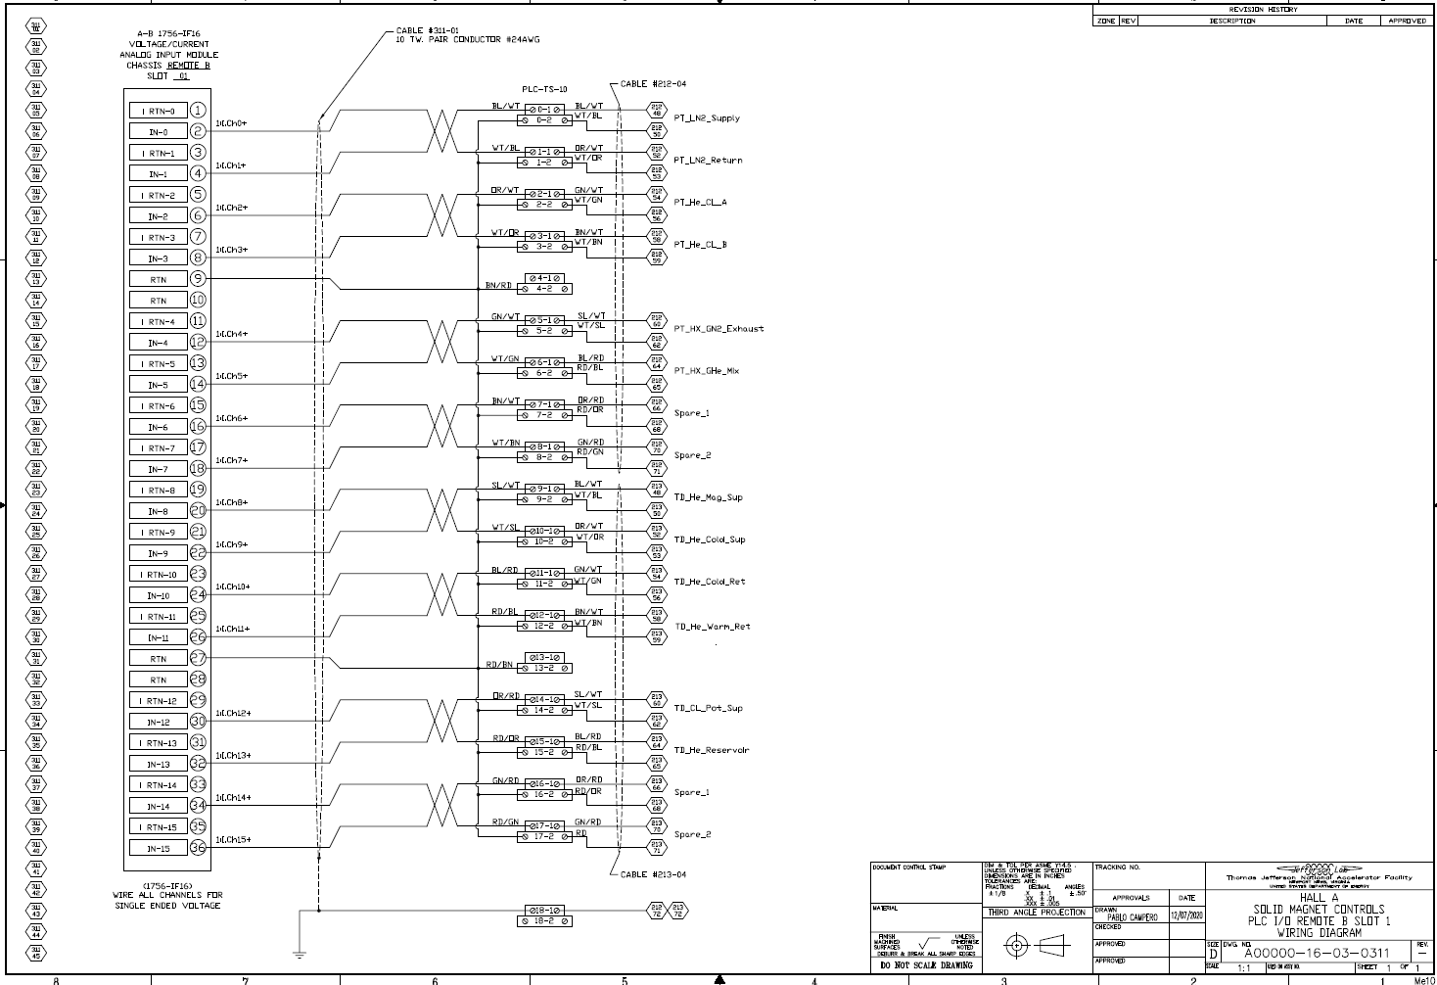
PLC_TS_11
Swap tag names
PT_HX_GHe_Mix is Channel 4 PT_HX_GN2_Exhaust is Channel 5
RD/GN

Slide 4
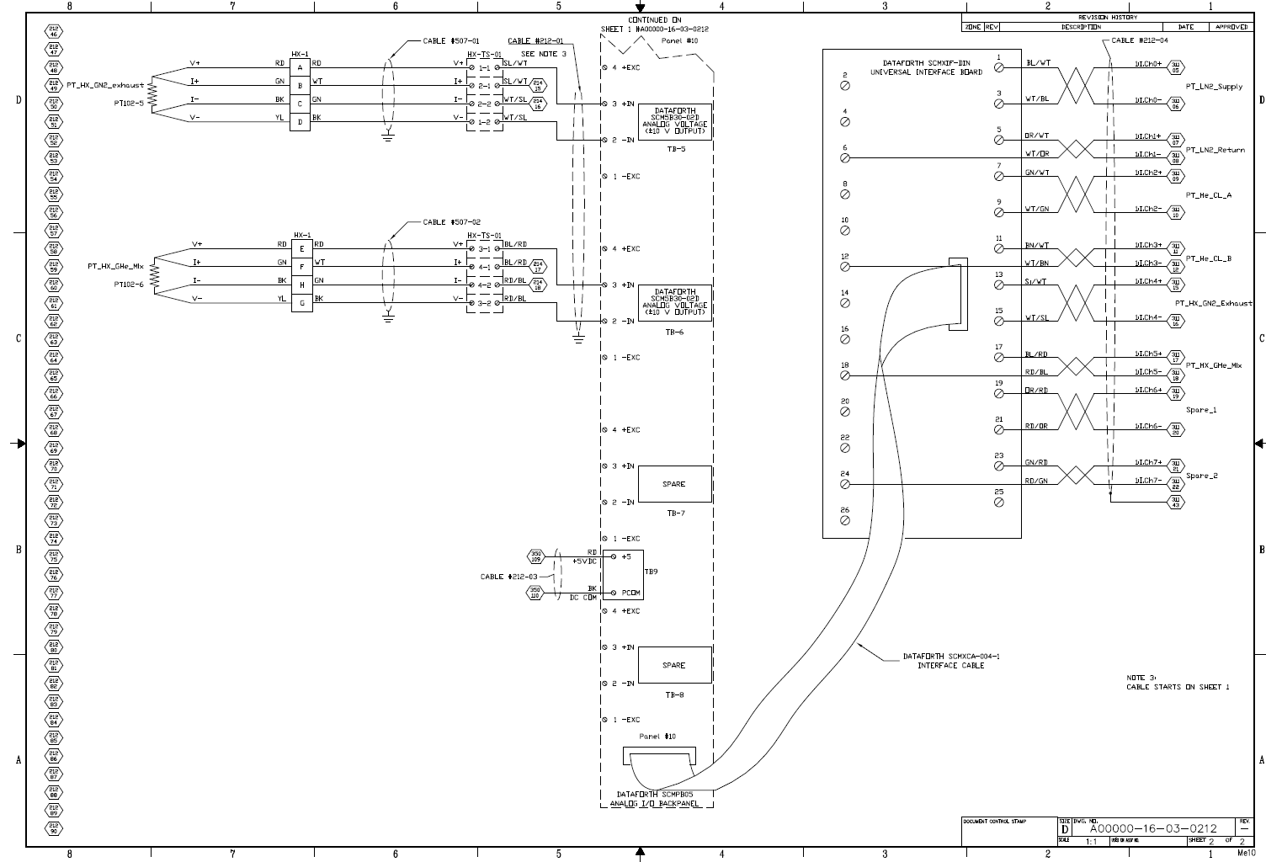
Swap tag name
Swap just the tag name, not the PT102-#

Slide 5
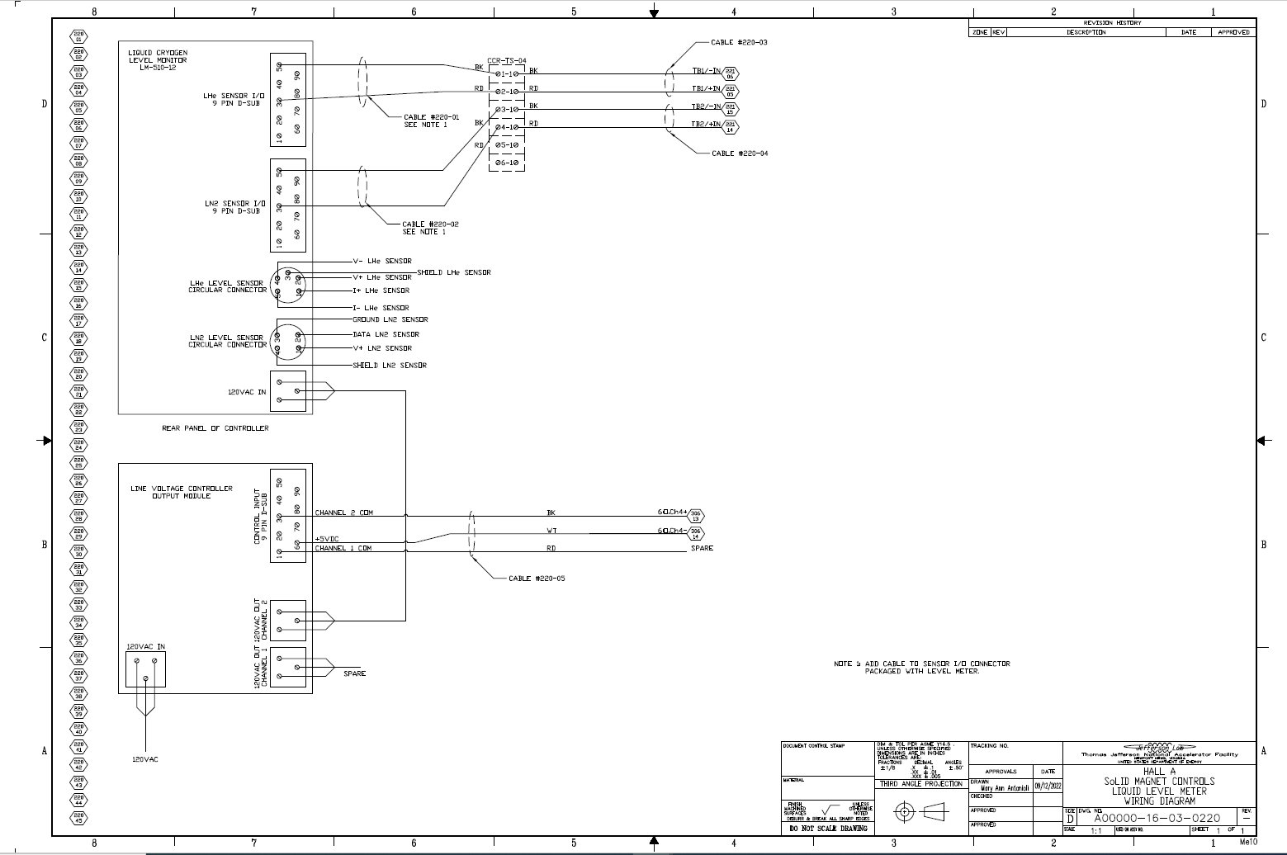
Terminal Strip was bypassed as the signals were crossed.
Cable 220-01 was wired directly to Dataforth panel #8 TB-1
Cable 220-02 was wired directly to Dataforth panel #8 TB-2
This temporary mod needs to be backed out and the source of the mis-wiring corrected.

Slide 6
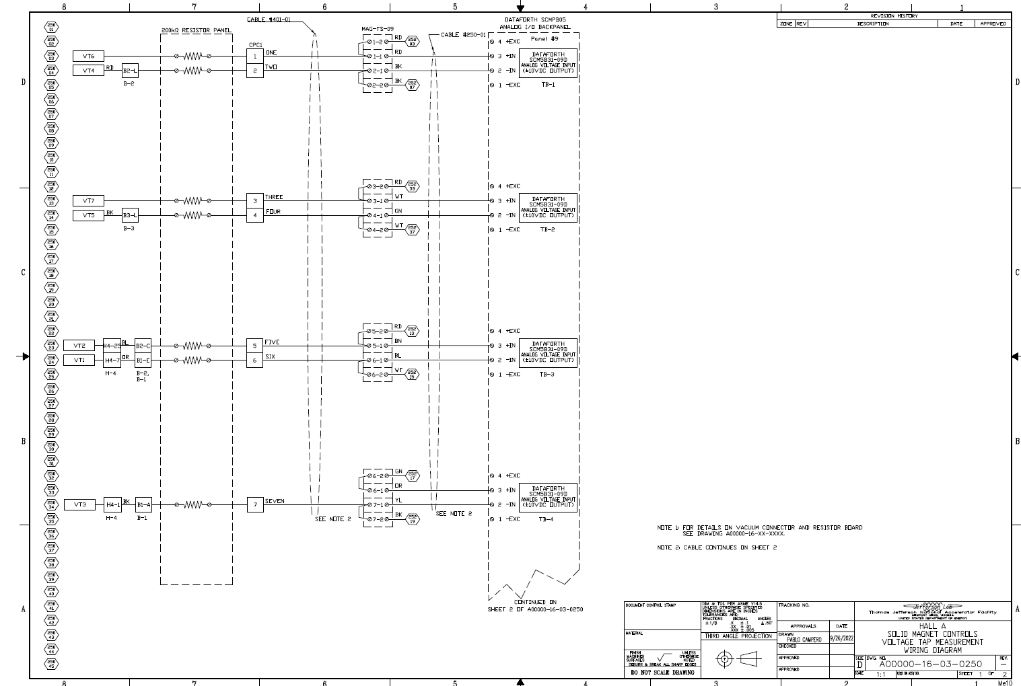
RD should be 1 BK should be 2
WT should be 3 GN should be 4
BN should be 5 BL should be 6
Two wires connected here WT / GN
OR should be 7 YL should be 8

Slide 7
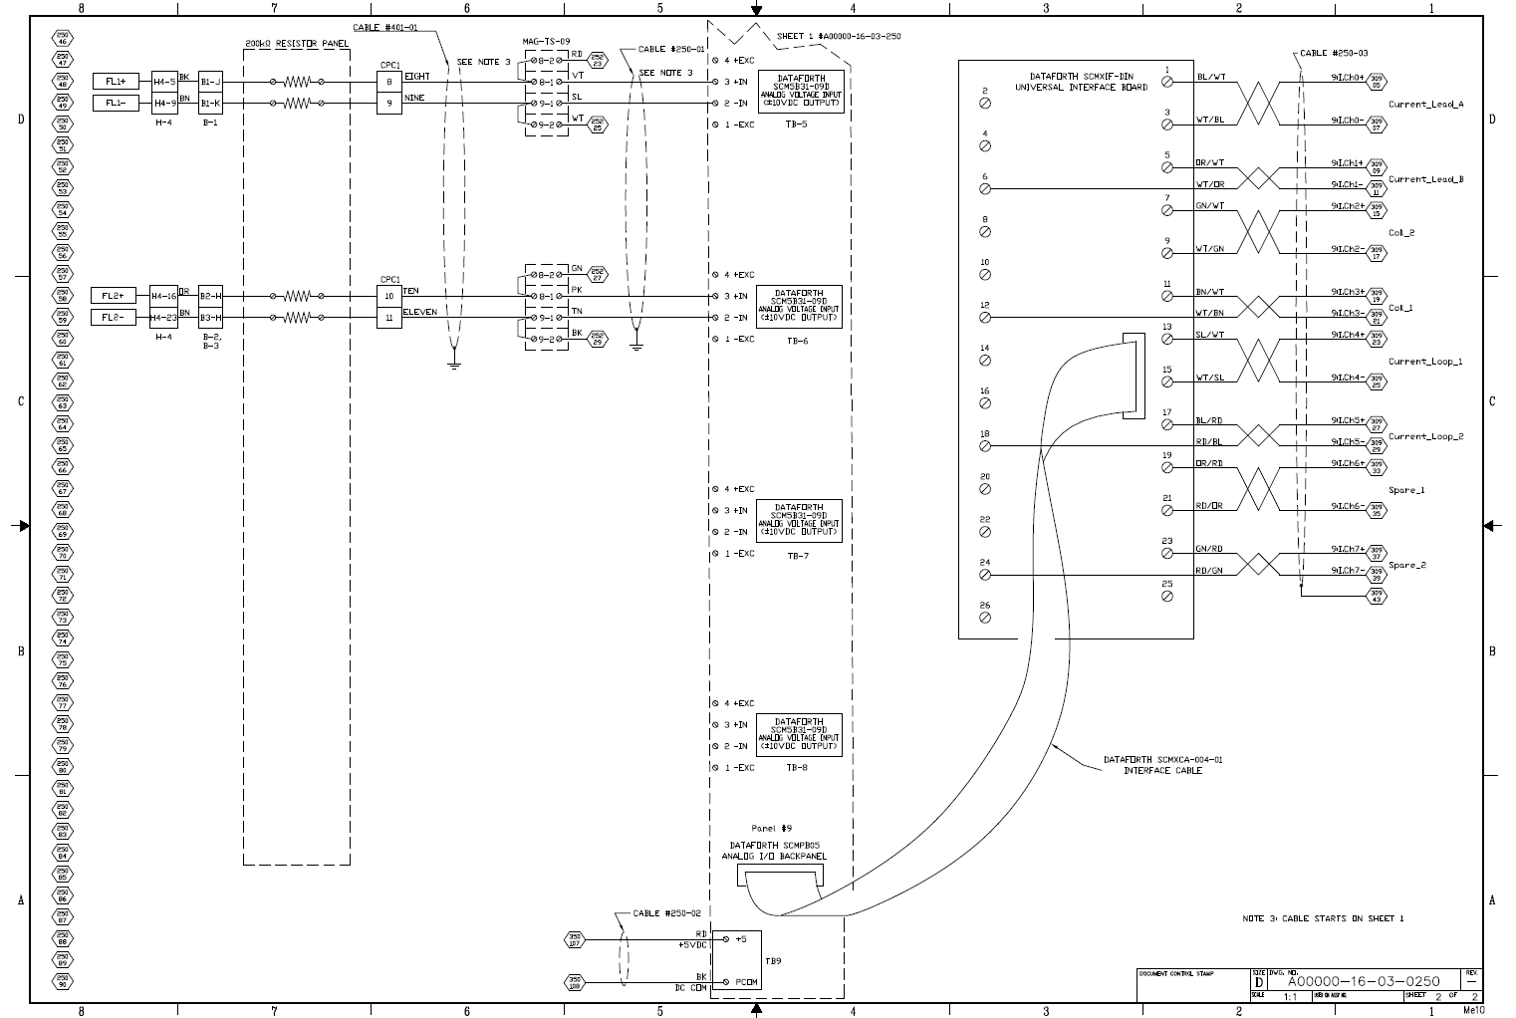
VT should be 9 SL should be 10
Two wires connected here RD / GN
PK should be 11 TN should be 12
Two wires connected here BK / BK
Change the tag names: Current_loop_1 to Flux_Loop_1
and Current_loop_2 to Flux_Loop_2
FL2+ was not working -> For the test FL1+ was wired into FL2+ as shown above. This should be backed out and restore to read FL2+ when it is repaired. The ground going to MAG_TS_09 11-1 and 11-2 will need to be removed for the L2+ signal wire. This may have been why FL2+ did not work.

