Slide 1


Hall B ALERT DC Gas Controls Manual
Marc McMullen
​ ​​
​ ​​
Tuesday, December 10, 2024

Slide 2
Contents
ALERT DC gas controls
ALERT DC gas operations
ALERT DC GUI components
Target gas controls tab
Process variables
ALERT DC Gas panel

Slide 3
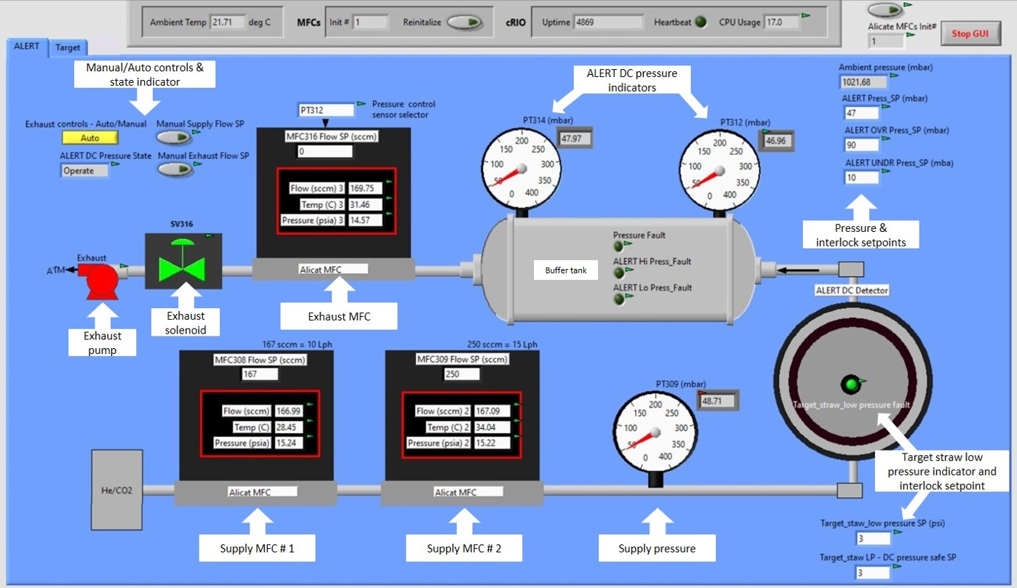
ALERT DC Gas Controls

Slide 4
ALERT DC Gas Operations
Open the ALERT DC GUI and start it by selecting the run arrow
  The system will be in automatic mode
    Pressure will be maintained by automatic control of MFC316 using PID
    Check and set any necessary parameters
      pressure setpoints
      pressure sensor selection
      high and low pressure setpoints
    Manual control of the MFCs or the solenoid should only be used during pressure fault recovery
The ALERT DC controls software should be running already
  If the GUI Heartbeat (located in the upper panel) is not pulsing, contact Hall B engineering
    The cRIO may need to be rebooted

Slide 5
ALERT DC Gas Operations
Pressure fault recovery (Located on the buffer tank)
  Pressure faults
    Low pressure recovery
      Set both supply and exhaust flow control setpoints to manual (indicator on)
      Set MFC 308 to 167 sccm
      Set MFC 309 to 250 sccm
      Set MFC 316 to 0
      Flow gas until both PT312 and PT314 exceed the “Low pressure set point”
      Set both supply and exhaust flow controls to automatic (indicator off)

Slide 6
ALERT DC Gas Operations
Pressure fault recovery continued (located on the buffer tank)
  Pressure faults
    High pressure recovery
      Set both supply and exhaust flow control setpoints to manual (indicator on)
      Set MFC 308 to 0 sccm
      Set MFC 309 to 250 sccm
      Set MFC 316 to 500
      Flow gas until both PT312 and PT314 are below the “High pressure set point”
      Set both supply and exhaust flow controls to automatic (indicator off)

Slide 7
ALERT DC Gas Operations
Pressure fault recovery continued (located on the buffer tank)
  Pressure faults
    Target straw pressure is low – Target Expert Only
      The Target straw low pressure interlock empties the ALERT DC volume of all gas if the target gas pressure is too low. This prevents the straw from collapsing
      If this occurs, Hall B engineering should be notified
      Once Hall B has verified that all target gas issues are resolved, the target pressure must be restored to greater than 3 psi by supplying gas through SVBT102 and SVBT108, while closing SVBT112 using the Target tabs manual mode
      This should clear the target straw low pressure fault and the ALERT DC should be in a low pressure fault (Low pressure recovery)

Slide 8
ALERT DC GUI Components
Manual/Auto control & state indicator, Exhaust pump, and solenoid
  Exhaust control – sets the exhaust solenoid to manual or automatic
    The exhaust pump can be turned on or off by clicking it at any time
  Manual supply/exhaust flow setpoint buttons – allows user to set the MFC flow rate for MFC308 and MFC309, and MFC316 respectively
  ALERT DC Pressure State indicator – displays program state (operate or fault)
ALERT DC pressure indicators
  PT309 displays the pressure (in mbar) after the supply MFCs
  PT312 and PT314 display the system pressure
    Note: The pressure control sensor selector (above MFC316) determines which sensor supplies the feedback to the PID
Pressure & Interlock setpoints
  Ambient pressure – pressure in Hall B (mbar)
  ALERT Press_SP – System pressure set point to be maintained by the PID (mbar)
  ALERT OVR Press_SP – System over pressure limit (mbar)
    If exceeded will set all MFC flows to 0
    Manual recovery required
  ALERT UNDER Press_SP – System under pressure limit (mbar)
    If exceeded will set all MFC flow to 0
    Manual recovery required
Mass Flow Controllers (MFC308, MFC309, and MFC316)
  MFC308 and MFC309 provide gas supply
    Setpoints are entered in the top box
    Values are in sccm
    MFC308 standard flow rate is 167 sccm
    MFC309 should be set higher (250 sccm)
  MFC316 controls the exhaust gas flow
  Is standardly controlled by the PID (Manual Exhaust Flow SP is off)
Target straw (TS) low pressure fault, pressure setpoint, and DC pressure safe setpoint
  TS low pressure fault indicator will indicate when the straw pressure is lower than the TS low pressure setpoint and will start exhausting the ALERT DC gas to atmosphere until it reaches the DC pressure safe value
    Recovery requires a BoNuS/Hall B target expert

Slide 9
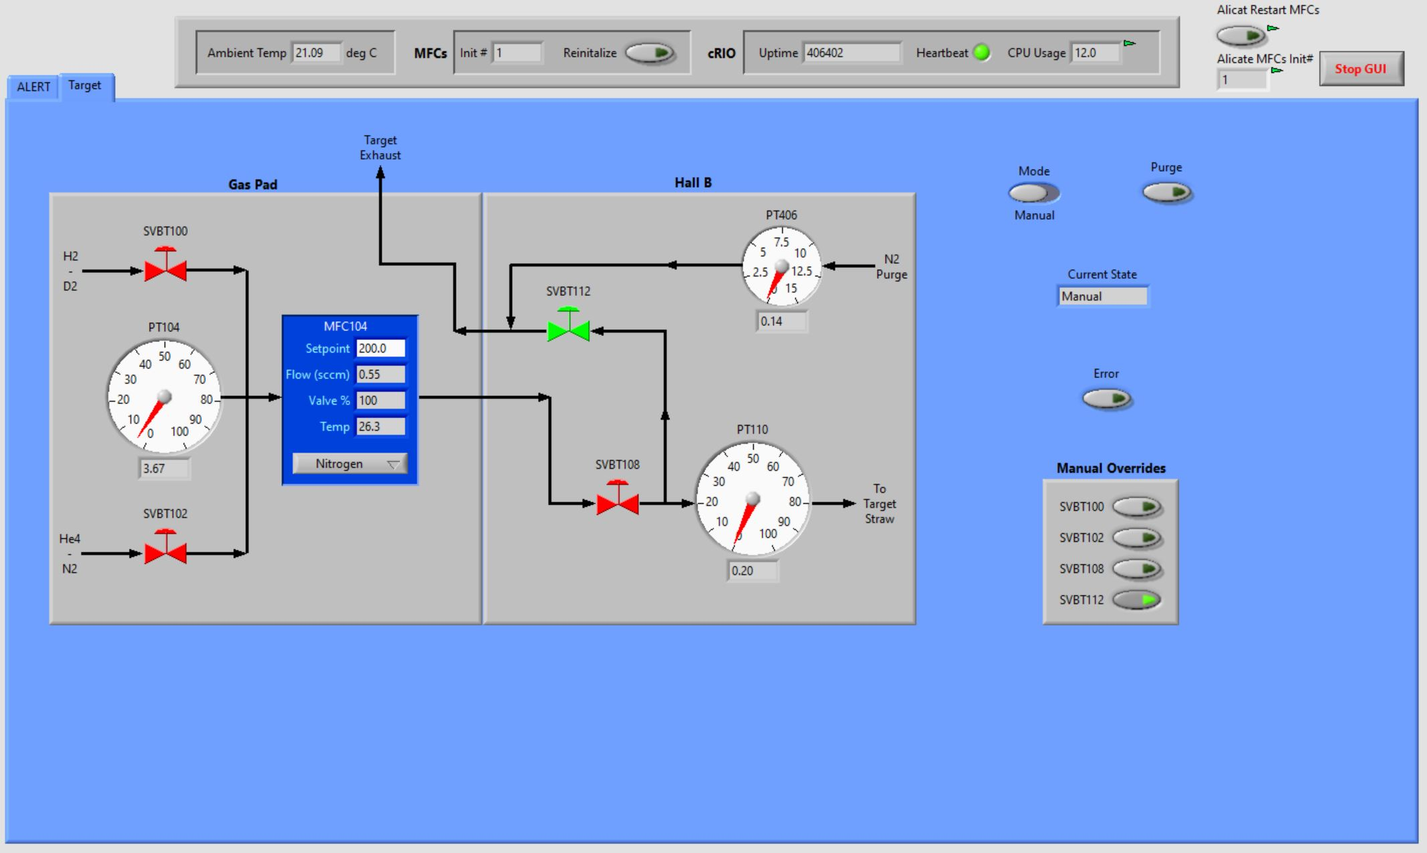
Target Gas Controls Tab
The Target tab is used to control the gas supply to the target straw and is used in the recovery process in the event of a low target straw pressure event

Slide 10
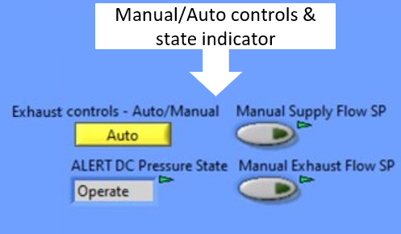
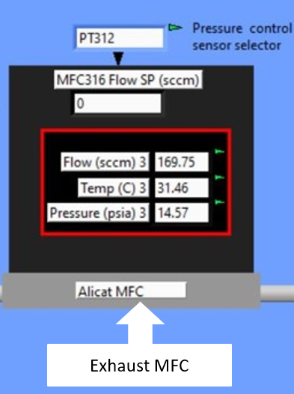
Process Variables
B_DET_ALERT_DC_GAS_Sensor_Select
B_DET_ALERT_DC_GAS_Man_Exh_CNTRL
B_DET_ALERT_DC_GAS_Man_Sup_Flow_CNTRL
B_DET_ALERT_DC_GAS_MFC316_SP_In
B_DET_ALERT_DC_GAS_MFC316_Flow
B_DET_ALERT_DC_GAS_MFC316_Temp
B_DET_ALERT_DC_GAS_MFC316_Press
B_DET_ALERT_DC_GAS_DC_State
B_DET_ALERT_DC_GAS_Man_Exh_Flow_CNTRL

Slide 11
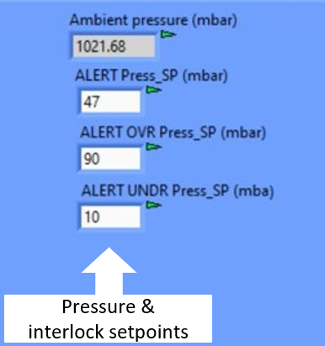
Process Variables
B_DET_ALERT_DC_GAS_Exh_PT314_Press
B_DET_ALERT_DC_GAS_Exh_PT312_Press
B_DET_ALERT_DC_GAS_Ambient_Press
B_DET_ALERT_DC_GAS_Press_SP
B_DET_ALERT_DC_GAS_OVR_Press_SP
B_DET_ALERT_DC_GAS_UNDER_Press_SP
B_DET_ALERT_DC_GAS_Press_Fault
B_DET_ALERT_DC_GAS_Hi_Press_Fault
B_DET_ALERT_DC_GAS_Lo_Press_Fault

Slide 12
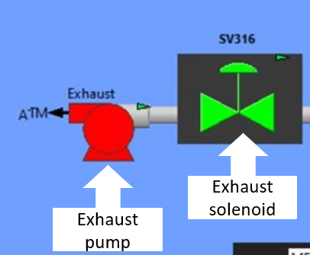
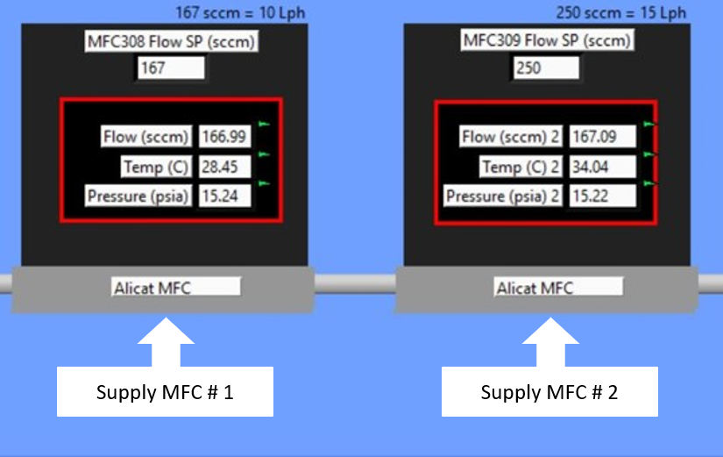
Process Variables
B_DET_ALERT_DC_GAS_Exh_Pump
B_DET_ALERT_DC_GAS_Exh_Solenoid
B_DET_ALERT_DC_GAS_MFC308_SP_In
B_DET_ALERT_DC_GAS_MFC309_SP_In
B_DET_ALERT_DC_GAS_MFC308_Flow
B_DET_ALERT_DC_GAS_MFC309_Flow
B_DET_ALERT_DC_GAS_MFC308_Temp
B_DET_ALERT_DC_GAS_MFC309_Temp
B_DET_ALERT_DC_GAS_MFC308_Press
B_DET_ALERT_DC_GAS_MFC309_Press

Slide 13
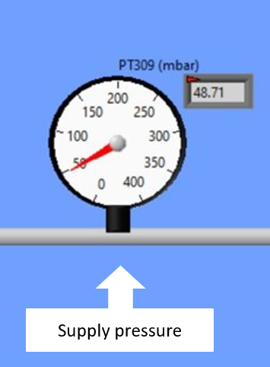
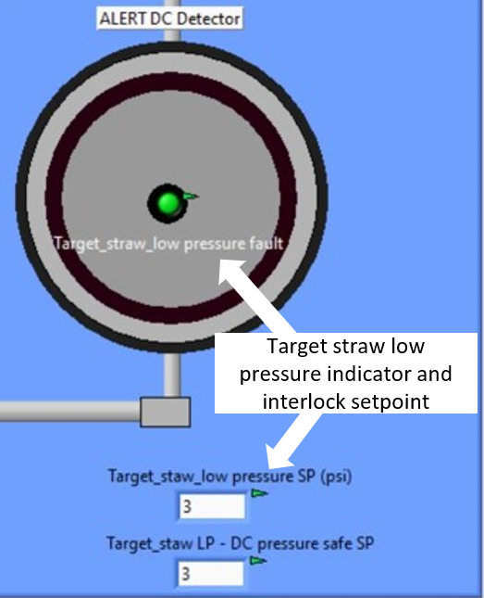
Process Variables
B_DET_ALERT_DC_GAS_Sup_PT309_Press
B_DET_ALERT_DC_GAS_TS_Lo_Press_Fault
B_DET_ALERT_DC_GAS_ TS_Lo_Press_SP
B_DET_ALERT_DC_GAS_ TS_DC_Safe_SP

Slide 14
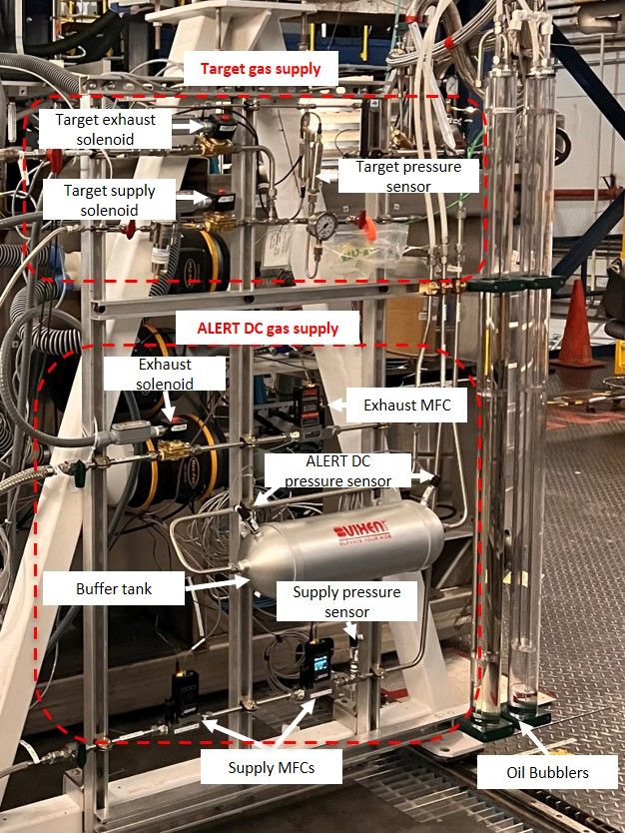
ALERT DC and Target Gas Panel

