Slide 1
LTCC Leak Study Data Collection
Marc McMullen
Physics Detector Support Group
06/20/2017

Slide 2
LTCC Leak Study
Study Background
Objectives
LTCC Gas Controls Background
Data Logging
Reviewing the data
Conclusion

Slide 3
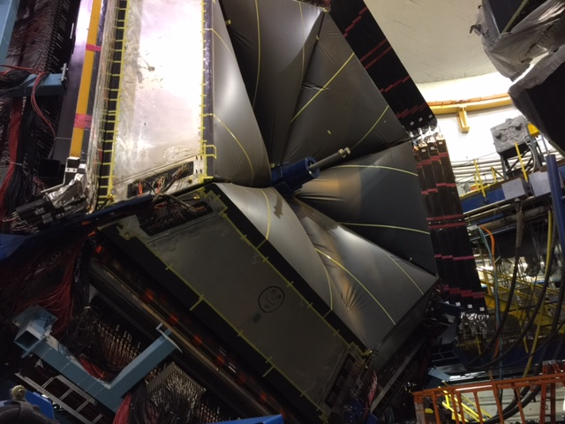
LTCC Leak Study Background
The LTCC sectors have been suspected to leak gas, evident by the continuous need to fill the sectors to the set point. The time between fills varies from sector to sector.
The history of the detector since it was first installed in CLAS also contributed give some understanding on how the detector behaves.
The studies conducted by the Physics Detector Support Group were done by continuous monitoring of the sectors controls sensors and transducer.
The current configuration of the gas system uses only the supply side of the gas panel.
All 6 manual valves to the exhaust manifold are closed.
Over and under pressure protections are handled by the bubblers on each sector.

Slide 4
LTCC Leak Study: Objectives
Identify the sectors which would require less gas.
Provide data necessary to calculate gas usage.
Identify the behavior of the sectors during differing pressure events.

Slide 5
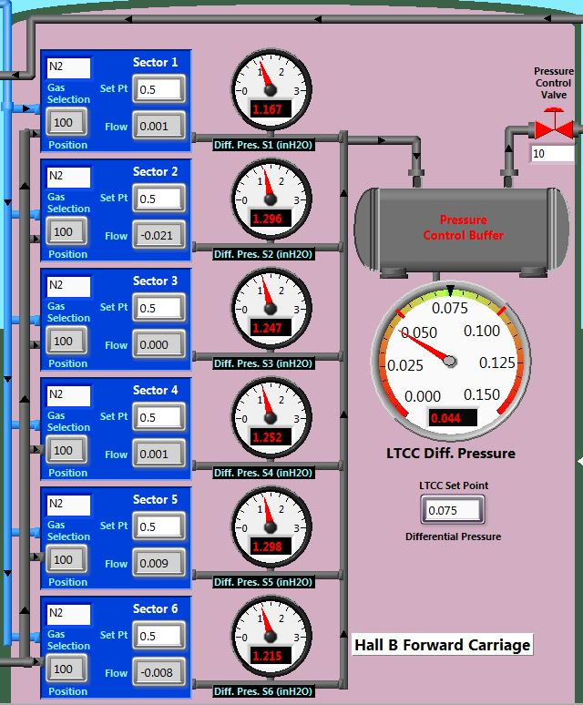
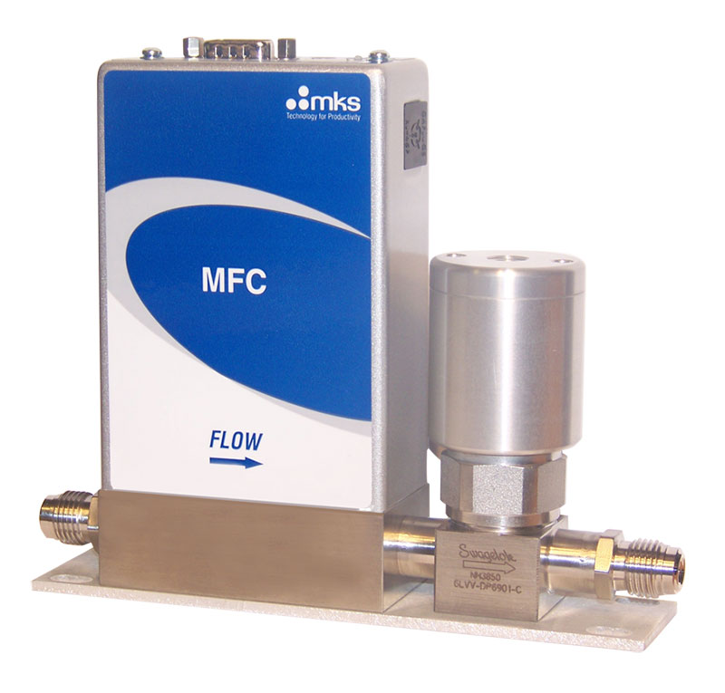
LTCC Leak Study: Controls
All 6 MKS GE50 mass flow controllers are set to flow 0.50 Lpm of nitrogen. The MFC also monitors the flow rate.
MKS GE50/250
Mass Flow Controller
Hall B Gas Controls GUI: LTCC Pressure and Flow

Slide 6
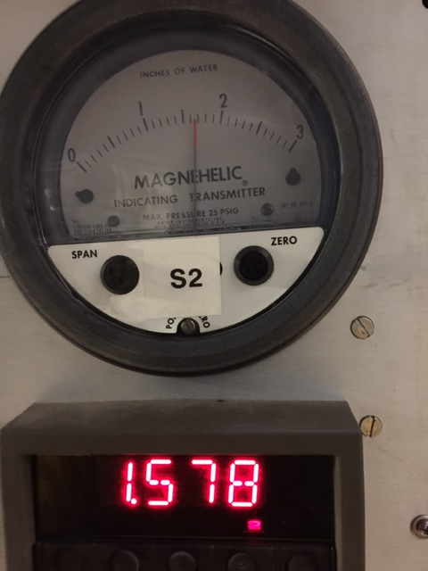
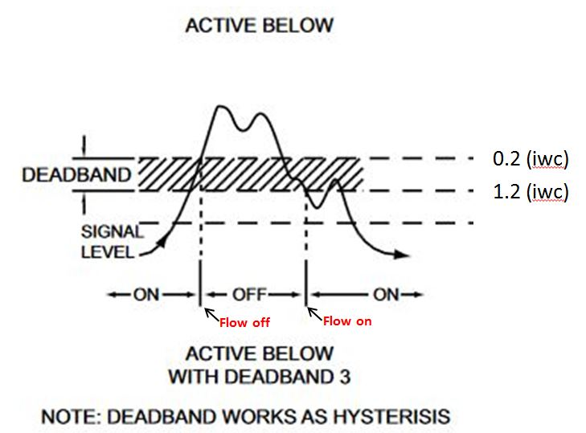
LTCC Leak Study: Controls
Sector pressure is monitored by Dwyer magnehelics. The magnehelics transmit a 4 to 20mA signal to Omega DP25a process controllers which have been programmed to trigger solenoid valves at preset values.
The solenoid controls flow to the detector sector. In addition the process controllers provide a pressure signal, which is monitored by the Hall B Gas Controls System.
Dwyer Magnehelic and
DP25a Process Controller
DP25a process controller deadband

Slide 7
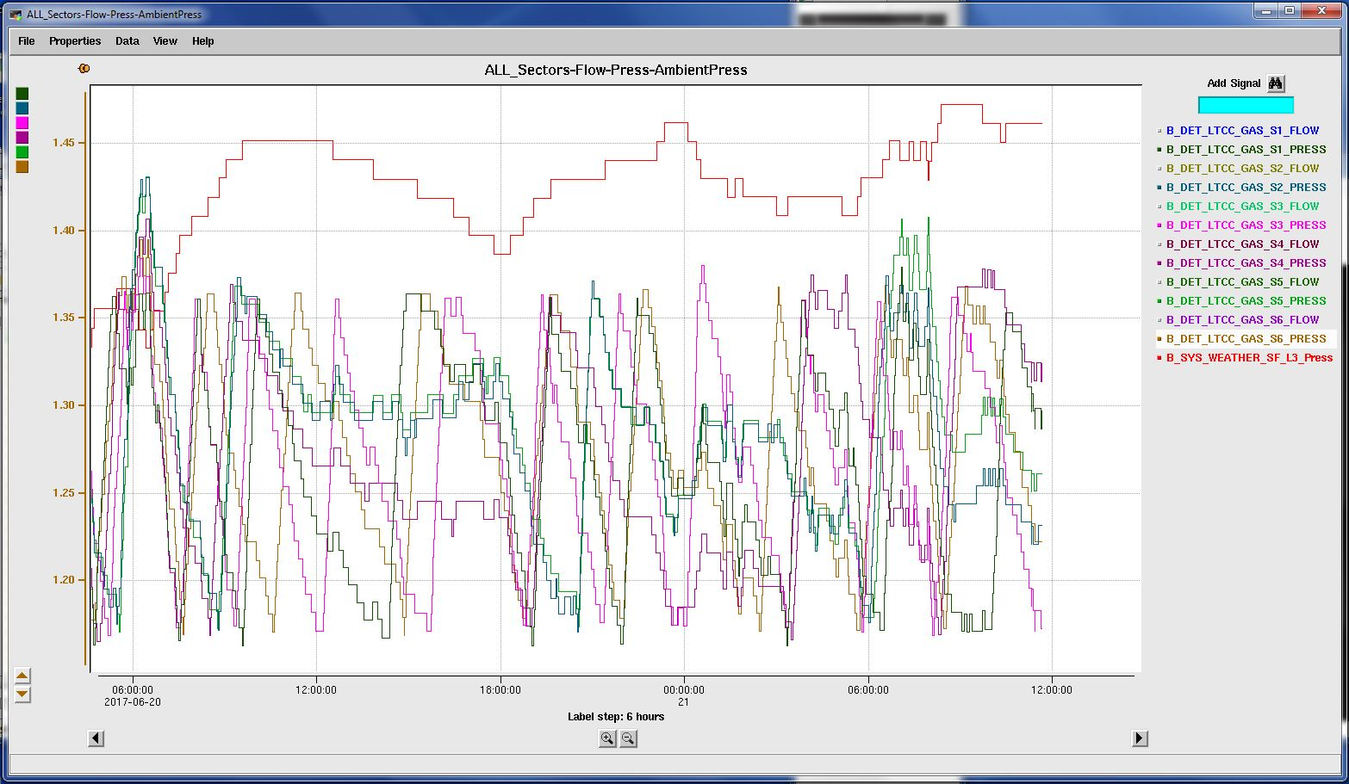
LTCC Leak Study: Data Logging
Initially archived EPICS data was view using the MYA viewer. MYA is the tool used to study EPICS signals.
Scripts such as MyData and MyGet were used to download the data to text files. This took many hours to download multiple signal over large periods of time.
MYA archiver plotting LTCC Pressures vs. Ambient

Slide 8
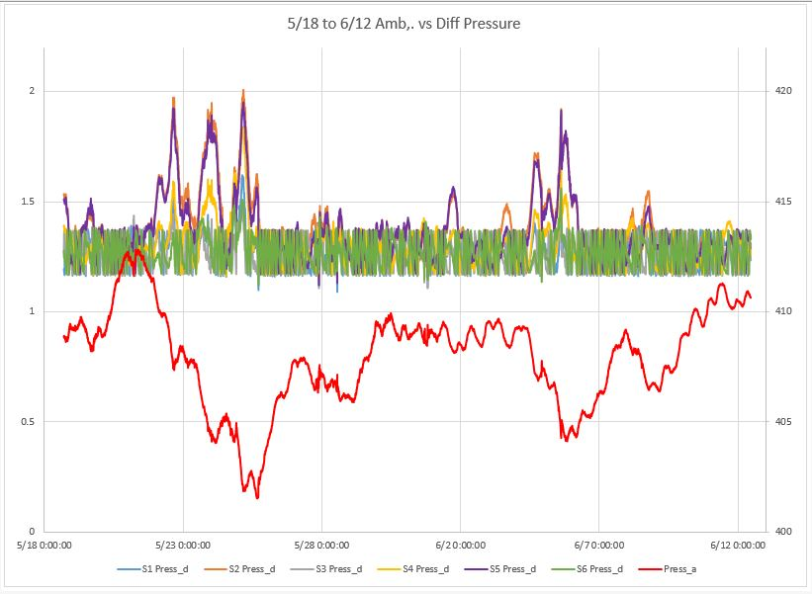
LTCC Leak Study: Data Logging
To provide a closer review of timing of flow, and pressure events a LabView based data-logger was developed to record the six sector flows and pressures, as well as plotting ambient pressure in Hall B.
The data is recorded to the internal storage of the Hall B Gas Controls cRIO (located on the Forward Carriage).
The data is downloaded via the Hall B network as a text file which is then imported to Excel.
The data is then formatted into columns which then can be extracted to perform calculations and graphed for visual tracking.

Slide 9
LTCC Leak Study: Reviewing Data
The first set of columns formats the text into a timestamp, and a display of the record cycle. The recorder loop is set for 1 second for each recorded value (13 total). If none of the sectors flow gas, the cycle changes to 10 seconds. This limits the amount of data.

Slide 10
LTCC Leak Study: Reviewing Data
For each sector, pressure and flow are recorded,. Flow is then formatted to eliminate values generated by the MFC when the solenoid is closed.
In principle this flow should be 0. When the solenoid opens the flow should be 0.5 Lpm (+/- 0.2% of 2 to 20% full scale). The “Flow_adj” column disregards all data below 0.12 Lpm.
The final column for any sector calculates the flow during that cycle. A 13 second cycle of approximately 0.5 Lpm is about 0.108 liters of flow. This column can be used to calculate flow amounts based on the action of the solenoids.

Slide 11
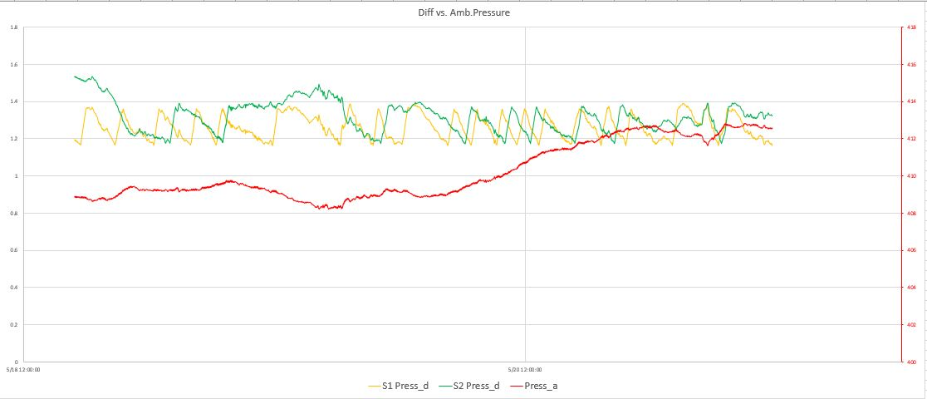
LTCC Leak Study: Reviewing Pressure
The pressure transducers used to control the solenoids are differential magnehelics. The system is designed to keep the detector sectors slightly higher than the ambient hall pressure, which fluctuates.
The process controller are currently set to energize the solenoid if the pressure falls below 1.2, and stay energized until pressure increases past 1.4.
Ambient vs. Differential Pressure on S1 and S2

Slide 12
LTCC Leak Study: Reviewing Pressure and Flow
While the volume of flow is controlled by the setpoint of the mass flow controller (0.5 Lpm), the actual flow to a sector is controlled by the supply solenoid and the pressure set points of the process controller which controls that solenoid.

Slide 13
LTCC Leak Study: Reviewing Outage Event
There was a nitrogen outage from 05/01 around noon to 05/02 around 08:45am. During the outage the ambient pressure was stable from 18:17 on 5/1 to 01:01 on 5/2.
These two events coincided to give an example of pressure loss in the detector over a period of hours. Sectors 2,5, and 4 were able to maintain pressure over a longer period of time, while 1,3, and 6 decayed at a faster rate.

Slide 14
Conclusion
All 6 LTCC sectors were monitored from 4/25 to 6/12.
All 6 require additional gas flow after filling.
Regions 2, 4, and 5 require filling much less frequently than 1, 3, and 6.
In addition to the data produced by the logger, a mass flow controller flow log was recorded and averaged over time.
MFC Total L is the average of the entire period.
L/Day is a daily average.
Each sector is ranked from most sealed to least (1-6)
4
1
5
3
2
6

Slide 15
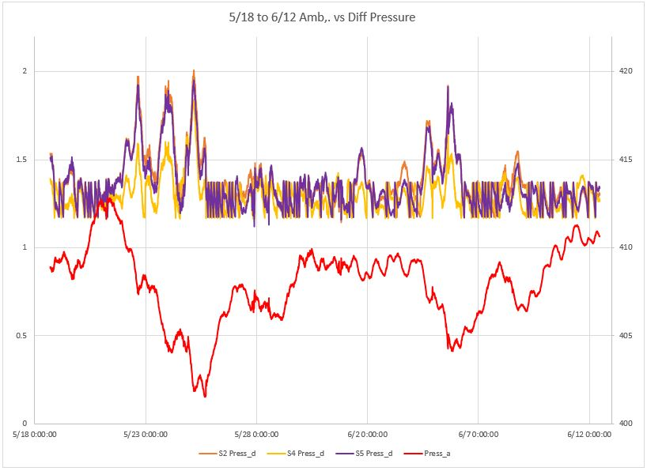
Conclusion
Sectors 2 and 5, and to a lessor extent 4 fill during increasing ambient pressure.
These sectors do not fill during decreasing ambient pressure as differential pressure tends to mirror image the action of the ambient.
S2 and 5 solenoids do not open from 5/21 until S5 takes gas on 5/25

Slide 16
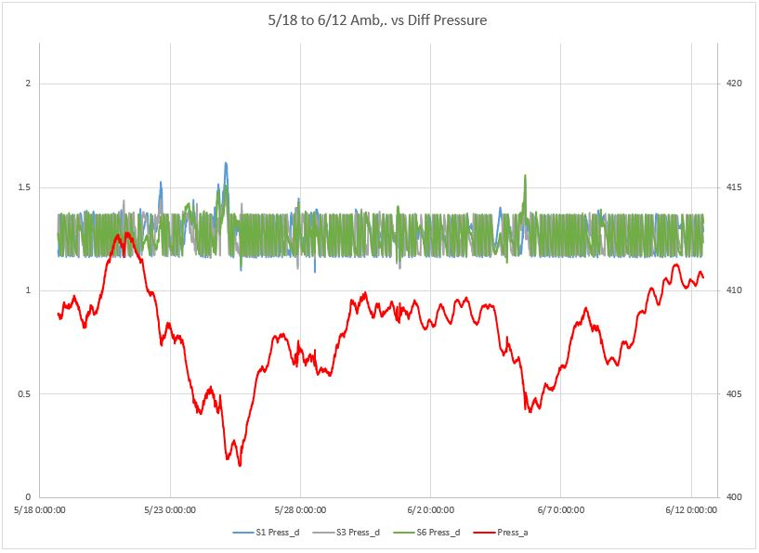
Conclusion
Sectors 1,3,and 6 tend to fill and decay at a more regular rate as decreasing ambient pressure has less effect.
This is because they are leaking at a greater rate and require more gas to stay within setpoint range.
S1,3, and 6 experience pressure decay to a greater extent than the other 3 sectors

Slide 17
DSG Staff

Slide 18
The End

